Slide 1
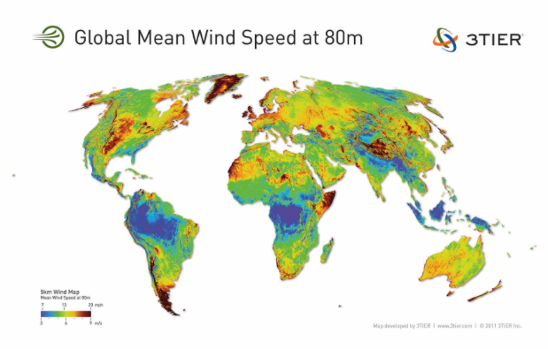

Slide 2
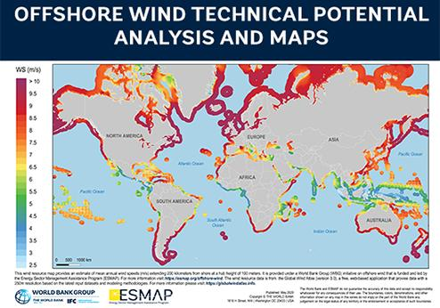

Slide 3
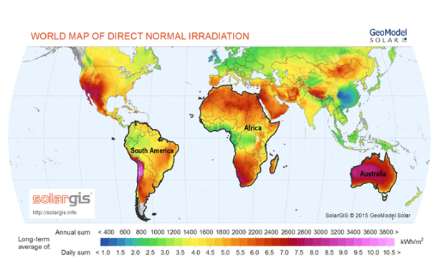

Slide 4
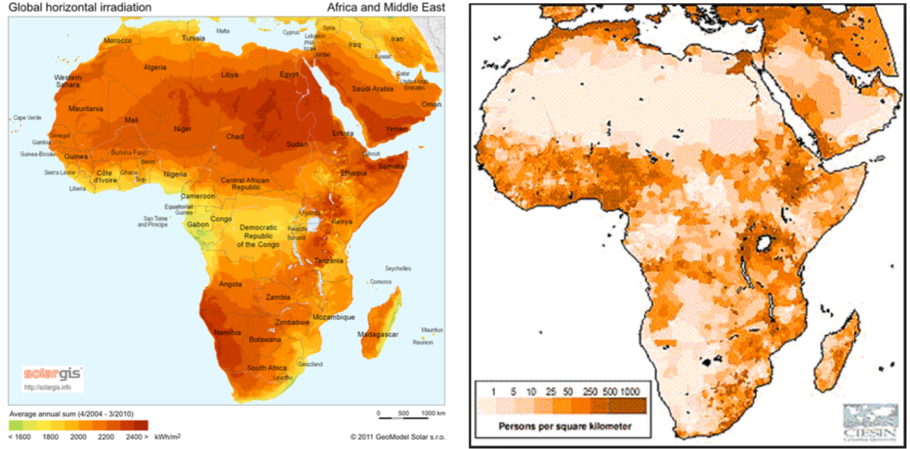

Slide 5
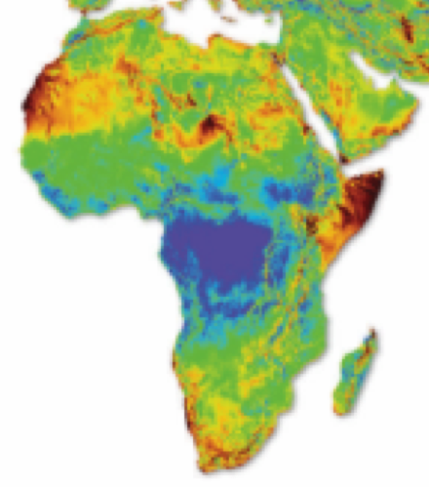

Slide 6
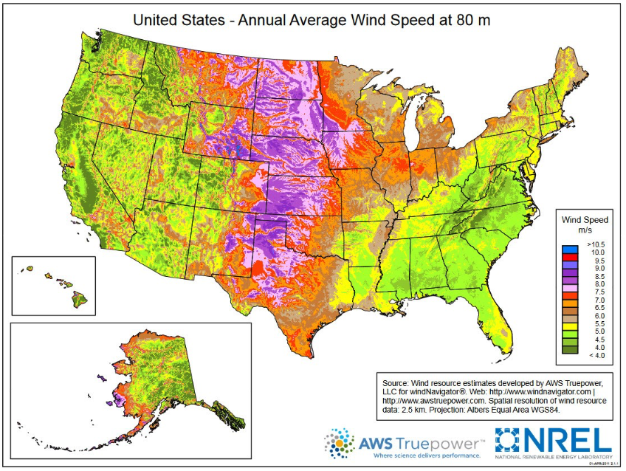

Slide 8
Population Density

Slide 9
Population Density

Slide 10
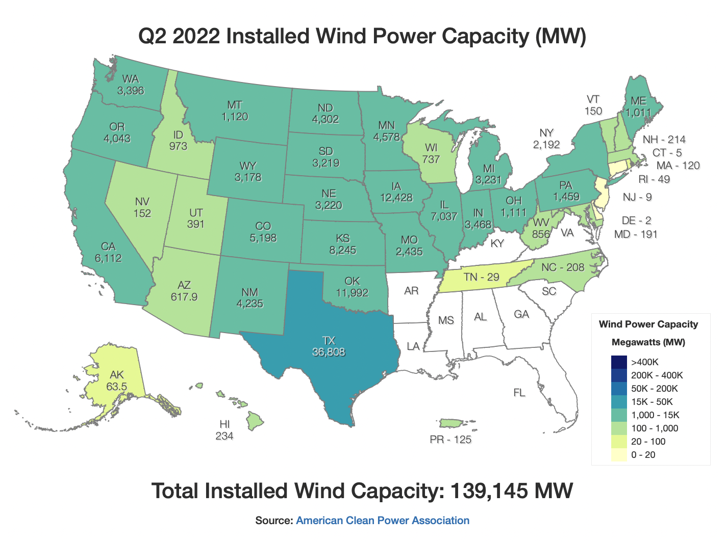

Slide 11
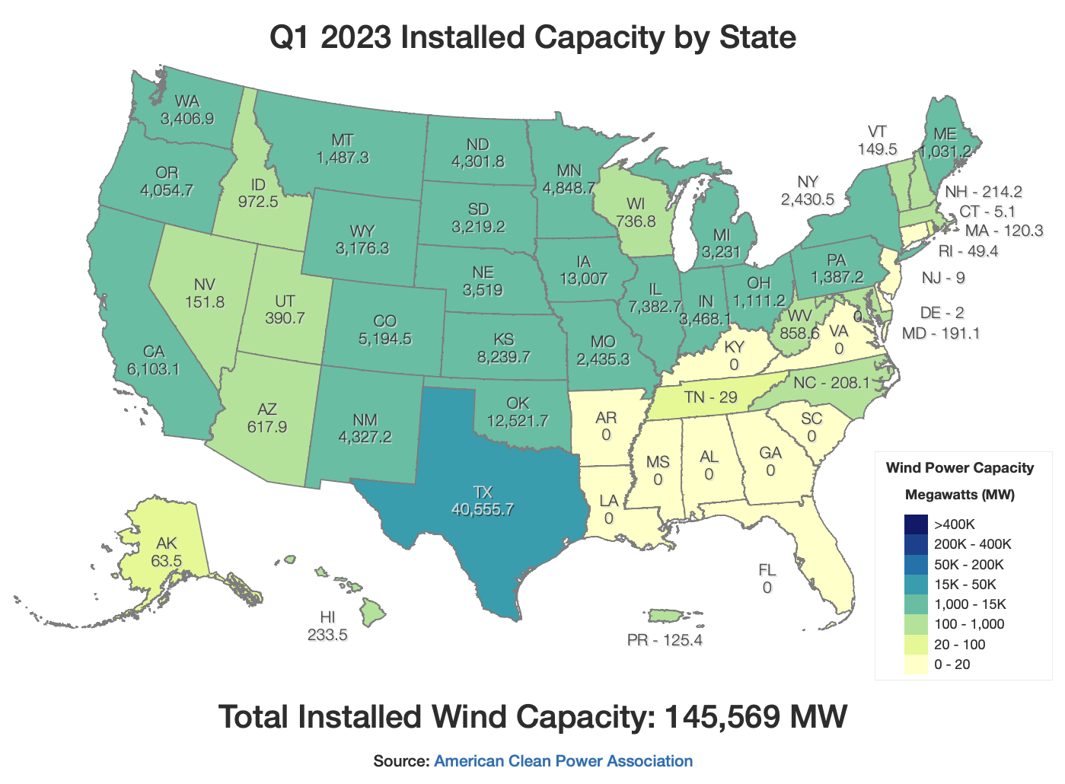
https://windexchange.energy.gov/maps-data/321

Slide 12
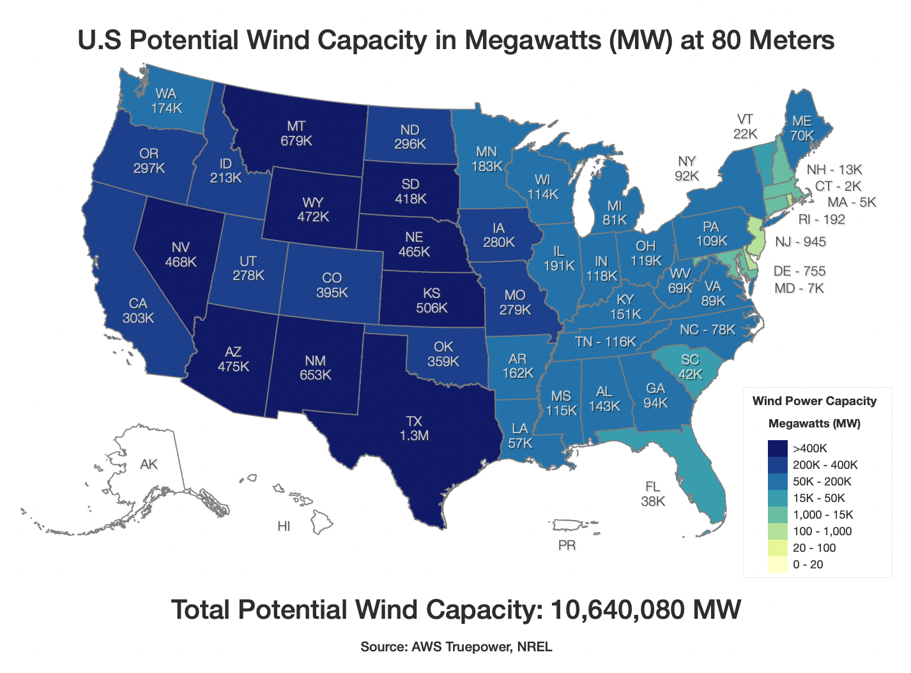

Slide 13
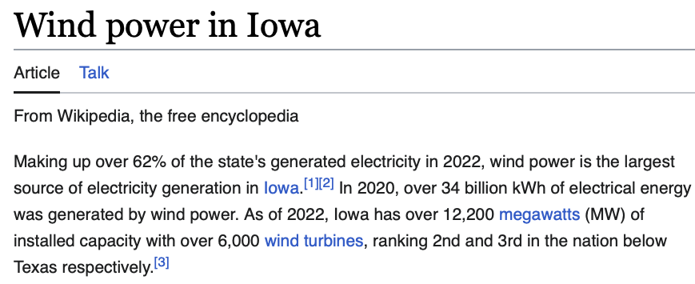
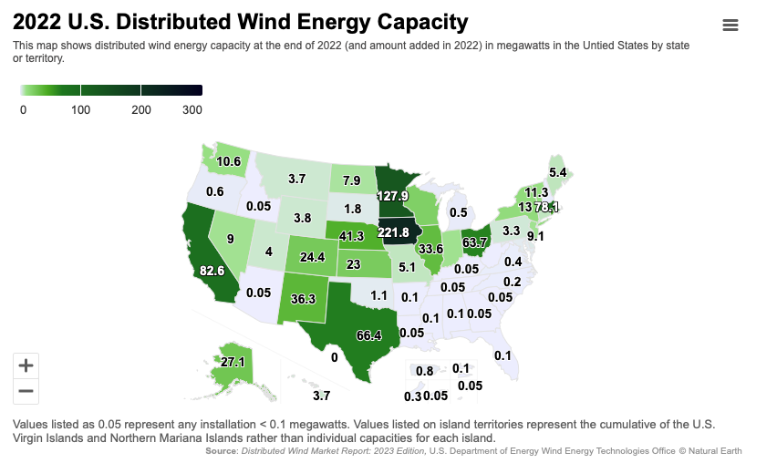

Slide 14
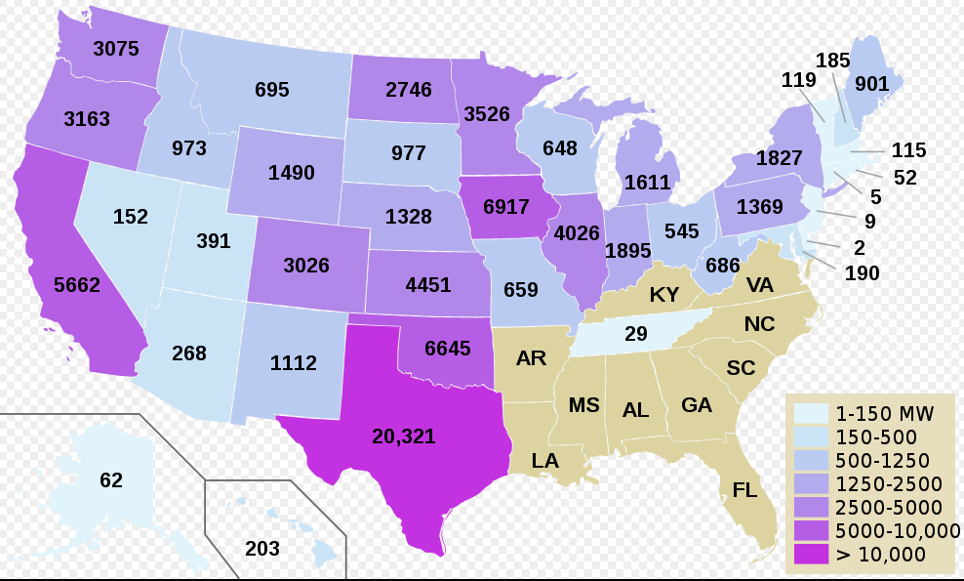

Slide 15
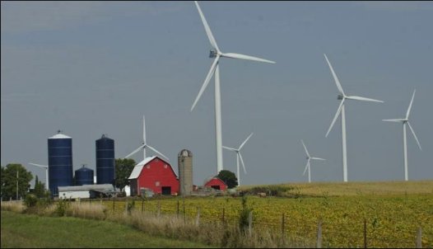
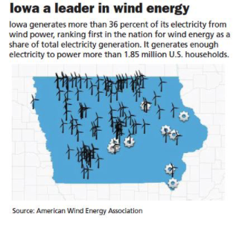
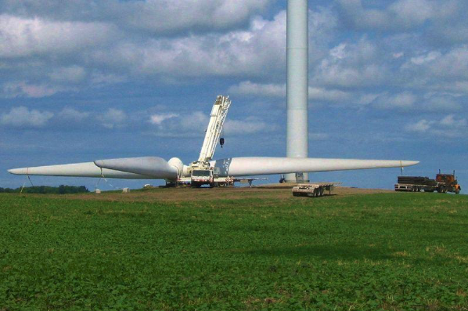

Slide 16
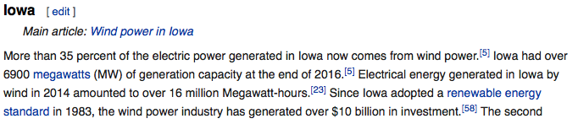
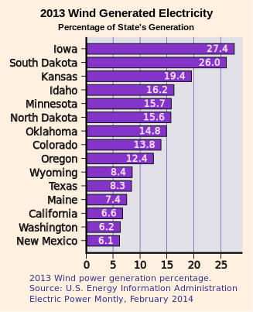

Slide 17
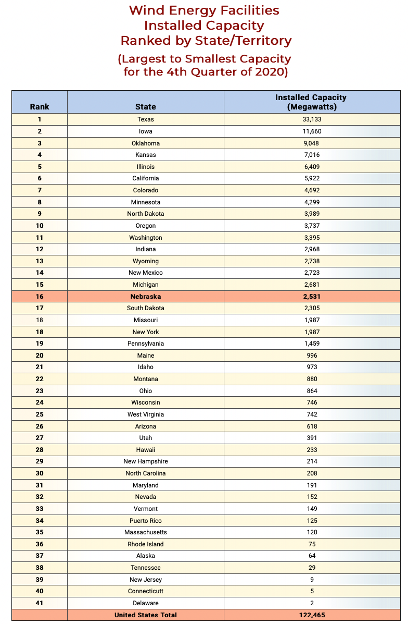

Slide 18
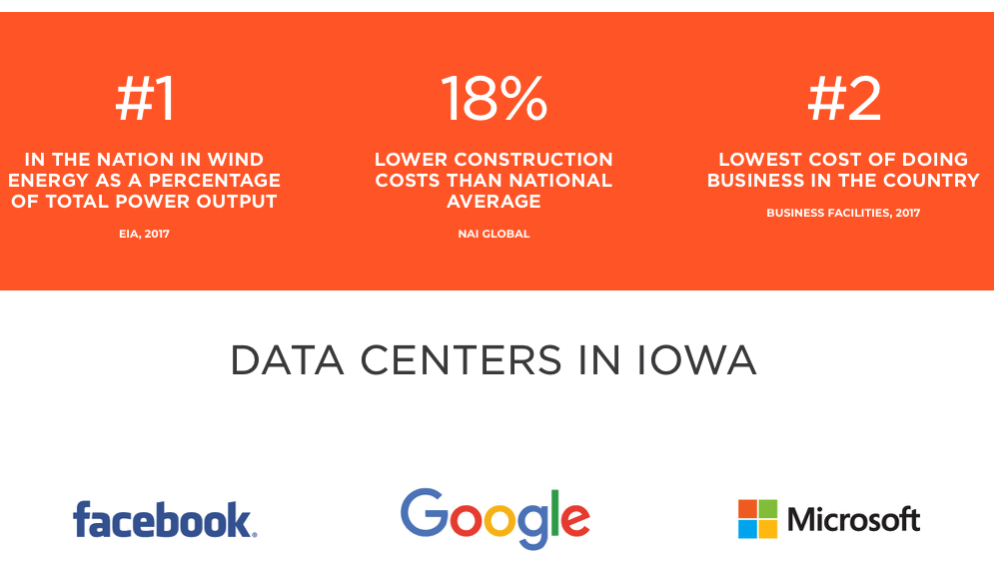

Slide 19
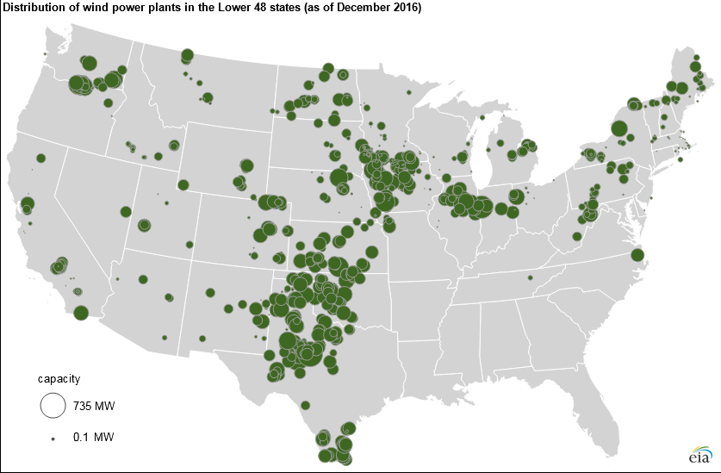

Slide 20
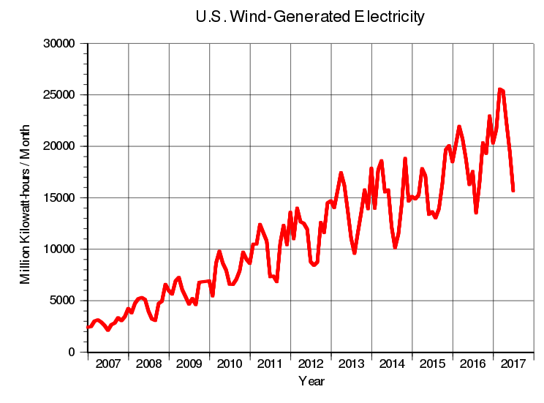

Slide 21
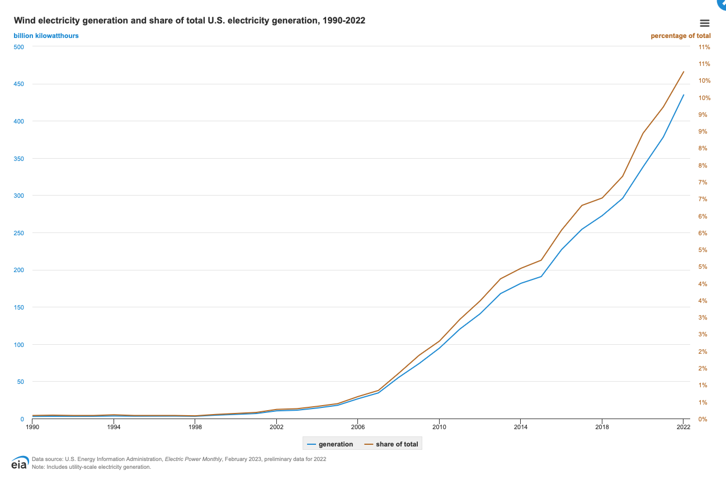

Slide 22
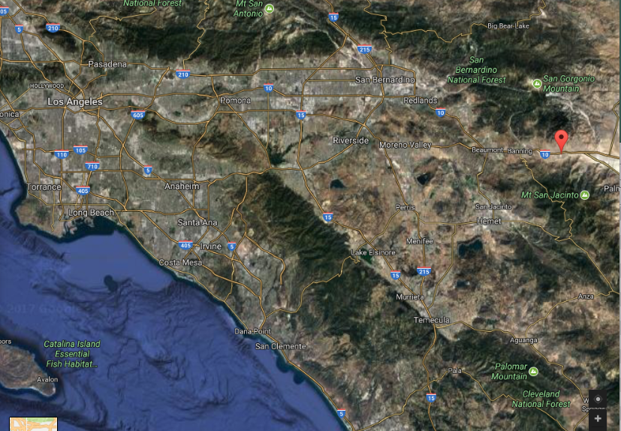
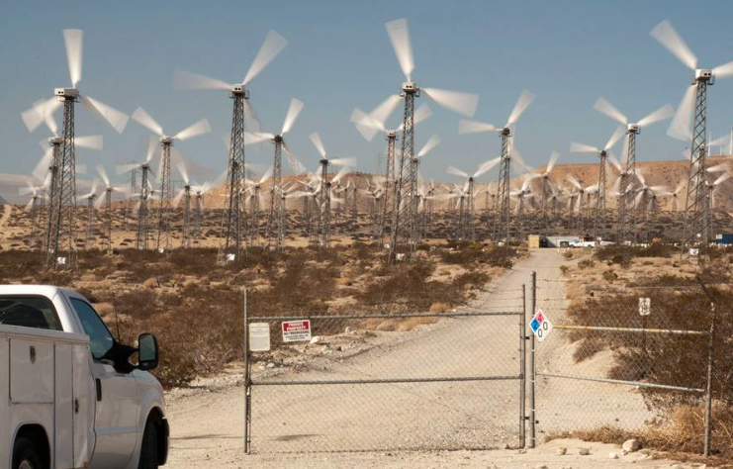
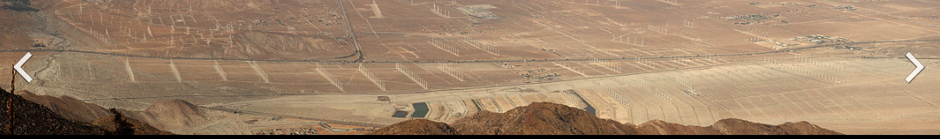
San Gorgonio Pass, CA

Slide 23
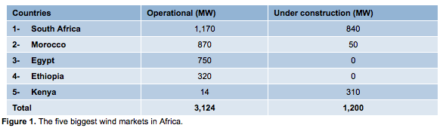
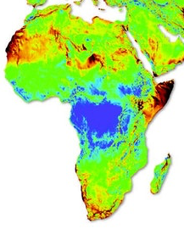
In Africa there is Some Wind Power
South Africa
Namibia
Somalia/Somaliland
And the Sahel
Have the greatest promise

Slide 24
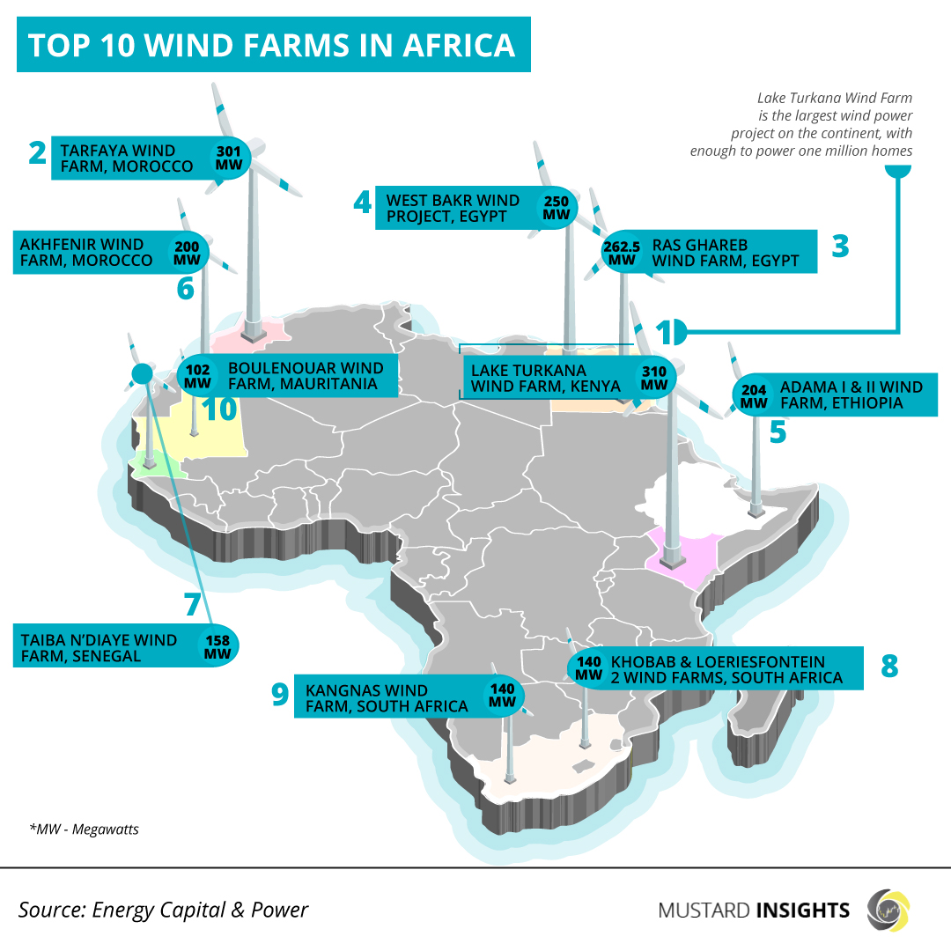
In Africa there is Some Wind Power

Slide 25
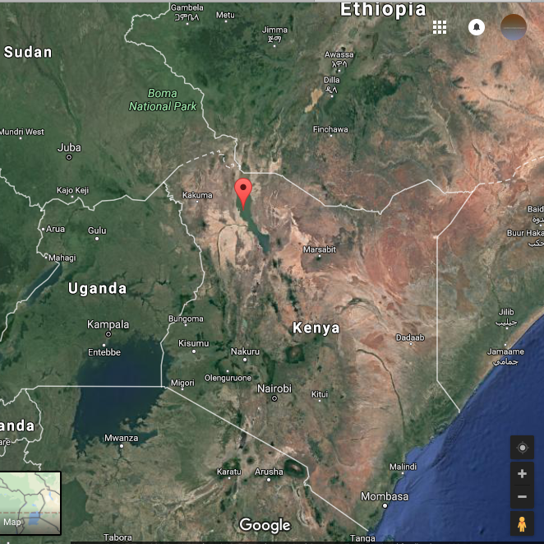
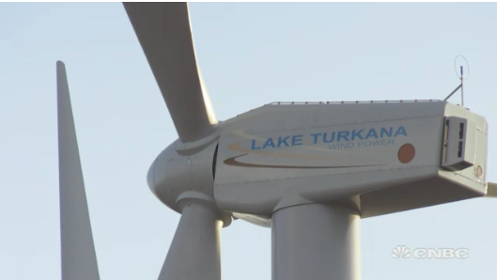
Kenya Wind Farm 300 MW
Lake Turkana
https://www.cnbc.com/2017/09/08/a-wind-farm-of-epic-proportions-is-taking-shape-in-africa.html

Slide 26
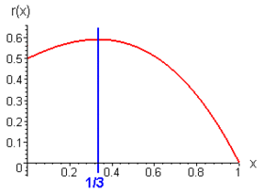

Betz Limit: 59.3% efficiency
A) Consider an ideal wind turbine that extracts 100% of the fluid energy, v_{out} = 0.
Power output is 0.
v_{in}
v_{out}
B) For an ideal wind turbine that extracts 0% of the fluid energy, v_{out} = v_{in}.
Power output is 0.
Efficiency, C_{p}
Power is proportional to v_{in}³
S is area of turbine
ρ density of fluid
Under optimum condition
v_{out}/v_{in} = 1/3
16/27 or 59.3% of energy is extracted
v_{out}/v_{in}

Slide 27
v_{in}
v_{out}
Betz Limit: 59.3% efficiency
Force
F = ma
= m dv/dt
= dm/dt Δv
= ρSv (v_{in} –v_{out})
Energy
dE = F dx
Power
P = dE/dt
= F dx/dt
= F v
P = ρSv² (v_{in} –v_{out})
Kinetic Energy
E = ½ mv²
P = dE/dt = ½ (dm/dt) v²
P = dE/dt = ½ (dm/dt) v²_{in} - ½ (dm/dt) v²_{out}
= ½ (dm/dt) (v²_{in} - v²_{out})
Continuity
(dm/dt) = ρSv
Power
P = ½ ρSv (v²_{in} - v²_{out})
Power
½ ρSv (v²_{in} - v²_{out}) = ρSv² (v_{in} –v_{out})
½ (v²_{in} - v²_{out}) = ½ (v_{in} - v_{out}) (v_{in} + v_{out}) = v (v_{in} –v_{out})
v = ½ (v_{in} + v_{out})

Slide 28
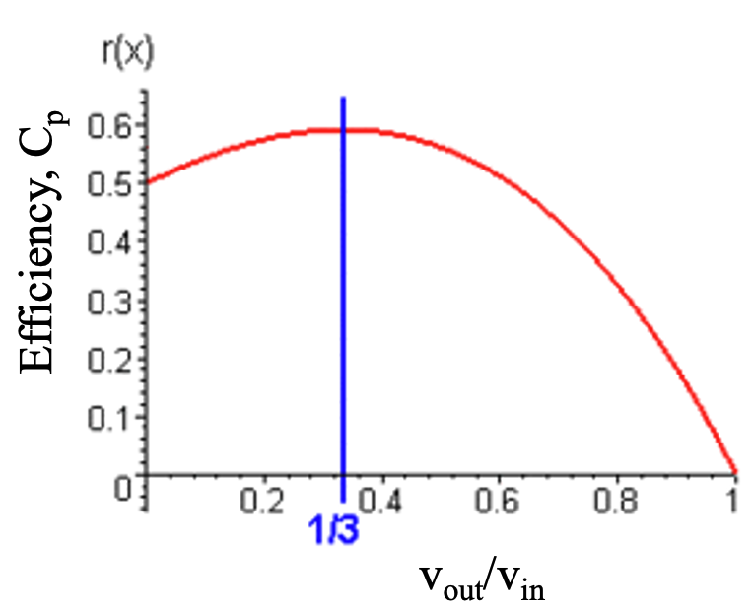
v_{in}
v_{out}
Betz Limit: 59.3% efficiency
v = ½ (v_{in} + v_{out})
Power
P = ½ ρSv (v²_{in} - v²_{out})
= ¼ ρS (v_{in} + v_{out}) (v²_{in} - v²_{out})
= ¼ ρS v³_{in} (1 – (v_{out}/v_{in})² + (v_{out}/v_{in}) - (v_{out}/v_{in})³)
Find Maximum Power at dP/d(v_{out}/v_{in}) = 0
(v_{out}/v_{in}) = 1/3
Plug into Power
Max Power = (16/27) (1/2) ρS v³_{in}
Incident Power = (1/2) ρS v³_{in}
-Power increases rapidly with wind speed
(this limits the wind range in which
a turbine can safely operate)
- (Max Power)/(Incident Power) = 16/27 = 0.593

Slide 29
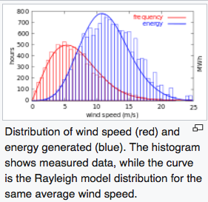

Slide 30

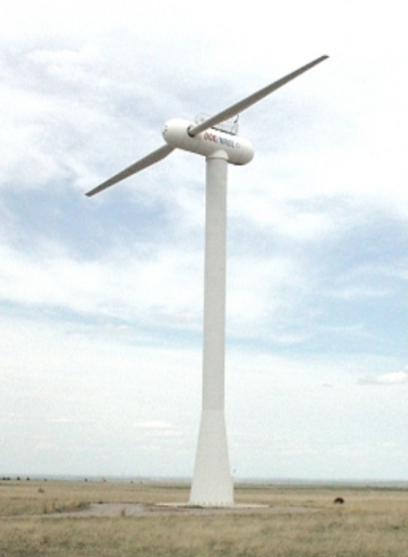
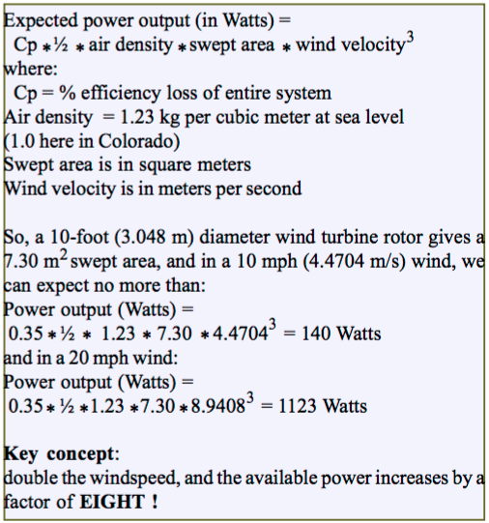

A small wind turbine can expect C_{p} = 35%
http://www.rebelwolf.com/essn/ESSN-Aug2005.pdf

Slide 31
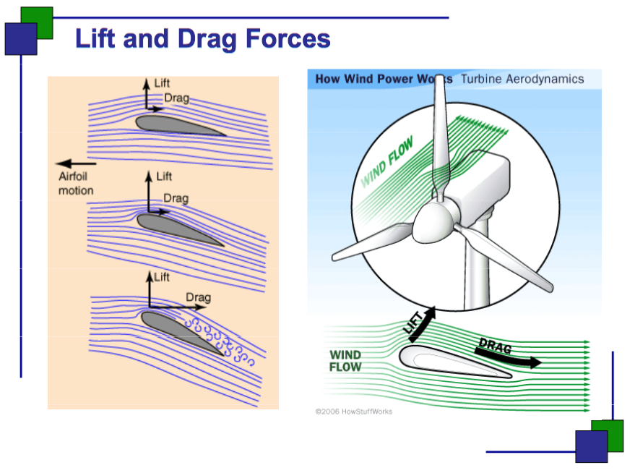
Two main types of wind turbine:
Drag (like a water wheel)
Lift (modern wind turbine)
The axis of rotation for the wind turbine can be horizontal or vertical.

Slide 32
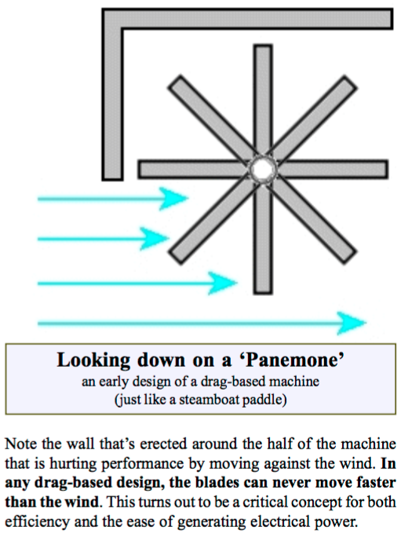
Wheel can’t move faster than the wind
½ of the area is wasted

Slide 33
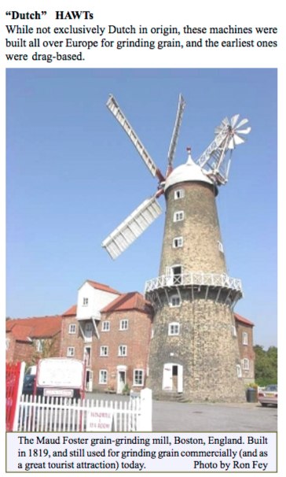
Drag based horizontal wind turbine
Slow speed is good for grinding grain (not good for electrical power generation)
Mechanical furling

Slide 34
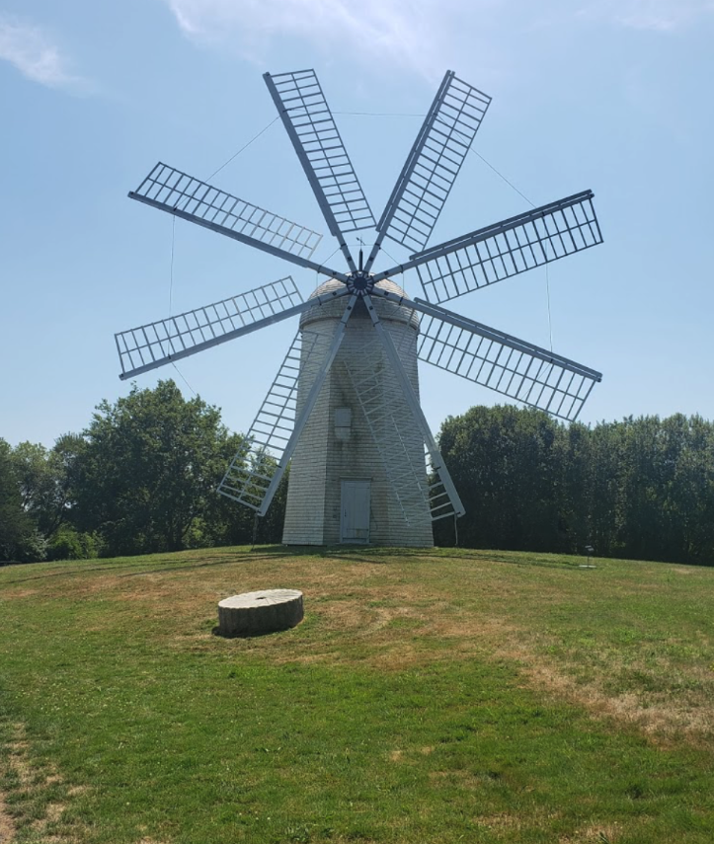
Middletown RI

Slide 35
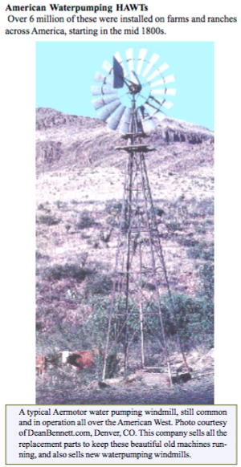
Drag based horizontal wind turbine
Slow speed is good for pumping water (not good for electrical power generation)
Tail allows furling of the turbine

Slide 36
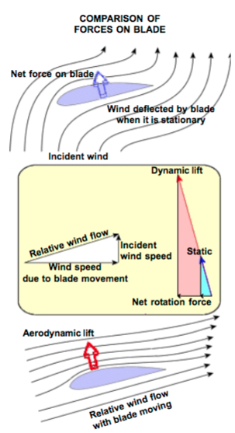

Slide 37
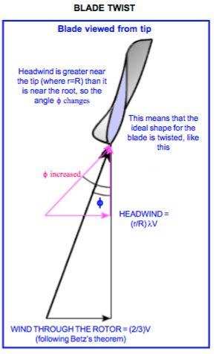
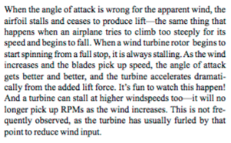

Slide 38
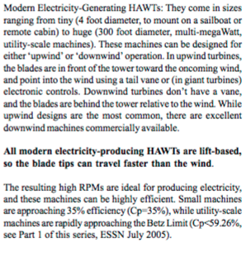
Horizontal Axis Wind Turbine (HWAT)
Up wind or down wind designs

Slide 39
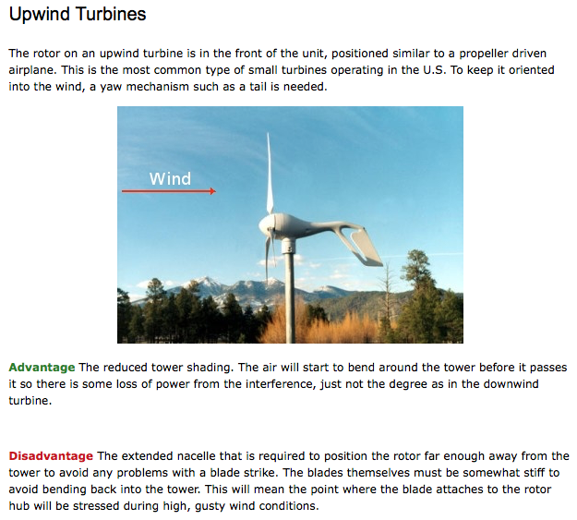

Slide 40
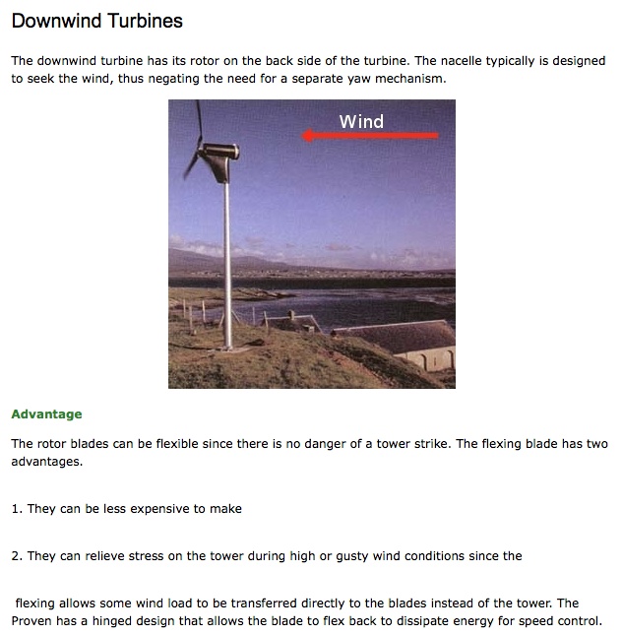


Slide 41
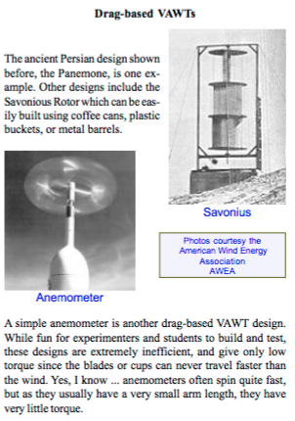
Vertical Axis Wind Turbine (VWAT)

Slide 42
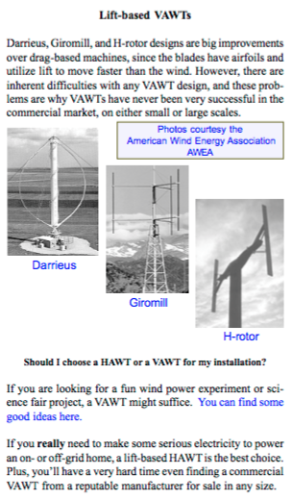

Slide 43
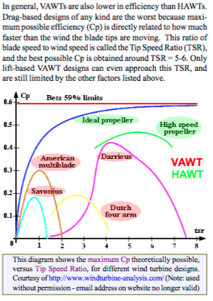
tsr
Ratio between the speed of the tip of the turbine blades and the wind speed

Slide 44
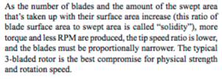
More blades = more torque but lower RPM
For power generation 2 or 3 blades are optimum
For moving air or pumping water/grinding grain 5 blades or more.

Slide 45

Massive power increase with wind speed
Alternator can’t handle this dynamic range
Design a turbine for optimum performance between 7 and 30 mph
Design to survive higher winds while still producing peak power
Options are:
Variable Pitch Blade: Tilt the blade (previous picture)
Tilt the entire turbine (old American west turbines)

Slide 46

http://www.power-talk.net/blade-pitch.html

Slide 47

http://www.power-talk.net/blade-pitch.html

Slide 48

http://www.power-talk.net/blade-pitch.html

Slide 49


Slide 50


Slide 51


Slide 52


Slide 53

Power Coefficient
Electrical Power/Wind Power

Slide 54


Slide 55
Construction of a Large Wind Turbine on Land
This is generally done by power companies like Duke
So Chemical Engineers often become involved in managing
These large scale power production projects

Slide 56

Components of A Wind Farm

Slide 57
Components of A Wind Farm
Nacelle: the box located on the top of the tower, made of fiberglass, that contains approximately 8,000 subcomponents and connects them to the rotor. The size and weight of the nacelle vary depending on capacity (75 tonnes for a 2 megawatt (MW) turbine).
•Rotor and blades: the rotor is typically composed of three rotor blades, the rotor
hub that holds the blades in position as they turn and a pitch mechanism that allows the blade to rotate in the direction of the wind, maximising its capacity to harness wind.
• Tower: the nacelle is mounted on the top of a high tower that allows using the best winds and avoiding obstacles. Towers for large wind turbines may be either tubular steel towers, concrete towers, or lattice towers.
In addition to the wind turbine, other components are needed to install and operate a wind farm, such as the following:
•Transformers to increase the voltage of the
electricity generated. The system inverters generate power output at approximately 480 volts. Electricity grids operate usually in kilovolts.
Capacitors to adjust the power factor and reduce the reactive energy generated.
The electric installation requires cables to connect wind turbines to the inverters, transformers and grid. The installation includes
contactors, circuit breakers and bypass contactors.
• Control equipment compromising microprocessor control, feeding source, heat resistors and coils.
• Electric protection equipment with relays and contactors of auxiliary or protection elements.
• Metering equipment to measure and control the quantity of electricity produced and supplied to the grid, and the reactive power.

Slide 58


Slide 59


Slide 60


Slide 61


Slide 62


Slide 63


Slide 64


Slide 65


Slide 66


Slide 67


Slide 68


Slide 69


Slide 70


Slide 72


Slide 73


Slide 74


Slide 75

https://www.youtube.com/watch?v=SBbBh5xZ1gQ
High Speed Construction of a Wind Turbine Site

Slide 76

https://www.youtube.com/watch?v=MHS10eGjNq8
100 Seconds

Slide 77


Slide 78


Slide 79

Hand Layout of Turbine Blades
https://www.youtube.com/watch?v=XVj_YyvgMbE

Slide 80



Slide 81

https://www.youtube.com/watch?v=iY0oBGo0-W4
Large Scale Layout

Slide 82



Slide 83


Slide 84


Slide 85


Slide 86


Slide 87

Offshore Wind Power

Slide 88
Offshore Wind Power

Slide 89
Offshore Wind Power

Slide 90
Offshore Wind Power

Slide 91
Offshore Wind Power

Slide 92
Offshore Wind Power

Slide 93
Offshore Wind Power

Slide 94
Offshore Wind Power

Slide 95

Offshore Wind Power

Slide 96


Offshore Wind Power

Slide 97

Offshore Wind Power
Scotland

Slide 98
Offshore Wind Power
Construction of the first floating wind farm

Slide 99

Offshore Wind Power
Wind Turbine Engineer

Slide 100
Can/should you build a wind turbine?
http://www.instructables.com/id/DIY-1000-watt-wind-turbine/

Slide 101


Slide 102


Slide 103


Slide 104


Slide 105

https://www.youtube.com/watch?v=o9EEHFKEckM

Slide 106

https://www.wikihow.com/Build-a-Wind-Turbine

Slide 107


Slide 108

http://mwands.com/store/wind-turbine-products/wind-turbine-generators?gclid=Cj0KCQiAi7XQBRDnARIsANeLIeuJ_ySg8h_VuxrAzPEIWaOvsSAJ4ktBl8IgBN_TRTITq8Oi3CnV6sYaAmWeEALw_wcB

Slide 109


Intrepid Malawi youth William Kamkwamba

Slide 110




Future of Solid-State Wind Power Generation
https://www.google.com/url?sa=t&rct=j&q=&esrc=s&source=video&cd=&ved=2ahUKEwjk1OzO99H6AhUfj2oFHVPRA0UQtwJ6BAgIEAI&url=https%3A%2F%2Fwww.youtube.com%2Fwatch%3Fv%3DnNp21zTeCDc&usg=AOvVaw1JDf2eN3SEBBaySfFd7NVV

