Slide 1
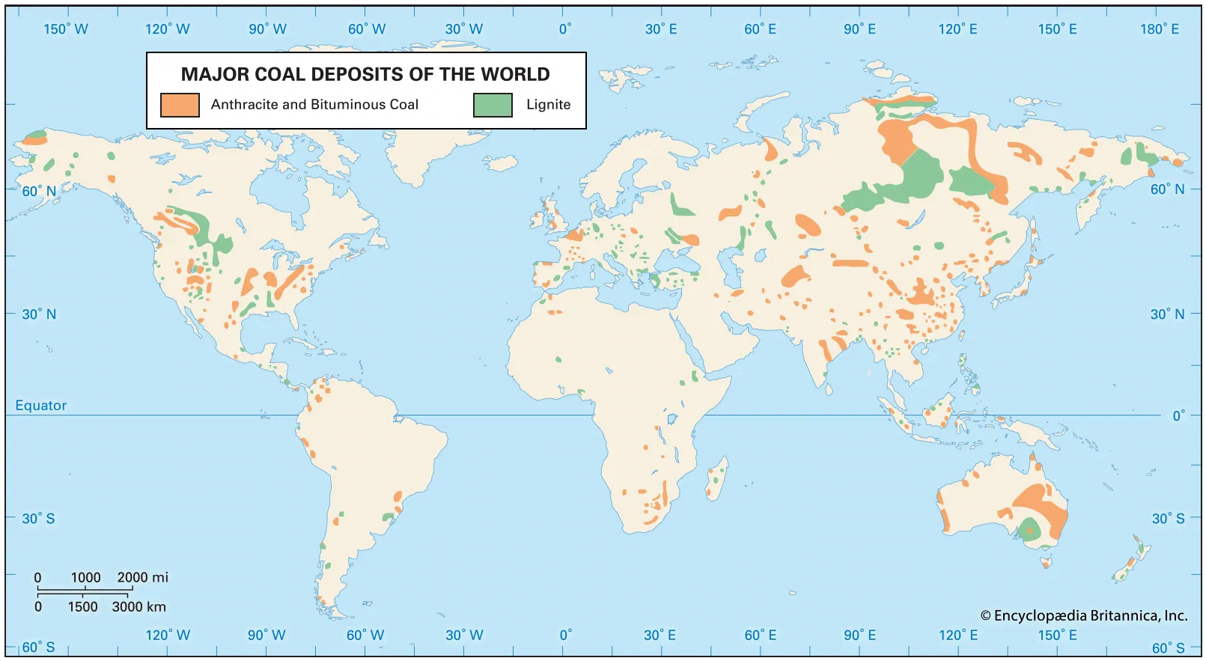

Slide 2
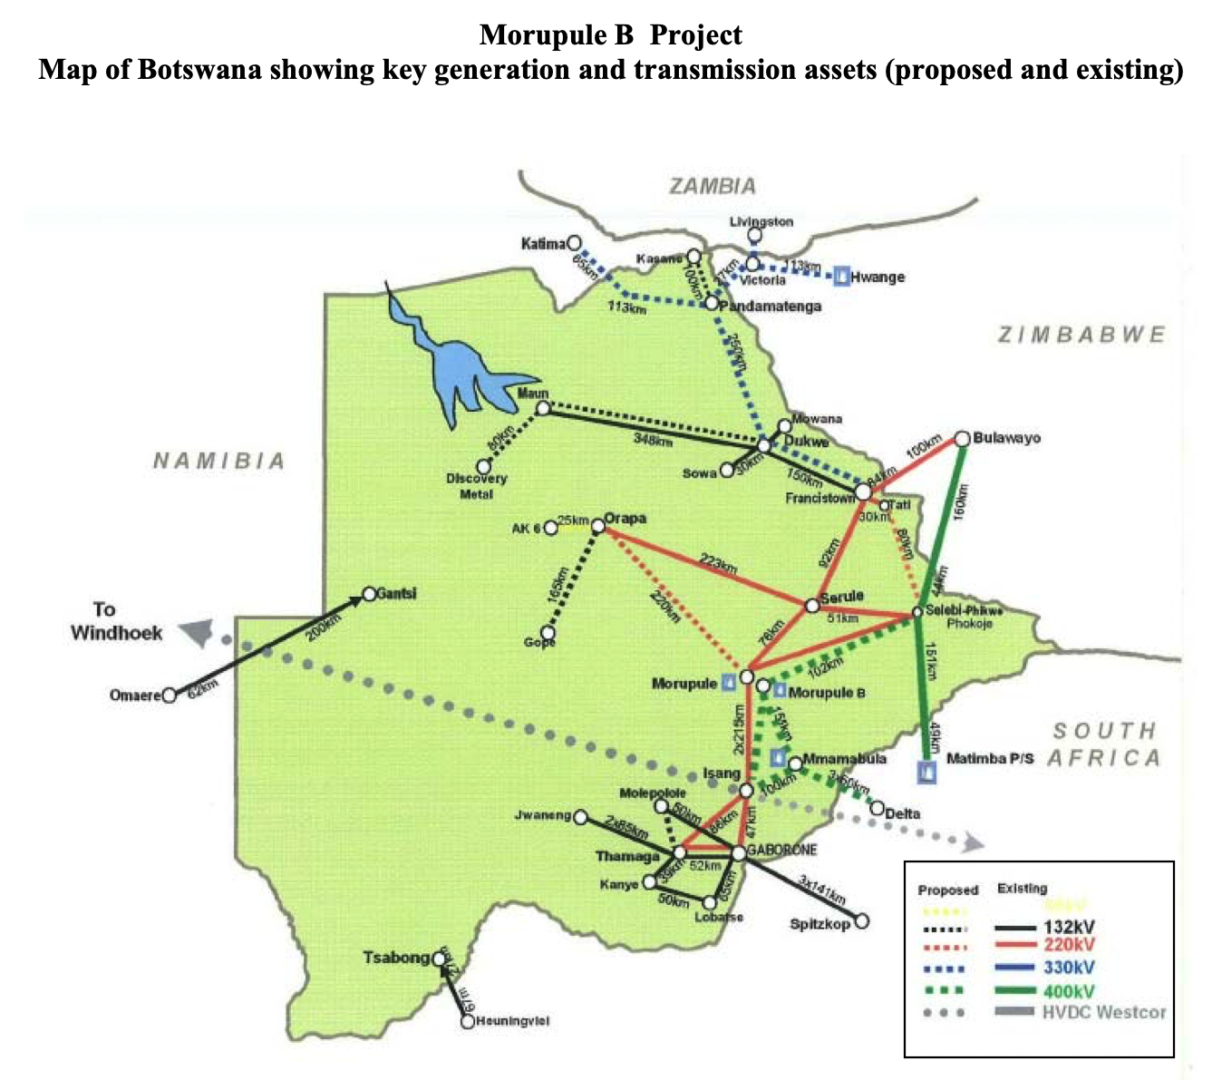

Slide 3
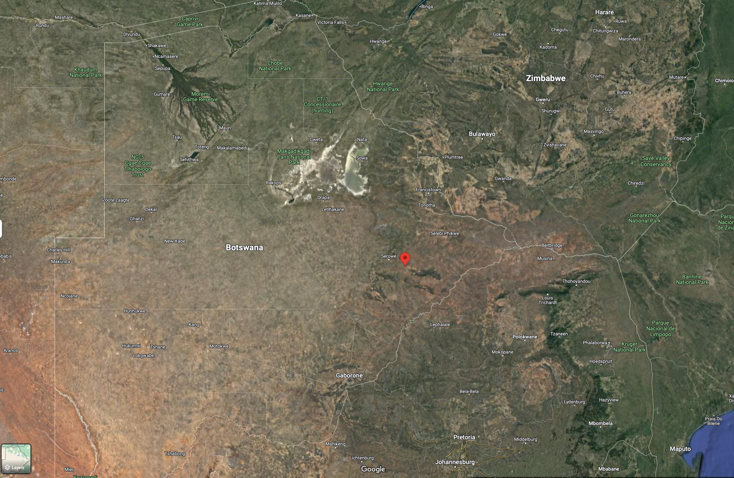

Slide 4
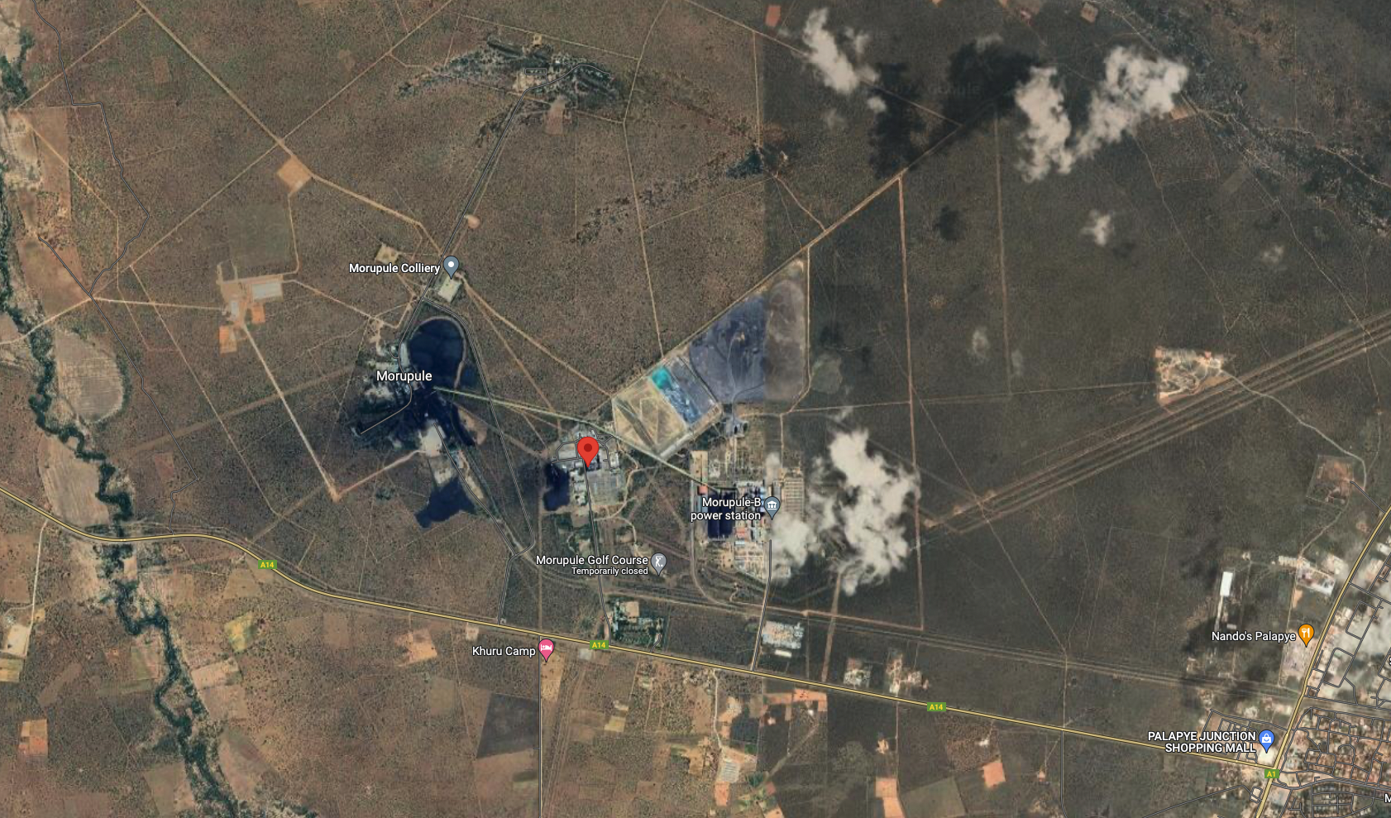

Slide 5

https://www.gem.wiki/Morupule_B_power_station

Slide 6
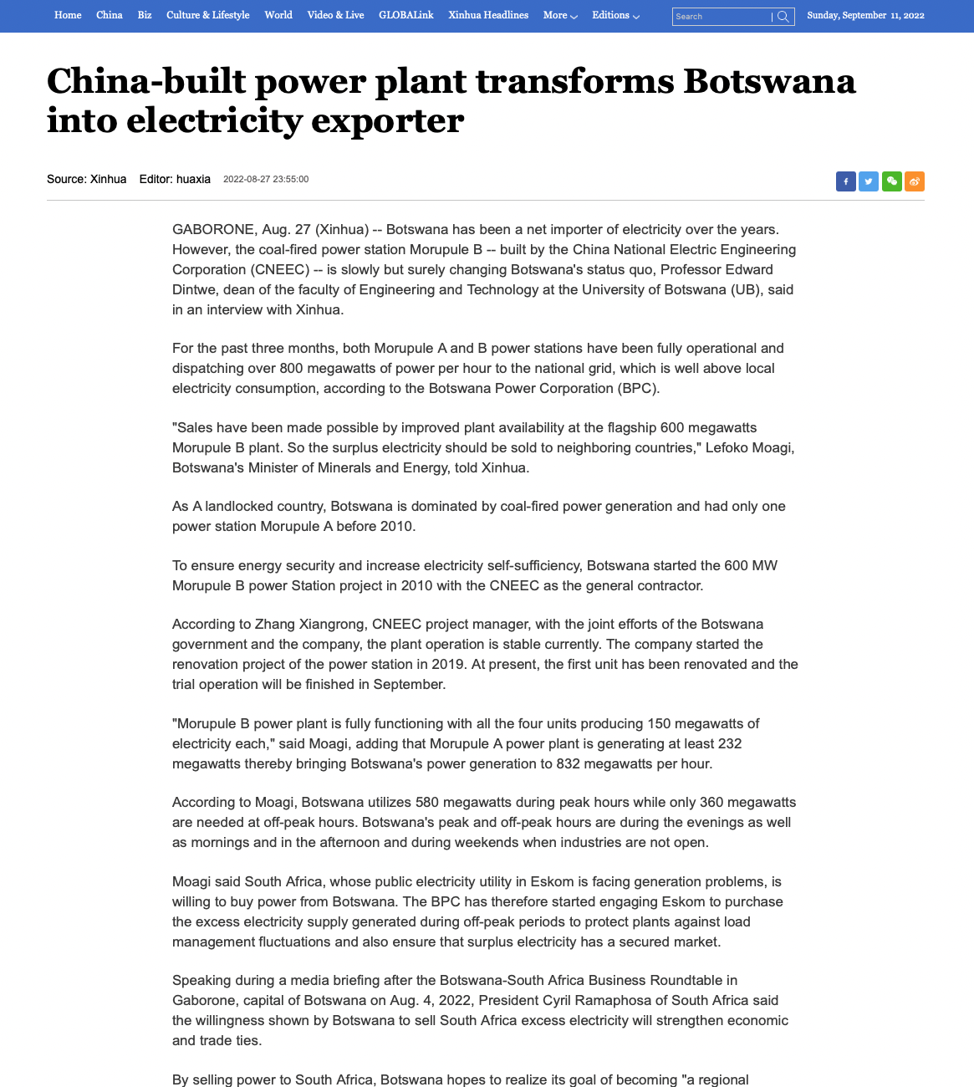
https://english.news.cn/20220827/c792d5c1ce664235b9a526b71f62330a/c.html

Slide 7
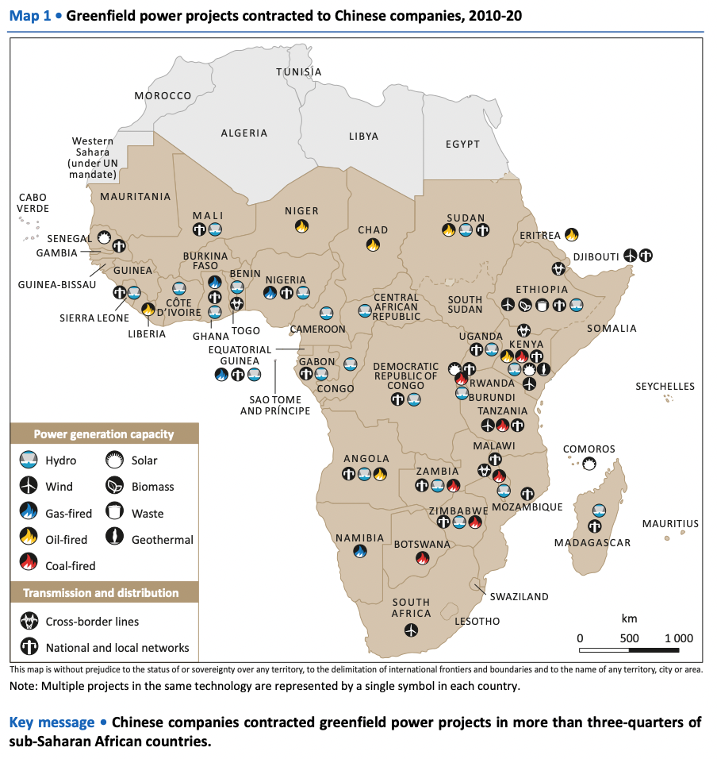
http://large.stanford.edu/courses/2017/ph240/li1/docs/iea-2016.pdf

Slide 8
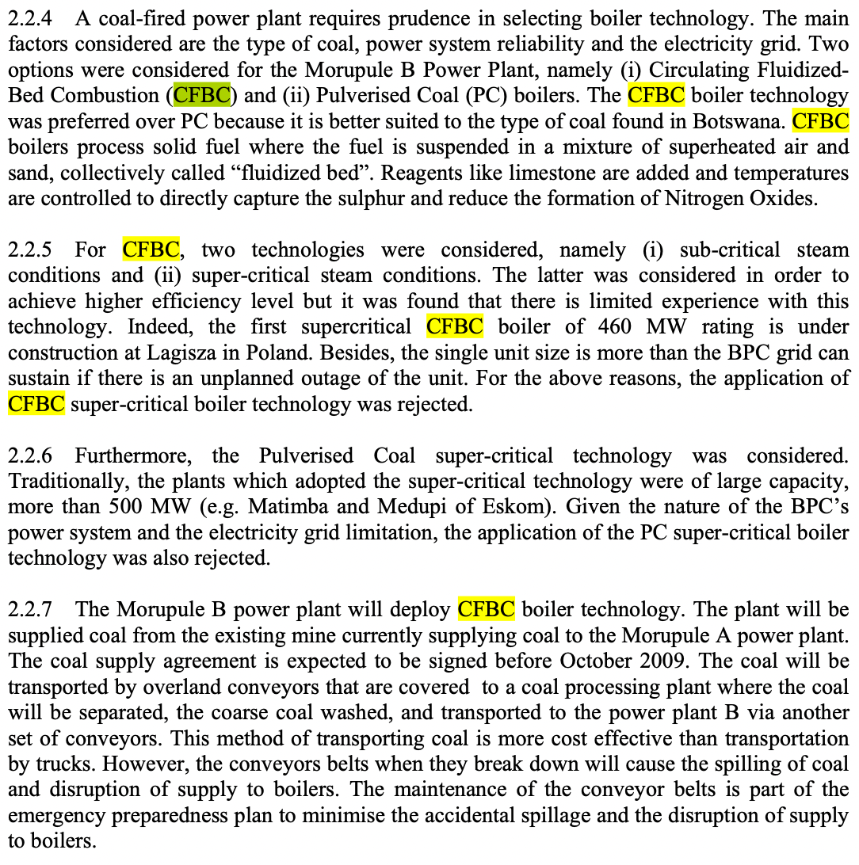

Slide 9
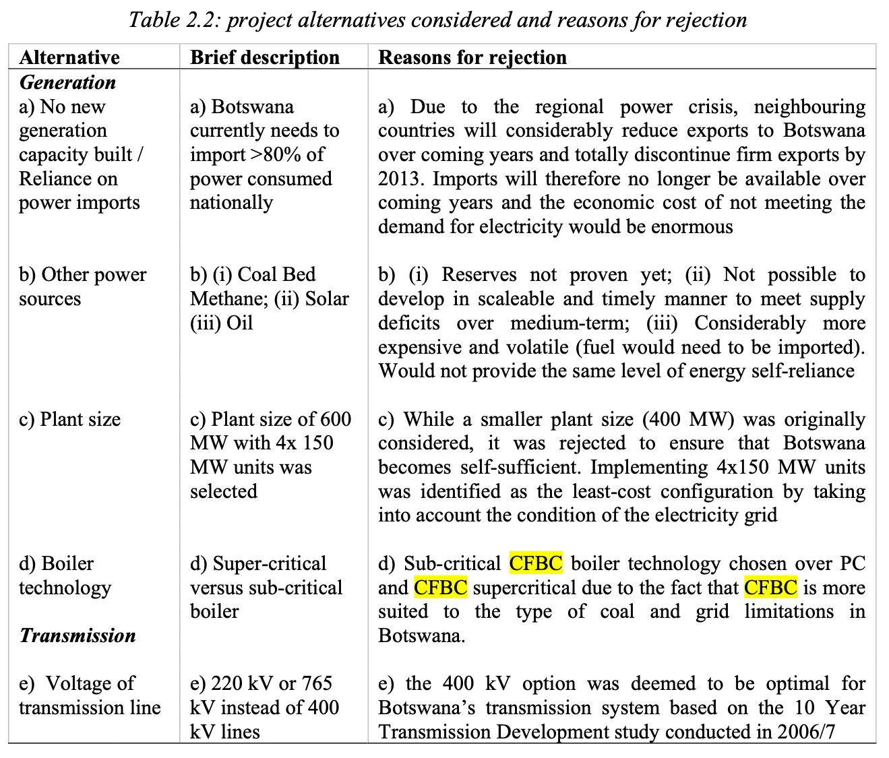

Slide 10
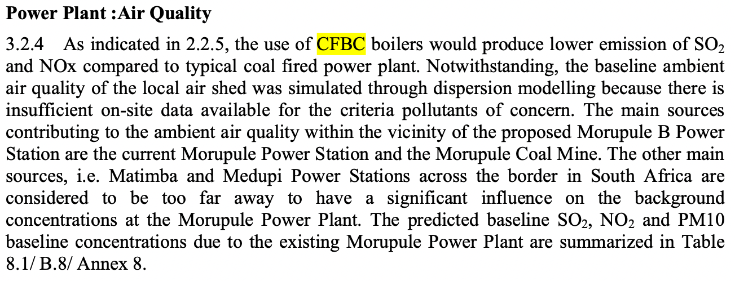


Slide 11
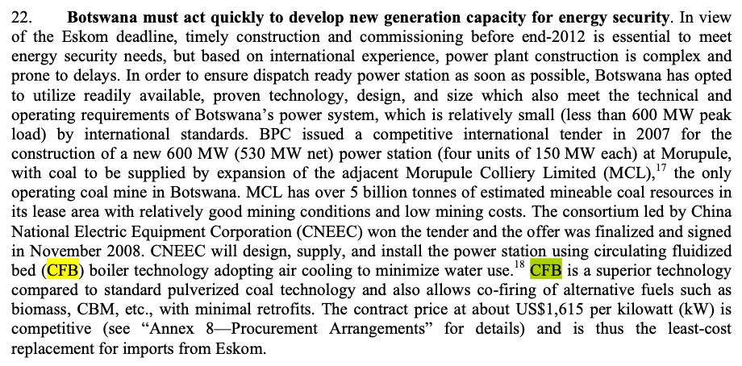
World Bank 2009

