Slide 1
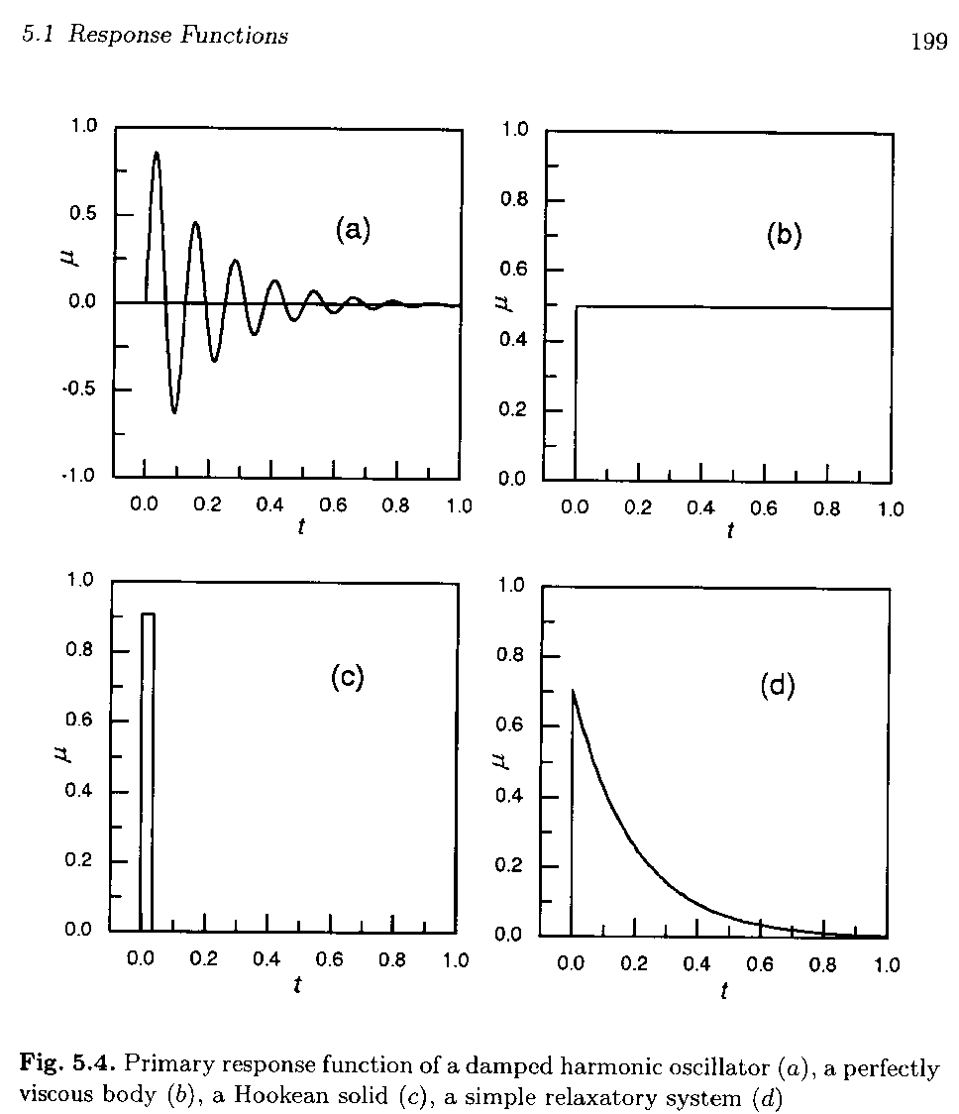

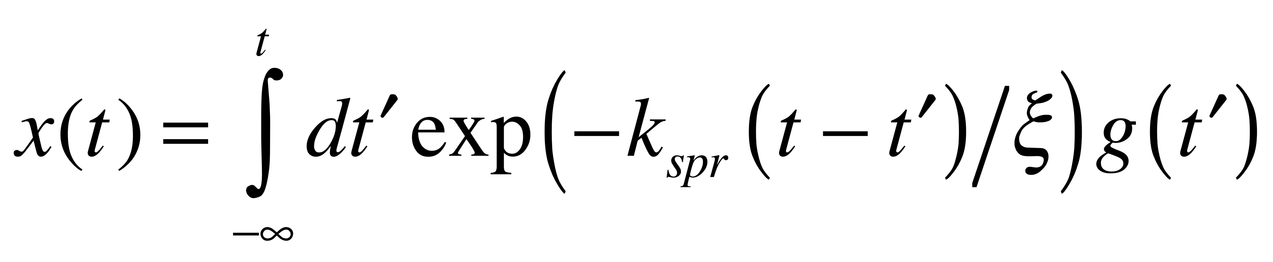
Dilute Solution Chain
Dynamics of the chain
For Viscous Motion (a relaxatory system)
F = ma = ζV
Integrate
Position is the integral of velocity dt
The exponential term is the “response function”
response to a pulse perturbation
g(t) is random ± pulses due to kT

Slide 2
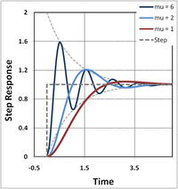
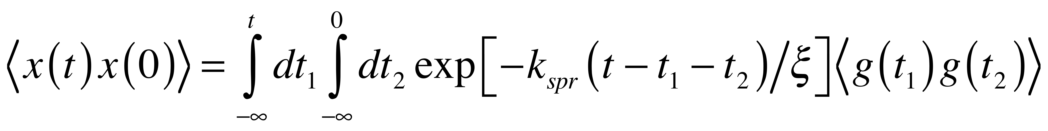
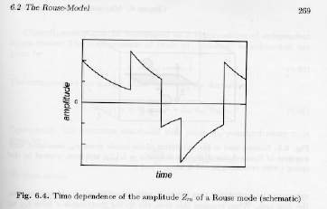
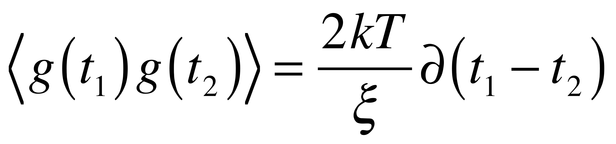
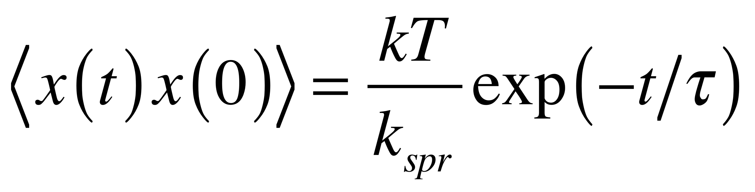
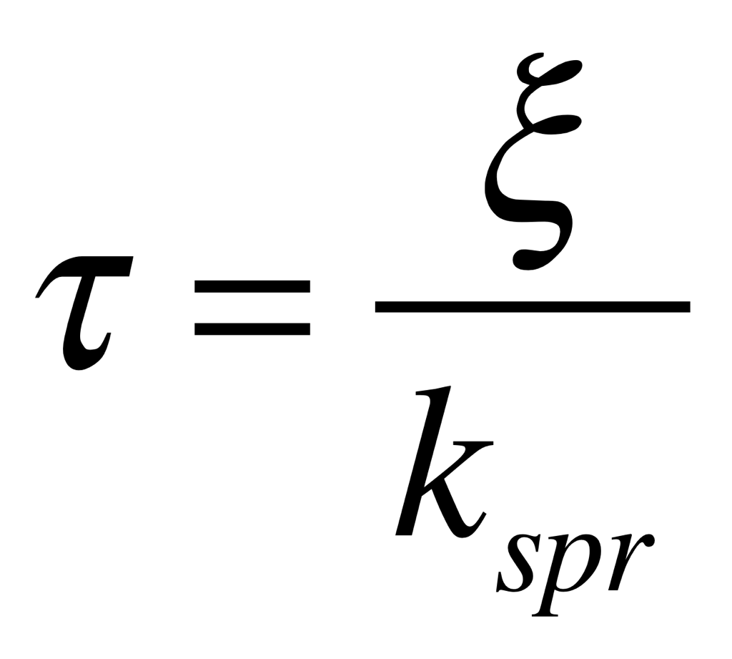
Dilute Solution Chain
Dynamics of the chain
For Brownian motion
of a harmonic bead in a solvent
this response function can be used to calculate the
time correlation function <x(t)x(0)>
for DLS for instance
Simple exponential relaxor
τ is a relaxation time.

Slide 3
Draining vs Non-Draining
Rouse vs Zimm
Consider Diffusion of a Chain
D = kT/ζ
For Non-Draining

Slide 4
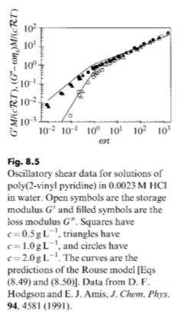




Slide 5
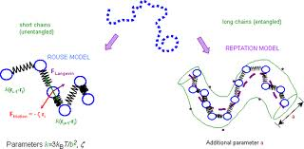
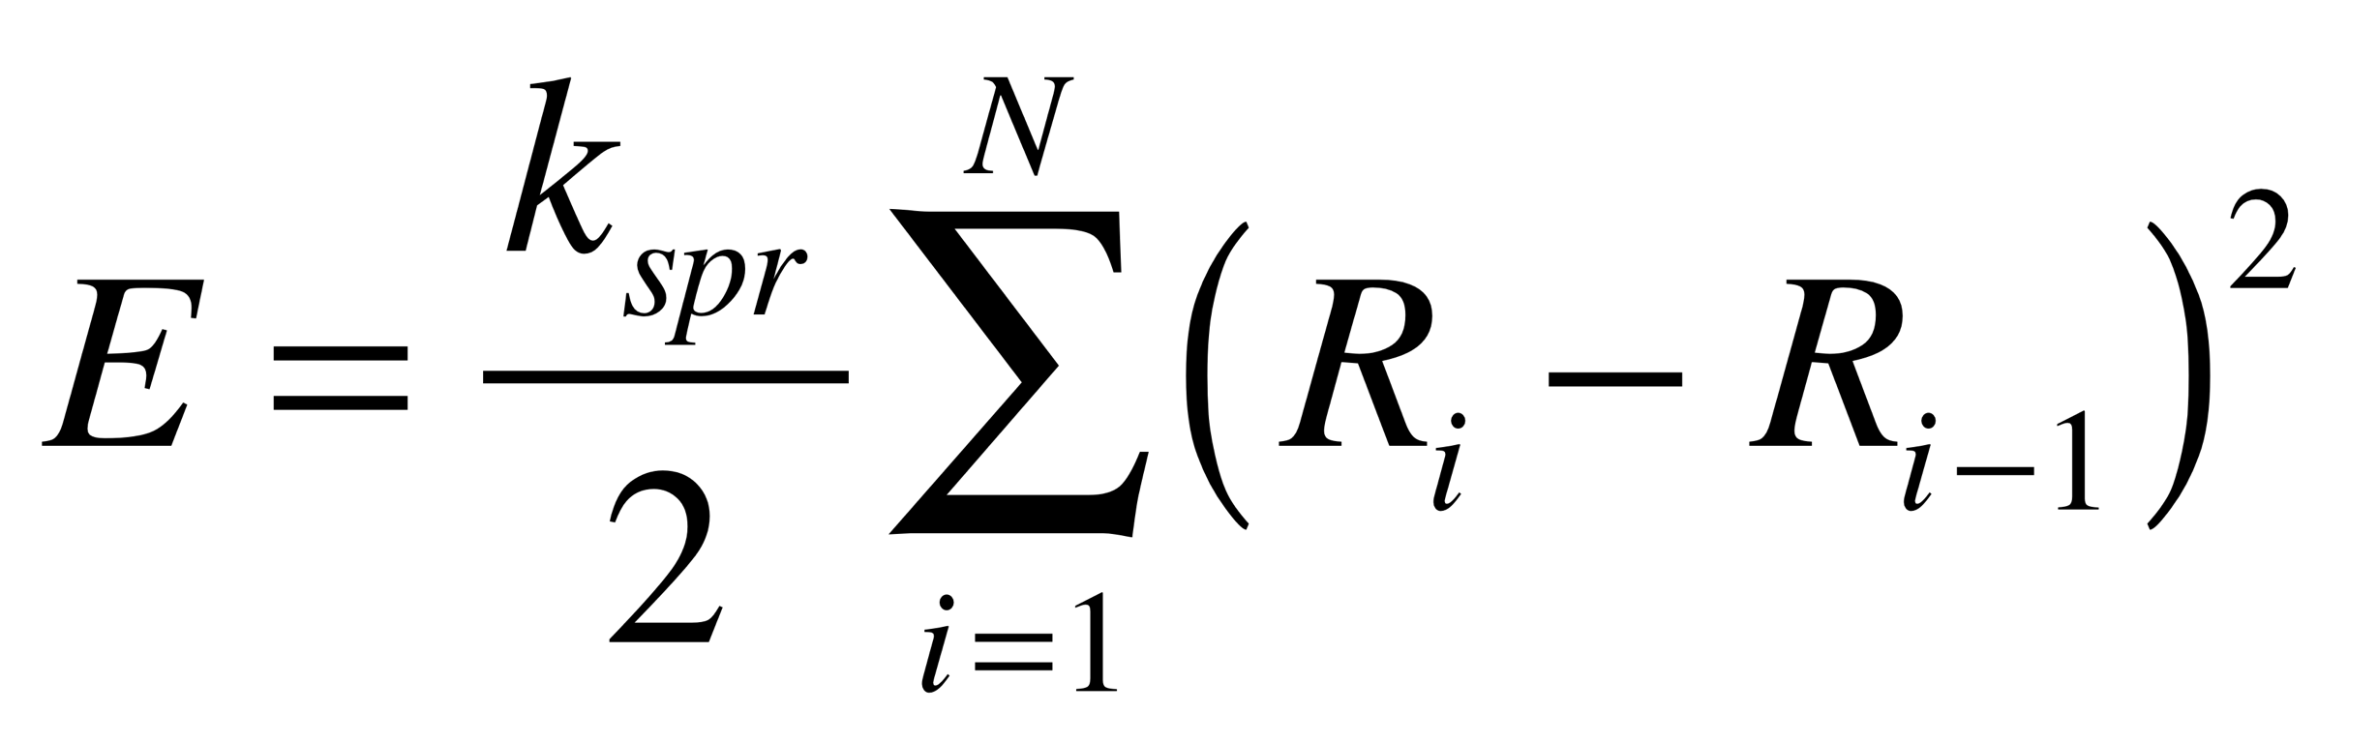
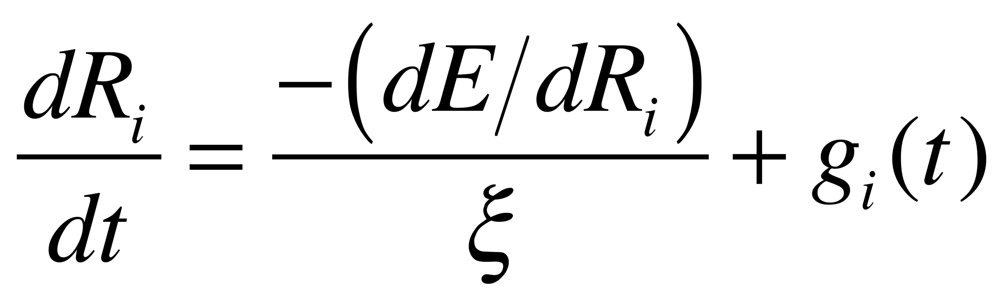
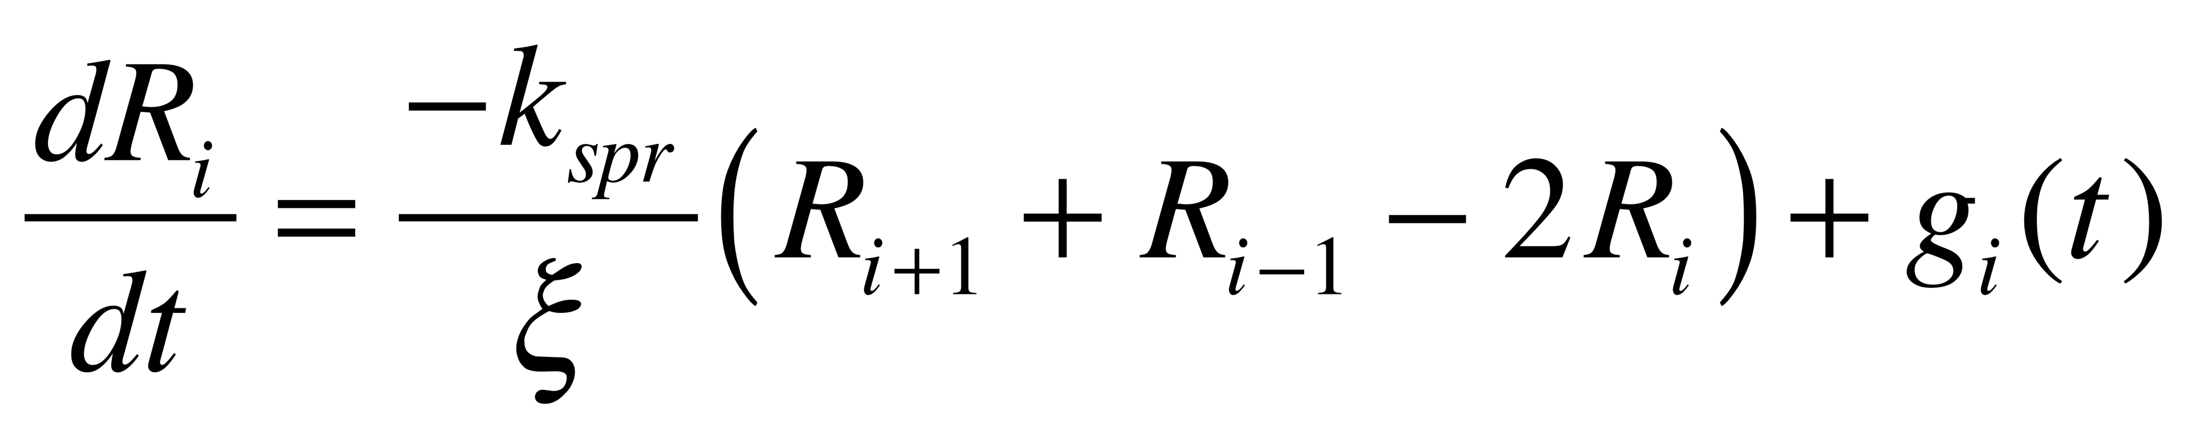
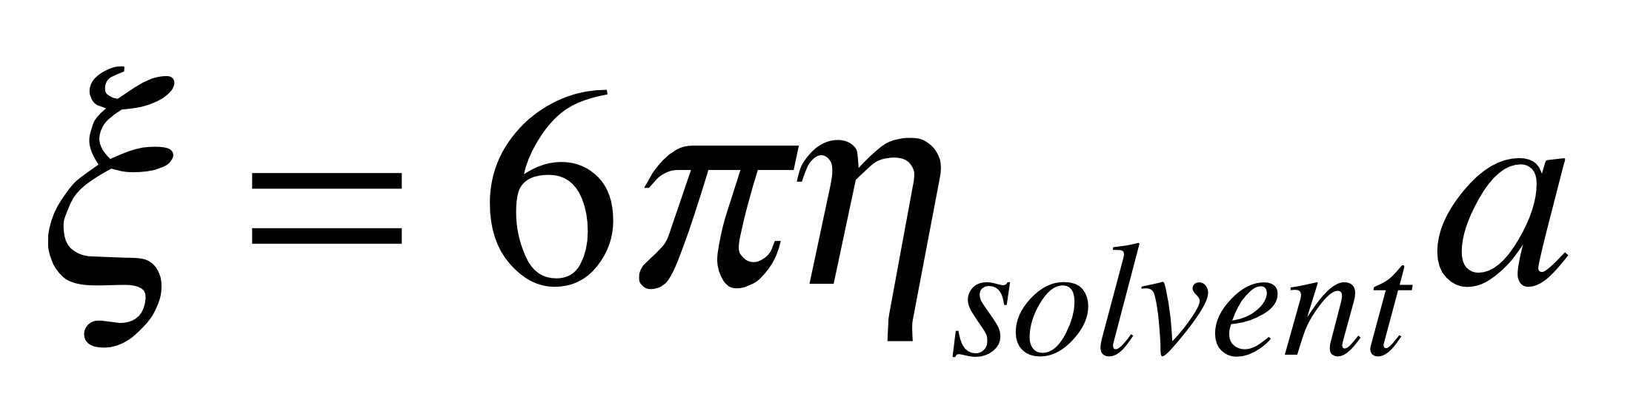
Dilute Solution Chain
Dynamics of the chain
Rouse Motion
Beads 0 and N are special
For Beads 1 to N-1
For Bead 0 use R-1 = R0 and for bead N RN+1 = RN
This is called a closure relationship

Slide 6
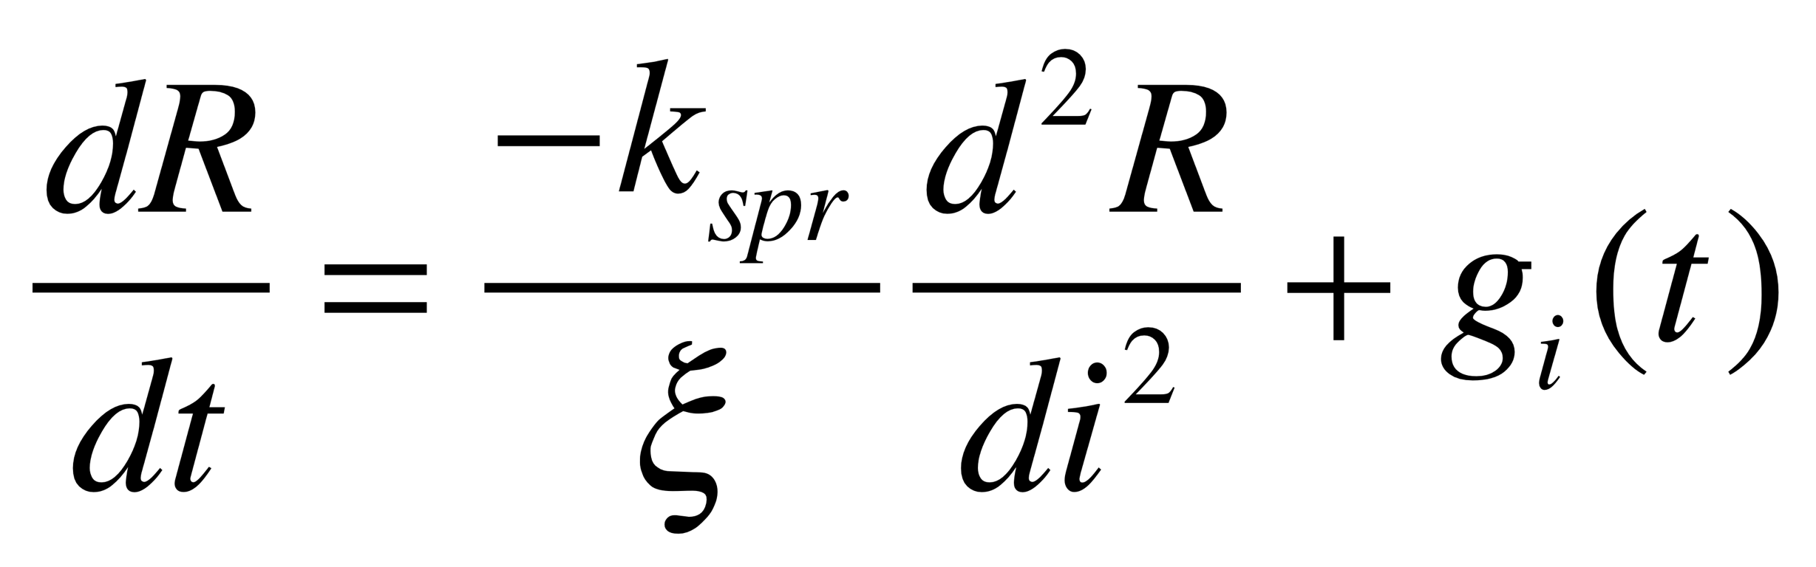
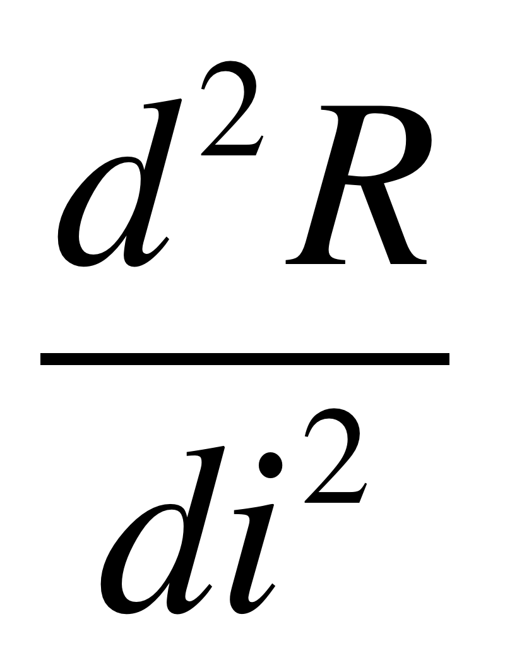
Dilute Solution Chain
Dynamics of the chain
Rouse Motion
The Rouse unit size is arbitrary so we can make it very small and:
With dR/dt = 0 at i = 0 and N
Reflects the curvature of R in i,
it describes modes of vibration like on a guitar string

Slide 7
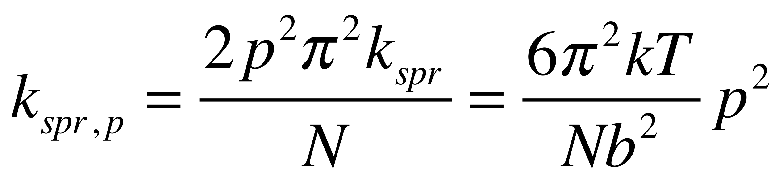
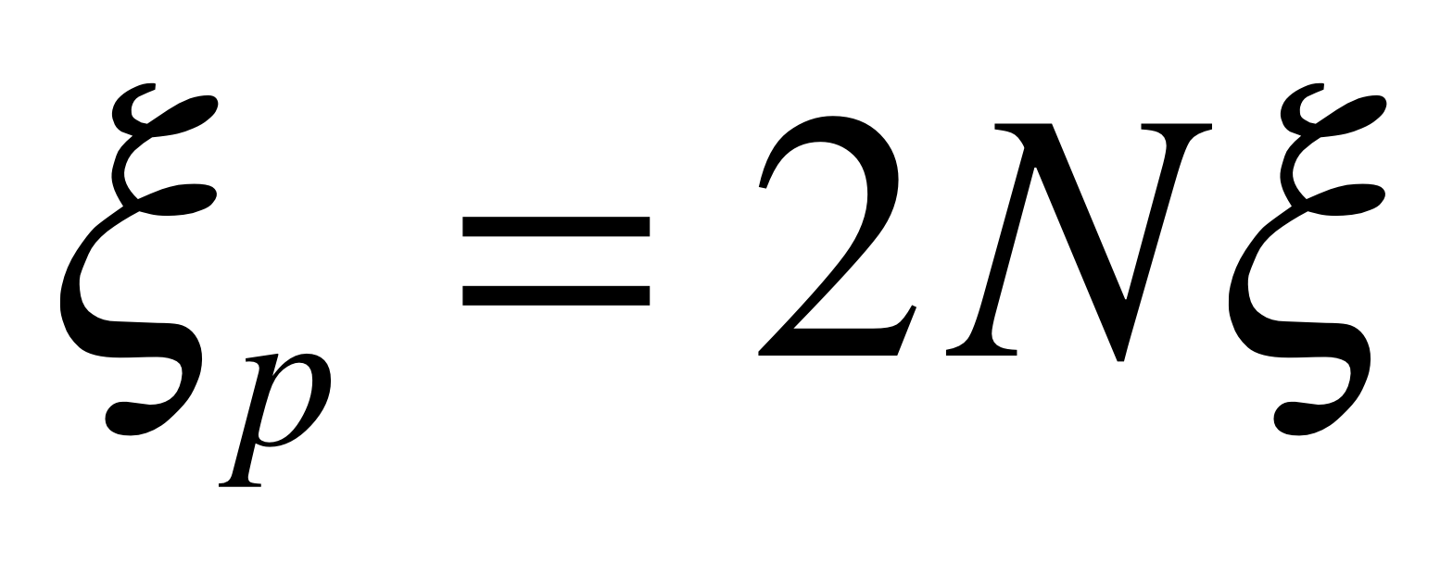
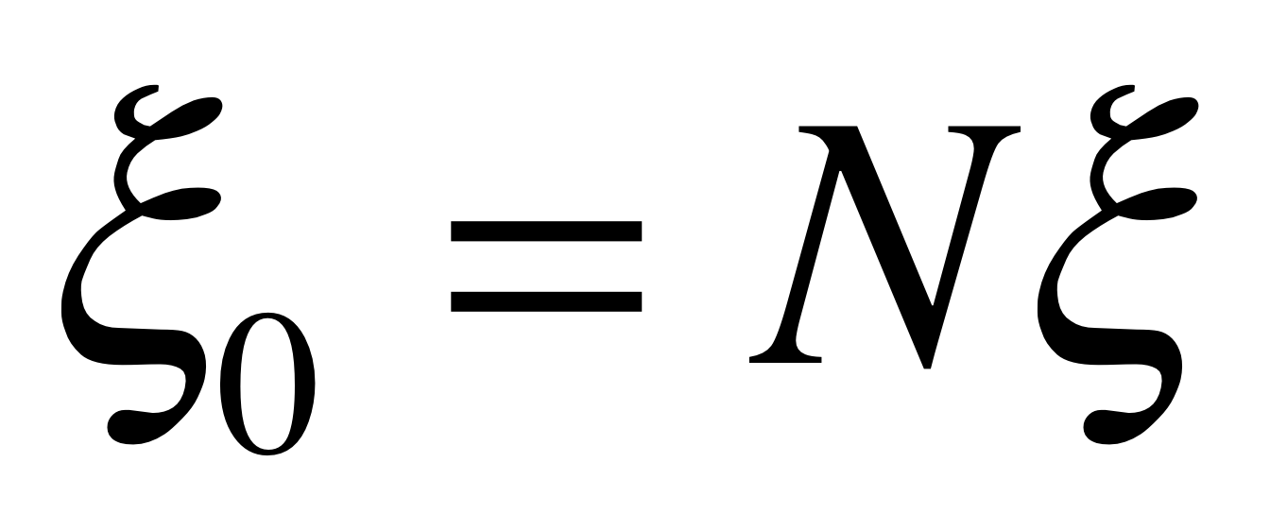
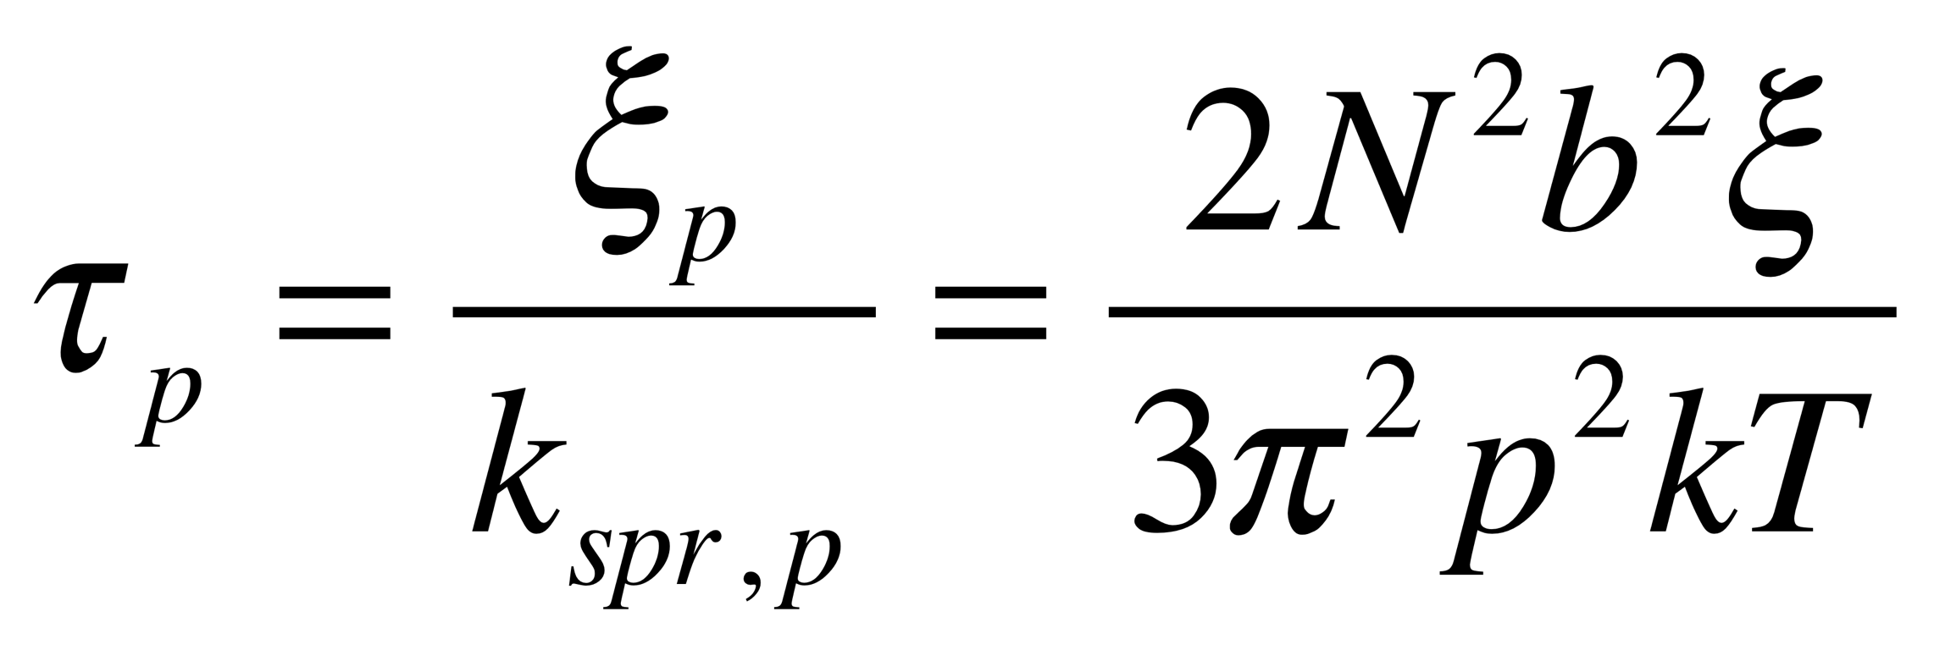
Dilute Solution Chain
Dynamics of the chain
Rouse Motion
Describes modes of vibration like on a guitar string
For the “p’th” mode (0’th mode is the whole chain (string))

Slide 8
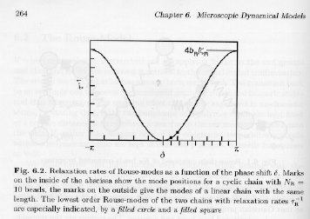
x, y, z decouple (are equivalent) so you can just deal with z
For a chain of infinite molecular weight there are wave solutions to this series of differential equations

Slide 9
For N_{R} = 10
Cyclic Boundary Conditions:
NR values of phase shift

Slide 10
For N_{R} = 10
Free End Boundary Conditions:
NR values of phase shift
NR Rouse Modes of order “m”

Slide 11
Lowest order relaxation time dominates the response
This assumes that
is constant, friction coefficient is proportional to number of monomer units in a Rouse segment
This is the basic assumption of the Rouse model,

Slide 12
Lowest order relaxation time dominates the response
Since

Slide 13
The amplitude of the Rouse modes is given by:
The amplitude is independent of temperature because the free energy of a mode is proportional to kT and the modes are distributed by Boltzmann statistics
90% of the total mean-square end to end distance of the chain originates from the lowest order Rouse-modes so the chain can be often represented as an elastic dumbbell

Slide 14
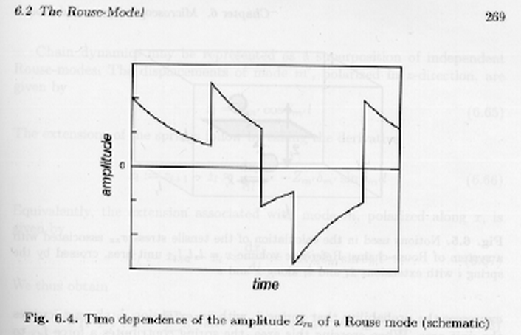
Rouse dynamics (like a dumbell response)
Dumbbell
Rouse

Slide 15
Rouse dynamics (like a dumbell response)
Also,
For t => 0,

Slide 16
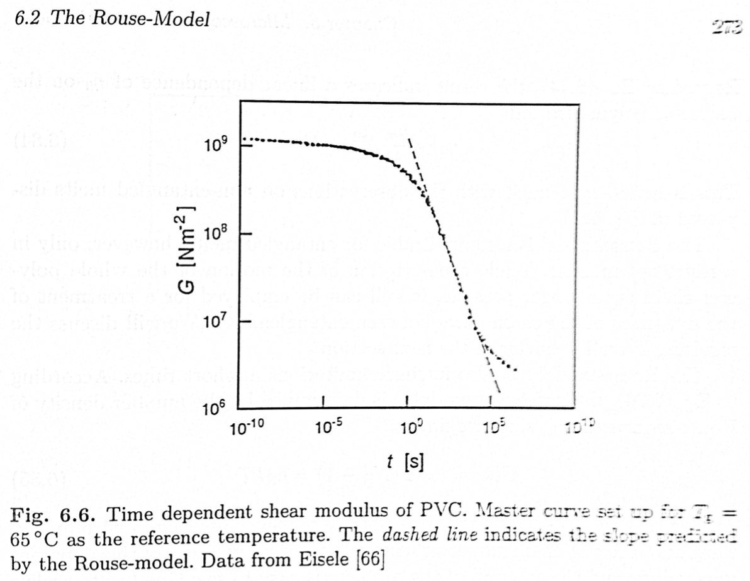
Predictions of Rouse Model

Slide 17
Dilute Solution Chain
Dynamics of the chain
Rouse Motion
Predicts that the viscosity will follow N which is true for low molecular weights in the melt and for fully draining polymers in solution
Rouse model predicts
Relaxation time follows N² (actually follows N^{3/df})
Diffusion constant follows 1/N (zeroth order mode is translation of the molecule) (actually follows N^{-1/df})
Both failings are due to hydrodynamic interactions (incomplete draining of coil)

Slide 18
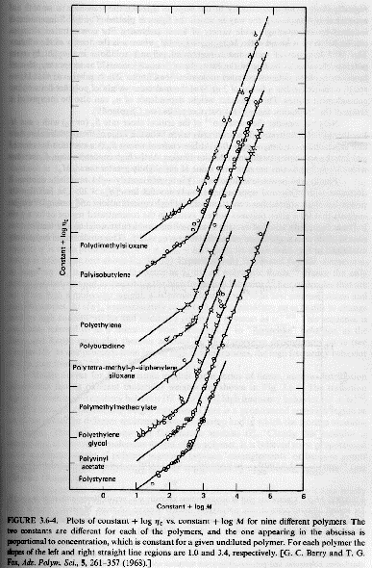
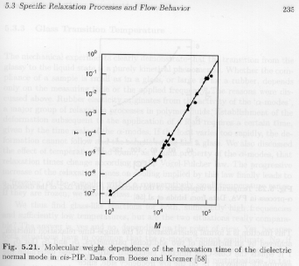
Dilute Solution Chain
Dynamics of the chain
Rouse Motion
Predicts that the viscosity will follow N which is true for low molecular weights in the melt and for fully draining polymers in solution
Rouse model predicts
Relaxation time follows N² (actually follows N³/df)

