Slide 1
Inelastic scattering:
Dynamics in polymer systems.
March 1, 2023
Jonathan Nickels

Slide 2
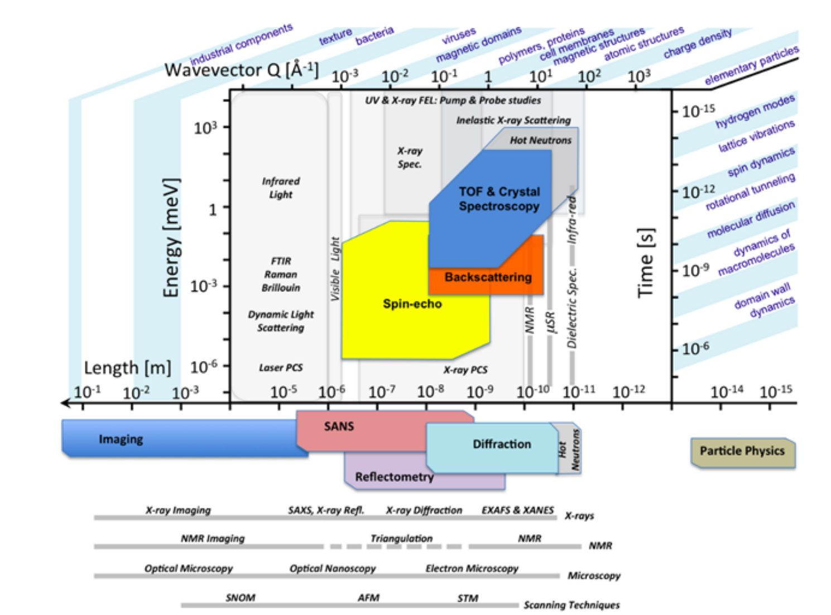
Dynamics in polymer systems
The molecular relaxations within polymer systems control diffusivity, viscosity/mechanical properties, aging/fatigue, conductivity, etc.
A range of experimental methods can be used to experimentally observe polymer dynamics.
Among these, inelastic neutron scattering has a unique role, probing molecular motions on the order of femtoseconds-microseconds over length scales from Angstroms to tens/hundreds of nanometers.
Neutrons also scatter from the atomic nuclei, giving them a useful set of scattering rules and non-destructive nature.

Slide 3
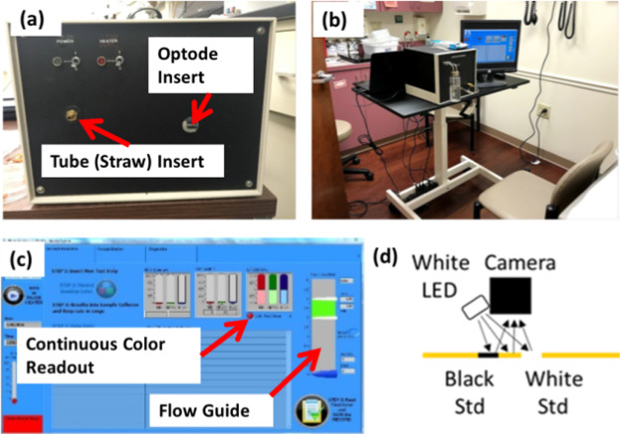
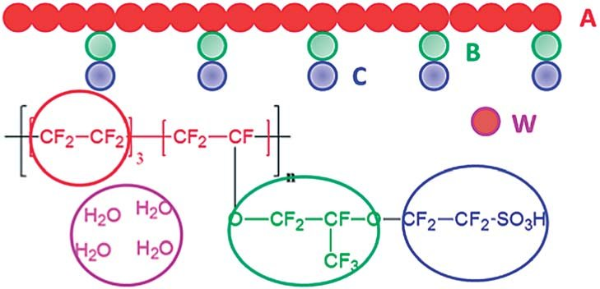
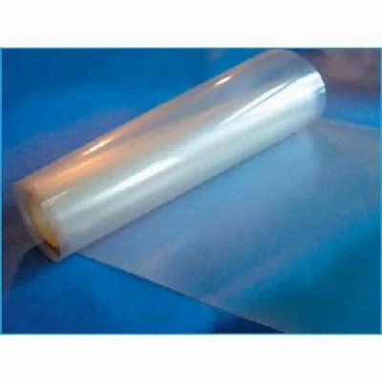
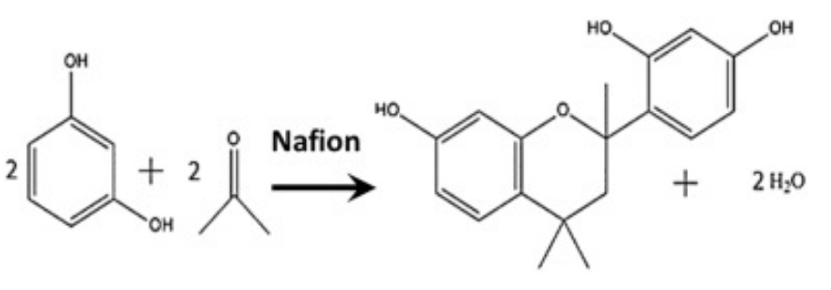
Dynamics of Acetone in Functionalized Nafion
Goal was to better understand transport within Nafion for use as an optode to monitor the dynamic evolution of biomarkers of metabolic health such as acetone (ketones) in the humid ambient environment or exhaled human breath.
Displacements smaller than the micrometer-sized domains within Nafion were not altered by the addition of VA – but were impacted by water content.
PFG NMR data present evidence that VA functionalization leads to a better separation of the diffusion pathways of water and acetone. Water molecules mostly diffuse along water channels and acetone molecules mostly diffuse in the interfacial regions – VA is likely localized in the interfacial PFE regions. This may explain the role of VA in preserving catalytic activity in the presence of water.
Combined study with PFG NMR, SAXS, and inelastic neutron scattering.
Inelastic scattering used to provide short length scale diffusion data.
Discussion from: Phys. Chem. Chem. Phys., 2022,24, 10069-10078 and J. Phys. Chem. B 2020, 124, 40, 8943–8950

Slide 4
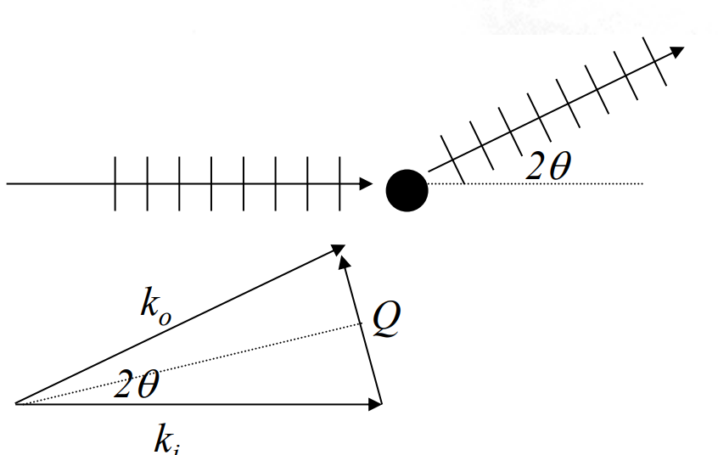
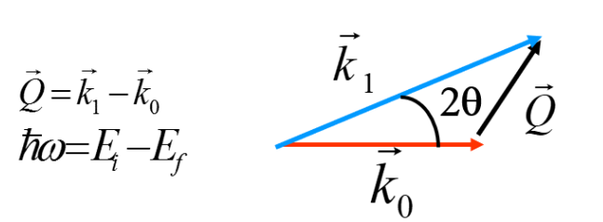

Scattering Methods
Scattering methods: elastic versus inelastic
$$Q=2k_{i}sinθ=\frac{4π}{λ}sin⁡θ$$

Slide 5
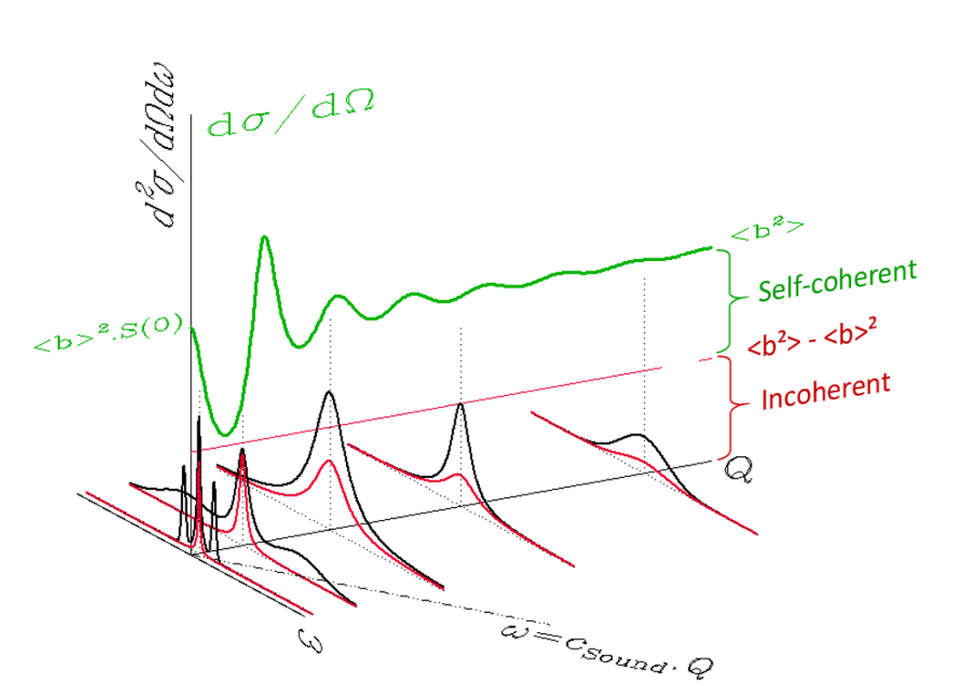
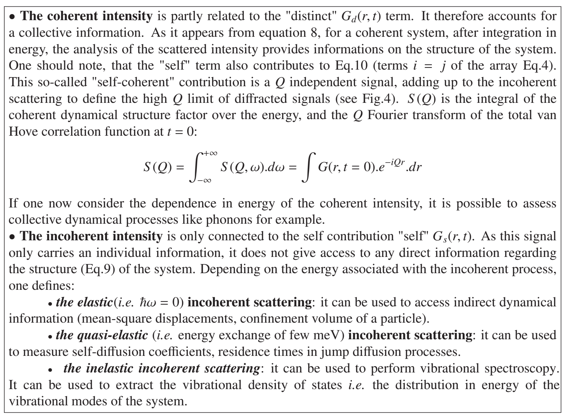
Structure/Dynamics – coherent/incoherent

Slide 6
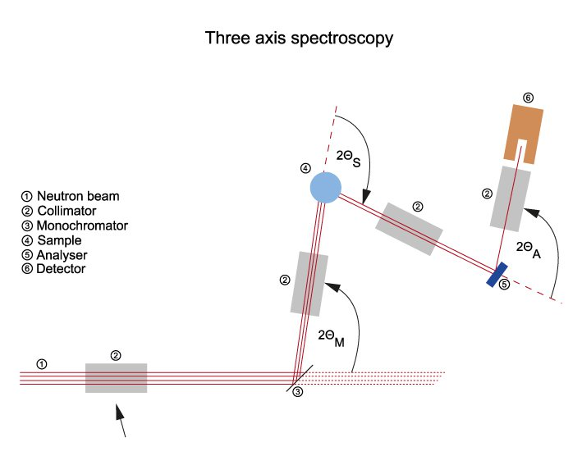
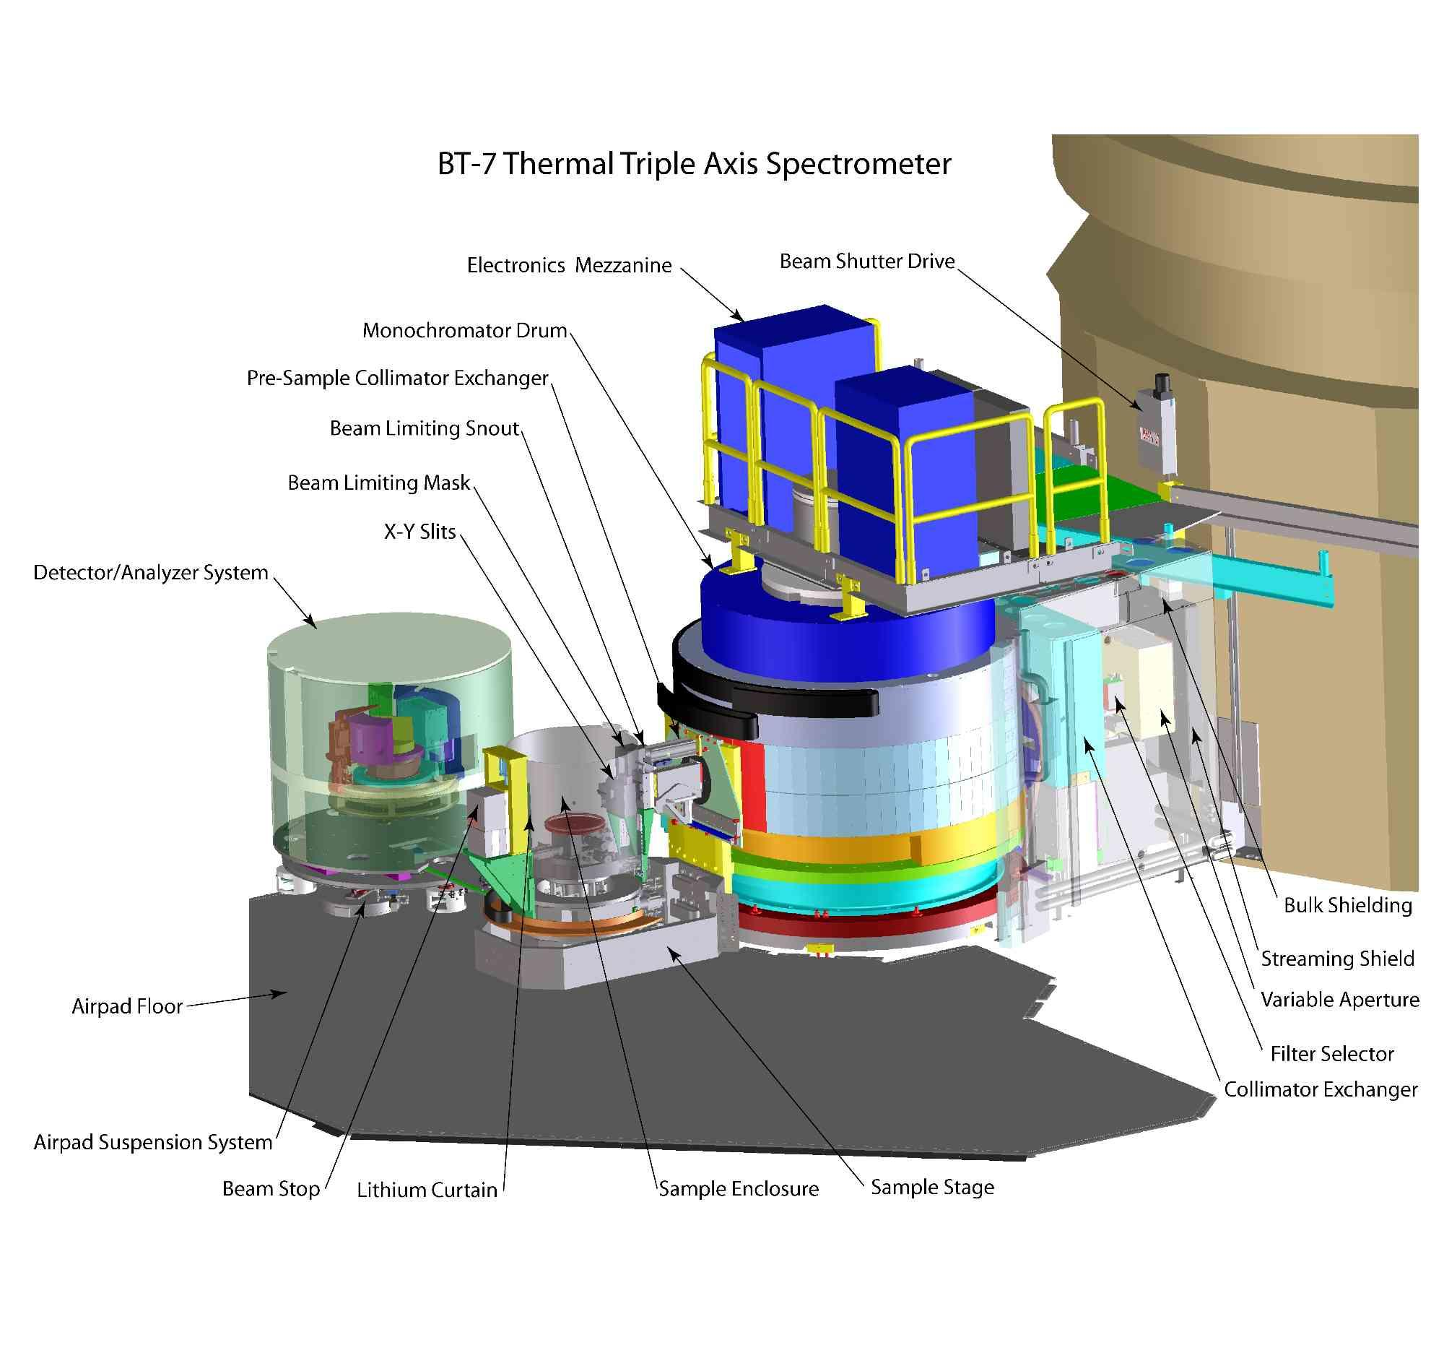
Inelastic scattering techniques
Triple Axis
TOF – time of flight
Backscattering
NSE – neutron spin echo

Slide 7
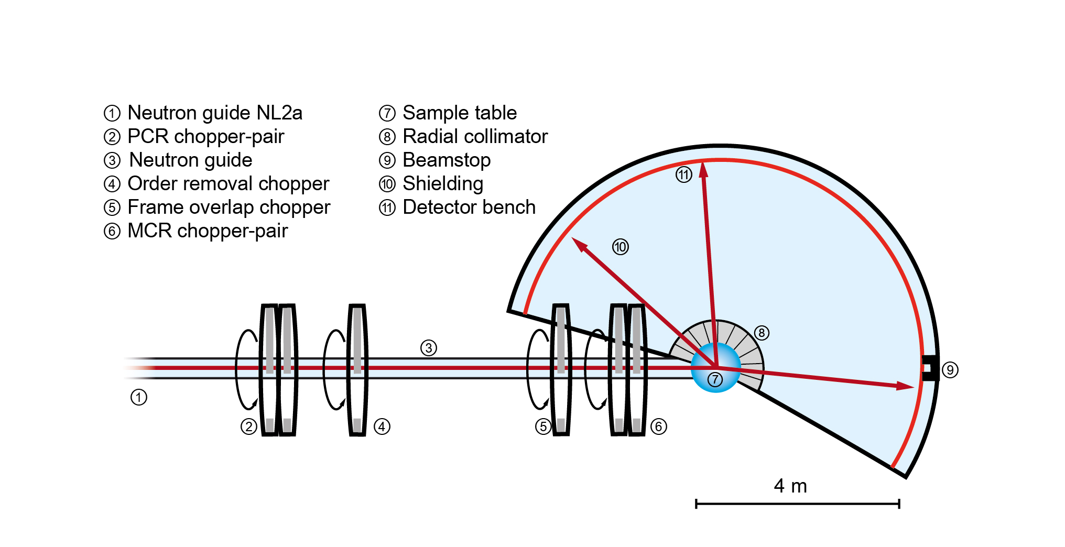
Inelastic scattering techniques
Triple Axis
TOF – time of flight
Backscattering
NSE – neutron spin echo

Slide 8
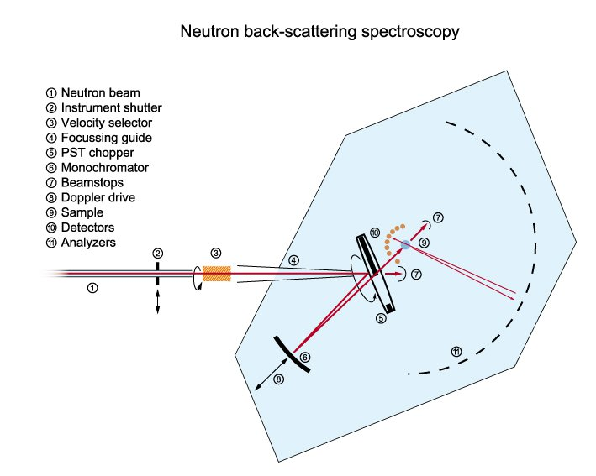
Inelastic scattering techniques
Triple Axis
TOF – time of flight
Backscattering
NSE – neutron spin echo

Slide 9
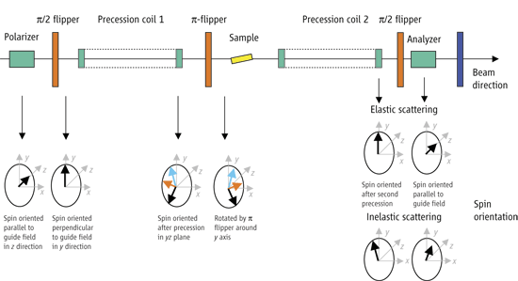
Inelastic scattering techniques
Triple Axis
TOF – time of flight
Backscattering
NSE – neutron spin echo

Slide 10
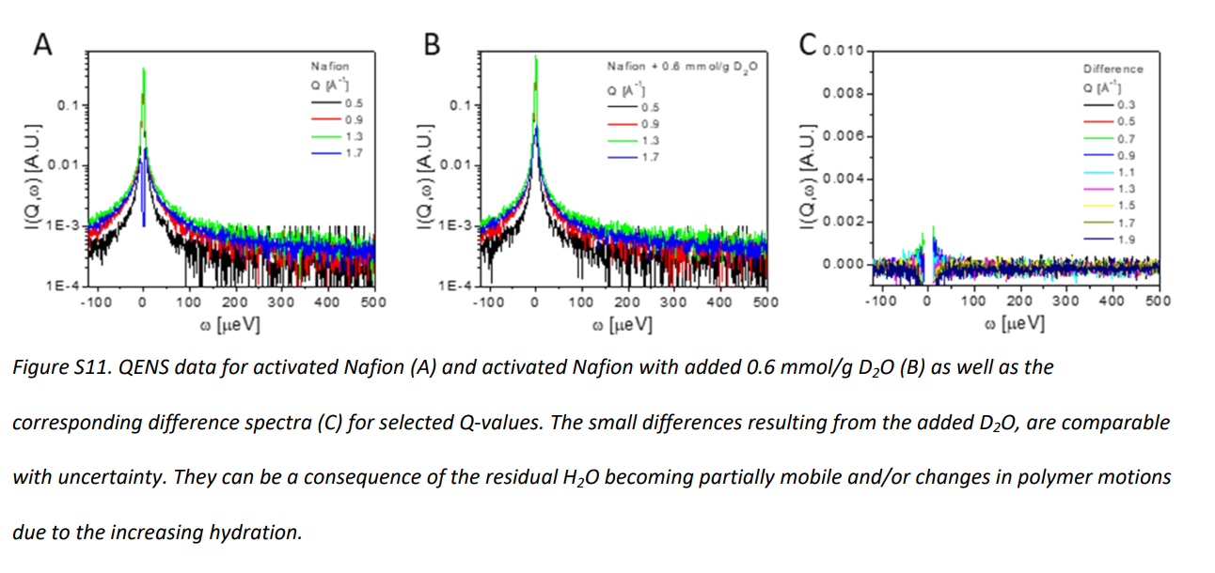
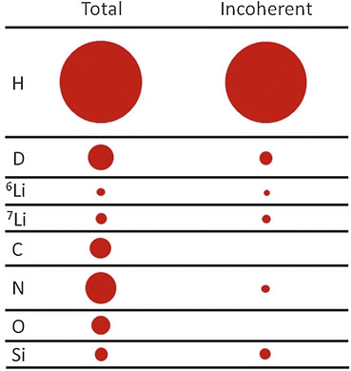
Nafion and D2O are ideal for QENS – isotopes.
Nafion is fluorinated – has a very low incoherent scattering cross-section.
Deuterium has a very small incoherent scattering cross-section.
Can isolate motions of hydrogenated acetone

Slide 11
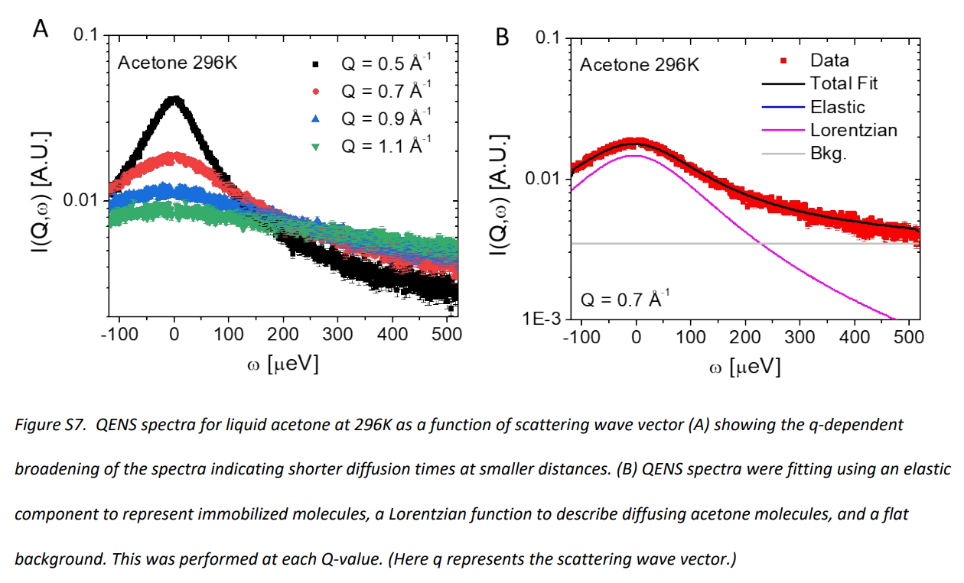
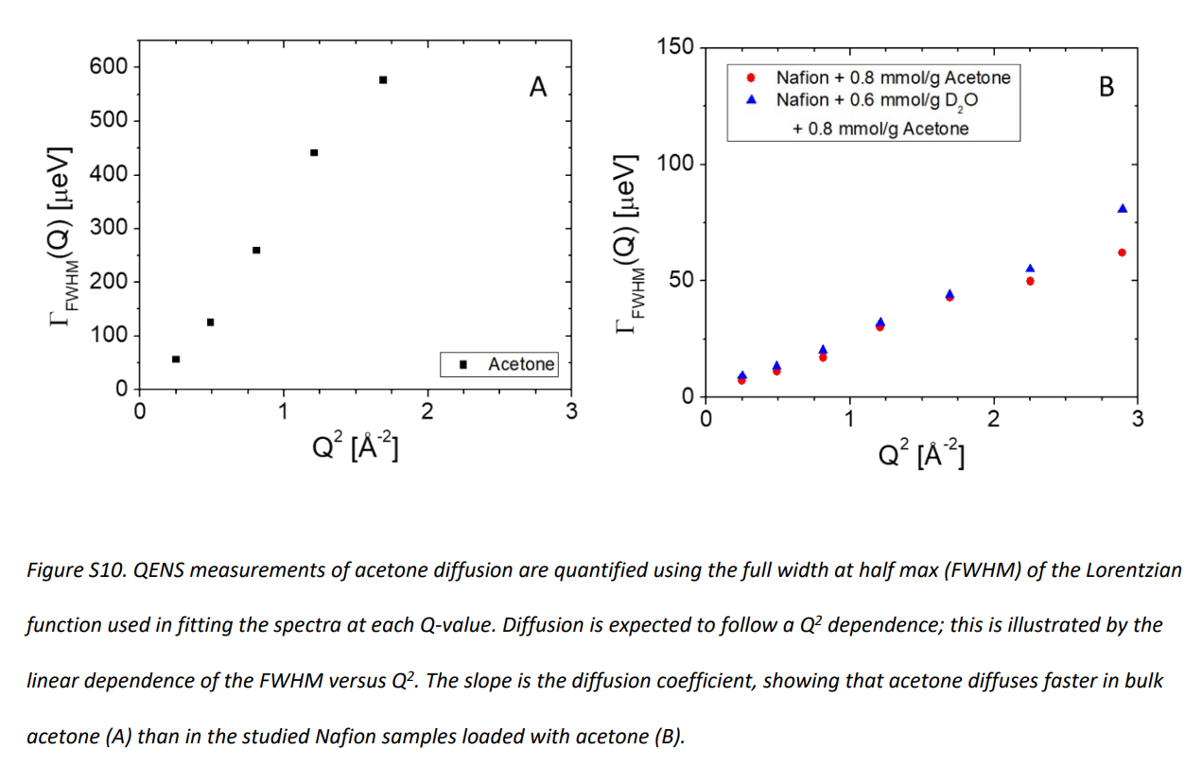
QENS measurements

Slide 12
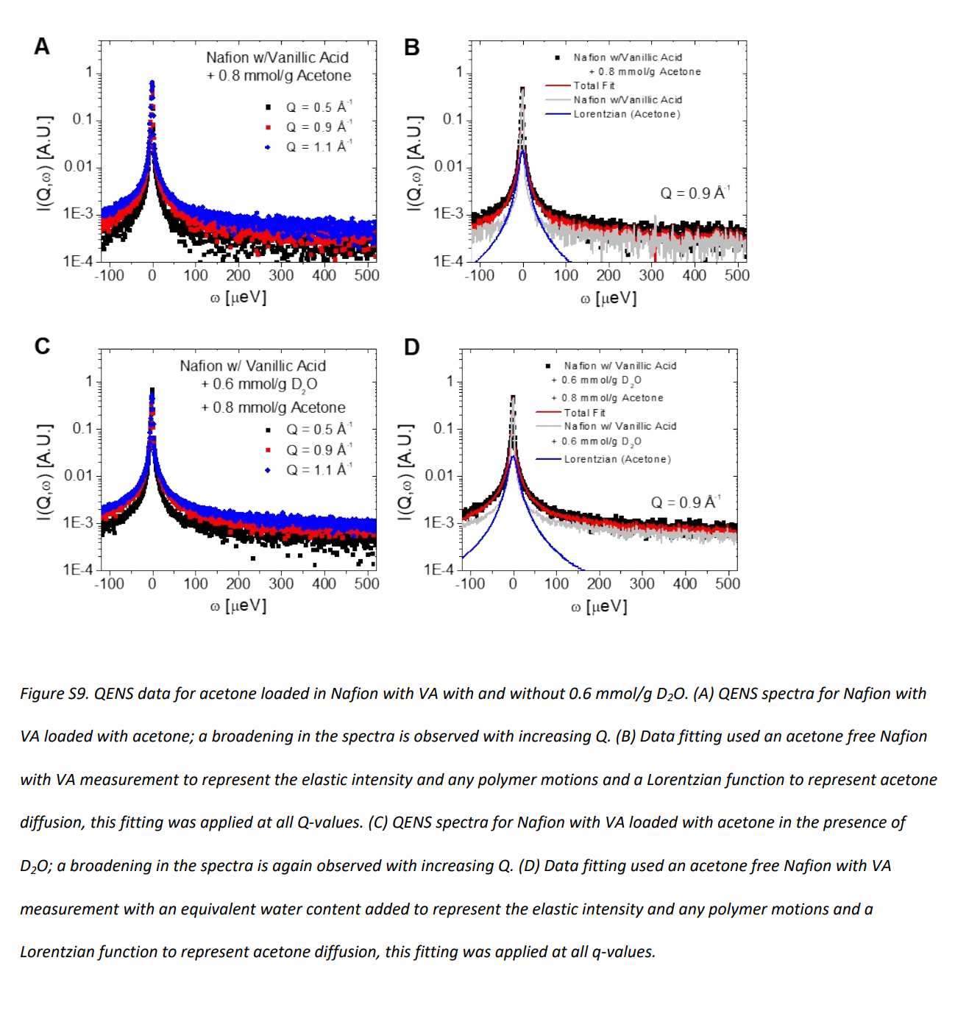
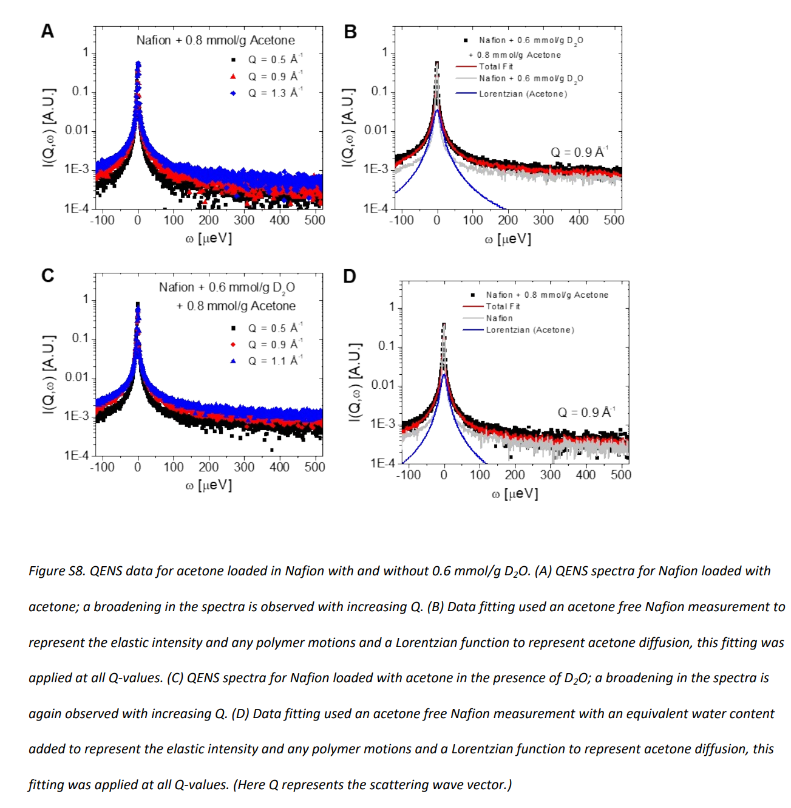
QENS measurements

Slide 13
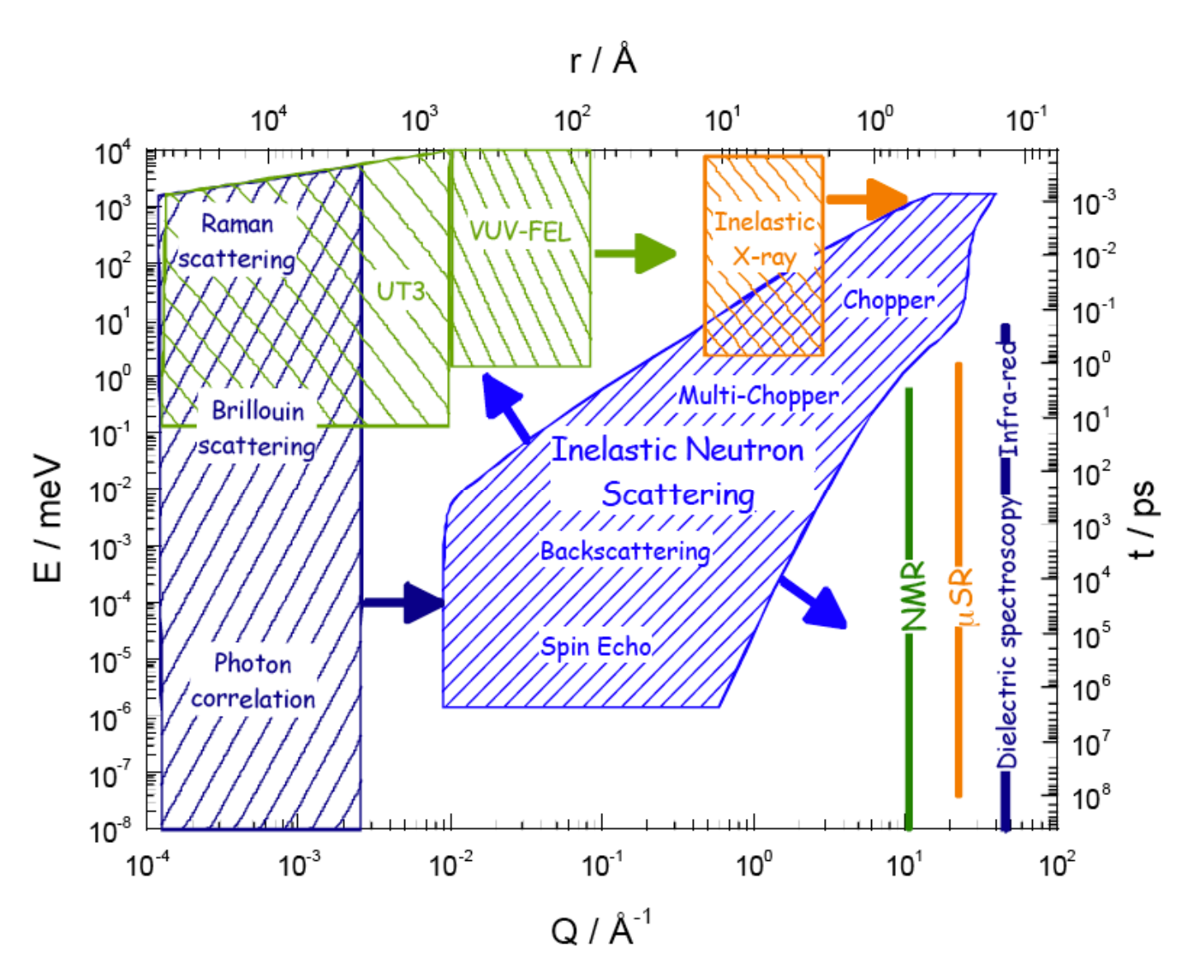
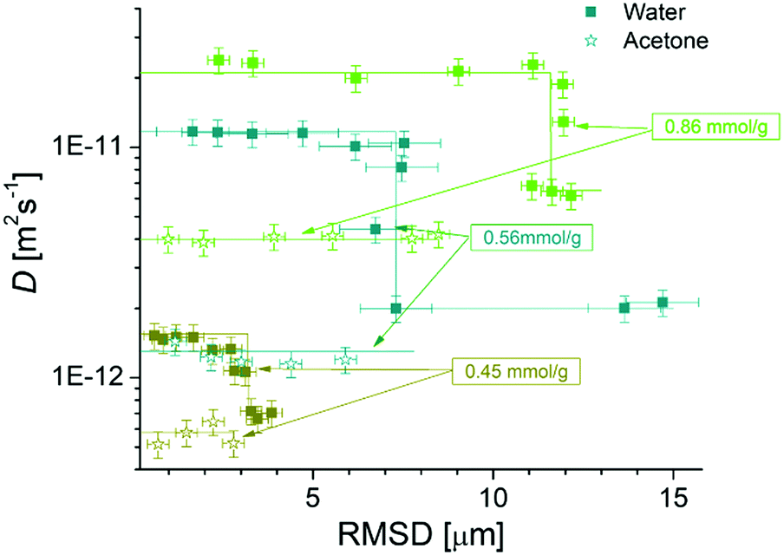
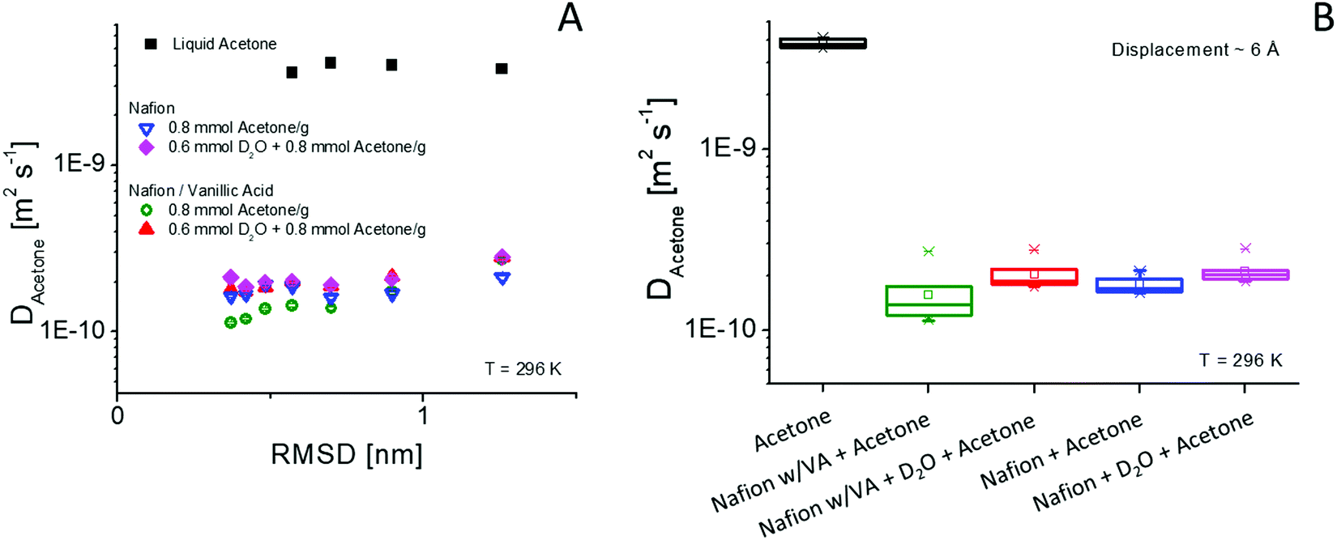
Dynamics measurements – implied length scale of motions.

