Slide 1
Colloids
A heterogeneous system in which particles of solid or droplets of liquid with dimensions 10 µm or less are dispersed in a medium.

Slide 2
Properties of Colloidal Dispersions
Very high surface area:
1 gal paint: 1 kg, 200 nm spheres 15,000 m² Interfacial Energy
Homework problem 1
Stability: Creaming, precipitation, coagulation, floculation (reversible)
What is the relationship between colloid stability and intermolecular forces?
Notes:
Flocculation is, in the field of chemistry, a process where colloids come out of suspension in the form of floc or flakes. The action differs from precipitation in that, prior to flocculation, colloids are merely suspended in a liquid and not actually dissolved in a solution. In the flocculated system there is no formation of a cake since all the flocs are in the suspension.
Coagulation often refers to blood clotting
floculation is reversible. In sec

Slide 3
Intermolecular Forces
The three components that constitute van der Waals Forces
Interaction
Origin of Interactions
Equation
Keesom
Dipole-dipole
Debye
Dipole – induced dipole
London (Dispersion)
Induced Dipole – Induced Dipole
water µ = 6.17×10⁻³⁰ C-m = 1.85 debye.
(1 debye = 3.33×10⁻³⁰ C-m)
Notes:
- Provides molecular level reasoning that at room temperature
Small molecules (Ar, He, CH₄) are gases,
Bigger molecules (hexane, decane) are liquids,
Even bigger molecules (C₃₅H₇₁) are solids.
Permativity of vacuum= 8.85 × 10-12 F/m
water has a dipole moment of 6.17×10⁻³⁰ (Cm) = 1.85 debye. (The debye is a unit used to measure dipole moments: 1 debye = 3.33×10⁻³⁰ (Cm).)

Slide 4
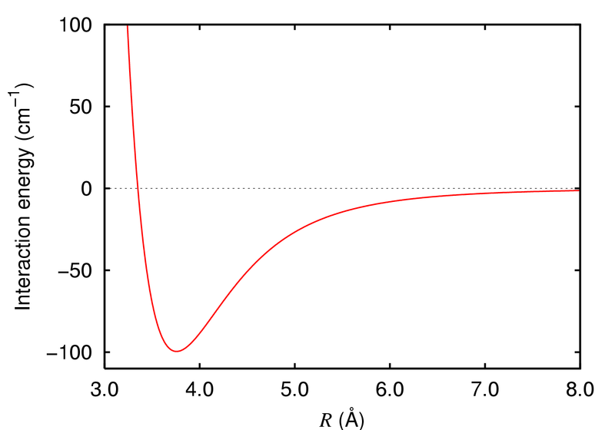
Forces Between Colloidal Particles
Surface energy
Potential between atoms
(“short range”)
dV₁
h
dV₂
Long range
Induced-dipole induced-dipole
Pair-wise interaction
(Derjaguin Approximation)
Forces are strong(>>kT) and long range (h⁻¹)
van der Waals
Interaction potential(J)
atoms
R(Å)
Notes:
Non retarded = instantaneous response of medium 1 to fluctuations in medium 2. surface tension of water is 0.07J/m2. 70 mJ/m2

Slide 5
Hamaker Constant, A_{H}
10²⁰ x Hamaker Constant (J)
Vacuum
25
20
18
15
13
12
13
6.5
Material
6H-SiC
tetra-ZrO₂
β-Si₃N₄
Al₂O₃
Y₂O₃
MgO
MgAl₂O₄
SiO₂
Water
13
8.8
7.0
5.2
4.0
3.2
3.5
0.83
n-Dodecane
1
6.8
5.0
3.6
2.6
1.9
2.1
0.15
A_{H} ≅ π x 10⁻²⁰ J
Bergström, L (1997), Adv. Colloid and Interface Sci., 70, 125
Notes:
IR Contribution is important, which is different for water and dodecane

Slide 6
Force of adhesion between particles
Radius 1 μm with A = 3.14x10⁻²⁰ J
(h ≅ 3Å)
V(h)
1/h
Energy of adhesion
R
h

Slide 7
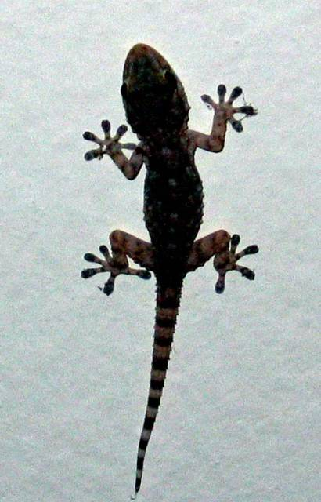
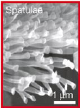
Geko Feet
Spatulae
Satae
Seta
1 billion toes in the van der Waals domain

Slide 8
Colloid Stabilization
Electrostatic Stabilization
Steric Stabilization

Slide 9
Electrostatic Forces (Repulsive)
Surface of colloids are usually charged.
(1) Direct Ionization of surface groups.
(2) Specific ion adsorption
O
-
+ H₂O

Slide 10
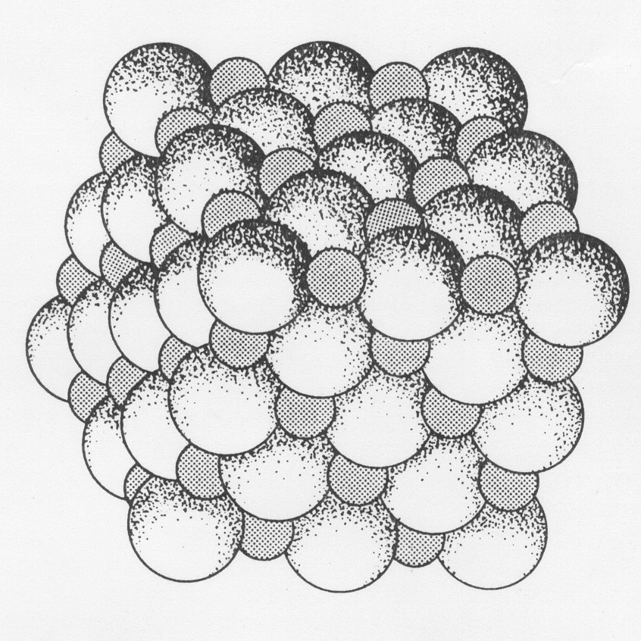
Electrostatic Forces
(3)Differential ion solubility: slight imbalance in number of lattice cations or anions on surface, eg. AgI, BaSO₄, CaF₂, NaCl, KCl
(4)Substitution of surface ions
eg. lattice substitution in kaolin

Slide 11
Electric Double Layers
x
-
-
-
-
SOLVENT MOLECULES
+
-
+
-
+
+
+
+
-
-
Φ₀
COUNTER IONS
HOP
Helmholtz Outer Plane
CO IONS
Surface Potential
Helmholtz (100+ years ago) proposed that surface charge is balanced by a layer of oppositely charged ions.
All colloids should flocculate.
Notes:
All colloids should flocculate

Slide 12
Zeta (ζ) Potential
Gouy/Chapman diffuse double layer + layer of adsorbed charge.
x
-
-
-
-
-
-
-
Diffuse layer
-
+
+
+
ζ
-
+
-
+
+
-
Φ_{stern}
-
+
-
+
-
Φ_{surface}
+
Shear Plane
Bulk Solution
Stern Plane (δ)
Φ = electrostatic potential (Volt = J/coulomb)
Notes:
The unit of electrostatic potential is the volt (V), and 1 V = 1 J/C = 1 Nm/C. Equation (25.4) shows that as the unit of the electric field we can also use V/m. A common used unit for the energy of a particle is the electron-volt (eV) which is defined as the change in kinetic energy of an electron that travels over a potential difference of 1 V. The electron-volt can be related to the Joule via eq.(25.3). Equation (25.3) shows that the change in energy of an electron when it crosses over a 1 V potential difference is equal to 1.6 . 10⁻¹⁹ J and we thus conclude that 1 eV = 1.6 . 10⁻¹⁹ J

Slide 13
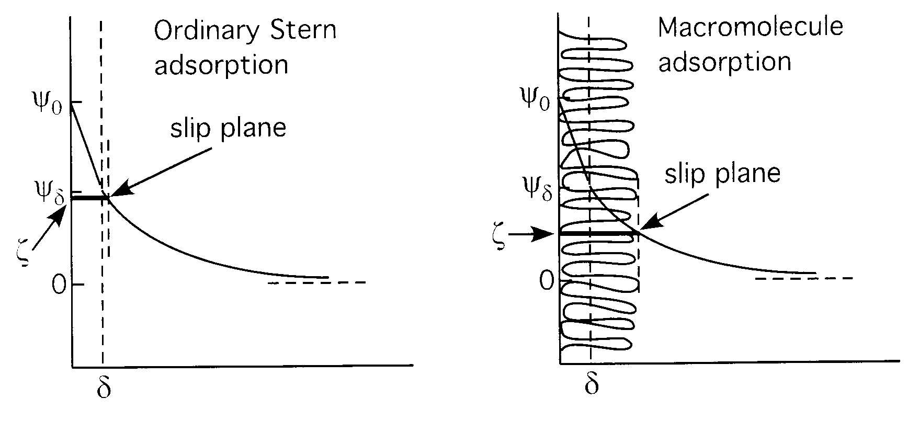
Stern Potential vs. Zeta Potential
Φ_{stern}
Φ_{stern} = ζ
Φ_{stern}
Φ_{stern} ≠ ζ
Zeta potential is approximately the Stern potential, except for the case in which adsorbed macromolecules shift the hydrodynamic slip plane outward beyond the Stern plane of the double layer.
Notes:
The key is to interpret the physical significance of a measured zeta potential. As shown, it can generally be regarded as equivalent to the Stern potential, except for the case in which adsorbed macromolecules shift the hydrodynamic slip plane outward beyond the Stern plane of the double layer.

Slide 14
Debye-Hückel approximation for Φ(x)
Gouy-Chapman Model
x
+
-
+
+
Φ
-
-
+
+
+
+
-
-
-
Exponential
function

Slide 15
Debye Screening Length (Problem 2)
Usually M = mol/L
10⁻⁵M NaCl
Notes:
print (1.6e-19^2*2e-2*6.02e23/(72*8.8e-12*298*1.38e-23))^-.5
Ionic Strength is usually molarity

Slide 16
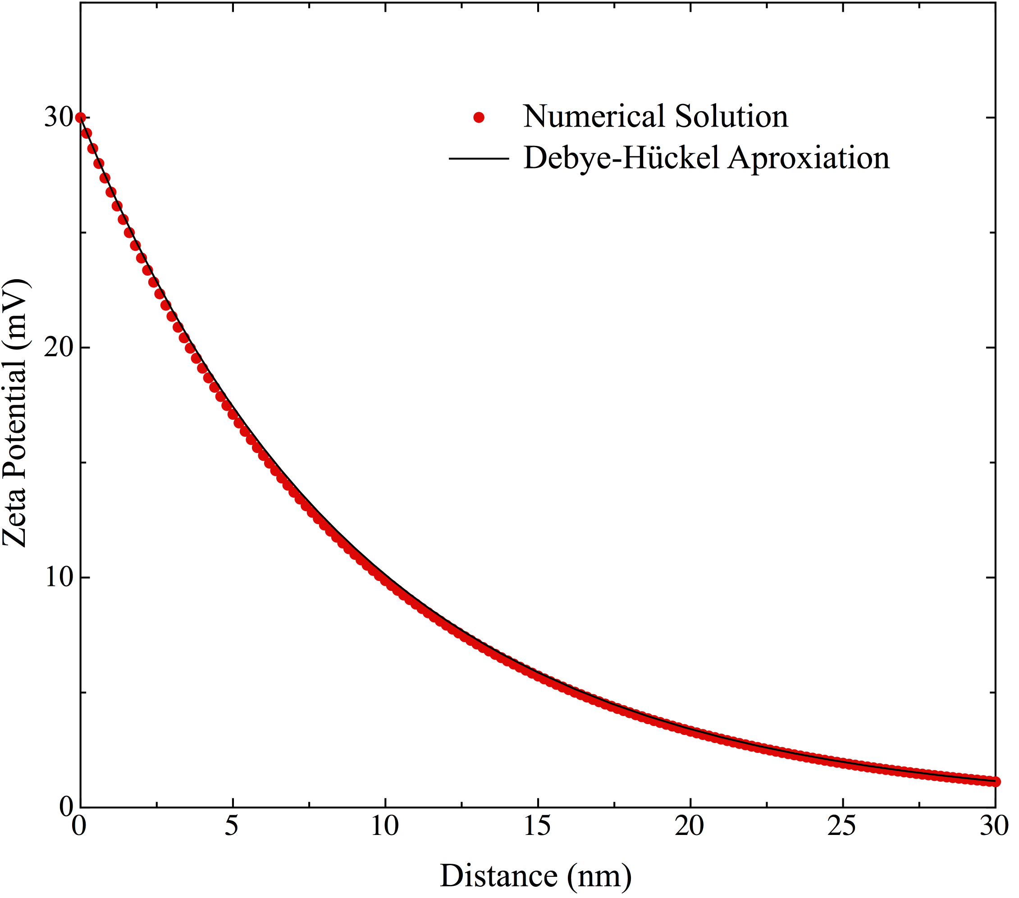
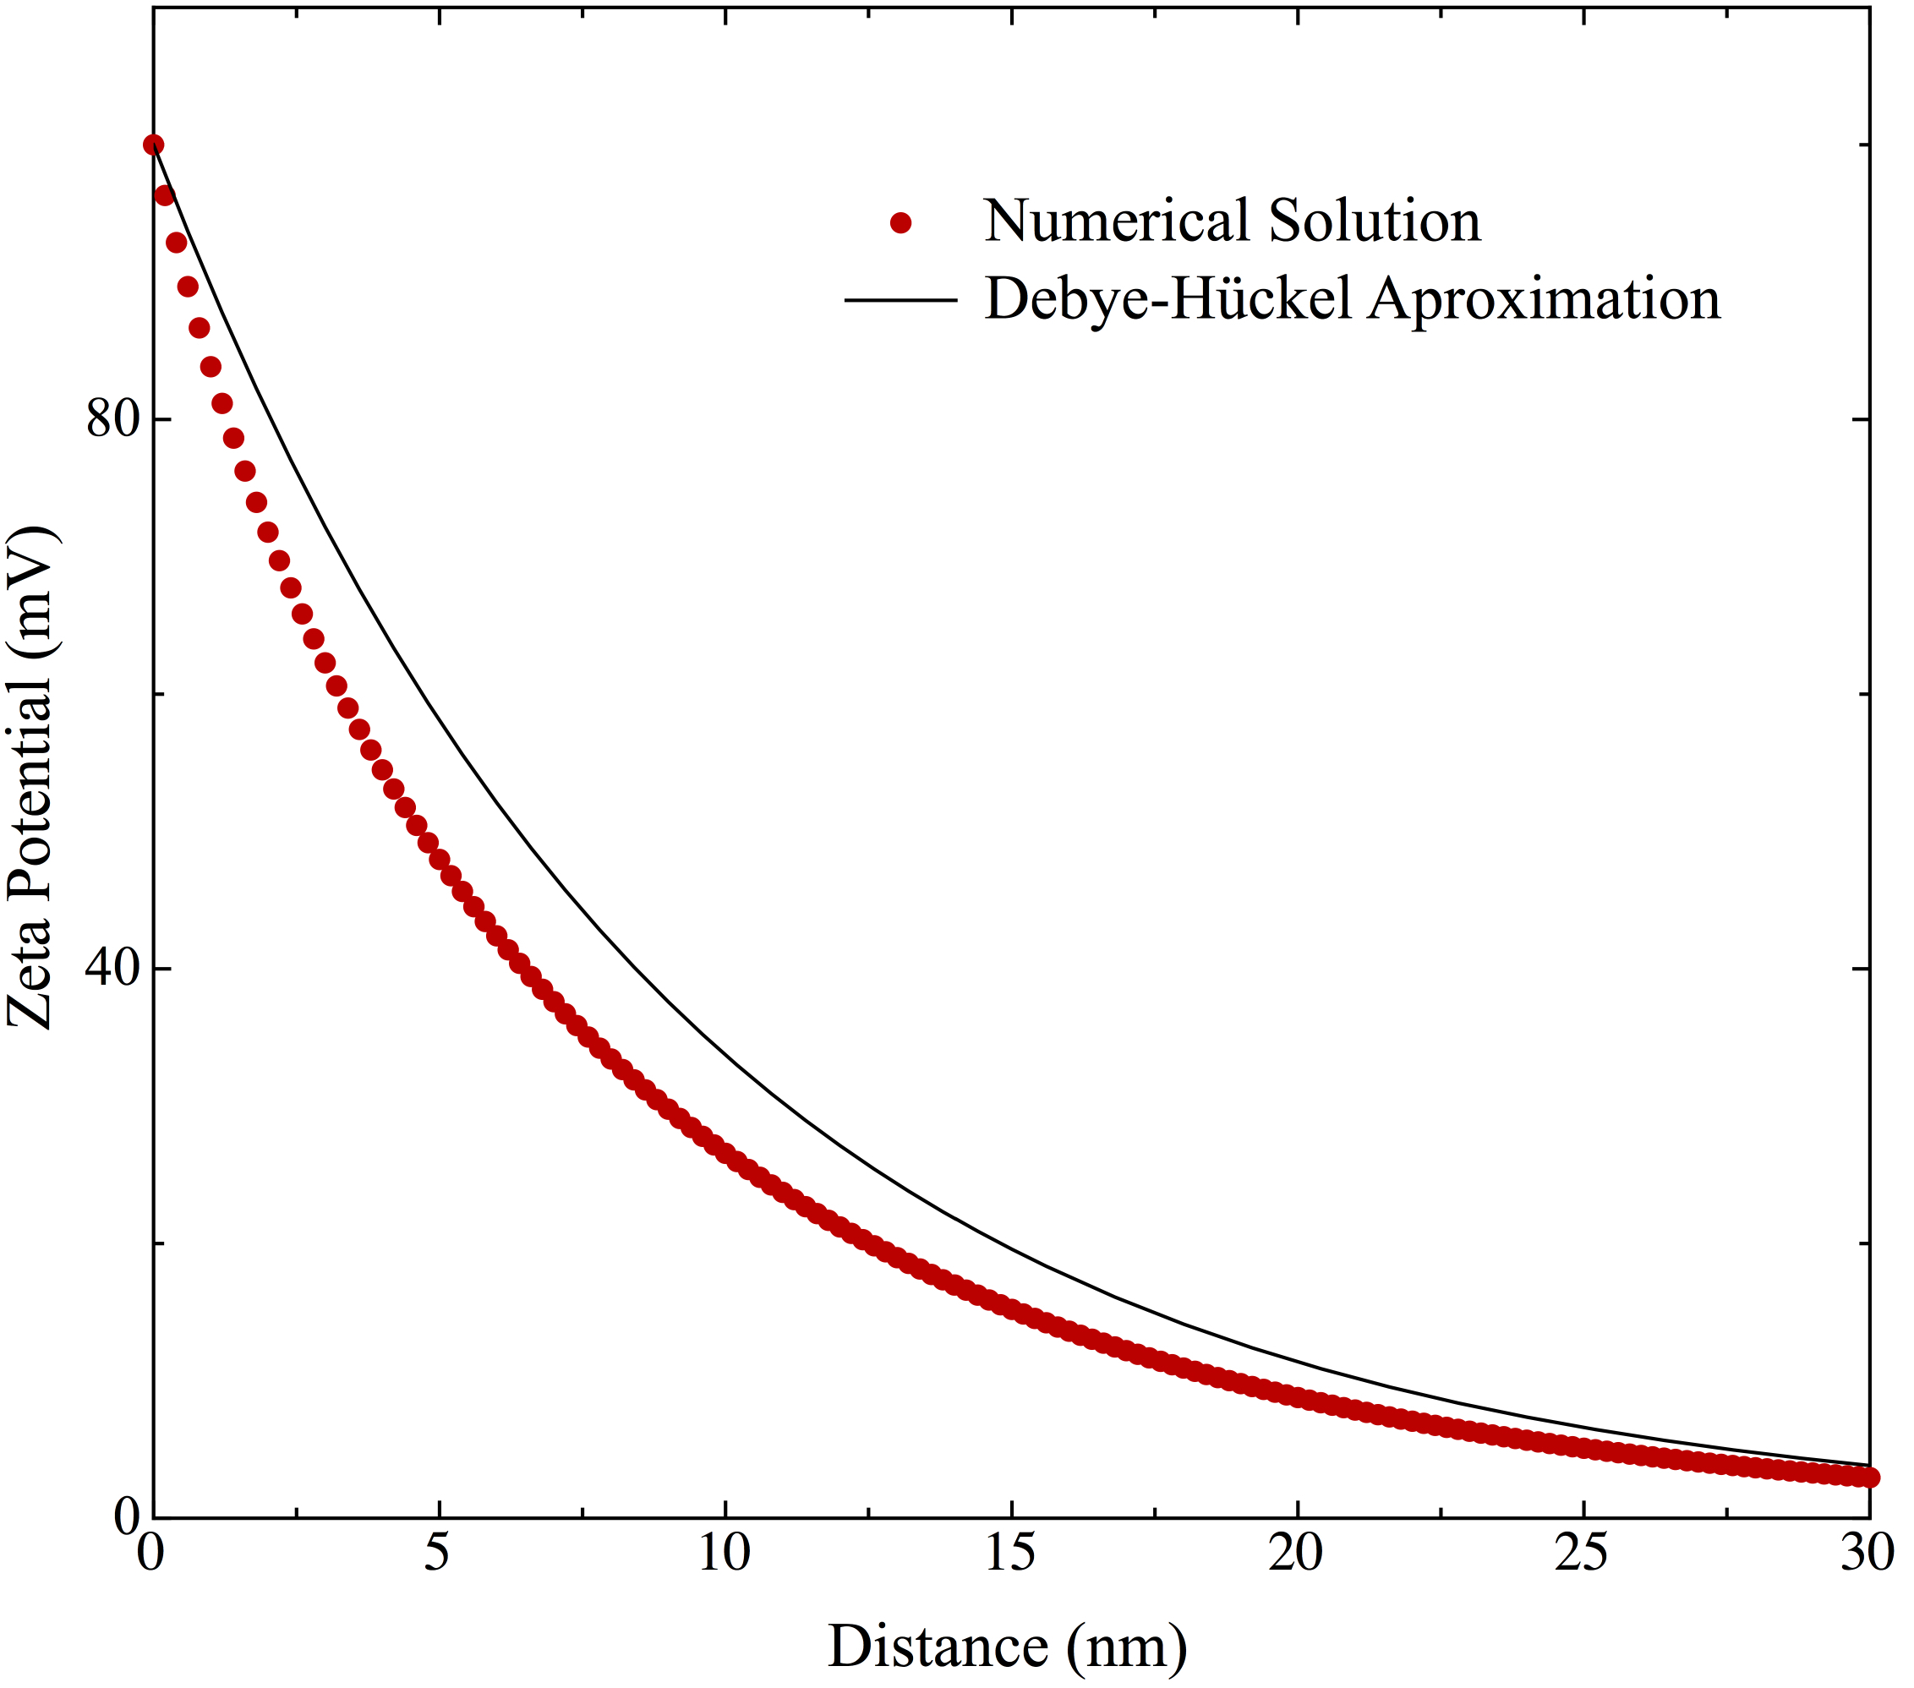
Comparison with Exact Solution
For 0.001 M 1-1 electrolyte
Electric Potential (mV)
Electric Potential (mV)

Slide 17
Debye length and valence
1
0
0
9
0
1
-
1
e
l
e
c
t
r
o
l
y
t
e
2
-
2
e
l
e
c
t
r
o
l
y
t
e
8
0
3
-
3
e
l
e
c
t
r
o
l
y
t
e
7
0
6
0
5
0
Debye Length κ⁻¹, (nm)
4
0
3
0
2
0
1
0
0
1
0
-
5
1
0
-
4
1
0
-
3
1
0
-
2
1
0
-
1
1
0
0
1
0
1
E
l
e
c
t
r
o
l
y
t
e
C
o
n
c
e
n
t
r
a
t
i
o
n
(
M
)
Ions of higher valence are more effective in screening surface charge.

Slide 18
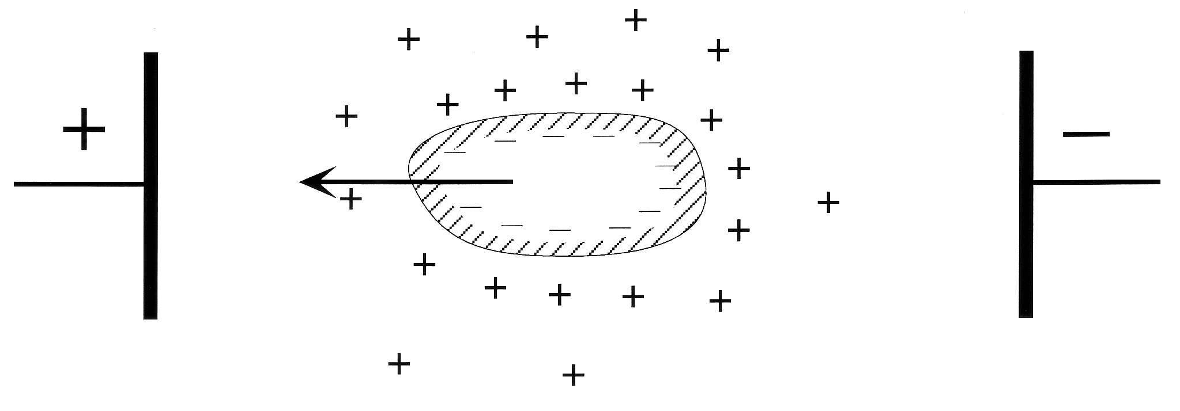
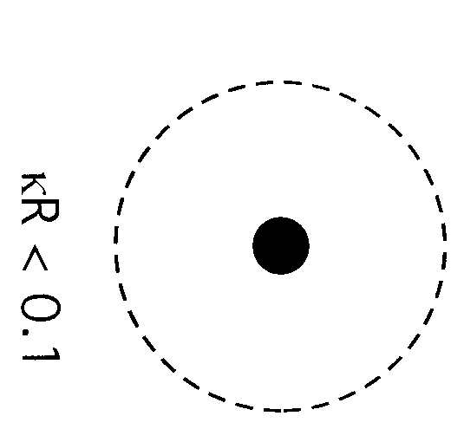
Measuring zeta Potential (ζ): Electrophoresis
v = electrophoretic velocity
Notes:
To the extent that electrophoresis is phenomenologically identical to electro-osmosis, the results just obtained may be applied to yield the steady electrophoretic velocity V_{p} of a colloid particle in an electric field.

Slide 19
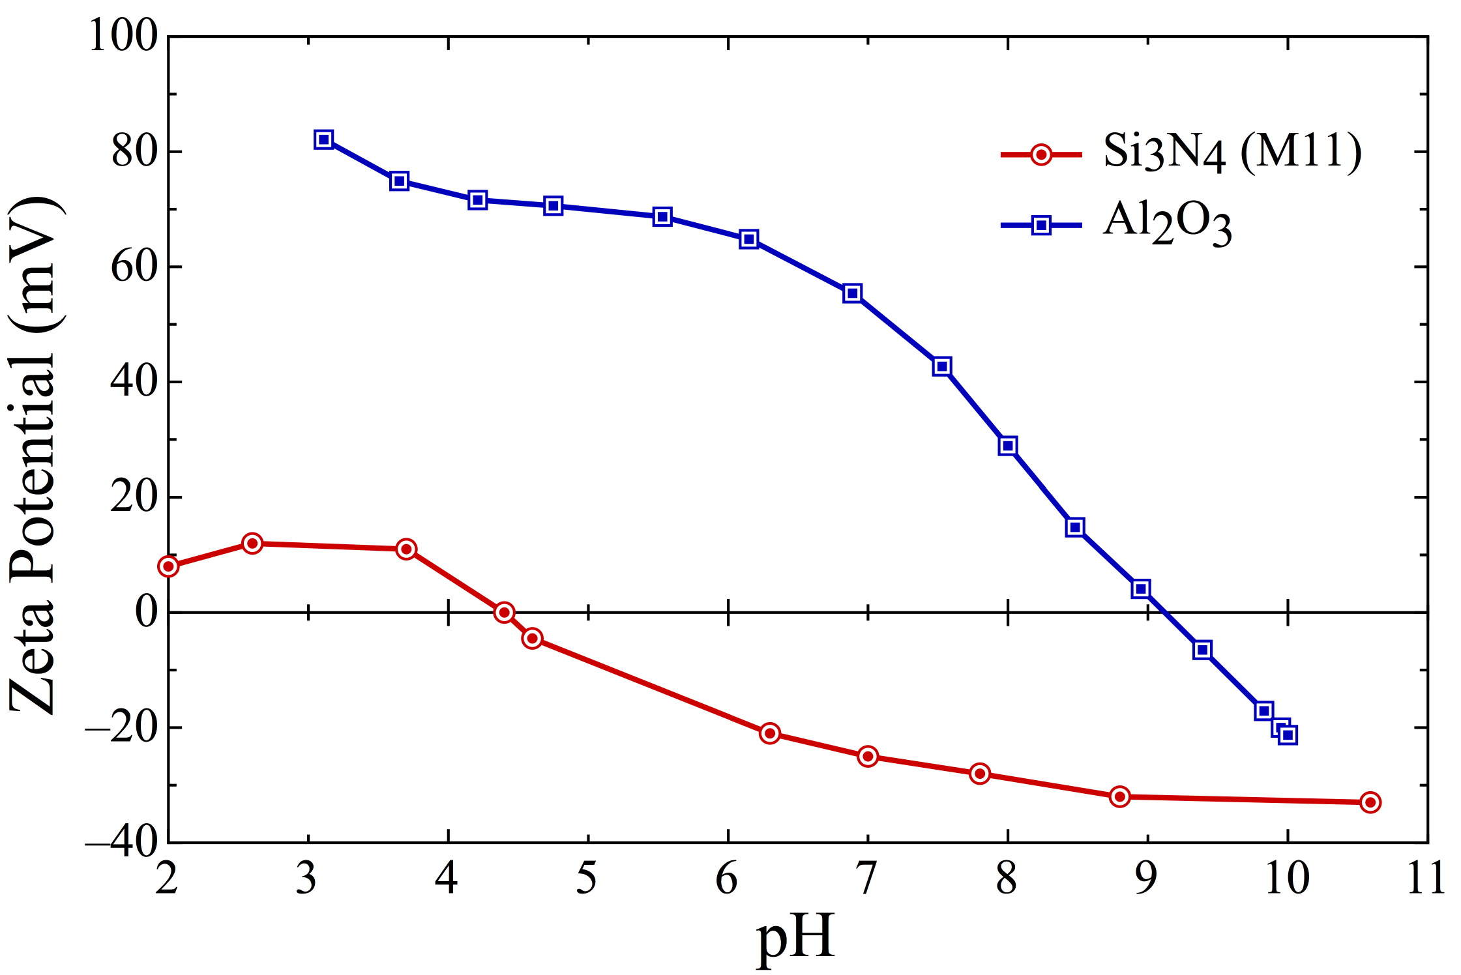
PZC and IEP
Shear Plane
ζ
Φ_{surf}
Point of Zero Charge (PZC) - pH at which surface potential = 0
Isoelectric Point (IEP) - pH at which zeta potential = 0
Question: What will happen to a mixed suspension of Alumina and Si₃N₄ particles in water at pH 4, 7 and 10?

Slide 20
Effect of Ionic Strength
5
0
Increasing
Ionic Strength
4
0
3
0
2
0
1
0
0
Zeta Potential (mV)
-
1
0
+
-
-
2
0
+
+
Φ
-
-
-
3
0
+
+
+
-
4
0
A
l
u
m
i
n
a
+
-
-
-
5
0
-
1
2
3
4
5
6
7
8
9
1
0
1
1
p
H
Shear Plane
Would you measure the IEP at high or low ionic strength?
Notes:
Would be hard to detect at high ionic strength. Might get specific ion adsorption.

Slide 21
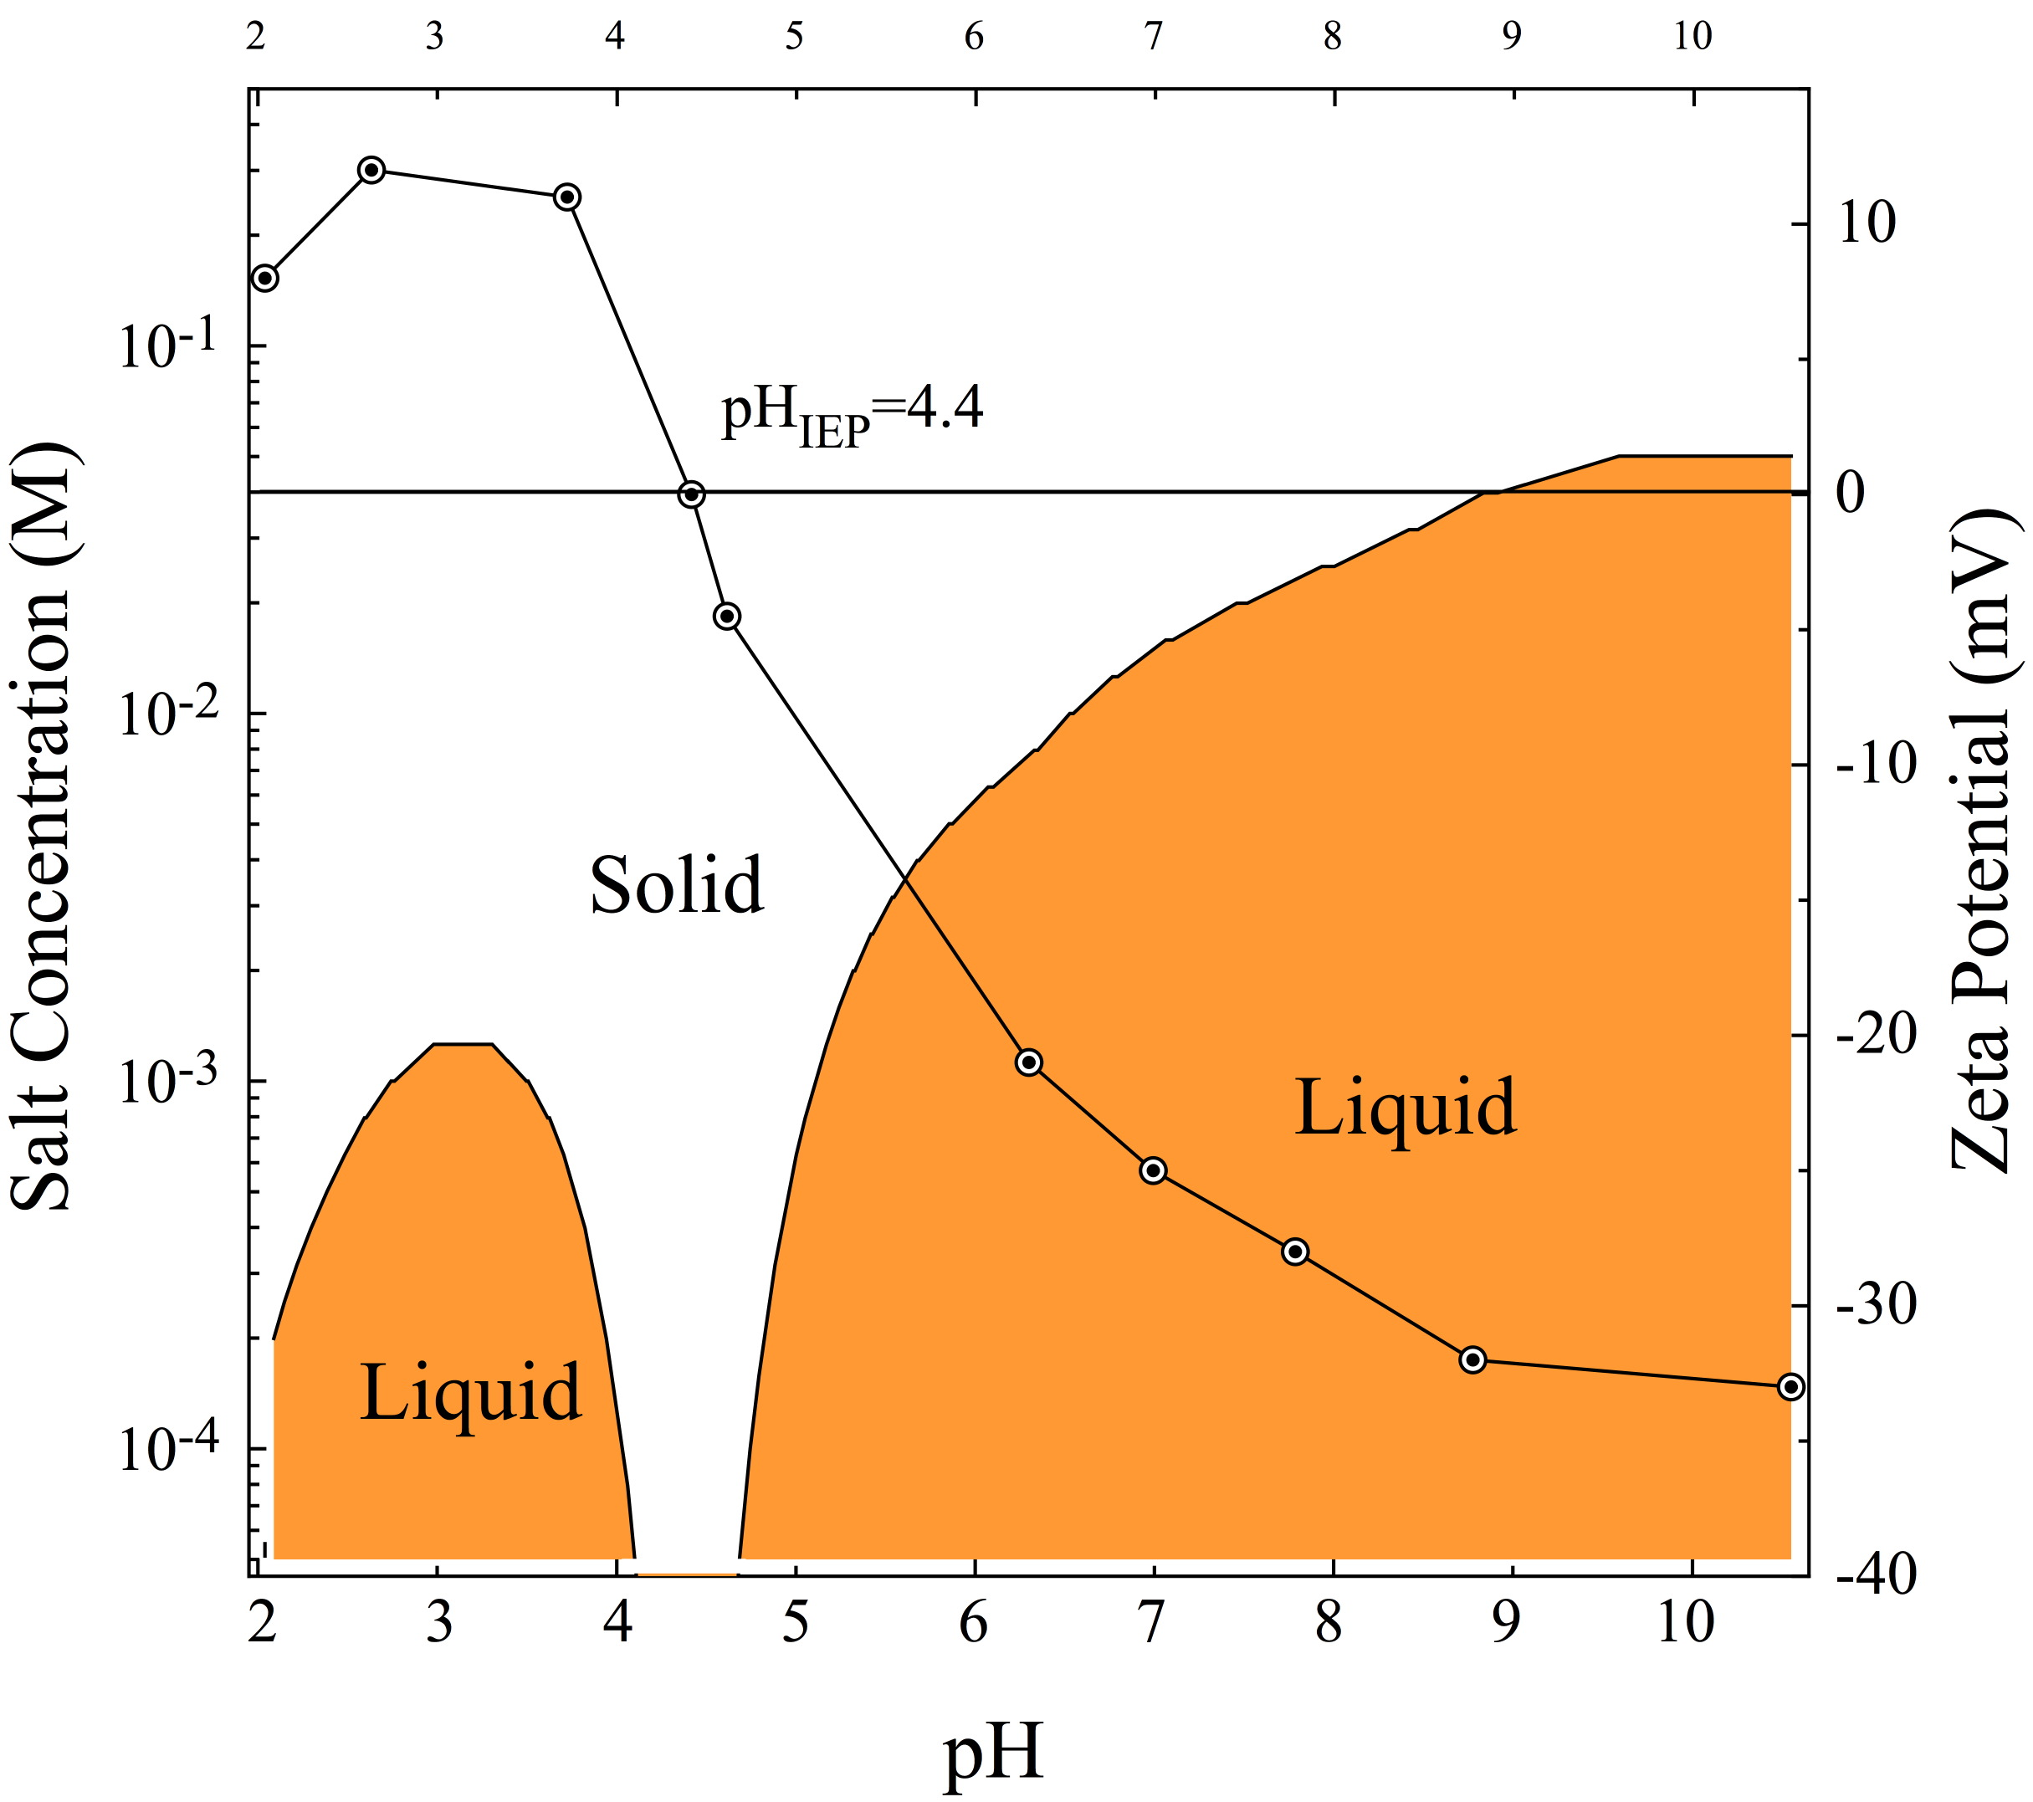
pH and Salt Concentration
Stability diagram for Si₃N₄(M11) particles.
Coagulate
Dispersion
Dispersion

Slide 22
Specific Adsorption
Shifting the isoelectric point to reverse the zeta potential
+
+
+
+
+
+
+
+
+
+
+2
+
+
+
+
- - - - -

Slide 23
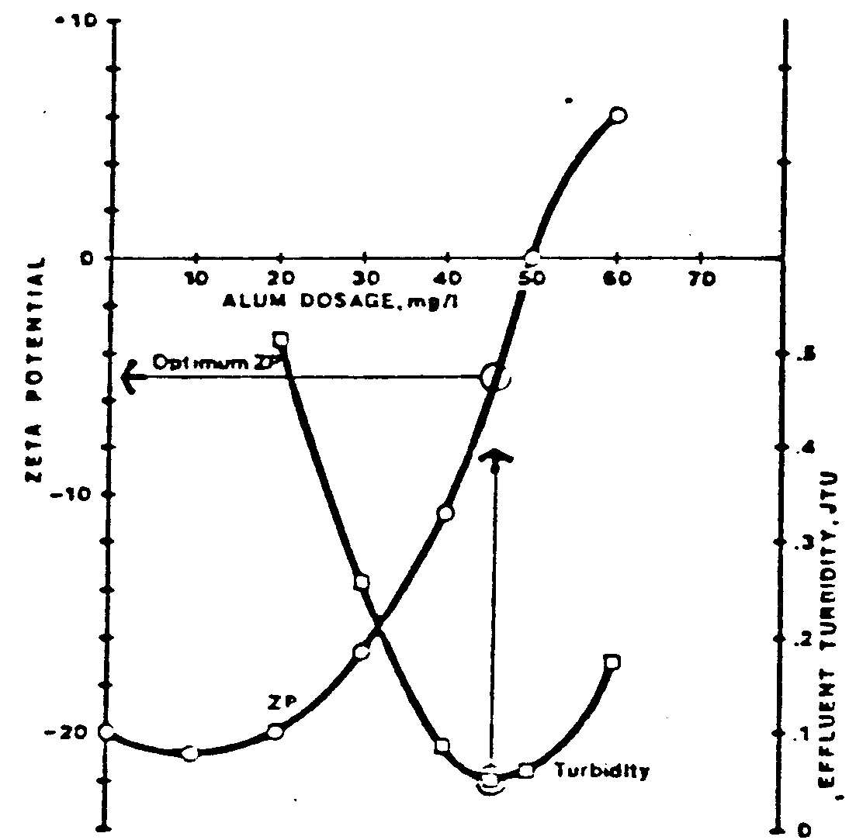
Wastewater
ZETA POTENTIAL AS A QC VARIABLE FOR WASTEWATER TREATMENT
Coagulant Dosage
Zeta Potential
Effluent turbidity
overdose (charge reversal due to specific adsorption)
Notes:
Zeta potential is a commonly used quality control parameter for monitoring the dosage of coagulant for wastewater treatment. The data show the correlation between the minima in turbidity and chemical oxygen demand (COD) in wastewater samples with coagulant dosages yielding a zero or near-zero value of ζ. Overdosing with coagulant often results in charge reversal due to specific adsorption of counter-ions, so it is important in practice to target the correct dosage as closely as possible.
hydrated potassium aluminium sulfate with the formula KAl(SO₄₎₂.12H₂O

Slide 24
8/2 | M | Colloids II |  | Schaefer
8/4 | W | Colloids III |  | Schaefer
8/9 | M | Quiz 4 Polymer Properties I | C15 | Schaefer | C532-561
8/11 | W | Polymer Properties II | C16 | Schaefer | C570-587
8/16 | M | Polymer Properties III | C16 | Schaefer | C588-607
8/18 | W | Stainless Steel and Corrosion | C14 | Schaefer | C673 - 690
8/23 | M | Corrosion and electrochem | C14 | Schaefer | C691-706
8/25 | W | Quiz 5 Corrosion Prevention | C14 | Schaefer
9/1 | W | Final 10:30-12:30 p.m.

Slide 25
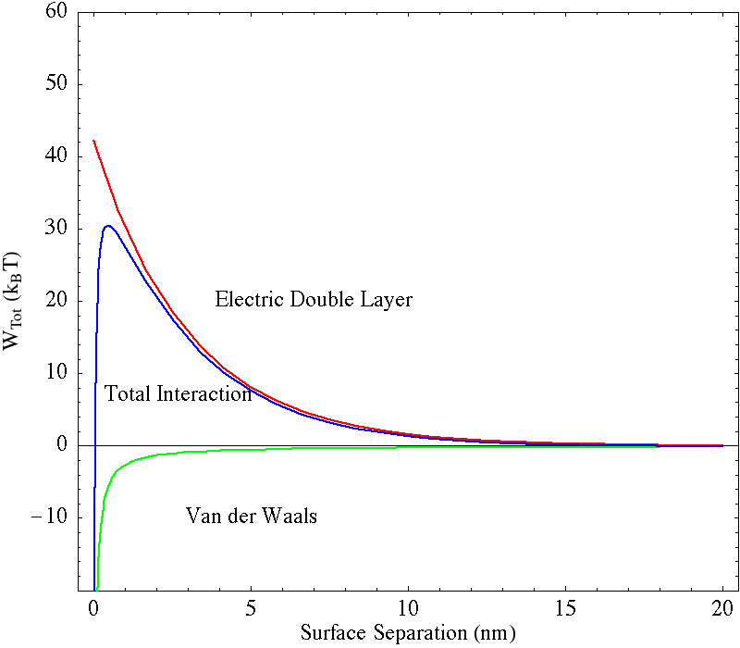
Derjaguin, Landau, Verwey and Overbeek (DLVO) Potential
Potential Energy Between Particles
V(h) /kT
R = particle radius (m)
κ⁻¹ = Debye screening length (m)
c_{o}= ions/m³
Φ_{o} = Stern potential (V)
h = separation (m)
z = valence
e = electronic charge (C)
A_{H} = Hamaker Constant (J)
h

Slide 26
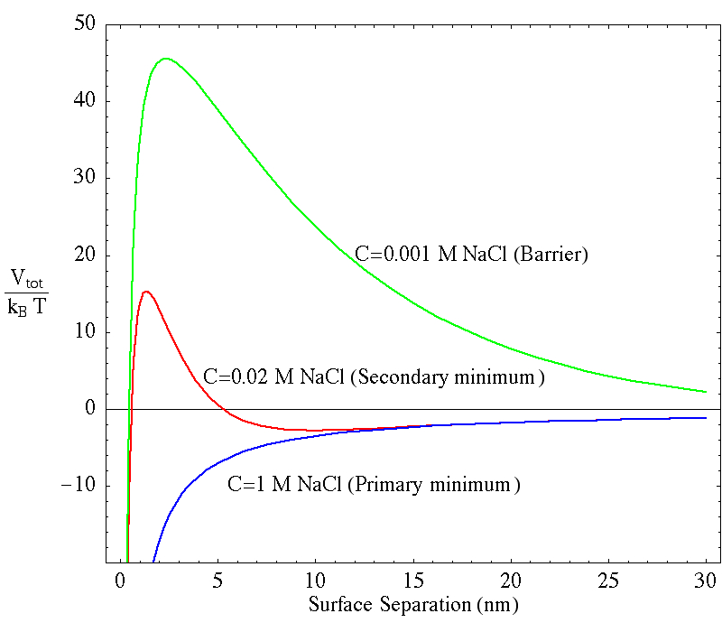
Effect of Salt
100 nm Alumina, ζ =-30 mV

Slide 27
Flocculation vs Coagulation
Hard Repulsion (< 0.5 nm)
No Salt added
Energy Barrier
x (distance)
Secondary Minimum
(Flocculation)
Primary Minimum
(Coagulation)

Slide 28


Steric Stabilization
Good Solvent for Polymers
Long chains
Strongly grafted
R_{g}
Poor Solvent for Polymer:
Unstable (Larger effective R)
V(h)
κ⁻¹
h
Problem: Calculate the molecular weight needed to stabilize a colloid?
segment length
l
EO
PEO

Slide 29
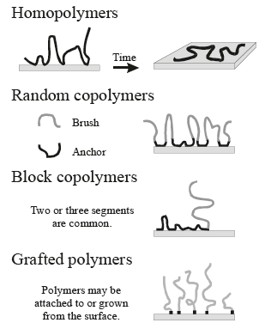
Polymer Stabilization
Works in non-aqueous solvents.

Slide 30
Bridging Flocculation
Wastewater Treatment: ppm polyacrylamide

Slide 32
Synthesis of Colloids

Slide 33
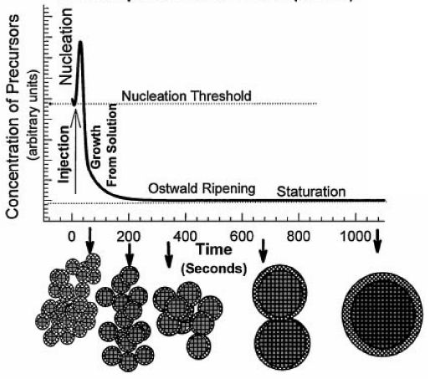
Sols: Nucleation and Growth
Nucleation
Colloidal Silver

Slide 34
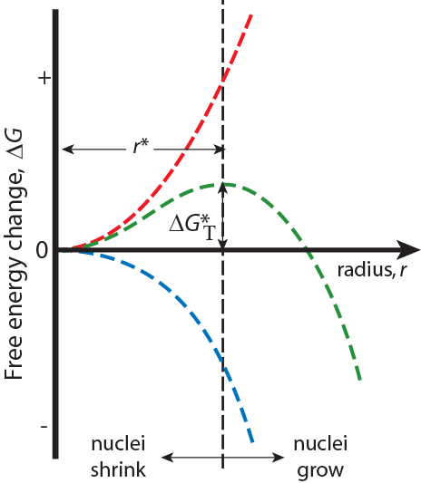
Homogeneous Nucleation & Energy Effects
Surface Free Energy - destabilizes
the nuclei (it takes energy to make
an interface)
γ = surface tension
ΔG_{T} = Total Free Energy
= ΔG_{S} + ΔG_{V}
Volume (Bulk) Free Energy –
stabilizes the nuclei (releases energy)
r* = critical nucleus: for r < r* nuclei shrink; for r >r* nuclei grow (to reduce energy)

Slide 35
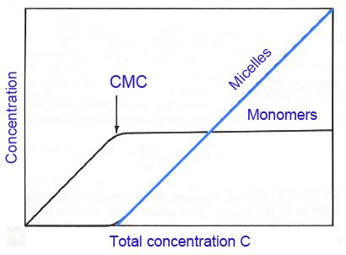
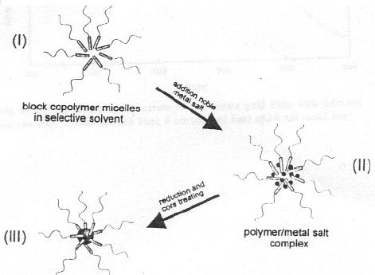
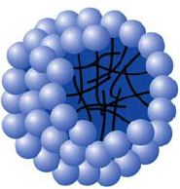
Micelle Synthesis
Surfactant Micelle

Slide 36
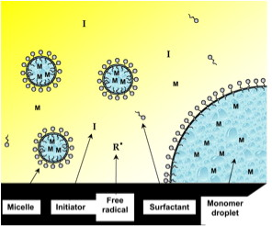
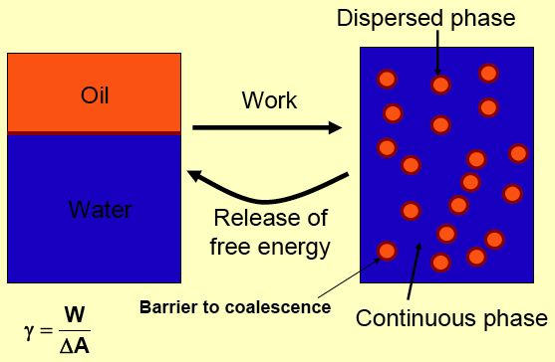
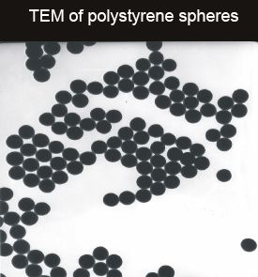
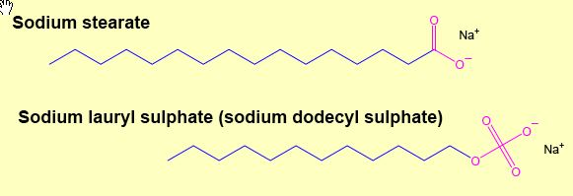
Emulsion Synthesis of Colloids

Slide 37
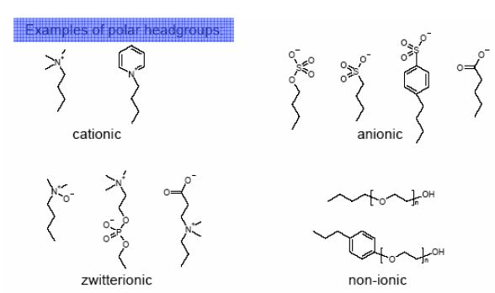
Surfactants
• HLB 1 to 3: Antifoams / inverse micelles
• HLB 3 to 8: Water-in-Oil Emulsifiers
• HLB 7 to 9: Wetting and spreading agents
• HLB 8 to 16: Oil-in-Water Emulsifiers
• HLB 13 to 16: Detergents
• HLB >15: Solubilizers
Hydrophilic-Lipophilic Balance
HLB (1 - 20)
3 - 6 W/O more lipophilic (fat loving)
8 - 19 O/W more hydrophilic (water loving)
Notes:
• HLB ca. 1 to 3: Antifoams / inverse micelles
• HLB ca. 3 to 8: Water-in-Oil Emulsifiers
• HLB ca. 7 to 9: Wetting and spreading agents
• HLB ca. 8 to 16: Oil-in-Water Emulsifiers
• HLB ca. 13 to 16: Detergents
• HLB ca. >15: Solubilizers

Slide 38
Emulsion Stability
I
II
formation
N droplets of size r
breakdown
Entropy of Mixing
k =1.38 × 10⁻²³ Nm K⁻¹
γ_{W-air}=0.0070 N/m
3. The interfacial tension between water and hexane is 50 mN m⁻¹ at 20°C.
(a) Show that it is not possible to prepare an emulsion for a 50:50 vol:vol binary mixture (calculate the droplet size).
(b) What critical surface tension would be required to form an emulsion of droplet size r = 10 nm?

Slide 39
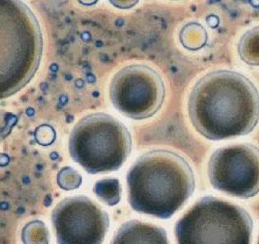
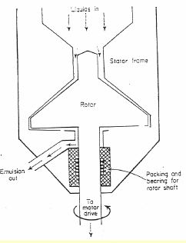
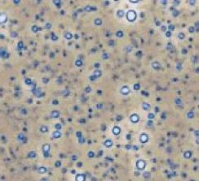
Homogenization
8 µm
High Shear Mixer
1 µm
Difficult to achieve a truly stable emulsion.

Slide 40
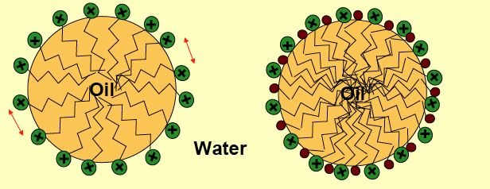
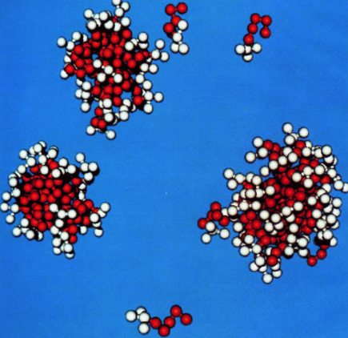
Co-surfactants
Realistic Picture

Slide 41
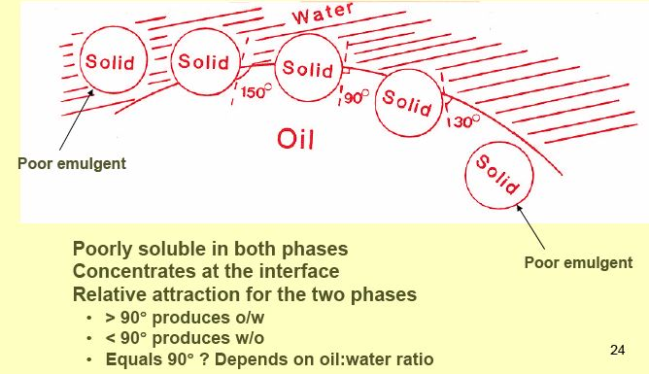
Solid Emulsifier

Slide 42
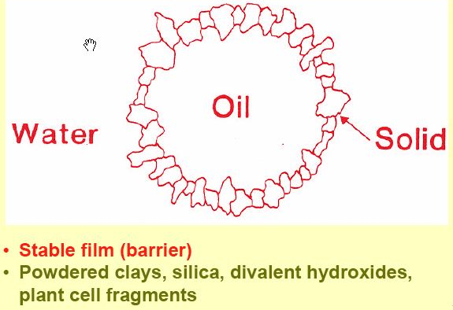
Particle emulsifiers

Slide 43

Water Drops Floating on Water
http://web.mac.com/drspam/iWeb/Alaska/Kvichak.html

Slide 44
Food Dispersion
Dispersed Continuous Name of Examples
Phase Phase Dispersion
Solid (S) Liquid (L) Colloidal dispersion Milk
Liquid (L) Liquid (L) Emulsion French dressing
Gas (G) Liquid (L) Foam Whipped topping
Gas (G) Solid (S) Solid Foam Foam candy, cake
Solid (S) Gas (G) Solid Aerosol Smoke for Flavor

Slide 45
Natural Surfactants
Phospholipids (Lecithin)
O
CH
2
O C (CH
)
CH
O
2
16
3
CH
CH O C (CH
)
CH
3
O
2
14
3
CH
+
3
N CH
2
CH
2
O P O CH
Hydrophobic
2
CH
3
O
-
fat-soluble)
Hydrophilic (water-soluble)
(
Mono-
Glycerides (mono-
stearate)
O
CH
2
O C (CH
)
CH
2
16
3
HO CH
HO CH
Hydrophobic
2
Hydrophilic
Di-glycerides (
di-stearate)
O
CH
2
O C (CH
)
CH
O
2
16
3
CH O C (CH
)
CH
2
16
3
HO CH
2
Hydrophobic
Hydrophilic

Slide 46
Synthetic GRAS Surfactants
Span 60 (sorbitan mono-stearate)
O
O
H
2
C CH CH
2
O C (CH
2
)
16
CH
3
HO
H
C CH
OH
C
Hydrophobic
H
OH
Hydrophilic
Tween 60 (polyoxyalkylene sorbitan mono-stearate)
O
O
H
2
C CH CH
2
O C (CH
2
)
16
CH
3
O
C CH
OH
Hydrophobic
CH
2
C
CH
2
O CH
2
CH
2
O CH
2
CH
2
OH
O CH
2
CH
2
OH
Hydrophilic

Slide 47
Stability Of A Food Dispersion
1. Dispersed particle size
2. Viscosity of continuous phase
3. Dispersed phase concentration
4. Density difference between 2 phases

Slide 48
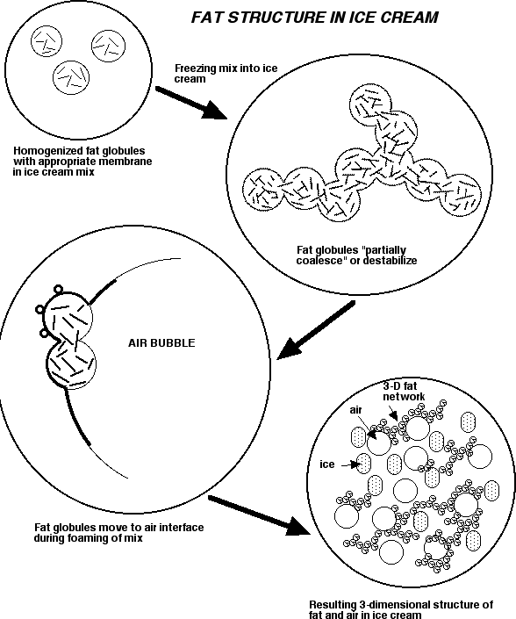
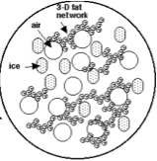
Ice Cream
up to 50% air
Freezing
Fat Globules
Fat globules coalesce and stabilize
Globules move to air interface
http://www.foodsci.uoguelph.ca/deicon/

Slide 49
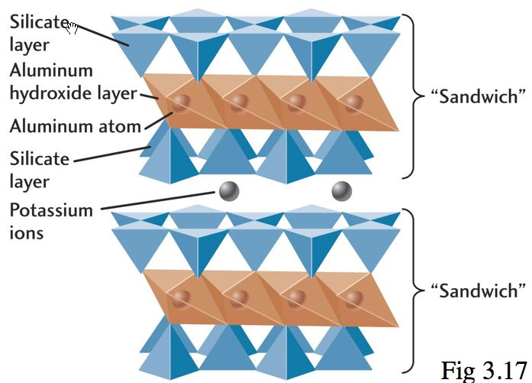
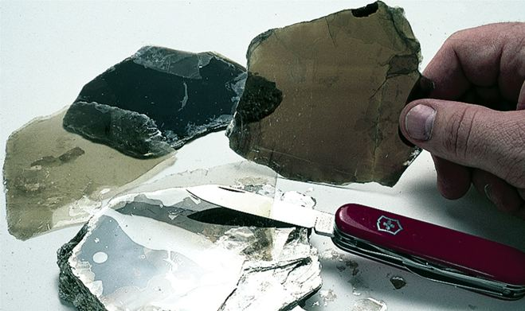
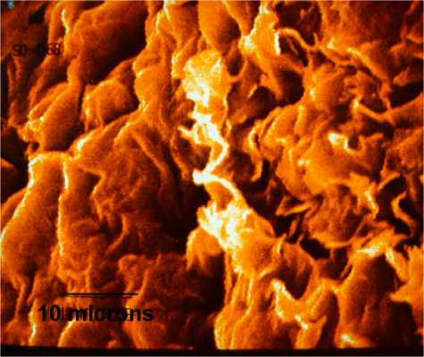
Clays
Mica
Bentonite Clay
Montmorillionite

Slide 50
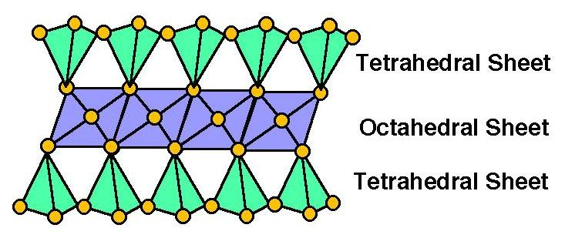
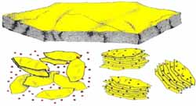
2:1 Clays: Montmorillonite, Bentonite
Swells in Water
Si
Al
Si
Si
Al
Si
Si
Al
Si
Drilling Mud
Notes:
(1) Bentonite mud. Bentonite is the most commonly
used drilling fluid additive and consists of finely ground
sodium bentonite clay. When mixed with water, the
resulting slurry has a viscosity greater than water, possesses
the ability to suspend relatively coarse and heavy
particles, and tends to form a thin, very low permeability
cake on the walls of the borehole. Because of these attributes,
bentonite drilling mud is superior to water as a
drilling fluid for many applications. Bentonite for drilling
is generally available in a standard grade which complies
with the American Petroleum Institute (API) Specification
13A (American Petroleum Institute 1983). A high yield
grade, which contains organic polymers, generally produces
approximately the same viscosity as the standard
grade with one-half the amount of bentonite. It should be
noted, however, that the standard grade bentonite may
contain peptizing agents and organic additives. For environmental
drilling where additives are unacceptable, pure
sodium bentonite is available from several suppliers.
The main functions of a Drilling Fluid/Mud can be summarised as follows:1. Remove cuttings from wellDrilling fluid carries the rock excavated by the drill bit up to the surface. Its ability to do so depends on cutting size, shape, and density, and speed of fluid traveling up the well (annular velocity). These considerations are analogous to the ability of a stream to carry sediment; large sand grains in a slow-moving stream settle to the stream bed, while small sand grains in a fast-moving stream are carried along with the water. The mud viscosity is another important property, as cuttings will settle to the bottom of the well if the viscosity is too low.Other properties include:･Most drilling muds are thixotropic (i.e. they gel under static condition). This characteristic keeps the cuttings suspended when the mud is not moving during, for example, maintenance.･Fluids that have shear thinning and elevated viscosities are efficient for hole cleaning.･Higher annular velocity improves cutting transport. Transport velocity = annular velocity ﾐ slip velocity･High density fluids may clean hole adequately even with lower annular velocities (by increasing the buoyancy force acting on cuttings). But may have a negative impact if mud weight is in excess of that needed to balance the pressure of surrounding rock (formation pressure), so mud weight is not usually increased for hole cleaning purposes.･Higher rotary drill-string speeds introduce a circular component to annular flow path. This helical flow around the drill-string causes drill cuttings near the wall, where poor hole cleaning conditions occur, to move into higher transport regions of the annulus. Increased rotation are the best methods in high angle and horizontal beds.2. Suspend and release cuttings･must suspend drill cuttings, weight materials and additives under a wide range of conditions.･drill cuttings that settle can causes bridges and fill, which can cause stuck-pipe and lost circulation.･weight material that settles is referred to as sag, this causes a wide variation in the density of well fluid. More frequently occurs in high angle and hot wells.･high concentrations of drill solids are detrimental to;･drilling efficiency (it causes increased mud weight & viscosity which in turn increases maintenance costs and increased dilution)･Rate of Penetration (ROP) (increases horsepower required to circulate)･mud properties that suspended must balanced with properties in cutting removal by solid control equipment.･for effective solids controls, drill solids must be removed from mud on the 1st circulation from the well. If re-circulated, cuttings break into smaller pieces and are more difficult to remove.･conduct a test to compare the sand content of mud at flow line and suction pit (to determine whether cuttings are being removed).

Slide 51
Peptization
Gel
Thixotropy
fluid
shear
Na₃PO₄
Peptization
+
+
+
+
_
+
_
_
_
_
_
+
_
_
_
_
_
+
_
_
_
_
_
_
_
_
Why is exfoliated bentonite used as a drilling mud?
_
_
_
_
Notes:
Drilling Muds
Bentonite mud. Bentonite is the most commonly used drilling fluid additive and consists of finely ground sodium bentonite clay. When mixed with water, the resulting slurry has a viscosity greater than water, possesses the ability to suspend relatively coarse and heavy particles, and tends to form a thin, very low permeability cake on the walls of the borehole. Because of these attributes, bentonite drilling mud is superior to water as a drilling fluid for many applications. Bentonite for drilling is generally available in a standard grade which complies with the American Petroleum Institute (API) Specification 13A (American Petroleum Institute 1983). A high yield grade, which contains organic polymers, generally produces approximately the same viscosity as the standard grade with one-half the amount of bentonite. It should be noted, however, that the standard grade bentonite might contain peptizing agents and organic additives. For environmental drilling where additives are unacceptable, pure sodium bentonite is available from several suppliers.
The main functions of a Drilling Fluid/Mud can be summarized as follows:
1. Remove cuttings from well. Drilling fluid carries the rock excavated by the drill bit up to the surface. Its ability to do so depends on cutting size, shape, and density, and speed of fluid traveling up the well (annular velocity). These considerations are analogous to the ability of a stream to carry sediment; large sand grains in a slow-moving stream settle to the streambed, while small sand grains in a fast-moving stream are carried along with the water. The mud viscosity is another important property, as cuttings will settle to the bottom of the well if the viscosity is too low.
Most drilling muds are thixotropic (i.e. they gel under static condition). This characteristic keeps the cuttings suspended when the mud is not moving during, for example, maintenance. Fluids that have shear thinning and elevated viscosities are efficient for hole cleaning. Higher annular velocity improves cutting transport. Transport velocity = annular velocity x slip velocity. High-density fluids may clean the hole adequately even with lower annular velocities (by increasing the buoyancy force acting on cuttings). But they may have a negative impact if mud weight is in excess of that needed to balance the pressure of surrounding rock (formation pressure), so mud weight is not usually increased for hole cleaning purposes. Higher rotary drill-string speeds introduce a circular component to annular flow path. This helical flow around the drill-string causes drill cuttings near the wall, where poor hole cleaning conditions occur, to move into higher transport regions of the annulus. Increased rotation is the best method in high angle and horizontal beds.
2. Suspend and release: Muds must suspend drill cuttings, weight materials and additives under a wide range of conditions. Drill cuttings that settle can causes bridges and fill, which can cause stuck-pipe and lost circulation. Weight material that settles is referred to as sag, which causes a wide variation in the density of well fluid. More frequently sag occurs in high angle and hot wells. High concentrations of drill solids are detrimental to drilling efficiency (it causes increased mud weight & viscosity which in turn increases maintenance costs and increased dilution) Rate of Penetration (ROP): (increases horsepower required to circulate) mud properties that suspended must balanced with properties in cutting removal by solid control equipment. For effective solids controls, drill solids must be removed from mud on the 1st circulation from the well. If re-circulated, cuttings break into smaller pieces and are more difficult to remove. Conduct a test to compare the sand content of mud at flow line and suction pit (to determine whether cuttings are being removed).

Slide 52
1:1 Clays: Kaolonite, Mica
Al
Does not swell in water
Si
Al
Si
Al
Si
Al
Si
Mica

Slide 53
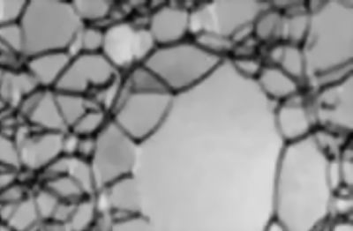
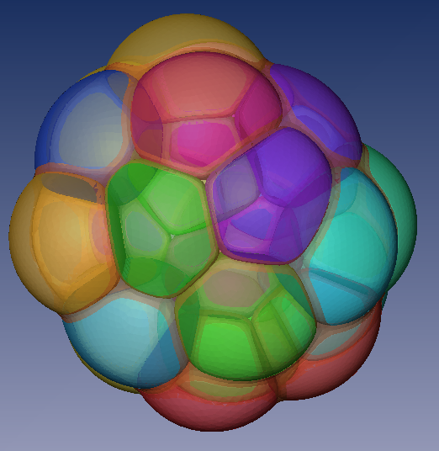
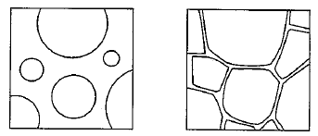
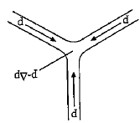
Liquid Foams
Plateau
borders
Liquid
Films
Reduced surface tension, γ, stabilizes the bubbles.
Pressure is higher in small bubbles → rupture
negative curvature at the “plateau borders”
Notes:
3.12 FOAMS
A foam is defined as a coarse dispersion of a gas in a liquid, where the volume fraction of gas is greater than that of the liquid. Solid foams (for example foam rubber or polystyrene foam) are also possible, but here we focus on more common liquid foams. These are always formed by mixtures of liquids (usually containing a soap or surfactant) and never by a pure liquid. The volume fraction of gas is not too high, the bubbles in the foam are spherical, but at higher gas volume fractions the domains are deformed into polyhedral cells, separated by thin films of liquid (Fig. 3.12). Typically the gas bubbles are between 0.1 and 3 mm in diameter. Foams are not thermodynamically stable due to their large interfacial area and thus surface free energy. However, some foams, particularly those formed by addition of small amounts of foaming agents such as soaps or surfactants, can be metastable. These foaming agents act to a certain extent to retard drainage of liquid from the foam and to prevent its rupture.
Foams formed by other liquids such as alcohols or short chain fatty acids are unstable, and the foam collapses rapidly. Foams formed by surfactants or soaps are not indefinitely stable because of two main effects. The first is drainage of liquid due to gravity, which leads to thinning of the liquid film. The second is rupture, which results from random disturbances (mechanical, thermo, evaporation, impurities). A foam that initially contains bubbles can develop into a foam containing polyhedral cells as a result of drainage, or the latter can develop rapidly from liquids of low viscosity if the volume fraction of gas is high.
The development of a form structure is a dynamic process involving several stages. Initially drainage of liquid occurs throughout the liquid film, leading to a polyhedral cellular structure. The vertices of the polyhedra are called plateau borders. Due to the curvature of the liquid film in this region, the liquid pressure is lower than in the surrounding channels because the gas pressure is uniform and the liquid interface area is larger where it is more curved (Fig. 3.13). This pressure drop leads to liquid flow at the plateau borders, and if the resulting forces overwhelm the surface tension supporting the liquid channels the film will rupture and the foam will collapse. Alliteratively, if there is a balance of forces the film may achieve a pseudo-equilibrium thickness. Addition of too much surfactant can cause the foam to collapse, since the interfacial tension can become too low. Foams can also be destabilized by creaming, i.e. the tendency for regions of high gas content to rise to the top of the foam, leaving denser regions close to the bulk liquid. Another important effect is the selective growth of large bubbles at the expense of small ones, a process is termed Ostwald ripening.
In foams formed by liquids containing surfactants the molecules tend to form lamellae parallel to the liquid film surface, at which there is an excess of surfactant. When draining occurs in such films, the Gibbs and Marangoni effects tend to oppose the destabilizing influence. If a film is subject to strong thinning forces, the surface area will increase and so the surface excess concentration of surfactant will decrease, which leads to an increase in surface tension. This increase in surface tension is termed the Gibbs effect and tends to oppose thinning. A related effect results from the difference in the static surface tension in the draining film and the dynamic surface tension. Surfactant molecules tend to flow into the region of temporarily reduced surface excess in order to restore the original surface tension (usually lower), which is termed the Marangoni effect. The opposite effect occurs if the surface area of the film is decreased. Whenever there is a change of surface area and thus surface excess, the resultant diffusion of surfactant molecules takes a finite time and there is a transient difference in surface tension. Other processes have been suggested to accompany the Gibbs-Marangoni effect, in particular it has been proposed that diffusing surfactant molecules at the liquid surface drag underlying liquid along with them, thus opposing the thinning process. The Gibbs-Marangoni effect results from the surface excess of surfactant and so does not occur in pure liquids.
A special effect is capillary flow to the vertex pont (Plateau borders).
The Laplace pressure is low, because of the negative curvature, hence
water will flow to these points, until they become unstable. If you add
e.g. glycerol to a soap solution, the viscosity increases, and the drainage
of the foam is slowed down: it takes a longer time before the foam collapses.

Slide 55
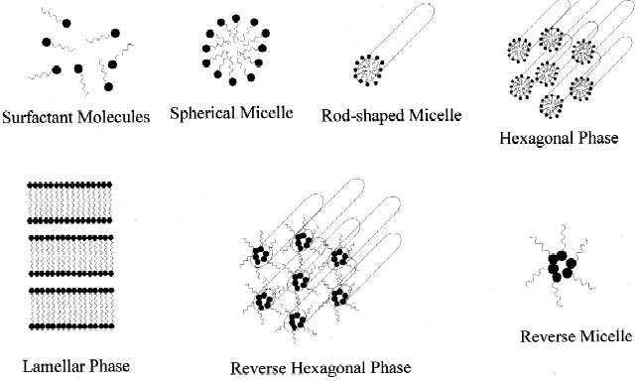
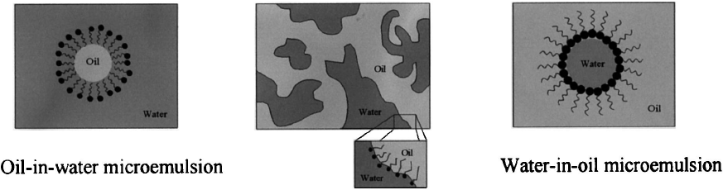
Microemulsions
Thermodynamically stable. Multiple phases. Small dimensional scales <1 µm

Slide 56
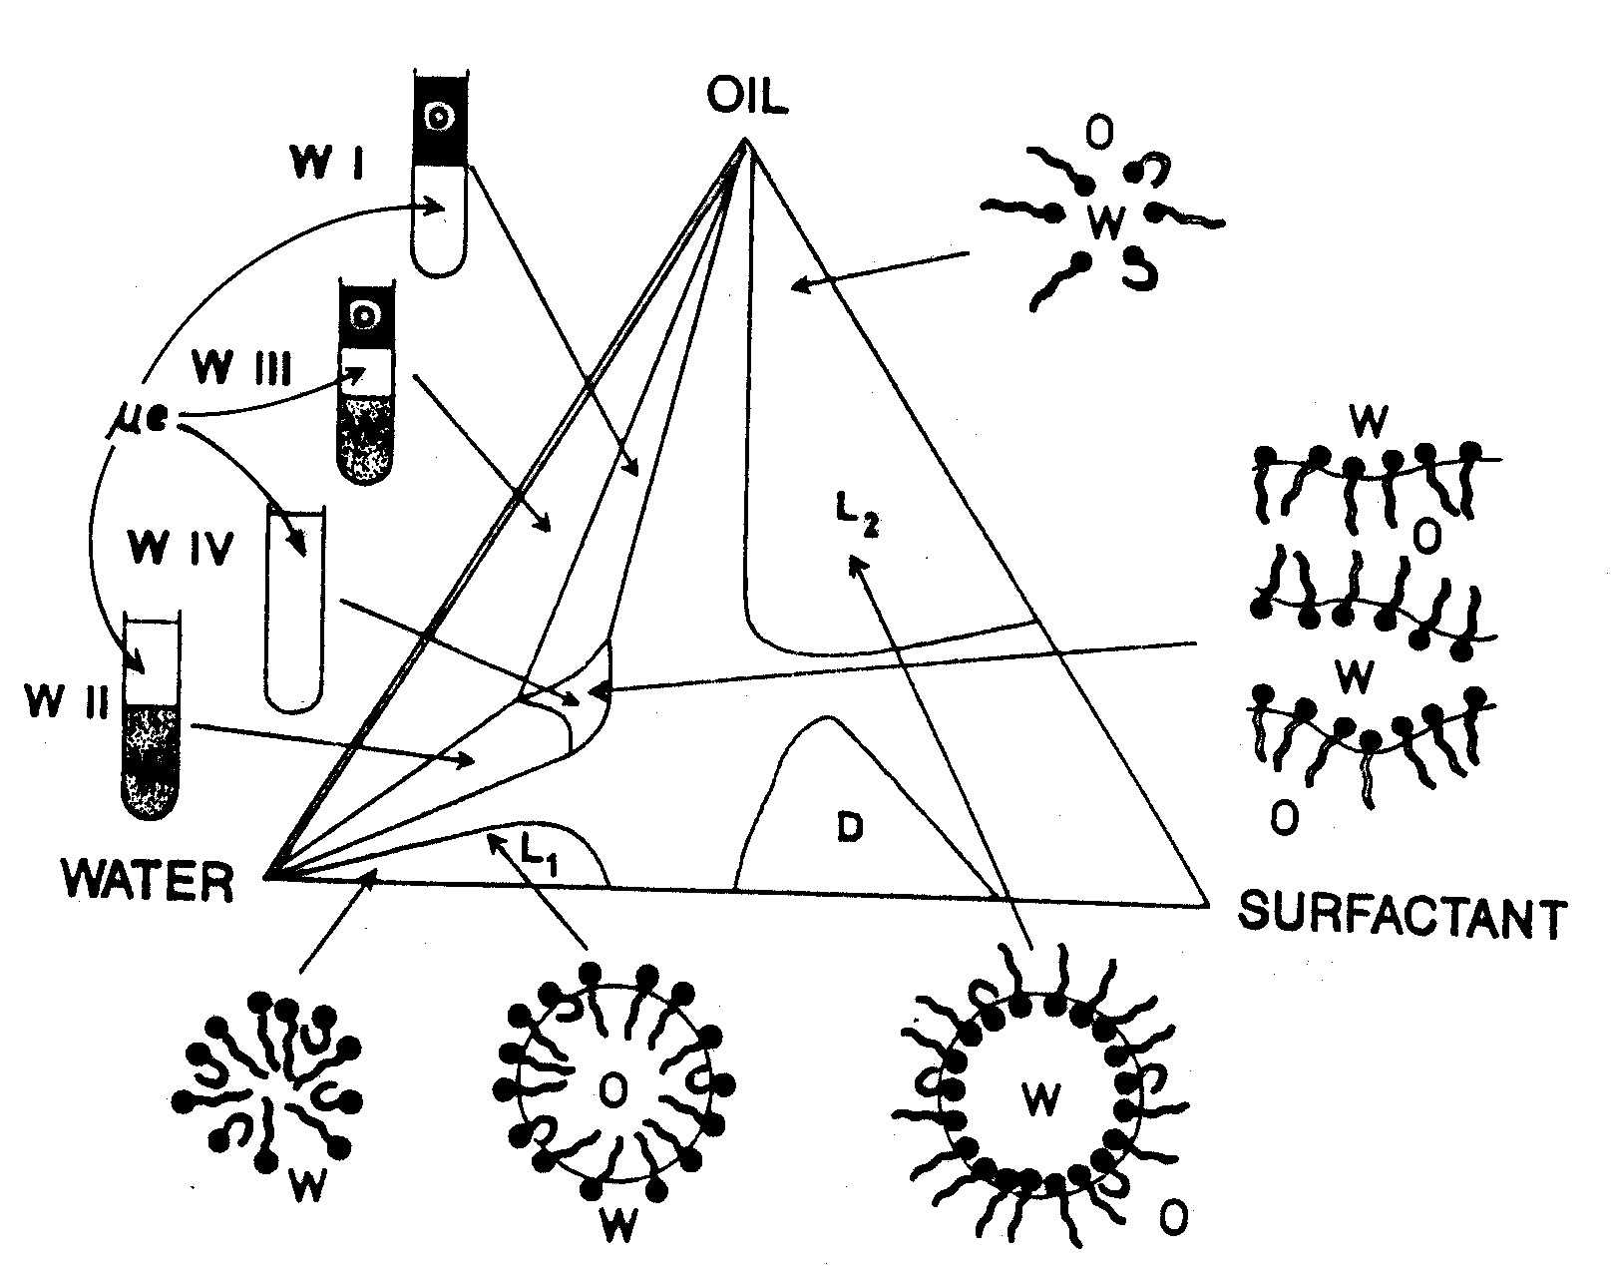
Microemulsion Phase Diagram

Slide 57
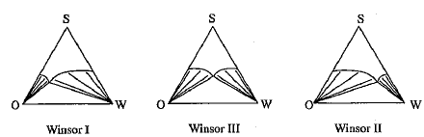

Winsor Classification
μE
excess
oil
O
OinW
M
OinW
excess
water
W
HLB >10
hydrophilic
surfactant
HLB < 6
hydrophobic
surfactant
Notes:
HLB (1 - 20)
3 - 6 W/O more lipophilic (fat loving) Anti Foaming Agents
8 - 19 O/W more hydrophilic (water loving)
Use water soluble surfactant for oil-in-water emulsions.
Use oil soluble surfactants for water-in-oil emulsions.

Slide 58
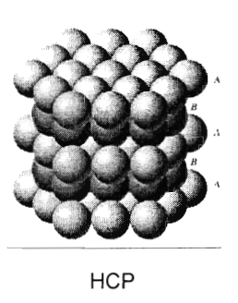
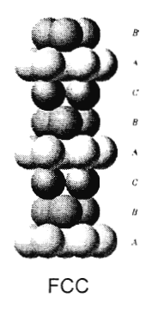
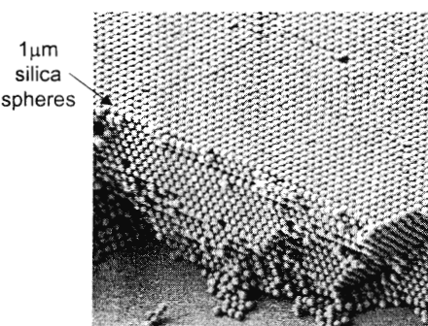

Concentrated Colloids
Colloidal Crystals

Slide 59


Ordering in Hard Sphere Systems
+
V(r)
0.494 0.545
0
kT
σ
T
-
r
ϕ
Must be entropy driven (packing)

Slide 60
Parking
FREE PARKING
REGULATED PARKING
Jammed ⇒
Low Entropy
Confined, but not jammed ⇒
Higher Entropy

Slide 61
Colloids with Strongly attractive forces
NEAR EQUILIBRIUM: Ostwald Ripening
Kinetic Growth: DIFFUSION LIMITED
Kinetic Growth: CHEMICALLY LIMITED
Precipitated Silica

Slide 62
Sticking Law
Particle-Cluster Growth
Cluster-Cluster Growth

Slide 63
Transport
Diffusion-Limited
Ballistic
Reaction-Limited
(Independent of transport)

Slide 64
Aggregation Models
Transport
Reaction-Limited
Ballistic
Diffusion-Limited
EDEN
VOLD
WITTEN-SANDER
D = 3.00
D = 3.00
D = 2.50
RLCA
SUTHERLAND
DLCA
D = 2.09
D = 1.95
D = 1.80

Slide 65
Aggregate Characterization: Fractal Dimension
M ~ M ~ R³
M ~ M ~ R²
M ~ M ~ R¹
M ~ M ~ R^{1.7}

Slide 66
Analysis of Fractals
Log Number
D
L
a
R_{o}
Log L

Slide 67
Self Similarity
Euclidian Objects
Fractal Objects
Magnify
Course Grain

Slide 69
Colloid Dynamics
J_{in}
Re << 1 for colloidal dispersion
dz
Sedimentation
J_{out}

Slide 70
Excluded Volume Effect
Ideal gas
An effective repulsion

Slide 71

Colloids with Long Range Repulsion
Electrostatic
Steric
Volume Fraction
KCl Concentration (molar)
Homework

Slide 72

Colloids with Weakly Attractive Interactions
Volume occupied by polymer
Volume occupied by colloid

Slide 73


Viscosity in Concentrated Dispersions
Concentration Dependence
Shear Rate Dependence
Dilute
Concentrated
rcp
shear-induced
order
Low shear
Relative Viscosity η/η_{o}
Relative Viscosity η/η_{o}
Volume Fraction ϕ
Peclet Number

Slide 75
Van der Waals Approach to Adhesion
Considering only van der Waals attraction, what is the energy of adhesion between two1 μm particles with A = 10⁻¹⁹ J.
H = H₀ ≅ 3Å
What if the particles were separated by 10 nm

Slide 76
Adhesion and Surface Energy
For rigid incompressible spheres the force of adhesion is related to the work of adhesion by
Derjaguin’s approximation
where R₁ and R₂ are the radii of the spheres.
Upon further application for identical materials
F = 2πRγ_{SL} two spheres in liquid
F = 2πRγ_{SG} two spheres in vapor
F = 4πRγ_{SL} sphere and plate in liquid
F = 4πRγ_{SG} sphere and plate in vapor
Unfortunately deformation needs to be considered for many materials.

Slide 77

Shifting the IEP
PO₄³⁻
Ca²⁺
pH
Multivalent cations shift IEP to right (calcite supernatant)
Multivalent anions shift IEP to left (apatite supernatant)
Amankonah and Somasundaran, Colloids and Surfaces, 15, 335 (1985).

Slide 78



Measuring ζ by Micro-Electrophoresis
- - - - - - - - - - - - -
- - - - - - - - - - - - -
Electrophoretic mobility
Notes:
Micro-electrophoresis provides the common methodology for determining zeta potentials, particularly in colloidal systems. The motion of the particles in an electric field is tracked and timed to yield the particle velocity. The quantity resulting from such an experiment in the electrophoretic mobility, as shown.

Slide 79


Surface force apparatus (J. Isrealachvili)
Bent Mica sheets

Slide 80

Surface Force Data

Slide 81

O/W or W/O

Slide 83

Critical Coagulation Concentration
Φ(h)
h
At 25 C

Slide 84

Depletion floculation
L
a
r
Attractive
Increase entropy of mixing when exclusion zones overlap
Polymers, other colloids

Slide 85
Gels
Colloidal Gel
Polymer
sol
Polymer
Gel
Gels support low shear stress
Very soft solids

Slide 86

Emulsion Polymerization
Anionic surfactants: CMC ~ 10⁻² M
Nonionic surfactants: CMC ~ 10⁻⁴ M

Slide 87



Segmented Flow Tubular Reactor

