Slide 1

BioPlastics

Slide 2
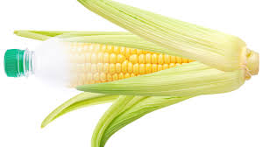
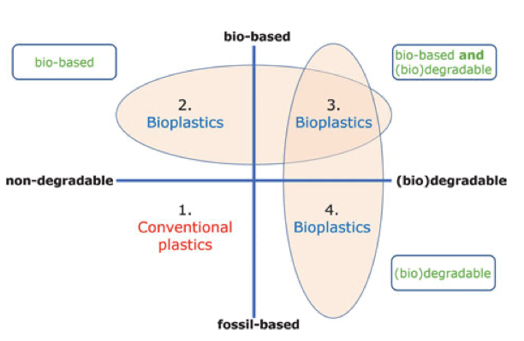

BioPlastics
Bio-based Corn ethanol => Ethylene => Polyethylene
Corn ethanol=> Ethylene glycol => PET
Biorefining
Biodegradable
Compostable
Industrially Compostable

Slide 3
BioPlastics
An Ideal BioPlastic:
100% properties until planned degradation lifetime when it totally degrades
Degradation products are non-toxic and non-eutrophic
(Degrades into O₂ and N₂ for instance)
Costs less than petrochemical plastics
Manufactured from a renewable resource (sunlight or seaweed)
Doesn’t compete with food production
Tunable properties such as barrier for films, modulus for injection molding Crack resistance, Temperature Use Range -50°C to 100°C
Totally interchangeable with existing plastics processing with no adjustment of processing equipment (plug and play)
Doesn’t require additives or non-toxic, biodegradable additives exist

Slide 4
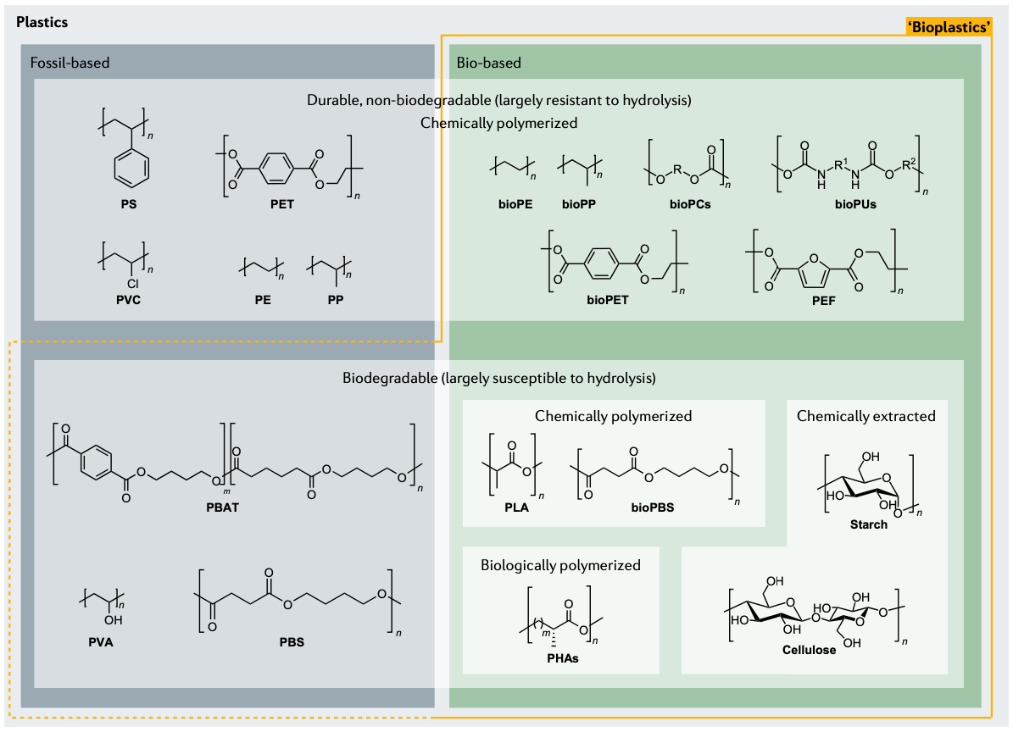
Bio-based What is the goal:
Mass-Balance Accounting of Monomers
Make Plastics from Crops
Make Plastics from Agricultural Waste (Fermentation/Separation)
Make Monomer from Fermentation & Industrial Polymerization
Biodegradable by genetic selection/engineering of microbes
Natural Biodegradation
Industrial Biodegradation
Degradable into small pieces (starch filler)
BioPlastics
PbaT, polybutylene adipate-co-terephthalate; PC, polycarbonate; Pe, polyethylene; PeF, polyethylene furanoate; PeT, polyethylene terephthalate; Pla, polylactic acid; PP, polypropylene; PS, polystyrene; Pu, polyurethane; Pva, polyvinyl alcohol; PvC, polyvinylchloride; PBS poly(butylene succinate)

Slide 5
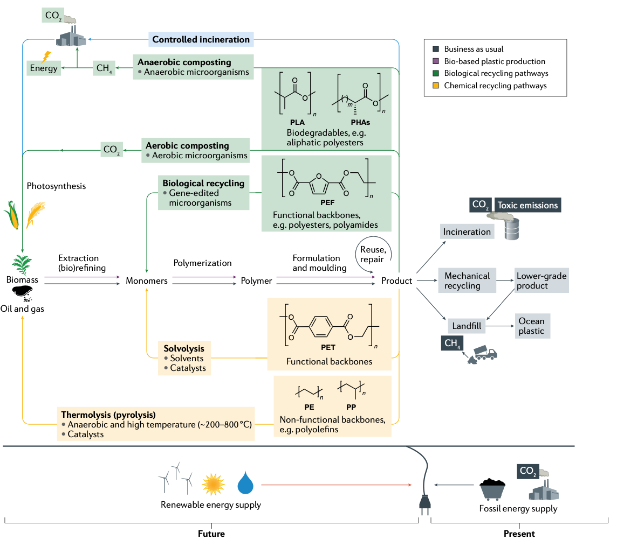
Plastics
Life-Cycle
Polyhydroxybutyrate
Start

Slide 6
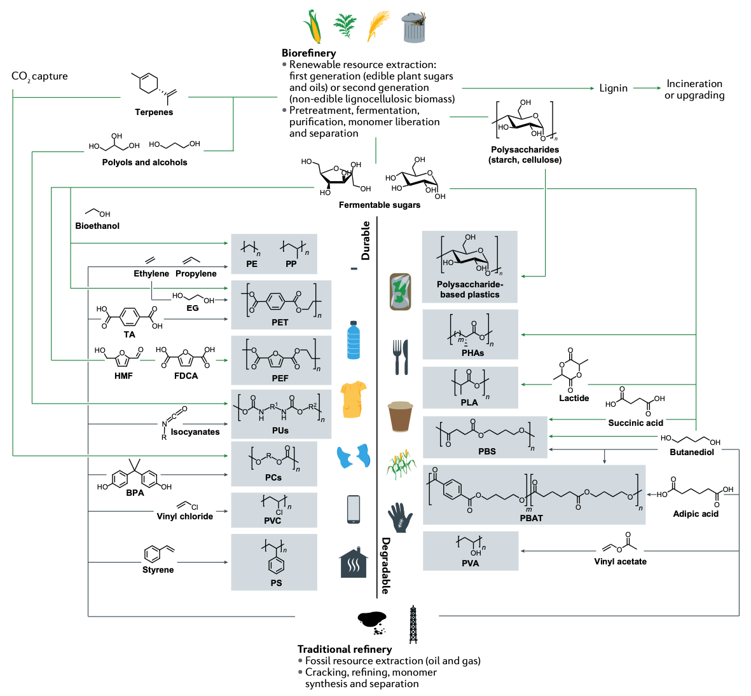
Polyhydroxybutyrate
Biorefinery vs Fossil Refinery

Slide 7
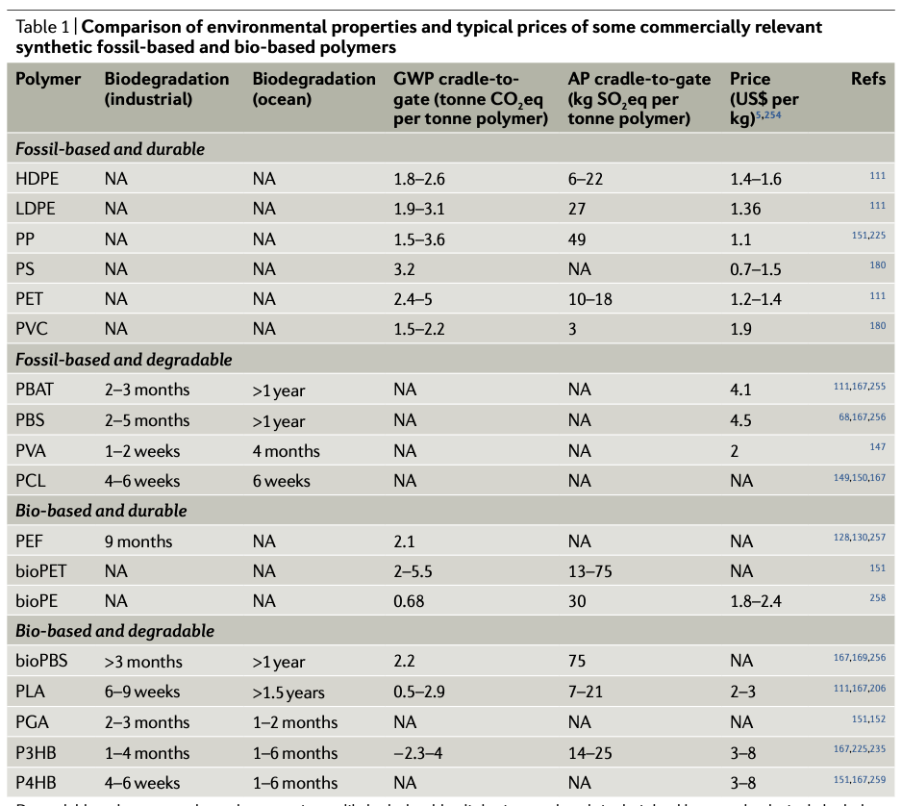
Degradable polymers are those that contain readily hydrolysable aliphatic ester bonds in their backbone and polyvinyl alcohol (PVA), whose degradation follows a diketone pathway. Durable polymers are those with a backbone that is typically more resistant to enzymatic and non-enzymatic hydrolysis, such as aromatic esters, amides and those with C–C bonds. Note that non-zero degradation may occur in any polymer. Biodegradation refers to industrial compostability under EN 13432 or ASTM D6400 conditions or degradation in ocean water according to the references. The values or ranges, where available, for global warming potential (GWP) and acidification potential (AP) are taken from a 2020 review of cradle-to-gate life cycle assessments6 or from other references, where indicated. HDPE, high-density polyethylene; LDPE, low-density polyethylene; NA, not available; P3HB, poly(3-hydroxybutyrate); P4HB, poly(4-hydroxybutyrate); PBAT, polybutylene adipate-co-terephthalate; PBS, polybutylene succinate; PCL, polycaprolactone; PE, polyethylene; PEF, polyethylene furanoate; PET, polyethylene terephthalate; PGA, polyglycolic acid; PLA, polylactic acid; PP, polypropylene; PS, polystyrene; PVA, polyvinyl alcohol; PVC, polyvinylchloride.
Polyhydroxybutyrate
Global Warming
Acidification

Slide 8
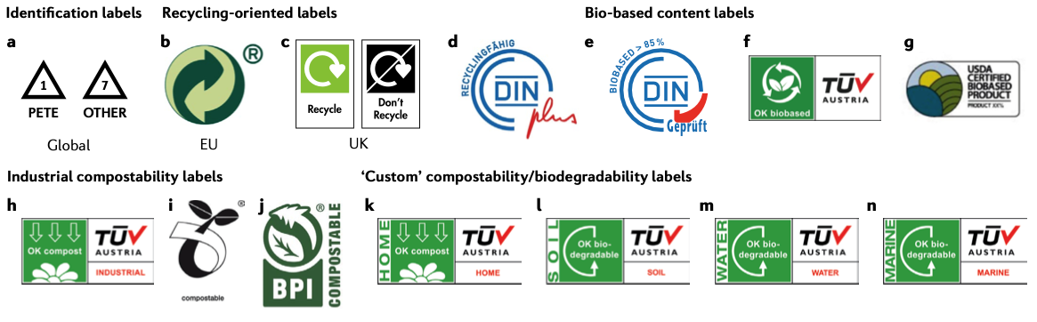
Bio-Based Plastics

Slide 9
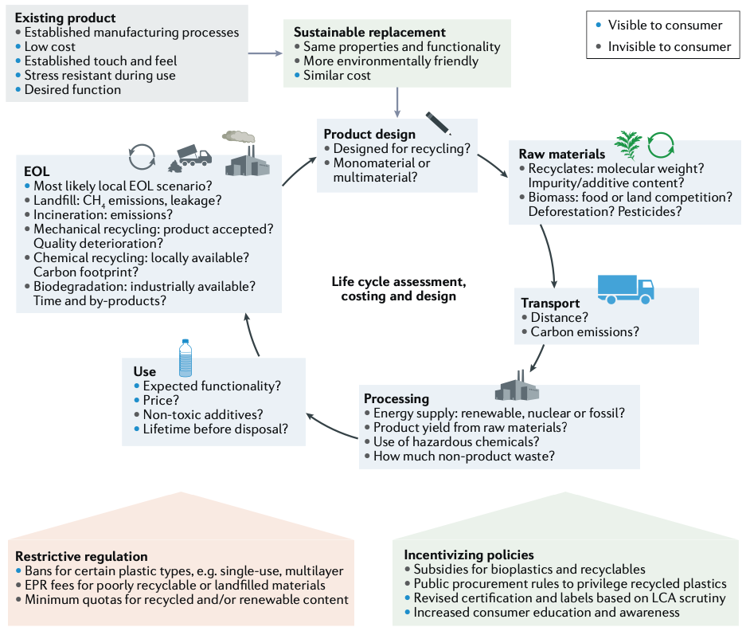
Bio-Based Plastics
Issues for Implementation of Bioplastics

Slide 10
Bio-Based Plastics

Slide 11
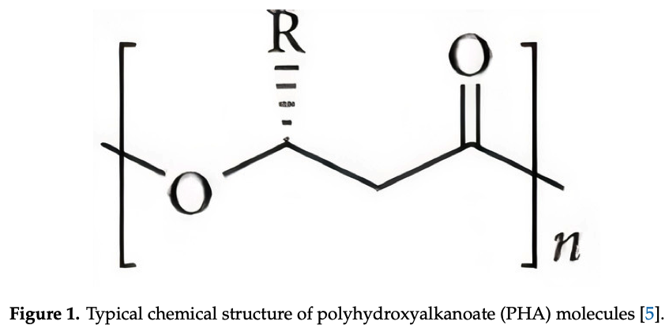
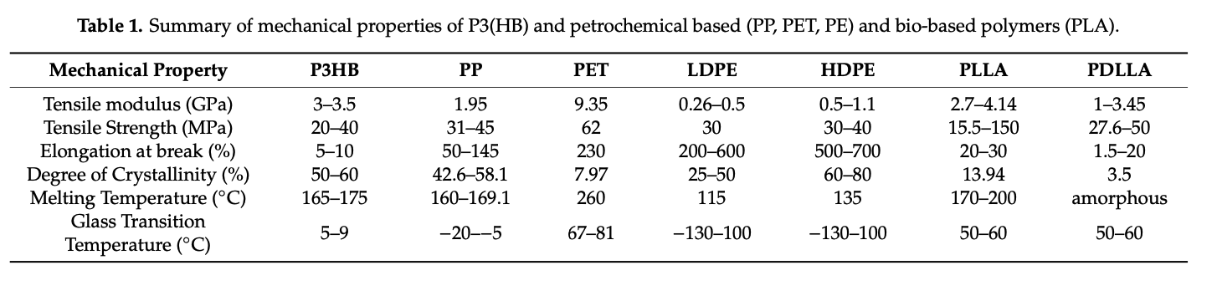
Polyhydroxybutyrate

Slide 12
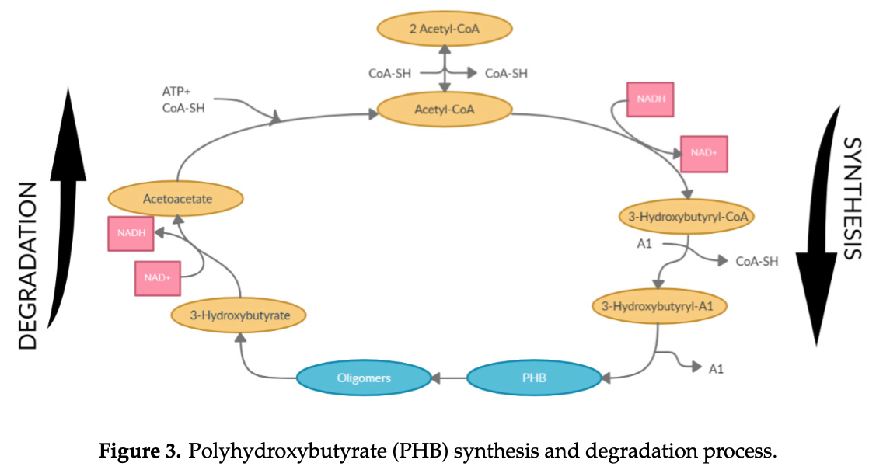
Polyhydroxybutyrate

Slide 13
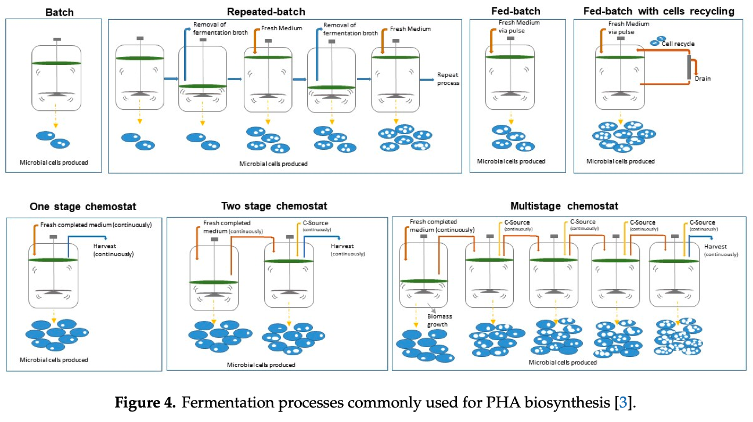
Polyhydroxybutyrate

Slide 14
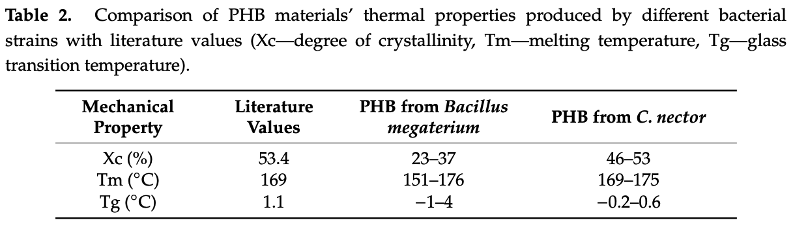
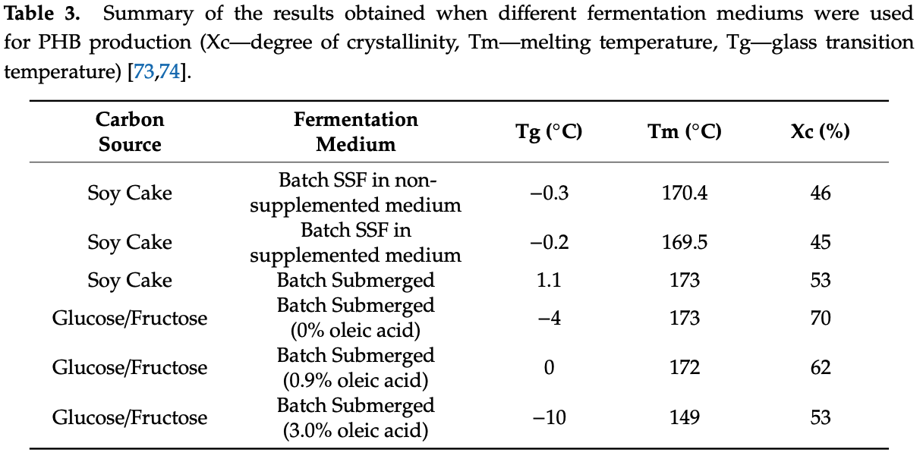
Polyhydroxybutyrate

Slide 15
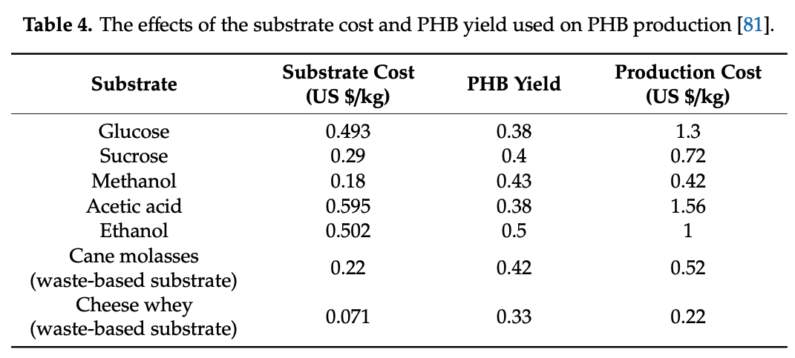
Polyhydroxybutyrate

Slide 16
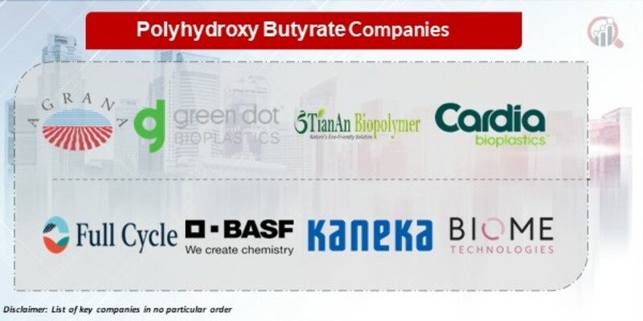
Polyhydroxybutyrate

Slide 17
Polyhydroxybutyrate
Bio-Innovation Pioneers: Giants like NatureWorks and Mitsubishi Chemical Corporation invest heavily in R&D, developing new strains of bacteria and fermentation processes to optimize PHB production, improve its properties, and reduce costs. Think genetically engineered bacteria that produce PHB with enhanced strength and flexibility, or innovative fermentation technologies that utilize waste materials as feedstock.
Cost-Conscious Champions: Regional players like Tianjin Green Bio and Zhejiang Hisun Biomaterials focus on affordability, utilizing efficient production processes and readily available feedstocks like corn and cassava starch to cater to price-sensitive segments and emerging markets. This strategy ensures their PHB solutions reach a wider audience.
Niche Specialists: Smaller players carve out their niches by specializing in specific applications or industries. Some focus on high-performance PHB for medical devices or drug delivery systems, while others cater to the growing demand for sustainable packaging solutions in the food & beverage industry. This targeted approach allows them to excel in specialized areas.

Slide 18
Polyhydroxybutyrate
Sustainability Spotlight: Consumer and regulatory pressure is pushing manufacturers towards eco-friendly solutions. PHB's biodegradability, compostability, and low carbon footprint resonate with environmentally conscious consumers and align with regulations promoting sustainable packaging and materials.
Performance Prowess: PHB boasts impressive properties like excellent biocompatibility, strength, and water resistance, making it suitable for diverse applications from medical implants to food packaging.
Technological Advancements: Advancements in fermentation technologies, genetic engineering, and material science are driving down production costs and enhancing PHB's performance, making it a more competitive alternative to traditional plastics.
Circular Economy Aspirations: PHB's ability to be biodegraded and recycled into new products aligns with the goals of a circular economy, further enhancing its appeal in a resource-constrained world.

Slide 19
Polyhydroxybutyrate
AGRANA Beteiligungs-AG (Austria)
Green Dot Bioplastics (USA)
TianAn Biologic Materials Co., Ltd. (China)
Tianjin GreenBio Materials Co., Ltd. (China)
Cardia Bioplastics (Australia)
FULL CYCLE BIOPLASTICS (USA)
PolyFerm Canada (Canada)
BASF SE (Germany)
Kaneka Corporation (Japan)
Biome Technologies PLC (UK)

Slide 20
Polyhydroxybutyrate
Recent Developments:
October 2023: NatureWorks unveils a new grade of PHB with enhanced heat resistance, opening doors for its use in automotive and electronics applications.
November 2023: Mitsubishi Chemical Corporation partners with a startup to develop PHB production technologies that utilize food waste as feedstock, promoting resource efficiency and circularity.
December 2023: Tianjin Green Bio expands its production capacity and establishes a new research facility dedicated to optimizing PHB production processes.
January 2024: Zhejiang Hisun Biomaterials enters into a collaboration with a major food packaging manufacturer to develop and supply PHB-based food trays and containers.

Slide 21
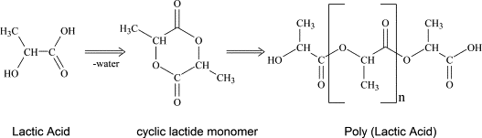
Polylactic Acid
Industrial composting

Slide 22
Polylactic Acid
Total Corbian PLA
Total Corbion was founded in 2017. It is a global technological leader in the PLA and acticide monomers based in Thailand. The corporation is a subsidiary of TotalEnergies, Corbion. They provide innovative solutions by producing materials that can be used in fresh food, packaging, consumer goods, fibers, food service ware and 3D printing.
Evonik is a German based chemical company. It was founded in 2007. Evonik Operations GmbH is a subsidiary and RAG – Stiftung its parent organization. It is one of the leading names among polyactic acid manufacturers. They specialize in production of specialty chemicals. It is headquartered from Essen, North Rhine-Westphalia, Germany.
Natureworks PLA
It is an international chemical manufacturing company that produces bioplastics as an alternative to conventional plastic that is made from petroleum. It has its headquarters in Minnetonka, Minnesota, United States. The NatureWorks corporation was founded in 1898. Cargill, PTT Public Company Limited, PTT Chemical International Private Limited are the parent organizations of the firm while Natureworks B.V is its esteemed subsidiary. They specialize in manufacturing Ingeo brand polylactic acid.
Futerro PLA
Futerro is a private plastic fabrication company. It is a Belgian based company that was founded in 1992. They develop lactic acid and polylactic acid. They envision offering ecological alternatives to conventional plastic; a sustainable future. This company has made its mark in the industry because of its futuristic vision.

Slide 23
Industrial Composting in Cincinnati (doesn’t seem to exist, despite claims)
Queen City Commons (not industrial composting, doesn’t take PLA)
GoZERO Services (doesn’t seem to be functional, they sell composted dirt for $20 a gallon?)
Grind the waste (trees, bones, meat, fish, and “normal” compost)
Monitor humidity and especially temperature to about 150°F (70°C)
Enough to kill bad bacteria but cool enough for good bacterial and fungi to work at high rates (4 months)
Home composting doesn’t grind and about 100°F slower rate (two years)
PLA only degrades in industrial compost

Slide 24
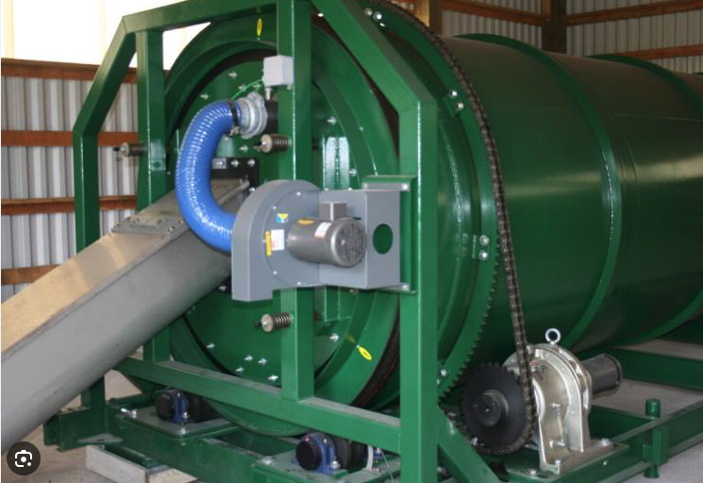
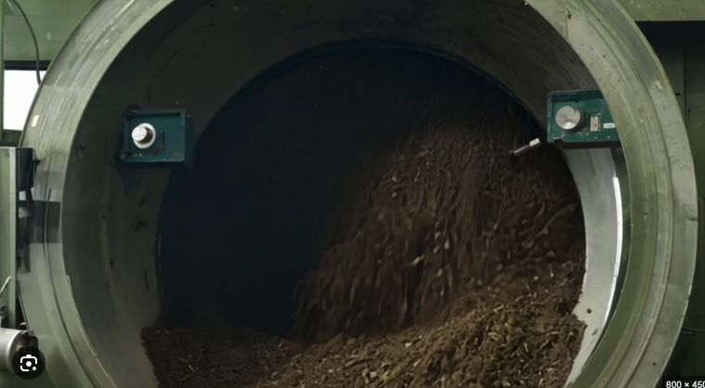
Polylactic Acid
Industrial composting

Slide 25
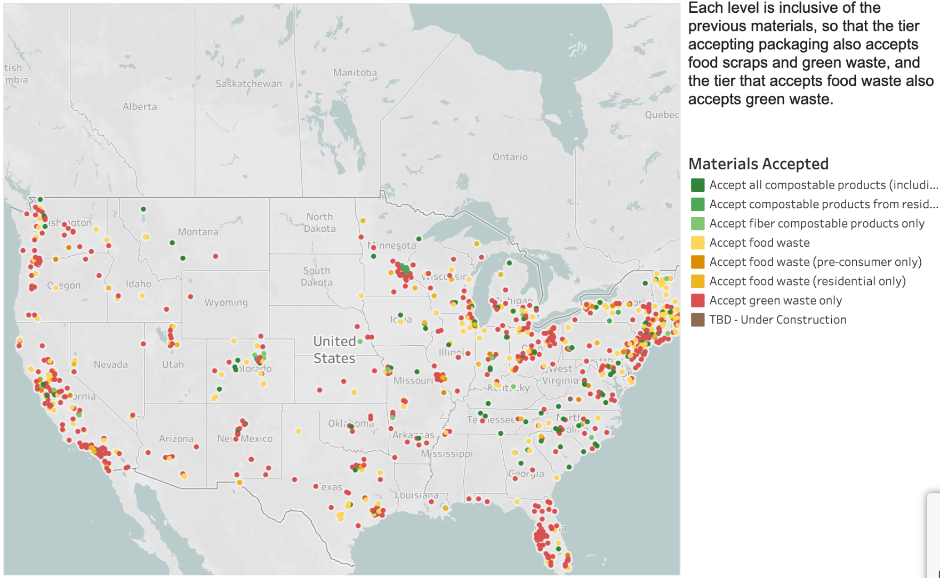
PLA

Slide 26
Industrial production of monomers from methane
Methane can come from compost or fossil source

Slide 27
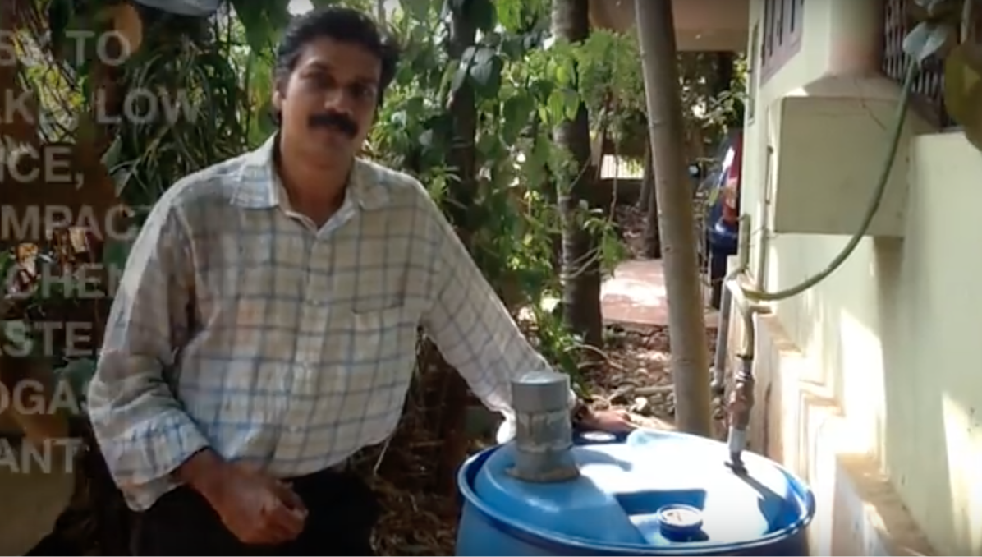
India Biogas Reactor (https://www.youtube.com/watch?v=9kKRdlAFuZw)

Slide 28
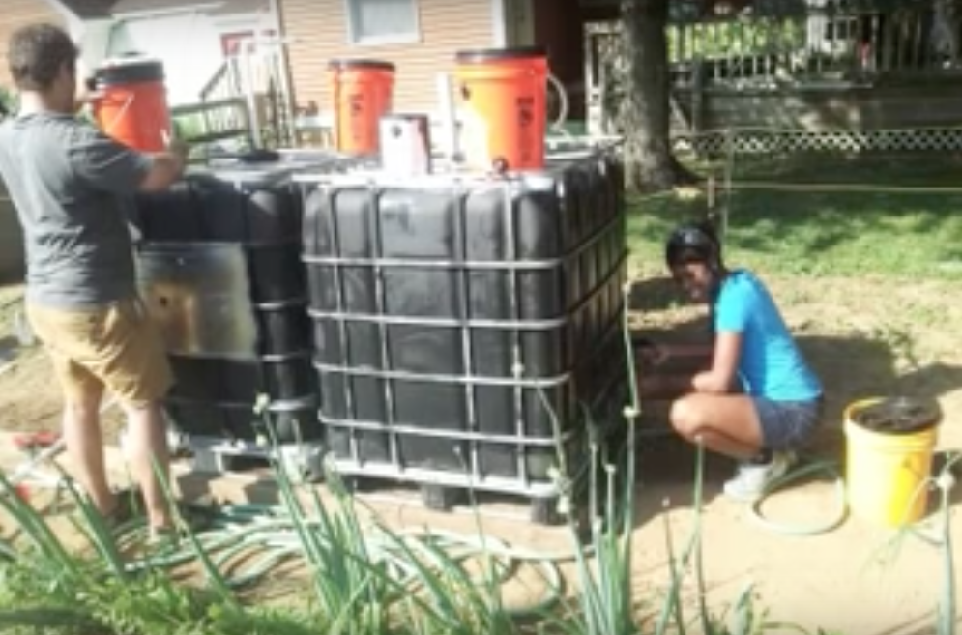
Biogas Reactor for the Developing World (https://www.youtube.com/watch?v=Cwm5Rm8uIsk)

Slide 29
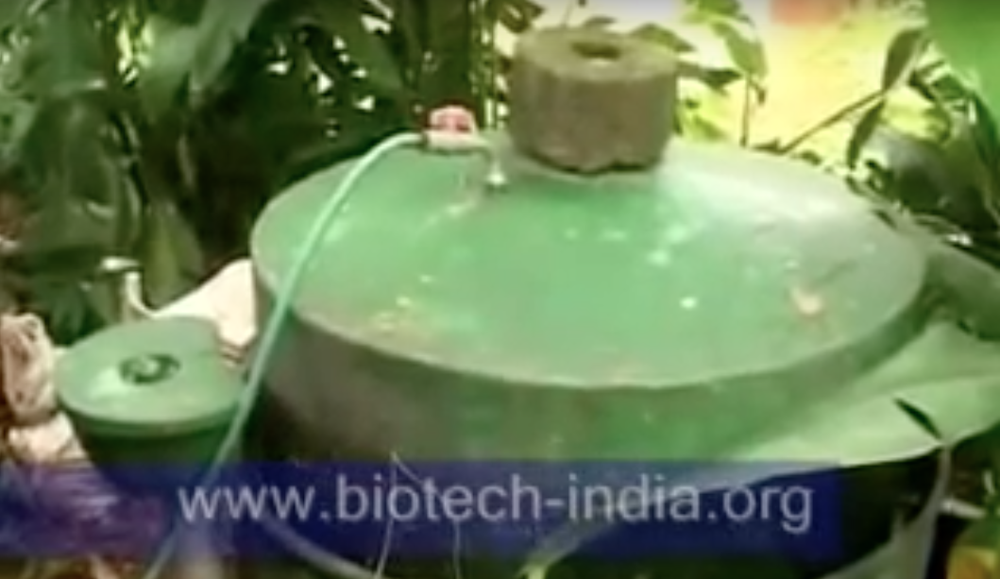
Biomass/Syngas
Single House Biogas (http://www.youtube.com/watch?v=3th2bcqHbsk)

Slide 30
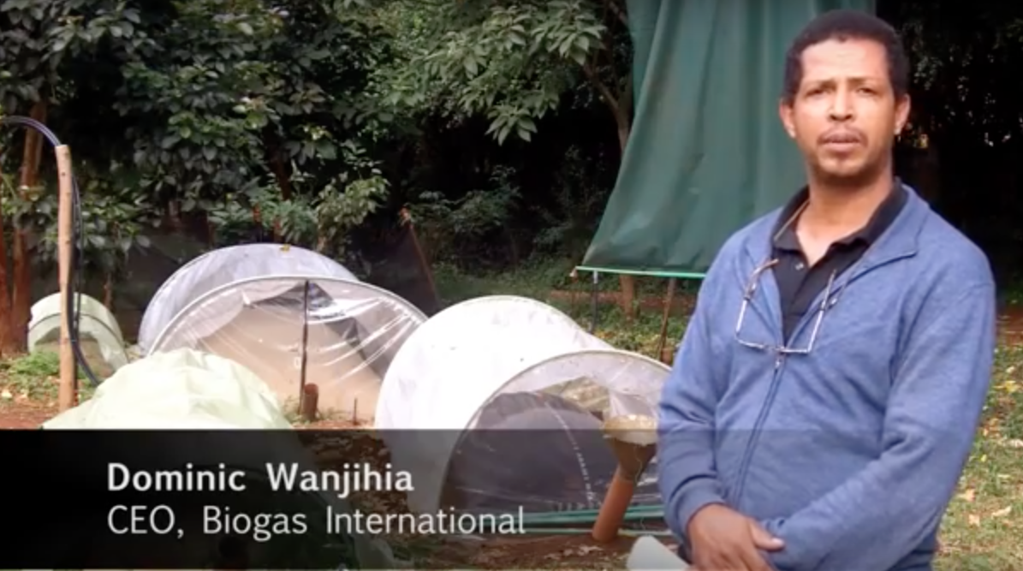
Biomass/Syngas
Biogas in Kenya (http://www.youtube.com/watch?v=qh3mmgiybTw)

Slide 31
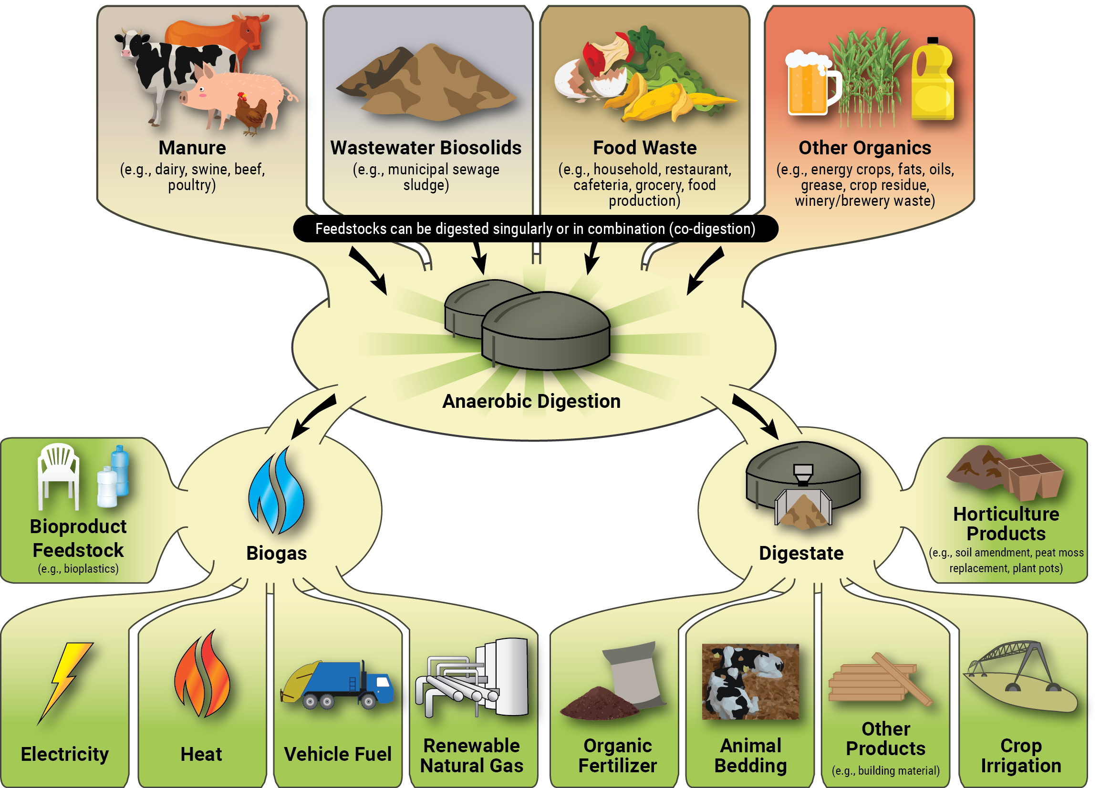

Slide 32
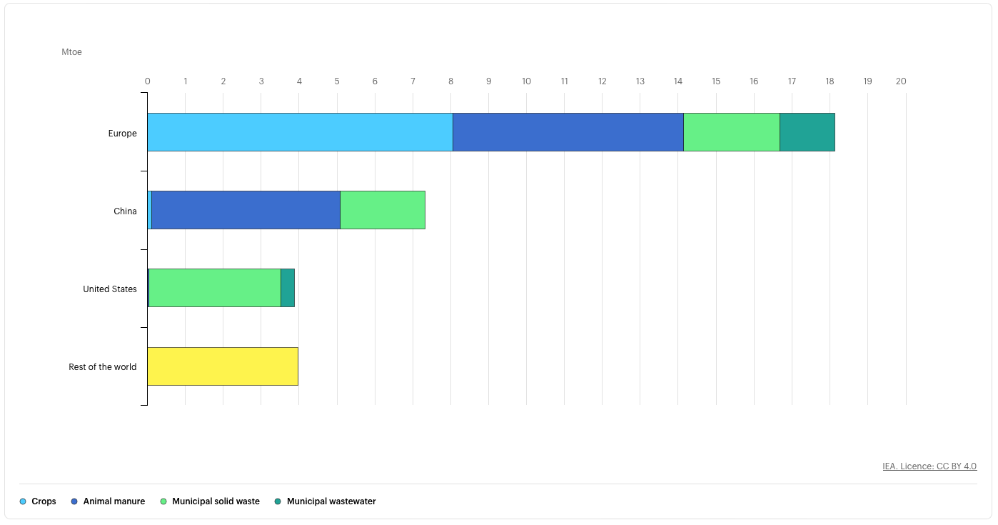
2018

Slide 33
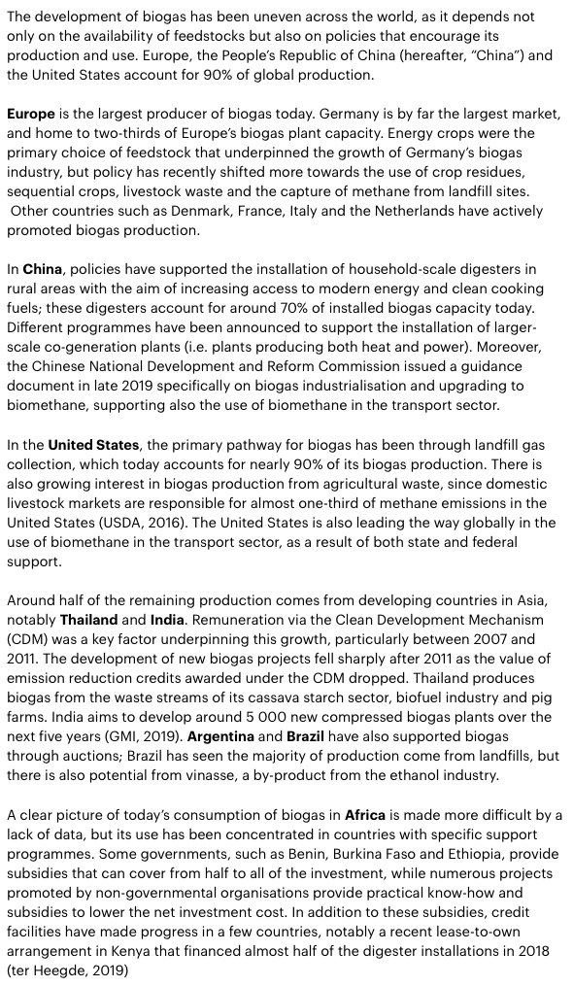

Slide 34
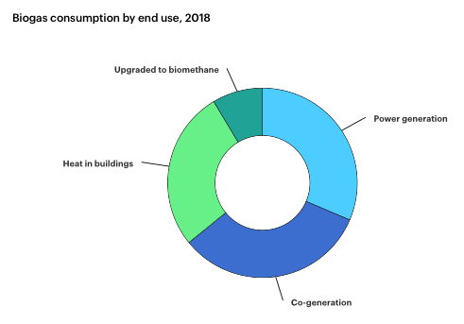

Slide 35
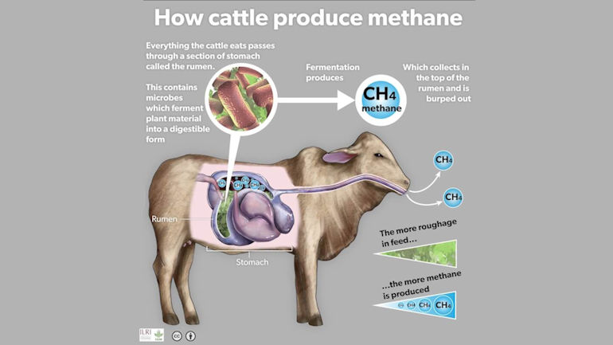
Bio-Based Plastics

Slide 36
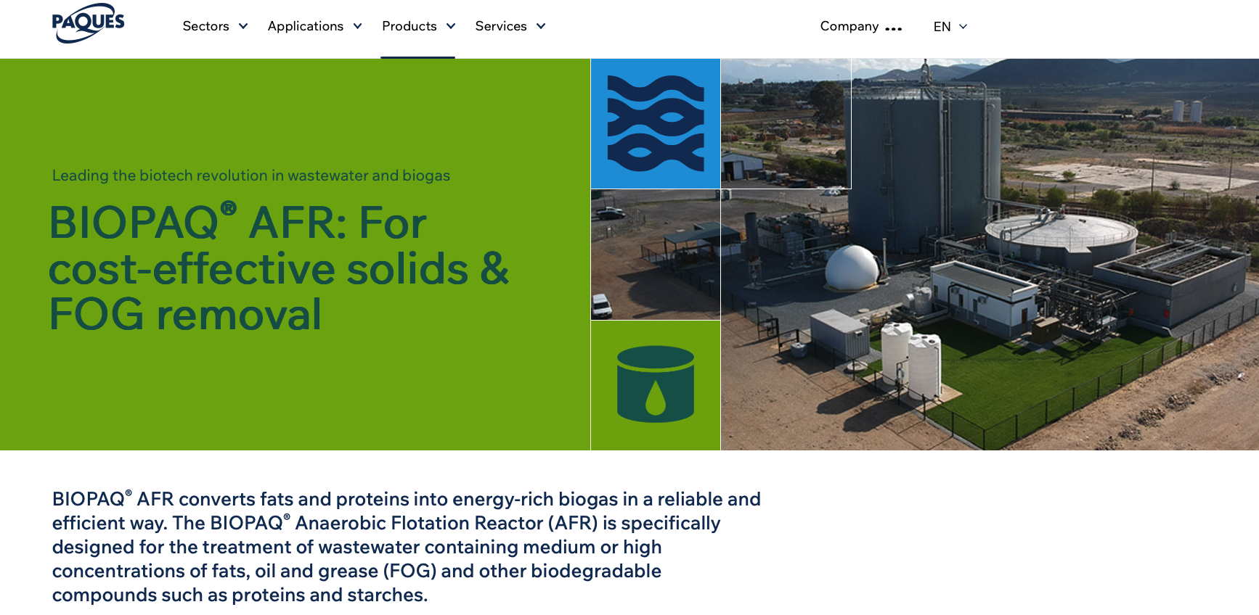
AFR Process Video for Methane Production

Slide 37
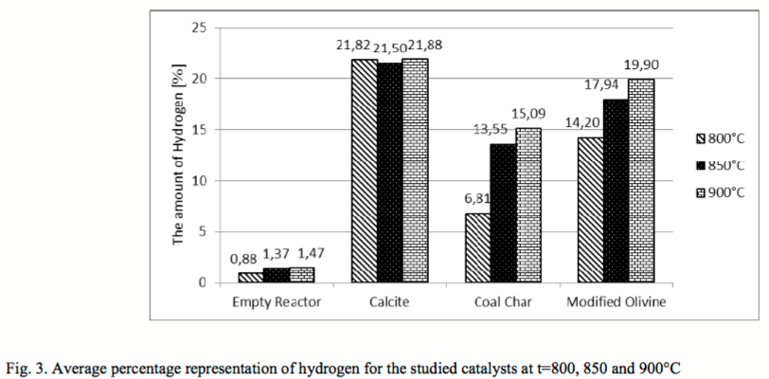
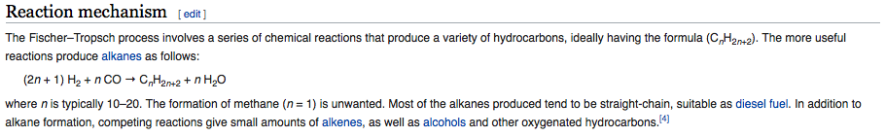
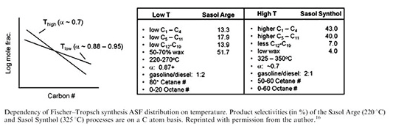
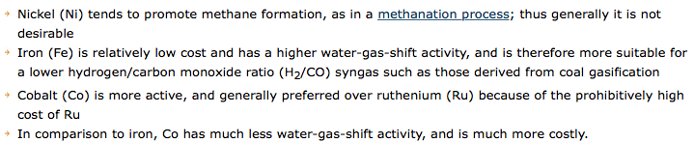
Methane from Cows, Sewage, Compost, Landfill, etc.
Steam Reforming Reaction: CH₄ to H₂ and CO
Biomass/Syngas
Water Shift Gas Reaction: CO to H₂
Fischer-Tropsch Reaction: H₂ and CO to Liquid Fuel

Slide 38
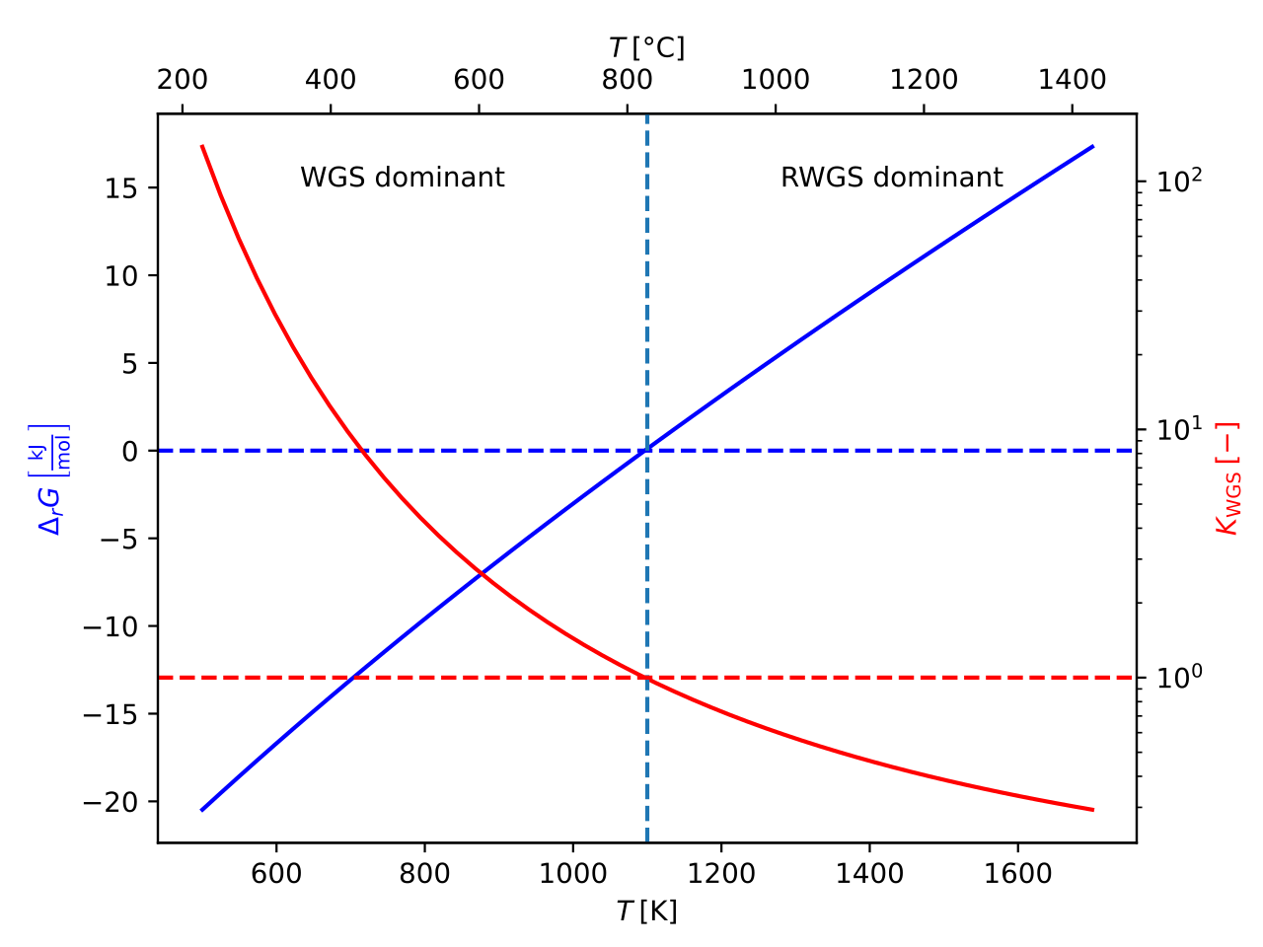

Biomass/Syngas
Steam Reforming Reaction: CH₄ to H₂ and CO
Water Shift Gas Reaction: CO to H₂
Fischer-Tropsch Reaction to Make Hydrocarbons from CO₂ and H₂

Slide 39
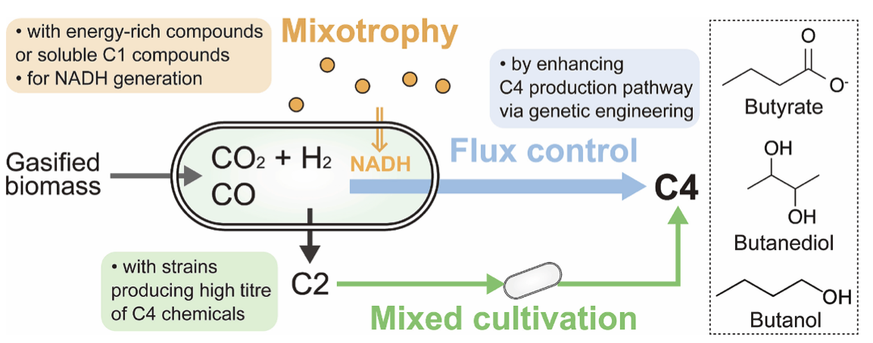
Fermentation of Syngas
Syngas can also be fermented to give ethanol (CH3 CH2 OH), 1-propanol (CH3CH2CH2OH), 1-butanol (CH3CH2CH2CH2OH), acetic acid (CH3COOH), butyric acid (CH3CH2CH2COOH), or other chemical building blocks.
Acetogens.
In the past few years, US-based company Lanzatech developed processes for the production of bio-based 2,3-butanediol (CH3CHOHCHOHCH3) and ethanol (CH3CH2OH). Also, US-based Synata Bio invested in pilot plant facilities to produce ethanol (CH3CH2OH) and 1-butanol (CH3CH2CH2CH2OH), starting from syngas feedstock.

Slide 40
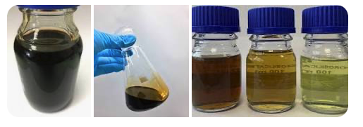
Pyrolysis Oil, biocrude or bio-oil
Anaerobic heat wood
water driven off 100°C
dry wood
270°C decomposition and heat
450°C charcoal and tar
600°C biochar
Remain at 400-500°C makes mostly biochar in hours
Above 700°C liquid and gas in seconds
  Bio-oil and syngas
  15% of the energy is consumed by the process

Slide 41
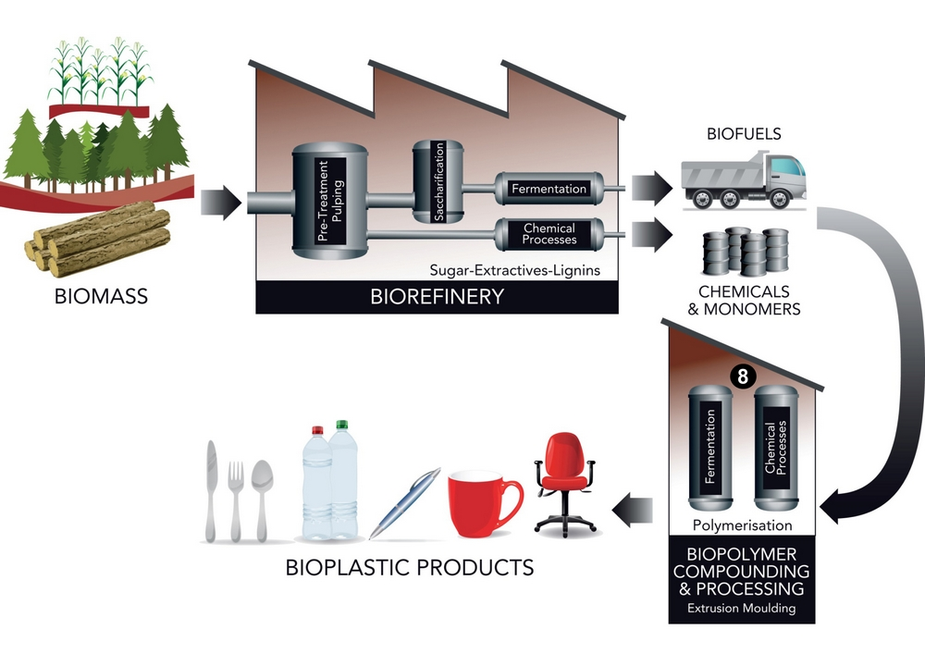
Pyrolysis Oil, biocrude or bio-oil
Hydrothermal liquification
Wet biomass
350°C and 21 MPa
Bio-oil with twice the energy density
  of pyrolysis oil
  Related materials:
Black Liquor (pulp mill lignin)
Rubber Oil (tires)
Use Pyrolysis Oil to make ”bio-plastic” by bio-refining

Slide 42
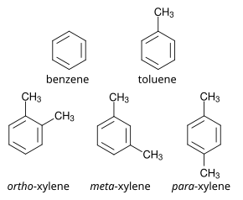
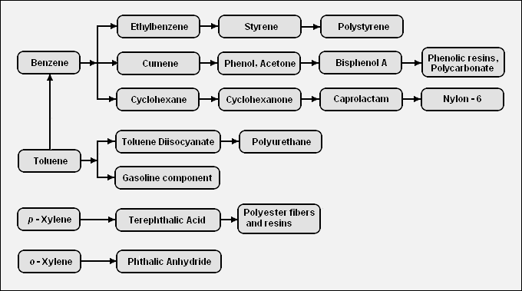

Bio-based Terephthalic Acid for biobased PET
Pyrolysis of organic matter.
Low Temperature/Slow Heating (<450°C) => Biochar
Intermediate Temperature/Rapid Heating=> Pyrolysis Oil
High Temperature/Rapid Heating (>800°C) => Gasses (CH₄, H₂, CO, and CO₂)
Bio-oil + Zeolite (Na₂Al₂Si₃O₁₀ . 2 H₂O) => bioBTX
BTX

Slide 43
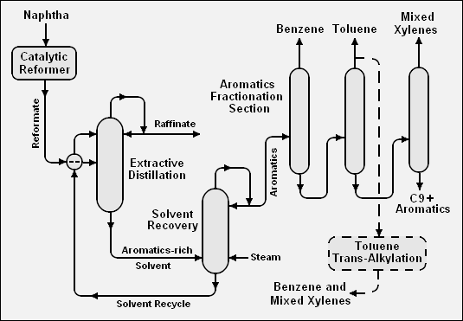
Bio-based Terephthalic Acid for biobased PET
Bio-BTX =>

Slide 44
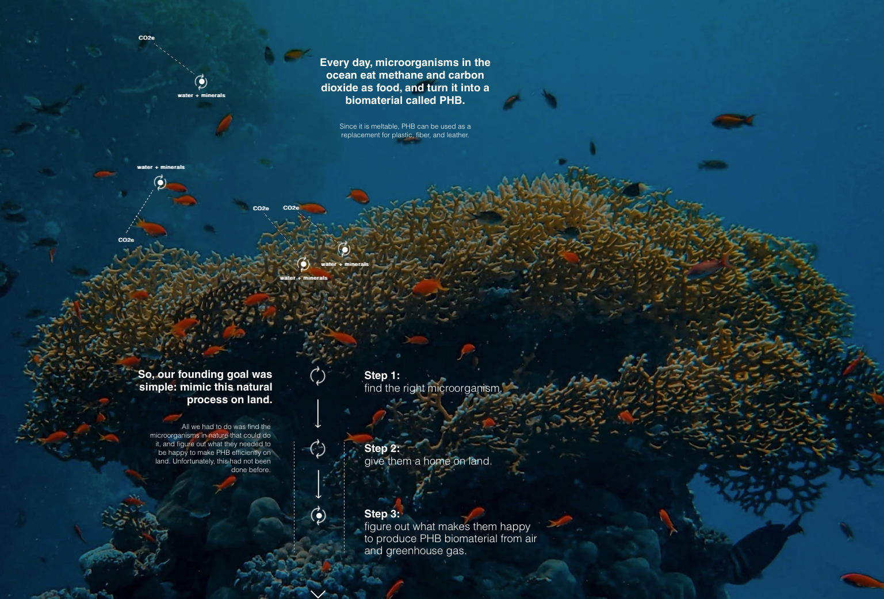
Methane from Cows, Sewage, Compost, Landfill, etc.
PHB from Methane (Newlight, Huntington Beach CA)

Slide 45
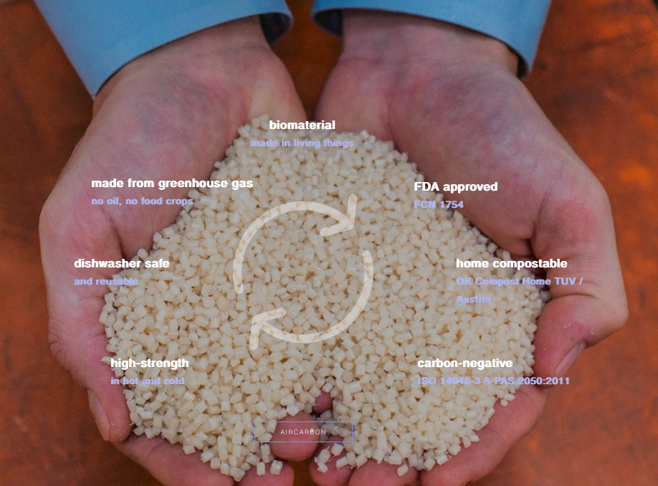
PHB from Methane (Newlight, Hunington Beach CA)

Slide 46
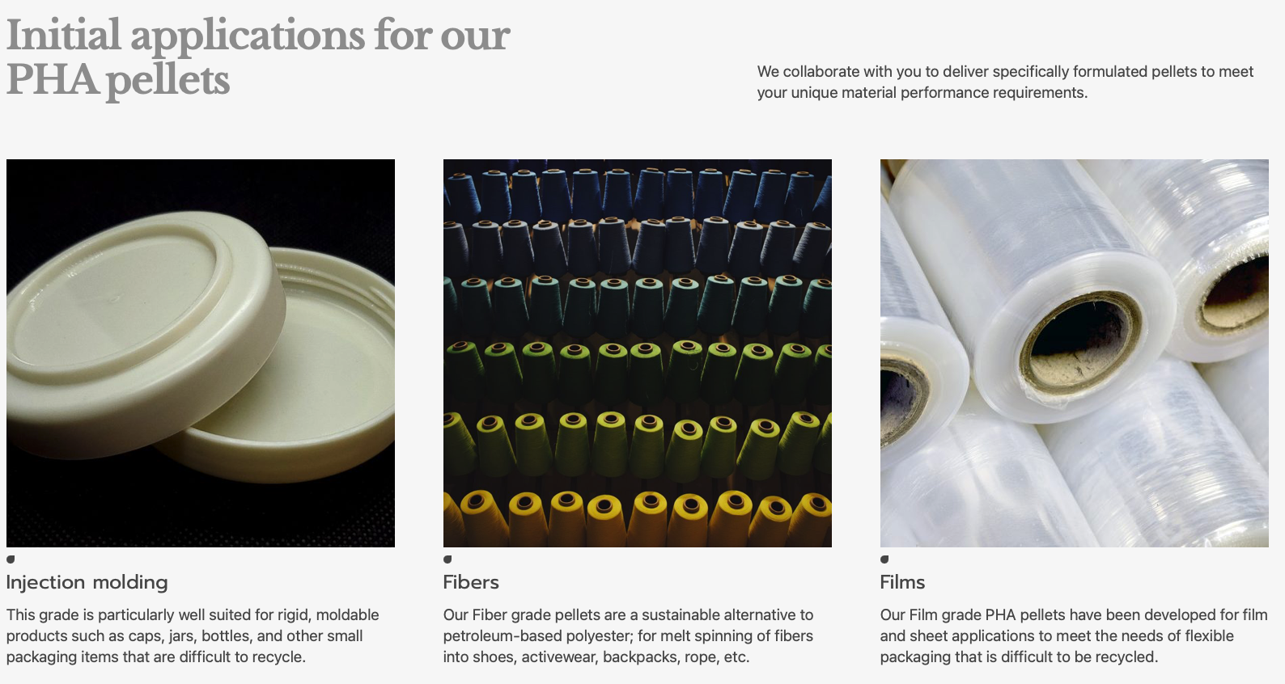
PHB from Methane (Mango Materials Berkley CA)

Slide 47
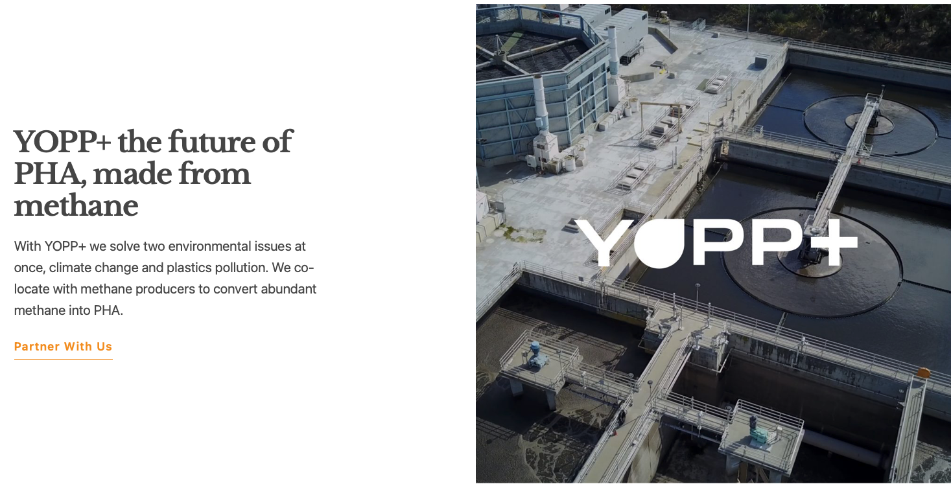
PHB from Methane (Mango Materials Berkley CA)

Slide 48
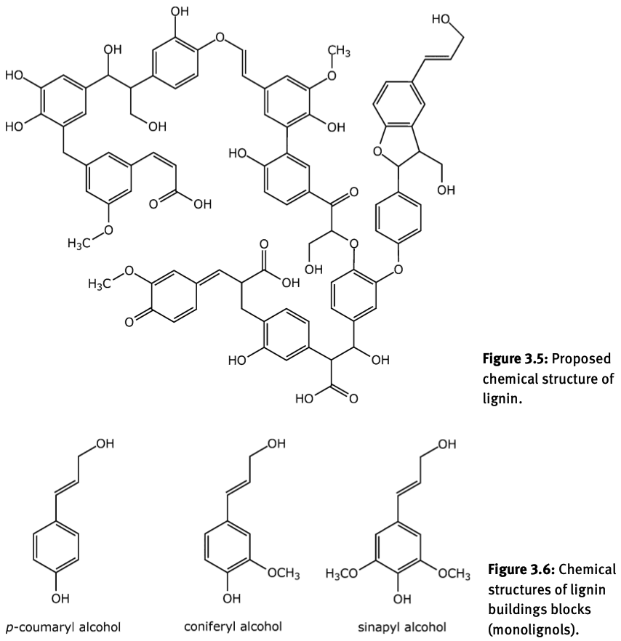
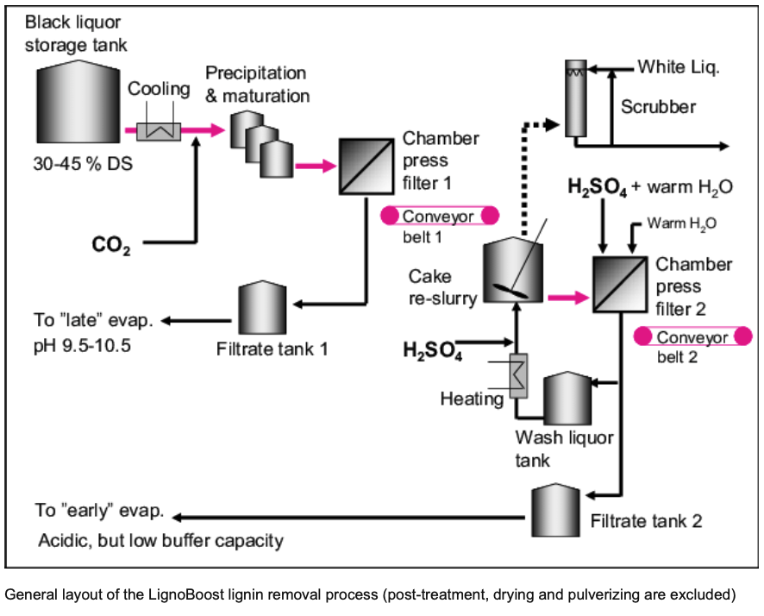
Lignin
LignoBoost (Sweden) and LignoForce (Canada)
a renewable source of aromatic compounds

Slide 49
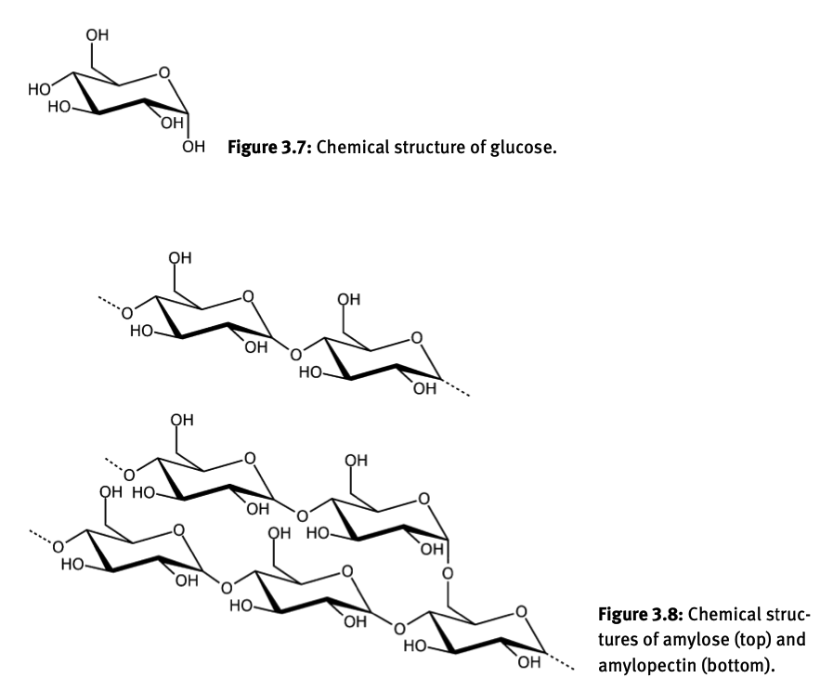
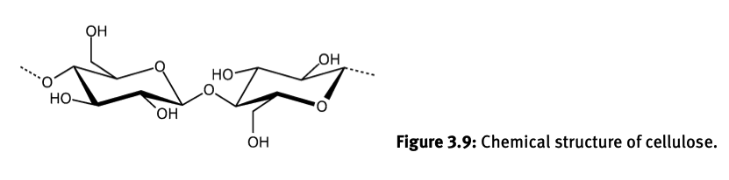
Starch, Cellulose and Glucose
β-1,4-glycosidic linkages
Starch
Amalose
α-(1,4)-glycosidic linkages
Amalopectin
α-(1,4)-glycosidic linkages
α-(1,4)-glycosidic bonds occasionally (1,6) (branches)

Slide 50
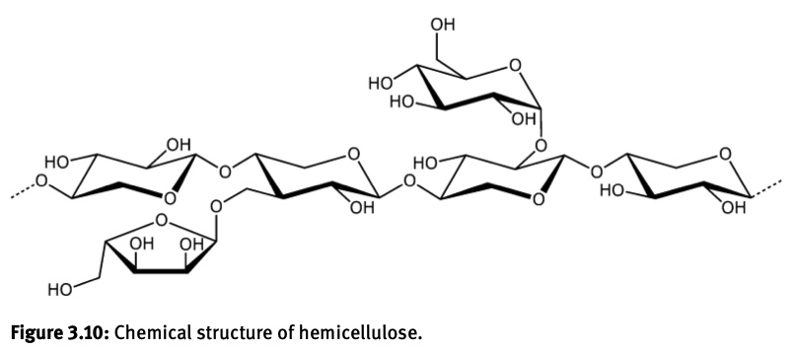
Starch, Cellulose and Glucose
β-1,4-glycosidic linkages
Only glucose and no branching
Different sugars and branching

Slide 51


Sugar-based Feedstock

Slide 52

Bio-Based Oils
Glycerol
CH2OHCHOHCH2OH
Fatty Acids
(C:D) C = number of carbons, D = unsaturated bonds
Saturated: palmitic (16:0), stearic acid (18:0)
Unsaturated oleic acid (18:1), linoleic acid (18:1), and α-linoleic acid (18:3)

Slide 53

Bio-Based Oils

Slide 54

Bio-Based Oils
Glycerol can be transformed into bio-based propylene in a one- step catalytic process using molybdenum-based catalysts.
The glycerol-to-propylene (GTP) process was first introduced by Quattor Petrochimica, headquartered in Rio de Janeiro (Brazil). In 2009, this company was incorporated by the Brazilian-based company Braskem.

Slide 55
Bio-Based Plastics
Primary feedstocks
Primary feedstocks include primary biomass that is harvested from forest or agricultural land.
Secondary feedstocks
Secondary feedstocks are process residues, such as sawmill residues or black liquor generated by the forests products industry.
Tertiary feedstocks
Tertiary feedstocks are postconsumer wastes or residues (such as waste waters or municipal solid waste).

Slide 56
Bio-Based Plastics
Renewable Feedstocks:
Dedicated feedstocks
– Sugar crops (e. g., sugar beet or sugar cane).
– Starch crops (e. g., wheat or corn).
– Lignocellulosic crops (e. g., wood or miscanthus).
– Oil-based crops (e. g., rape seed oil, soya oil, palm oil, or jatropha). – Grasses (e. g., green plant materials).
– Marine biomass (e. g., micro and macro algae).
Residues
– Oil-based residues (e. g., animal fat from food industries or used cooking oil from restaurants, households, and other sources).
– Lignocellulosic residues (e. g., crop residues or saw mill residues).
– Organic residues (e. g., organic urban waste or household waste).

Slide 57


Slide 58



Bio-Based Plastics

Slide 59


Slide 60



Slide 61
Bio-Based Plastics
– Bio-based (or partly bio-based), non-biodegradable plastics, such as bio-based polyethylene (PE), polypropylene (PP), polyethylene terephthalate (PET) (so-called drop-in solutions)
– Bio-based and biodegradable plastics, such as polylactic acid (PLA), polyhydroxyalkanoates (PHA), polybutylene succinate (PBS), and starch blends
– Plastics that are based on fossil resources (fossil-based) and biodegradable, such as poly(butylene-co-adipate-co-terephthalate) (PBAT)
Sugar based
type 3

Slide 62


Slide 63

Polyethylene
Oxidative coupling of methane (OCM) uses special developed nanowire OCM catalysts.
The OCM process, also called the Gemini technology, was developed by Siluria Technologies.

Slide 64

Bio-Based Plastics
Process starts with methane to produce ethylene

Slide 65

Bio-Based Plastics

Slide 66
Bio-Based Polyethylene (Bio-PE)
Dehydrate bio-ethanol (bio-based ethanol, CH3CH2OH) to bio-based ethylene (CH2=CH2) and subsequently polymerizing bio-based ethylene into bio-based polyethylene (bio-PE).
1G feedstocks: 85% or bioethanol comes from sugar cane (in Brazil) or corn starch (in USA).
2G feedstocks: Lignocellulose. Low-cost crop and forest residues, wood process waste, and the organic fraction of municipal solid waste can all be used as lignocellulosic feedstocks
Ethylene from lignocellulose by 2 methods: 1) biochemical route and 2) acid hydrolysis route

Slide 67
Lignocellulose to ethylene
Biochemical route:
Enzymes and micro-organisms convert cellulose or hemicellulose to complex sugars.
Saccharification: A cellulase enzyme breaks down the cellulose molecule into monosaccharides such as glucose, or shorter polysaccharides and oligosaccharides.
Because cellulose molecules bind strongly to each other, cellulose breakdown is relatively difficult compared to the breakdown of other polysaccharides such as starch.
The sugars are further fermented to produce bio-ethanol.
Acid hydrolysis route:
Lignocellulosic feedstock is pretreated and,
Subsequently, acid hydrolysis (using either dilute acid or concentrated acid) breaks down cellulose to glucose,
Fermentation to produce bio-ethanol.
Yeasts are added to convert the sugars to bio-ethanol,
which is then distilled off to obtain bio-ethanol up to 96 % in purity.
One glucose molecule (C6H12O6) is fermented into two molecules of bio-ethanol (CH3CH2OH) and two molecules of carbon dioxide (CO2)

Slide 68

Bio-Based Plastics

Slide 69

Bio-Based Plastics

Slide 70

In 2015, DuPont Industrial Biosciences opened the doors to the largest cellulosic ethanol plant in the world.
The DuPont biorefinery, located in Nevada, Iowa (USA), is powered by corn stover and produces 115 million liters of bio-ethanol a year.
By the end of 2018, it was announced that the German-based firm VERBIO acquired DuPont’s cellulosic 2G bio- ethanol plant and a portion of its corn stover inventory.
VERBIO installed additional facilities to produce renewable natural gas (RNG) made from corn stover and other cellulosic crop residues at the site.
VERBIO has two other cellulosic 2G bio-ethanol production facilities in Schwedt (Germany) and in Pinnow (Germany).

Slide 71

Generations 1 and 2 bio-ethanol
Route 2 Acid hydrolysis
Route 1 Biochemical
Gen 1
Route 2
Gen 2
Route 1

Slide 72

Generation 1 Bio-Plastics
Braskem (Brazil)
200,000 metric tons a year
30 bio-based HDPE, LDPE, and LLDPE grades
Tetra Rex® cartons from Tetra Pak
Danone with Activia
Proctor and Gamble Pantene bottles.
LEGO Group “botanical” elements range, prepared from Braskem’s I’m GreenTM bio-PE

Slide 73

Generation 2 bio-ethanol
Acid Hydrolysis Route 2

Slide 74

ZEACHEM
Bio-Based Plastics

Slide 75
Bio-Based Polypropylene
Since 2019, the Finnish group Neste has been providing its partners LyondellBasell in Wesseling (D) and Borealis in Kallo and Beringen (B) with so-called “bio-naphtha” (hydrogenated vegetable oils, largely from used fats or non-food oils).
LyondellBasell offers potential customers an approx. 30% bio-based PP variant produced from this (scale: 5-10 kt per year).
Borealis launched a PP containing a percentage of bio-based materials at the end of 2019.
Bio-based percentages of up to about 75% are possible.
A significant price premium (in the order of 50–100%).

Slide 76


Bio-Based Polypropylene
Mitsui’s process, Route 1

Slide 77
Bio-Based Polypropylene
Braskem Process

Slide 78

Bio-Based Polypropylene
Lyondell Basell and Neste bio-PP and bio-PE.
Food packaging marketed under the brand names CirculenTM and Circulen PlusTM, the new family of Lyondell Basell circular economy product brands.

Slide 79

Bio-Based Polypropylene
Cathay Industrial Biotech
Cobalt Technologies, Butamax Advanced Biofuels, Metabolic Explorer, Eastman Renewable Materials

Slide 80

Bio-Based Polypropylene
Olefin metathesis can also be applied to produce bio-based propylene, starting from both bio-based ethylene (CH2=CH2) and 2-butylene (CH3CH=CHCH3).
In the process, bio-based ethylene is obtained from sugar fermentation. Bio-based 2-butylene can be produced from bio-based ethylene, via dimerization into 1-butylene and subsequent isomerization into 2-butylene.

Slide 81

Bio-Based Polypropylene

Slide 82

Bio-Based Polypropylene
France-based Global Bioenergies (GBE) announced a process for the direct conversion of glucose to propylene using bioengineered bacteria.

Slide 83

Bio-Based PVC
Inovyn “bio-attributed” PVC tradename BiovynTM.
Chlorine (Cl2) and ethylene (CH2=CH2) are used to produce 1,2-dichloroethane (ClCH2CH2Cl)
Oxychlorination process ethylene reacts with hydrogen chloride (HCl) and oxygen to form 1,2-dichloroethane.
1,2-Dichloroethane converted to vinyl chloride by thermal cracking (EDC pyrolysis)
The hydrogen chloride (HCl) by-product can be recycled to the oxychlorination plant.

Slide 84
Bio-Based PVC
Inovyn bio-PVC is part of INEOS which has this statement on their webpage.
Several INEOS businesses continue to substitute fossil-based raw materials with recycled and bio-based feedstocks at commercial scale.
For example, at our olefins plant in Cologne (Germany), biomass co-produced by the wood pulping industry has been successfully converted into bio-olefins. Similarly, our Inovyn plant in Tavaux (France) is producing bio-attributed epichlorohydrin (REODRINTM) from renewable feedstocks that do not compete with the food chain, reducing GHG emissions by up to 70% compared to the fossil-based equivalent. INEOS has also started producing commodity chemicals, such as phenol, acetone, styrene, and PVC, with bio-based feedstocks.
INEOS’ bio-attributed products can be made with 100% substitution of bio-feedstock on a mass-balance basis and provide significant GHG savings in the value chains of our products. It results in products which have a proven positive impact on the environment without sacrificing product performance.
Using alternative feedstocks can also have a positive impact on INEOS’ emissions from its operations by reducing non-biogenic emissions released from chemical reactions or when process steps can be avoided by using more refined or recycled feedstocks. This is why the use of alternative feedstocks is included in our 2030 roadmaps, even if the impact of this pathway on scope 1 and scope 2 emissions is modest.

Slide 85


Fossil-Based Polystyrene
Route 1
Ddehydrogenation of ethylbenzene produced on a large scale by combining benzene (C6H6) and ethylene (CH2=CH2) in an acid-catalyzed chemical reaction.

Slide 86

Fossil-Based Polystyrene
Route 2
Propylene oxide— styrene monomer (POSM, Lyondell Chemical Company) or styrene monomer/propylene oxide (SM/PO) (Shell). Ethylbenzene (C6H5CH2CH3) is treated with oxygen (O2) to form the ethylbenzene hydroperoxide. This hydroperoxide is then used to oxidize propylene (CH2=CHCH3) to propylene oxide. The resulting 1-phenylethanol is dehydrated to give styrene

Slide 87

Fossil-Based Polystyrene
Route 2
Propylene oxide— styrene monomer (POSM, Lyondell Chemical Company) or styrene monomer/propylene oxide (SM/PO) (Shell). Ethylbenzene (C6H5CH2CH3) is treated with oxygen (O2) to form the ethylbenzene hydroperoxide. This hydroperoxide is then used to oxidize propylene (CH2=CHCH3) to propylene oxide. The resulting 1-phenylethanol is dehydrated to give styrene

Slide 88

Bio-Based Polystyrene
Dow Chemical Proposed Route

Slide 89

Bio-Based Polystyrene
Dutch BioBTX Company

Slide 90

Bio-Based Polystyrene
Dutch BioBTX Company

Slide 91
Bio-Based Polystyrene
Dutch BioBTX Company
Bio-based benzene can be used, together with bio-based ethylene (from bio- ethanol), to produce in a Friedel-Crafts acylation bio-based ethylbenzene. Ethylbenzene can be dehydrogenated to bio-based styrene. The resulting bio-based styrene could be the basis for bio-based polystyrene (bio-PS).
Xylene or dimethylbenzene is any one of three isomers of dimethylbenzene. Xylene exists in three isomeric forms. The isomers can be distinguished by the designations ortho- (o-), meta- (m-) and para- (p-), which specify to which carbon atoms (of

Slide 92

Aside: Bio-Based PET from BioBTX
Dutch BioBTX Company
Xylene or dimethylbenzene is any one of three isomers of dimethylbenzene. Xylene exists in three isomeric forms. The isomers can be distinguished by the designations ortho- (o-), meta- (m-) and para- (p-), which specify to which carbon atoms (of the benzene ring) the two methyl groups are attached. On industrial scale, xylenes are produced by methylation of toluene, and benzene. p-Xylene is the principal pre- cursor to terephthalic acid and dimethyl terephthalate, both monomers used in the production of polyethylene terephthalate (PET). o-Xylene is an important precursor to phthalic anhydride.

Slide 93

Bio-Based Polystyrene
Microorganisms are utilized for the production of styrene. Phenylalanine, an essential α-amino acid, is produced by a fermentation process that use glucose or sucrose as the carbon source using specially engineered micro-organisms for the biotransformation.
For example, L-phenylalanine can be produced from glucose via the glycolysis pathway and the subsequent shikimate pathway. In the glycolysis pathway, glucose is converted into pyruvate (CH3COCOO−).
The shikimate pathway (shikimic acid pathway) is a seven-step metabolic pathway for the biosynthesis of aromatic amino acids (such as L-phenylalanine). Subsequently, a co-culture system can be used consisting of L-phenylalanine ammonia lyase (PAL, wherein NH3 is released) and phenylacrylic acid decarboxylase (FDC1, wherein CO2 is released).

Slide 94

Bio-Based Polystyrene

Slide 95

Fossil-Based Polyvinylacetate (PVAc)/Polyvinyl alcohol (PVA)
/Polyethylenevinylacetate (EVAc)

Slide 96
Fossil-Based Polyvinylacetate (PVAc)/Polyvinyl alcohol (PVA)
/Polyethylenevinylacetate (EVAc)
Polyvinylacetate can be hydrolyzed to polyvinyl alcohol (PVA)
Sometimes, a base-catalyzed transesterification with ethanol (CH3CH2OH) produces PVA and ethyl acetate (CH3COOCH2CH3)

Slide 97

Fossil-Based Polyvinylacetate (PVAc)/Polyvinyl alcohol (PVA)
/Polyethylenevinylacetate (EVAc)

Slide 98

Bio-Based Polyvinylacetate (PVAc)/Polyvinyl alcohol (PVA)
/Polyethylenevinylacetate (EVAc)
German chemical company Wacker Chemie

Slide 99

Fossil-Based Polyacrylic Acid (sodium acrylate super absorbant)
BASF, Dow, Arkema, Evonik, Nippon Shokubai, LG Chemical, Mitsubishi, Jiansu Jurong Chemical, and Formosa Plastics

Slide 100

Proposed Bio-Based Polyacrylic Acid (sodium acrylate super absorbant)
Genomatica

Slide 101

Proposed Bio-Based Polyacrylic Acid (sodium acrylate super absorbant)
BASF, Cargill, and Novozymes
Genetic Engineering Bacteria
Dow Chemical and OPX Biotechnologies (OPXBio) similar process

Slide 102

Proposed Bio-Based Polyacrylic Acid (sodium acrylate super absorbant)
Novomer

Slide 103

Proposed Bio-Based Polyacrylic Acid (sodium acrylate super absorbant)
Arkema Group

Slide 104

Proposed Bio-Based Polyacrylic Acid (sodium acrylate super absorbant)
Metabolix
Commercial to this stage
Genetically engineered
fast-acting, selective thermolysis

Slide 105

Proposed Bio-Based Polyacrylic Acid (sodium acrylate super absorbant)
Myriant (GC Innovation America)
and SGA Polymers
Commercial to this stage

Slide 106

Fossil-Based Polymethylmethacrylate
Coproduces substantial amounts of ammonium sulfate and toxic and dangerous HCN

Slide 107

Fossil-Based Polymethylmethacrylate
Mitsubishi Route
Co-product formamide is dehydrated to HCN for recycling

Slide 108

Fossil-Based Polymethylmethacrylate

Slide 109

Bio-Based Polymethylmethacrylate
BASF, Dow Chemicals, Arkema Group, Asahi-Kasei, Mitsubishi Rayon, and Evonik. Both bio-based methyl methacrylate (bio-MMA) and polymethyl methacrylate (bio-PMMA) are not yet commercially available.
Aspergillus terreus and Aspergillus itaconicus

Slide 110

Bio-Based Polymethylmethacrylate
Lucite International and Mitsubishi Rayon

Slide 111
Bio-Based Plastics

Slide 112
Bio-Based Plastics

Slide 113
Bio-Based Plastics

Slide 114
Bio-Based Plastics

Slide 115
Bio-Based Plastics

Slide 116
Bio-Based Plastics

Slide 117
Bio-Based Plastics

Slide 118
Bio-Based Plastics

Slide 119
Bio-Based Plastics

Slide 120
Bio-Based Plastics

Slide 121
Bio-Based Plastics

Slide 122
Bio-Based Plastics
Challenges: the ‘5Es’
We have identified five main challenges that hinder the implementation of bioplastics.
Economics
most bioplastics are currently more expensive to produce than fossil-based plastics, mostly owing to economies of scale and the price competitiveness of crude oil.
Efficiency
bioplastic manufacturing processes can be less energy efficient than fossil-based plastic processes and come with other environmental burdens associated with agricultural farming.
End of life
For most bioplastics, recycling streams have yet to be established to make them truly ‘circular’. Consumers remain uncertain of how to deal with bioplastics after use. Compostable bioplastics are often rejected by composters.
Ethics
using first-generation biomass, which is often edible, remains controversial owing to potential competition with food production. Processes to efficiently use second-generation biowastes need to be established.
Education
Consumers and plastic converters are confused about the usefulness
of bioplastics, owing to inconsistent labelling, contradicting life cycle assessments and ‘greenwashing’. Improved information distribution and consistent global standards need to be established.

