Slide 1
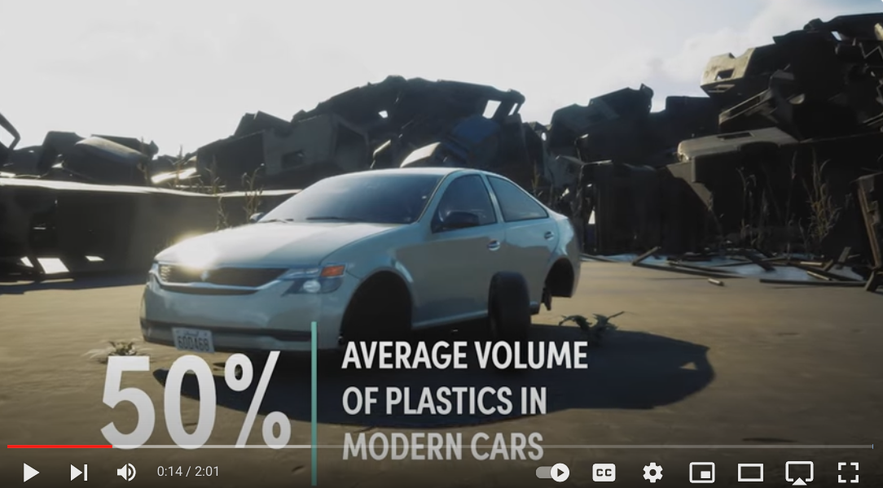
Globally 27 Million End of Life Cars per year (2021)
10 Billion Pounds of Auto Shredder Residue (ASR)
Goes to Landfill or Incinerator
Eastman Chemicals Promo Video

Slide 2
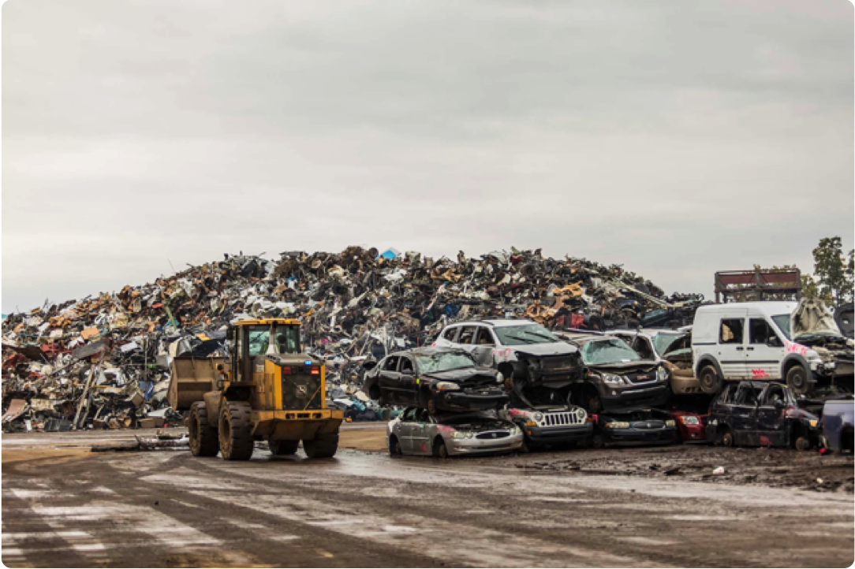
One Car => 4,000 lbs of waste
80% metal and glass
20% Automotive Shredder Residue (ASR)
5 million tons in the US per year

Slide 3
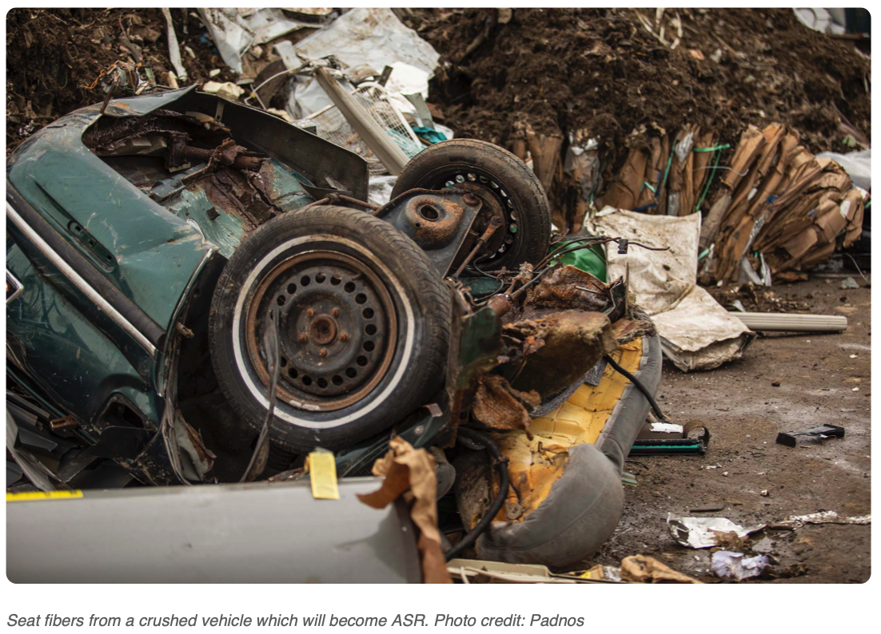

Slide 4
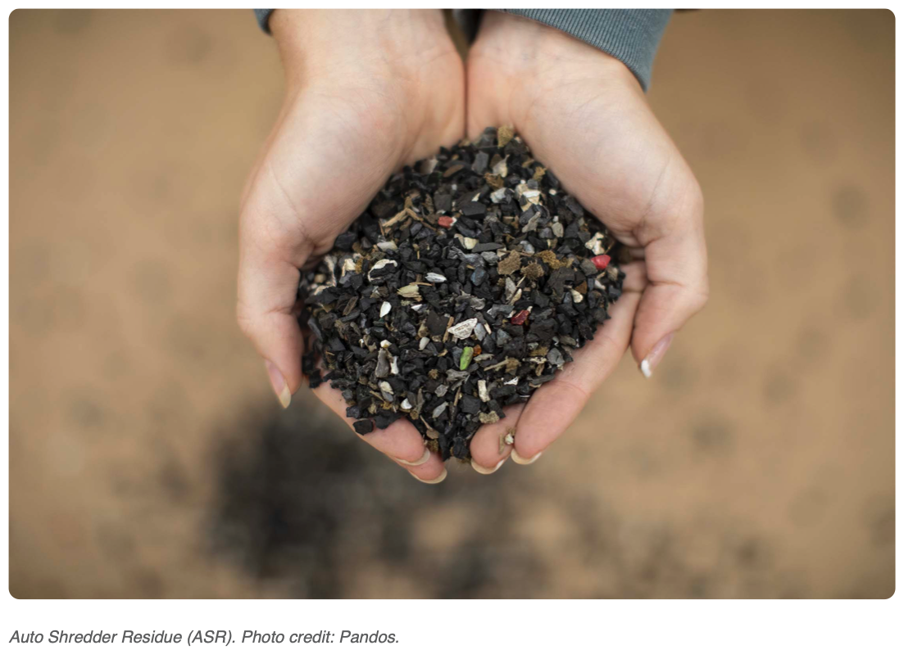

Slide 5
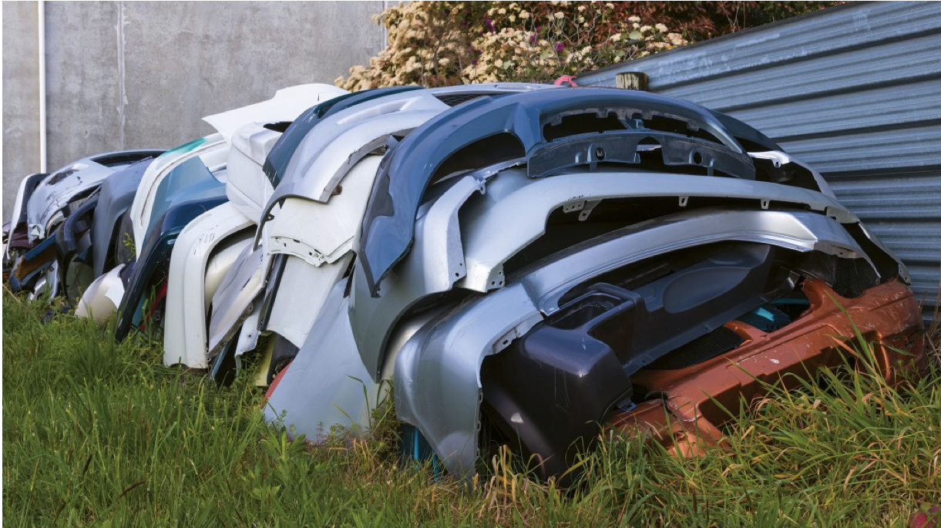
Ford 2023 85% of plastic in their cars is recycled
Volvo promises in 2025 25% recycled plastic
Renault as some models with 30% and some with 90% recycled plastic

Slide 6
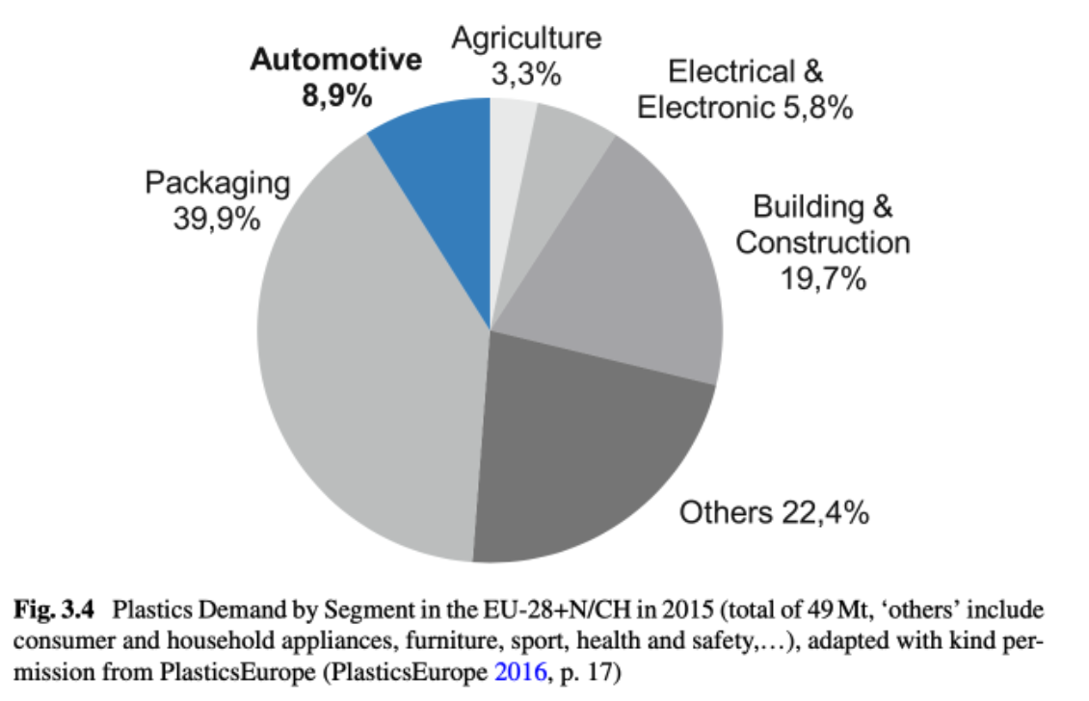
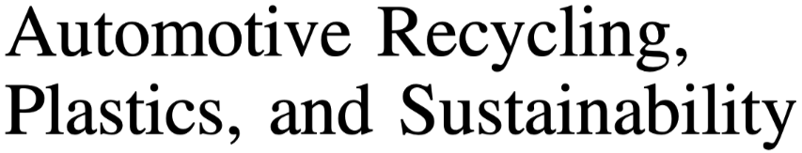


Slide 7
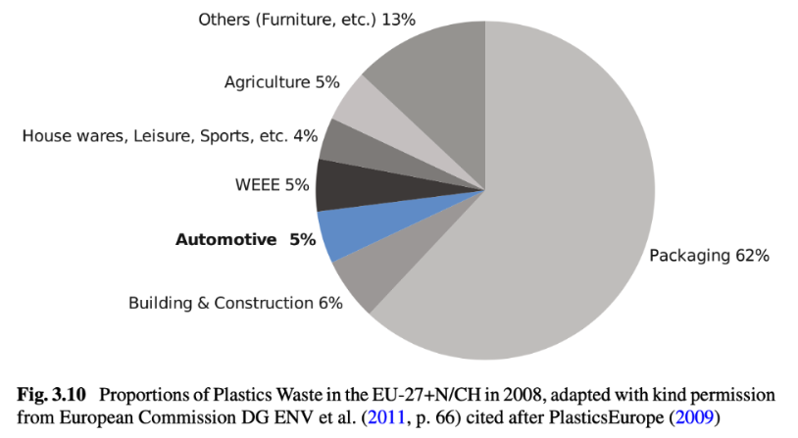

Slide 8
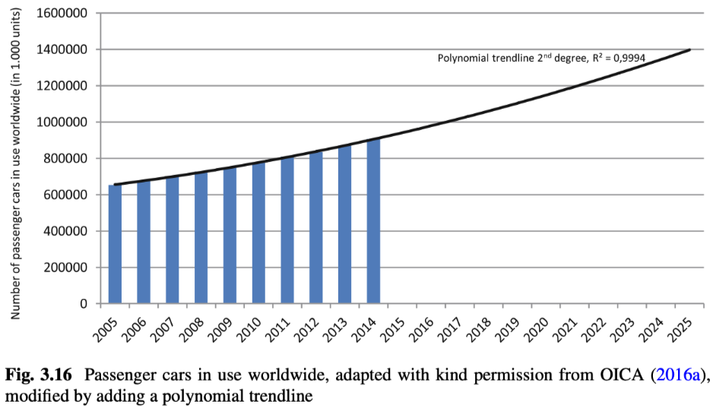

Slide 9
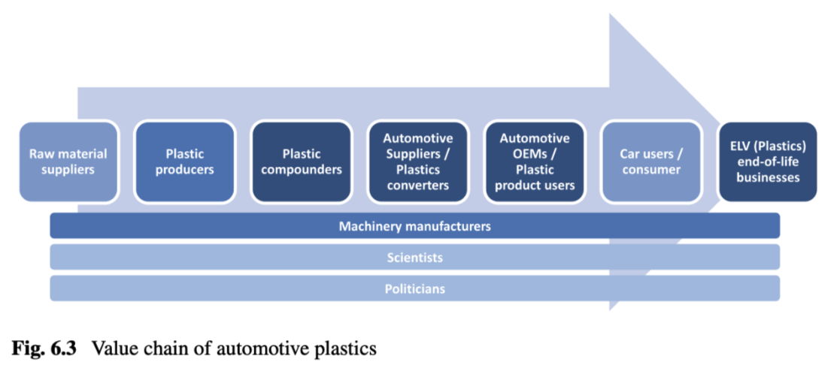

Slide 10
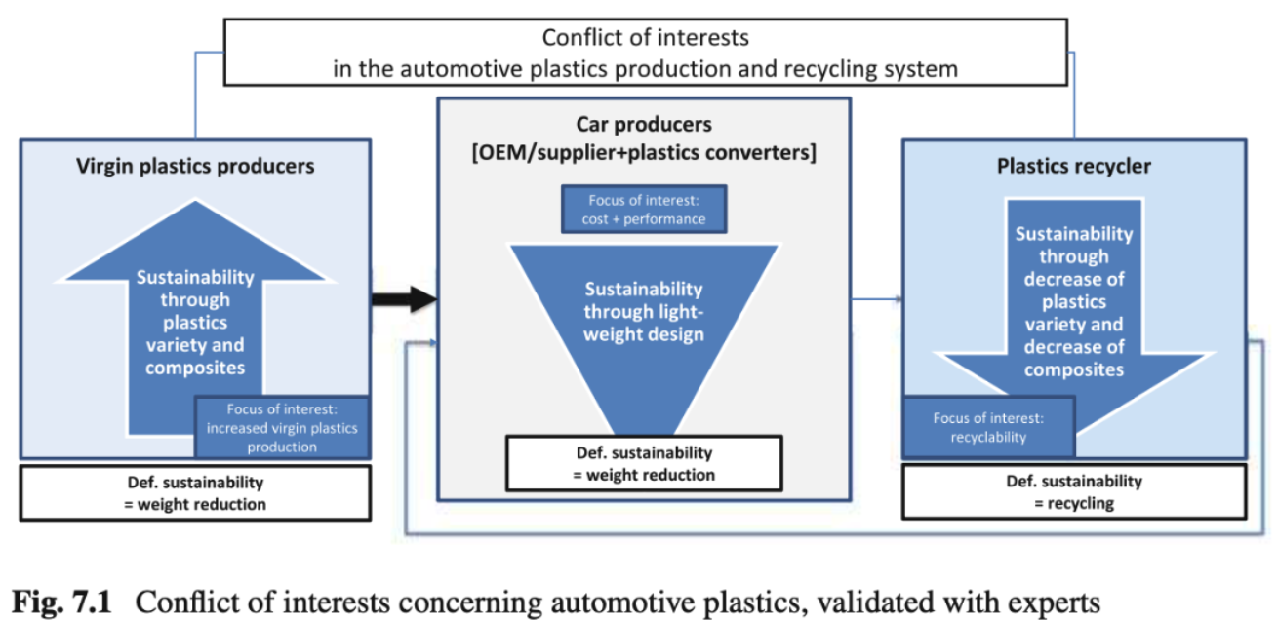

Slide 11
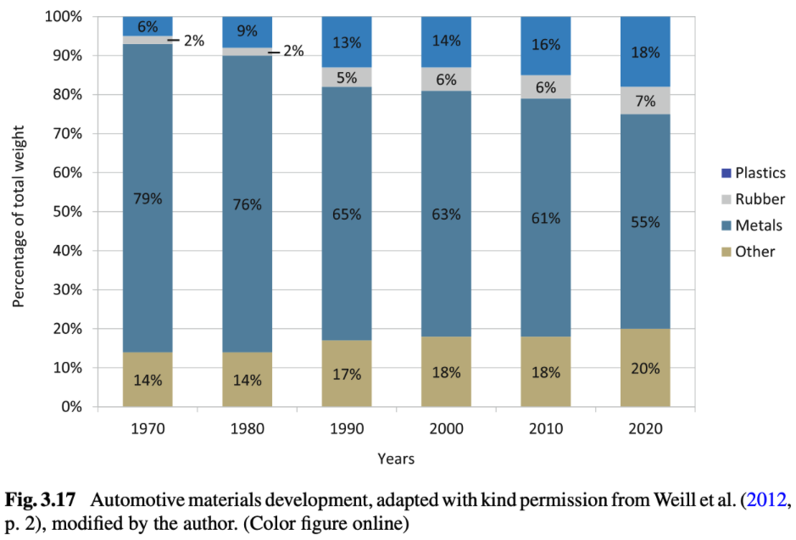

Slide 12
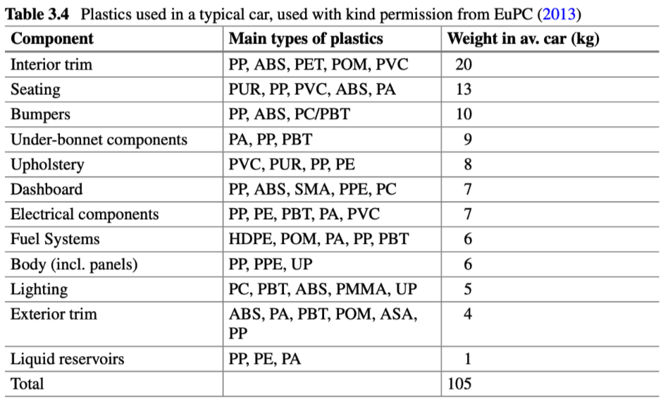
SMA styrene maleic anhydride; PPE polyphenylene ether; UP Urethane plastic; ASA Acrylonitrile styrene acrylate

Slide 13
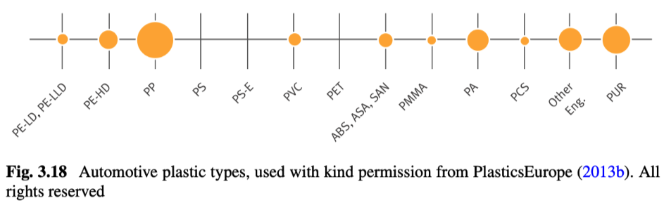
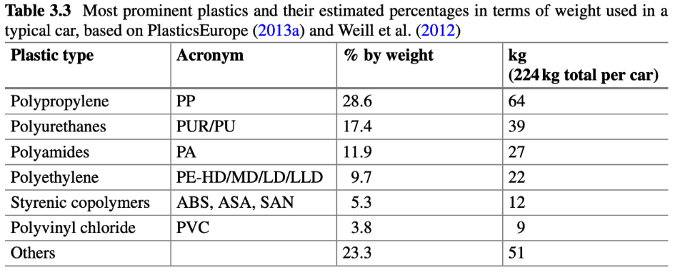

Slide 14
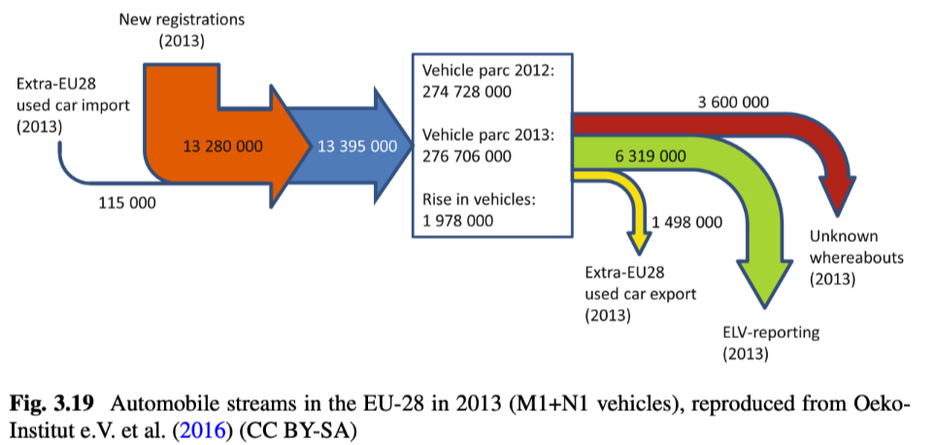

Slide 15
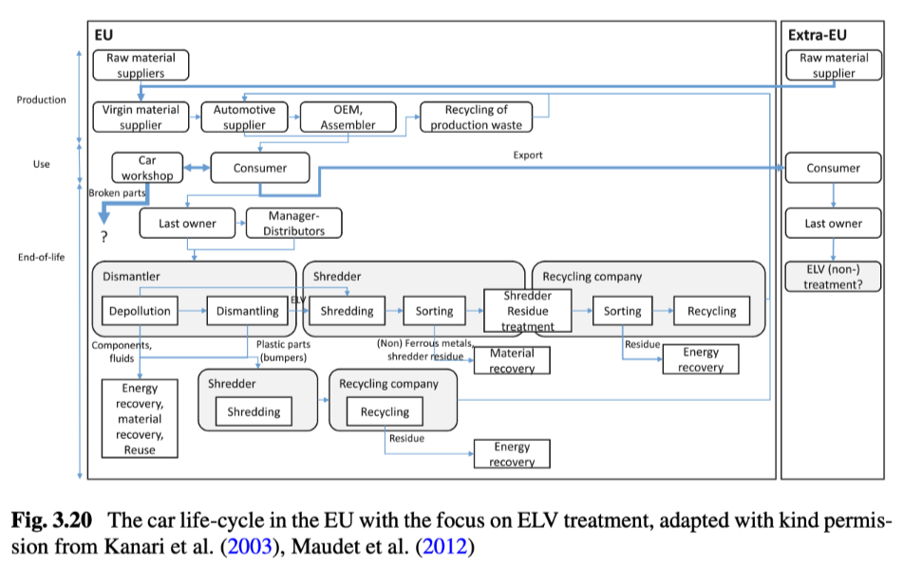

Slide 16
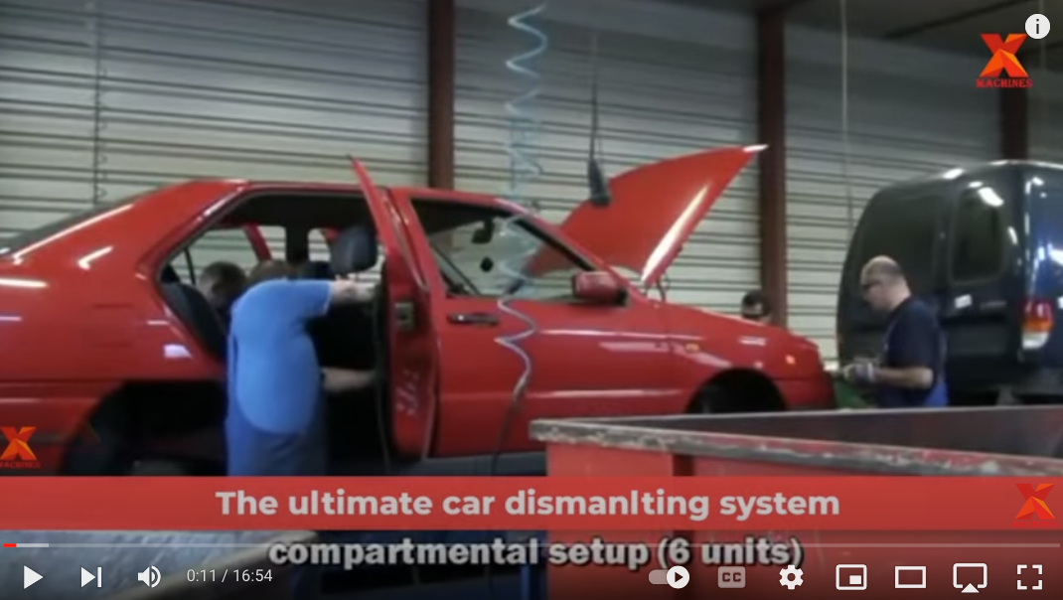
Two ways to shred a car

Slide 17
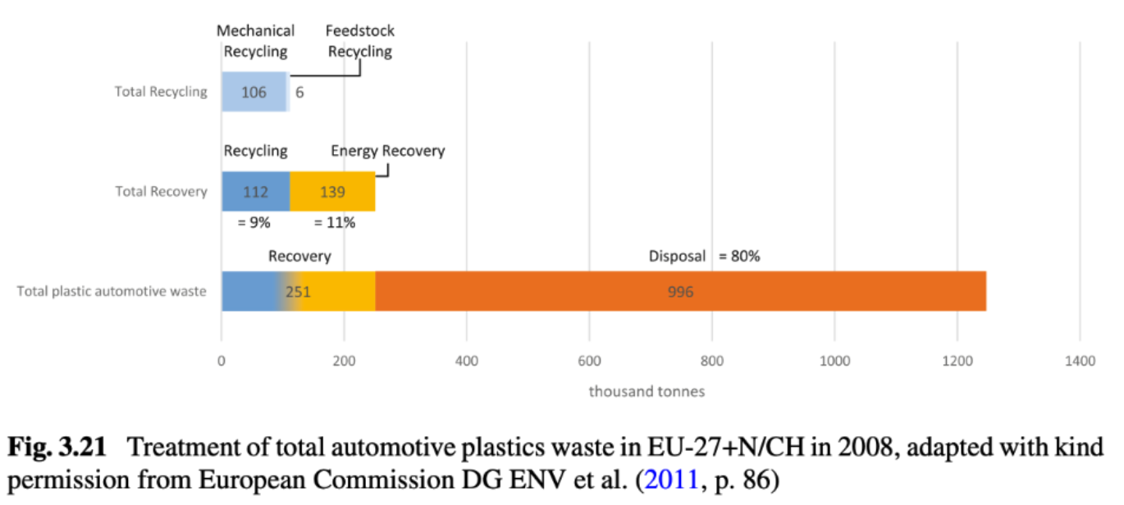

Slide 18
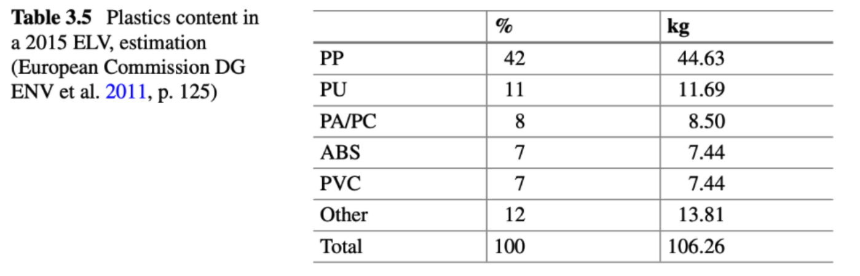

Slide 19
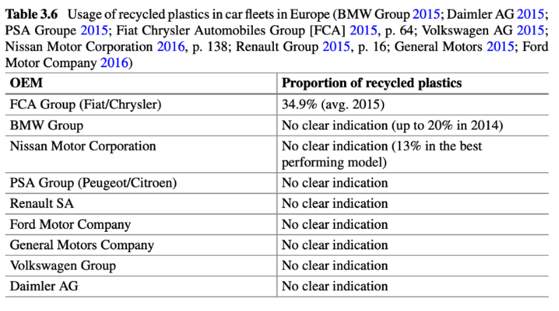

Slide 20
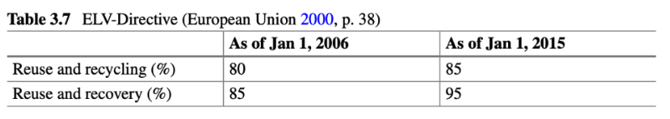

Slide 21
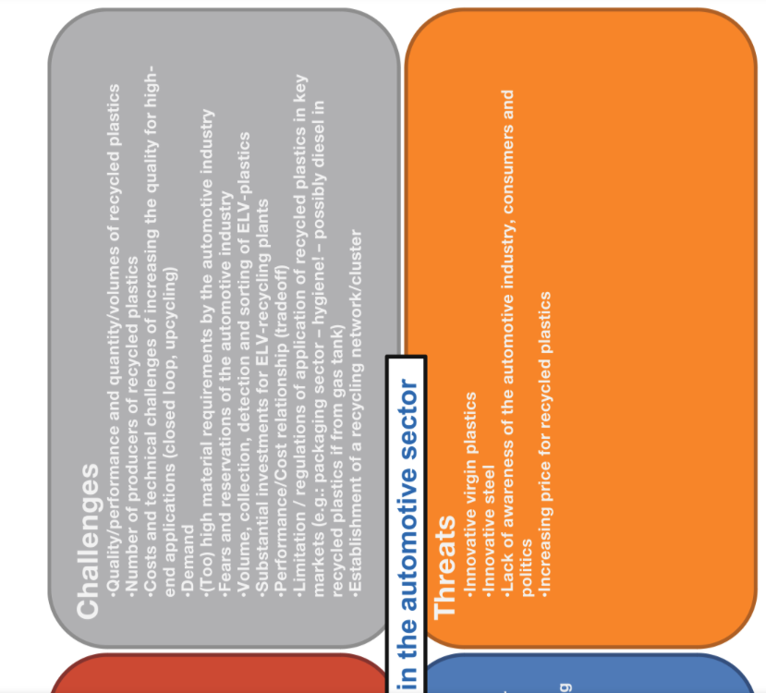
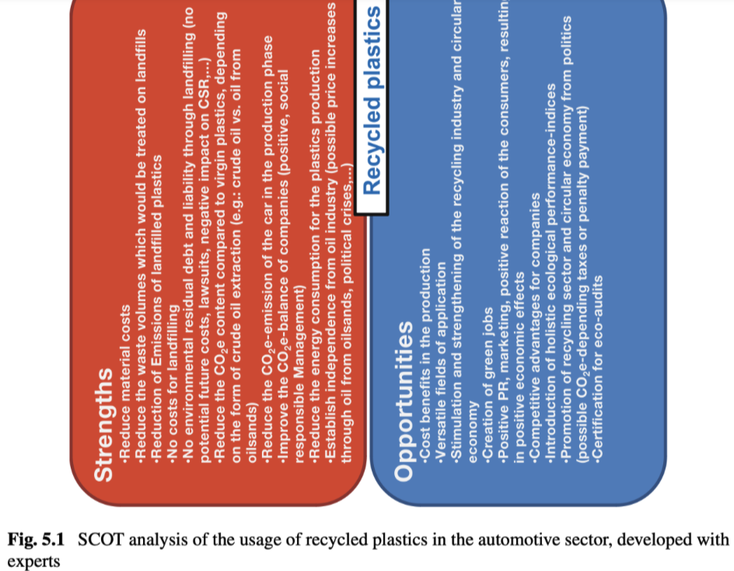

Slide 22
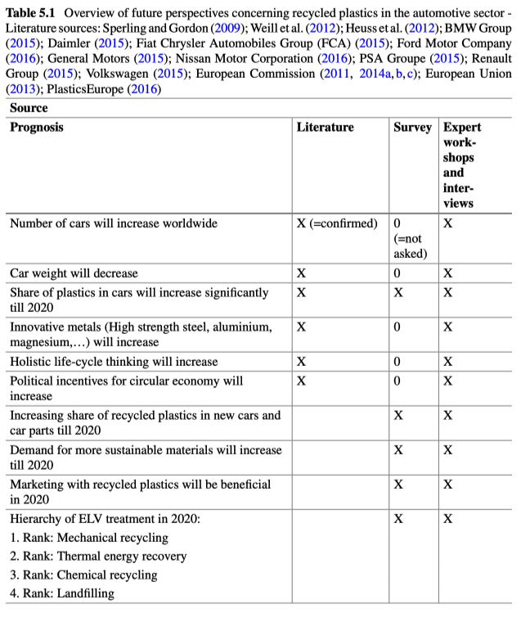

Slide 23
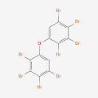
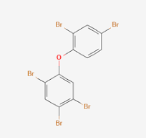
Automotive Shredder Residue, ASR (25% of End-of-Life Vehicles (ELVs))
May/probably contain bromine flame retardants (BFRs)
Hexabromodiphenyl ether and heptabromodiphenyl ether (also known as octabromodiphenyl ether or commercial octaBDE which is a commercial mix of several types of BDEs); used as a flame retardant for some acrylonitrile-butadiene-styrene (ABS) thermoplastics particularly for those used for electronic goods such as computer monitor and television casings, photocopiers, microwave ovens, laptops, and printers. Also used in coatings and lacquers, and in polyurethane foam for auto upholstery.
b. Tetrabromodiphenyl ether and pentabromodiphenyl ether (also known as commercial pentaBDE); used predominantly in polyurethane foams for vehicles seats and fittings and foams used for furniture, mattresses, carpet underlay, and electronic equipment.
BFRs are toxic and pose a risk of causing adverse effects to human health and the environment. They are capable of long-range transport, persist in the environment, and bioaccumulate in human and animal tissue.
They have the potential to be transformed into brominated dioxins when burnt at low temperatures or when the chemicals break down. This can occur during handling, recycling or disposal. The brominated dioxins are extremely toxic and carcinogenic.

Slide 24
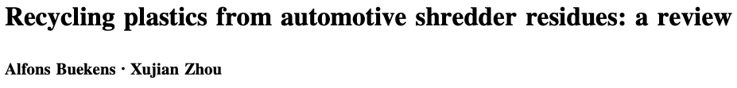
Automotive Shredder Residue, ASR (25% of End-of-Life Vehicles (ELVs))
ASR contains a variable mix of thermoplastics, rubbers, thermosets, foam, felt, fiber,
glass, metal (copper), stones, mud, wood, water, dirt
Unpredictable, useless extraneous material
Hazardous substances: Mercury, Lead, Cadmium, PCBs, BFRs
ASR is classified as hazardous
ASR is being landfilled
Sorted resins are eligible for recycling, most for pyrolysis or incineration

Slide 25
Automotive Shredder Residue, ASR (25% of End-of-Life Vehicles (ELVs))
Average at 13.7 years we reach ELV
Transfer of ELV from affluent to Africa, Asia, Eastern Europe
Scrap yard for cannibalization (systematic or upon demand)
Car wrecks are depolluted by removal of fluids, catalytic converters, batteries, PCBs
Systematic dismantling (rare) bumpers, cushions,
Shredder (1950s to now) result in fist size metal, fine shredder dust (aluminum/magnesium/plastics), dense shredder dust
Fiber glass bodies, hybrid and EVs are a problem for conventional shredders

Slide 26
Automotive Shredder Residue, ASR (25% of End-of-Life Vehicles (ELVs))
Switzerland, Japan and later the Netherlands pioneered pyrolysis for ASR. EU followed.
ELV Directive of the European Parliament and of the Council of 18 September 2000 on end-of- life vehicles 2000/53/EC [10, 11, 16];
Directive 2000/76/ EC (December 4, 2000) on the incineration of waste [17];
Directive 1999/31/EC (April 26, 2000) on the disposal of waste in landfills [18].
EU Regulation on Registration, Evaluation, Authorisation, and Restriction of Chemical substances (REACH, 2007) [19, 20], to protect people and the environment from chemical hazards, impacts the potential recycling of automotive materials.

Slide 27
Automotive Shredder Residue, ASR (25% of End-of-Life Vehicles (ELVs))
EU regulations:
Carmakers must reduce their use of hazardous substances (mercury, hexavalent chromium, cadmium, or lead) when designing and producing vehicles.
Producers must use International Organization for Standards (ISO) guidelines for labelling and identification of vehicle components suitable for reuse and recovery and meet the costs for collection and recovery.
EU Member States are required to establish collection systems for ELVs and ensure that all vehicles are transferred to authorised treatment facilities, through a system of vehicle deregistration based on a certificate of destruction.
The last holder of an ELV may dispose of it free of charge (free take-back).
Vehicle dismantlers must obtain permits to handle ELVs.
Storage and treatment of ELVs are strictly controlled through de-pollution procedures and designated parts removal requirements (cf. 2006/12/EC [21]).
Vehicle manufacturers compile data and report regularly to the authorities designated.
Every 3 years Member States are required to report to the European Commission on implementation.
ELV Directive (2000/53/EC) is the first Extended Producer Responsibility Law (EPR)

Slide 28
Automotive Shredder Residue, ASR (25% of End-of-Life Vehicles (ELVs))
In the EU ASR is classified as hazardous waste.
Most ASR is landfilled
To a rising extent energy is recovered, mainly by co-combustion with municipal solid waste [22] or in cement kilns.

Slide 29
Automotive Shredder Residue, ASR (25% of End-of-Life Vehicles (ELVs))
Japan:
Retrieve CPCs, airbags, and ASR
Car producers own recycling companies
Consumers pay at purchase for recycling
South Korea:
Car producers and importers responsible for ELV
US:
“Product Stewardship” calls for ”shared responsibility”. No mandates.
Some industrial groups have formed to address the problem, ASR hasn’t been specifically addressed

Slide 30
Automotive Shredder Residue, ASR (25% of End-of-Life Vehicles (ELVs))
Car Crushing
Decontamination: Removal of fluids and batteries etc
Flattening: crushing of car
Bailing: Ship bails to shredding plant (hopefully)

Slide 31
Automotive Shredder Residue, ASR (25% of End-of-Life Vehicles (ELVs))
Shredding Process
Remove Recoverable Parts: wheels and tires, steering columns, fenders, radios, engines, starters, transmissions, alternators, selected plastic parts and components, air bags, glass, foams, catalytic convertors, mercury switches, bumpers, cushions, dashboards
Shredder: fist size wrinkled plates of steel and light fluff (ASR and light weight metals) and heavy fluff (steel fragments and other metals)
Light fluff: magnetic separation followed by eddy current separators for aluminum and other nonferrous metals.
Heavy fluff: sink float separators for different metals and plastic-coated wires etc.

Slide 32
Automotive Shredder Residue, ASR (25% of End-of-Life Vehicles (ELVs))
ASR Composition:
Residual ferrous and non- ferrous metals (5–23 %),
plastics (20–49 %),
rubber (3–38 %),
textile and fibre material (4–45 %),
wood (2–5 %),
and glass (2–18 %)
0.7 to 25 % moisture
18 to 68 % ash
14 to 30 MJ/kg for fuel
plastics (ca. 38 MJ/kg)
rubber (23 MJ/kg)
textiles (17 MJ/kg)
ASR Classification:
Light fluff, generated during shredding, following spontaneous air classification (75 % of ASR; 10–24 % of the ELV)
Heavy fluff, remaining after metal separation from the heavy shredded fraction (25 % of ASR; 2–8 % of the ELV)
Fine soil and sand are sometimes reported separately, but usually part of the heavy ASR (\2.5 % of the ELV)

Slide 33
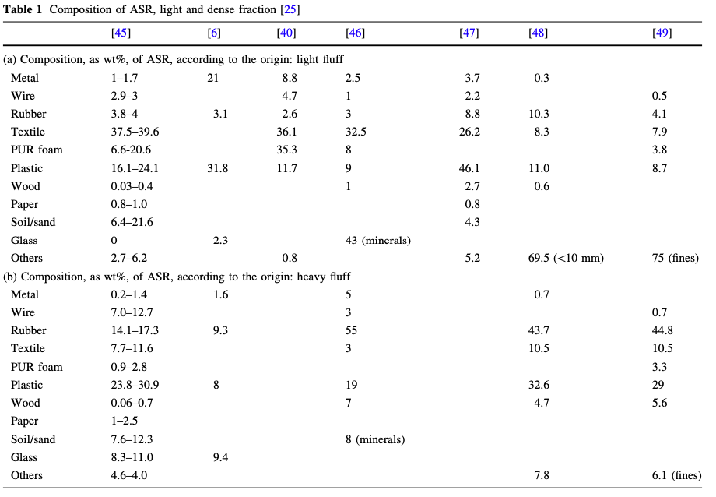
Automotive Shredder Residue, ASR (25% of End-of-Life Vehicles (ELVs))

Slide 34
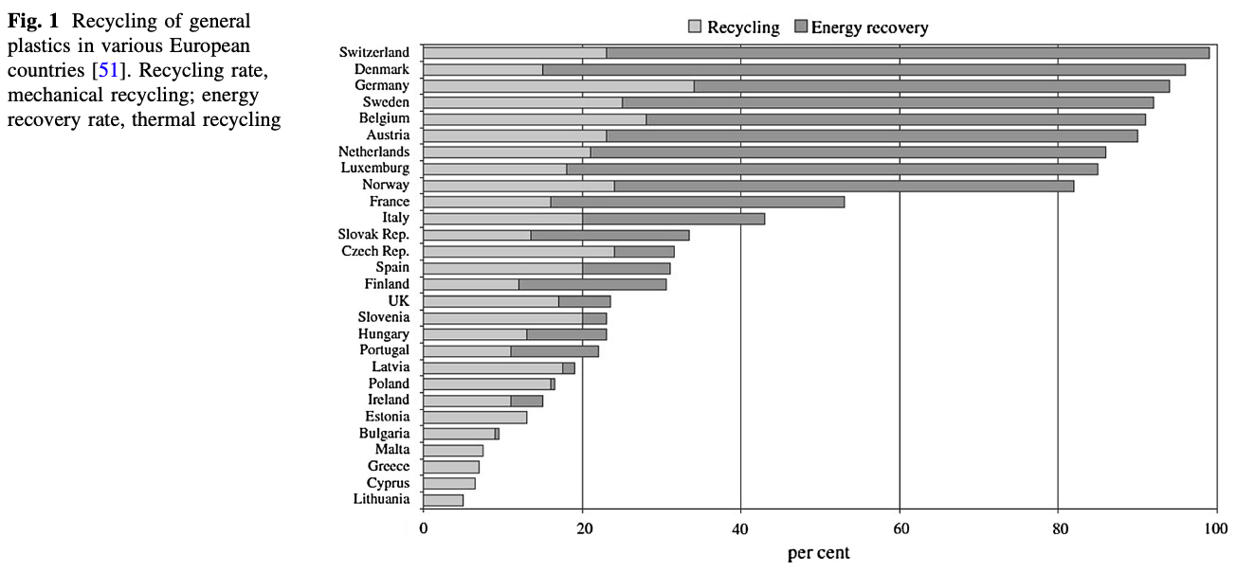
Automotive Shredder Residue, ASR (25% of End-of-Life Vehicles (ELVs))

Slide 35
Automotive Shredder Residue, ASR (25% of End-of-Life Vehicles (ELVs))
Sorting of ASR
liberate large pieces of metal,
the mixed plastics are classified and a light fraction is sorted out.
subsequent wet separation allows sorting it into different subfractions, graded according to their density.
then the ABS-PS (styrenics sinks in water) and PE-PP concentrates (polyolefins float) are mechanically and thermally dried.
remaining metal and other conductive contaminations are subsequently separated, using hamos electrostatic separators.
downstream electrostatic separators convert the ABS-PS or PE-PP mixtures into separate fractions.
if required, light-colored plastics fractions can be produced using optical-electronic sorting.
WEEE-plastics can be treated similarly

Slide 36
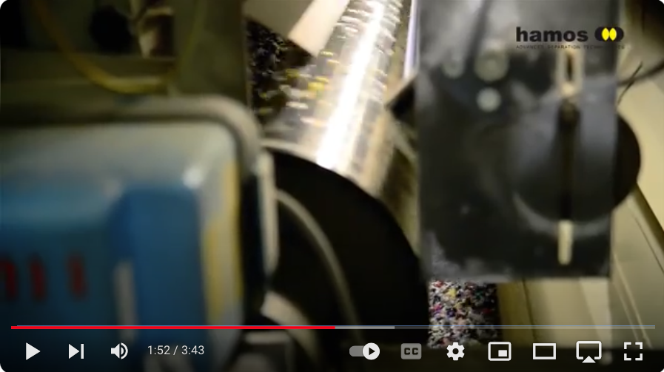
Automotive Shredder Residue, ASR (25% of End-of-Life Vehicles (ELVs))
https://www.youtube.com/watch?v=bmk-lQieQdg

Slide 37
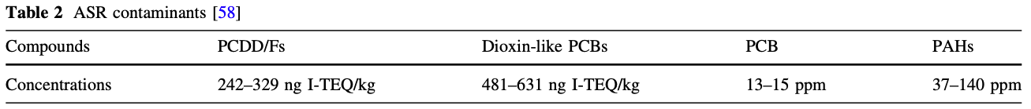
Automotive Shredder Residue, ASR (25% of End-of-Life Vehicles (ELVs))
Co-incineration with limited addition of few per cent ASR to another main-stream is feasible without violating emission standards.
ASR typically contains significant amounts of chlorine (Cl), sulphur (S), nitrogen (N), and a wide range of heavy metals.
Polychlorinated dibenzodioxins PCDD
Polychlorinated dibenzofurans
Polychlorinated biphenyls

Slide 38
Automotive Shredder Residue, ASR (25% of End-of-Life Vehicles (ELVs))
Heavy metals of miscellaneous origins.
Various paint pigments, plastics additives, and corrosion products bring in a number of heavy metal compounds;
brominated flame retardants (BFRs), e.g. from printed circuit boards or car cushions are routinely accompanied by antimony oxides.
Mercury used in switches, relays, and gas discharge lamps,
Shredding a single lead battery would impregnate a lot of ASR with lead and its oxides.
zinc (Zn, 2.10 %),
copper (Cu, 1.85 %),
lead (Pb, 0.26 %),
chromium (Cr, 0.16 %),
nickel (Ni, 0.12 %),
antimony (Sb, 230 ppm),
cadmium (Cd, 77 ppm),
mercury (Hg, 3 ppm)

Slide 39
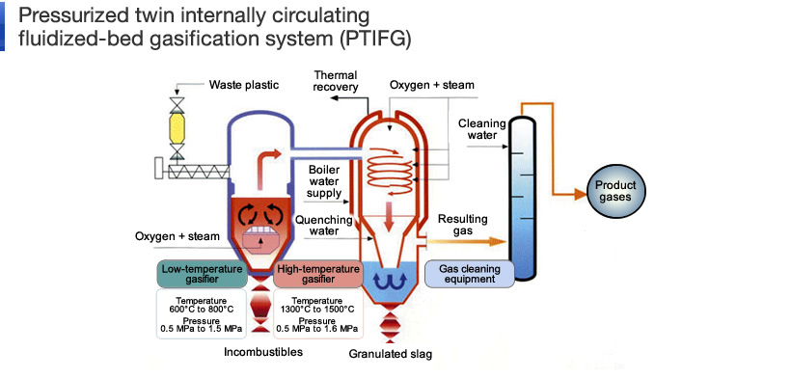
Automotive Shredder Residue, ASR (25% of End-of-Life Vehicles (ELVs))
https://www.eep.ebara.com/en/business_technology/technology_3.html

Slide 40
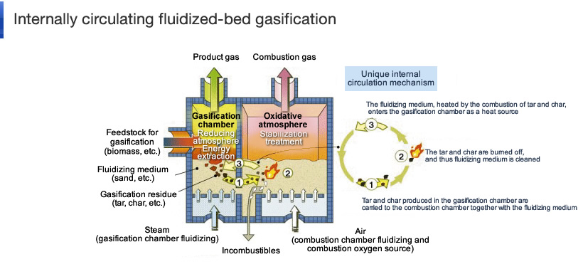
Automotive Shredder Residue, ASR (25% of End-of-Life Vehicles (ELVs))
https://www.eep.ebara.com/en/business_technology/technology_3.html

Slide 41
Automotive Shredder Residue, ASR (25% of End-of-Life Vehicles (ELVs))
ASR Incineration
burning ASR directly, recovering some supplemental metal from incinerator residue and possibly even from fly ash.
technical and environmental factors.
Tested in 1980s with Belgian shredder enterprise (IWONL/IRSIA R&D-project), but due to its high calorific value and melting characteristics the ASR burned too fiercely, leading to uncontrollable combustion, local lack of oxygen, agglomeration of burning ASR, and carry-over of unburned fines

Slide 42
Automotive Shredder Residue, ASR (25% of End-of-Life Vehicles (ELVs))
Co-incineration can be conducted in a wider range of incinerator categories, such as mechanical grate furnaces, fluidised bed and vortex combustors, rotary kilns, and cement kilns.
Such solutions are called Solution by Dilution by operators of duly licensed hazardous waste incinerators.

Slide 43
Gasification of ASR:
Fluidized bed gasification (Winkler, Leuna Werke, Germany) at unusually low temperature (750–900 °C). An air factor was used of 25–40 % of the stoichiometric combustion air requirements: partial combustion of char supplies the heat required for autothermal operation. Gasification of carbon with steam or carbon dioxide is still slow below 850 °C. Yet, operating temperatures are restricted by weakening of the ash, leading rapidly to loss of fluidization. Air as gasification agent introduces large amounts of nitrogen in the producer gas, thereby reducing the calorific value of generator gas.
Vertical shaft gasifiers (Lurgi, Frankfurt) operate in counter-current, with rising gasification products and the charge gradually descending towards the hearth at temperatures up to 1200 °C. Air is replaced as a gasification agent by a balanced mix of oxygen and steam. Ash is tapped periodically as molten slag, unless gasification temperature is severely limited.
A rotary kiln can be used, operating at a higher ratio of (volume reacting gases)/(volume of the charge) and adding tumbling action to the charge. The Landgard partial oxidation plant of Monsanto (Baltimore, MI, USA) was scaled-up too rapidly from pilot to full-scale and fell victim to sequentially occur- ring operating problems, starting with shredder explosions, solidification of stored shredded fuel, clogging of the slag tapping hole, etc.
Co-current flow combustion of pulverized fuel (Koppers-Totzek). The reactor is simply a combustion chamber, into which several pulverized coal burners inject their incomplete combustion products. Temperatures of 1400–1600 °C are reached, so that tar conversion and a fully slagging operation is ensured.
Montecatini, Texaco, and Shell all developed processes for converting heavy fuel oil (or any pumpable fuel), injecting these together with oxygen and steam into a combustion chamber at sufficiently high temperatures. Their designs differed mainly in the methods used to separate soot particles and to recover sensible heat from the gas.

Slide 44
Automotive Shredder Residue, ASR (25% of End-of-Life Vehicles (ELVs))
Pyrolysis to monomer
Polymerization of reactive monomers, such as vinyl com- pounds or olefins and dienes, or gradual polycondensation to form polyesters and polyamides, is thermodynamically favored at low temperature. With rising temperature this trend gradually reverses and monomers become more stable than their polymers.

Slide 45
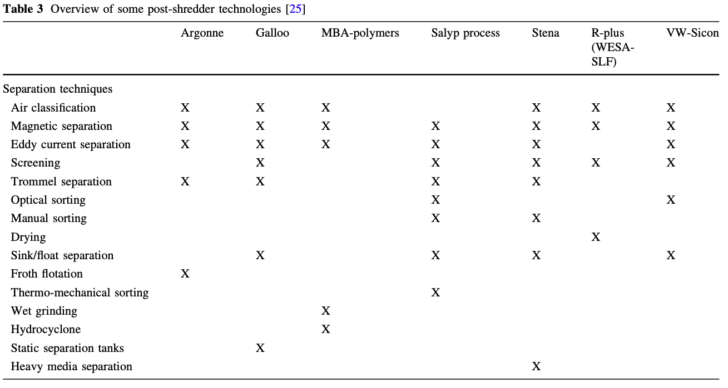
Mechanical Separation:

Slide 47
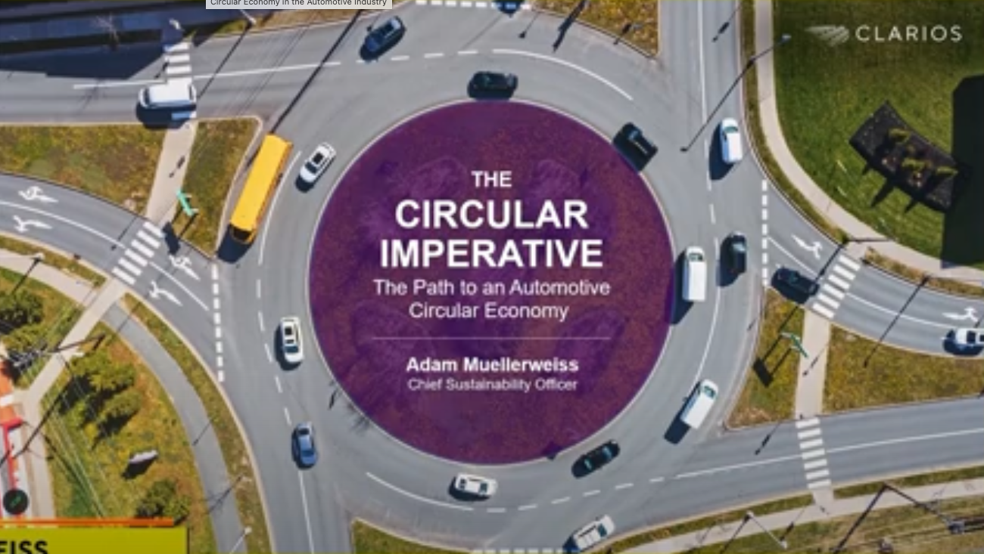

Slide 48
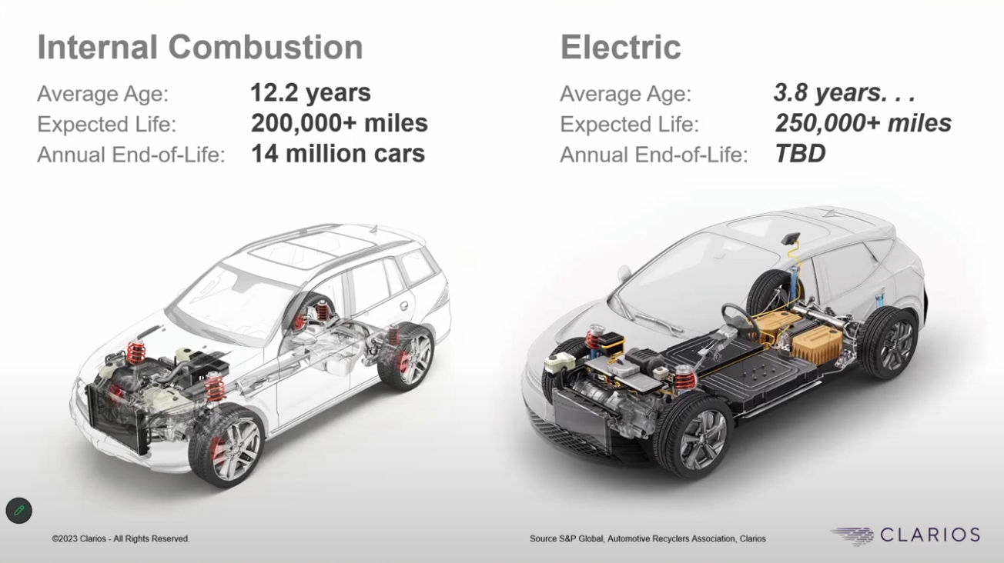

Slide 49

World
Greenhouse gas emissions

Slide 50

Population with no car

Slide 51
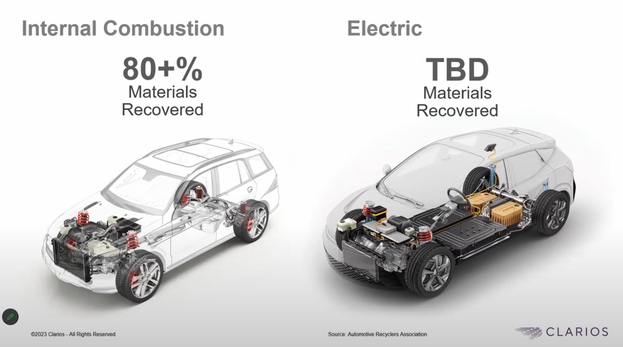

Slide 52
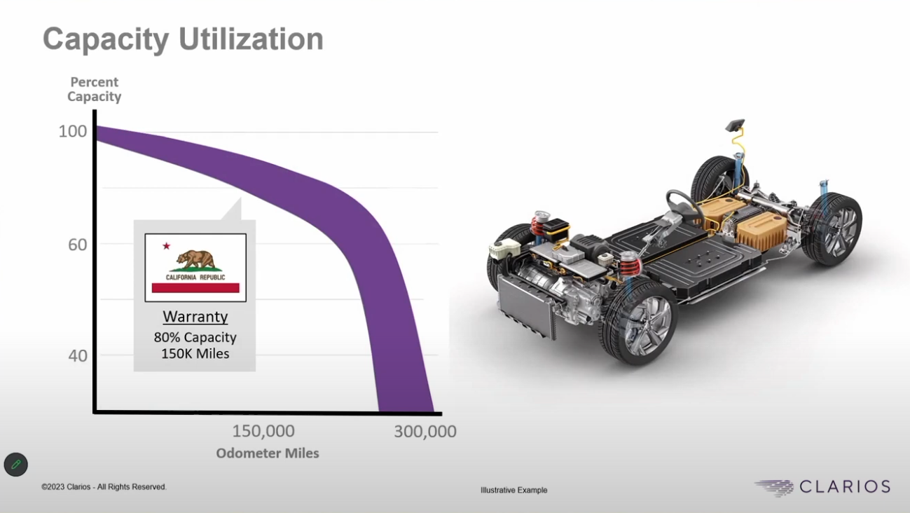

Slide 53
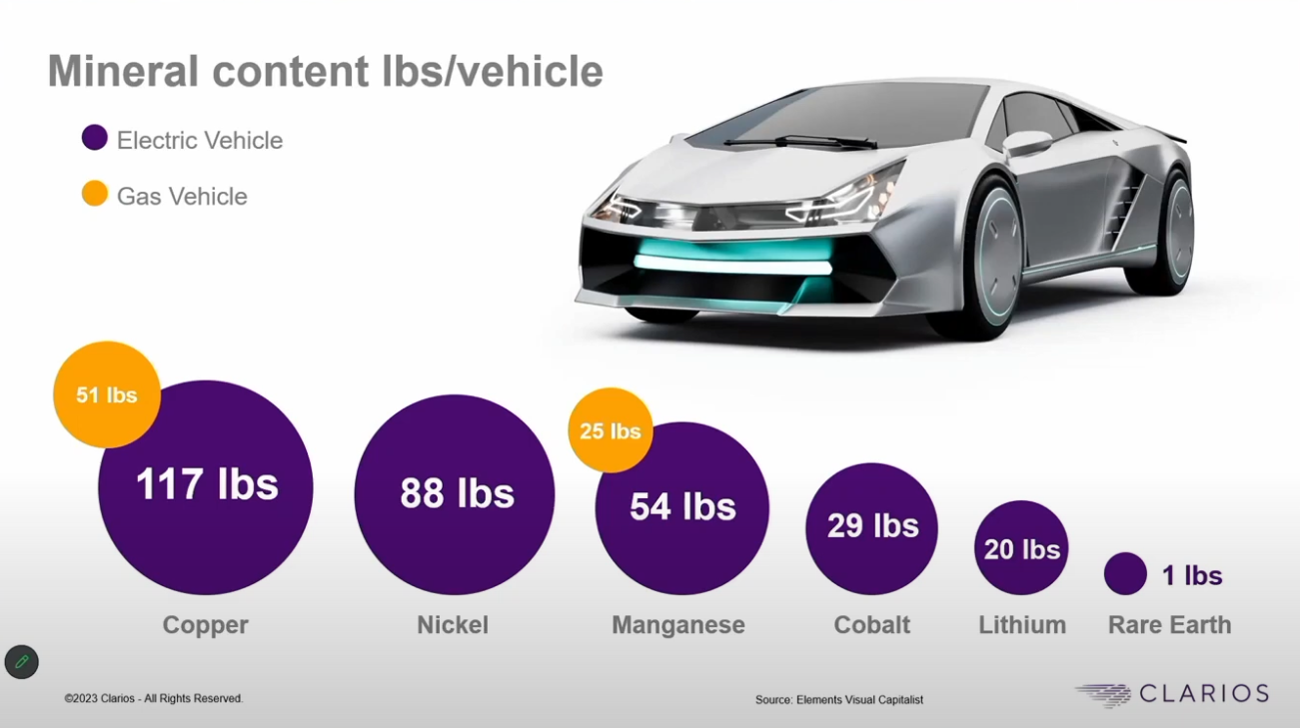

Slide 54
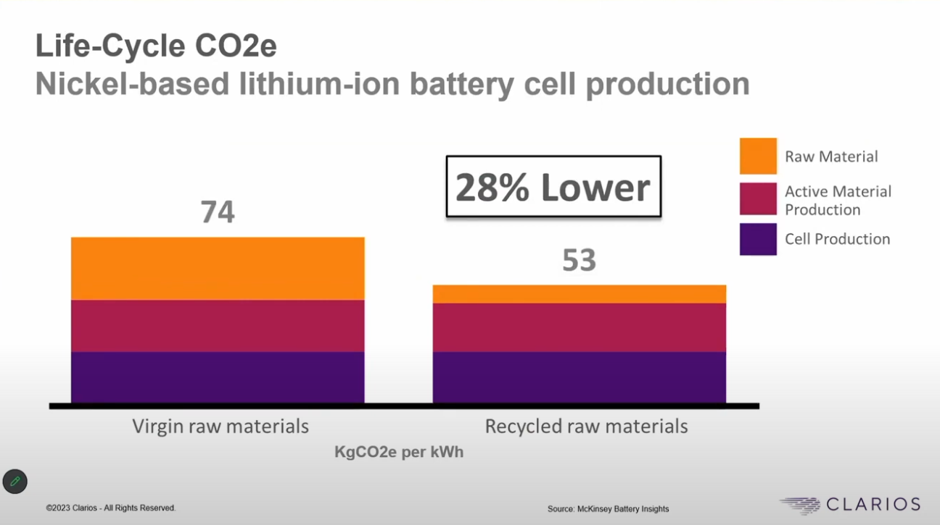

Slide 55
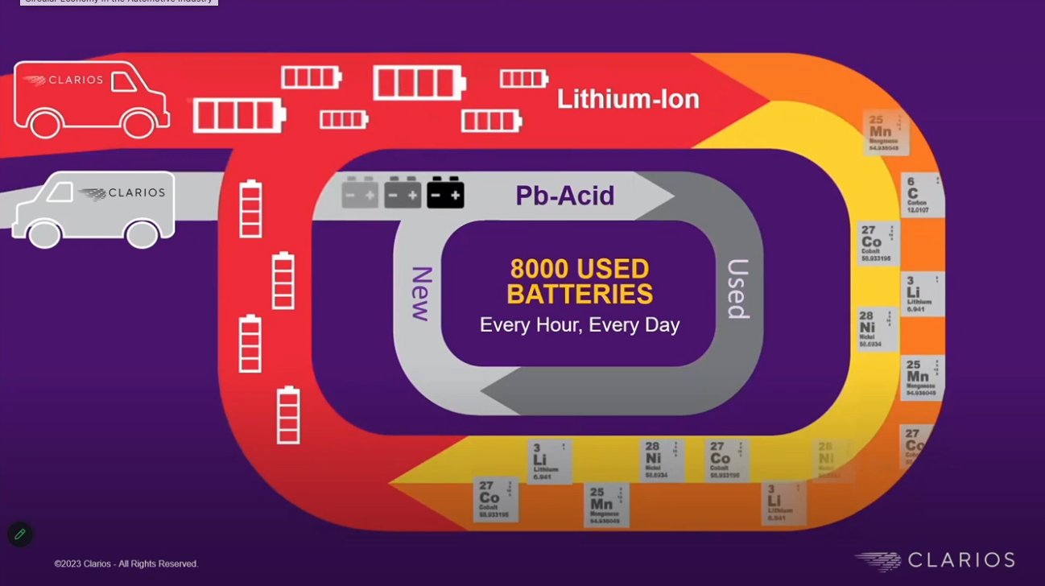

Slide 56


Slide 57
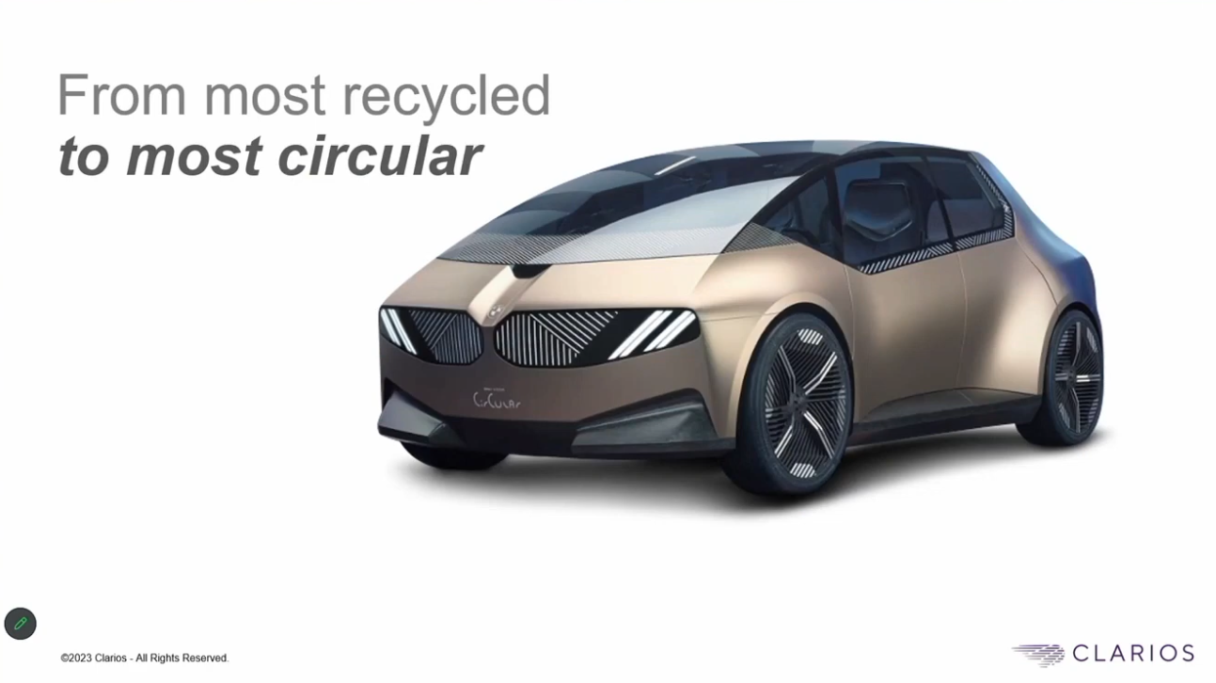

Slide 58
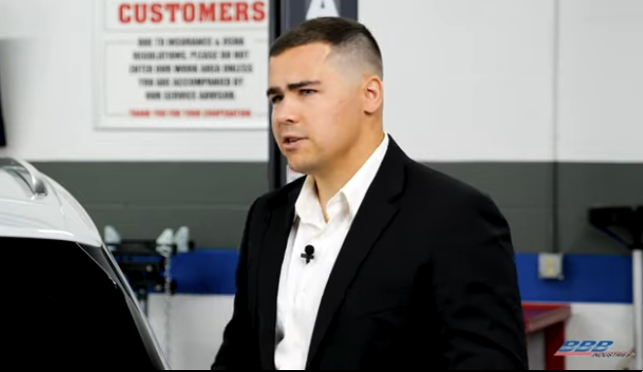
Are EVs more circular that ICEs?

