Slide 1
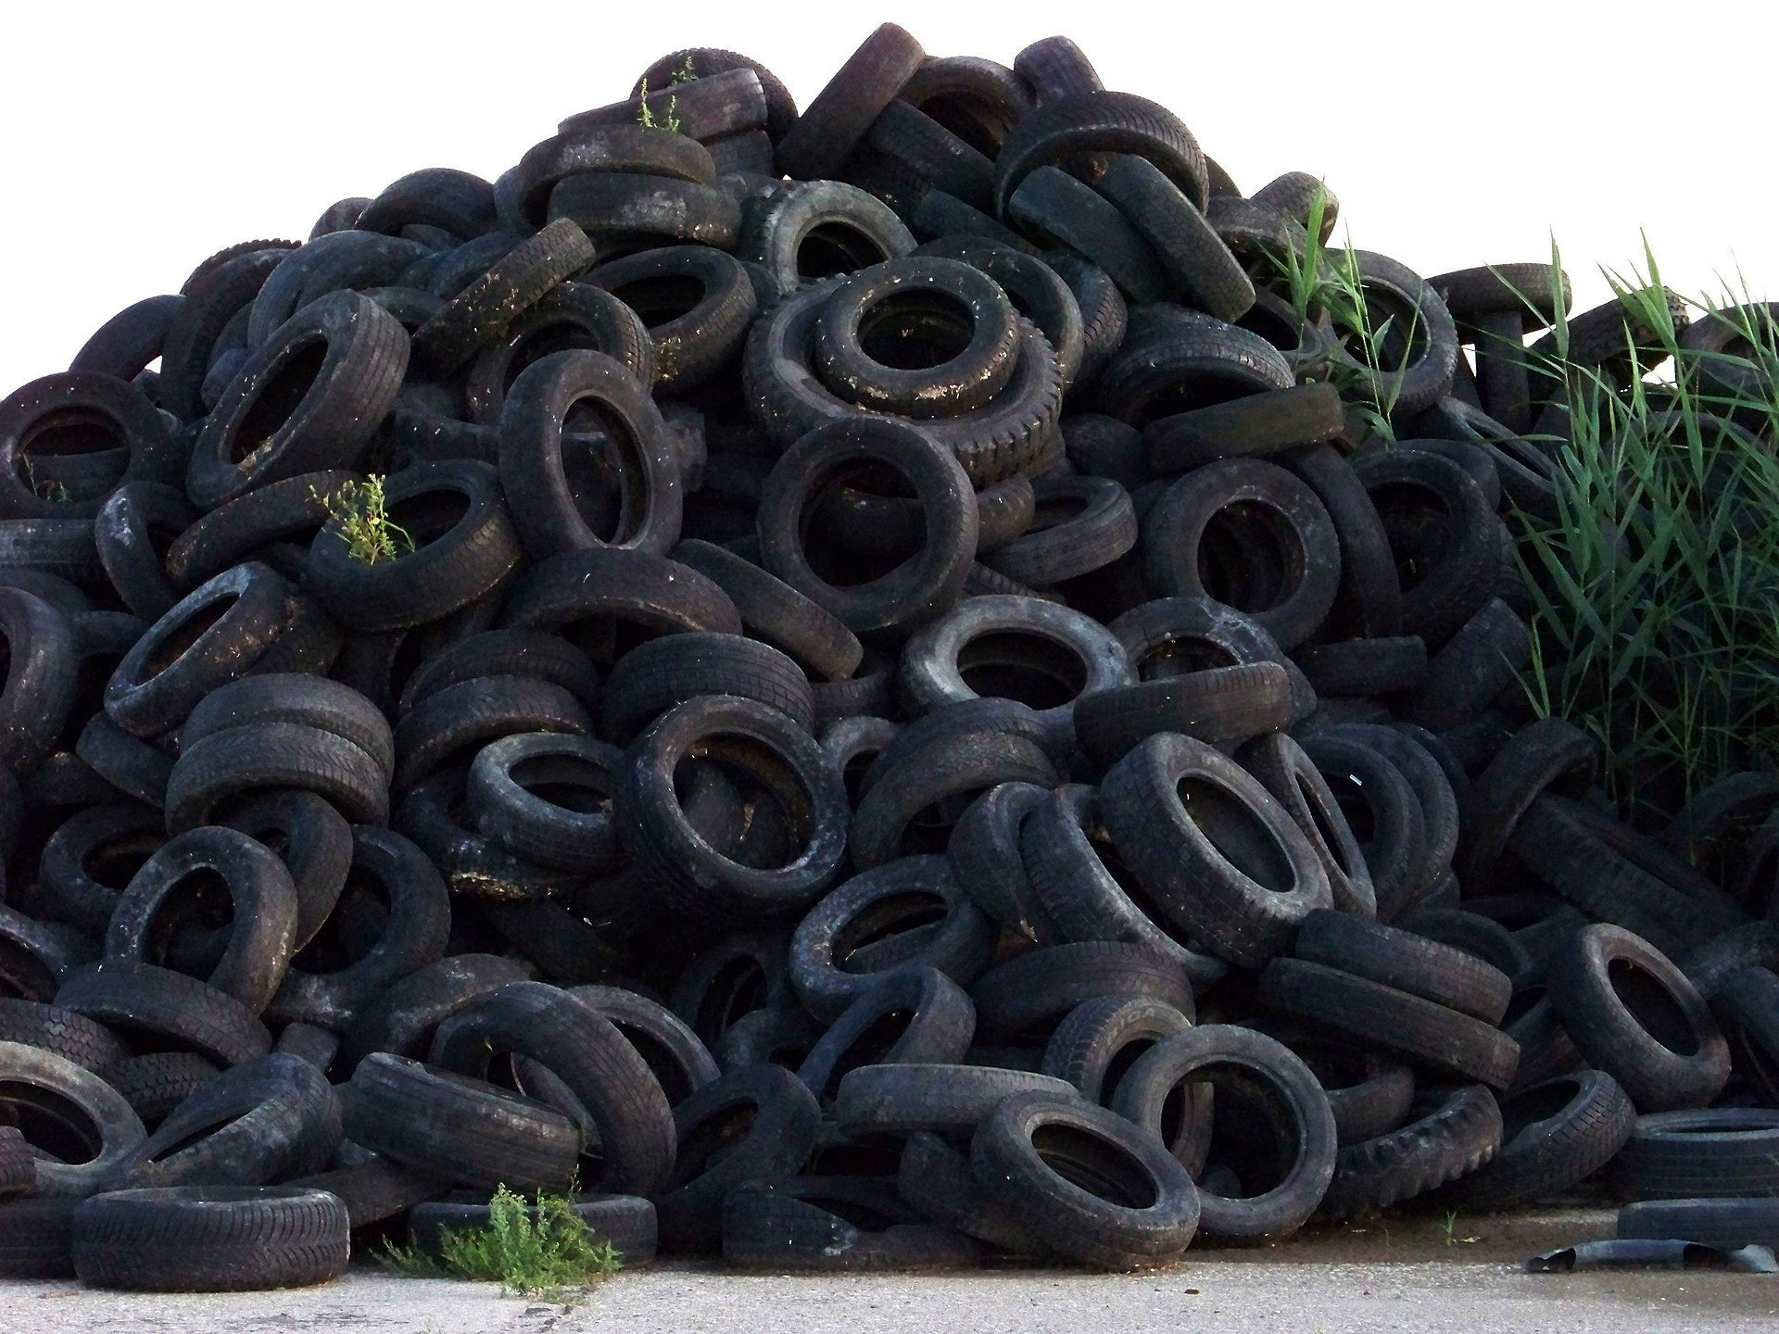
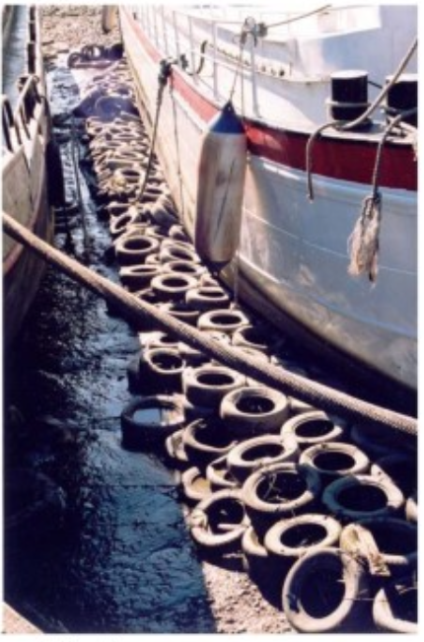
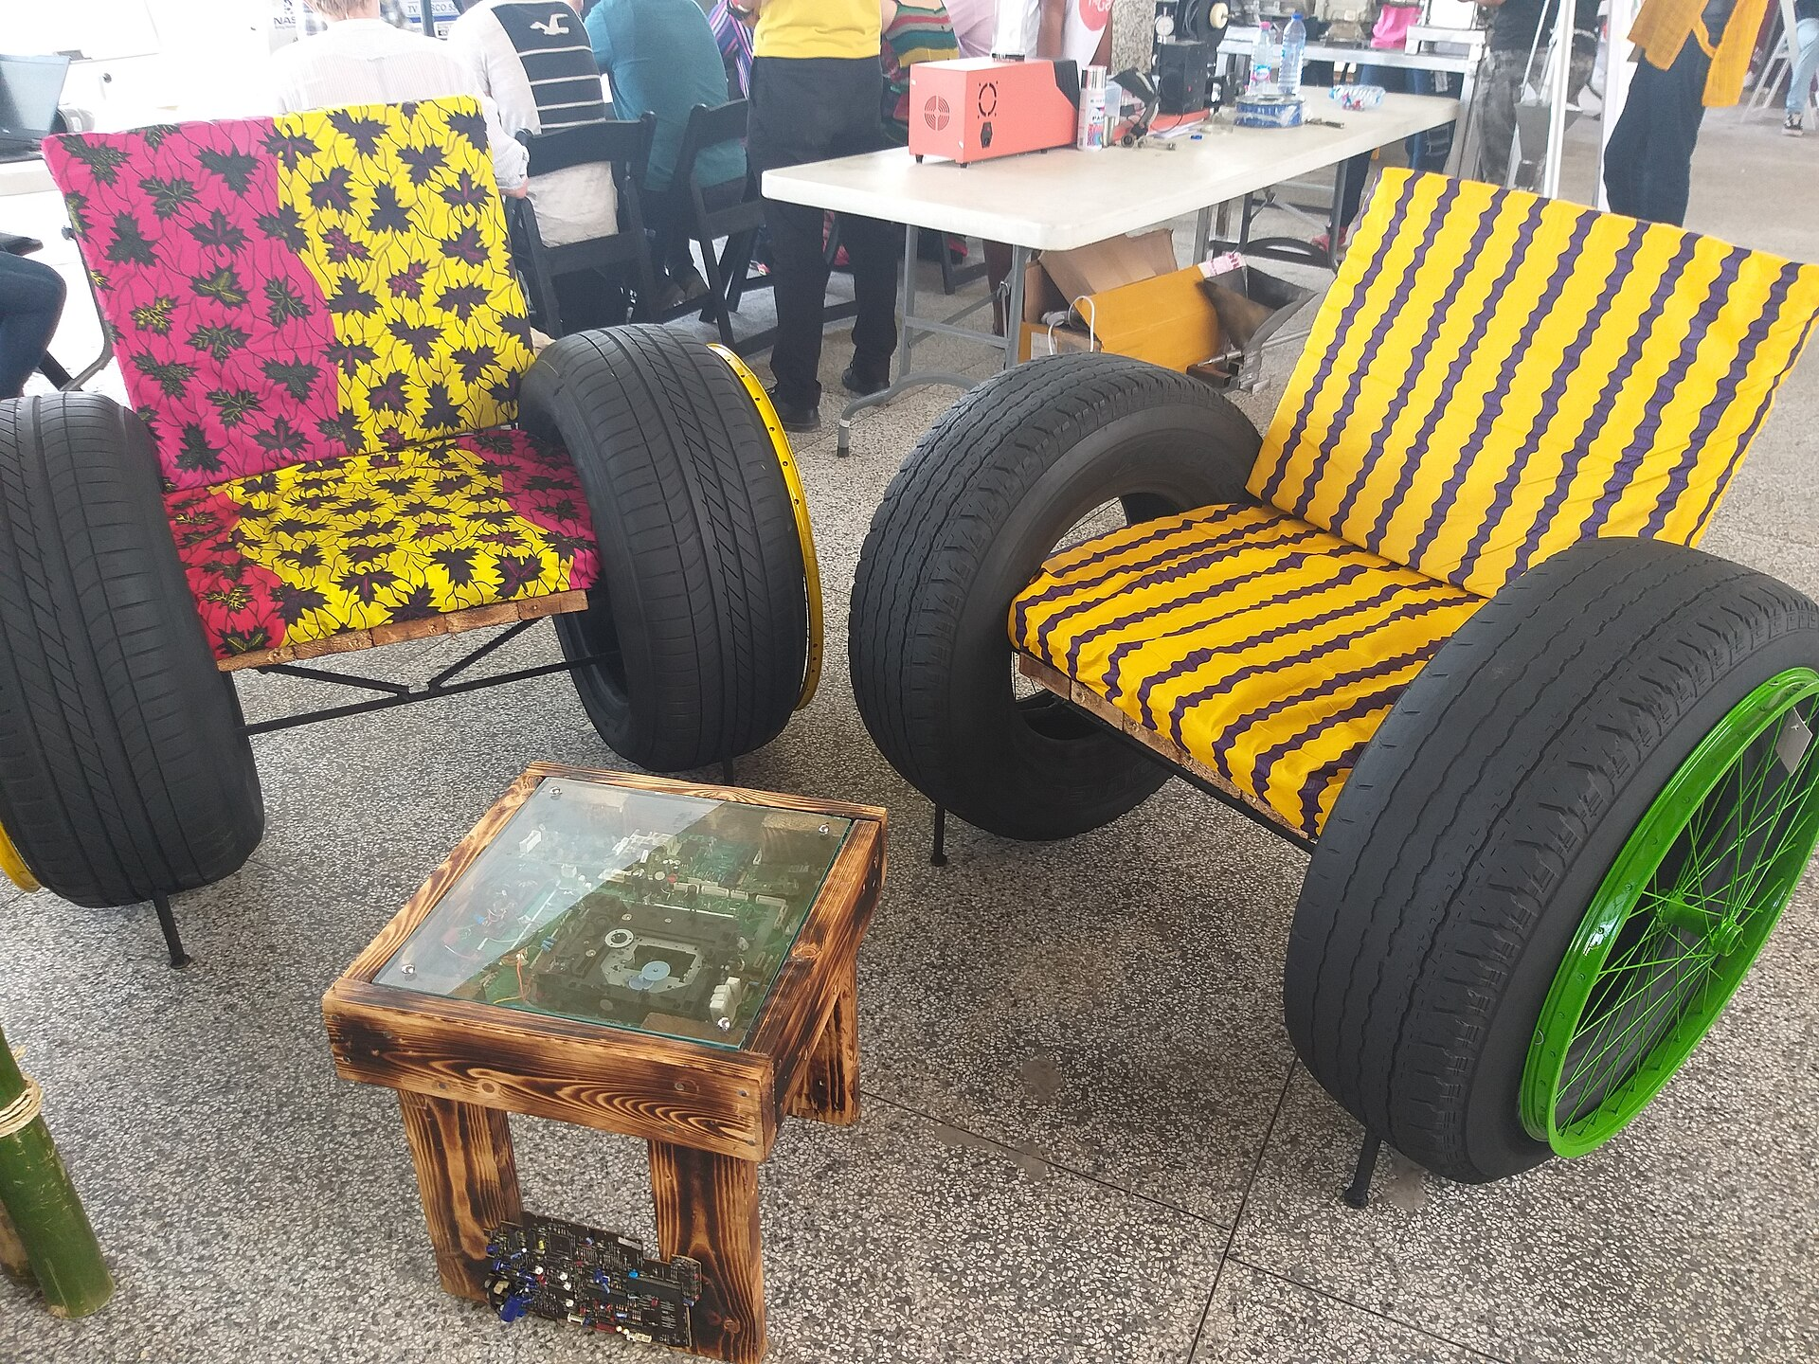
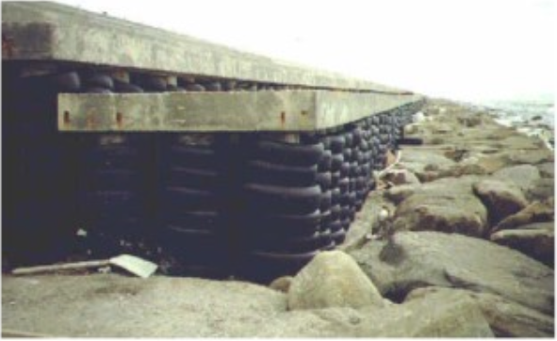
Tire Recycling

Slide 2
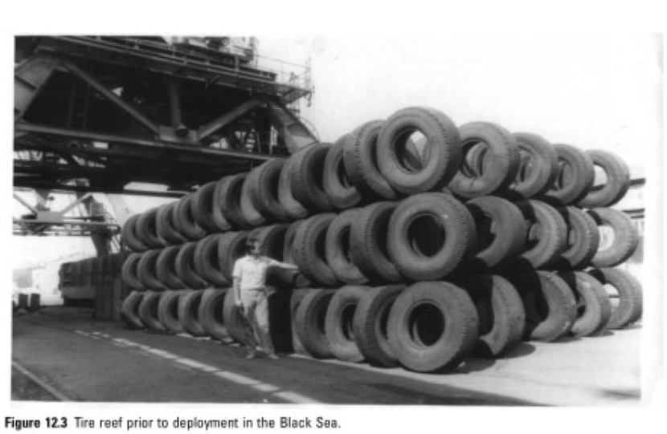
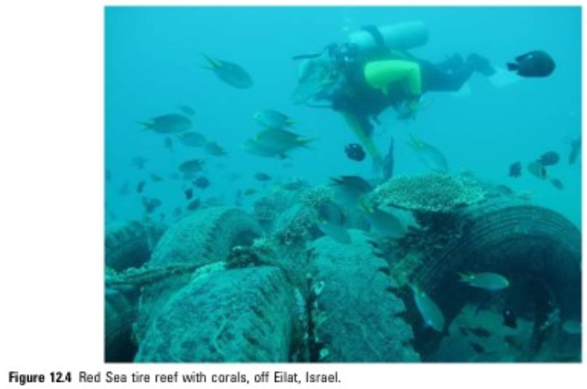
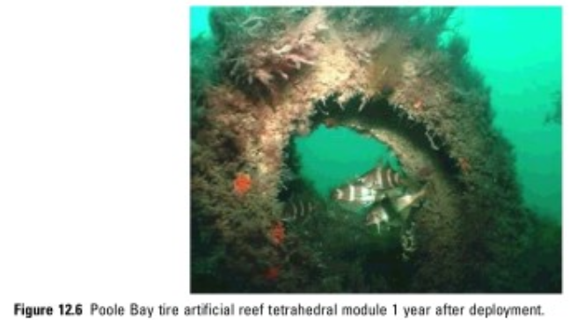
Tire Recycling

Slide 3
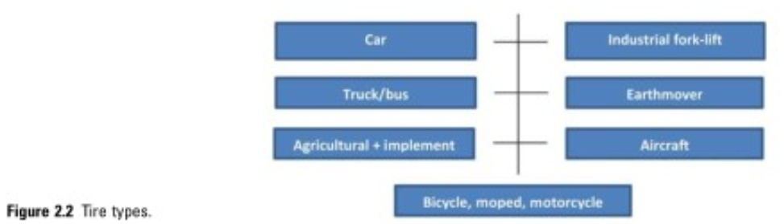
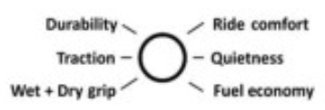
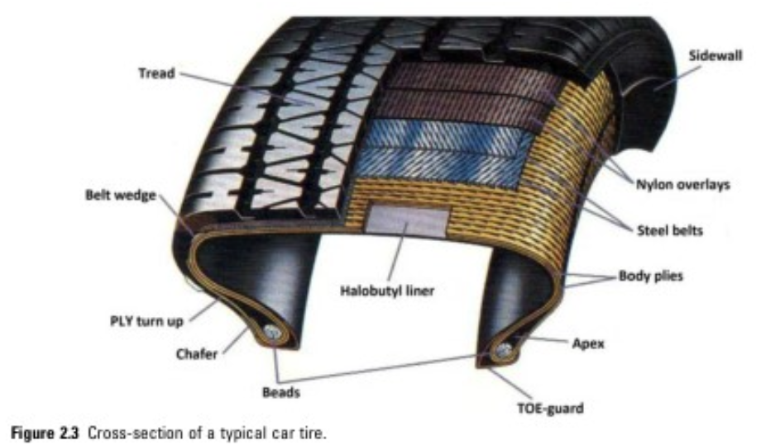
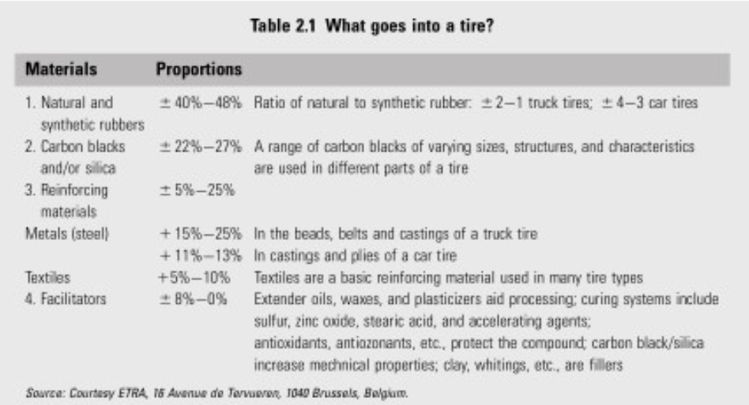
What is a Tire?

Slide 4
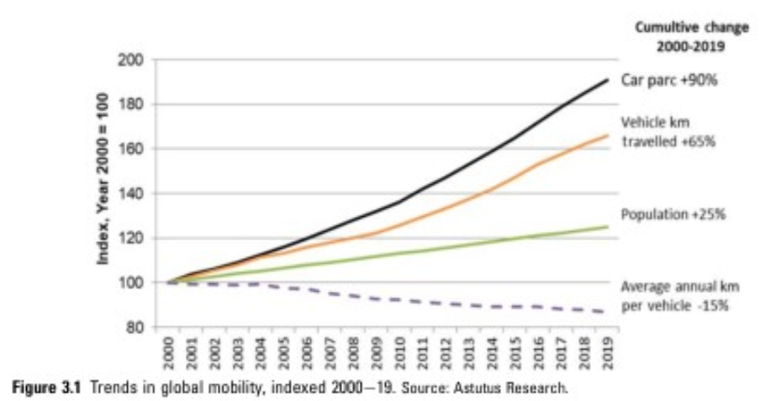
More Tires Every Year
Parc = # registered vehicles

Slide 5
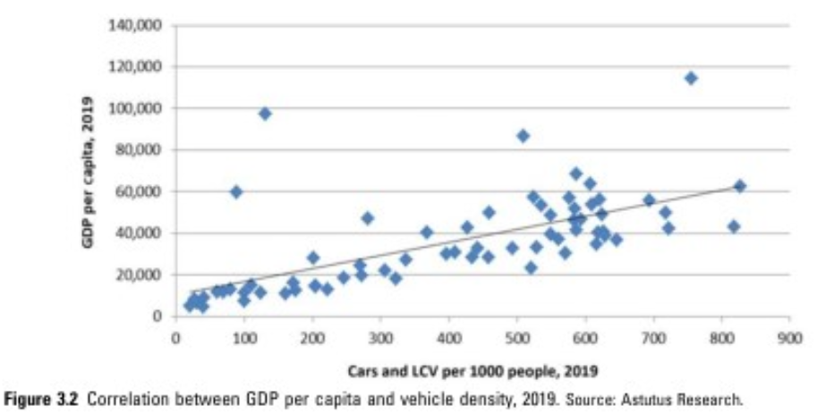
More Tires Every Year

Slide 6
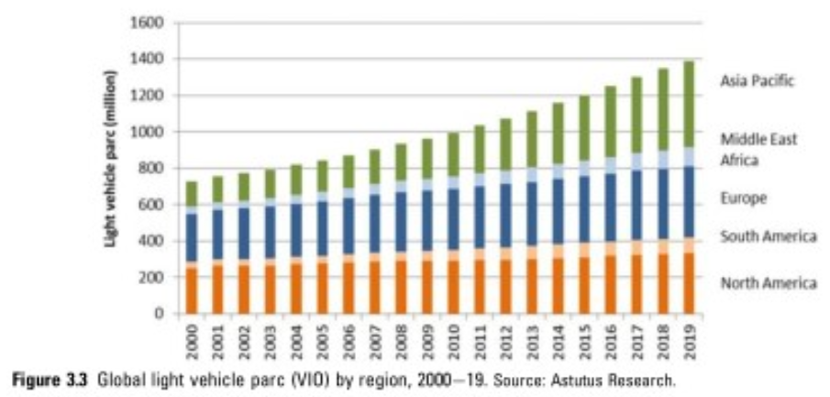
More Tires Every Year
Parc = # registered vehicles

Slide 7
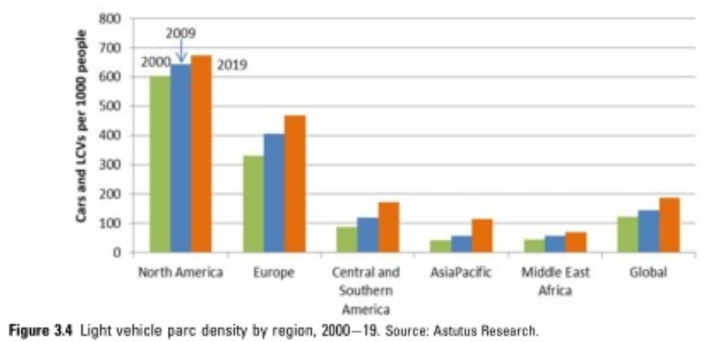
More Tires Every Year
Parc = # registered vehicles

Slide 8
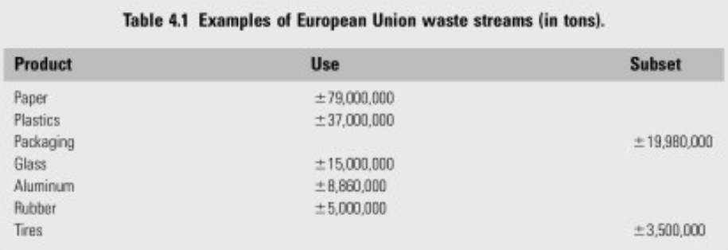
End-of-Life Tires

Slide 9
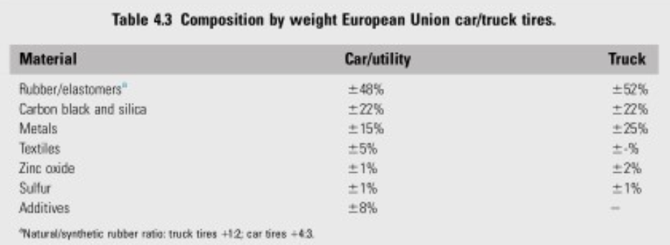
End-of-Life Tires

Slide 10
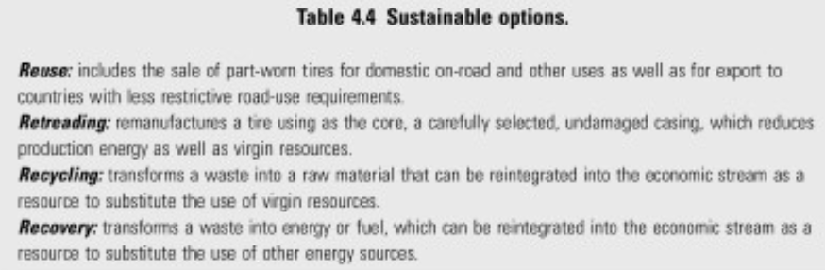
End-of-Life Tires

Slide 11
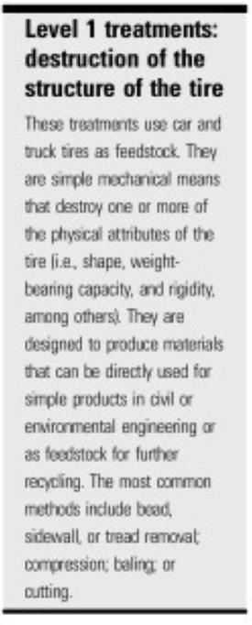
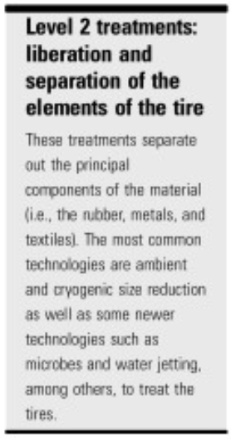
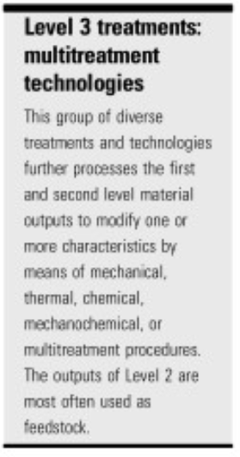
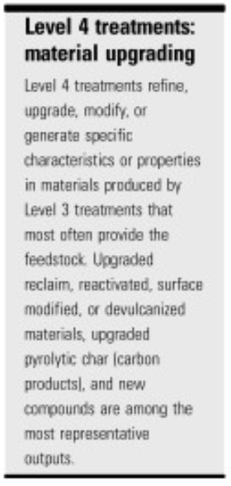

Slide 12
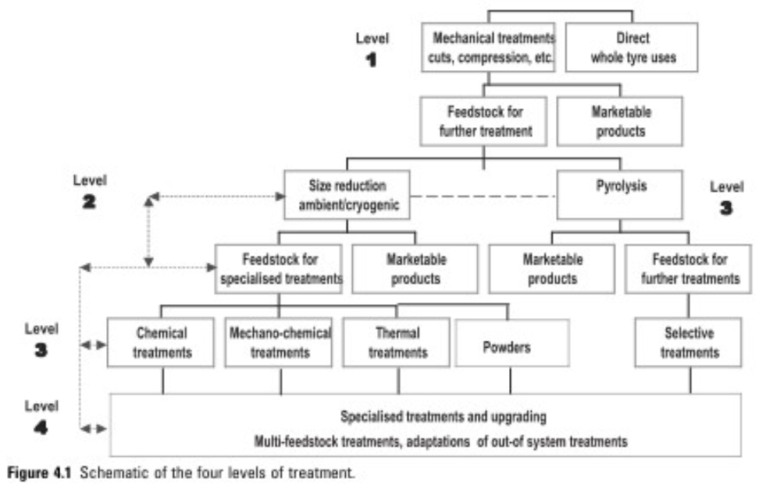
End-of-Life Tires

Slide 13
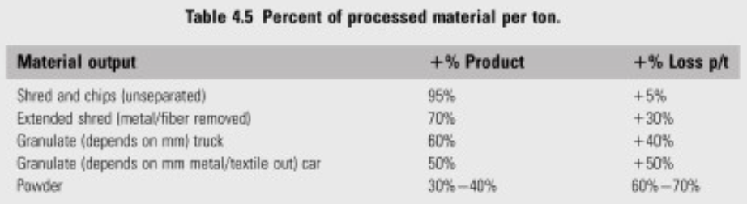
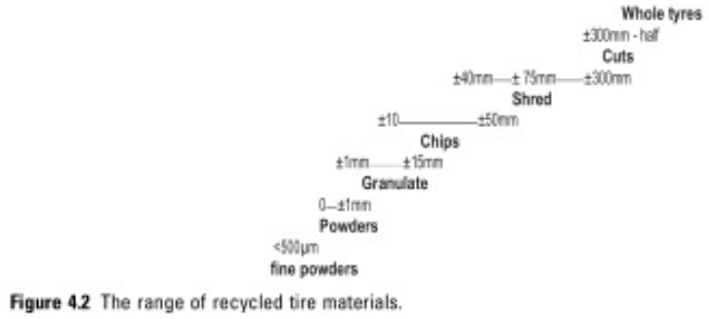
End-of-Life Tires
All mm

Slide 14
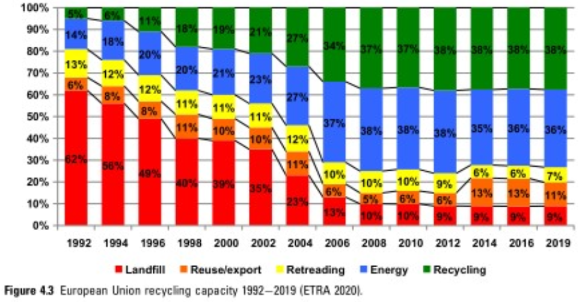
End-of-Life Tires

Slide 15
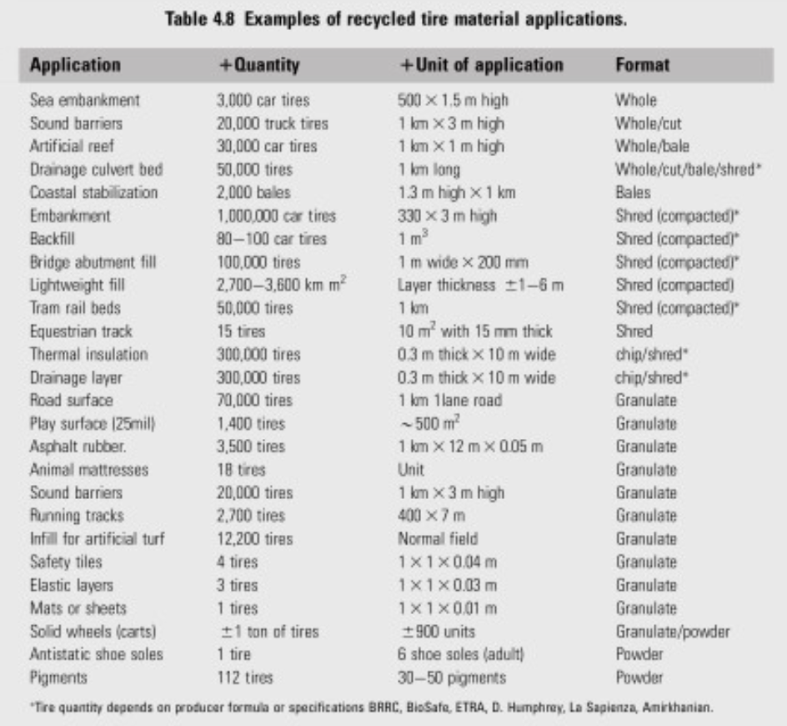
End-of-Life Tires

Slide 16
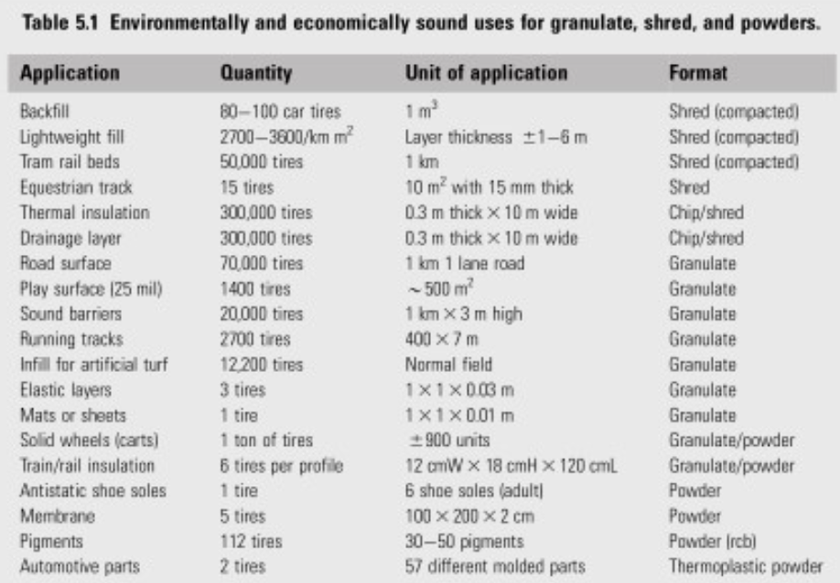
End-of-Life Tires

Slide 17
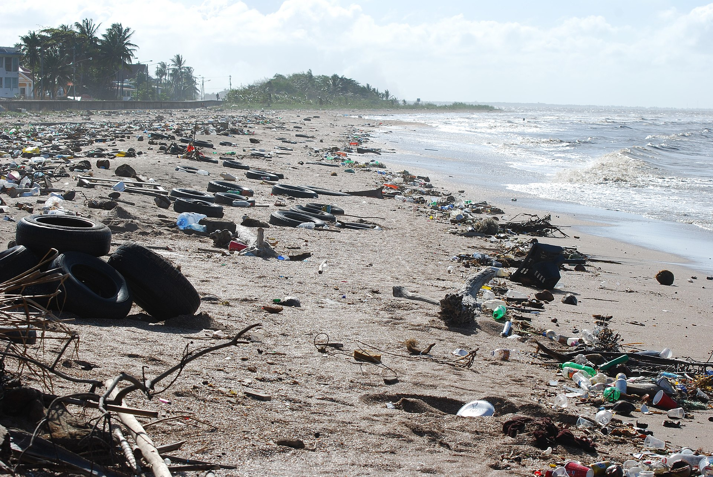
Tire Recycling
In the US
1990 1 billion tires
2015 67 million
In 2017
13% sold as used tires
37% fuel in cement manufacturing
22% ground rubber
7% civil engineering
7% other uses (playground)
15% landfill
Beach in Ghana
Tires to Landfill

Slide 18
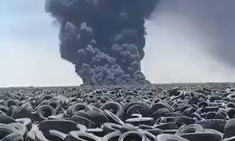
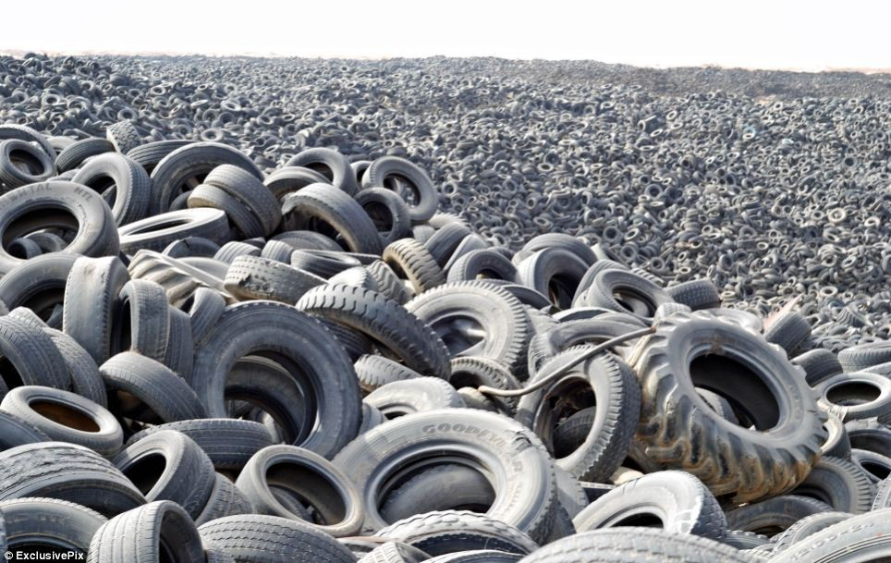
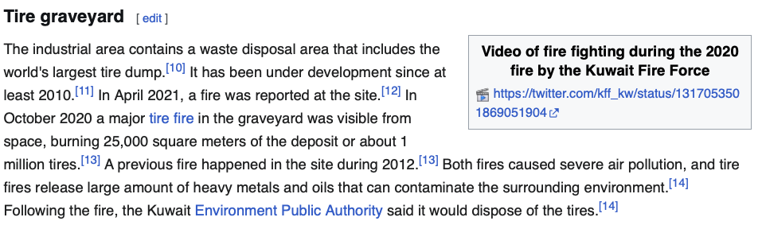
15% Land Fill
Sulaibiya tire graveyard, Kuwait

Slide 19
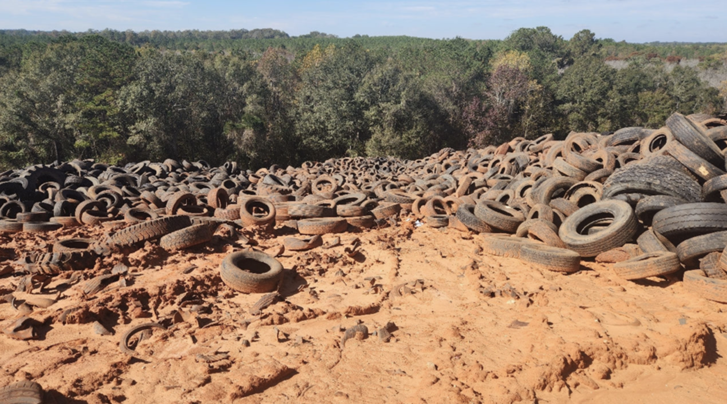
15% Land Fill
Tires are 75% air so they take up a lot of space in a landfill
Tires can trap methane gas produced in a land fill, this gives tires buoyancy and they rise in the landfill. Engineered landfills have a layered structure with barrier PE film, tires rip through this structure and end up on the top
Leaching of tire additives could be a problem 6PPD-q for instance
Alabama Landfill

Slide 20
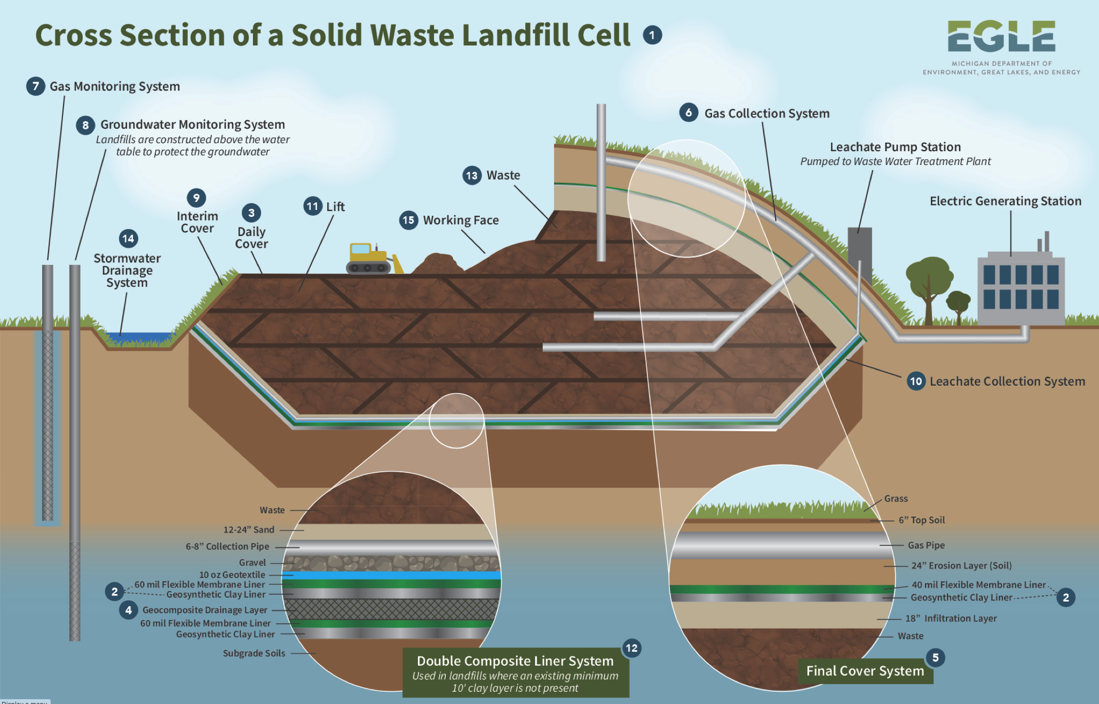
Tire Recycling

Slide 21
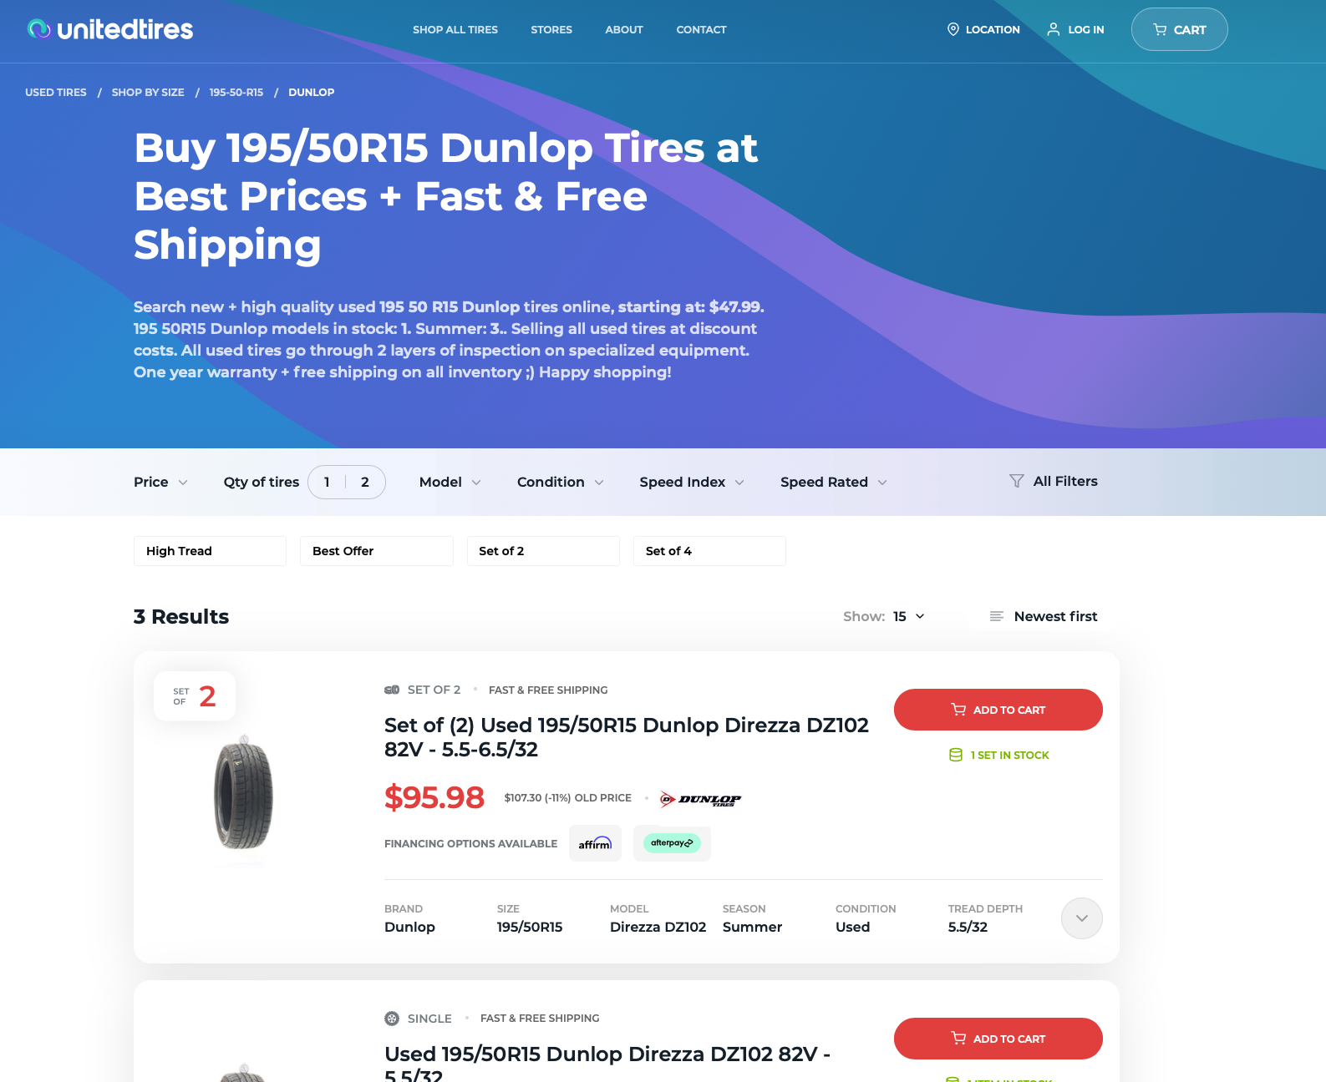
Used Tires

Slide 22

Used Tires

Slide 23
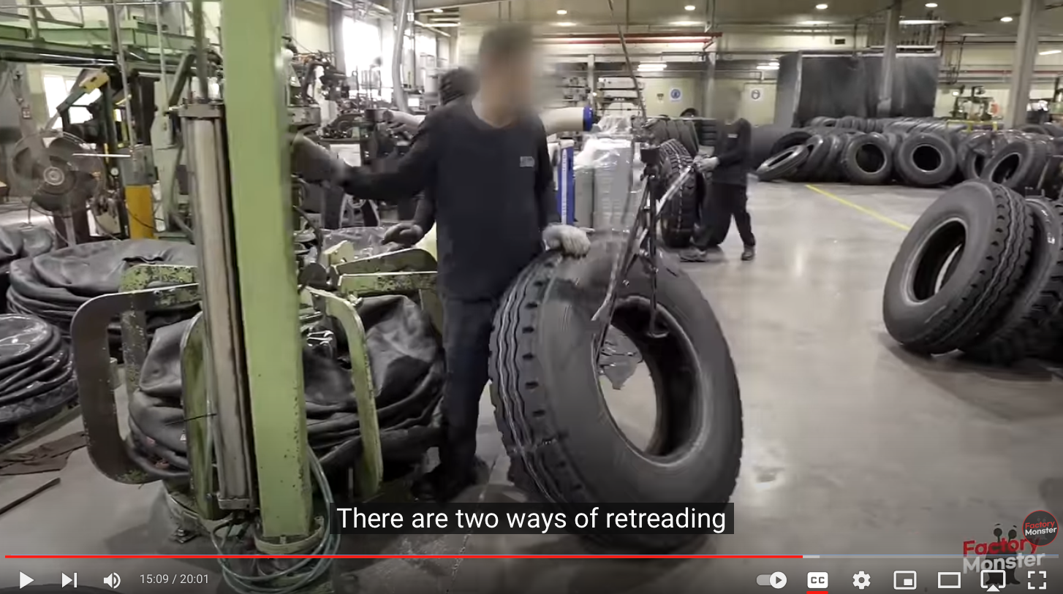
Retread Tires (Mostly Truck/Airplane Tires)
Short Haul Truck tires are retreaded 5-6 times, long haul 3-4 times
Airplane tires are retreaded 7 or more times (tires changed after 100 landings)
65% of the original material is reused in a retread.

Slide 24
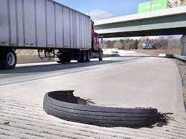
Retread Tires (Mostly Truck/Airplane Tires)

Slide 25
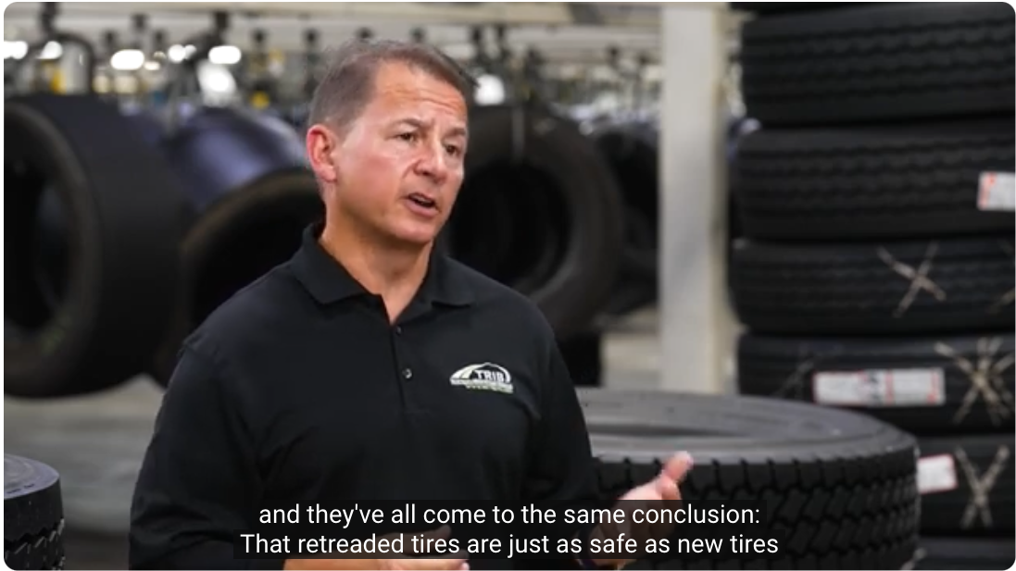
Retread Tires (Calfornia)

Slide 26
Cement 37% of Waste Tires
CaCO₃ (limestone) => CaO (Lime) + CO₂
<850°C typically 1500 to 1650°C this is where tires come in
This reaction is responsible for 8% of CO₂ emissions
2 or 3 CaO + SiO2 (silica/sand) => (2 or 3) CaO SiO₂
Dicalcium or tricalcium silicate
3 CaO + Al₂O₃ (alumina Clay or Fly Ash) => 3CaO Al₂O₃
Tricalcium aluminate
4 CaO + Al₂O₃ (alumina Clay) + Fe₂O₃ => 4CaO Al₂O₃ Fe₂O₃
Brown millerite
Result is called clinker and is ground to a caustic (pH 13) powder
To use mix with water and exothermically form hydrates
At 1,600°C you can use anything as fuel and there are no byproducts except CO₂ and NO_{x}
Hazardous Waste, sewage sludge, tires
Hazardous metals are incorporated into the clinker and finally into the concrete

Slide 27
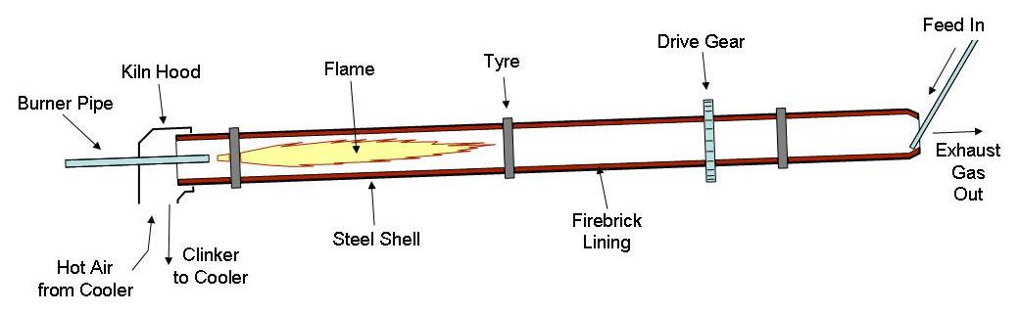
Cement

Slide 28
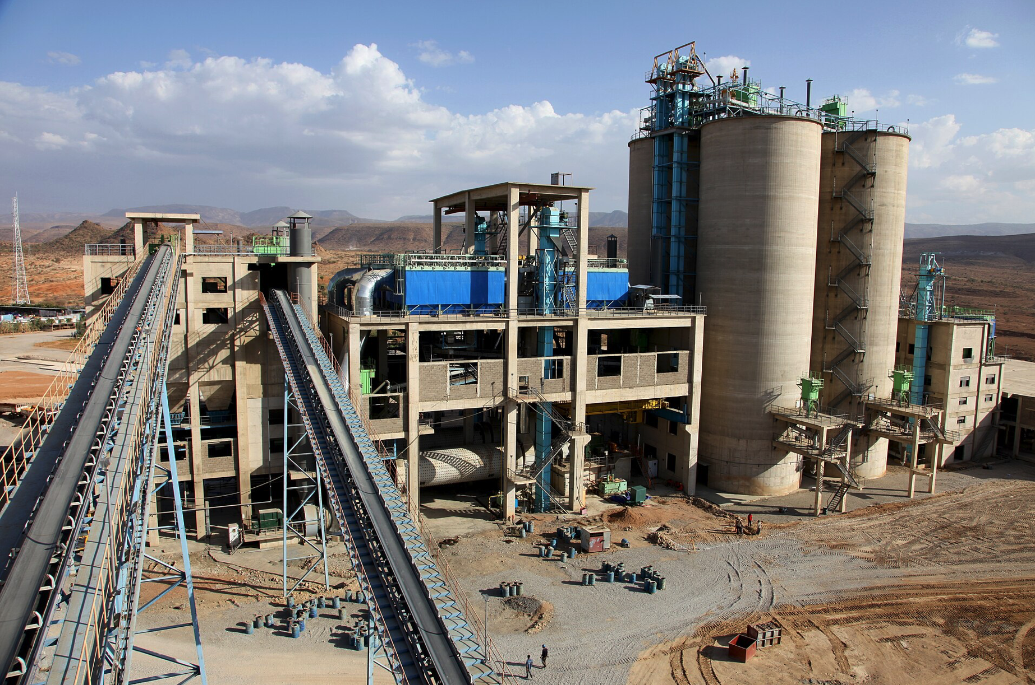
Cement

Slide 29
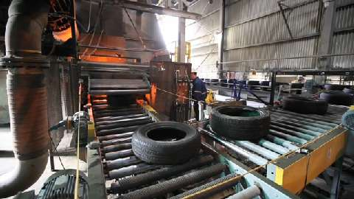
Cement

Slide 30
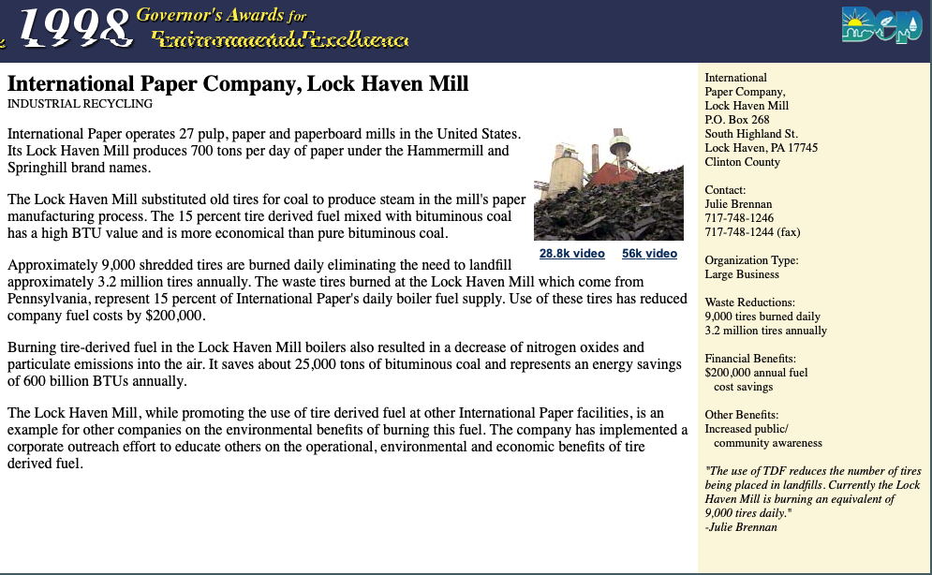
Paper Mills

Slide 31
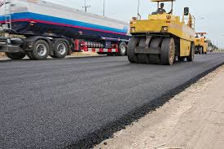
22% Ground Rubber

Slide 32
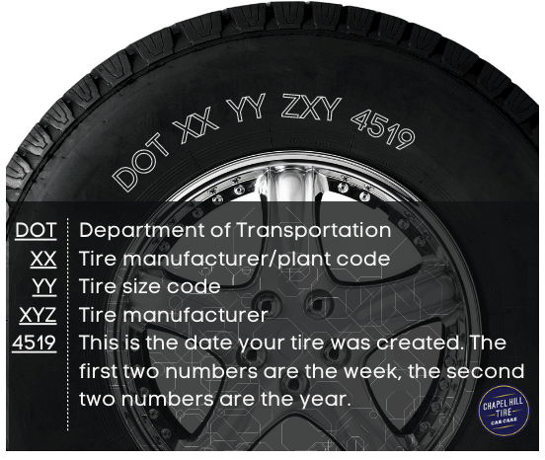
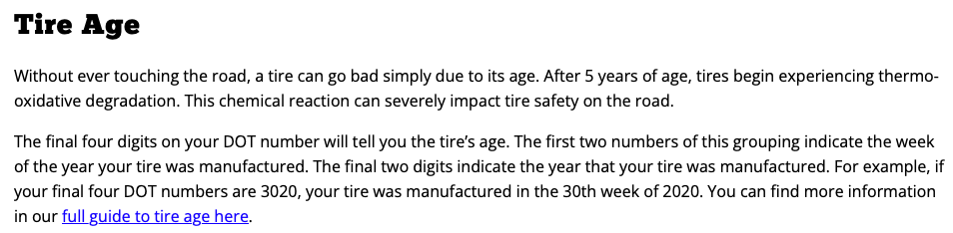
DOT Code
You can’t reuse/retread a tire older than 2019

Slide 33
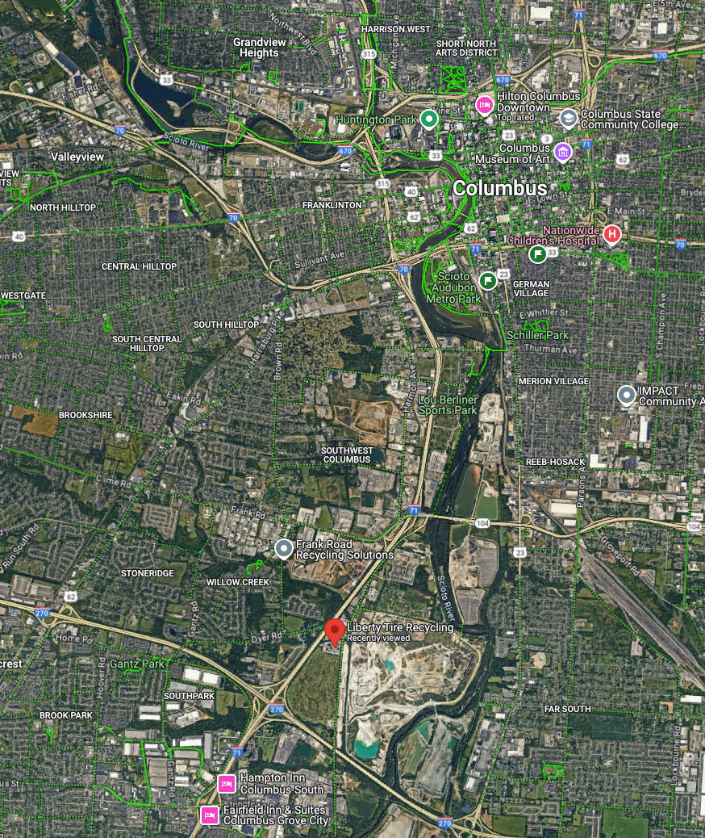
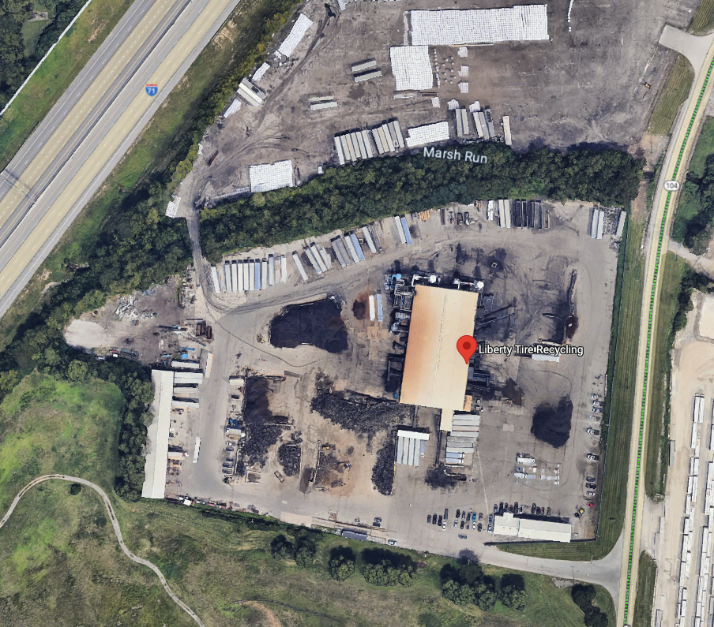
Tire Recycling

Slide 34
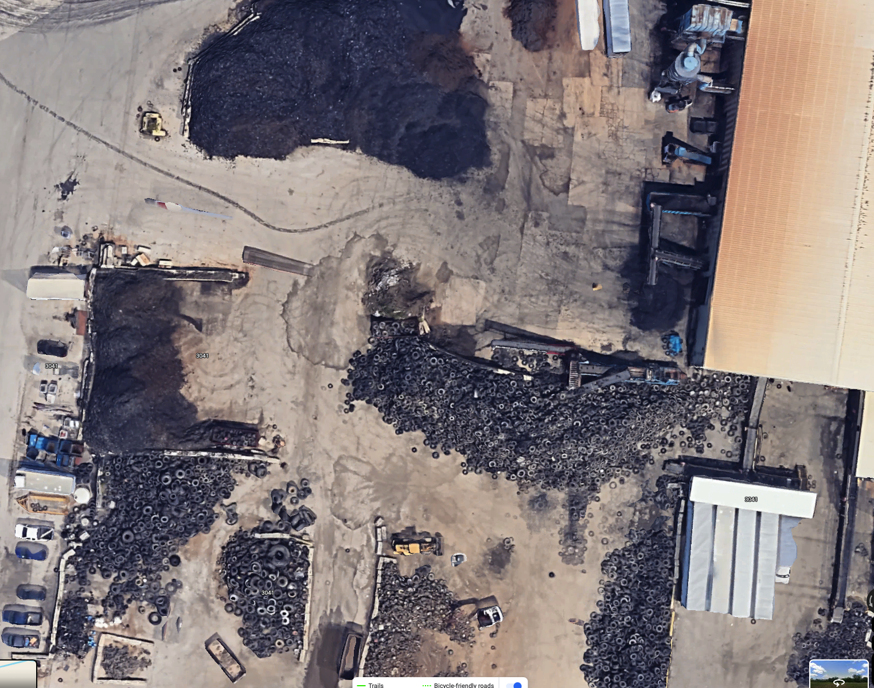
Tire Recycling

Slide 35
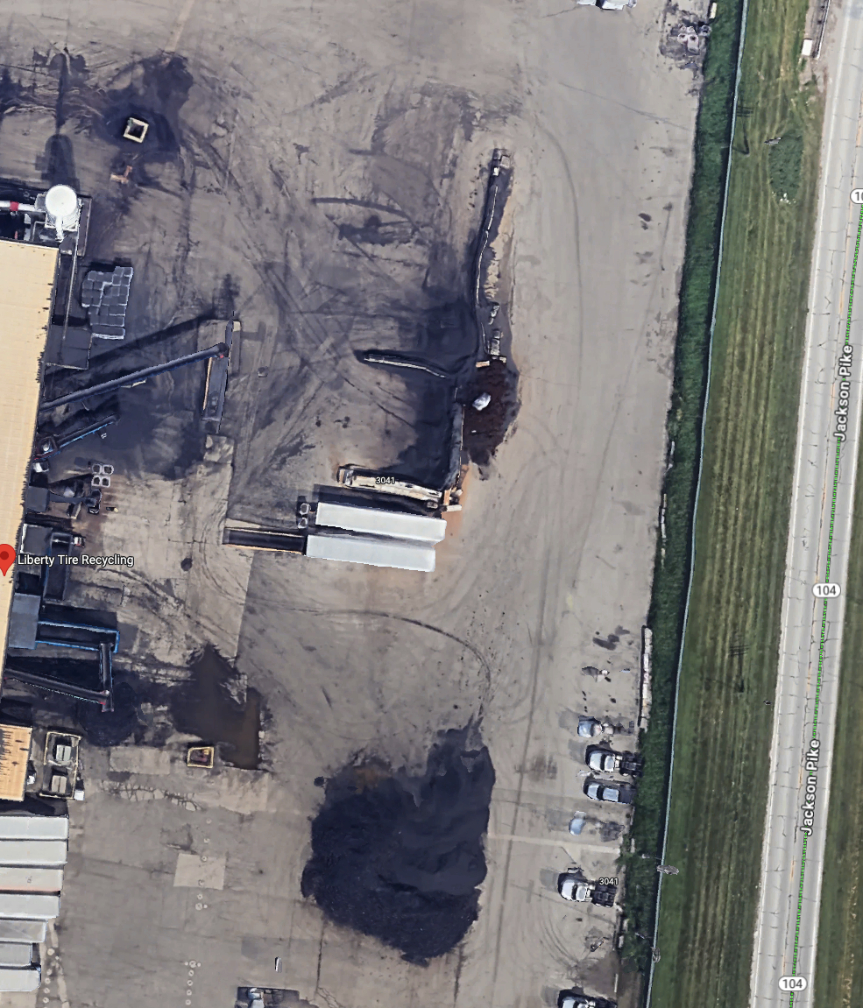
Tire Recycling

Slide 36
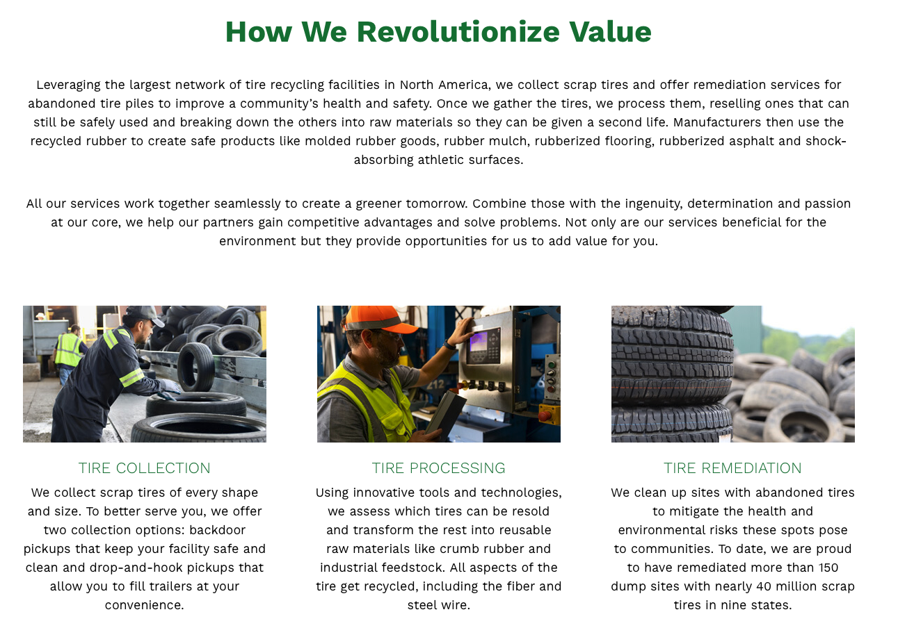

Slide 37

Tire Recycling

Slide 38

Tire Shredder

Slide 39

Tire Shredder

Slide 40

Total rubber processing from tire to powder and steel

Slide 41


Rubberized Aspalt

Slide 42


Crumb Rubber

Slide 43



Slide 44



Slide 45


Slide 46

Rubberized Asphalt Concrete

Slide 47

Tire Derived Aggregate (TDA)

Slide 48

Tire Derived Aggregate (TDA) For Raliroads

Slide 49

Tire Derived Aggregate (TDA) For Road Repair

Slide 50

Recovered Carbon Black

Slide 51

Synthesis of Carbon Black

Slide 52

Recovered Carbon Black

Slide 53

Recovered Carbon Black

Slide 54


Slide 55

Recovered Carbon Black Talk 30 min

Slide 56

Tire Recycling

Slide 57



What does ozone do to tires?
Anti-ozonant
6PPD
6PPD-quinone

Slide 58

What does ozone do to tires?
Anti-ozonant
6PPD
6PPD-quinone

Slide 59

What does ozone do to tires?
Anti-ozonant
6PPD
6PPD-quinone

Slide 60


Slide 61



Polybutadiene has double bonds
That react with sulfur in vulcanization
But can also react with Ozone
Formed by UV light on O₂
Smells like chlorine

Slide 62

Tire Recycling

Slide 63

Antiozonants

Slide 64

6PPD-q

Slide 65
Tire Recycling

