Slide 1
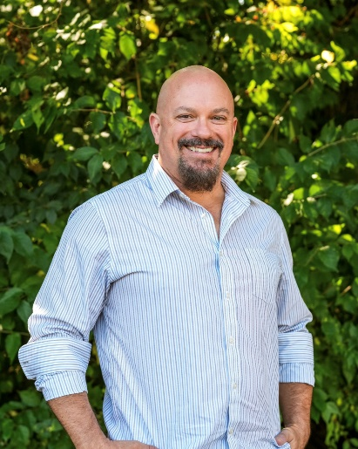
Past, Present, and Future Outlook of Materials in Packaging
ACI North American Biopolymers Summit, October 2nd & 3rd, 2024
“Life can only be understood backwards, but it must be lived forwards.”
(Soren Kierkegaard)
Kelly Williams, Managing Director, Laminations Division for EarthFirst®
Notes:
Excited to give this talk for the first time.
So many trying to anticipate a future state when the accuracy of projecting forward is only as good as your curation of the appropriate points in history.

Slide 2
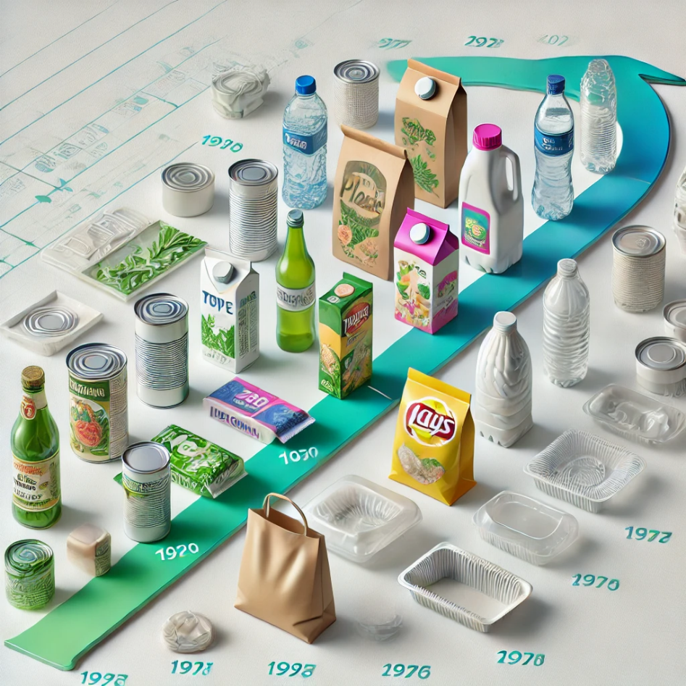
Agenda
Evolution
  Retailers & Brands
  Packaging materials & manufacturers
  Single-use plastics waste
Future look
  Materials
  Packaging manufacturing
Notes:
So, we take a peek back in time hovering over the industry noticing the key inflection points then we take a peek forward to see where it is going.

Slide 3
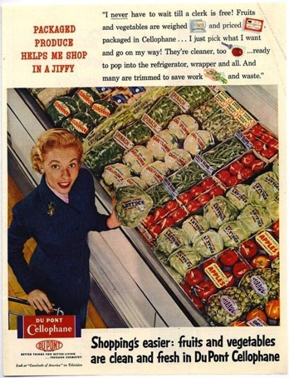
1900 – 1940 “Discovery”
PVDC-coated Cellophane and glassine-coated paper
Piggly Wiggly (1916) | standardization & brand loyalty | Lower prices
The Great Depression Grocery Store housing many necessities under one roof + car culture
First use of metallization on paper (decorative)
Real paper science!
Packaging started with materials derived from nature versus the ancient fossil past
Notes:
The beginning of the food packaging industry, particularly flexible packaging, started with PVDC-coated cellophane and glassine-coated paper.
If you don’t know what Cellophane is – first true barrier packaging film that could be heat sealed, transparent paper, true nano cellulose
This predates plastics so back then paper research was much different
Metallization will prove to be the WD-40 to open the fossil plastics spigot throughout

Slide 4
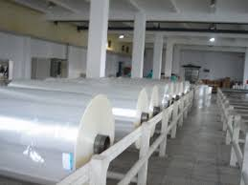

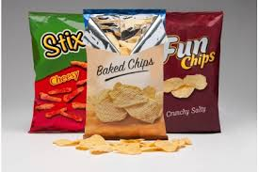
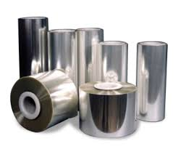
1940 – 1980 “Breakthroughs”
Discovery of free-radical polymerization of LDPE
Zieglar develops catalyst to make HDPE & LLDPE
  1st major spigot inflection before mega mergers 1998 – 2004
Military MRE’s | LDPE for extrusion coating paper and foil laminations
(1954) Natta develops catalyst to make PP that led to research on film orientation (late 1950s) with widespread adoption of BOPP in packaging in 1960s-1970s
  Cellophane declines for barrier packaging as a result
(1941) Discovery of PET
Oriented PET films by DuPont in 1960s
Metallization for barrier of BOPP and PET films (Mylar name is still synonymous!)
  PE film co-extrusion goes to 5-7 layers to compensate for lost OTR as BOPP eliminates cellophane
Notes:
Polyethylene was not discovered yet. The first version was like the Ghostbusters ray gun then Zieglar discovered that if you coordinate the process with a catalyst, you can make a straight line and then add side streets, this was the first turn of the plastics spigot later followed by the mega mergers of the late 1990s
Once we found a good use for PP in BOPP, the packaging backdrop changed substantially then when oriented PET came along and metallizing them, we entered the next phase

Slide 5
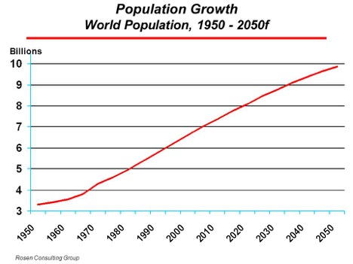

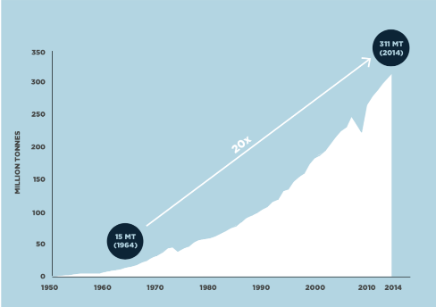

1980 – 2010
“Optimization”
Barrier coatings (AlOx, SiOx, etc.)
EVOH/PE/Nylon coextrusions (Tie Layers)
Reverse print + laminating using solventless adhesives
Recapitalization of old packaging lines
Pre-made bags and stand-up pouches
SKU proliferation: B&M | rise of e-commerce
Industry consolidation up/down value chain
Introduction to plant-based biopolymers (PLA, PHA)
!!!
The fossil spigot is now on full throttle
The feedstock convenience of hydrocarbons versus biomass
Notes:
When we went from monolayer blown film to 3-layer it was not for barrier, it was to reprocess our plant waste – it was cost and efficiency driven. Once BOPP took share from cellophane, the lost oxygen barrier led to 5, 7 and now 9+ layer blown film lines
Solventless adhesive came along for cheap bottle wrap for 2-liter bottles, and it climbed up the performance chart essentially redefining the way packaging would be, and still is largely made today.
The success of SPI’s Italian actor as the crying Indian was successful in convincing us plastic good, paper bad and when brands and packers started recapitalizing older converting lines to form/fill/seal and premade bags, it further opened the plastics spigot.
The first Pouch Forum in 2006 “we are gonna hit a billion pouches!”
Dow turning to life sciences meets up with big food grower and processor to realize 1) nature makes lactic acid rather easily and in the right chiral form, converting to lactide is an engineering process, and making PLA is chapter 1 of polymer chemistry handbook.
The watermelon analogy helps explain why hydrocarbons where so timely (explain more in a couple of slides)

Slide 6
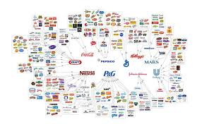
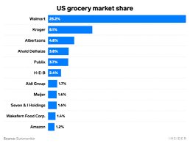
2010 – Present “Chaos”
Retailers & Legacy Brands – is getting bigger good or bad?
  Store Brand versus Legacy Brand
  Access to packaged goods – B&M, e-commerce, Club, Membership
  The rise of SMBs! …and Digital Printing
Packaging Manufacturer & Raw Material Supplier Concentration
Sustainability & bioaccumulation
  Why ‘Earth Digestible’ is becoming increasingly attractive
Notes:
Many dichotomies forming in this period –
Retailers getting bigger, brands getting bigger, SKU’s inside average retail store climbing as producers of packaging are getting fewer and bigger, the way we make packaging slow and painful, because of ecommerce and social media, ANYONE can become a brand. There are estimated 25-30,000 SMBs in the US alone.

Slide 7
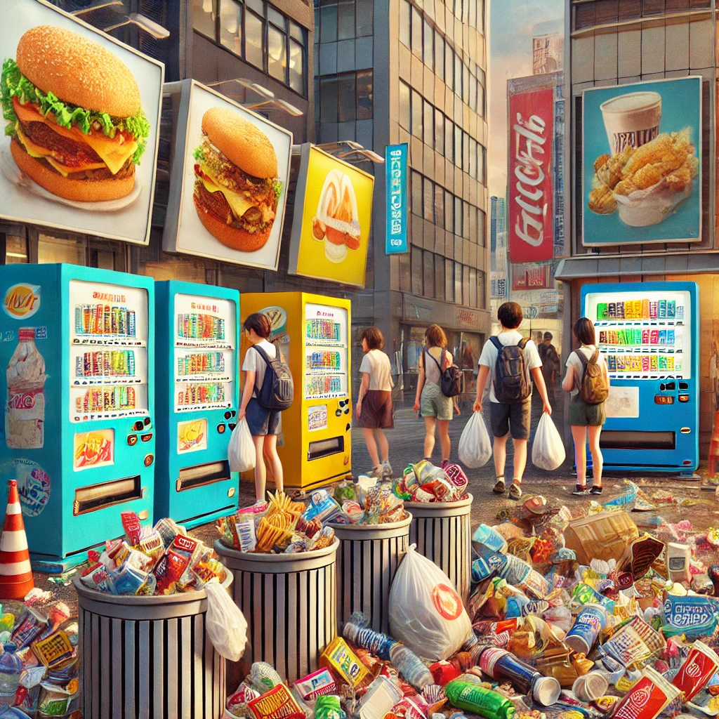
The CTQ We All Missed: Bioaccumulation
The Sustainability benefits of flexible packaging versus rigid packaging was overwhelmingly positive.
The “sustainability” was the ability to sustainably feed societal addiction to convenience while keeping up with excess food production.
Those of us that played a part at the time knew the deep, dark secret but none of us imagined where we are today as a result.
Notes:
We have amassed humongous supply lines made possible from packaging that are fatigued and vulnerable.
Circularity means smaller and more management circles where food is grown, harvested, processed, and consumed within a region that includes the sources of the materials used for the packaging itself.

Slide 8
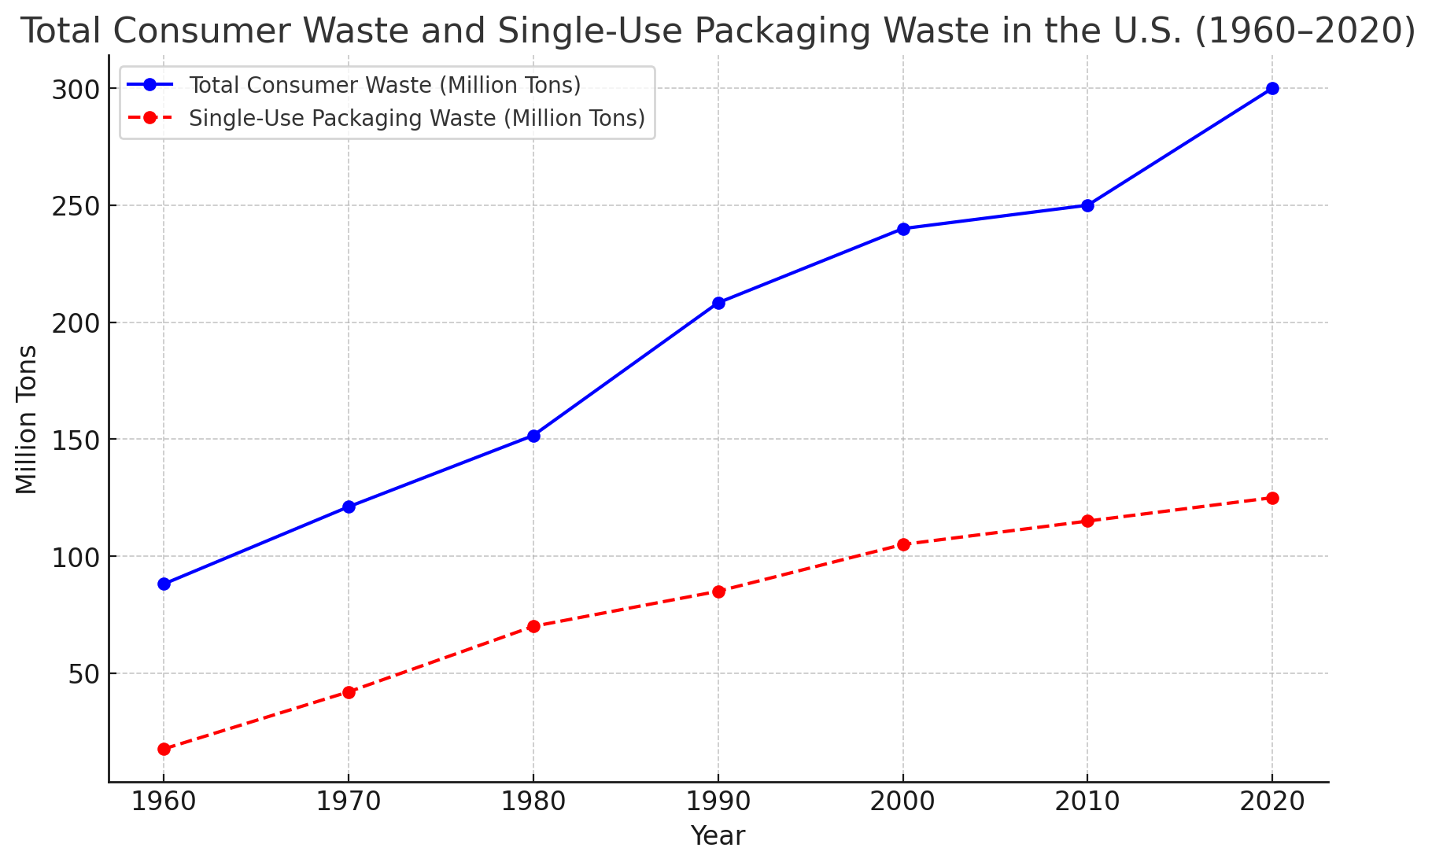
United States Environmental Protection Agency (EPA). Advancing Sustainable Materials Management: 2018 Fact Sheet. Municipal Solid Waste generation from 1960 to 2020, derived from EPA waste management trends.
Industry Estimates on Single-Use Packaging: Derived from various sources tracking packaging trends over the decades.
We rarely consider the vastness of in-process waste from extrusion to printing/laminating to copackers
Notes:
United States Environmental Protection Agency (EPA). Advancing Sustainable Materials Management: 2018 Fact Sheet. Available at: EPA MSW Reports.EPA Historical Data: Municipal Solid Waste generation from 1960 to 2020, derived from EPA waste management trends.Industry Estimates on Single-Use Packaging: Derived from various sources tracking packaging trends over the decades.

Slide 9
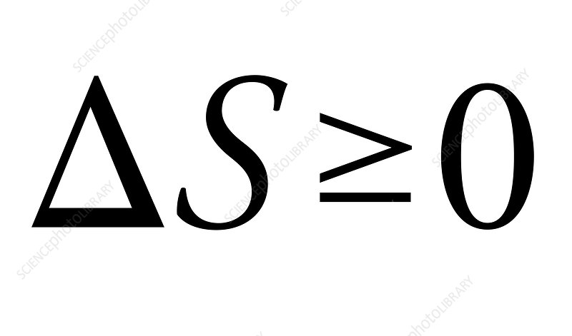
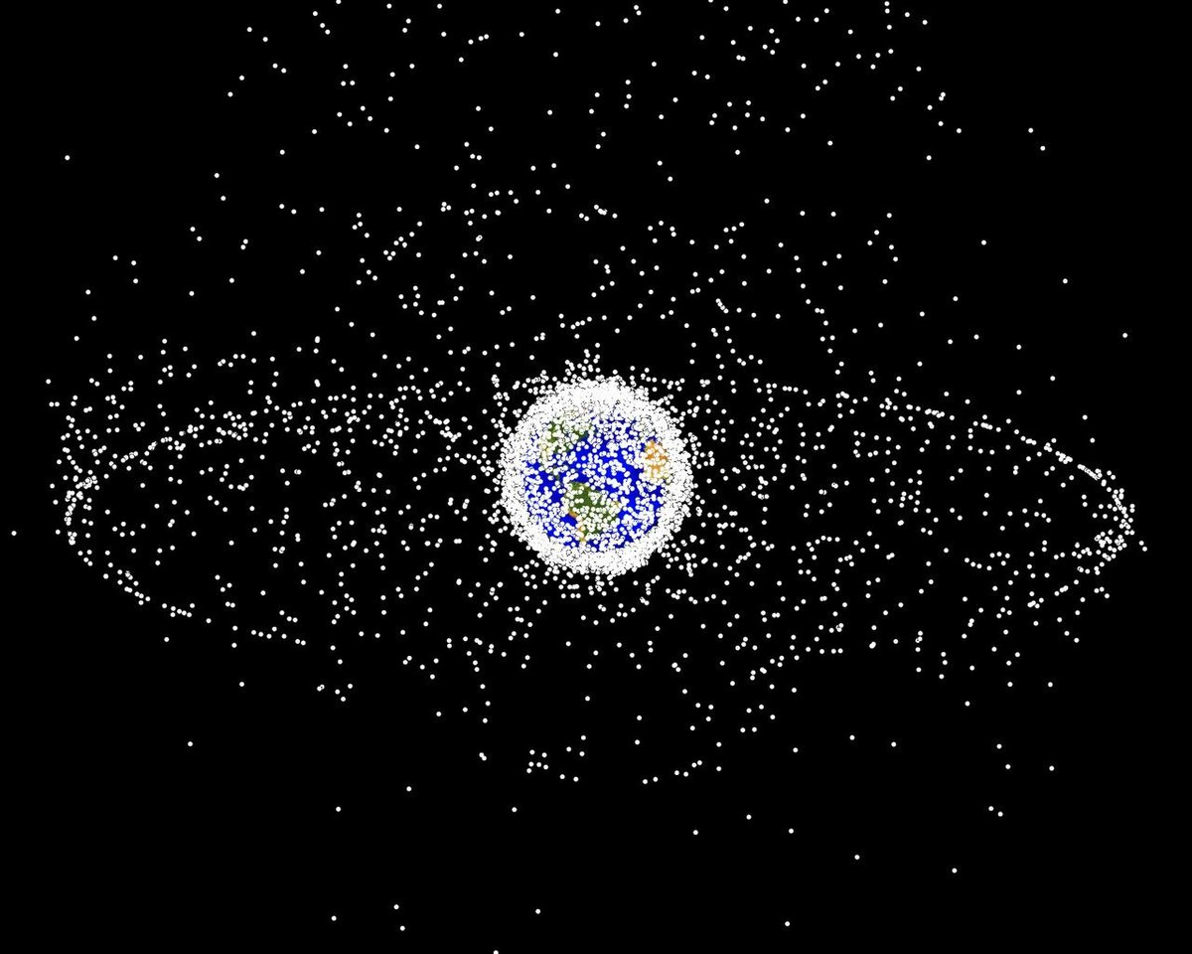
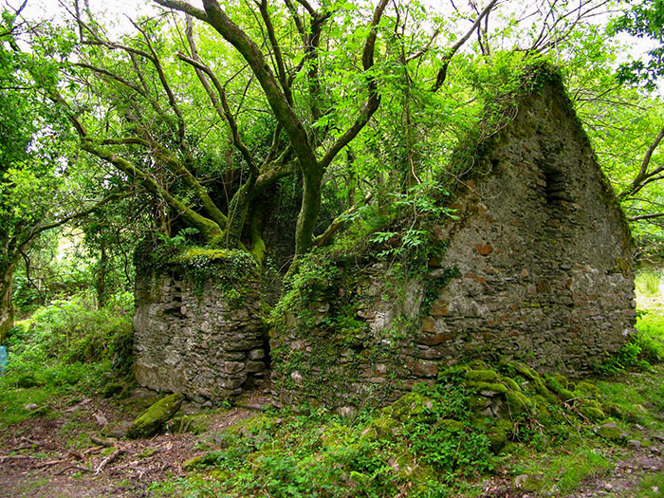
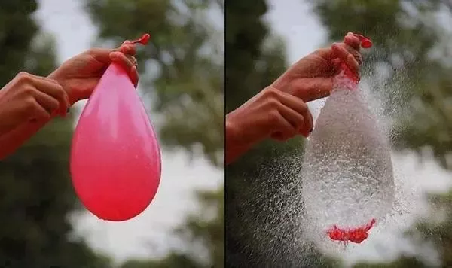

Sustainability is governed by the same Universal Laws
Sustaining 8B people is inexplicably entropic. Our balance with nature implies that we need lower entropy ways of daily living. Dispersing plastics and expecting it to be returned in a realistic way at such a phenomenal scale is a Fool’s Errand.
Human Entropy + System Entropy + Enormity of scale = need to engineer for inevitable ecological escape.
2nd Law of Thermodynamics, otherwise known as Entropy
The term entropy was introduced by the German physicist Rudolf Clausius in 1895 and comes from a Greek word that means “transformation”. This concept is symbolized by the letter “S” and is the cornerstone of the second principle of thermodynamics.

Slide 10
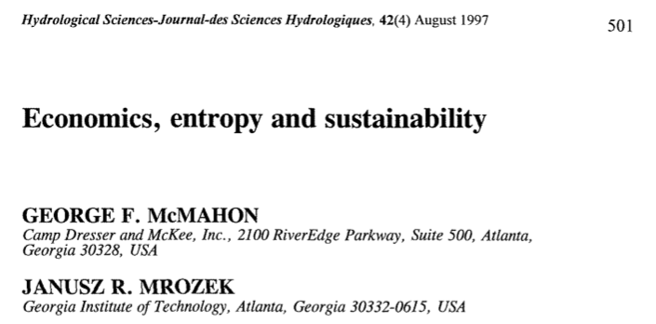
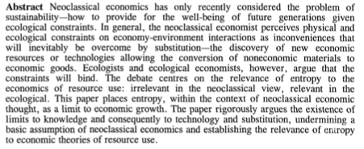

Slide 11
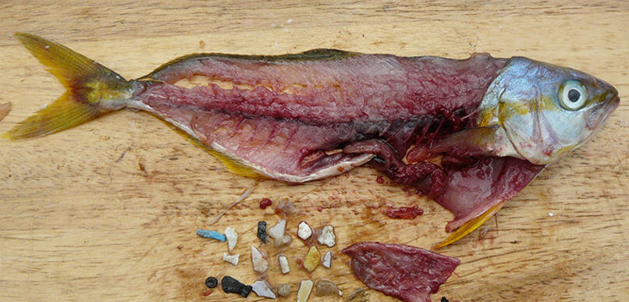
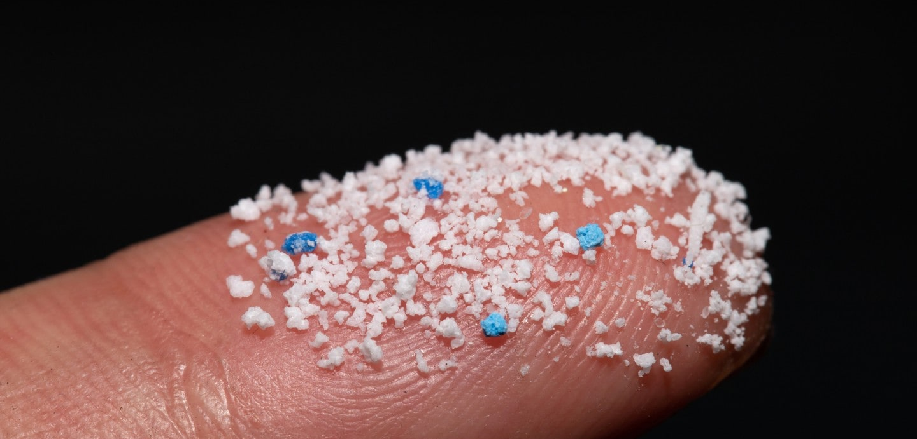
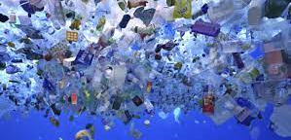
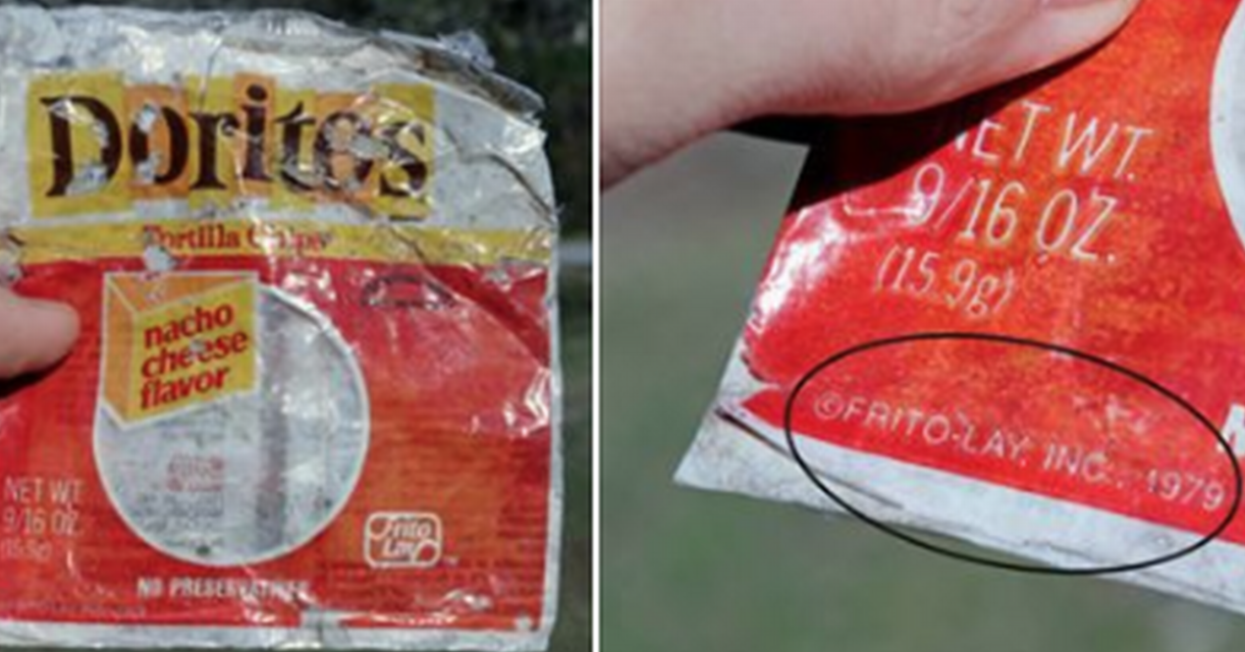
Entropy
Notes:
There is 1.4 to 1.8 trillion packages sold per year globally. This does not count the waste to make it and the large amount of landfilled write-off waste packaging nor does it count the bags, molded goods, and plastics waste that is not part of packaging. That is an enormous burden to "suction back" after use. Not to mention, almost every package today is designed, as part of opening it, to have a small piece be removed!!!
The scarier part is what happens to plastics over time - they break down into microparticles that we are just now understanding their dangers. UGA turtle study, phytoplankton
1,500,000,000,000

Slide 12
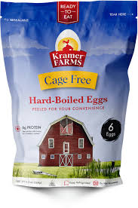
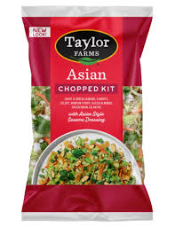
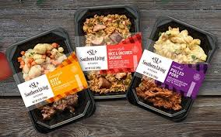
Trigger Points to Current Crisis of Plastics Bioaccumulation
Haber-Bosch Process
Green Revolution
Processed Foods
Packaging Demands
Population Growth
From war bombs to farmlands
Ammonia process
Brute force to the soil
Pesticides & chemicals
Dehydration/salt/smoke, lactic acid & fermenting to canning, pasteurizing & milling to oils/fats/sugars/dyes
Massive supply lines enabled by cheap, over-engineered plastics
As population rises, processed foods shift to ultra processed leading to human health concerns
Equipment & practices
Seasonal crops now year round
Single-Use Plastic Packaging
Catalyzed PE & PP + fabrication methods + packaging engineering
SPI’s success with the Triangle of Arrows
Mega mergers
Feed the addiction to Convenience

Slide 13

How do we take where we were, where we are, and see where to go?
We are addicted to convenience & capitalism will service
Fossil extraction for packaging is not sustainable or sun-stainable
Human & planet health demand for compost appears clear
Political influence from fossil fuels industry will increase as science continues to unfold
  Micro/Nano plastics | PFAS | Additives in plastics & rubber | Air & Water
Decarbonization and redirecting food waste
Notes:
Fossil extraction is that – extraction of energy. Sun stainable means it comes from free energy (CO2 + sunlight)
How many more flavors of IBS or auto immune do we need to make the connection?
Plastics industry knows the truth about impact on human/planetary health from micro/nano plastics is inevitable. One should be able to predict the public opinion swaying tactics

Slide 14

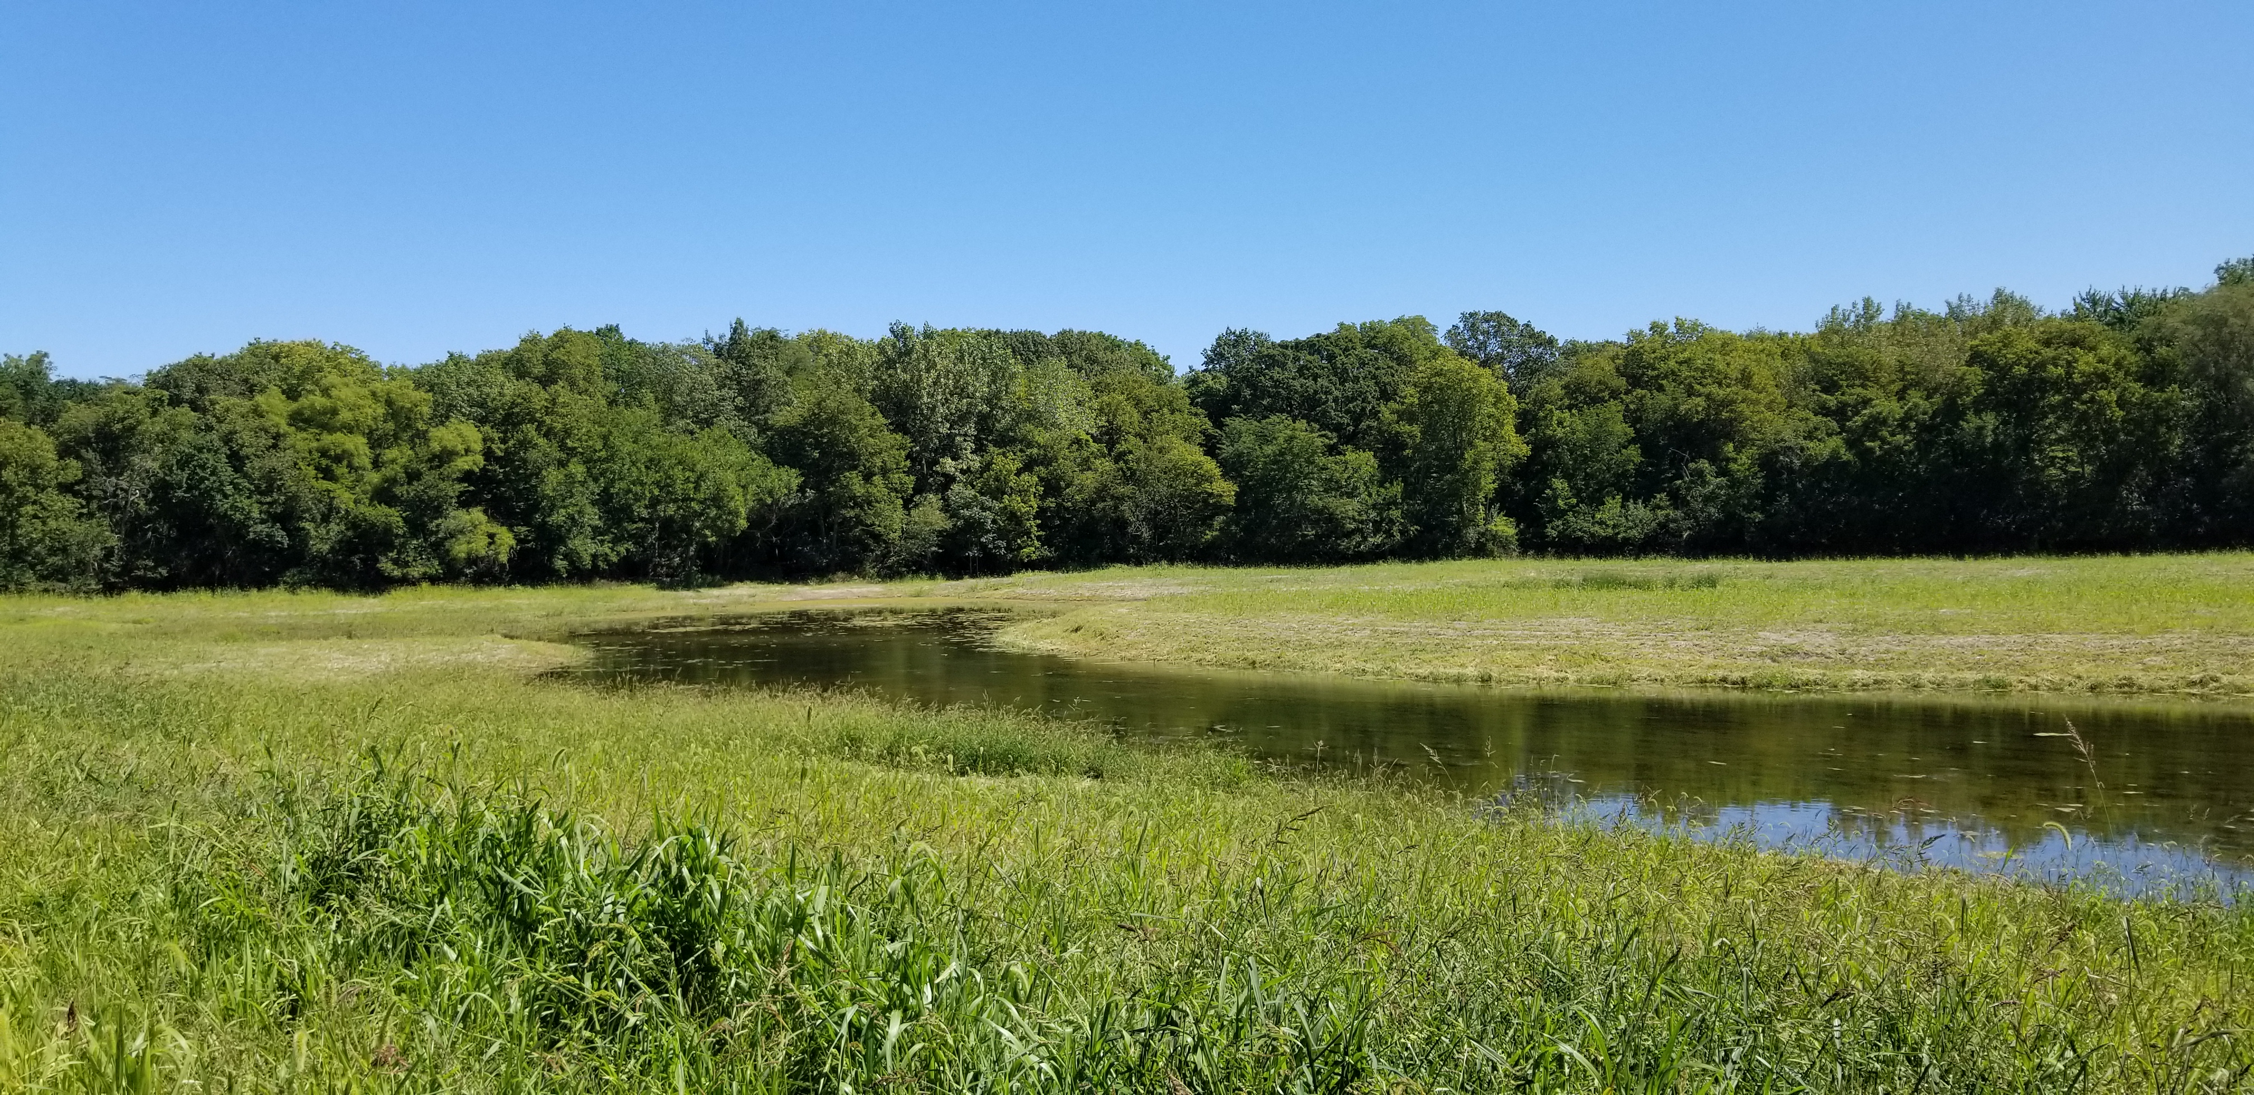
The 8th Era in Human History is already here: The New Materials Age
Stone (2.5M - 3200BC)
Bronze (3200-1200BC)
Iron (1200-100AD)
Glass (1300-pres)
Steel (1800-pres)
Alum (1800-pres)
Plastics (1907-pres)
Biobased & Biorenewable (Now!)
Hall-Heroult process
The next level in packaging
Nature’s preferred monomer is CO₂…
Rethinking ”raw materials”
The first true “packaging”
1st industrial process –
“can we do it?”
”The Blessing and the Curse.”
Man-made advancement on elemental iron
Bessemer’s Invention
Tools, weapons, agriculture
Nature has already made and optimized what we need to live like ants
Tools, cooking, writing

Slide 15
Where to go, as it relates to Bioplastics & Packaging:
The Future P’s of Packaging:
Compostability addresses:
  System & Human Entropy (Escape)
  Helps get food waste to composting (Emissions)
  Potential value-added source of carbon in IC (Feedstock)
Paper
PLA
The “chassis” to then augment with other biopolymers
Circularity addresses:
  Level of Symbiotic and Regenerative balance with environment.
  Degree of Extractive versus Regenerative practices both External and Internal.
Biological | Regenerative |
Circular | Compostable |
Material Ubiquity

Slide 16

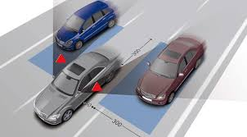
Hint This may be a blind spot!
Is the divide between paper and fossil plastics all these years because one is regenerative and the other extractive?
Cellulosics and biopolymers will not just come together with new glues, they will be valorized at the molecular level!

Slide 17
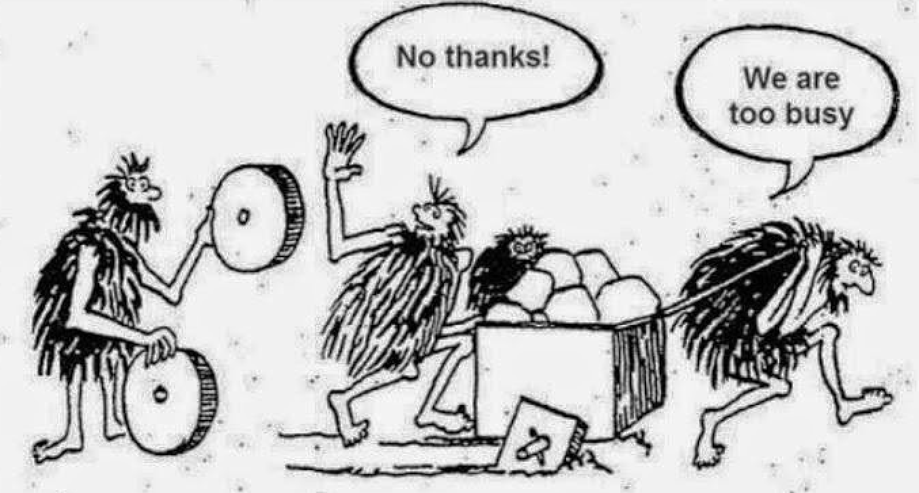

Slide 18
Back ups

Slide 19
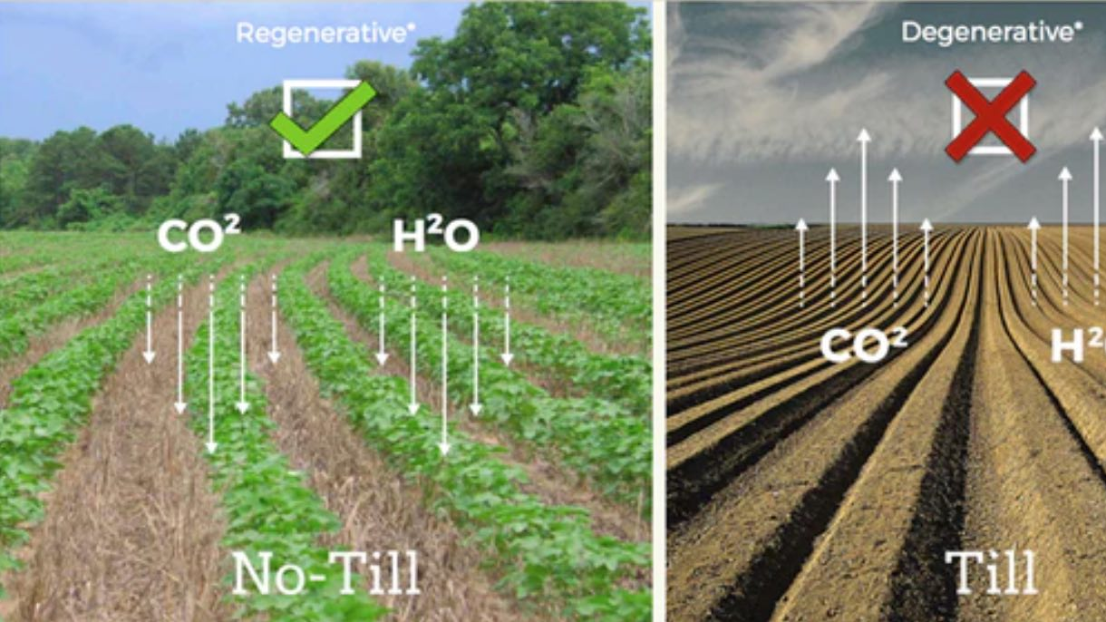
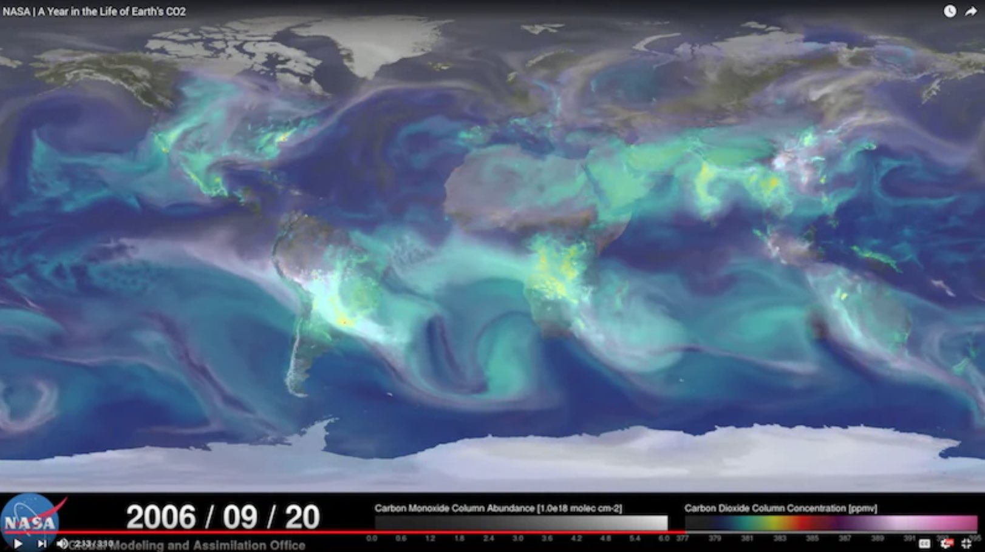
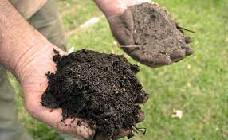
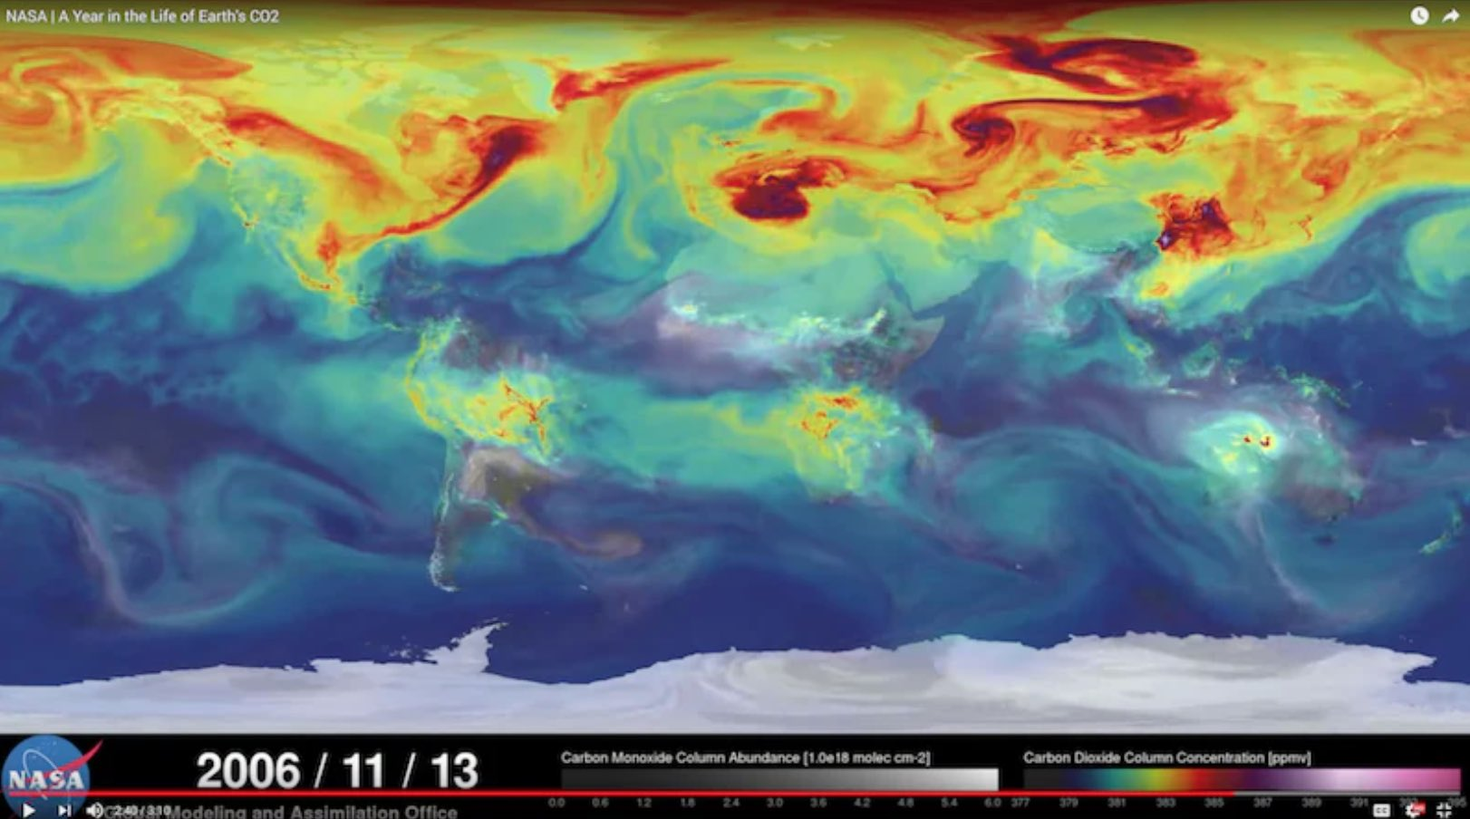
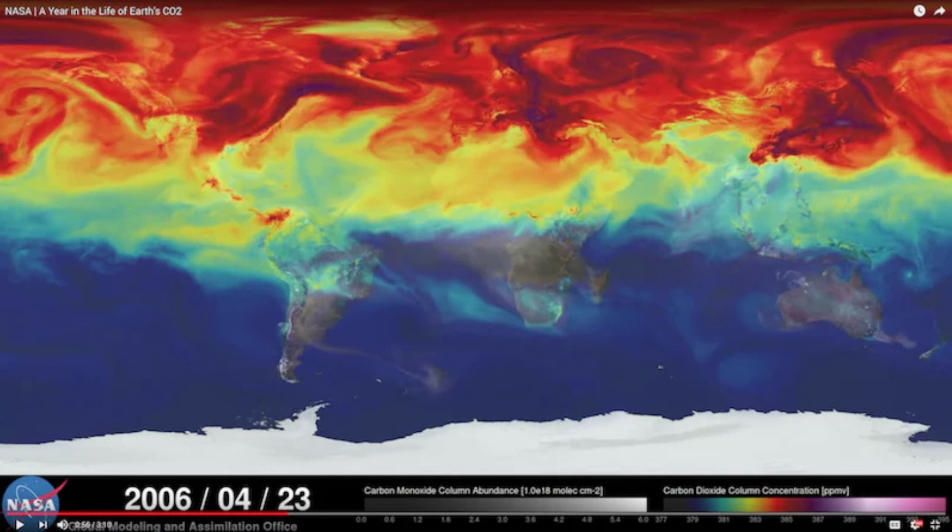
Compost

Slide 20
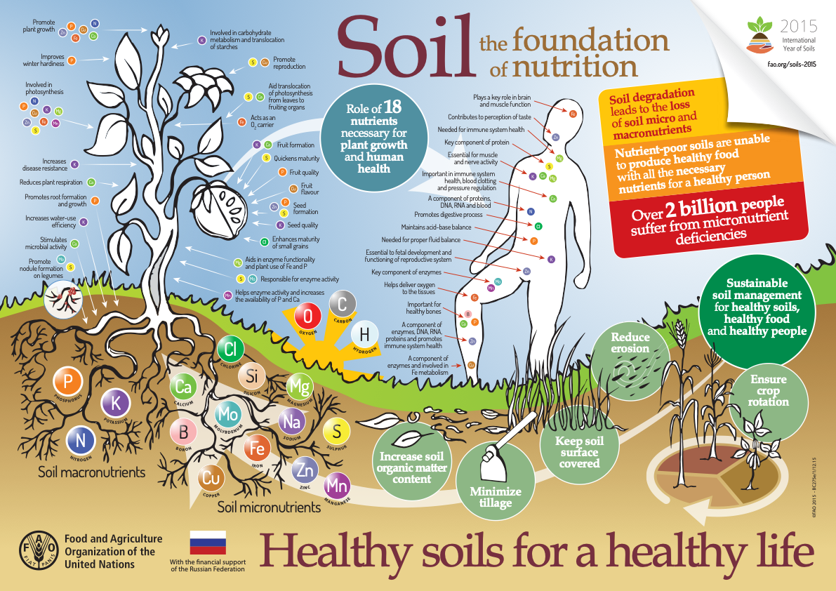

Slide 21
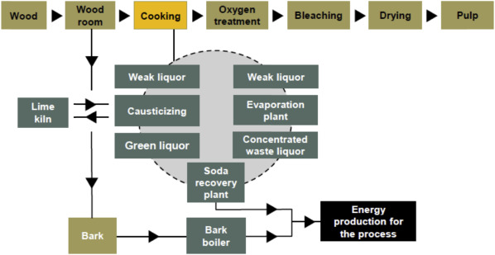
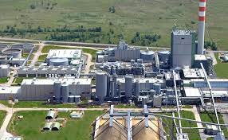
Kraft pulping process
93% of the world’s pulping process
”The solution to pollution is dilution”

Slide 22
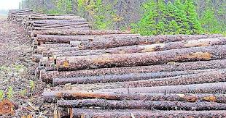
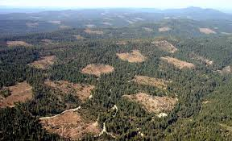
In pursuit of this
We end up with this
*A notebook size piece of paper requires 10 liters of water to make
*5th largest consumer of energy and electricity
*3rd largest polluter of air, water, and soil
*>100M Kg of toxic pollution/year in US alone!
*26% of landfill waste
*From 2001 – 2019 we lost 10% of our trees in the world (386M hectares)
*We lose a football field size every second
*US offices use 12.1 trillion sheets of paper/year (50% of office waste is paper)
*We can build a 12-ft high wall of paper from NY to CA each year
*A tree produces enough O₂ for 3 people to live

Slide 23
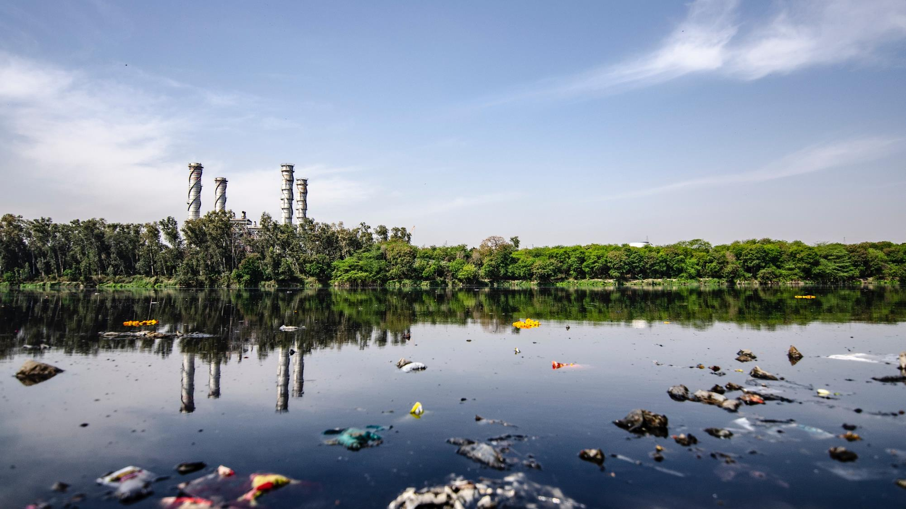

Houston World, We Have a Problem
…an existential one
Population
Addiction
Behavior
Notes:
When we look at the current landscape of single-use packaging you could say “Houston, we have a problem”, however, and more appropriately, it is World we have a problem.
And this problem is an existential one.
What I would like to do today is break this problem down into three areas that tie back to what that truth is: CLICK Population, CLICK Addiction, and CLICK Behavior.

Slide 24
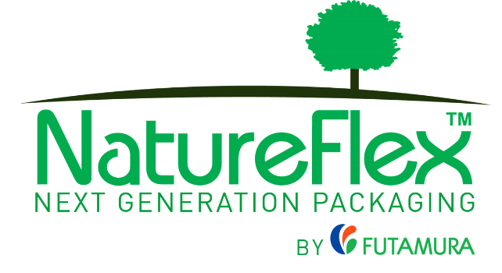
Floating in the ocean for 40 years and still looking good
1-year after going from cello to PP.
Cheap and fast on the front end, centuries on the back end.

Slide 25
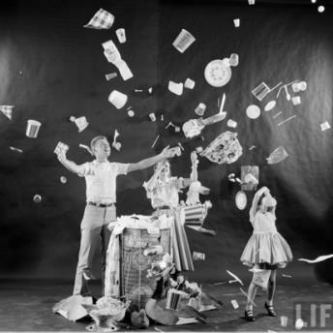
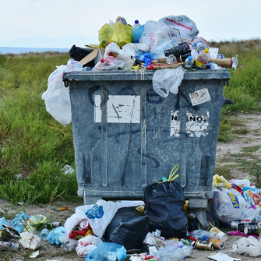
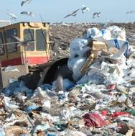




Addiction to Convenience
(It is built into the Animal Kingdom DNA)
This
Leads to this
Which has led to this
Humans are not the only ones
Notes:
We are NOT addicted to plastics we are addicted to CONVENIENCE. Plastics just happen to be the preferred vehicle to deliver that convenience.
This (CLICK), leads to this (CLICK), which then leads to this (CLICK).
When was the last time you were at a kid’s soccer game and saw a parent bring homemade snacks and drinks versus having done a CostCo run for packaged snacks? No one does! Going to a store to get pre-packaged snacks and drinks is far more convenient. You would most likely get looked at as weird or poor if you brought something made at home!
So, the addiction to convenience is a very important one. Capitalism cannot be stopped, nor can it be easily curbed. Businesses make profits by enabling that convenience.
Being delivered in its current plastic form that will outlive our great, great grandchildren to only become more dangerous microparticles is a very real problem.
CLICK
But, I do want to make note that this isn’t just a human issue. Any species, if their hierarchy of needs are met, AND, they do not have a threat from predators, will take advantage of that convenience. If you look at the developed world as these animals and that convenience disappears because it can no longer be made available, what happens?

Slide 26
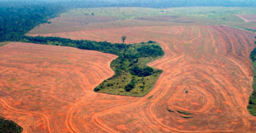
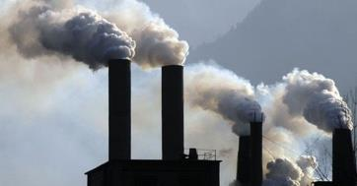
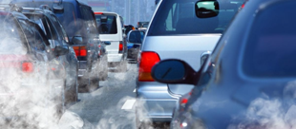
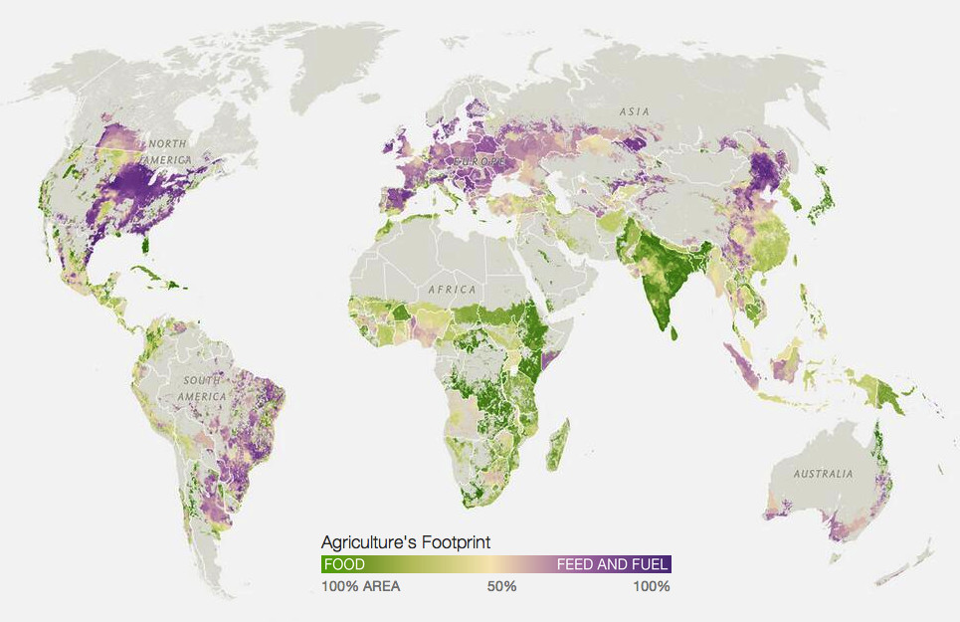

Unsustainable Behaviors
Notes:
Feeding the convenience addiction has led to some serious aggregate behaviors as the population continues to explode.
Let’s first talk about manufacturing. We built our current mfg methods back when the question was, "CAN WE DO IT?" versus today where the question should be: "SHOULD WE DO IT?" This slide is its own presentation so will leave it at that. The point is that our manufacturing systems were never designed with the long-term downstream consequences in mind.
Then we have the outcome of too many people who are driving too many cars and stuck in never-ending traffic.
Going back to mfg, we have water usage and water contamination. At some point, we must agree that the SOLUTION TO POLUTION ISN'T DILUTION. Diluting to meet quality standards is futile as this does not account for accumulation over time.
Un-managed forestry clears land for development, agriculture, and meat production (which is the acclaimed cause of the recent Brazil wildfires), and even to make things look pretty. In my view, businesses and municipalities need to STOP scraping the land for the purpose of making it look pretty. The retention ponds with zero surrounding trees is WHY the goose population is out of control. They have no fear of predators in these cleared settings. Once you scrape out the earth, the natural habitat is destroyed.
Did you know that in the US, only 27% of crops are grown for human consumption and 67% for animal feed?
CLICK (Enter Map)
Here's a map from University of Minnesota researchers showing where food is grown to feed people versus food grown for animals. Did you know that it takes 100 grain calories to produce 12 calories of chicken or 3 calories of beef? It will take the production equivalent of two additional India's to meet the demands of 9B people by mid-century, and that is assuming there is enough fresh water to do so.
CLICK (Exit Map)
At last year's Climate Day that preceded Natural Products Expo West, Tom Chi, Co-founder of Google X gave a keynote and used this comparison which I found to be brilliant way to shine light on the problem versus chasing solutions to the symptoms of the problem.
Humans versus ants.
If you were to weigh all the people on the planet, and all the ants on the planet, you would have approximately the same weight, roughly 350M tons. One stark difference is ants eat 3 times more food energy than humans. The difference is the framing of the problem - it is not a question of how many people can the planet hold AND feed but rather how do they measure up in the equation of NET ECOLOGICAL SERVICE VERSUS ECOLOGICAL DEMAND.
Humans score embarrassingly bad with this equation! We have a far greater demand on the environment than our service to the environment.

Slide 27
Unsustainable Behaviors
NET ECOLOGICAL SERVICE VS. ECOLOGICAL DEMAND
Humans:
Ants:
350MMT
3% food uptake
350MMT
30% food uptake
Notes:
Feeding the convenience addiction has led to some serious aggregate behaviors as the population continues to explode.
Let’s first talk about manufacturing. We built our current mfg methods back when the question was, "CAN WE DO IT?" versus today where the question should be: "SHOULD WE DO IT?" This slide is its own presentation so will leave it at that. The point is that our manufacturing systems were never designed with the long-term downstream consequences in mind.
Then we have the outcome of too many people who are driving too many cars and stuck in never-ending traffic.
Going back to mfg, we have water usage and water contamination. At some point, we must agree that the SOLUTION TO POLUTION ISN'T DILUTION. Diluting to meet quality standards is futile as this does not account for accumulation over time.
Un-managed forestry clears land for development, agriculture, and meat production (which is the acclaimed cause of the recent Brazil wildfires), and even to make things look pretty. In my view, businesses and municipalities need to STOP scraping the land for the purpose of making it look pretty. The retention ponds with zero surrounding trees is WHY the goose population is out of control. They have no fear of predators in these cleared settings. Once you scrape out the earth, the natural habitat is destroyed.
Did you know that in the US, only 27% of crops are grown for human consumption and 67% for animal feed?
CLICK (Enter Map)
Here's a map from University of Minnesota researchers showing where food is grown to feed people versus food grown for animals. Did you know that it takes 100 grain calories to produce 12 calories of chicken or 3 calories of beef? It will take the production equivalent of two additional India's to meet the demands of 9B people by mid-century, and that is assuming there is enough fresh water to do so.
CLICK (Exit Map)
At last year's Climate Day that preceded Natural Products Expo West, Tom Chi, Co-founder of Google X gave a keynote and used this comparison which I found to be brilliant way to shine light on the problem versus chasing solutions to the symptoms of the problem.
Humans versus ants.
If you were to weigh all the people on the planet, and all the ants on the planet, you would have approximately the same weight, roughly 350M tons. One stark difference is ants eat 3 times more food energy than humans. The difference is the framing of the problem - it is not a question of how many people can the planet hold AND feed but rather how do they measure up in the equation of NET ECOLOGICAL SERVICE VERSUS ECOLOGICAL DEMAND.
Humans score embarrassingly bad with this equation! We have a far greater demand on the environment than our service to the environment.

Slide 28
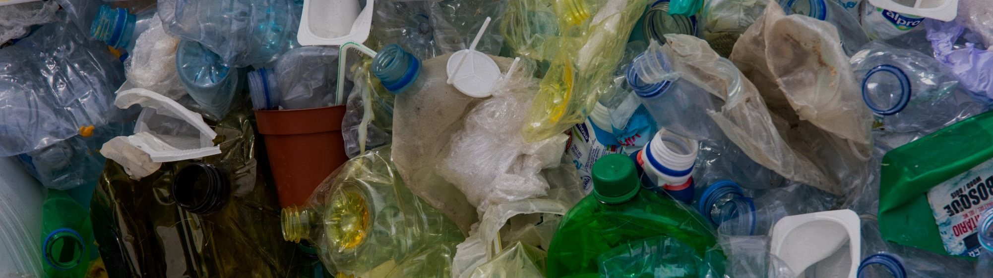
The Inconvenient Truth About Single-Use Plastic Packaging
Political/Legislative Influences
Cannot recycle repurpose our way out of this
Cannot collect the uncollectible
Fortressed Incumbent Position (FIP)
Entangled Relationships & Influence (ERI)
How can an energy bar wrapper become another energy bar wrapper? What exactly do we make out of mixed flexibles?
How do you get 7.8B people globally to cooperate?
We can’t even design it to be less wasteful
Or, to make it stay in one piece while opening!
Notes:
This brings us to the inconvenient truth about single-use flexible packaging.
We have built an out-of-control apparatus to feed an addiction that is now being impacted by a storm of fear, emotion, concern, logic, illogic, and a whole spectrum of self-interests and motives of self-preservation. Keeping the status quo under false hopes, convenient fallacies, even the definition of a Fool's Errand is the "Sustain" in Sustainability. To Sustain the current path. When we hear the use of the word “sustainable” perhaps we should ask for whom it applies?
CLICK
Big Plastics funds the Plastic Industry Association who is intertwined with the American Legislative Exchange, or ALEC, who in turn is a short arm's length with the American Plastic Bag Alliance who is the entity working to lobby and drive local, state, and federal legislation to "ban the bans" on plastics. Just like what happened recently in my own state of Ohio, where local municipalities were banned from enacting their own legislation to ban single-use plastic items including grocery bags and straws. At least Coral Gables, FL has the drive to take this to the Supreme Court, but I suspect it will not avert the course. There is too much money in plastics to rethink it all. Instead, we put blind faith that we can eek out a few more generations of "sustain-ability."
I have come up with two new acronyms - FIP which stands for Fortressed Incumbent Position and ERI which stands for Entangled Relationships & Influence. Bio Oil slash Plastics has embedded both of these into political and corporate influence to "Sustain" its position under the guise of "circularity" for which, the only true circularity is to start with nature and end with nature.
CLICK
Yet, at the end of the day, except for some PET applications, it isn't even RECYCLING, it is repurposing or even refurbishing; perhaps we create a more appropriate term and call it REFURBLING?
MRF's (the material recovery facilities) that sort collected waste were never designed to handle flexible plastics, whether they’re chemically compatible with detergent bottles or not, if it doesn't get removed, it contaminates the paper and paperboard stream.
For store take-back, if everyone actually did save all of their flexible packages and returned it to stores, the stores would have to redesign themselves to accept the enormity of the situation.
And let's say this was accomplished, a granola bar wrapper will never become another granola bar wrapper. How many dog toys and park benches can we mfg to convert the supply of generated plastic waste? Assuming, of course, that consumers are willing to fully cooperate on a GLOBAL scale and have access to recycling centers. It is worth noting that polyolefins, in particular, are destined to waste because they have, at best, a few melt processing passes before the polymer degrades and is unusable. Is it is still recycling if it can only be reprocessed a few times?
CLICK
It comes down to not being able to collect the un-collectible. The flow of it is too massive. The joules and grams of this problem are on too large of a scale. It is like taking 1/4 cup of water from Niagara falls!
We cannot even change the wasteful way we make flexible packaging which is 100% controllable by the manufacturing supply chain. We currently use an entire layer of plastic film to do nothing but carry and protect ink. Rather, we should be simplifying the functional structures, using earth digestible materials, and pushing printing from the first step to the last possible step. Advances in packaging converting that simply did not exist a few years ago will enable us to create a more lean and flexible supply chain, which also lends itself to trends in product marketing. Furthermore, we can't even design packaging that doesn't require smaller pieces to be separated while opening the pack, from tamper shrink film and lidding to the top of your stand-up pouch to how chips, bars, and overwraps are now opened. Much of flexible packaging ends up in two pieces.

