Slide 1

Regulations/Litigations and Plastics in the Circular Economy
Federal Regulations (the best government money can buy)
When that fails litigation
When that fails State regulations (New Jersey, Oregon, Washington, California)
When that fails people power (Ballot initiatives and state constitutional amendments)
International agreements (infancy and political)
EU (advanced)
China (advanced)
Africa

Slide 2
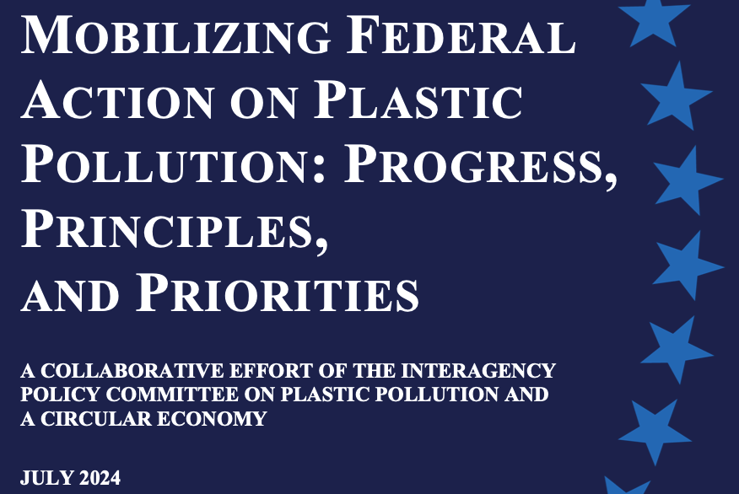
Regulations and Plastics in the Circular Economy

Slide 3
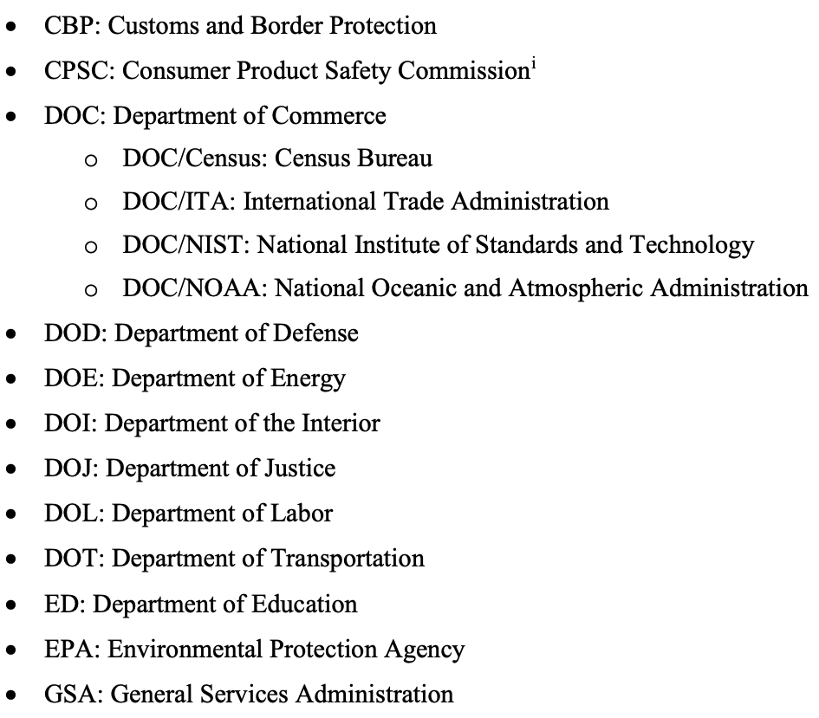
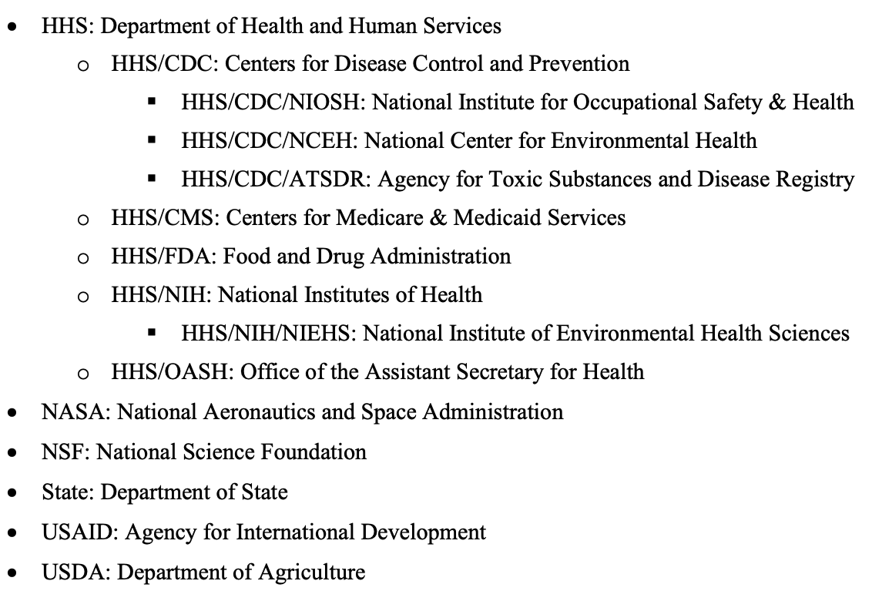
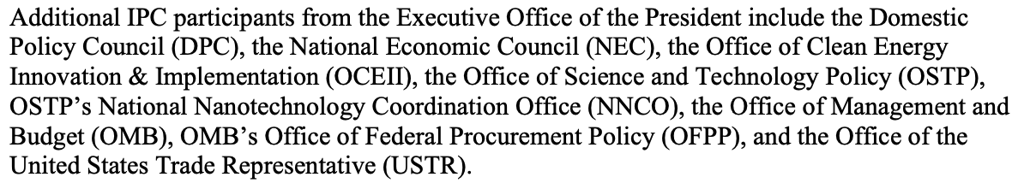

Slide 4
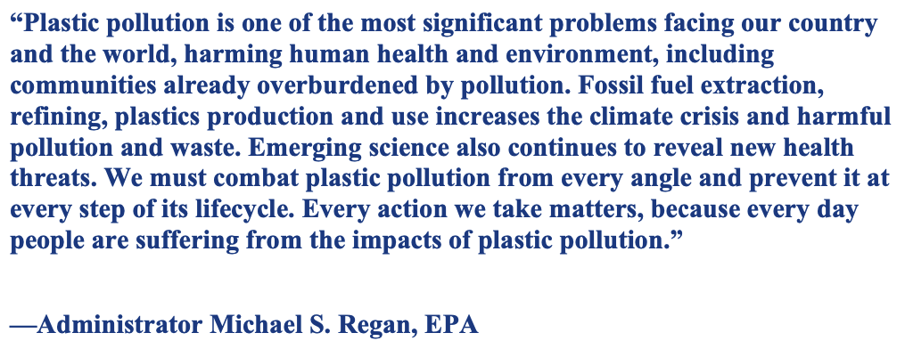

Slide 5
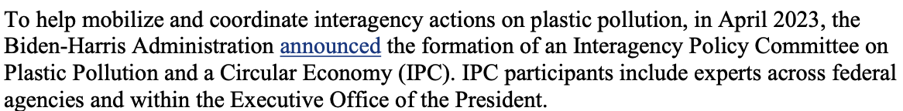
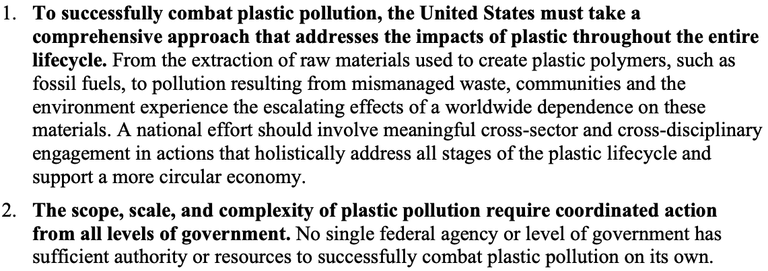
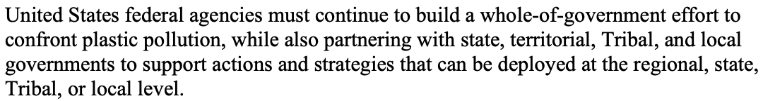

Slide 6
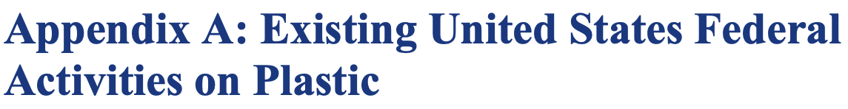
For the most part this involves encouraging agencies to purchase fewer water bottles
And a bit of research money that seems to go nowhere
It is a difficult problem to solve if the political campaigns are funded by petrochemical companies. If we can’t address the climate catastrophe, we have no hope of addressing this relatively minor problem through Federal action but there are alternatives to Federal action.

Slide 7
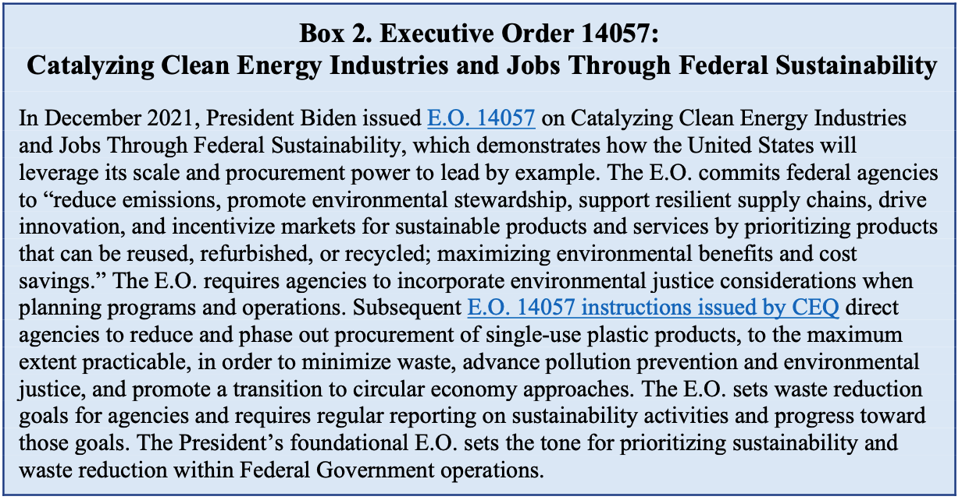

Slide 8
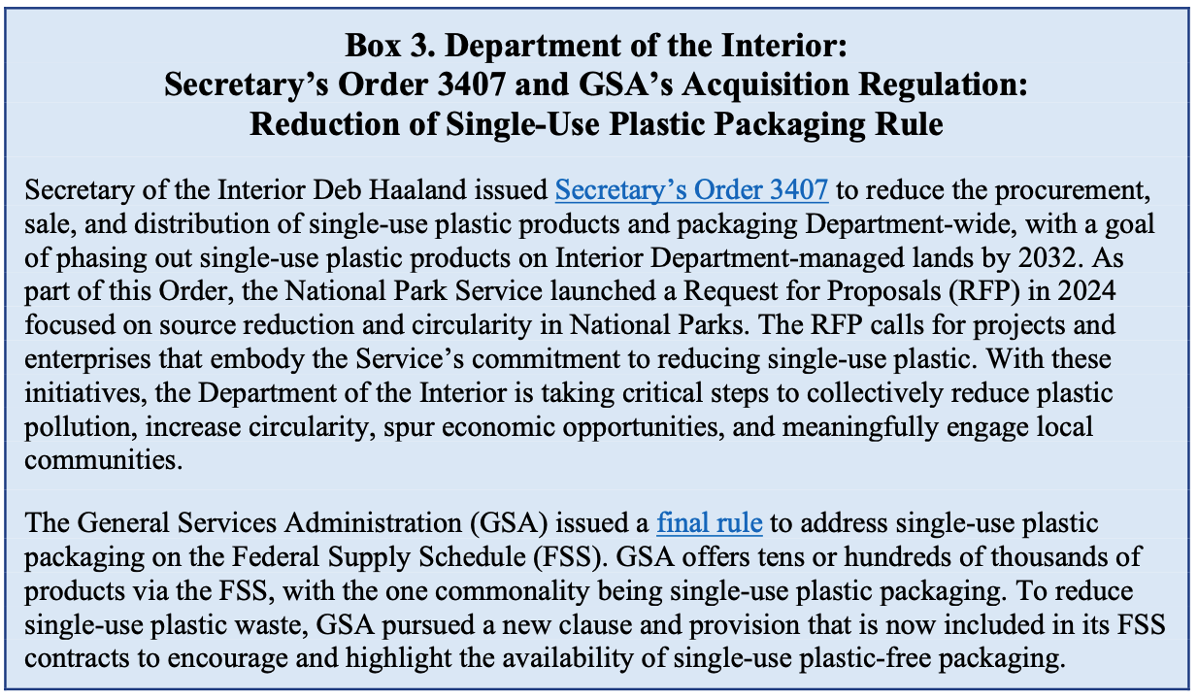


Slide 9
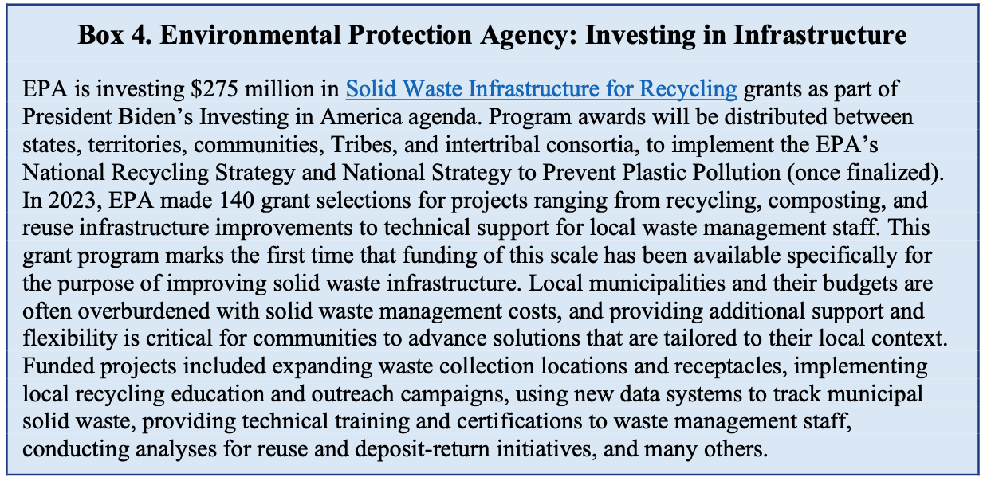

Slide 10
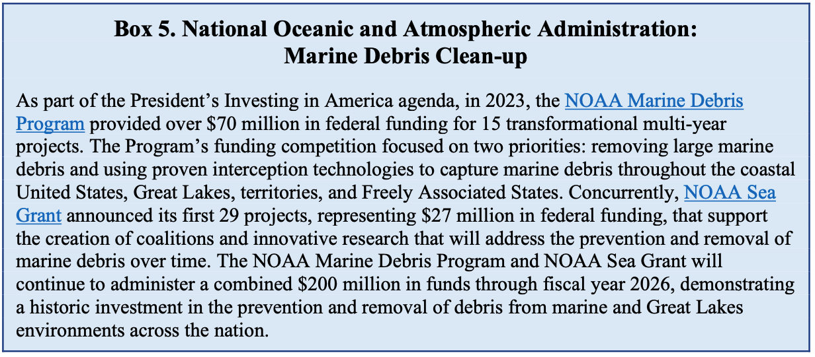

Slide 11
A list of all of the federal legislation that has been proposed:
In addition to the Report on Microfiber Pollution, the Fighting Fibers Act of 2024 has been introduced by U.S. Senator Merkley (OR), specifically to address microfiber pollution from clothing. The Act has two main components: a requirement for washing machines to include microfiber filtration and a requirement for future research on the impact of microfibers.
Bill failed to make it out of committee

Slide 12
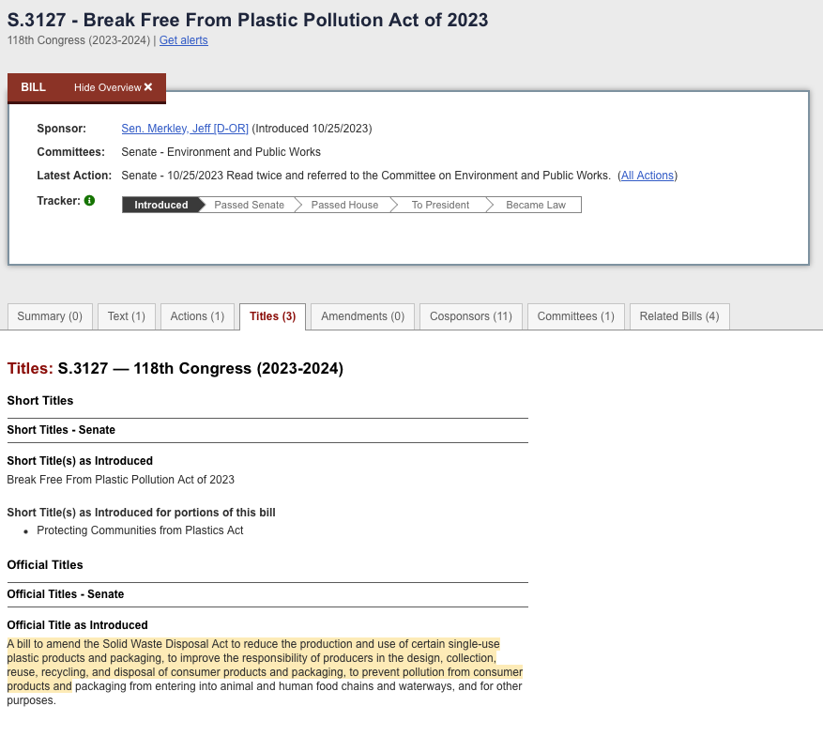
A list of all of the federal legislation that has been proposed:
In addition to the Report on Microfiber Pollution, the Fighting Fibers Act of 2024 has been introduced by U.S. Senator Merkley (OR), specifically to address microfiber pollution from clothing. The Act has two main components: a requirement for washing machines to include microfiber filtration and a requirement for future research on the impact of microibers.

Slide 13
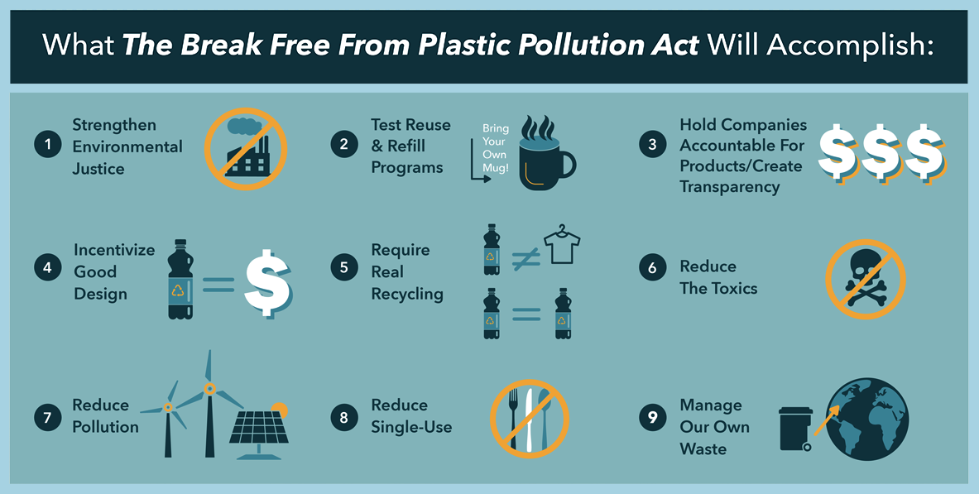
A list of all of the federal legislation that has been proposed:
In addition to the Report on Microfiber Pollution, the Fighting Fibers Act of 2024 has been introduced by U.S. Senator Merkley (OR), specifically to address microfiber pollution from clothing. The Act has two main components: a requirement for washing machines to include microfiber filtration and a requirement for future research on the impact of microibers.

Slide 14
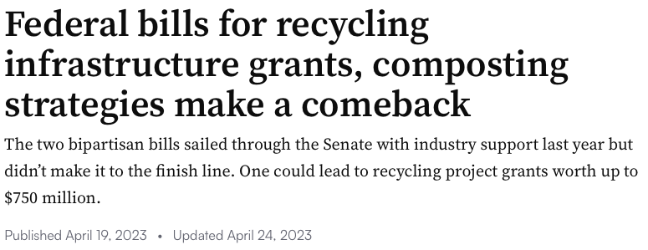
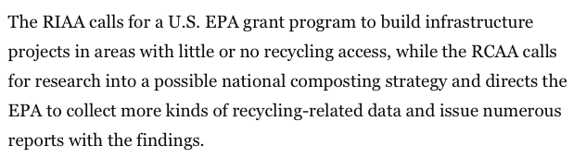
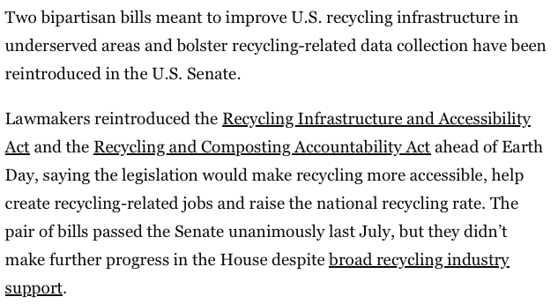
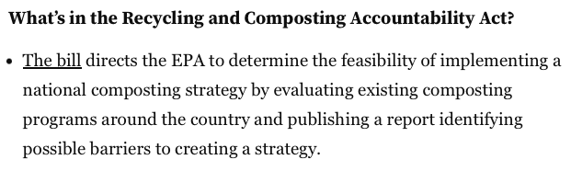


Slide 15
Can existing federal legislation be used by interested regulatory agencies (EPA, NIOSH)
(The current supreme court has greatly limited the ability of agencies to interpret laws to form regulations)
From Reckoning with Plastic Waste in Oceans (aka the clean water act)
https://youtu.be/jQYbxZCcWB8?si=kQdXWHfbkigKmWnf

Slide 16
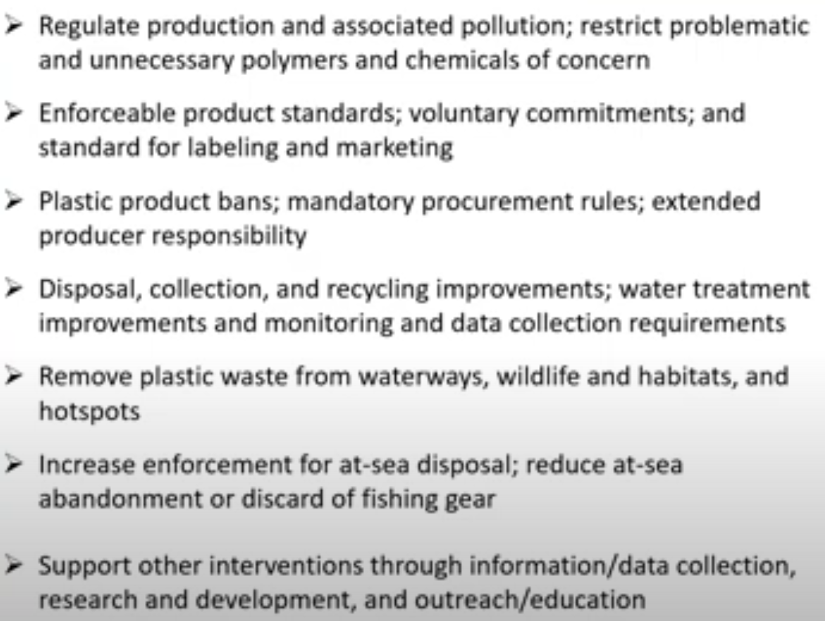
What the existing laws could be used to do:

Slide 17
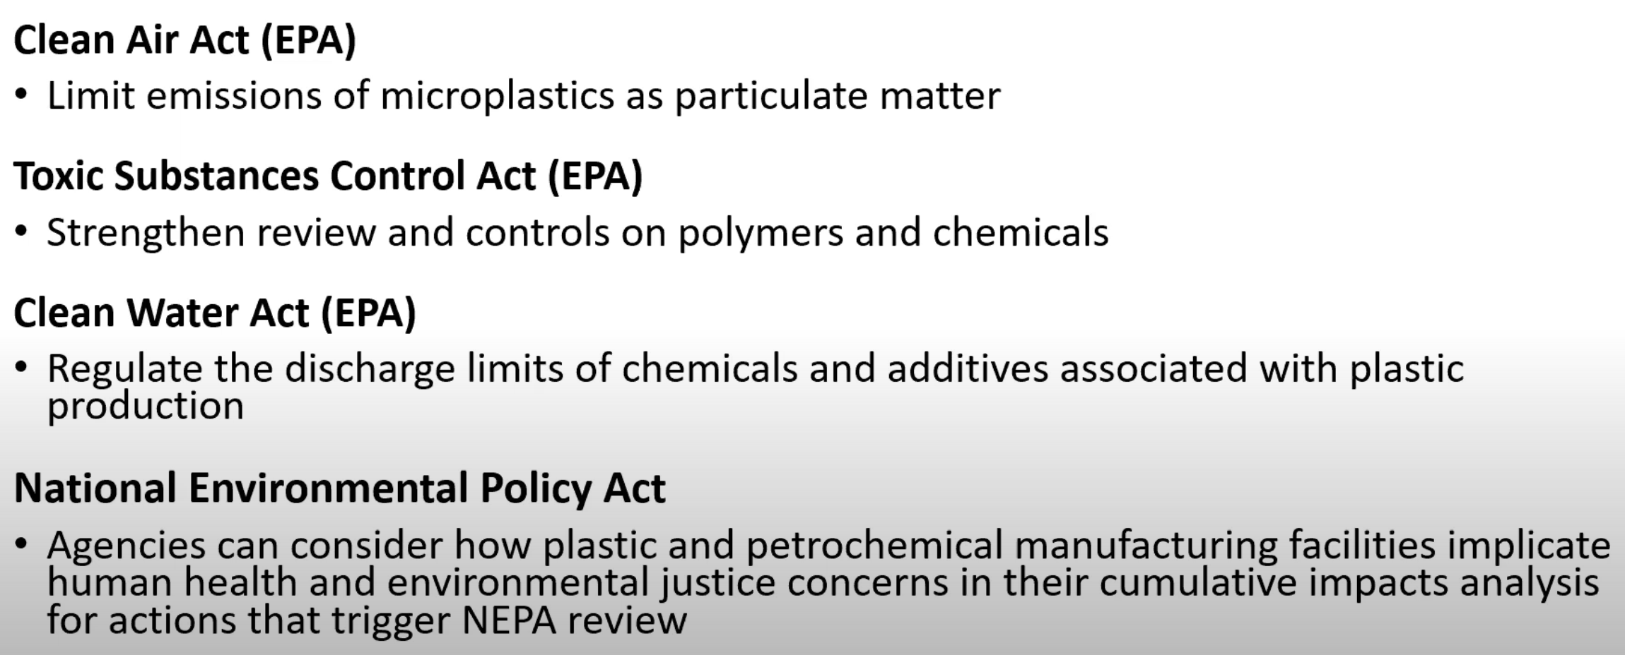
Basically, no Federal regulations specifically on plastics in the circular economy
Enforceable laws that could be used

Slide 18
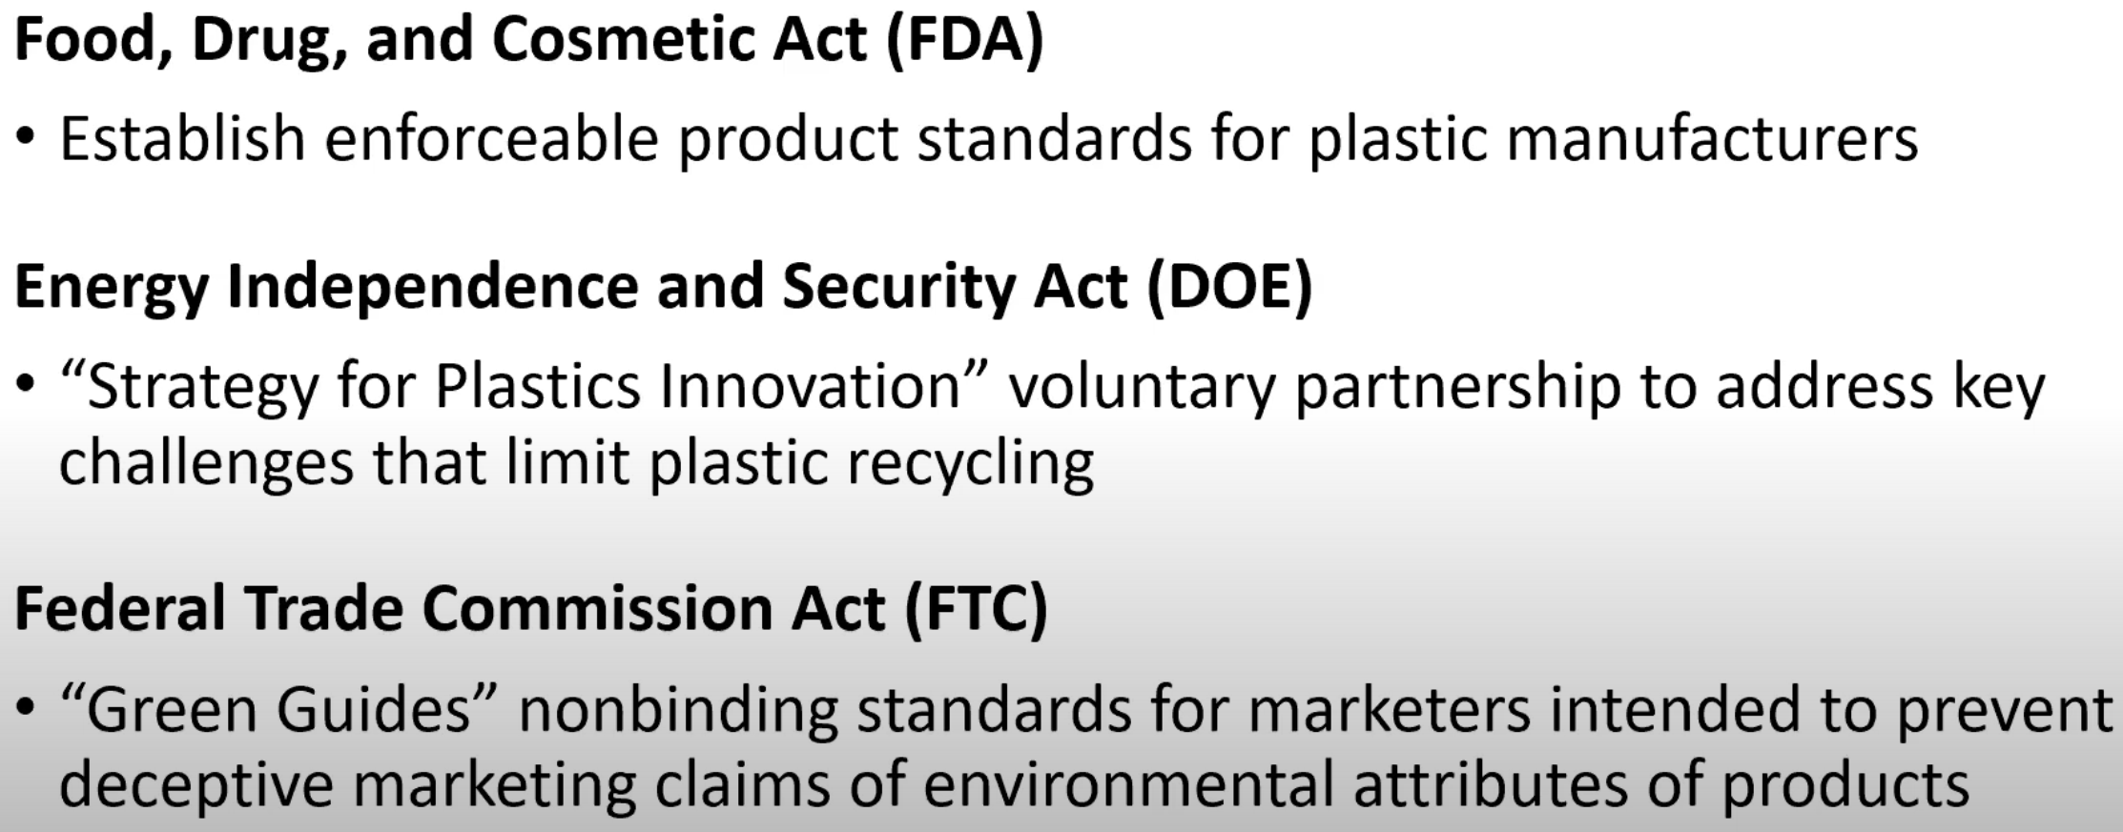
Voluntary actions

Slide 19
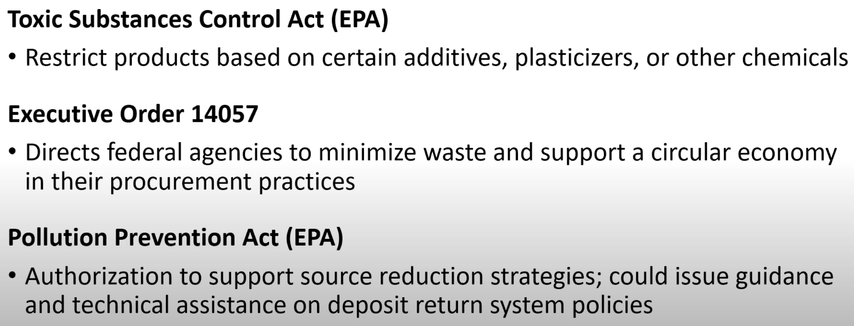
Decrease waste

Slide 20
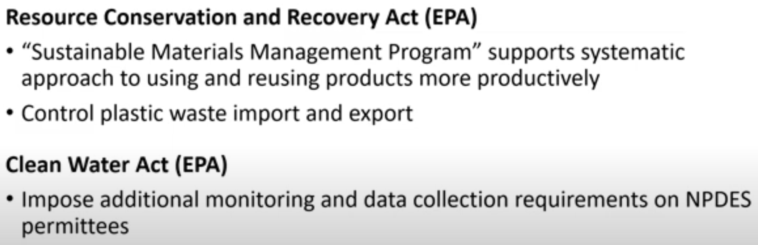
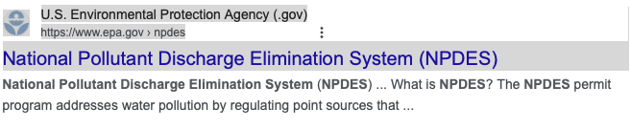
Don’t export waste

Slide 21
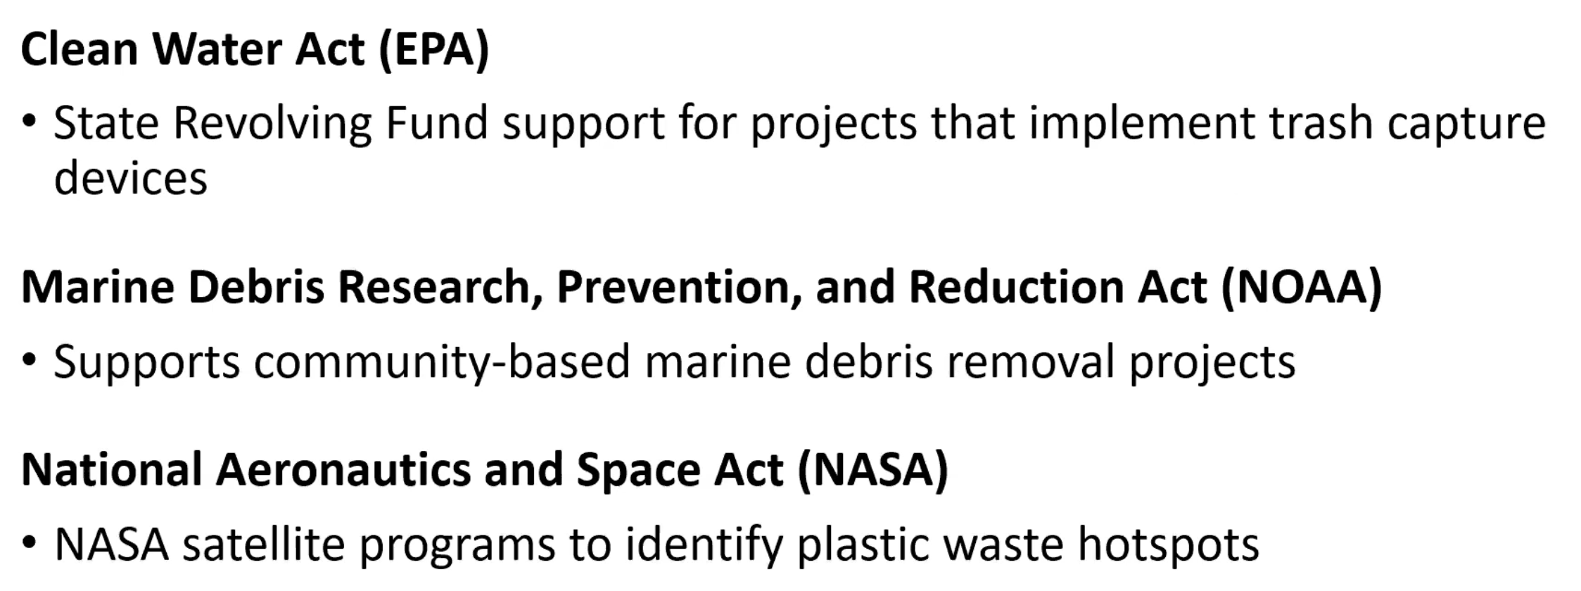
Monitor waste

Slide 22
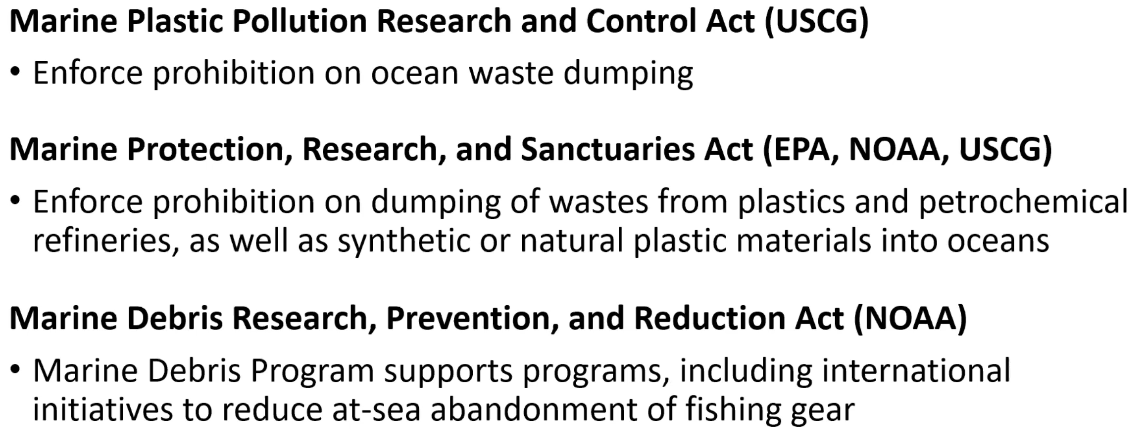
Plastics Police

Slide 23
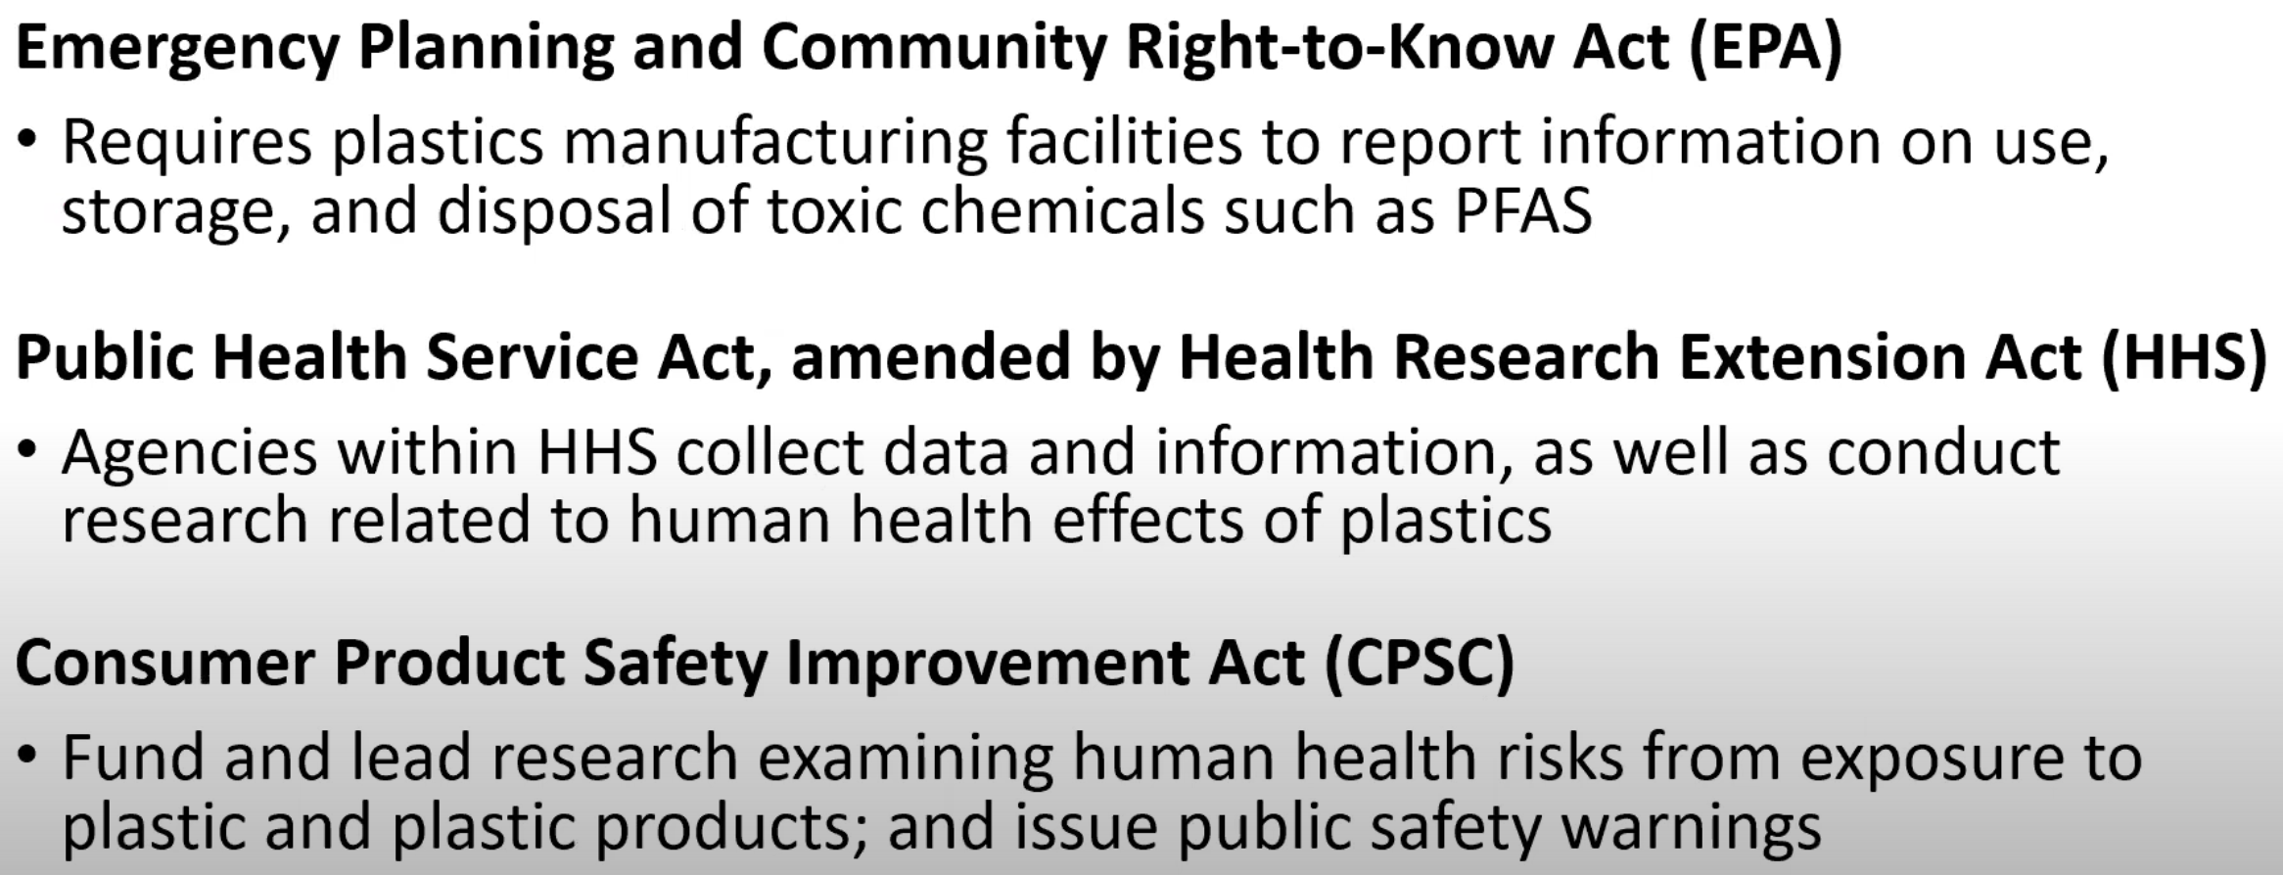
Reporting requirements

Slide 24
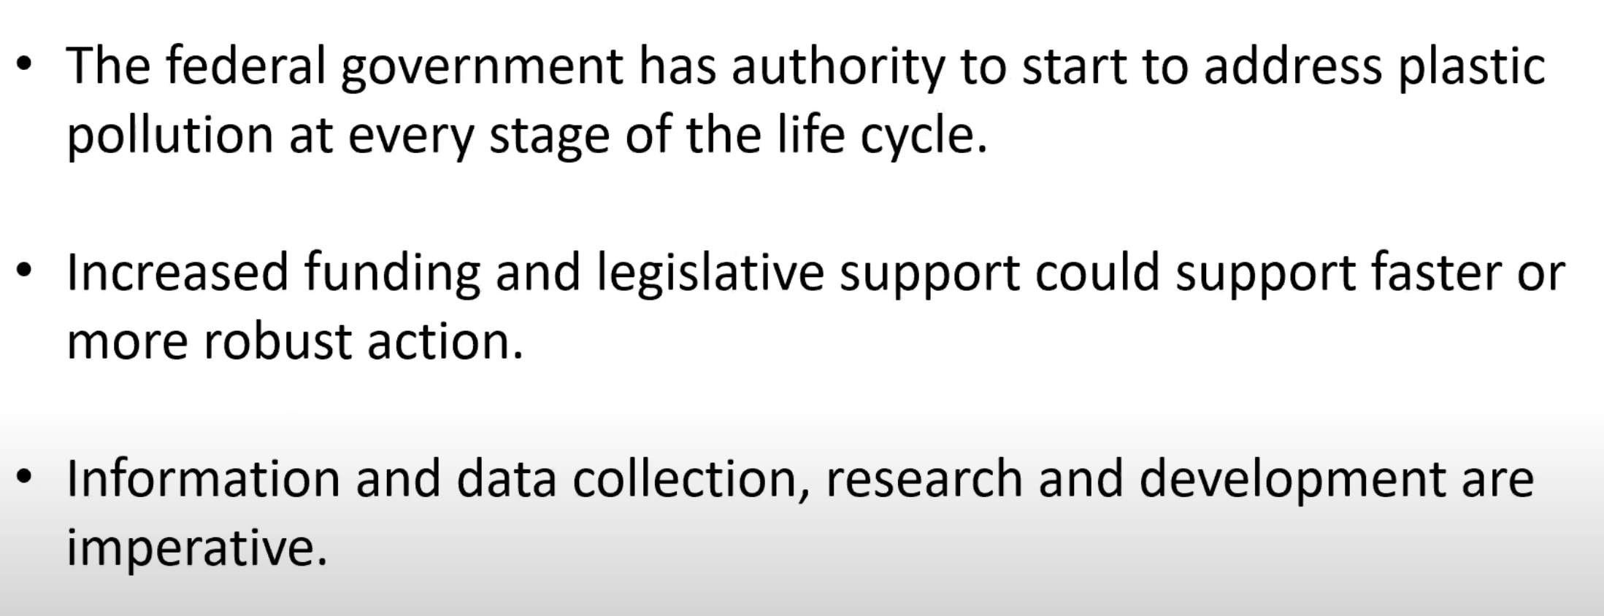

Slide 25
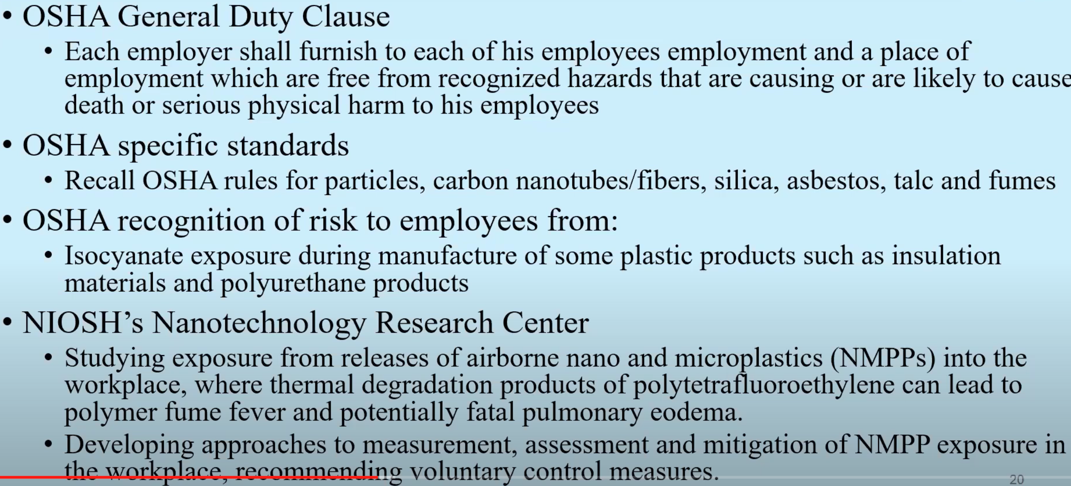
It can be argued that the government already has broad authority to regulated plastics waste.
This would require a political will to act since there is a political (campaign donation) risk (aka don’t hold your breath).

Slide 26
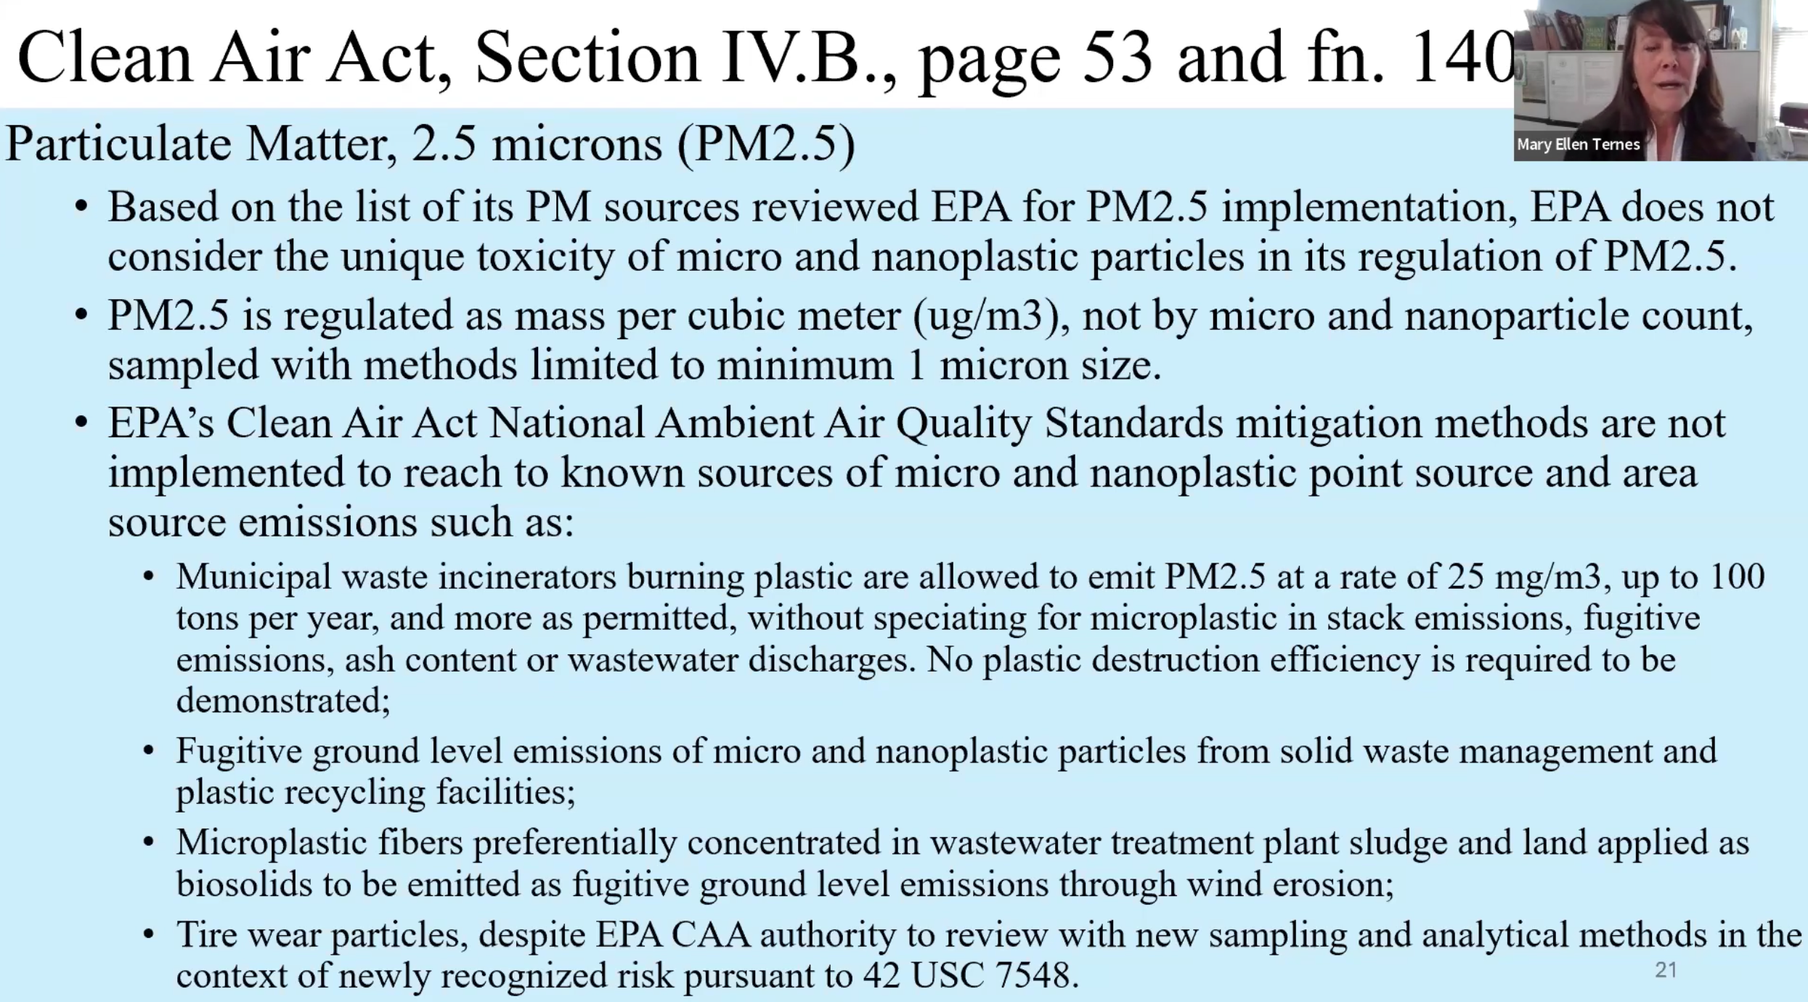
It seems like it will take some lawyers to sort this out.

Slide 27
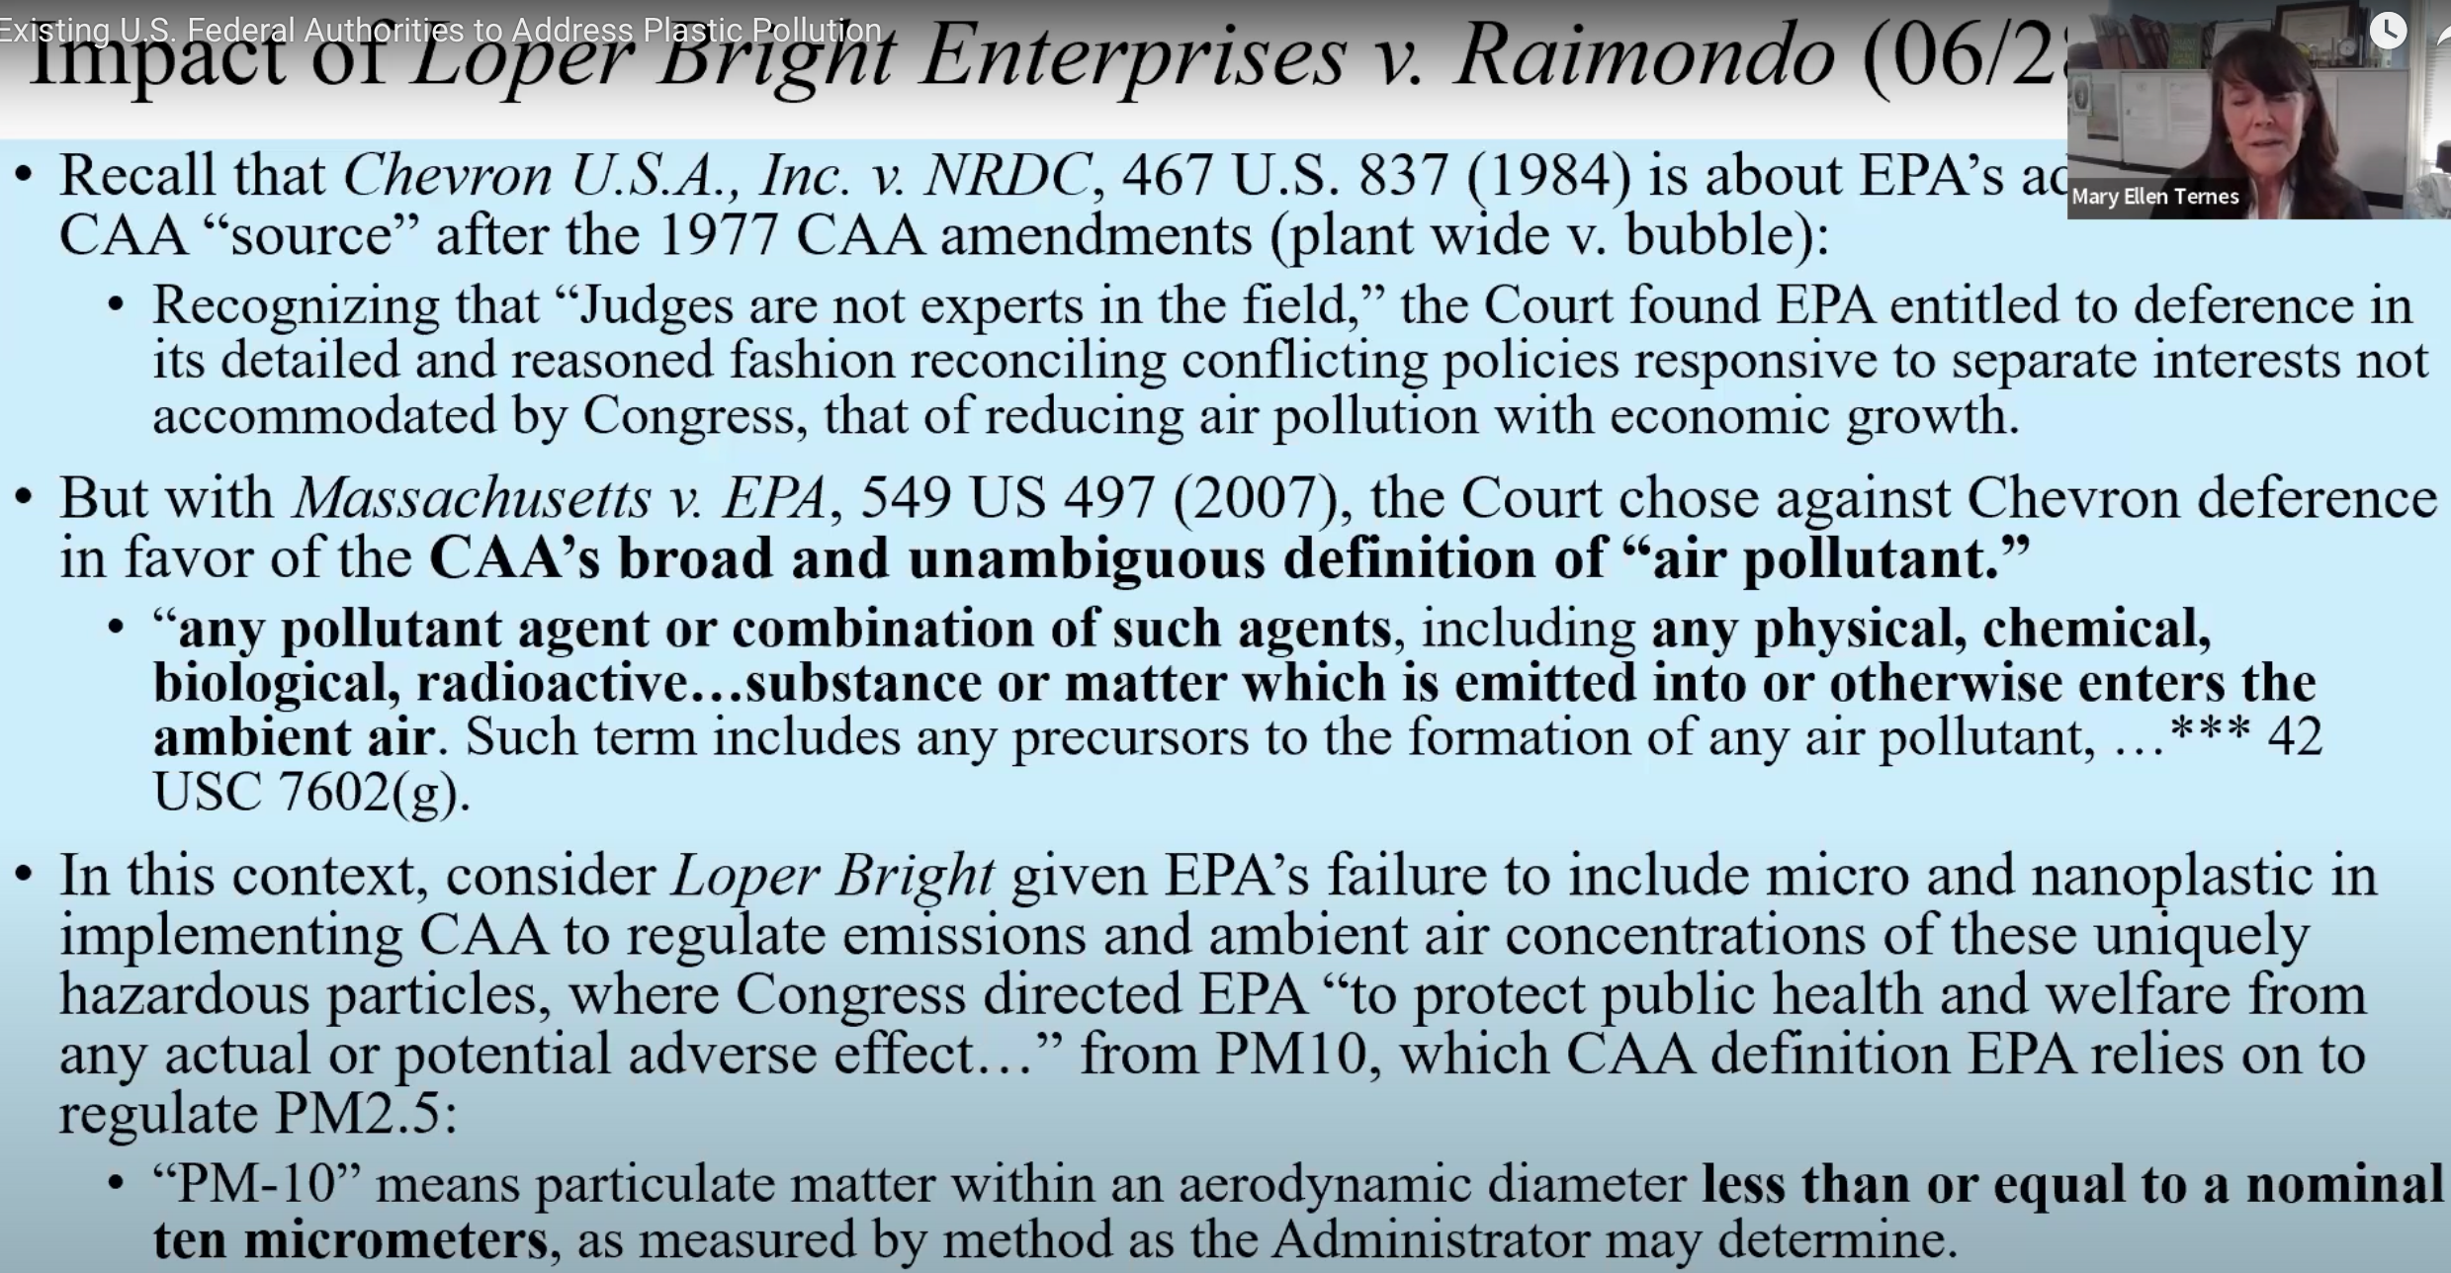
Natural Resources Defense Council
Clean Air Act
(CAA)

Slide 28
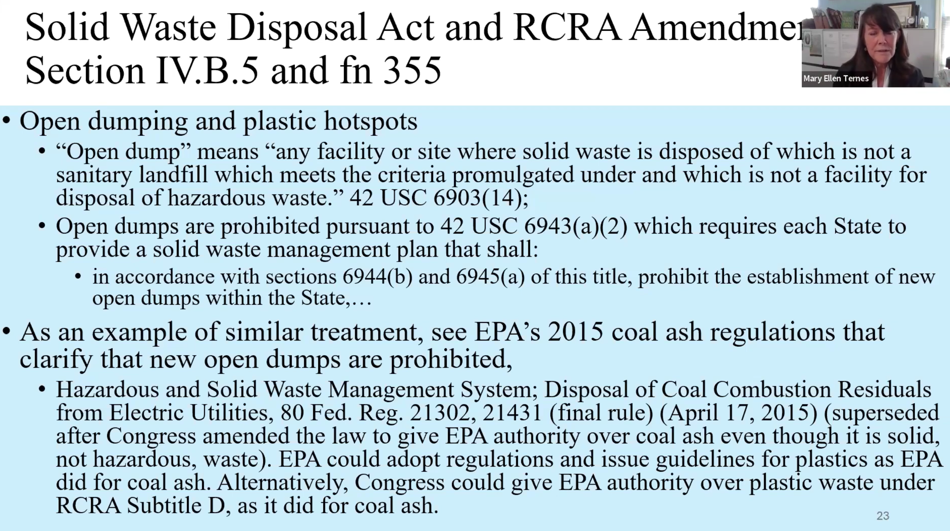
Resource Conservation and Recovery Act (RCRA)

Slide 29
Litigation: Why not just sue “them”?

Slide 30
Litigation: Why not just sue “them”?
Litigation is why we have seat belts, head rests, collapsable steering wheels, air bags, exit signs in movie theaters, no smoking in theaters, fire escapes (two exits for each floor), breaker bars on exit doors, warnings for babies on plastic bags, ...
Go to another country and notice the absence of routine and obvious safety features.
Same car sold in US or Brazil is a bit cheaper ($500) but has no seat belts, air bags etc.
Movie theaters in Switzerland allow smoking and have no exit signs.
Airbnb in the lake district is on 4’th floor with only one exit down a narrow wooden staircase (aka a burning chimney; but has a great view and a working gas fireplace!) etc.
It is an effective way to bring about needed control to an out-of-control society
American Museum of Tort Law (aka the Ralph Nader Could have been Presidential Library, he ran five times)

Slide 31
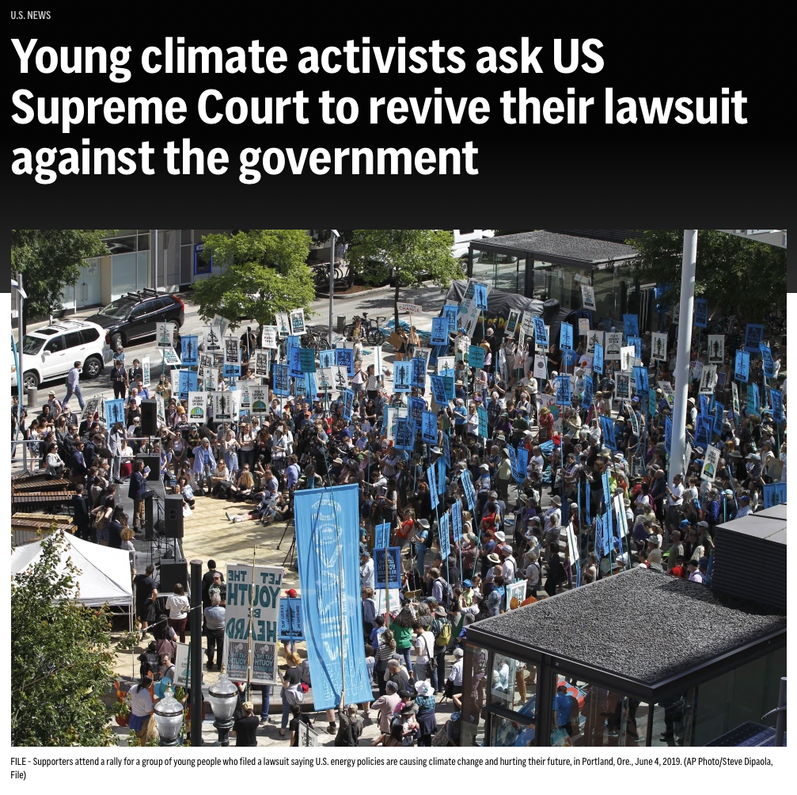
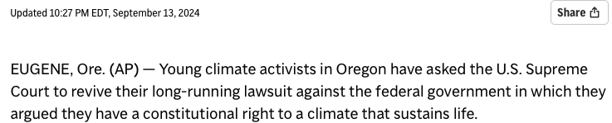
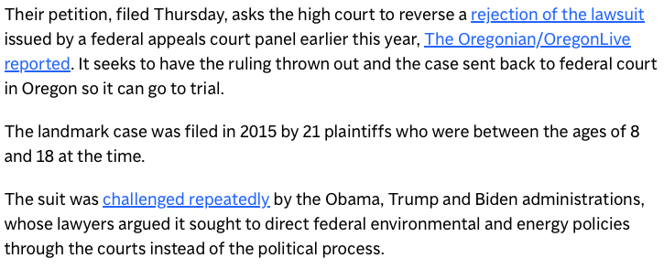
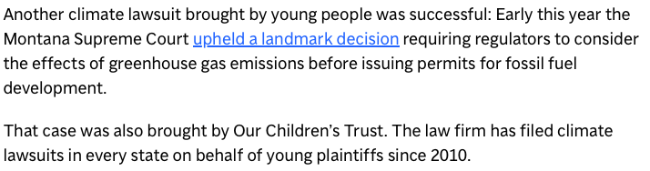
Why not for plastics waste?
The political process works so well…

Slide 32
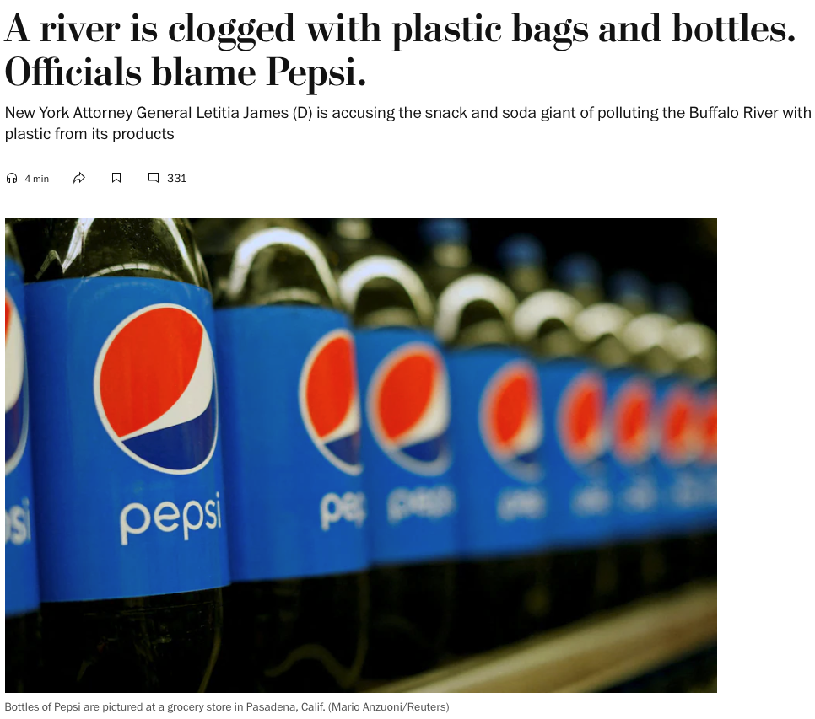
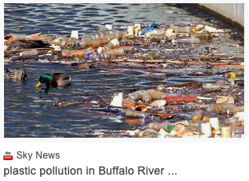
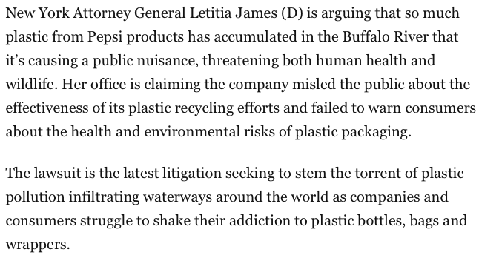
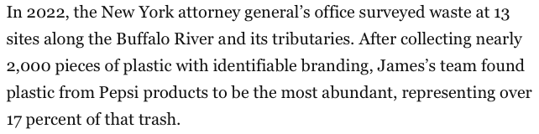

Slide 33
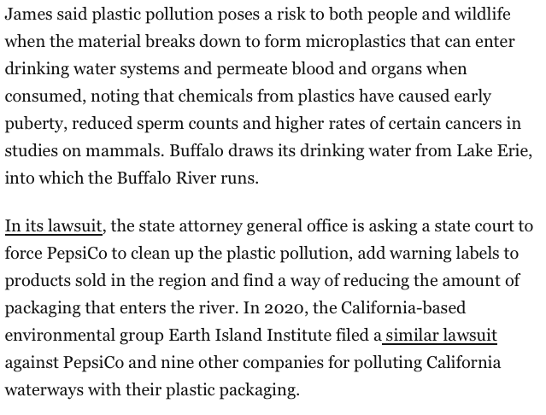

Slide 34
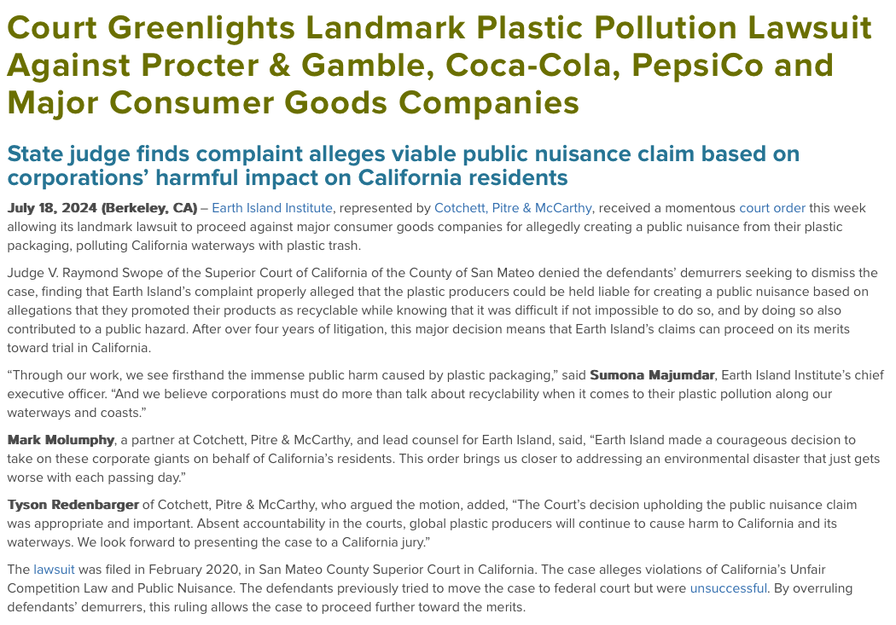

Slide 35
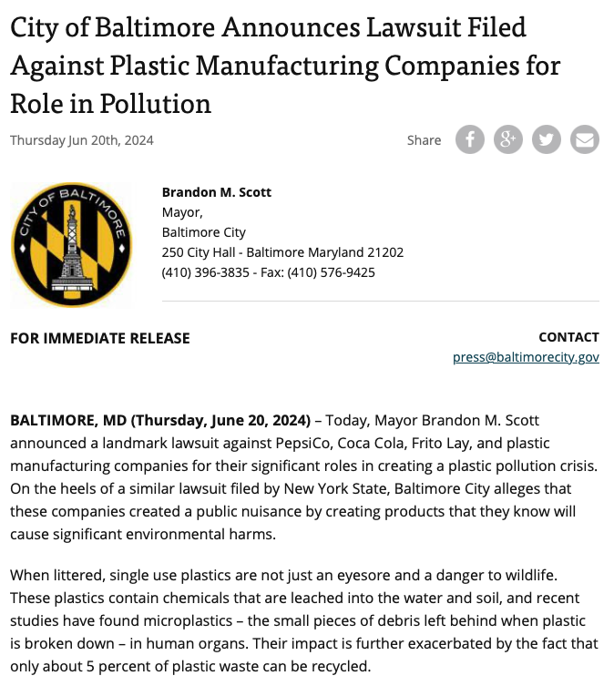
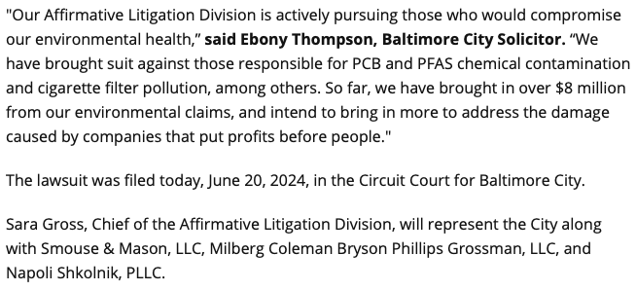

Slide 36
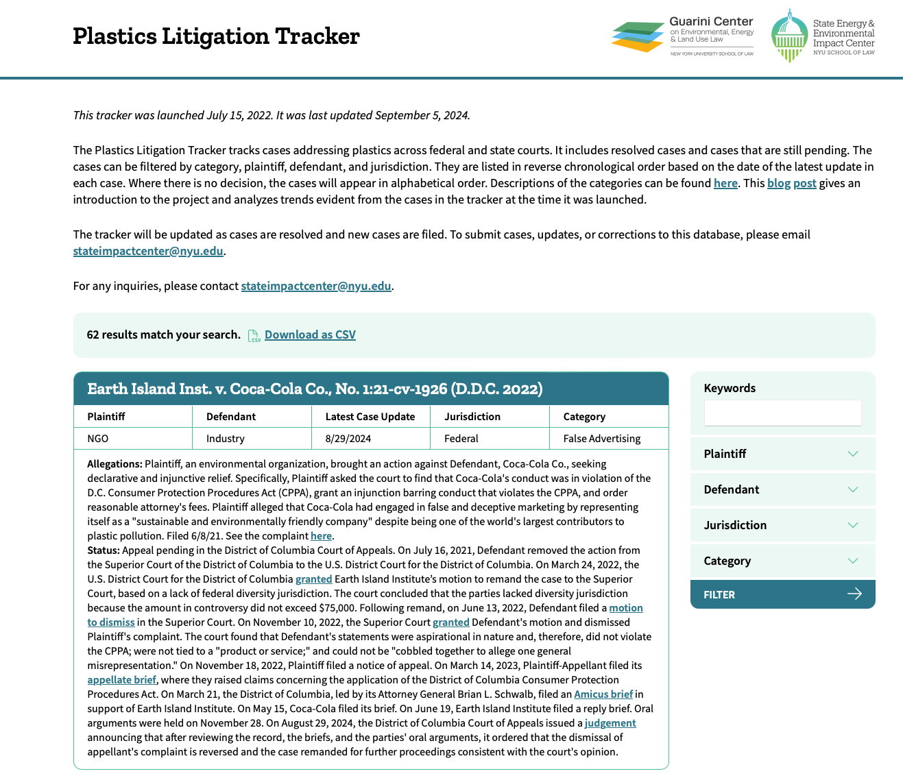

Slide 37
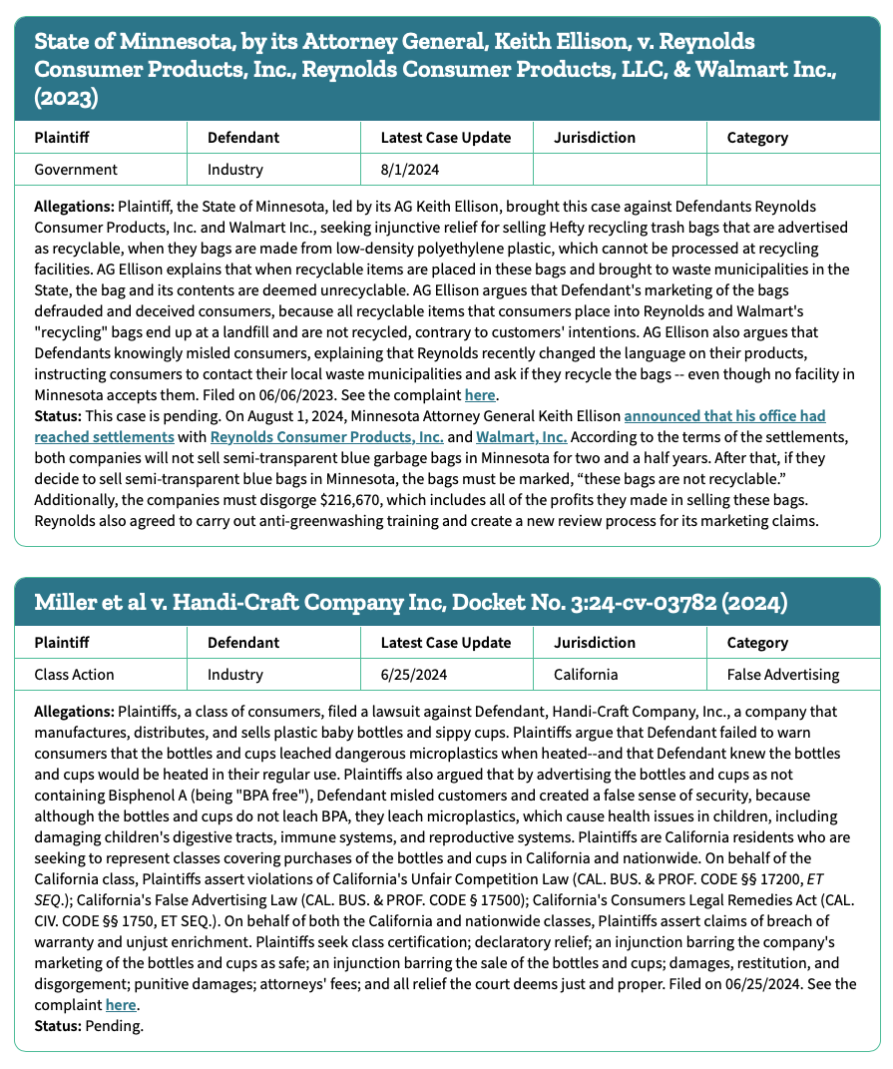
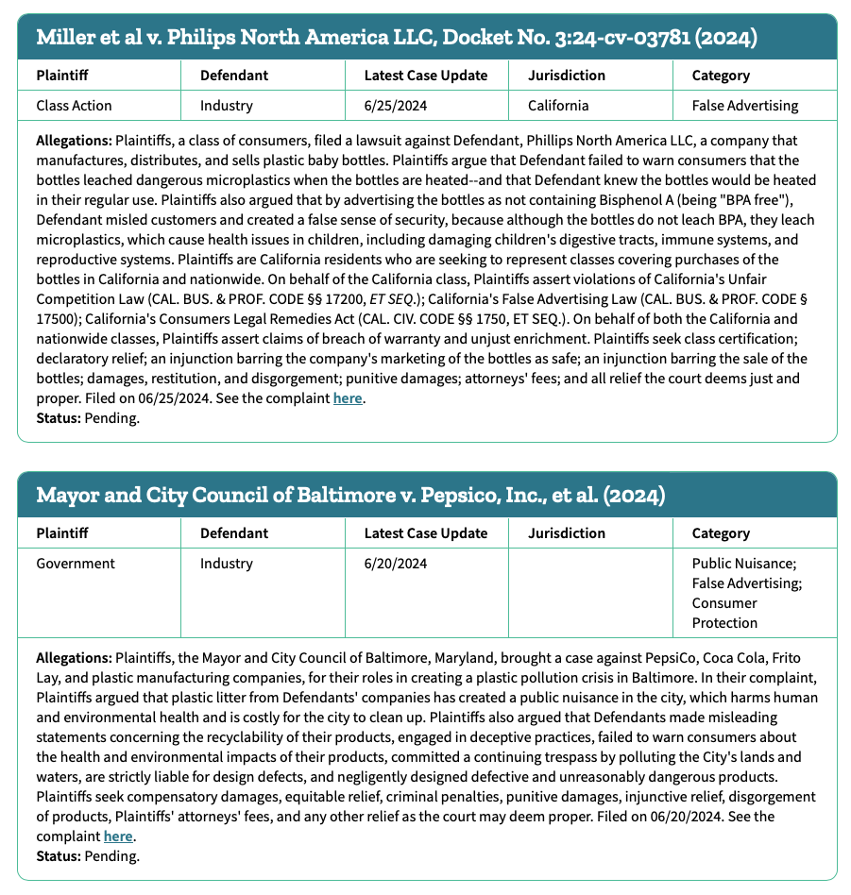

Slide 38
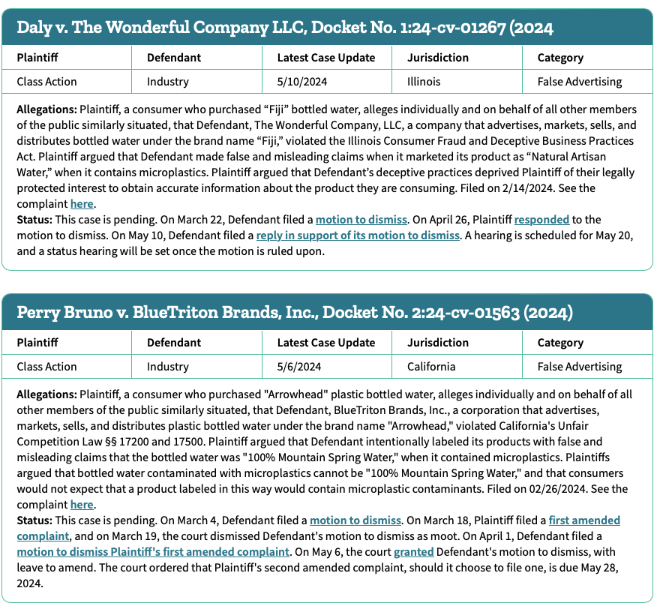
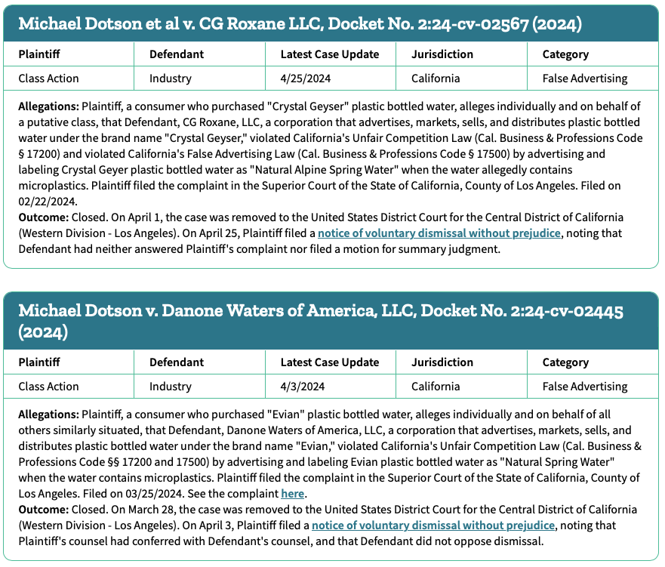

Slide 39

There are 7 pages on this website
https://plasticslitigationtracker.org/page/7

Slide 40
Cases attacking state and local restrictions
These are mostly plastic bag and foam container restrictions
The plaintiffs have predominantly been organizations aligned with plastic product manufacturers and retailers. One case, though, involved several local governments challenging Pennsylvania’s prohibition on local governments enacting taxes or bans on single-use plastic products. Most of these cases have been brought in California (seven cases) and New York (four cases).
Industry groups have used a variety of legal theories in their challenges, including that the bans or taxes at issue were preempted by state law, inconsistent with the state constitution, and/or violated state environmental statutes.

Slide 41

Cases attacking state and local restrictions
These are mostly plastic bag and foam container restrictions
The plaintiffs have predominantly been organizations aligned with plastic product manufacturers and retailers. One case, though, involved several local governments challenging Pennsylvania’s prohibition on local governments enacting taxes or bans on single-use plastic products. Most of these cases have been brought in California (seven cases) and New York (four cases).
Industry groups have used a variety of legal theories in their challenges, including that the bans or taxes at issue were preempted by state law, inconsistent with the state constitution, and/or violated state environmental statutes.
Or the corporations can just enact legislation to deal with the problem of litigation

Slide 42
Cases attacking claims of recyclability
Recent research has documented very low recycling rates for certain types of plastic products. Consumers and NGOs have relied on this research (predominantly an extensive report by Greenpeace) to challenge the recyclability representations on plastic products. They have used state consumer protection law, such as false advertising or deceptive business practices statutes, and relied on guidance from the Federal Trade Commission (FTC) about what should be labeled as “recyclable.” A small number of cases has also involved challenges to plastic producers’ public representations that they are “sustainable and environmentally friendly.”
The eleven cases in this category³ have, for example, implicated “recyclable” labels on products such as Coca-Cola beverages and Walmart’s proprietary plastic packaging. Most were filed in California, which has a statute governing the use of environmental marketing claims (though a handful of states have similar statutes).
Most of these cases are ongoing. But plaintiffs have been successful in securing favorable decisions or settlements when they have targeted the specific representations on plastic products that influenced consumers’ purchasing decisions.
For example, Keurig entered into settlement negotiations with a nationwide consumer class because the plaintiffs had presented evidence that undermined the accuracy of the recycling labels on Keurig’s coffee pods and showed that consumers had paid more for the pods because they believed that the pods were recyclable.

Slide 43
Claims against Plastics Producers
In April 2022, California Attorney General Rob Bonta announced his office’s investigation into the fossil fuel and petrochemical industries for their role in aggressively promoting plastic products, exacerbating plastic pollution, and concealing the harmful effects of their products from the public. As part of the investigation, AG Bonta issued a subpoena to ExxonMobil, a major manufacturer of plastics. In June 2022, Connecticut Attorney General William Tong announced his office’s lawsuit against Reynolds Consumer Products for violating Connecticut’s Unfair Trade Practices Act. AG Tong alleges that the company falsely and deceptively marketed Hefty trash bags as “recyclable” despite knowing that they could not be recycled in Connecticut recycling facilities. These claims are similar to those that consumer classes and environment groups have brought against plastic distributors and retailers (discussed in the preceding section). More state attorneys general may join AGs Bonta and Tong in investigating or litigating against the plastic industry.

Slide 44
State laws

Slide 45


State laws
2023

Slide 46



Slide 47



Slide 48


Slide 49



Slide 50


Maine

Slide 51

Oregon

Slide 52



Slide 53



Slide 54



Slide 55



Slide 56



Reflecting Corporate Desire for “Advanced Recycling”

Slide 57



Slide 58

Reflecting Corporate Desire for “Advanced Recycling”

Slide 59



Slide 60



Slide 61


Slide 62


Slide 63



Slide 64



Slide 65



Slide 66


Slide 67


Slide 68


Slide 69
Ballot Initiatives (Power to the People?)
Well, there is only one example on a statewide level
Many on a local level

Slide 70

Ballot Initiatives (Power to the People)

Slide 71


Slide 72


Slide 73


Slide 74




Slide 75




Slide 76




Slide 77




Slide 79
International laws

Slide 80


International laws
2022

Slide 81






https://elaw.org/plastic

Slide 82



Slide 83



Slide 84




Slide 85


Extended Producer Responsibility (EPR)

Slide 86



Slide 87


Slide 88



Slide 89


Slide 90





Slide 91



Slide 92



Slide 93


Slide 94


Dumping of US plastic waste in China, Thailand, Malaysia, Vietnam…

Slide 95


Slide 96

Also, in China microplastics rules

Slide 97


Slide 98

Chinese Laws on Recycling Plastics

Slide 99



EPR

Slide 100


