Slide 1
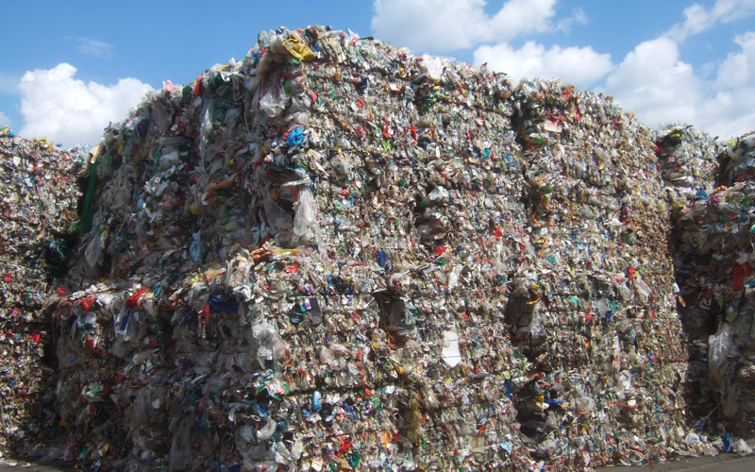
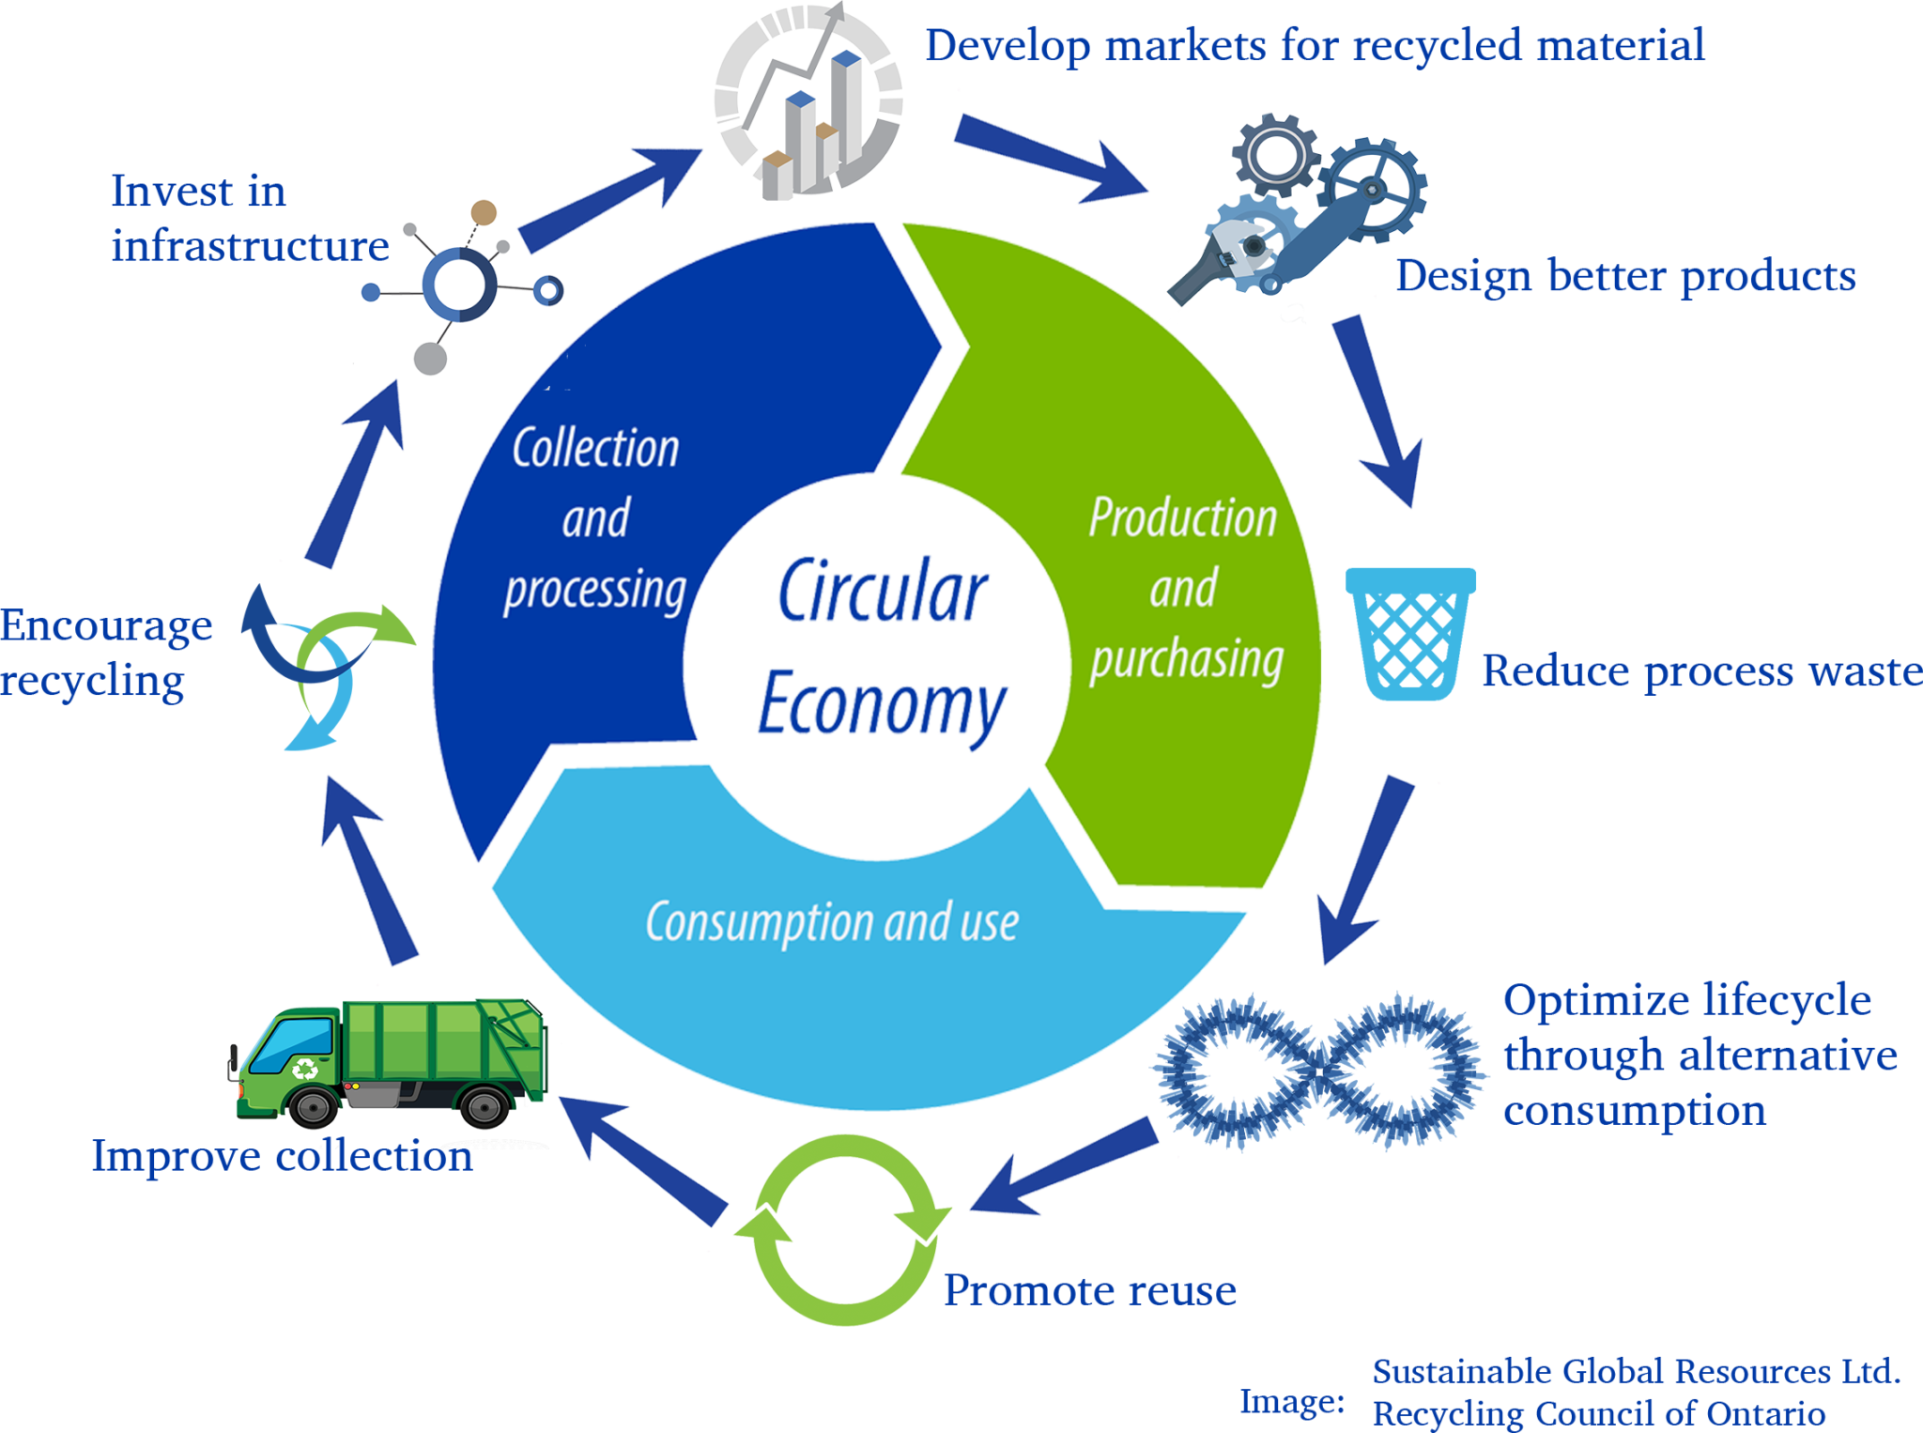
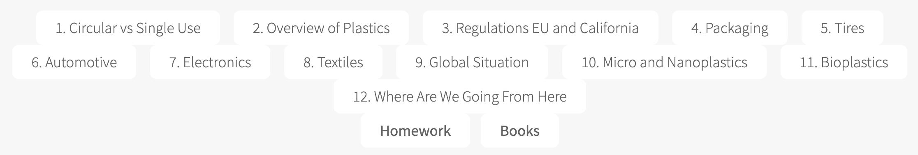
Plastics in a Circular Economy
Course Outline
Course webpage:
https://www.eng.uc.edu/~beaucag/Classes/PlasticsInACircularEconomy/PlasticsInACircularEconomy.html
Class meets Tuesday and Thursday 3:30-4:15 Rec Center 3200
Greg Beaucage
Expert in Plastics and Polymer Science

Slide 2
Plastics in a Circular Economy
Course Requirements
Weekly group homework due on Monday at noon
Rules:
Everyone contributes on each question (at a minimum in critique of the answer)
When someone doesn’t participate, you are required to report them to me
When you don’t participate, you are transferred to a non-participatory group for the semester, and you get a 0 grade for that week
The homework are generally easy, qualitative problems that hopefully spur some discussion within your group

Slide 3
Plastics in a Circular Economy
Course Requirements
Final homework (UG)/Review article (GS)
Rules:
The final homework is an individual assignment and is due Friday December 12
Graduate students, in addition to the weekly group homework, will need to prepare a review paper on plastics in a circular economy that will be due on Friday December 12. This could be related to your research topic or could be just something of interest to you (10-20 pages plus references: abstract, introduction, body, conclusion).

Slide 4
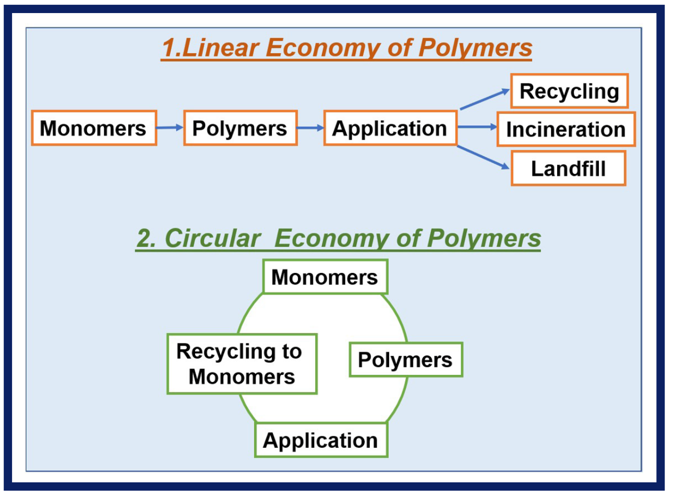
Circular versus Single Use
Reuse, Recycle, Repair, Repurpose
Upcycle, Recycle, Downcycle (, precycle, wish-cycle)

Slide 5
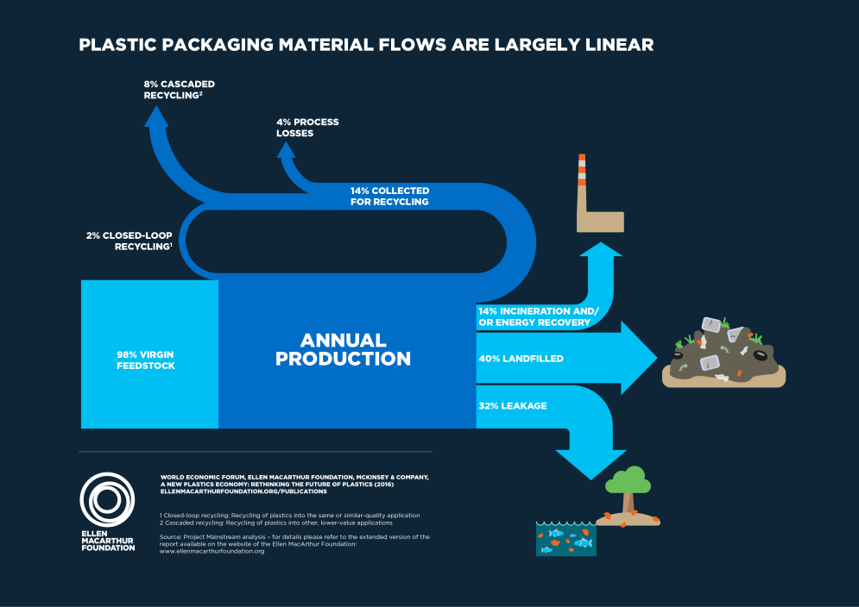
Circular versus Single Use

Slide 6
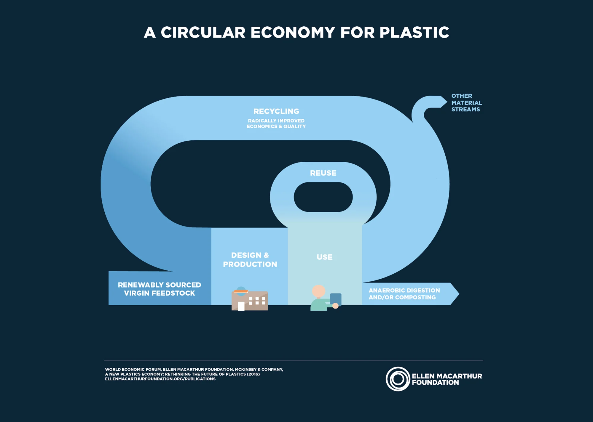
Circular versus Single Use

Slide 7
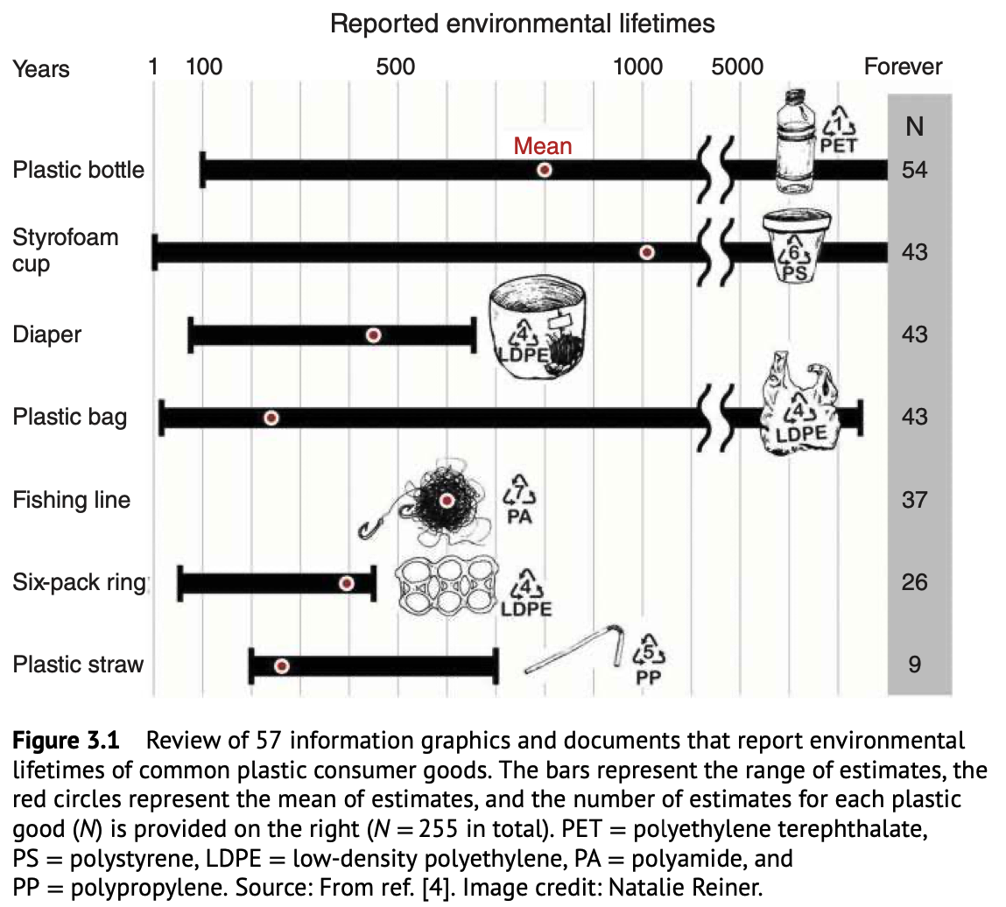
Circular versus Single Use
Reuse, Recycle, Repair, Repurpose
Upcycle, Recycle, Downcycle (, precycle, wish-cycle)

Slide 8
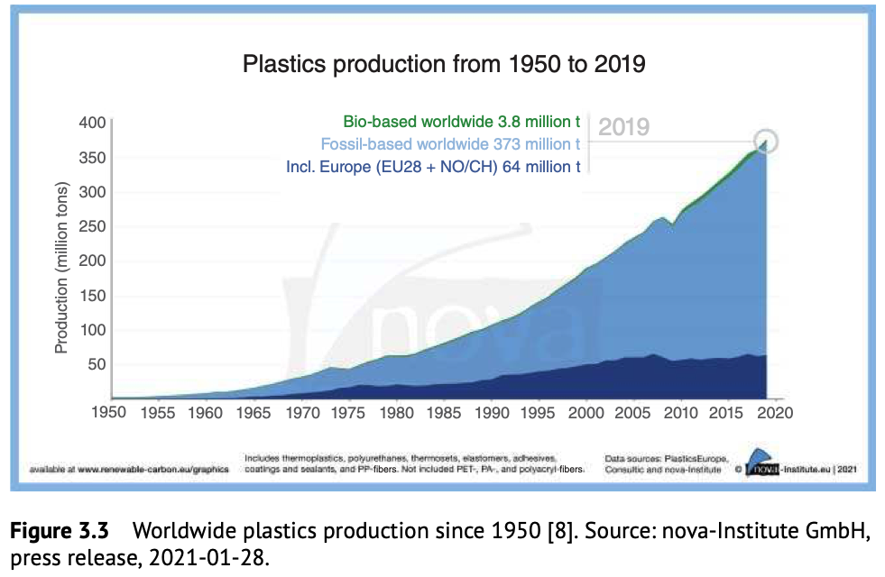
Circular versus Single Use
Reuse, Recycle, Repair, Repurpose
Upcycle, Recycle, Downcycle (, precycle, wish-cycle)

Slide 9
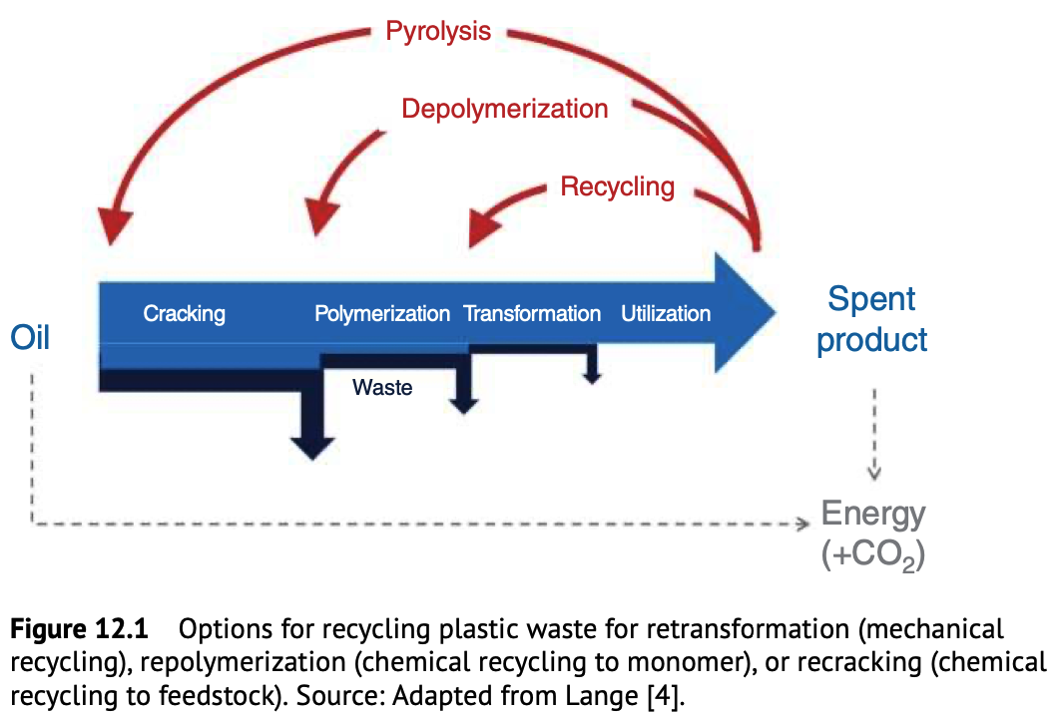

Slide 10
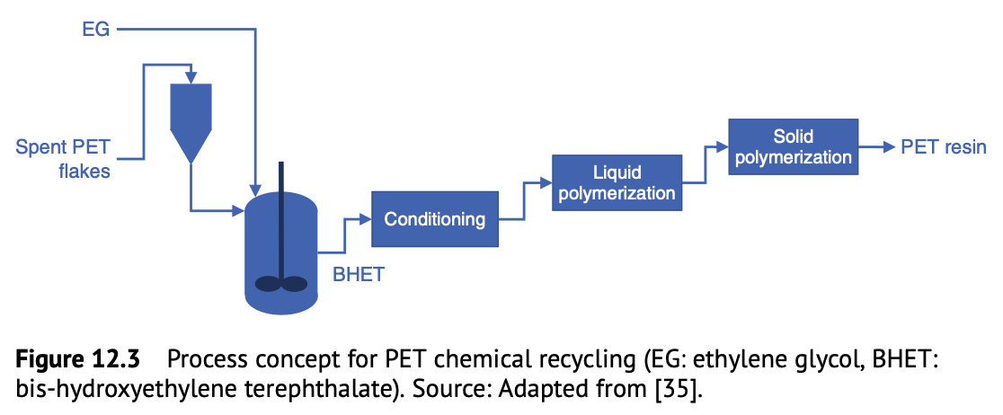

Slide 11
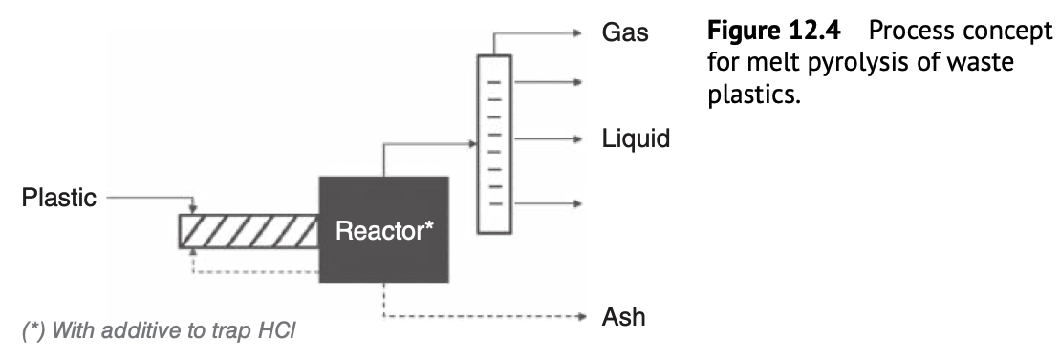

Slide 12
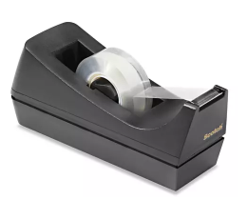
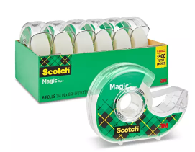
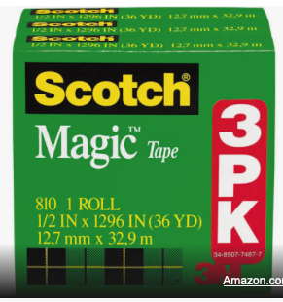
Where did we go wrong? The origin of Single Use Plastics
You want to make a product like a scotch tape container.
Carbon filled ABS plastic
# 7.2 plastic
These are recycled in a mixed plastic
stream for park benches
$5.50 for one
$17.70 for 6
$2.95 each
Polystyrene holder
Could be recycled
but is not recyclable
#6 plastic
https://exploreloop.com
$10.89 for 3
$3.63 each
It would seem that demand for single use product drives the price down

Slide 13
Circular versus Single Use
2/3 of greenhouse gases come from ”linear processes” of extraction and mining, manufacturing, disposal of consumer products
The “take-make-waste” system

Slide 14
Circular versus Single Use
Who pays the costs of a linear economy, planned obsolescence, single use, ”trading up”, “take-make-waste system”
Extraction of oil for plastics, ore for metals, timber for paper
Processing by distillation and chemical conversion, reduction at
high temperatures, pulping
Disposal in landfills
Long term environmental damage from each stage and
associated health costs
Quality of life
It is easy to lay blame on industry, politicians, investors (basically capitalism), partial blame is on over population growth (we need fewer of us), wasteful consumption (private jets or long showers), unwholesome living (Buddhist thing)
The solution could seem to lie with consumers/users and public
perception/demand but partly with the resulting regulations

Slide 15
Circular versus Single Use
Plastics:
We burn about 1,000 years of earths biomass production per year in the form of petrofuels refined from crude oil
Main waste streams of crude oil refining are ethylene and propylene gases which are vented and flared in the developing world (to some extent, cracking of kerosine (which could be a fuel) is a major source of olefins)
In the US we pipe ethylene and propylene to plastics manufacturing plants where they are converted into polyolefins making up 80% of the plastics waste problem
Similarly, production of caustic (NaOH) from brine leads to an excess of HCl which is converted to a Cl₂ waste stream (we use more NaOH than HCl). This is used to make PVC, CPE and other halogenated plastics (10% of plastics) as well as disinfectants
If we don’t make plastics, we may have an upstream waste disposal problem
If we terminate refining, we run out of cheap plastics
We have an industrial system of “interbeing” where ecodisruption may have unexpected consequences

Slide 16
Circular versus Single Use
At some point we ”decided” to run our economy on oil
This was a complicated ”decision” based on the availability of almost limitless energy by digging a hole in the ground.
At that point we were destine to consume a huge amount of PE/PP/PVC/CPE
That said, these materials are largely inert but have low density ~ 1 g/cc
PE is high molecular weight linear alkane wax
If we converted ethylene into wax (PE of 12 dop), would we have a “wax problem”?
For instance, a 65 kWhr EV battery has the energy of 2 gallons of refined gasoline. This is the crack cocaine of energy. It takes the energy of a gallon of oil to refine a gallon of gasoline so at the get go it is a 50% efficiency. 65kWh drives a large EV SUV 300 miles so something like 150 miles per gallon of equivalent gasoline. About 5 times the efficiency of a hybrid SUV. 50%/5 = 10% efficiency of the oil you pumped not including the energy to pump the oil, transport the oil etc. (and the wars Kuwait, Iraq possibly Iran, Venezuela, etc.) We really waste something like 95% of the energy of the crude oil if you drive a gas car.

Slide 17
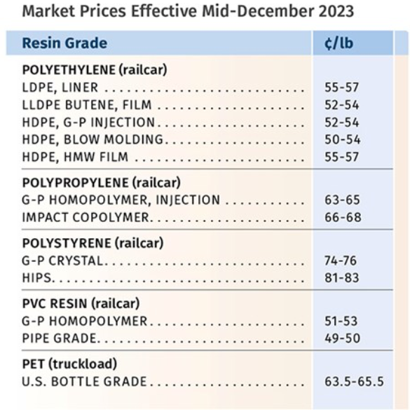
Circular versus Single Use
PET water bottle 62g 9 cents
i-PP lid 12g 1.6 cents
Comparable glass bottle 27 cents
Aluminum can 7.5 cents
Plastic doesn’t break
Transparent
Low weight
For the most part these three are comparable in price
Why do we use plastic bottles?

Slide 18
Circular versus Single Use
When you go to design a product
First step is to make a prototype out of plastic using 3D printing
Next step is to choose a material that can be mass produced
You find an injection molding operation where they can make test runs
https://www.questindustries.net/services/injection-molding
Then you find a shop in China that can mass produce
Seems to all be geared around plastics

Slide 19

Circular versus Single Use
$80 mostly plastic vacuum cleaner
Injection molded from mostly HDPE and i-PP (some PS and PVC tubing) in China
Sold on Amazon
Broke in 10 months due to a small plastic piece that changed the height
Company refunded the purchase cost rather than repairing
With no return of vacuum so vacuum was disposed of in general waste stream
Problem and solution seemed to be routine for this product from a Google search
You would have to assume that for this company to make a profit the vacuum must cost about $5 to manufacture, $10 to ship, $2 for warrantee handling
Business model is that most people won’t ask for a refund or some of the vacuums aren’t used enough to fail within the 12-month warrantee period.
From my perspective, $80 is a good deal for a vacuum that worked well before its untimely demise. The company was responsive to the problem (which they seemed to anticipate). It is difficult to tell if the problem is plastics or capitalism or just a system with nobody overseeing or judging reasonableness.
From a solid waste perspective this is a disaster

Slide 20
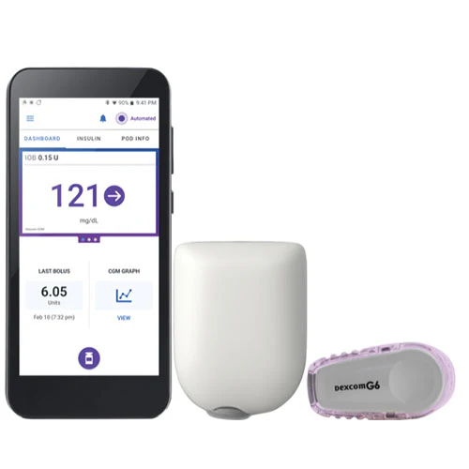

Circular versus Single Use
$250 99.5% plastic disposable insulin pump (extremely small needle, magnet and spring are the only metal parts) (pairs with Dexcom plastic disposable glucose sensor and largely plastic cell phone)
Injection molded from mostly HDPE and i-PP (some PS and PVC tubing), (Dexcom is polystyrene) made in China.
Planned lifetime is 3 days for pump, 10 days for sensor.
Original multiuse is a glass syringe and metal needle that would be boiled to make sterile.
Replaced by single use preloaded syringes made of plastic and a bit of glass.
Replaced with a reusable pump with disposable PVC tubing.
Main factor is ease of use, sterility. During COVID disposable masks were also a topic for circular vs single use.
From a solid waste perspective this is a minor problem

Slide 21
Current stats on recycling in the US
90 million tons recycled annually
Saves $3 billion in disposal fees
$100 billion economic activity
540,000 jobs
Public/Private Partnerships
NYC/Pratt Industries wastepaper
NYC/Simms Municipal Recycling
$100/ton disposal fee becomes income
Minneapolis/Eureka Recycling
contamination reduction in recycle stream
Chicago/Lakeshore Recycling Systems
San Francisco
Seattle
Cincinnati/Columbus Rumpke Recycling
Austin/Balcones Resources

Slide 22
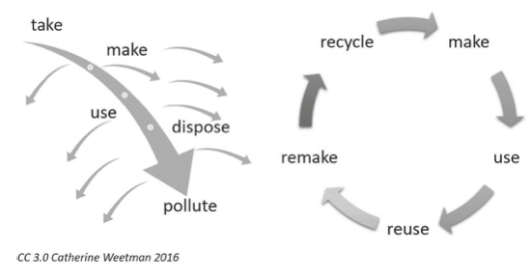
Circular versus Single Use

Slide 23
Circular versus Single Use
What is a “circular economy”?
Investment/research in materials, design, manufacturing with the goal of a “zero-waste”, “closed-loop” system
Local manufacturing to reduce transportation costs and emissions
Use/develop sustainable materials (non-fossil or mineral resources), repurposed materals, recycled materials, biodegradable materials
Design for longevity (not planned-obsolescence)
Harmony with nature, people, communities
What does “circular economy” ignore?
Basic problem is over population which is exponentially getting worse https://www.worldometers.info/world-population/
Demand driven economies value low costs at any societal expense
Use/develop sustainable materials (non-fossil or mineral resources), repurposed materials, recycled materials, biodegradable materials
Design for longevity (not planned-obsolescence)
Harmony with nature, people, communities

Slide 24
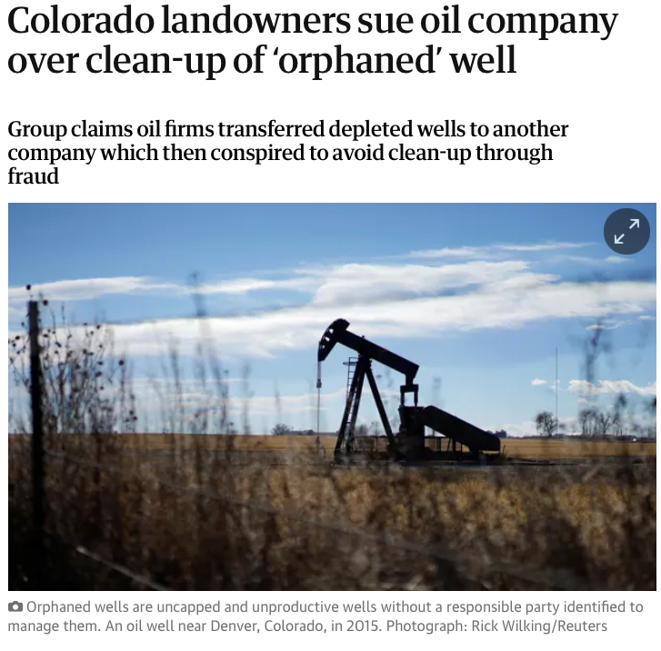
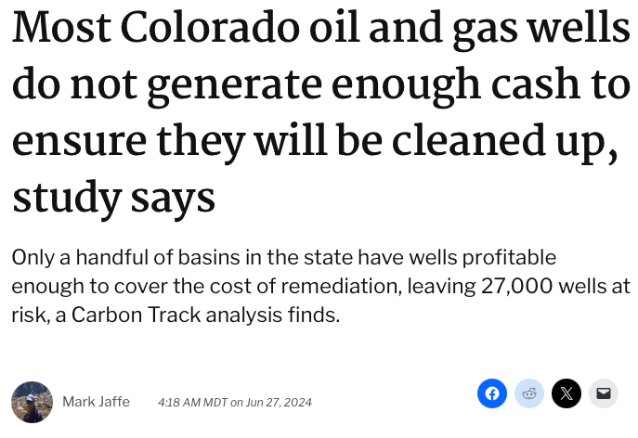
Circular versus Single Use
Who pays for a linear economy?

Slide 25
Circular versus Single Use
Corporate motivation towards circularity
Profit from (claimed) circular products
Climate change
Supply-chain challenges due to depletion of natural resources
Public accountability (oil wells in Colorado)
EU regulations (circular car mandate)
China regulations
California regulations
Minimum recycled content in vehicles
The plastic contained in each vehicle type that is type-approved under Regulation (EU) 2018/858 would have to contain a minimum of 25 % of plastic recycled by weight from post-consumer plastic waste. At least 25 % of this target would have to be achieved by including plastics recycled from end-of-life vehicles in the vehicle type concerned.
Furthermore, the Commission would be empowered to adopt delegated acts setting up a minimum share of steel recycled from post-consumer steel waste to be incorporated into vehicle types. The minimum share of recycled steel would have to be based on a feasibility study, carried out by the Commission and to be finalised by 23 months after the date of entry into force of the proposed regulation.
Circularity requirements for vehicle design and management of end-of-life vehicles 7
By 35 months after the date of entry into force of the proposed regulation, the Commission would have to assess the feasibility of setting a requirement on the minimum share of:
➢ aluminium and magnesium and their alloys, recycled from post-consumer waste and
incorporated into vehicle types;
➢ neodymium, dysprosium, praseodymium, terbium, samarium or boron recycled from
post-consumer waste and incorporated into permanent magnets in e-drive motors.

Slide 26
Circular versus Single Use
The three (five or more) R’s of Circular Economy
Reduce
Reuse
Recycle
Reduce-use insulation to reduce fuel consumption
Reuse-Space-X booster rockets are reused
Remake-Retread truck tires, airplane tires (8 times)
Recover-Design cars for disassembly (EU regulations)
Renew-Renewable energy solar power, Green roofs, bioplastics

Slide 27
Circular versus Single Use
Unilever (European/UK company) commitment:
Reduce virgin plastic packaging by 50% with 1/3 from reduction in mass
Collect and process more packaging plastic than they sell
100% reusable, recyclable or compostable plastic
Increase post consumer plastics content in packaging to 25%
These are all EU regulations that are used to advertise the company

Slide 28
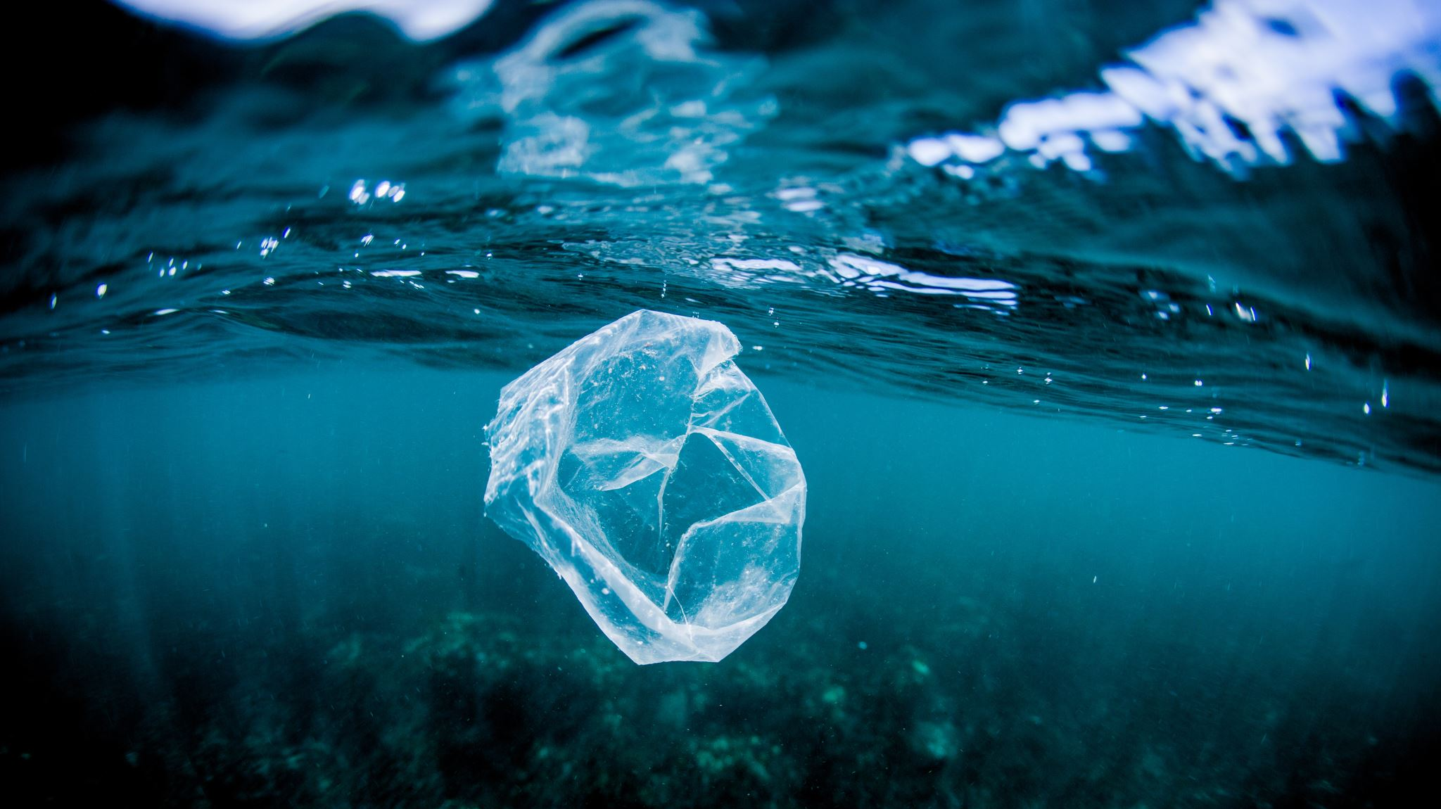
Circular versus Single Use
“The plastic bag menace”

Slide 29
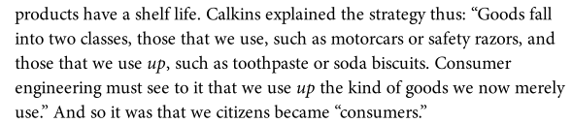
Circular versus Single Use
Citizens become consumers (1920s)

Slide 30
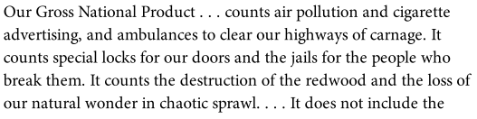
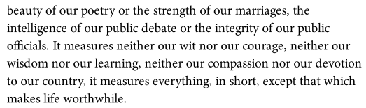
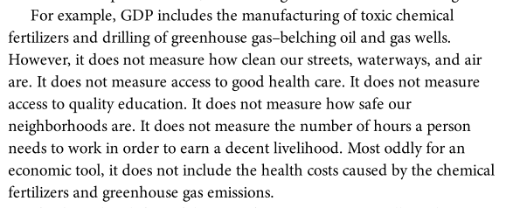
Circular versus Single Use
Roaring 20’s
WWI
WWII
Wall Street
Madison Avenue
Gross Domestic Product (GDP)
RFK

Slide 31

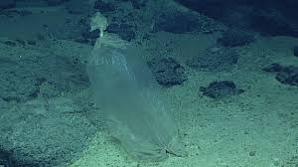
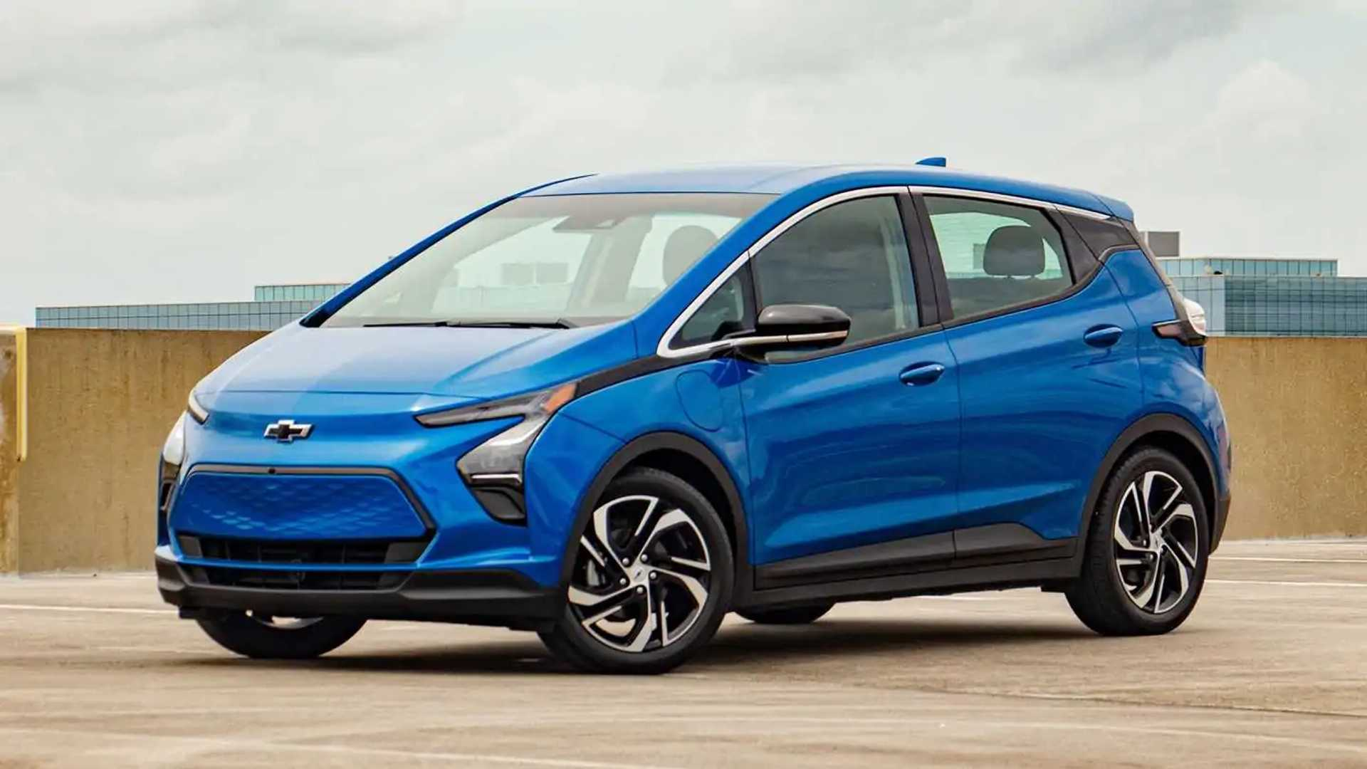

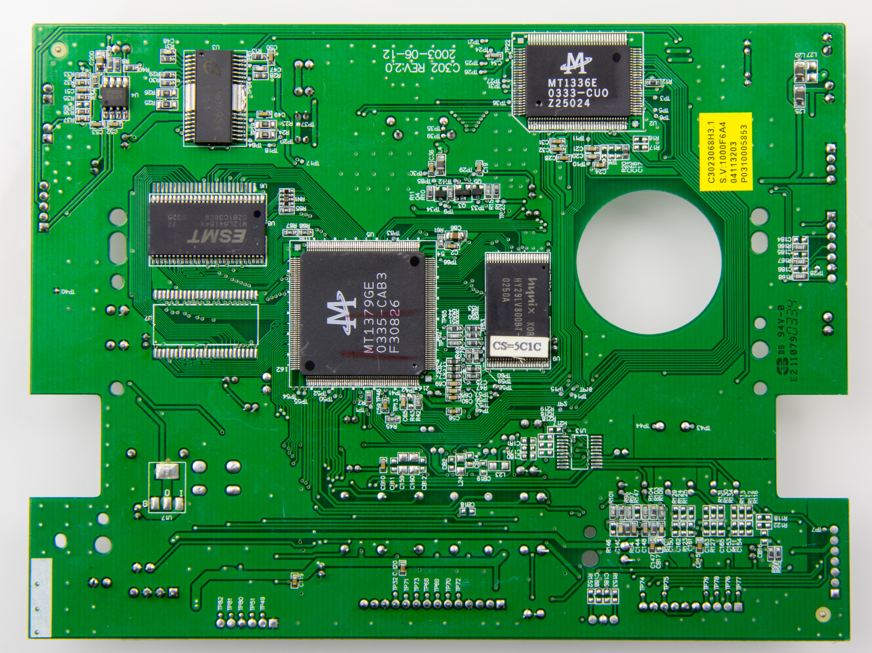
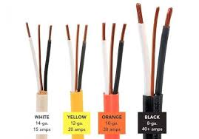

Circular versus Single Use
Chapter 7
300 million tons of plastic per year produced (6% of crude oil so we burn 5 trillion tons of oil, which would seem to be a greater problem)
Plastic bags in Mariana Trench
Great Pacific Garbage Patch
Plastics are necessary for cars, wires, electronics, aerospace, medical
French long-distance swimmer, swimming the patch in plastic scuba suit

Slide 32
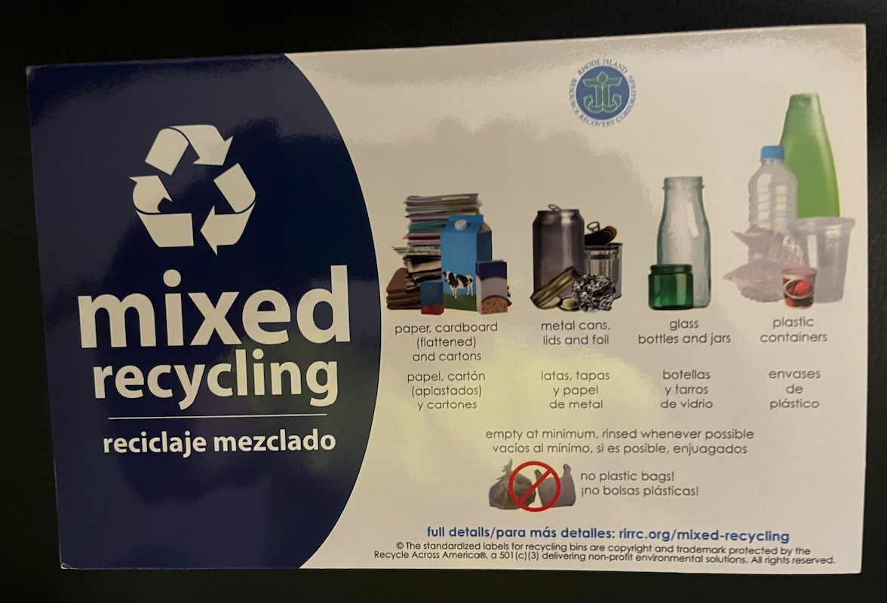
Refrigerator Magnet, Ferrite power in PVC (not recyclable)
Metalo-Organic Ink and Gloss Finish
Additives are a big problem in the recycle stream

Slide 33
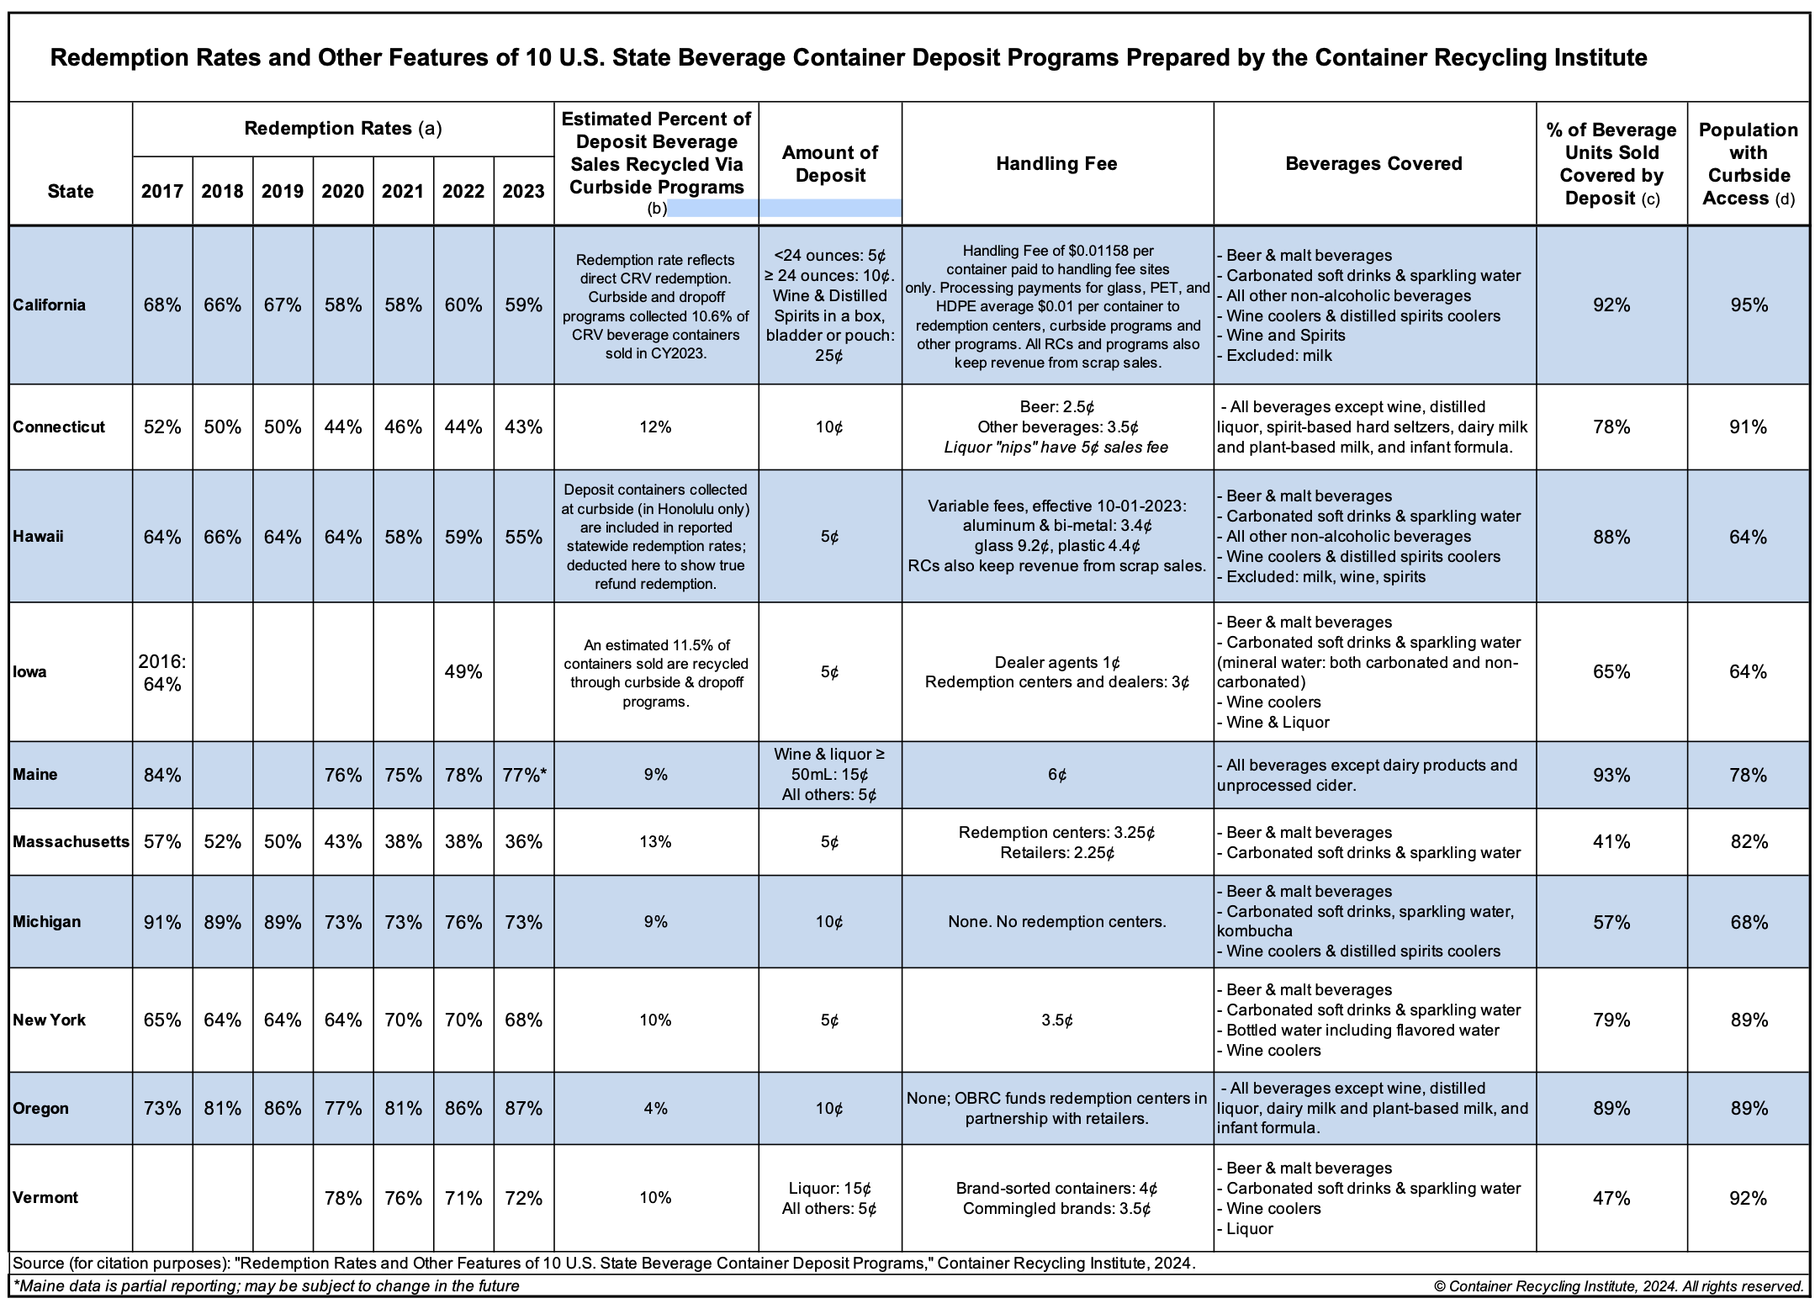
Use a deposit to drive recycling

Slide 34
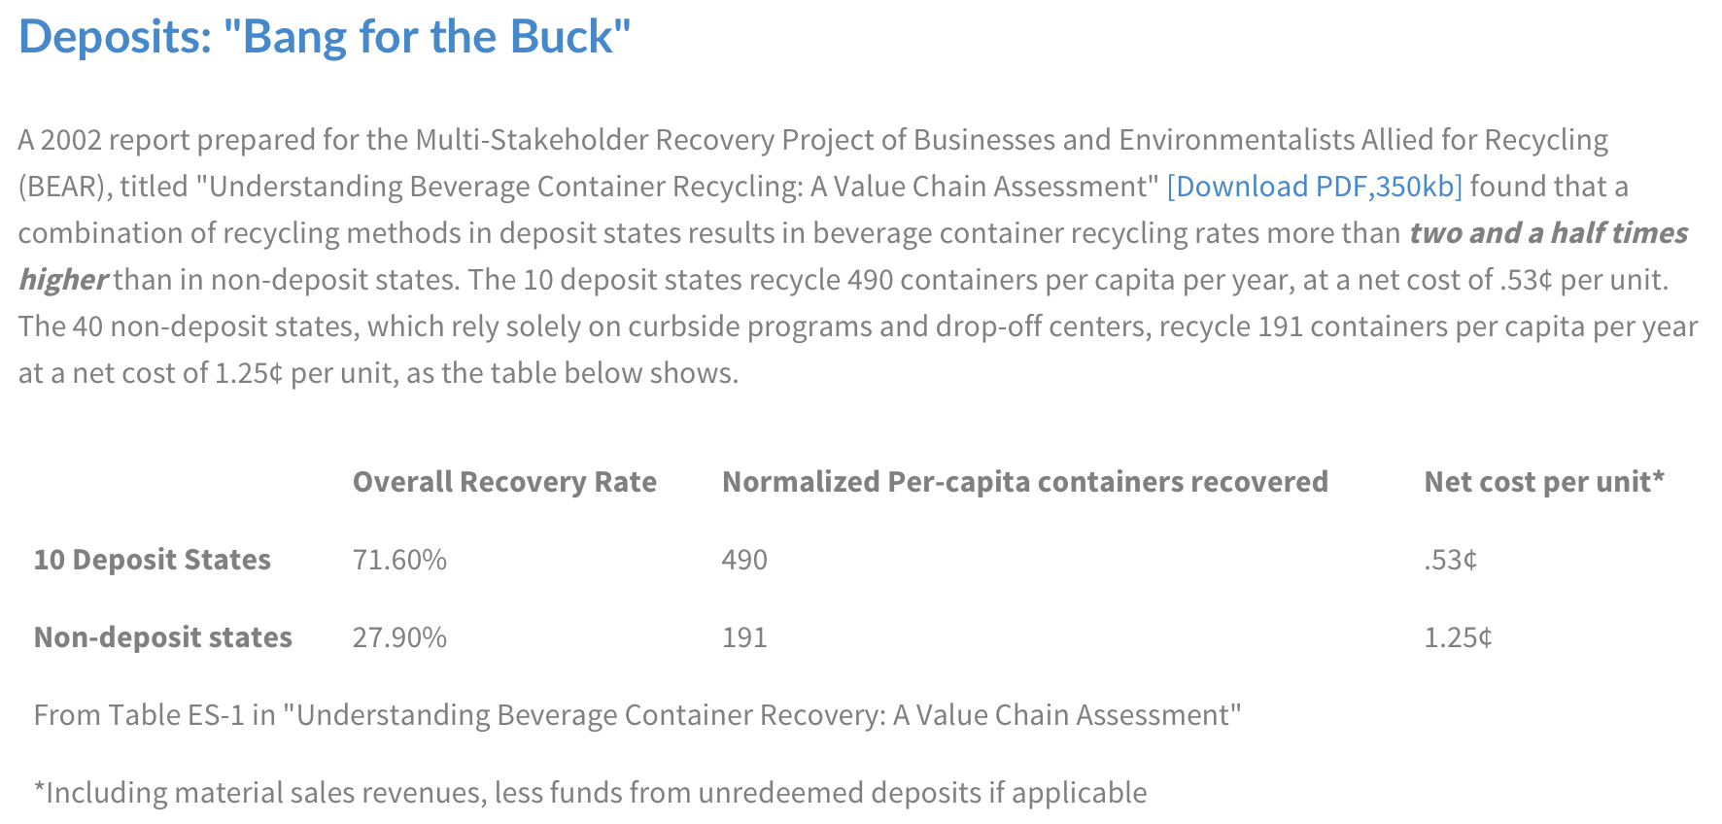
Circular versus Single Use
https://www.bottlebill.org/index.php/benefits-of-bottle-bills/bottle-bills-complement-curbside-recycling-programs

Slide 35
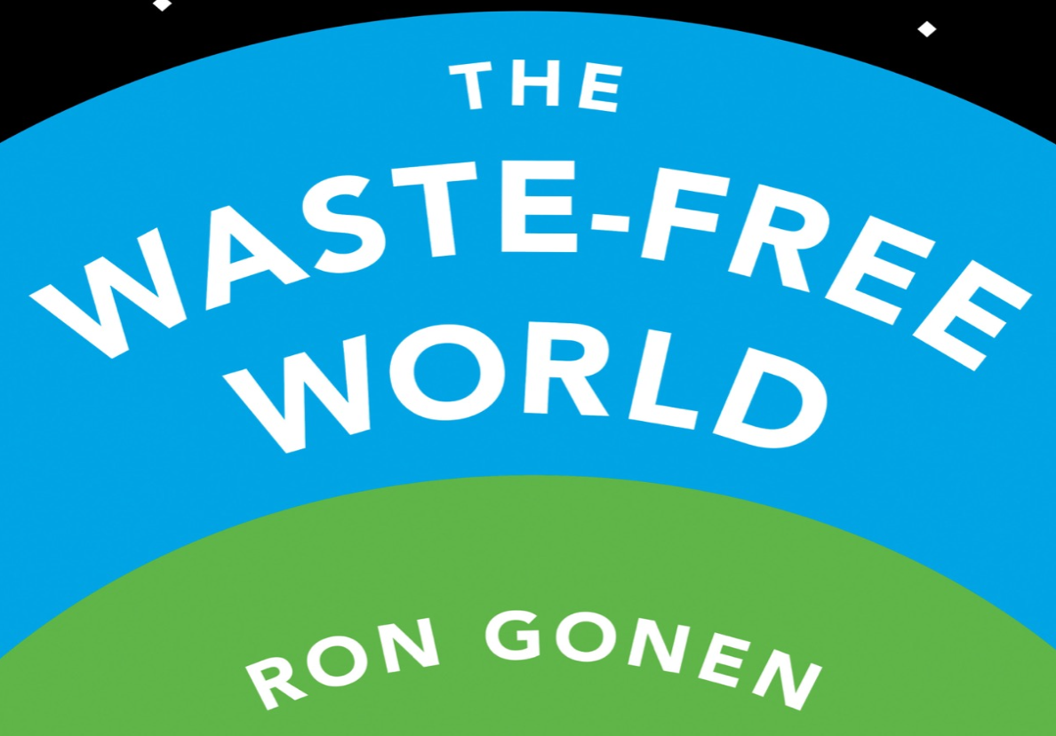
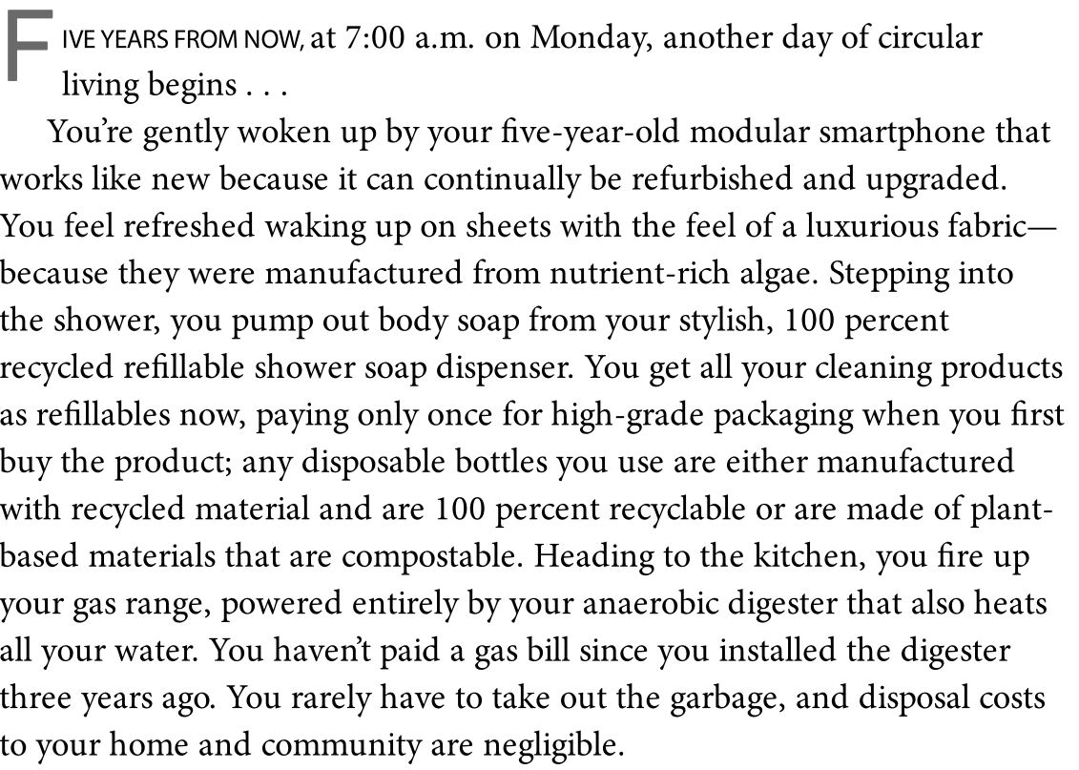
Circular versus Single Use
Chapter 10

Slide 36
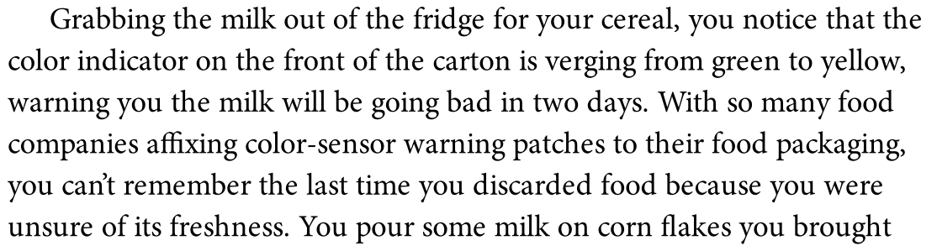
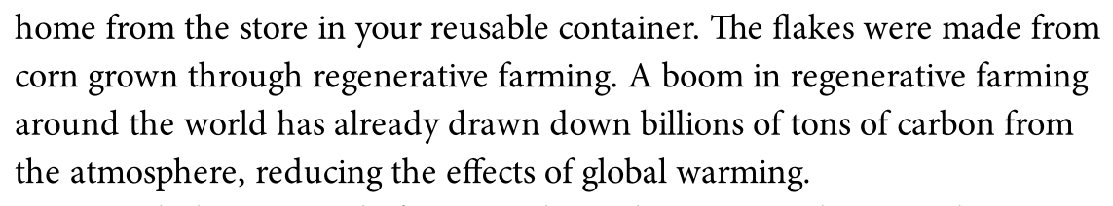
Circular versus Single Use
Chapter 10

Slide 37
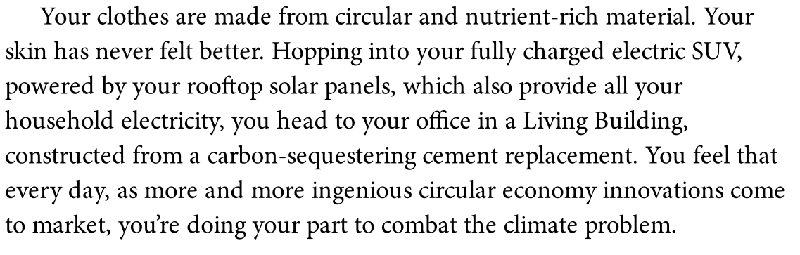
Circular versus Single Use
Chapter 10

Slide 38
Circular versus Single Use

Slide 39
Circular versus Single Use

Slide 40
Circular versus Single Use

Slide 41
Circular versus Single Use

