Slide 1
Specular reflectivity – Examples and applications
Sandip Argekar

Slide 2
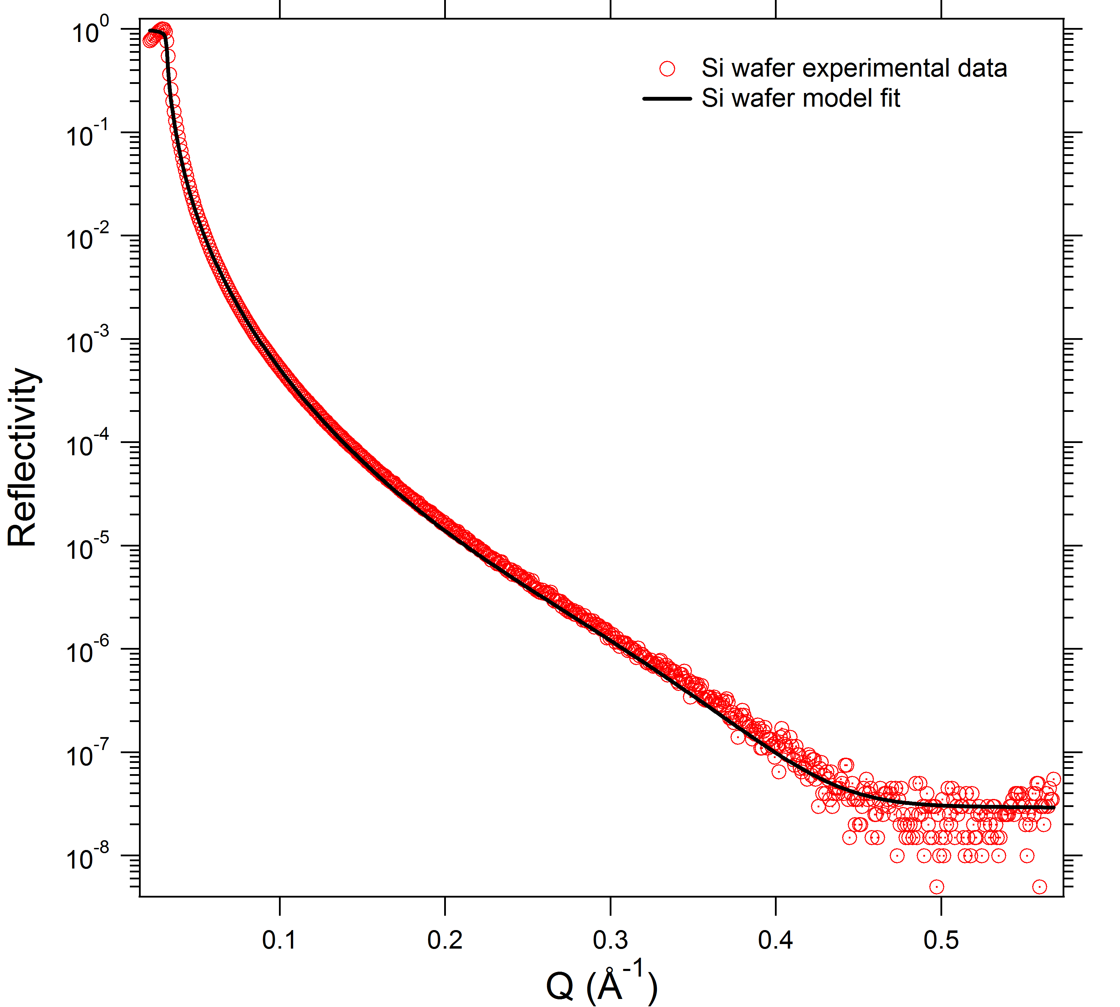
Specular reflectivity
Footprint, Critical angle
Ѳ_{refl}=Ѳ_{incident}
q⁻⁴ decay, roughness
Quantitative information of thickness and SLD in Z direction
7 to 8 orders of magnitude drop in intensity
Background

Slide 3
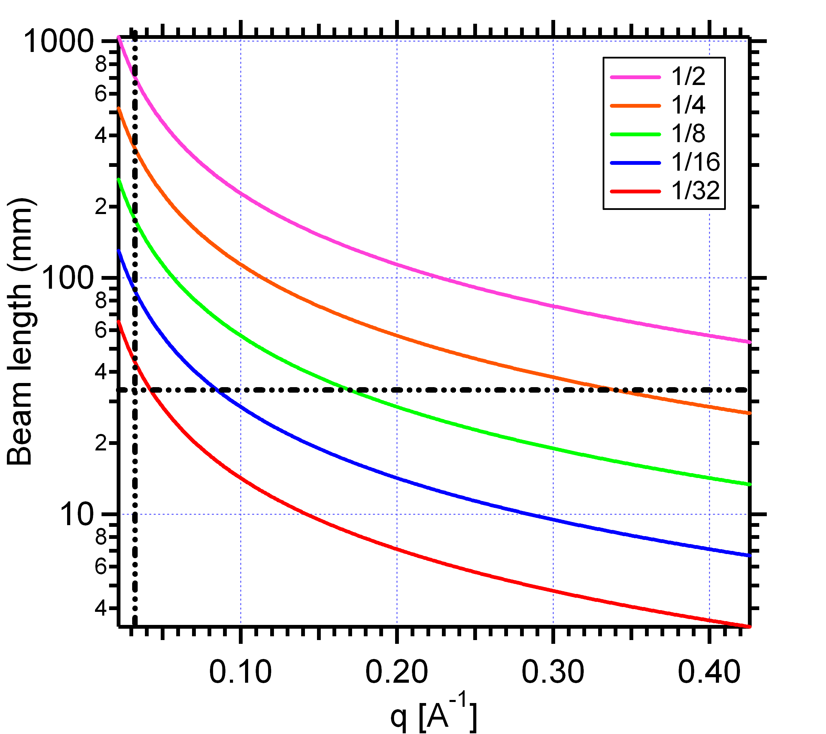
Features - Footprint effect
In the regime of total external reflection, some intensity is lost as the footprint on the surface is too large
Low q
High q
Foot print depends on beam width & sample geometry

Slide 4
Critical edge
The refractive index for x-rays and neutrons in materials is less than 1.
Total external reflection occurs

Slide 5
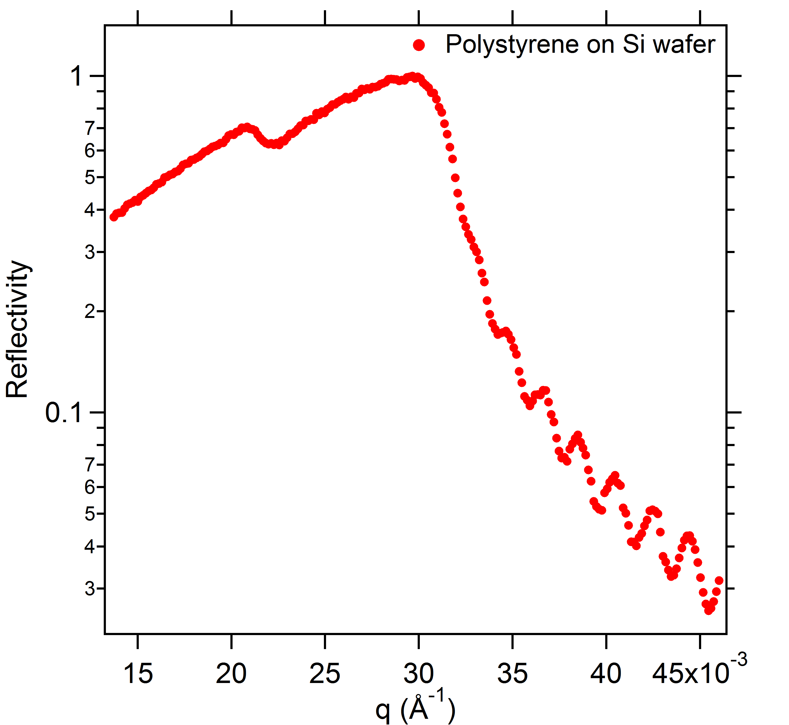
Double critical edge – Better guestimation of layer SLD
2 critical edges observed

Slide 6
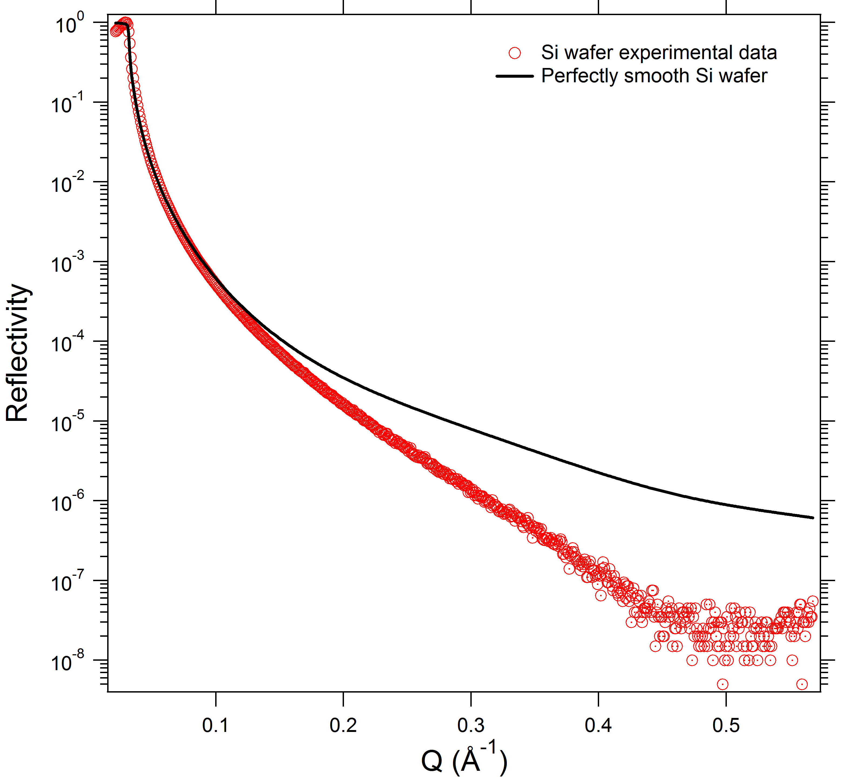
Effect of roughness on the reflectivity profile
Smooth surface
Maximum specular reflection
Rough surface
Increased non-specular reflection
Loss of intensity and sharpness
Effect of roughness depends on coherence length l_{c}
Only If roughness features < , reflectivity profile is affected

Slide 7
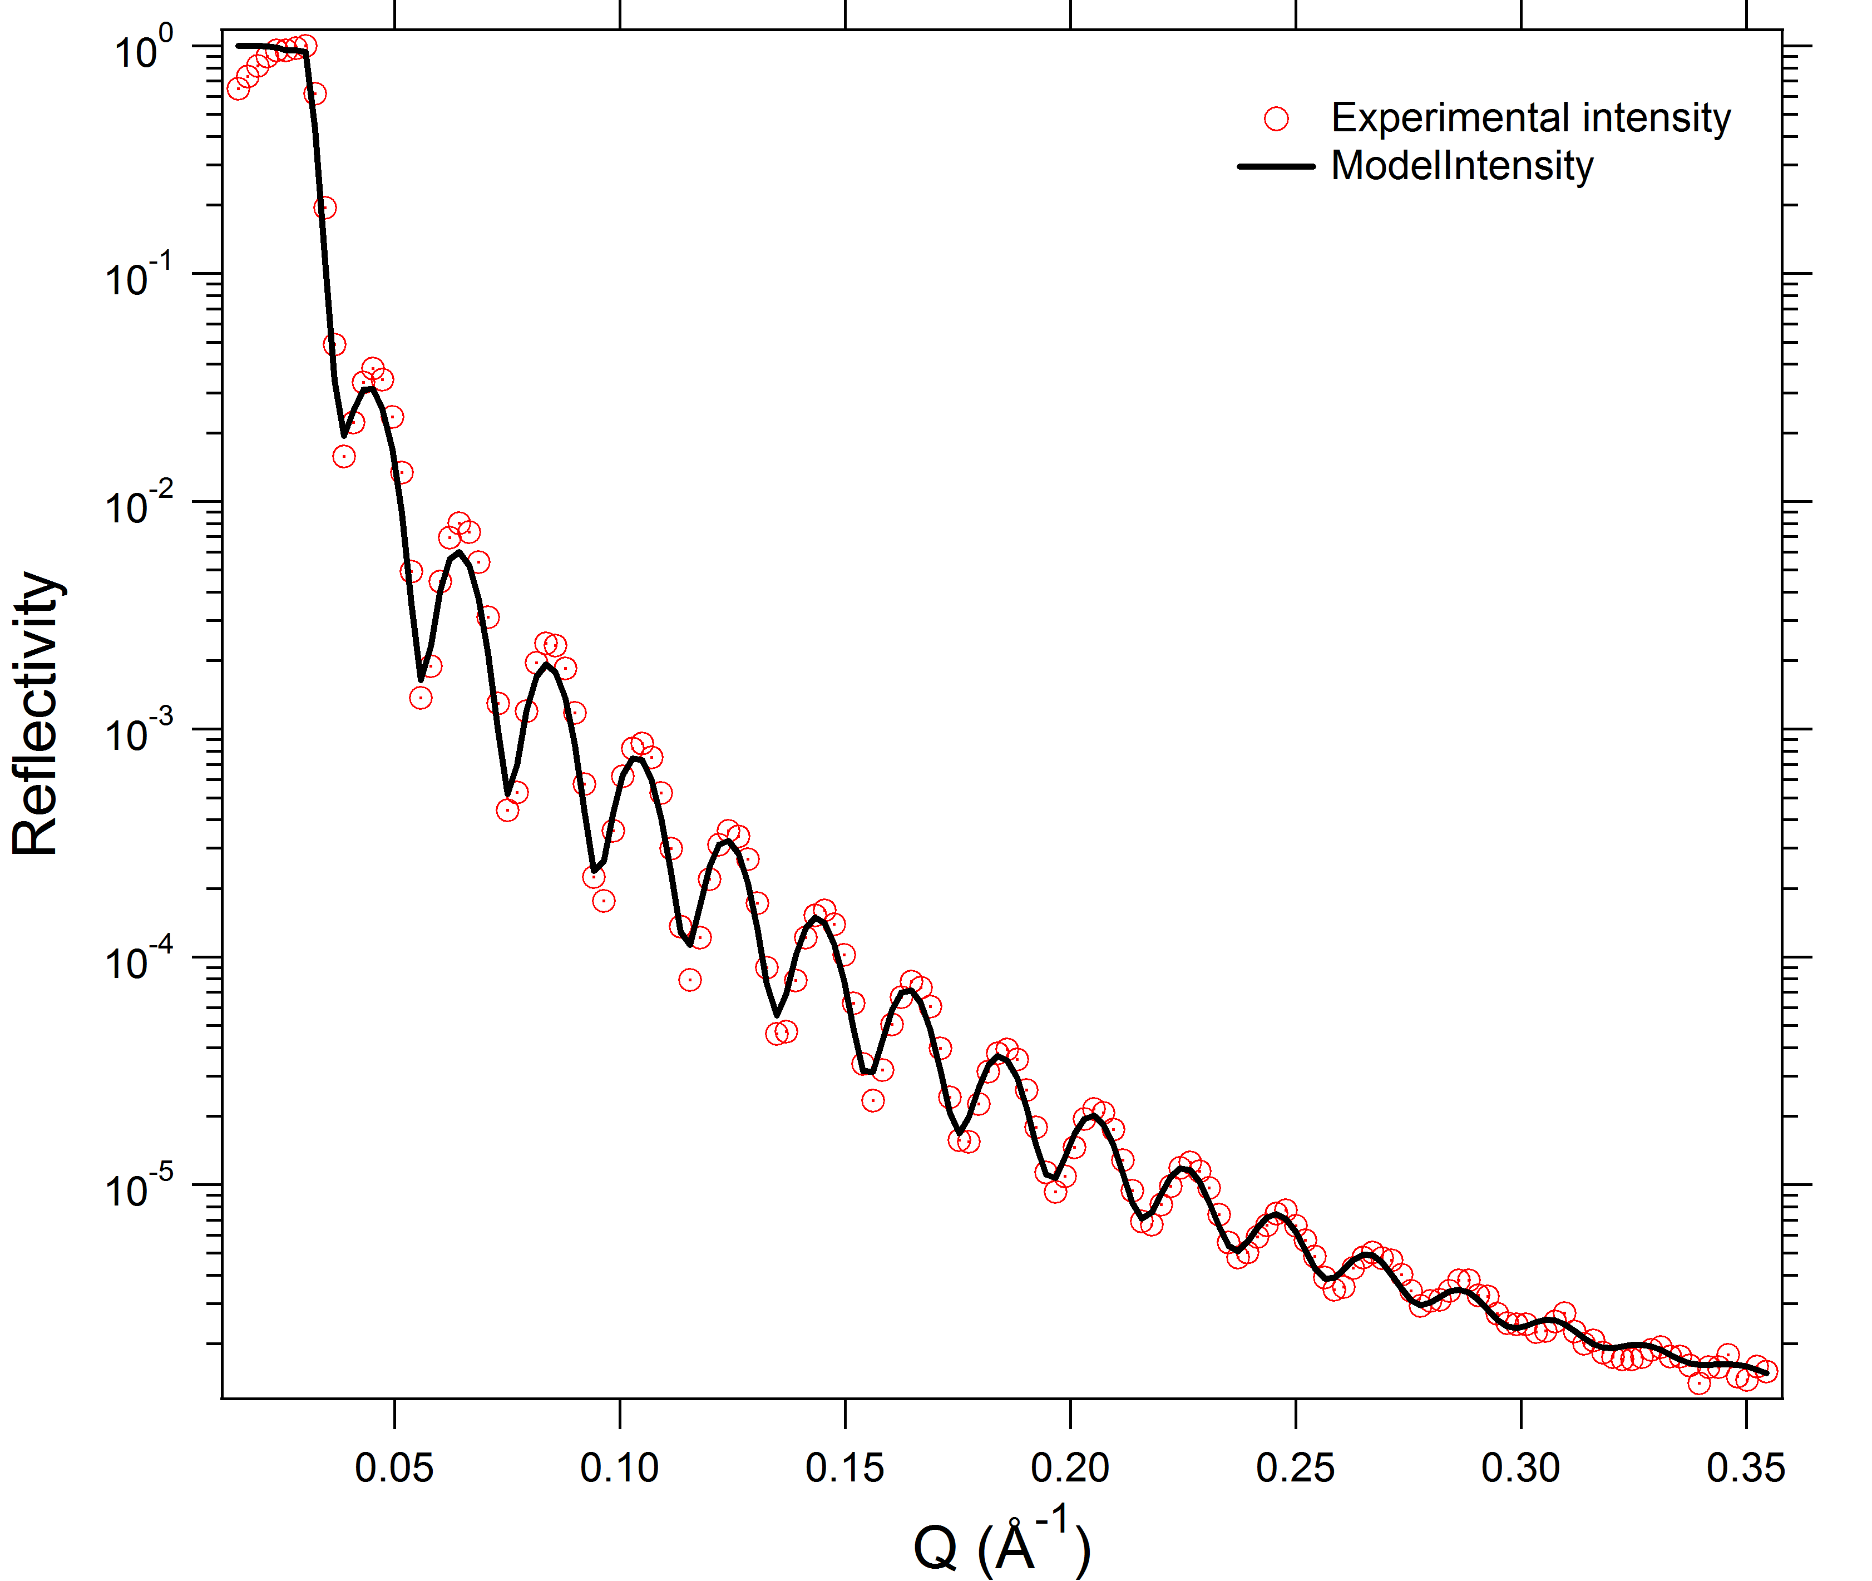
X-ray reflectivity single layered system
Fringes with uniform spacing
Thickness of the layer :
Kiessig fringes
SLD of the layer pushes the curve up or down

Slide 8
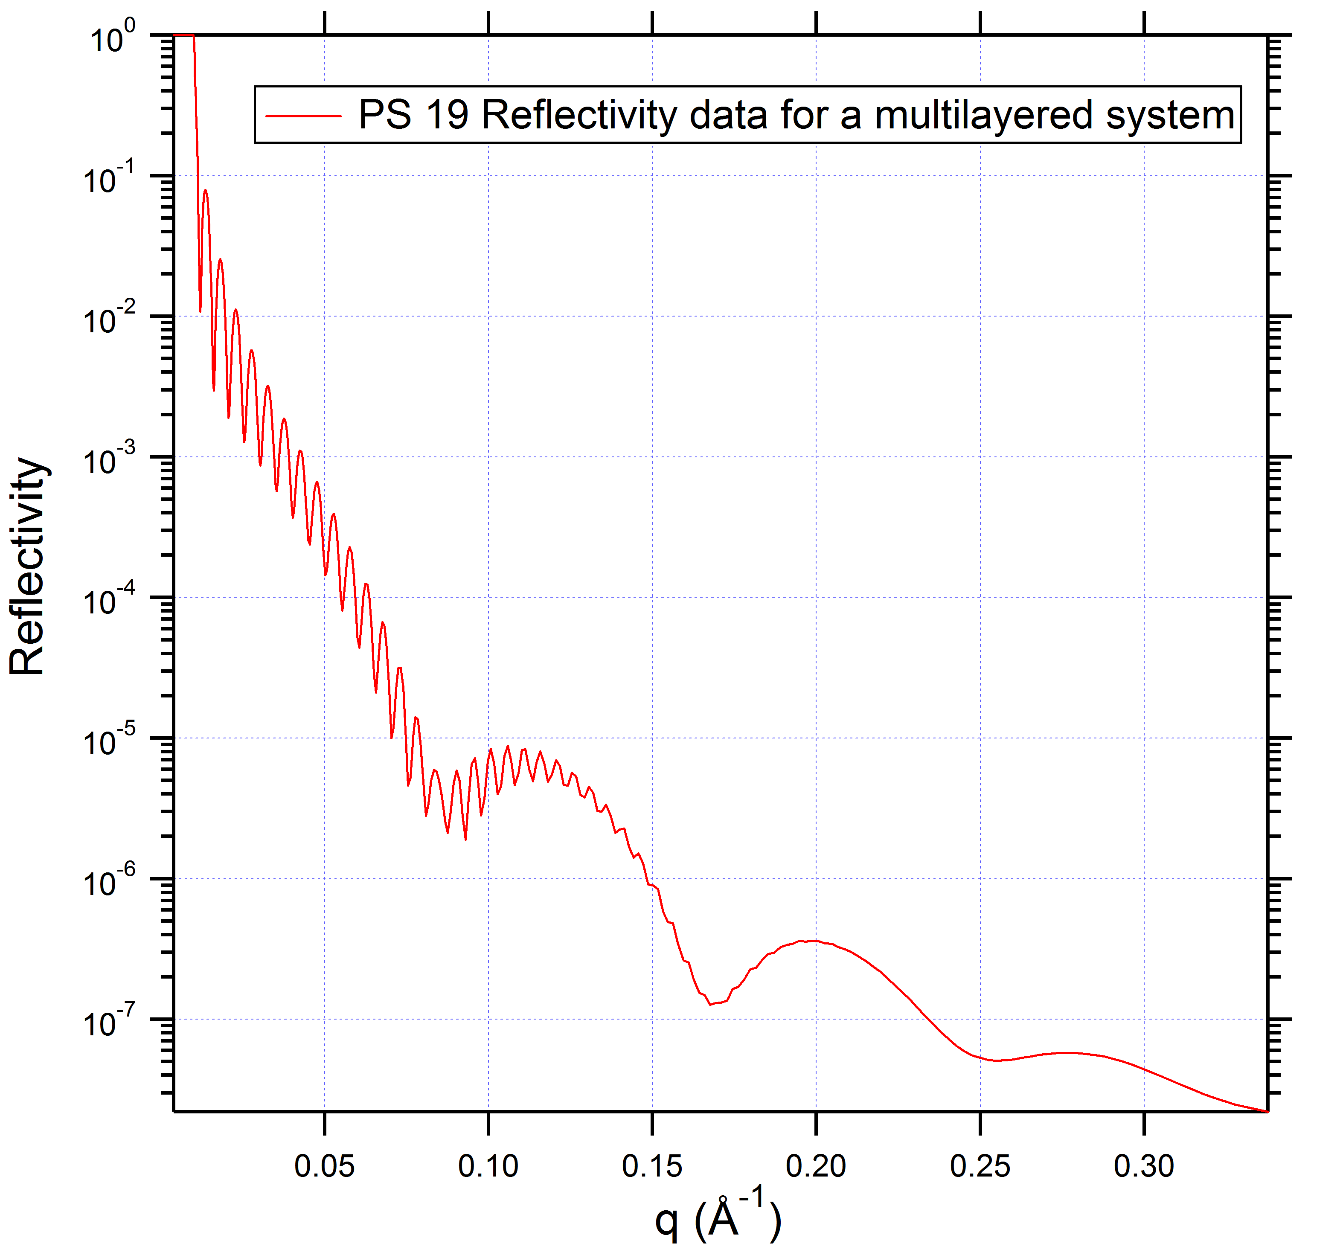
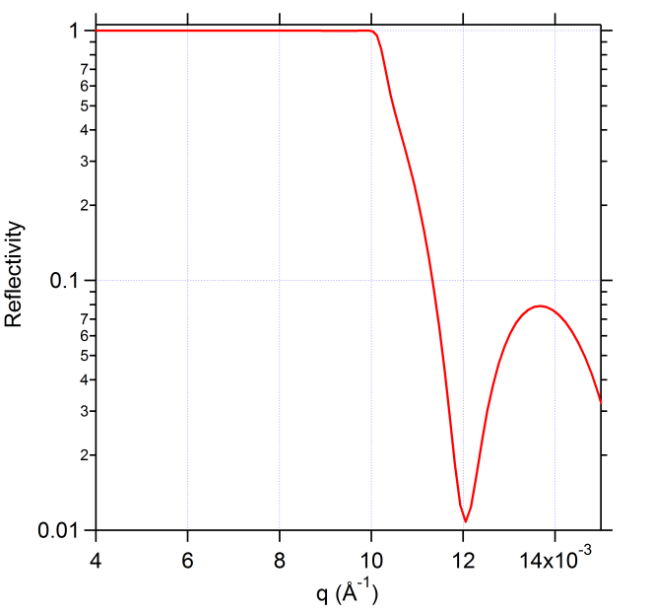
Multilayered systems – PS 19
Identify critical edge
  Calculate substrate SLD
Guess number of layers
  Based on practical expt
  Calculate approx SLD
Guess preliminary thickness
7 crests

Slide 9
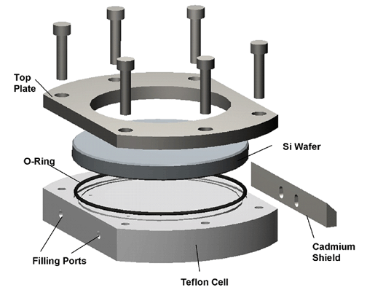

Neutron reflectivity
Utilize contrast between H and D to understand polymeric and biological systems
Swelling studies under dueterated solvents
Neutrons penetrate through Si
For Neutrons
D₂O becomes the new substrate
Liquid cell configuration
Si
D₂O

Slide 10
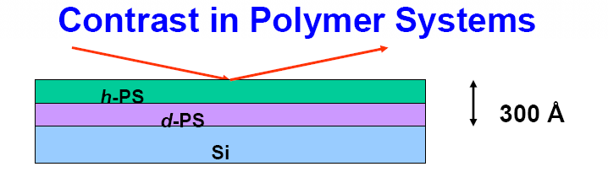
Courtesy - Peng Wang presentation

Slide 11
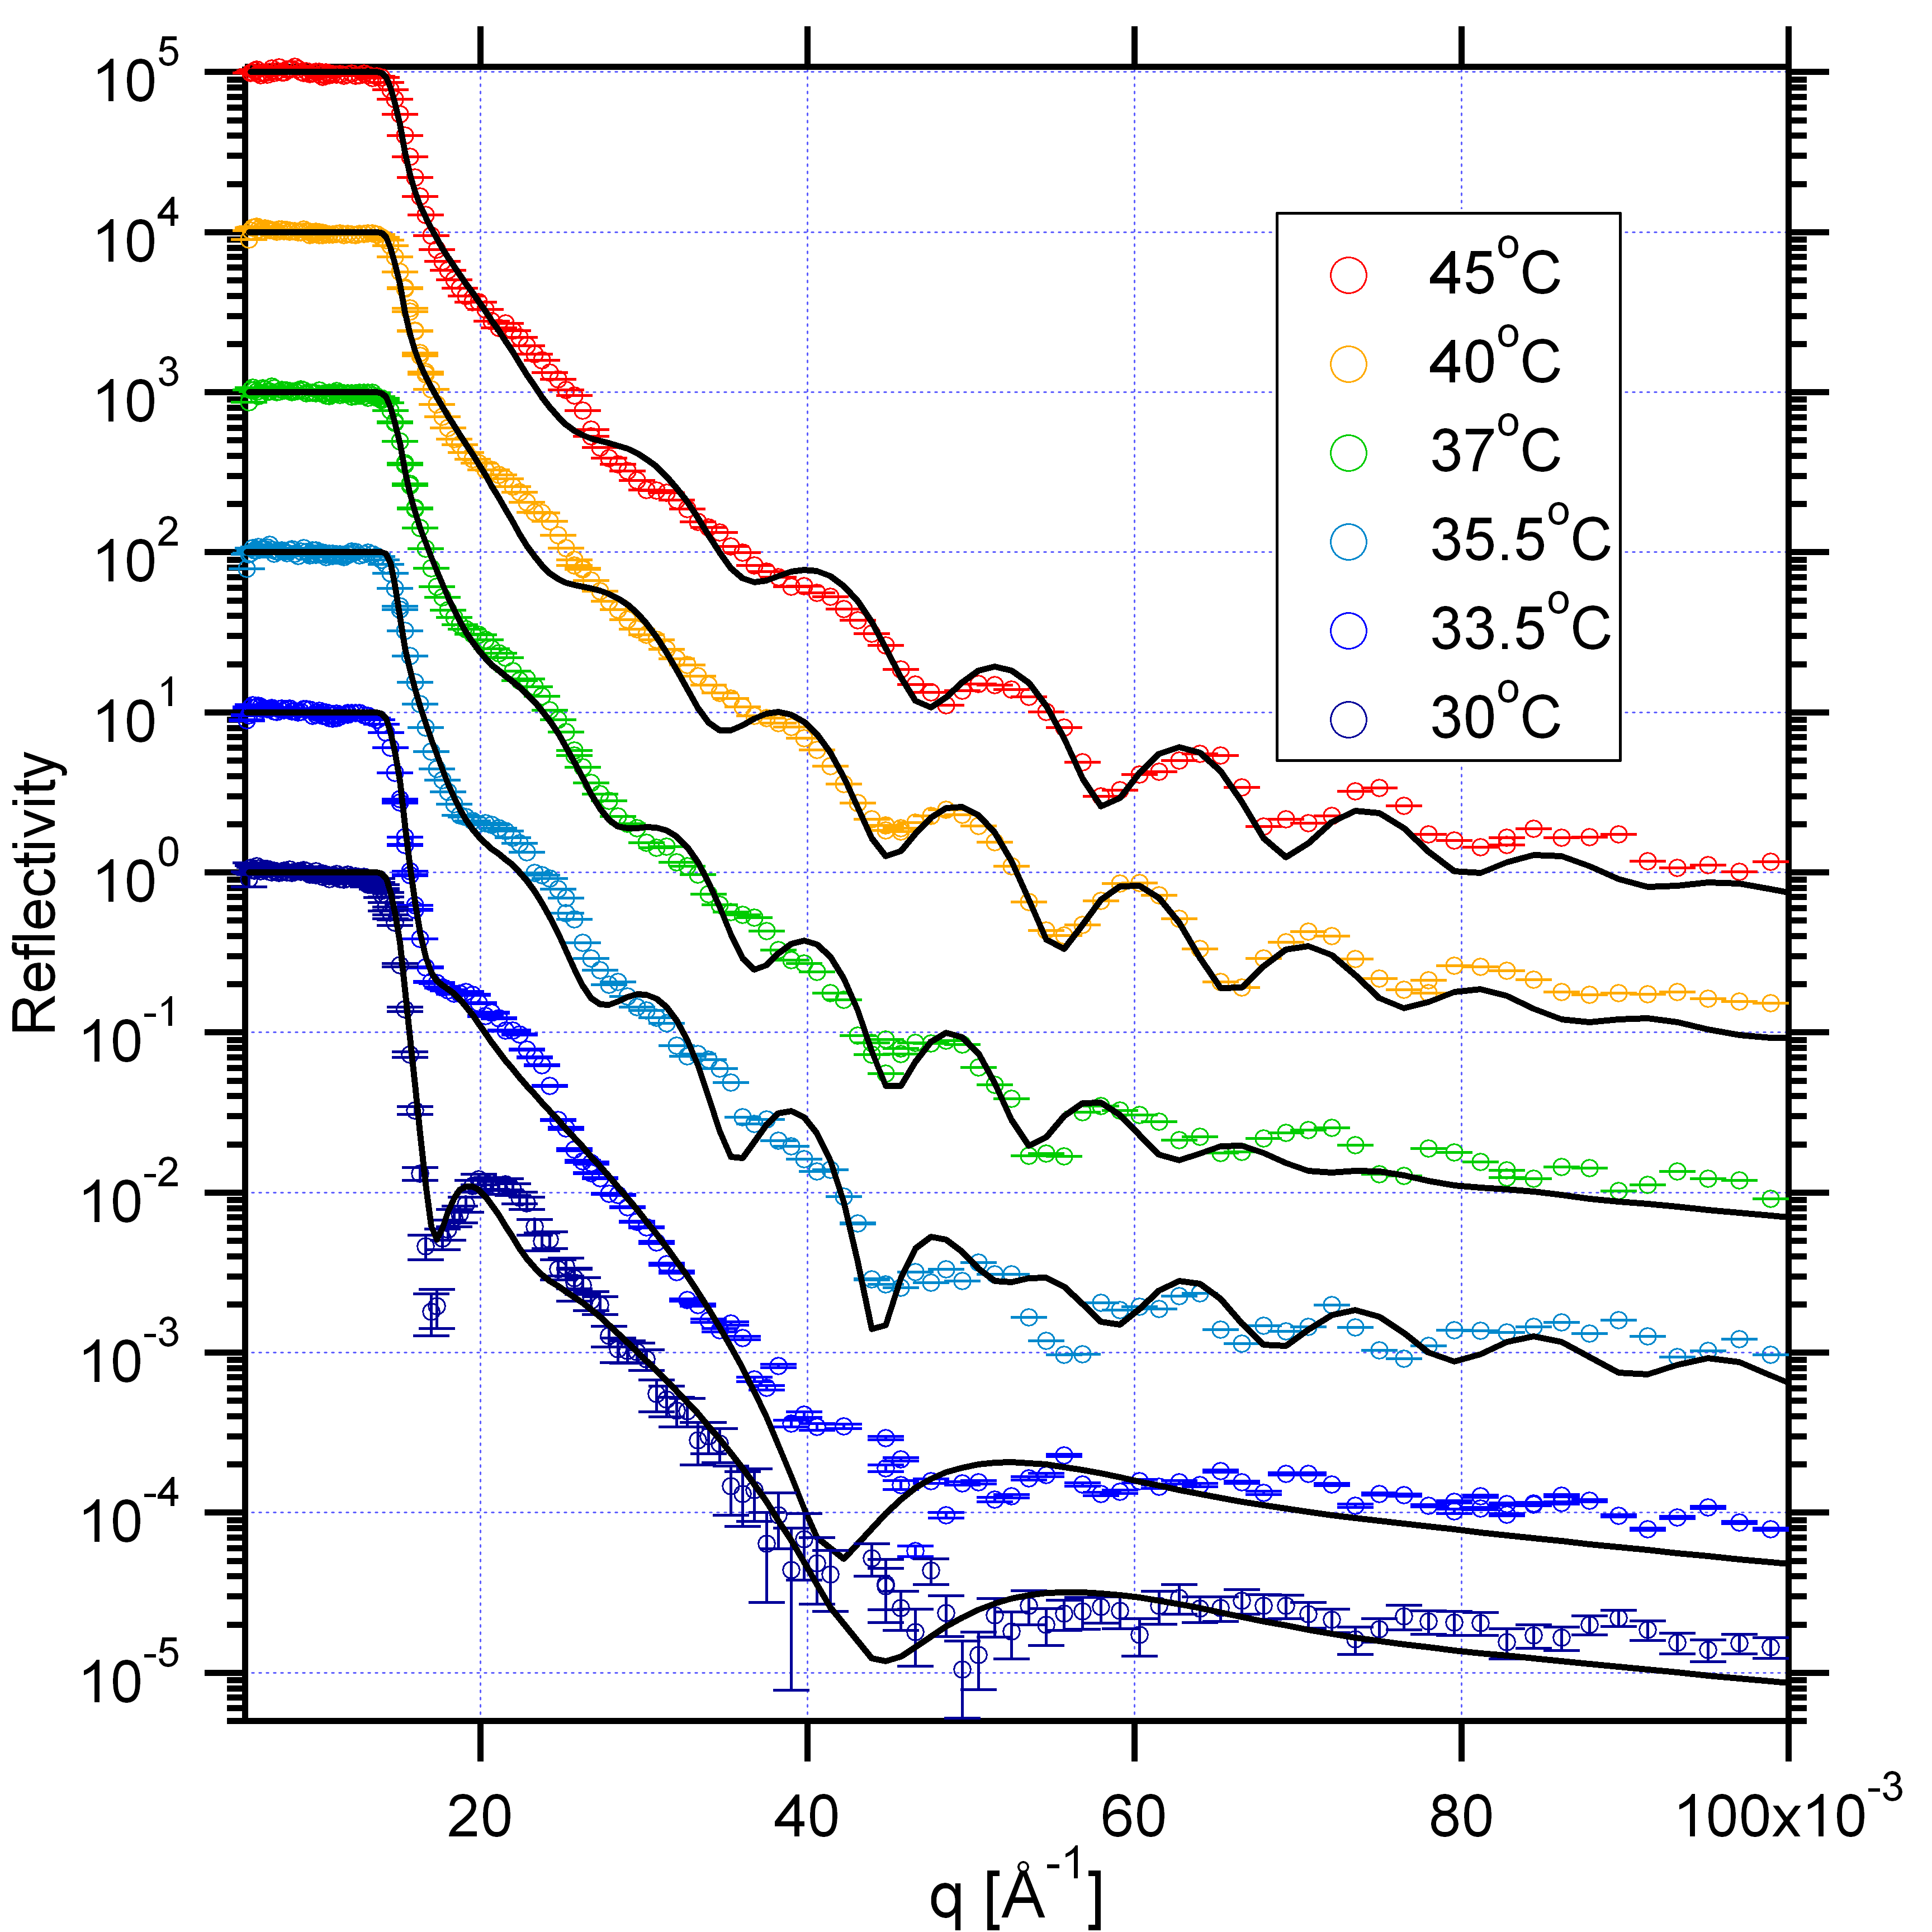
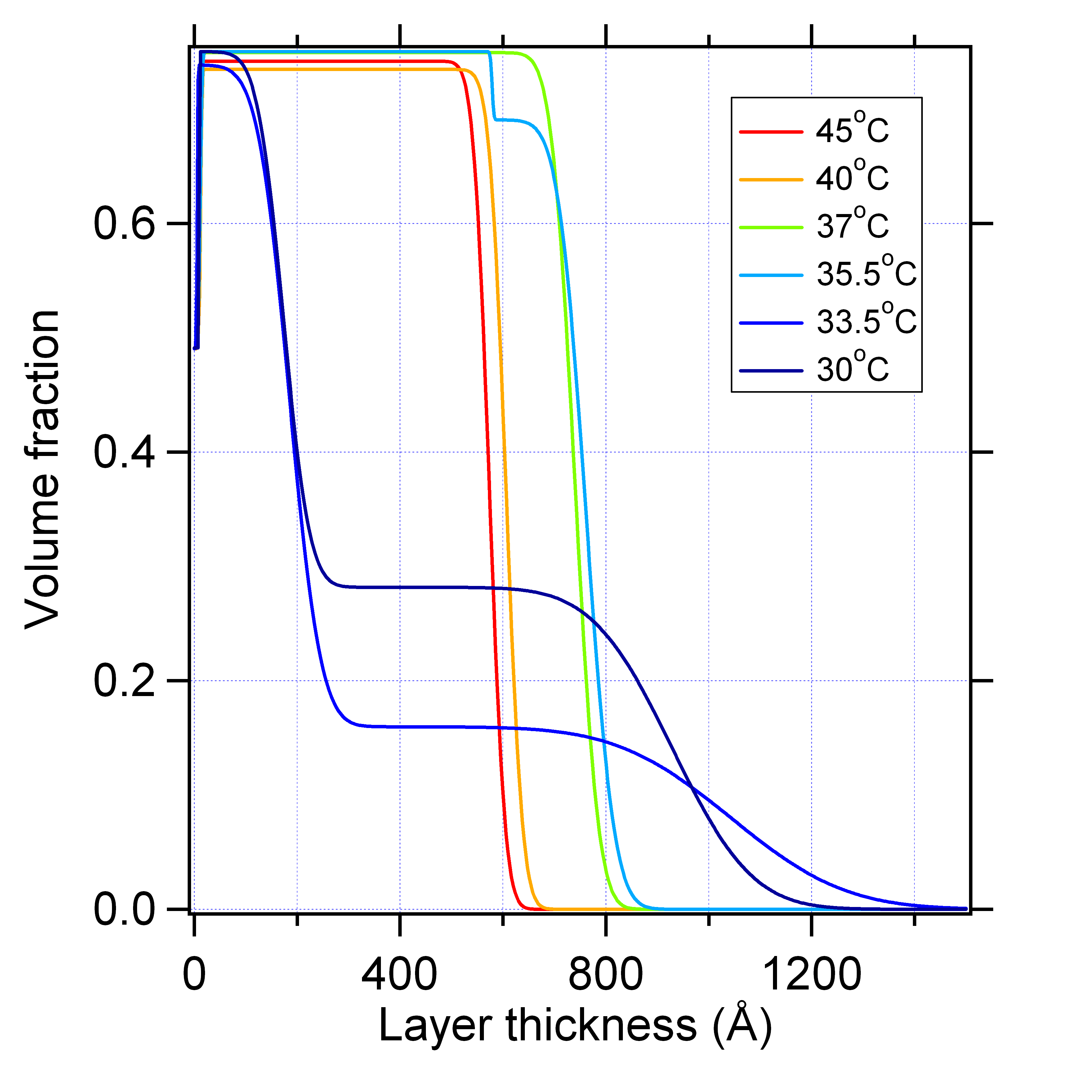
Temperature dependent swelling of poly (N-isopropylacrylamide)
Swelling of a hydrogenated polymer with D₂O
Water penetration shows a diffuse profile
Non-swollen polymer at the substrate interface
Critical temperature
Diffuse layer

Slide 12
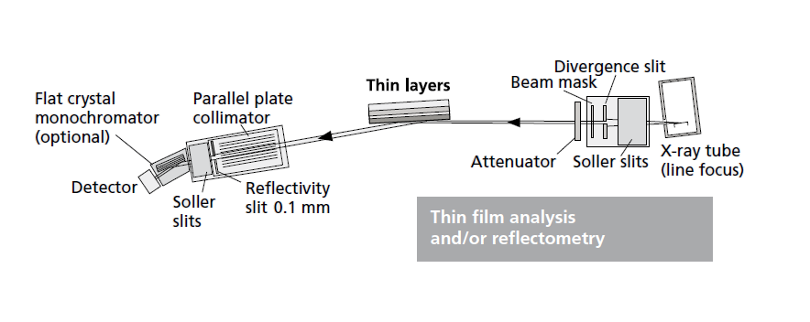
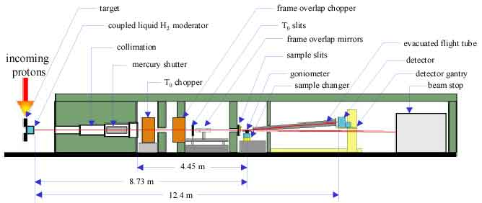
Panalytical XRD pro MD setup – X-ray reflectivity – Goniometer based
LANSCE –SPEAR - Neutron reflectivity – Time of flight approach

Slide 13
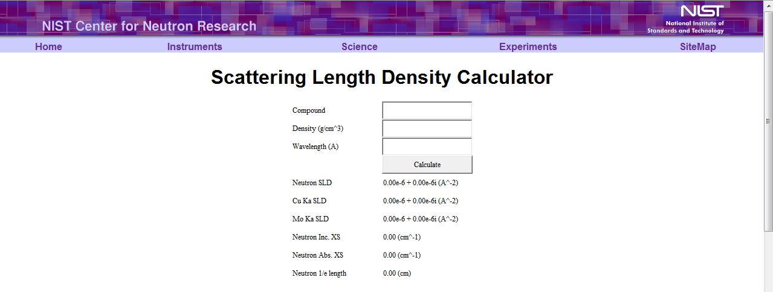
Handy tools – SLD calculator
http://www.ncnr.nist.gov/resources/sldcalc.html

Slide 14
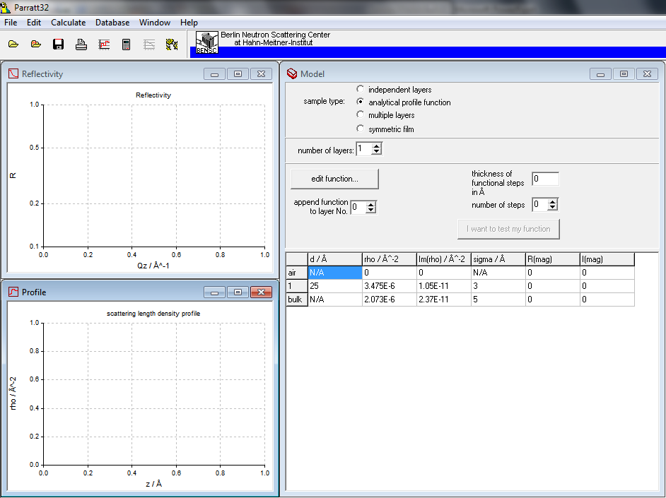
Handy tools – Reflectivity data fitting Parratt 32

Slide 15
