Slide 1
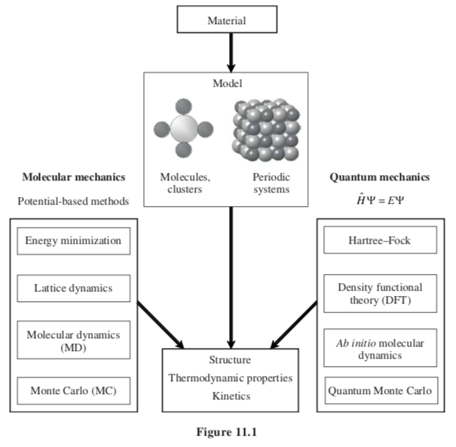
Thermodynamics and Materials Modeling
Coarse Grain Simulations
DPD Simulations
(Dissipative particle dynamics)
Machine Learning
Data Mining Techniques

Slide 2
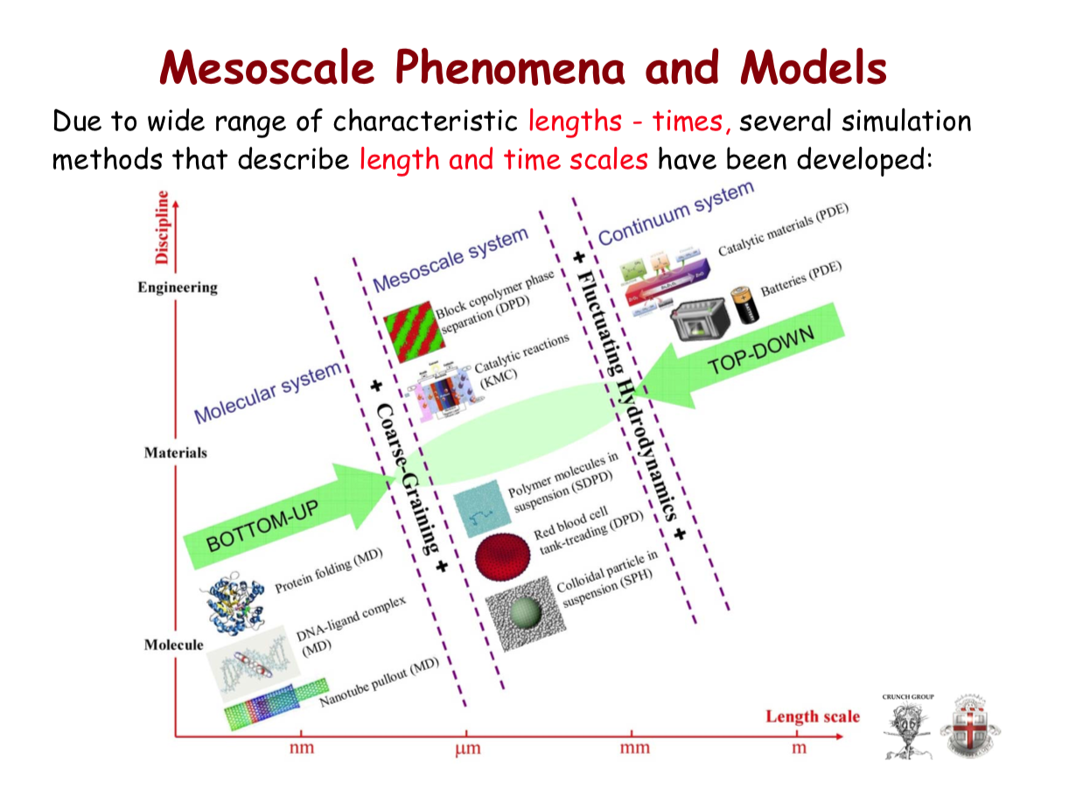
Partial differential equations
Coarse Grain Simulations
DPD Simulations
Machine Learning
Data Mining Techniques
DPD Dissipative particle dynamics
KMC Kinetic Monte Carlo
Smoothed DPD for fluid surfaces
SPH Smoothed particle hydrodynamics

Slide 3
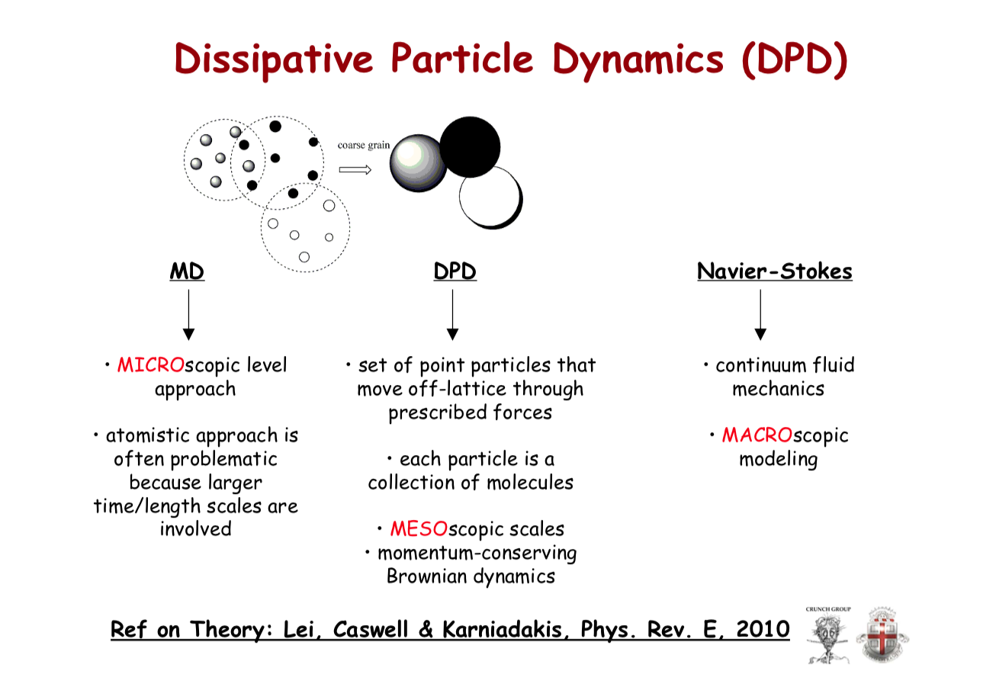
Coarse Grain Simulations
DPD Simulations
Machine Learning
Data Mining Techniques

Slide 4
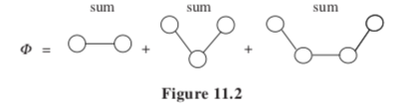
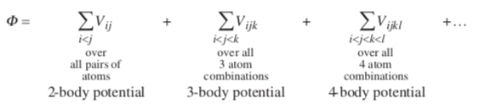
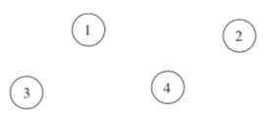

Intermolecular/inter-particulate potentials

Slide 5
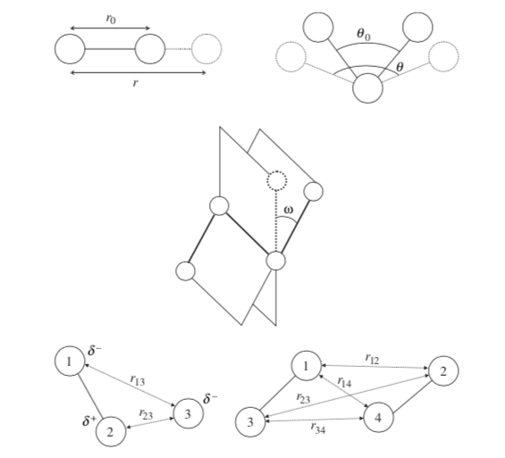
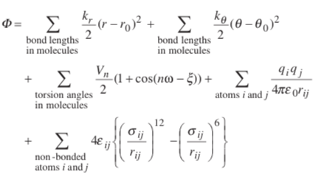
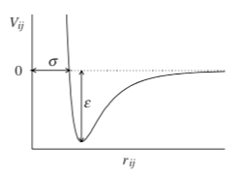
Molecular Solid
Intramolecular interactions
Harmonic Potential 2-body
Harmonic Potential 3-body
4-body torsion
Coulomb
Long-range
Van der Waals
Repulsion and Pauli dispersion
Intermolecular interactions

Slide 6


Ionic Solids
Buckingham Potential (Rather than 6-12 potential)

Slide 7
Energy Minimization/Lattice Statics
Static limit at 0K no vibrations
Yields the low temperature 0K phase
Z_{i} are length of bonds, separation distances, angles, positions

Slide 8





Elevated Temperatures and Lattice Dynamics
-SUV
H A
-pGT
Monte Carlo
Molecular Dynamics
Lattice Dynamics
At p = 0
Quasi-harmonic approximation: at T we can write:
Good up to 2T_{m}/3 where anharmonic effects become important
Simple Harmonic Oscillator
Zero point energy
Phonon frequencies at wave vector q
From Chapter 8.2
Frequency can be obtained from the potential function as a function of atomic positions

Slide 9
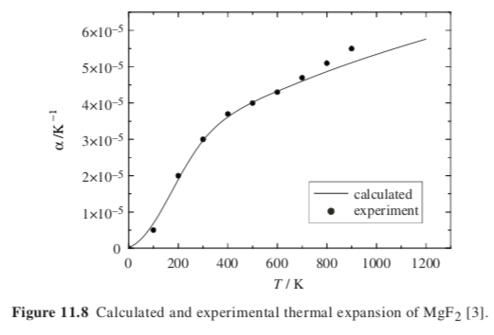

Lattice dynamics example
T_{m} = 1536 K
2/3 T_{m} = 1024 K
N. L. Allan, G. D. Barrera, J. A. Purton, C. E. Sims and M. B. Taylor, Phys. Chem., Chem. Phys. 2000, 2, 1099

Slide 10


-SUV
H A
-pGT
Allows for experimental verification

Slide 11
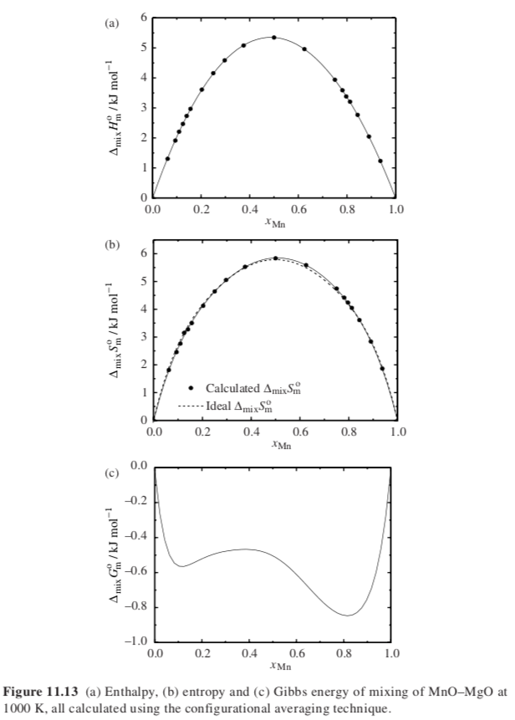
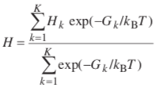

Solid solutions and non-stoichiometric oxides
Fix unit cell size (super cell, 4 atoms, 8 atoms, 64 atom etc.) for a given composition find all random arrangements “k”
With lattice vectors and positions as variable at T minimize G_{k}
For all “K” arrangements find the average properties
Vary cell size and find convergence with larger cell sizes
N. L. Allan, G. D. Barrera, J. A. Purton, C. E. Sims and M. B. Taylor, Phys. Chem., Chem. Phys. 2000, 2, 1099
E. Bakken, N. L. Allan, T. H. K. Barron, C. E. Mohn, I. T. Todorov and S. Stølen, Phys. Chem., Chem. Phys. 2003, 5, 2237.

Slide 12


Monte Carlo Method
Periodic Boundary Conditions
Fix T, V, N
“Z” is a state of the system
Move atoms at random
Calculate “Q”
Take the average
This doesn’t work because P(Z) depends on U(Z) and T
Low energy states have more weight
Metropolis Algorithm
Bias the probability with

Slide 13

Monte Carlo Method
Periodic Boundary Conditions
Fix T, V, N
“Z” is a state of the system
Calculate φ(Z) by molecular mechanics with potentials
Accept a configuration “Z” if it has a low energy relative to kT with some randomness
Calculate the average
Start with a random configuration calculate φ(Z)
Move one atom or molecule or group of molecules
Calculate φ(Z’) if lower than φ(Z) accept
If higher than φ(Z) calculate exp(-Δφ/kT) and a random number from 0 to 1
If lower than random number accept
Repeat

Slide 14
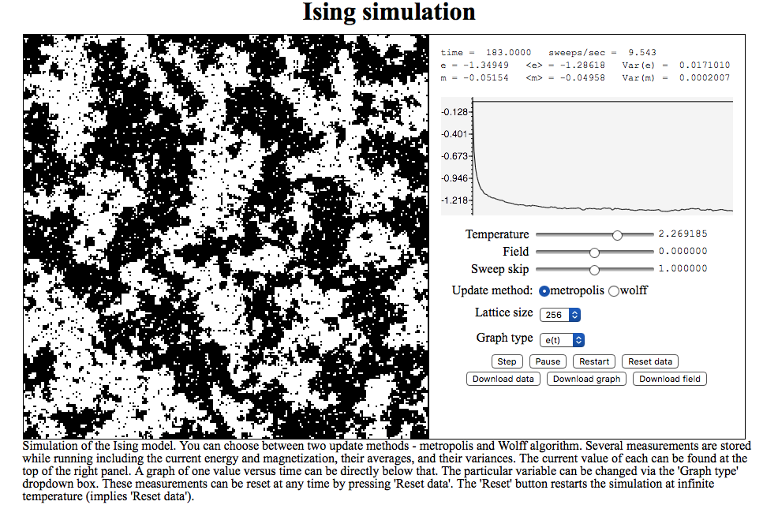
Monte Carlo Method
Ising Model Simulation
Start with a random configuration calculate φ(Z)
Move one atom or molecule or group of molecules
Calculate φ(Z’) if lower than φ(Z) accept
If higher than φ(Z) calculate exp(-Δφ/kT) and a random number from 0 to 1
If lower than random number accept
Repeat

Slide 15


Molecular Dynamics
Generate initial condition with particles identified by position and velocity
Calculate the force on each particle using potentials
Forces (accelerations) remain constant for a time step, position and velocity change
Repeat 3) until temperature is constant
After steady state record velocities and positions so that <r²> = 6Dt is found
Time calculation is on the order of nanoseconds.
Neither Monte Carlo nor Molecular Dynamics can calculate the free energy since they ignore large energy regions of phase space
They can calculate differences in free energy for phase diagram construction

Slide 16



Thermodynamic Perturbation Method
Which is more stable, B) MgO or A) a mixture of MnO and MgO?
Simulate B using Monte Carlo Metropolis Method, calculate A_{B}
Temporarily substitute the potential functions for A and calculate A_{A}
Find the difference, A_{A} – A_{B} to determine stability.
This can work if (A_{A} – A_{B}) < kT
If not, then use a coupling parameter between 0 and 1

Slide 17
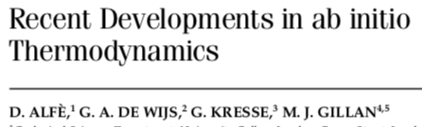


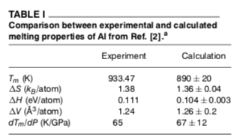
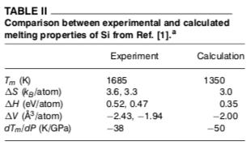
Thermodynamic Integration

Slide 18


Quantum mechanical/ab initio methods
Electronic wavefunction is independent of the nuclei since electrons are much smaller and move much faster: Born-Oppenheimer Approximation
Solve the Schrodinger equation
Hamiltonian in atomic units:
r_{i} electron positions; d_{α} nuclear positions, Z_{α} nuclear charge
Kinetic Energy – e⁻ nuc. attraction + e⁻ e⁻ repulsion + Nuc. Nuc. repulsion
Solve approximately since true wave function can’t be found directly. Compare proposed function results with data. Variational Principle: lowest energy wins.
4) Obey Pauli exclusion principle.

Slide 19

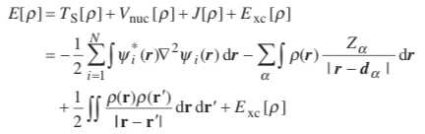
Density functional theory
Ground state can be obtained through minimization of E(ρ) of ρ(r)
Parallel non-interacting system (NIS)
3) Write the energy functional as
KE of NIS + e⁻ nuc. int. + Coulomb + exchange correlation energy
Minimize E[ρ] to obtain wave functions then iterate to obtain the ground
state density and energy
Exchange energy is energy of swapping identical electrons
Correlation energy is energy of interaction with all other electrons, how is the movement of one electron impacted by all other electrons
Neither of these are known so you use a Low-Density Approximation (LDA)

Slide 20
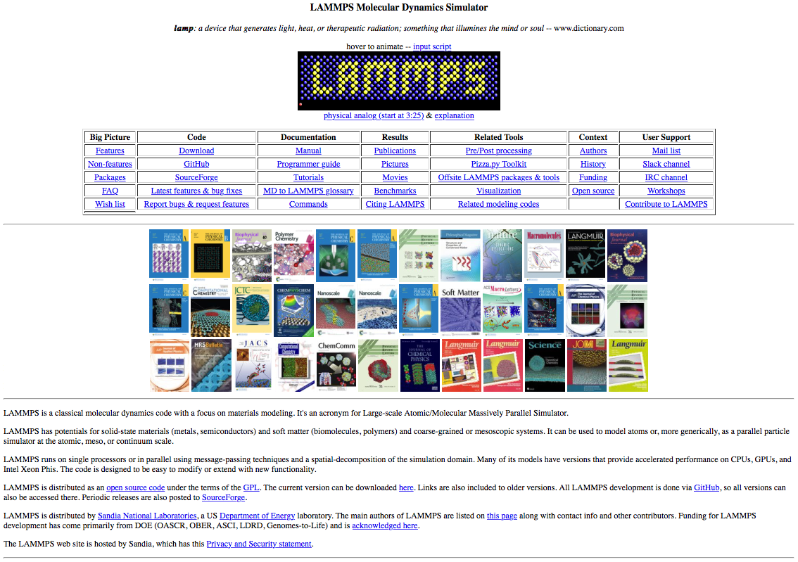
Molecular Dynamics
In order to do molecular dynamics, you do not write a program.
Software is available to perform the calculations. LAMMPS
LAMMPS

Slide 21
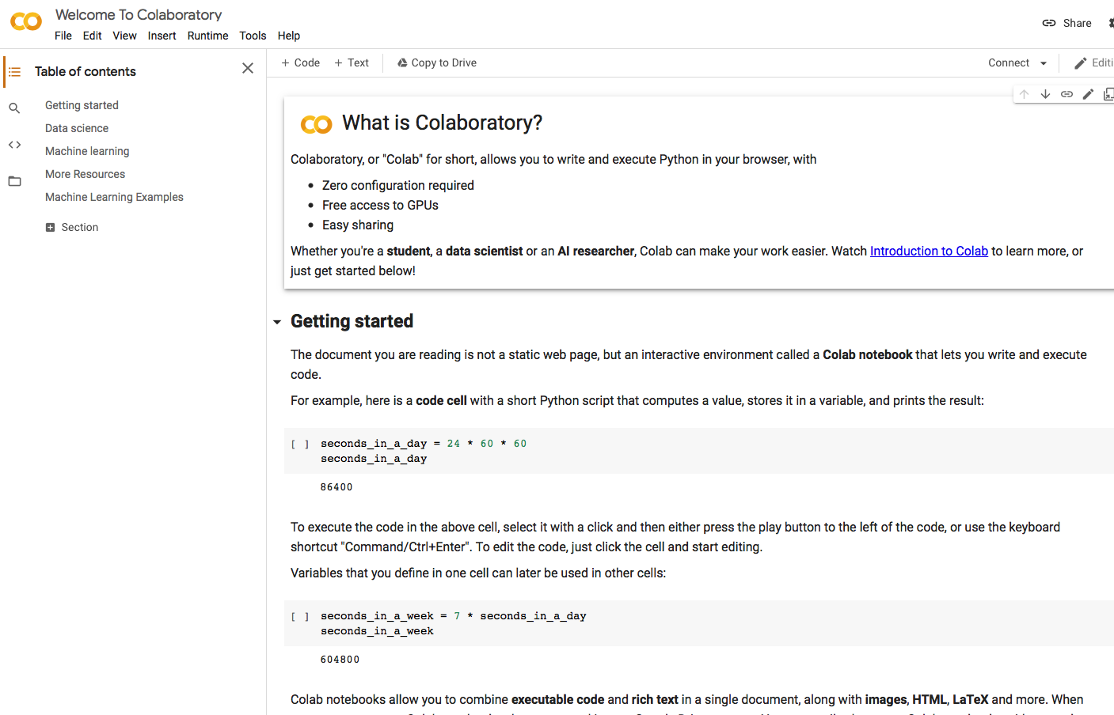
Free access to graphical processing units (GPU)
Colaboratory

Slide 22
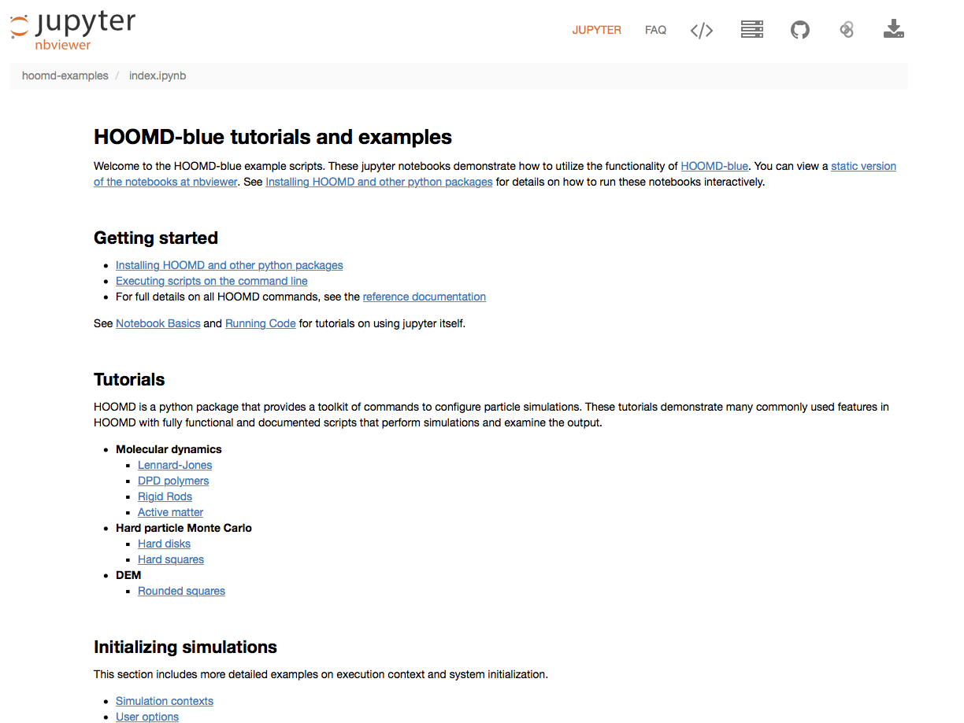
HOOMD-blue MD simulations

Slide 23

Dissipative particle dynamics
Off-lattice particles moving in space and time
A particle is a molecule or fluid region (not a single atom)
Particles experience dissipative and random forces (details are integrated)
Access to long times and distances
Up to 0.1 micron and 50 microseconds
Non-bonded forces within a set cutoff distance are considered for particle “i” interaction with particles “j”
Conservative Force, Dissipative Force, Random Force
Conservative Force- gives particle an identity
Random and dissipative forces act as a thermostat
Momentum is conserved locally so you can work with small numbers of particles
Random force between two interaction particles must be of opposite sign
One random force calculation for each pair of interacting particles
(This differs from Brownian motion where each particle experiences an independent random force)
Particles connected by Hookean springs if desired
Usually N, V and T are kept constant

Slide 24
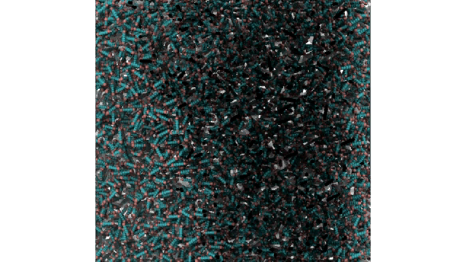
Parallelization in Dissipative particle dynamics
DPD interactions are short range so different processors can run in parallel for very large systems (micron and milliseconds (1000 microseconds))
http://gpiutmd.iut.ac.ir/en/gallery/video-gallery
LCD self-assembly
Smectic Crystal
Rod-Shaped particles
1 microsecond time

Slide 25
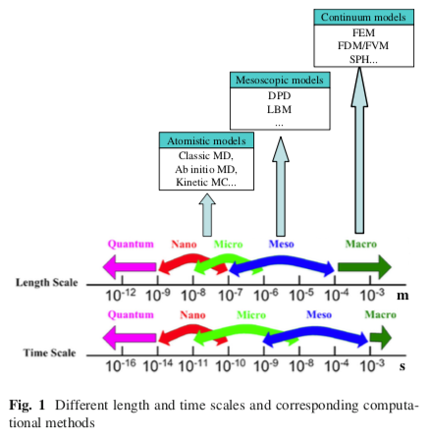
FEM Finite Element (Difference or Volume) Method
SPH Smoothed Particle Hydrodynamics
DPD Dissipative Particle Dynamics
LBM Lattice Boltzmann Method (fluids)

Slide 26
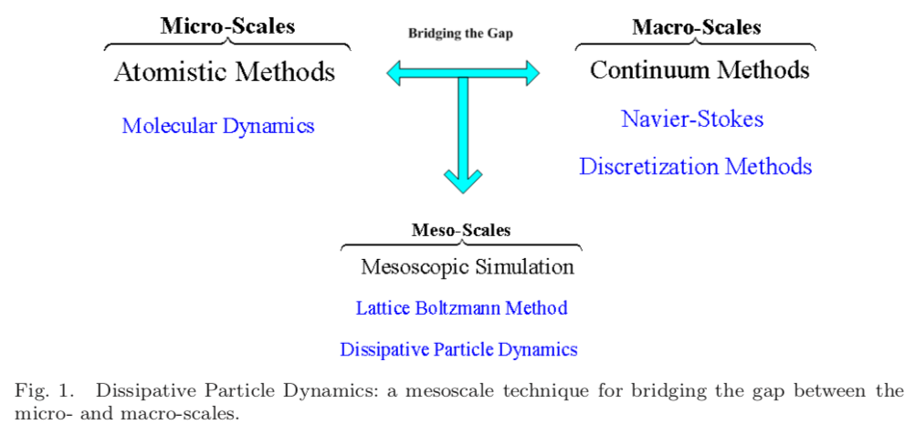

Slide 27
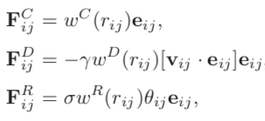





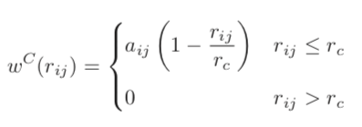

Dissipative particle dynamics
Coarse Graining Parameter N_{m} = number of molecules per particle
Speedup time is 1000 N_{m}^{8/3} for N_{m} = 3 you get 20,000X; for 7, 200,000X
Particles are “soft” not LJ particles
Repulsive
Drag
Random
All forces act within a sphere of interaction, r_{c}
Thermostat requirements:
w are “weight functions”
γ and σ are coefficients
White noise function
a_{ij} is the repulsion between particles “i” and ”j”

Slide 28
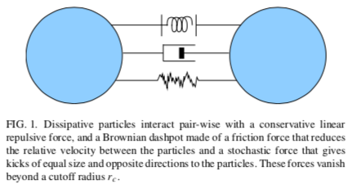
Dissipative Particle Dynamics (DPD)

Slide 29
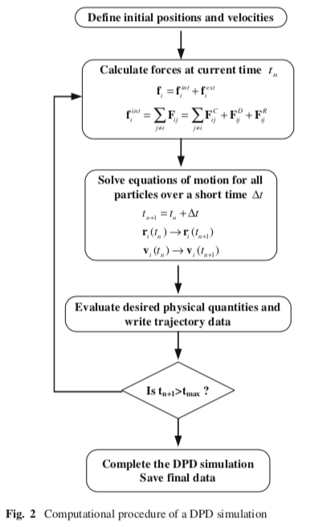

Slide 30
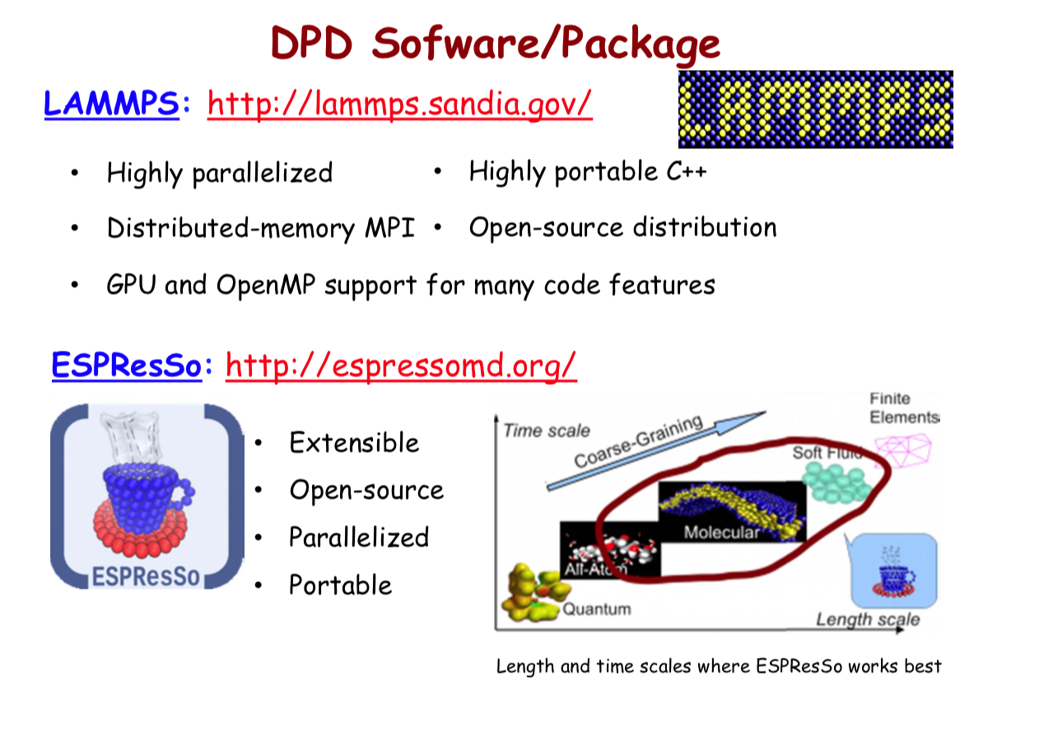

Slide 31
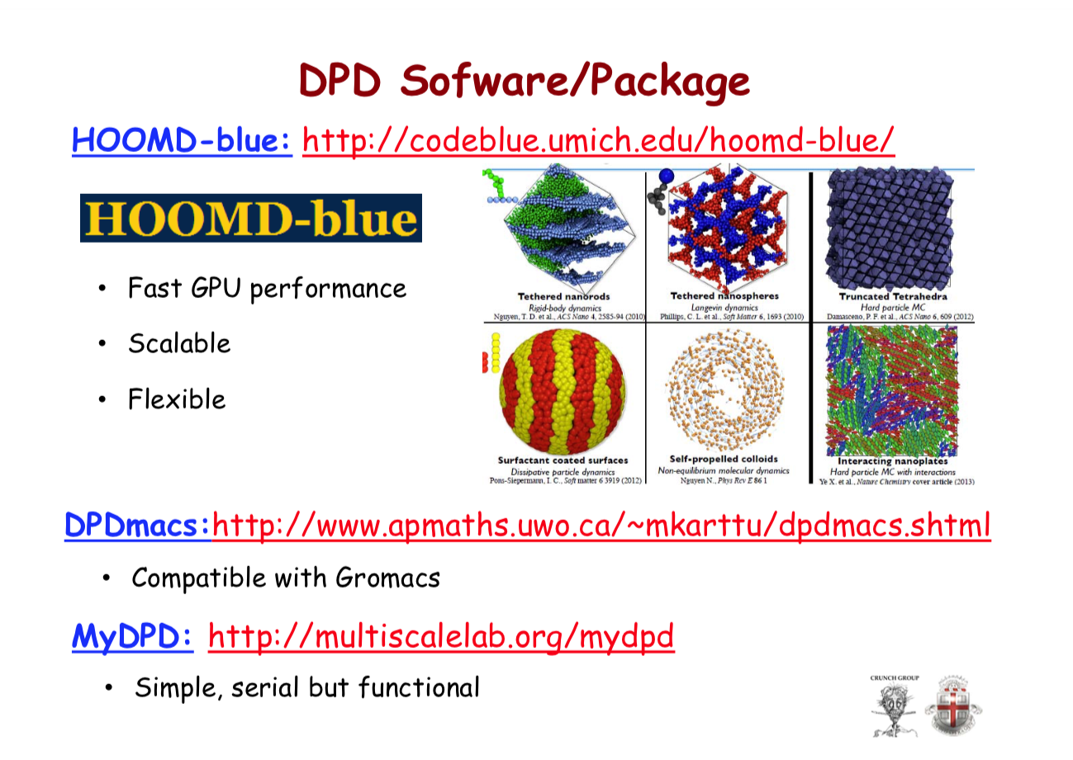

Slide 32
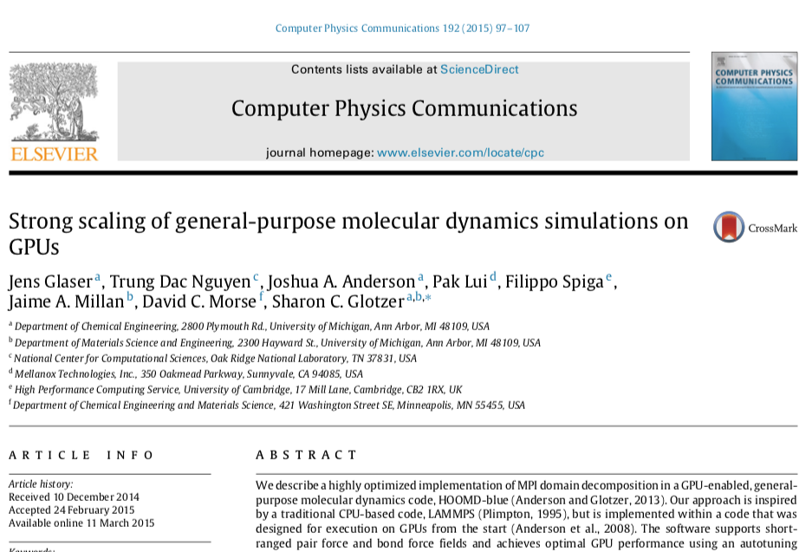

Slide 33
Some available simulation packages that can (also) perform DPD simulations are:
CULGI: The Chemistry Unified Language Interface, Culgi B.V., The Netherlands
DL_MESO: Open-source mesoscale simulation software.
DPDmacs
ESPResSo: Extensible Simulation Package for the Research on Soft Matter Systems - Open-source
Fluidix: The Fluidix simulation suite available from OneZero Software.
GPIUTMD: Graphical processors for Many-Particle Dynamics
Gromacs-DPD: A modified version of Gromacs including DPD.
HOOMD-blue: Highly Optimized Object-oriented Many-particle Dynamics—Blue Edition
LAMMPS
Materials Studio: Materials Studio - Modeling and simulation for studying chemicals and materials, Accelrys Software Inc.
SYMPLER: A freeware SYMbolic ParticLE simulatoR from the University of Freiburg.
SunlightDPD: Open-source (GPL) DPD software.

Slide 34
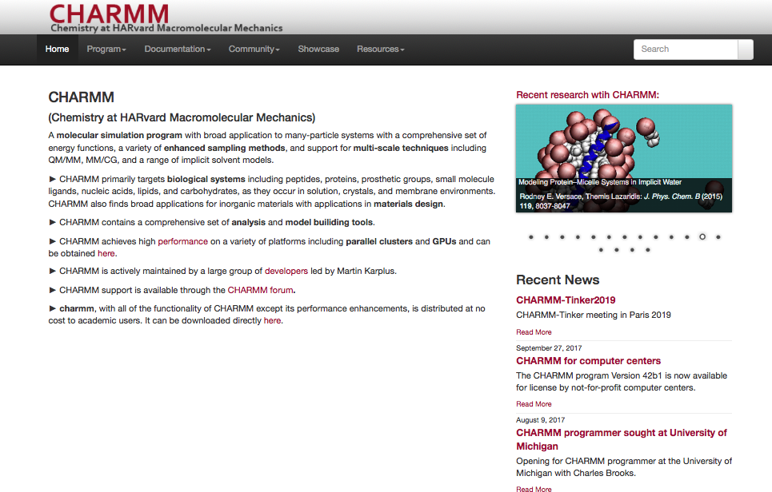

Slide 35
