Slide 1
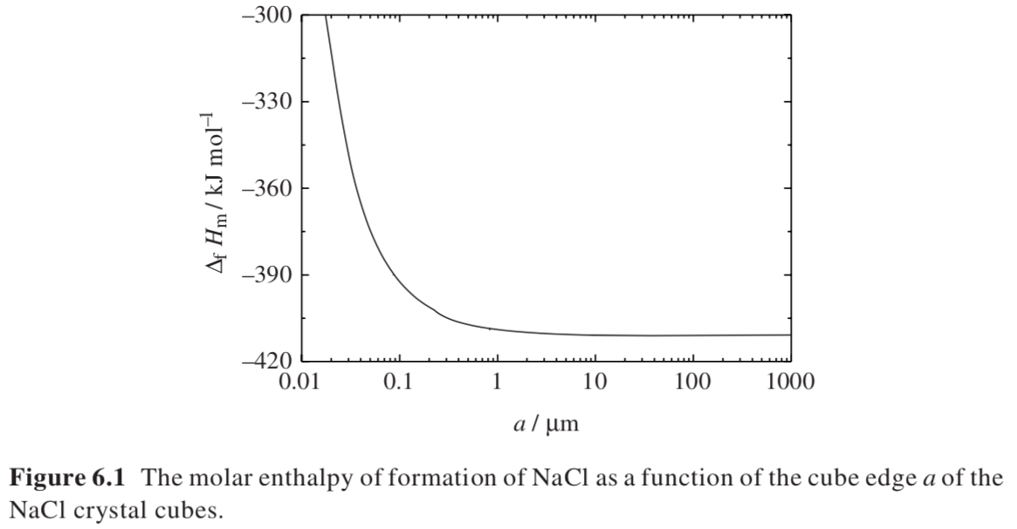
Surfaces impact the free energy
It takes energy to form surfaces
Small particles dissolve easier
There are limits to grinding, fine powdered sugar is about 50µm

Slide 2
Surfaces impact the free energy
ΔH/r³ = ΔH_{b}r³/r³ + σr²/r³
= ΔH_{b} + σ/r
It takes energy to form surfaces
Small particles dissolve easier
There are limits to grinding, fine powdered sugar; about 50µm

Slide 3
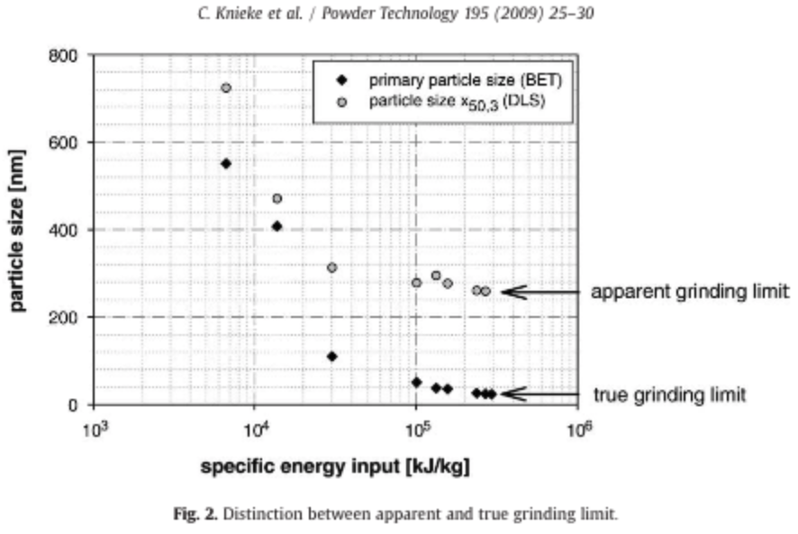
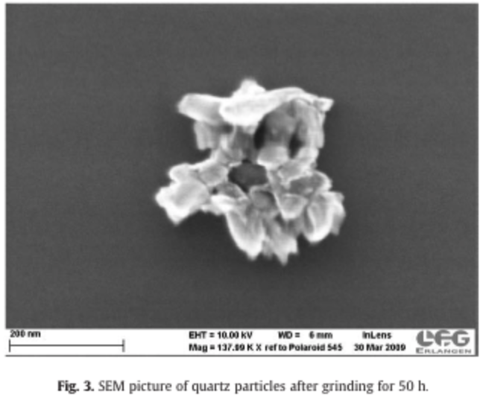
Aggregates versus primary particles

Slide 4
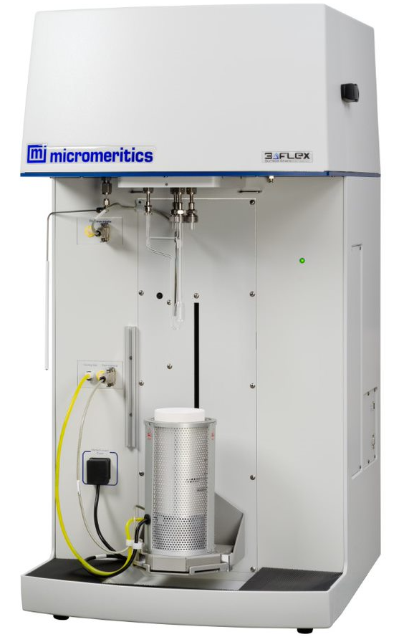
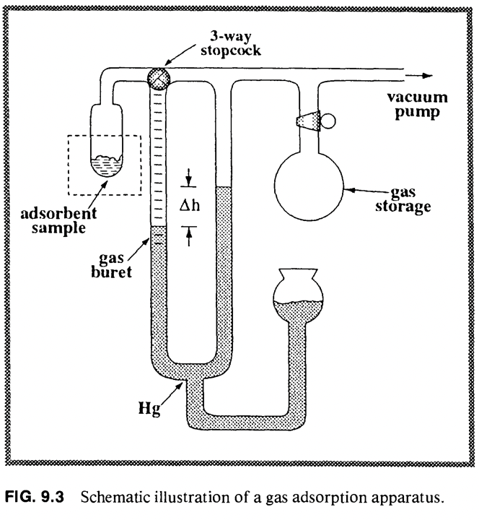
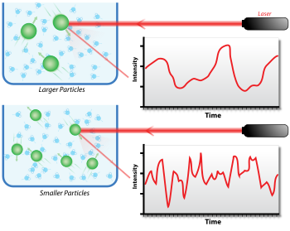
Nitrogen (or Argon) adsorption
Aggregates versus primary particles
Other methods:
SAXS
TEM
SEM
OM
XRD (Scherrer Equation)
Aerosol Methods (DMA)

Slide 5
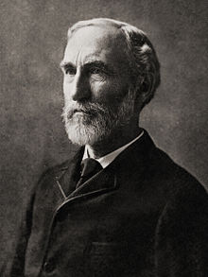
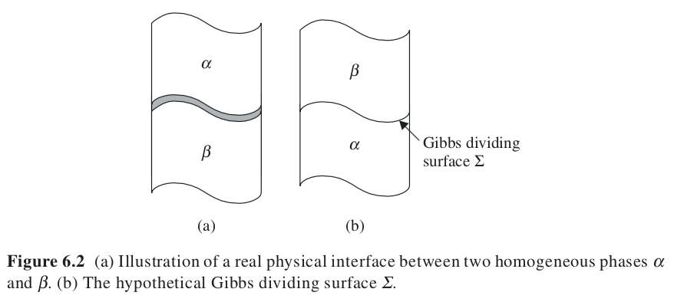
Liquid-gas or solid-gas interface is called a surface
For surfaces we define a surface tension, σ, energy/area
Liquid/liquid or solid/liquid or solid/solid is just called an interface
For interfaces we define the interfacial energy, γ, energy/area
Gibbs Surface

Slide 6


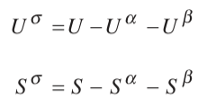

Adsorption (not Absorption) see video
Surface Excess Moles
Adsorption of i
The adsorption of “i”
There could be surface excess “i” or surface depletion of “i”
Γ_{i} can be positive or negative
Surface Excess Γ_{i}
Surface Excess Properties

Slide 7


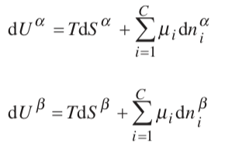



What is the change in internal energy by introduction of a surface?
-SUV
H A
-pGT
V doesn’t change
Surface excess
Surface Excess

Slide 8
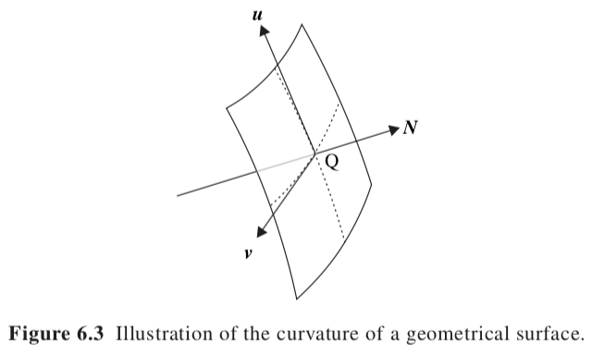

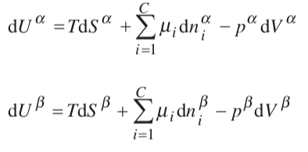
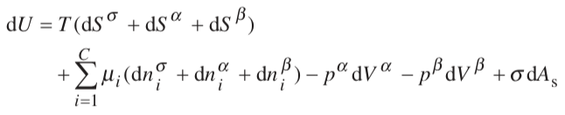


Two additional contributions to the surface energy
1) Surface Area and 2) Curvature Energy Terms, c_{x} = 1/r_{x}, c_{y} = 1/r_{y}
If the thickness is much smaller than r you can ignore curvature
For V/L or V/S
Definition of
Surface Tension
Enthalpic Term
Surface Tension

Slide 9






Derive Laplace Equation
Curved Interface (Laplace Equation p_{sat} ~ σ/r)
Force/Area x Distance = Energy/Area
Pressure reaches equilibrium
α
dl
dA_{s} = 0 for flat surface
β
α
For a sphere A =4π/3 r² :: dA =8π/3 r dr
c = 1/r so dA = 2A/r dr = 2Acdr
if dr = dl dA = 2cAdl
dl
β
Change in internal energy is proportional to the change in interfacial width

Slide 10


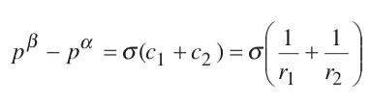
Laplace Equation
For a 100 nm (1e⁻⁵ cm) droplet of water in air (72 e⁻⁷ J/cm² or 7.2 Pa-cm)
Pressure is 720 MPa (7,200 Atmospheres)

Slide 11


For S/S, S/L, L/L
Solid interface in a 1-component system
-SUV
H A
-pGT
Work to create the interface
Interfacial energy, γ
Surface creation always has an energy penalty.
is always positive
Nano-particles are unstable (increase in free energy with a surface)
Differences in surface energy for different crystal surfaces leads to fibrous or lamellar crystals

Slide 12
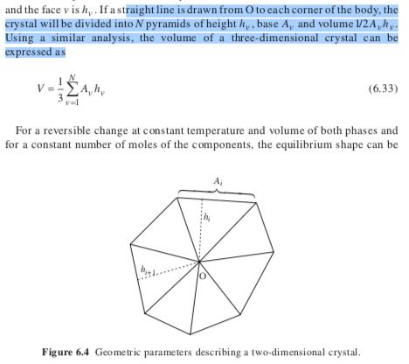

Gibbs-Wulff Theorem
Crystal surface energy ~ number of bonds * bond energy
Density of bonds decreases with Miller Indices
FCC Nearest Neighbors Number of bonds
[111] 6 3
[110] 12 6
[100] 8 4
(Each pair share a bond)
Liquid droplets minimize surface area for a given volume
So, Spheres form
At high temperatures crystalline solids also form spheres
Because surface energy becomes less important
Consider a crystal with constant volume with N facets.
Draw a vector from the center of a crystal to a face, h_{ν}.

Slide 13

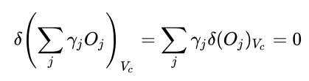
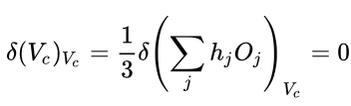






Wulff Construction
Surface excess energy
O is area
γ surface energy
Draw a vector from the center of a crystal to a face.
Gibbs-Wulff Theorem states that the length of the vector is proportional to the surface energy
h_{j} = λ γ_{j}
Higher energy surfaces grow preferentially (λ is a constant)
Minimization to find the lowest free energy
h_{j} O_{j} is proportional to the volume of a facet so for constant volume:
And for constant volume:
And
So:
And
Diffusion rates and twinning can alter the crystal shape for large crystals

Slide 14

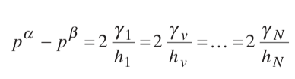
Pressure difference for solid crystal facets
Isothermal
Equilibrium
γdA/V = 2γd(1/h) = -dp
(Force/length)/length = Force/Area
Laplace Equation

Slide 15
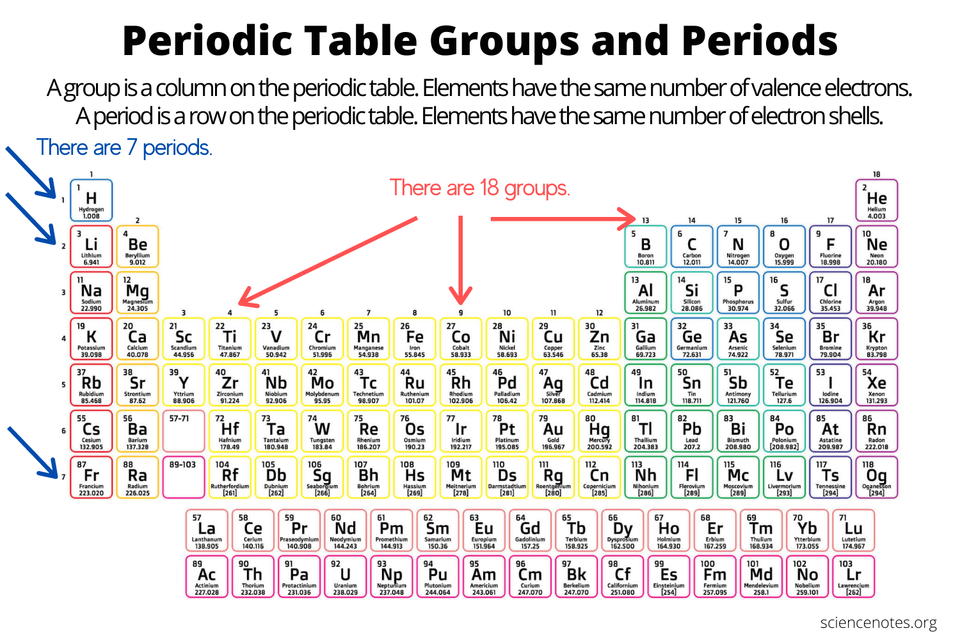
Strength of bonding impacts surface tension
d-block transition metals have strong bonds

Slide 16
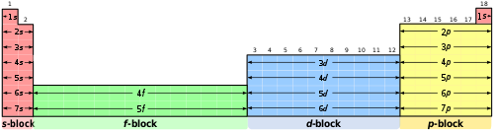
Strength of bonding impacts surface tension
d-block transition metals have strong bonds

Slide 17
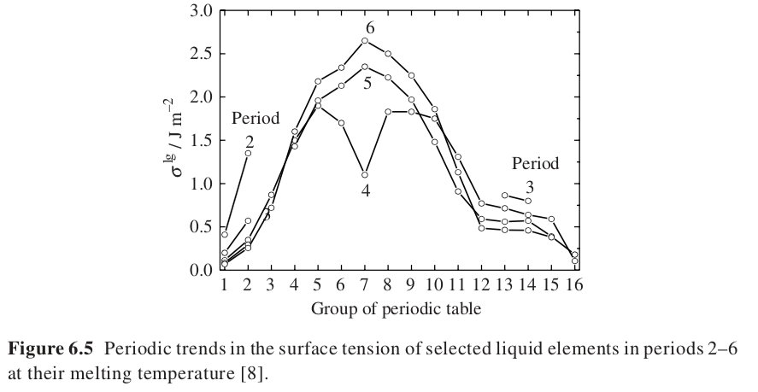
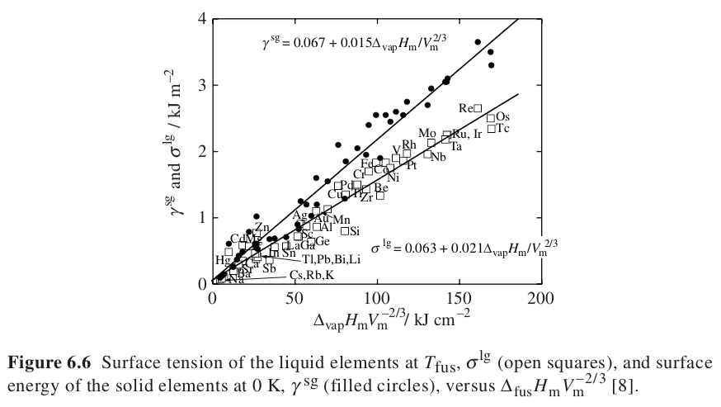
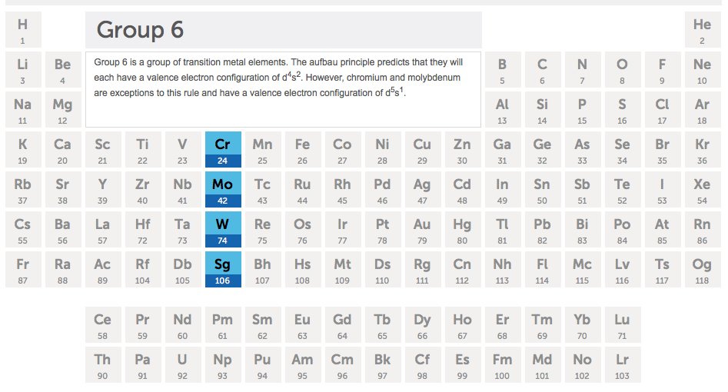
Strength of bonding impacts surface tension
d-block transition metals have strong bonds

Slide 18
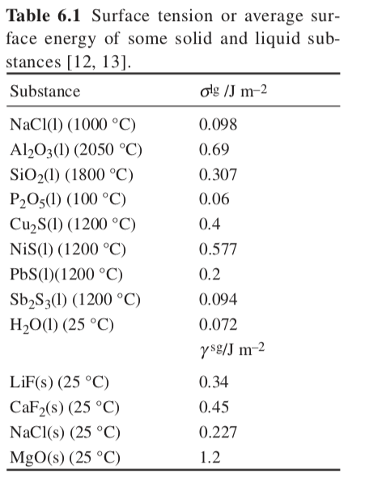
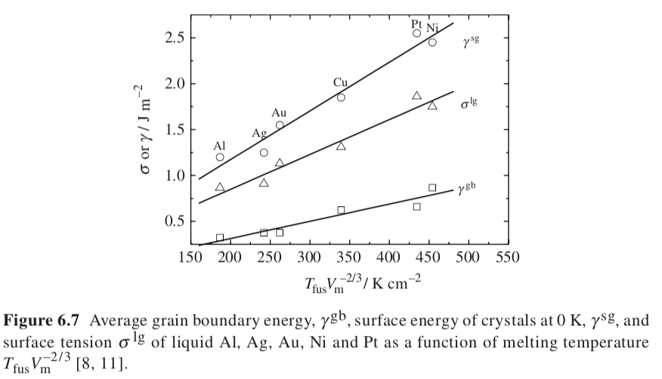

Slide 19
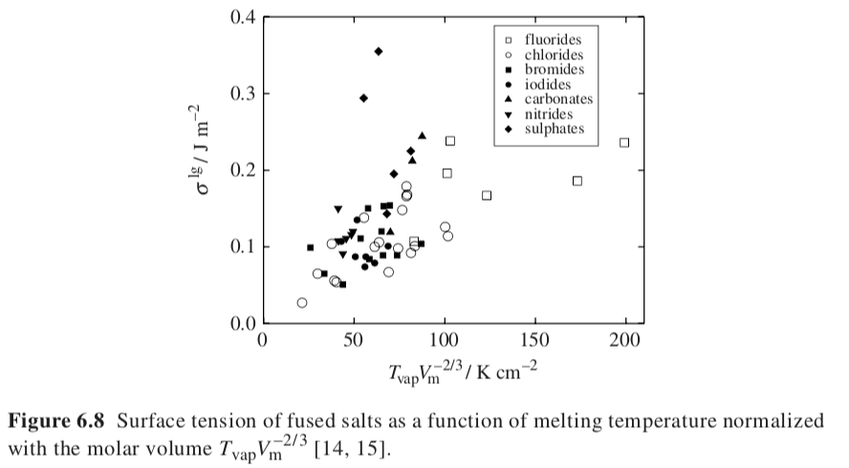
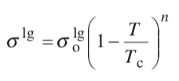
Empirical relationship for the temperature dependence, entropy at interface is high, n ~ 1.2 for metals.
For a liquid with its own vapor
Reminiscent of ΔG = ΔH(1-T/T*)
Liquid/Vapor surface

Slide 20
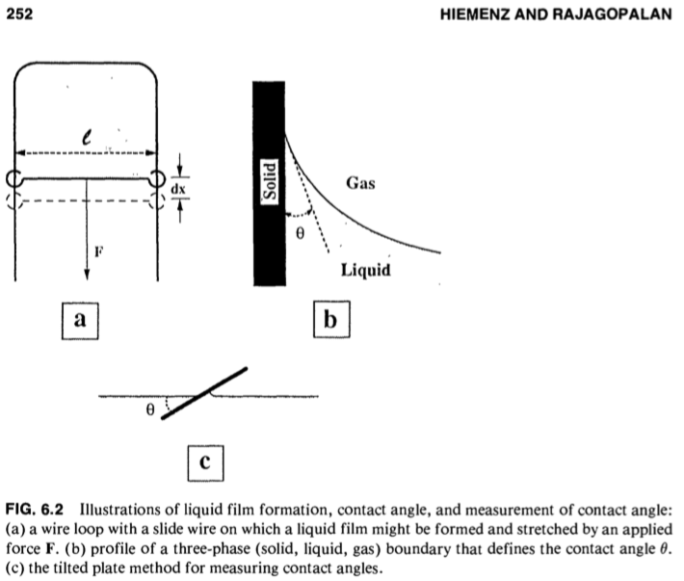
From Hiemenz’s Book
Force to increase a 2d film area
You apply the force to the the side l and the opposite side l so 2l. F ~ 2l or F/(2l) = γ

Slide 21


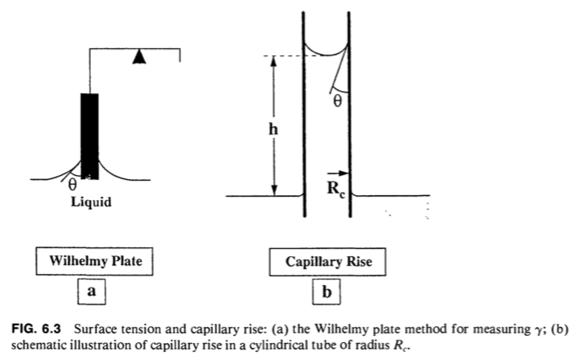

Perimeter gamma cosθ= mgh
w = Force
P = Wetted Perimeter
t = Thickness
l = Plate Length
Jurin’s Law

Slide 22
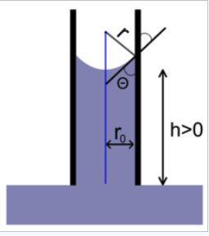

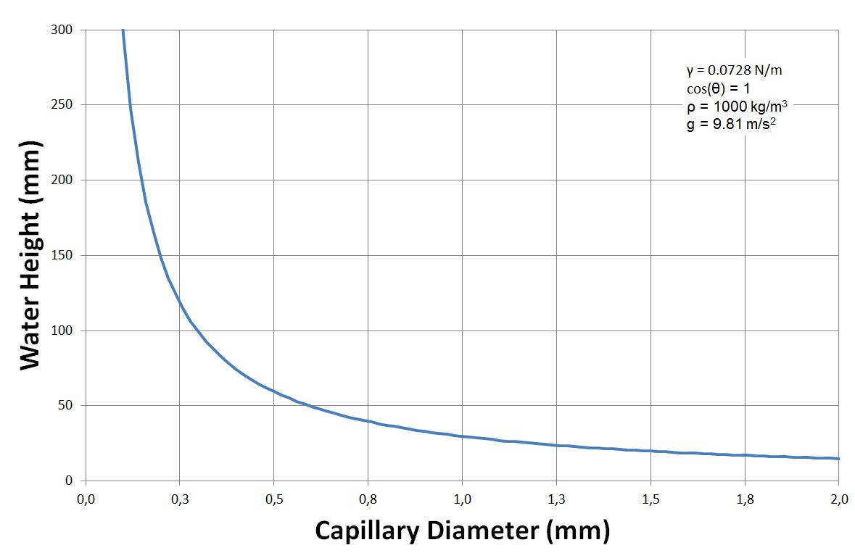
Jurin’s Law
1) Atmospheric Pressure above, Liquid pressure below
Laplace law indicates
Δp = 2σ/r where r is r₀/cosθ if the meniscus is circular
2) Pressure in the tube follows p = p₀ - ρgh where p₀ is atmospheric pressure (hydrostatic pressure)
3) At equilibrium ρgh = 2σ cosθ / r₀
So, h = 2σ cosθ /(ρg r₀)

Slide 23

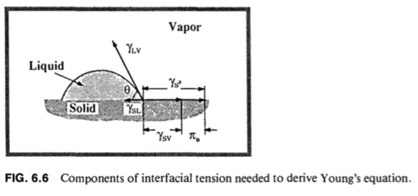
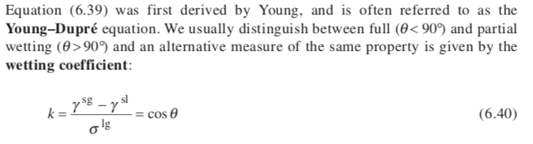
Young-Dupré Equation

Slide 24
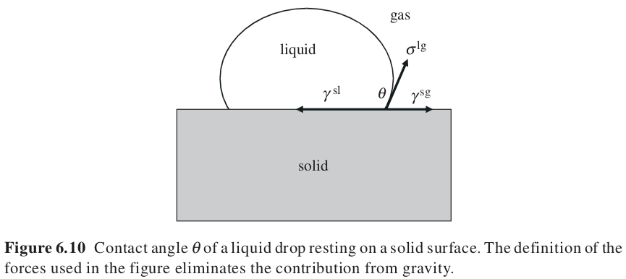

Young-Dupre Equation

Slide 25
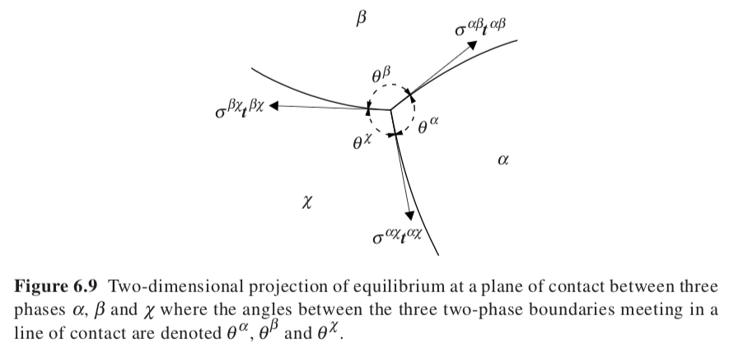

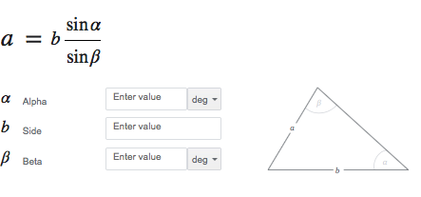
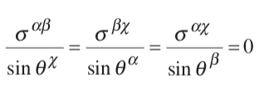

t is the tangent vector along the surface at the point of contact, tσ is a force in the tangent direction
Larger angle means smaller displacement t, t ~ 1/sin(θ)
This defines the observed angles in a micrograph in terms of the surface tension for the various phases
Law of sines

Slide 26
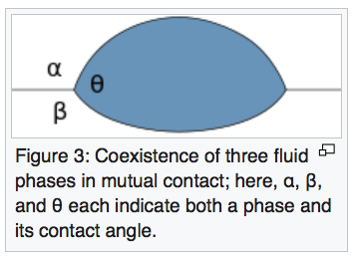
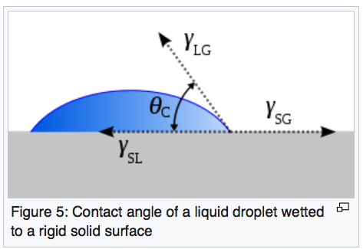


Three phases and three angles
Define the phase by the angle
Take the α, θ line as the vector direction then
γ^{αθ} + γ^{θβ}cos(θ) + γ^{βα}cos(α) = 0 using the dot product of the vectors
For the θ, β line as the vector direction then
γ^{αθ}cos(θ) + γ^{θβ} + γ^{αβ}cos(β) = 0 using the dot product of the vectors
For the α, β line as the vector direction then
γ^{αθ}cos(α) + γ^{θβ}cos(β) + γ^{αβ} = 0 using the dot product of the vectors
3 equations and
3 unknowns
You can solve for three interfacial tensions
β is a flat rigid surface, β = π
γ^{αθ}cos(θ) + γ^{θβ} + γ^{αβ}cos(β) = 0
γ^{gl}cos(θ) + γ^{ls} - γ^{gs} = 0
Spreading Parameter: S>0 wets; S<0 partially wets
For S<0

Slide 27
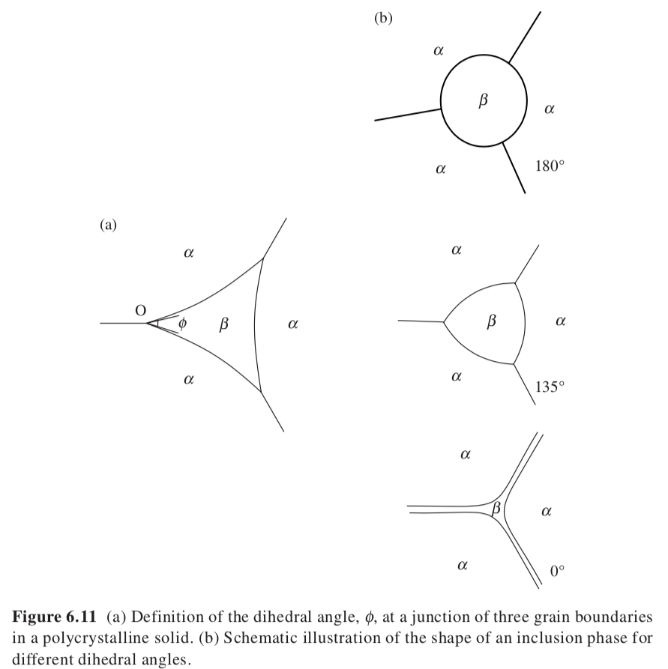
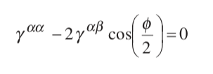
Dihedral Angle

Slide 28

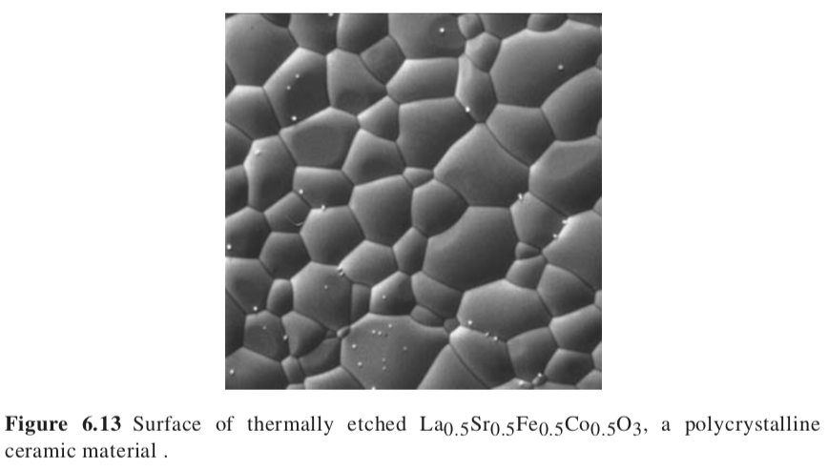
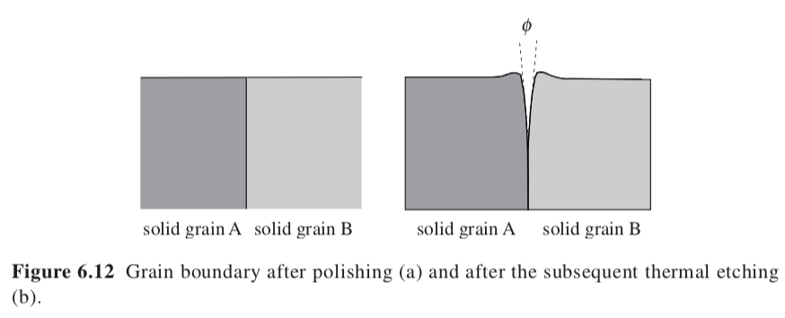
Dihedral Angle in Microscopy

Slide 29



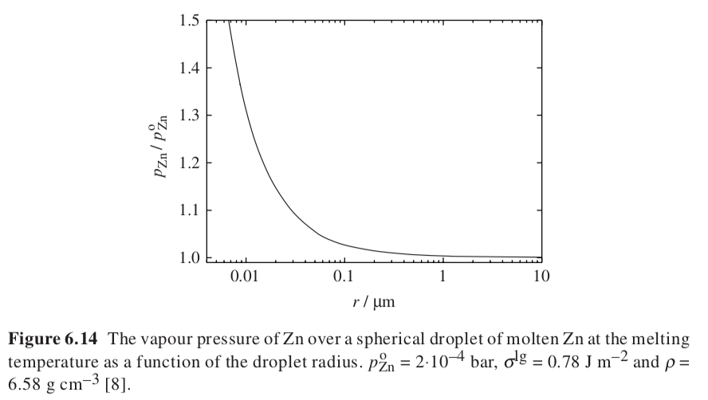

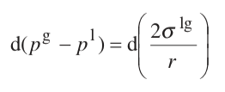
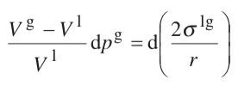



How do you make small particles? (Nanoparticles)
-SUV
H A
-pGT
Pressure for equilibrium of a liquid droplet of size ”r”
Reversible equilibrium
At constant temperature
dp^{l} =V^{g}/V^{l} dp^{g}
Differential Laplace equation
Small drops evaporate, large drops grow
Large excursions away form the equilibrium pressure makes nanoparticles (deep quench far from equilibrium)

Slide 30





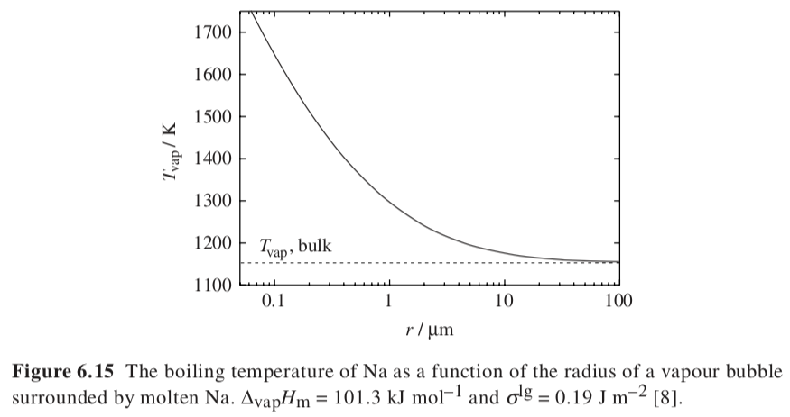
Initial Bubbles on Boiling
-SUV
H A
-pGT
In the absence of nuclei, the initial bubbles on boiling can be very small
These bubbles are unstable due to high pressure so boiling can be prevented leading to a superheated fluid
Equilibrium
Ideal gas
Laplace equation for pressure
Smaller bubbles at higher temperatures
(Far from equilibrium)

Slide 31
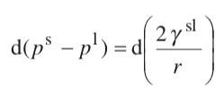




Ostwald-Freundlich Equation
Solubility and Size, r
Consider a particle of size r_{i} in a solution of concentration x_{i} with activity a_{i}
Derivative form of the Laplace equation
-SUV
H A
-pGT
Dynamic equilibrium
For an incompressible solid phase
Definition of activity
Solubility increases exponentially with reduction in size, r
(x_{i}^{l})_{r} = (x_{i}^{l})_{r=∞} exp(2γ^{sl}/(ρRT r))
Small particles dissolve to build large particles with lower solubility
-To obtain nanoparticles you need to supersaturate to a high concentration (far from equilibrium).
-Low surface energy favors nanoparticles. (Such as at high temperatures)
-High temperature and high solid density favor nanoparticles.
Supersaturation is required for any nucleation
One form of the Gibbs-Thompson Equation

Slide 32

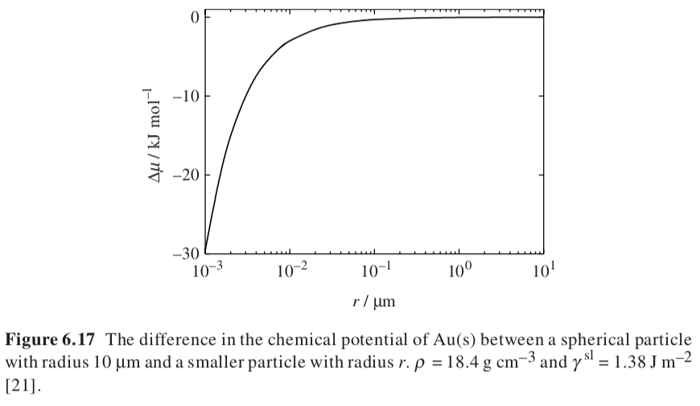
Ostwald Ripening
Dissolution/precipitation mechanism for grain growth
Consider small and large grains in contact with a solution
PV = μ
Grain Growth and Elimination of Pores

Slide 33


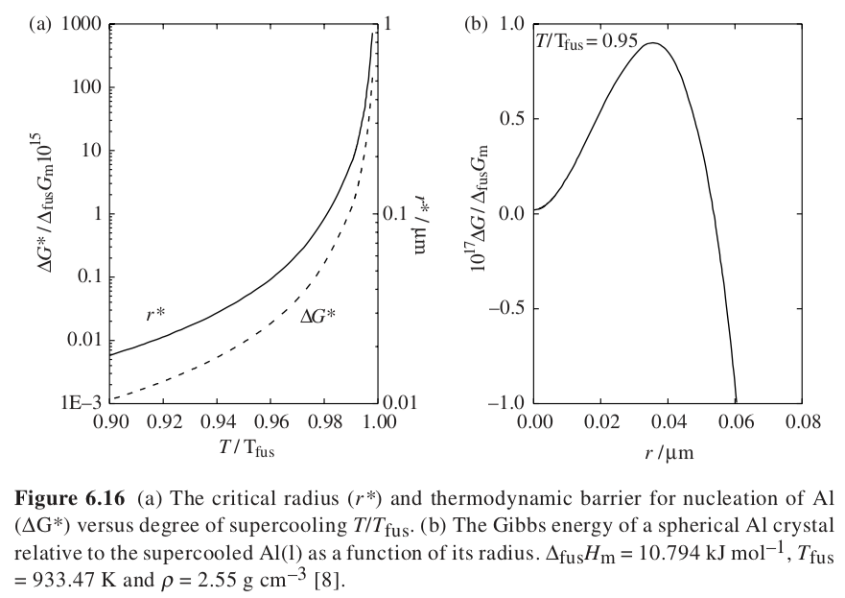



Critical Nucleus and Activation Energy for Crystalline Nucleation (Gibbs)
Bulk decreases free energy
Surface increases free energy
(M/ρ) is molar volume
Barrier energy for nucleation at the critical nucleus size beyond which growth is spontaneous

Slide 34

Critical Nucleus and Activation Energy for Crystalline Nucleation (Gibbs)

Slide 35
Critical Nucleus and Activation Energy for Crystalline Nucleation (Gibbs)
Δ_{fus}G_{m} = Δ_{fus}H_{m} - TΔ_{fus}S_{m}
Lower T leads to larger Δ_{fus}G_{m} (Driving force for crystallization)
smaller r* and smaller Δ_{l-s}G*
Deep quench, far from equilibrium leads to nanoparticles
One form of the Gibbs-Thompson Equation

Slide 36



Third form of the Gibbs-Thompson Equation
Third form of GT Equation/ Hoffman-Lauritzen Equation
B is a geometric factor from 2 to 6
Crystallize from a melt, so supersaturate by a deep quench
At equilibrium for an infinite crystal (r = ∞) Δf = 0 = ΔH – TΔS so ΔS = ΔH/T∞
For a small crystal of size “r” at “equilibrium”
Free energy of a crystal formed at supercooled temperature T
r = BγT∞/(ΔH(T∞-T))
Small particles at deep quench

Slide 37




Heterogeneous versus Homogeneous Nucleation

Slide 38












Formation of a surface nucleus versus a bulk nucleus from n monomers
Homogeneous
Heterogeneous (Surface Patch)
Bulk vs n-mer
So, surface excess chemical potential
Surface energy from the sides of the patch

Slide 39


Barrier is half the height for surface nucleation
Stable size is half the size

Slide 40

Adamson Physical Chemistry of Surfaces pp. 328 Classical Nucleation Theory

Slide 41




condensation

Slide 42

Growth rate I is related to collisions Z and Boltzmann probability

Slide 43


Slide 44






Three forms of the Gibbs-Thompson Equation
Ostwald-Freundlich Equation
x = supersaturated mole fraction
x∞ = equilibrium mole fraction
ν₁ = the molar volume
Free energy of formation for an n-mer nanoparticle from a supersaturated solution at T
Difference in chemical potential between a monomer in supersaturated conditions and equilibrium with the particle of size r
At equilibrium
For a sphere

Slide 45

Three forms of the Gibbs-Thompson Equation
Ostwald-Freundlich Equation
Areas of sharp curvature nucleate and grow to fill in. Curvature κ = 1/r
Second Form of GT Equation

Slide 46

Three forms of the Gibbs-Thompson Equation
Third form of GT Equation/ Hoffman-Lauritzen Equation
B is a geometric factor from 2 to 6
Crystallize from a melt, so supersaturate by a deep quench
Free energy of a crystal formed at supercooled temperature T

Slide 47
Nitrogen (or Argon) adsorption

Slide 48


Langmuir Equation (Wikipedia)
Can be obtained using Equilibria or Kinetic Model
The surface containing the adsorbing sites is a perfectly flat plane with no corrugations (assume the surface is homogeneous). However, chemically heterogeneous surfaces can be considered to be homogeneous if the adsorbate is bound to only one type of functional groups on the surface.
The adsorbing gas adsorbs into an immobile state.
All sites are energetically equivalent, and the energy of adsorption is equal for all sites.
Each site can hold at most one molecule of A (mono-layer coverage only).
No (or ideal) interactions between adsorbate molecules on adjacent sites. When the interactions are ideal, the energy of side-to-side interactions is equal for all sites regardless of the surface occupancy.

Slide 49




Langmuir Equation (Wikipedia)
Can be obtained using Equilibria or Kinetic Model
Equilibrium Reaction Model
Solvent = 1; Solute = 2; s = surface bound; b = bulk solution free
a₁^{b} ~ 1

Slide 50


Langmuir Equation (Wikipedia)
Can be obtained using Equilibria or Kinetic Model
Kinetic Reaction Model

Slide 51

Langmuir Equation (Wikipedia)
Can be obtained using Equilibria or Kinetic Model
Kinetic Reaction Model

Slide 52


Slide 53

Adsorption, Surface Area and Porosity

Slide 54

1938 Stephen Brunauer, Paul Emmett, and Edward Teller
(P/P₀)/(v_{ads}(1-P/P₀)) = 1/(K_{eq}v_{mono ads}) + (P/P₀)(K_{eq} - 1)/(K_{eq}v_{mono ads})

Slide 55



Langmuir
BET

Slide 56

Empirical power-law equation for adsorption

Slide 57
Adsorption, Surface Area and Porosity

Slide 58

Adsorption, Surface Area and Porosity

Slide 59




Surface Energy Term and Block Co-Polymers
Micro-Phase Separation

Slide 60




How can you predict the phase size? (Meier and Helfand Theory)
Consider lamellar micro-phase separation.
For a symmetric binary blend of polymers, the Flory Huggins equation predicts a critical point at χN = 2.
If the same two polymers are bonded, they microphase separate at χN = 10.5, the bonding makes the polymers more miscible.
Enthalpy associated with phase segregation
Entropy associated with locating the junction points at the phase interface
Entropy associated with stretching the chains
Drives a positive enthalpic contribution that favors micro-phase separation
Assume transition from perfectly mixed to perfectly demixed
An interfacial layer of thickness d_{t},
Area per polymer chain o_{p}

Slide 61




How can you predict the phase size? (Meier and Helfand Theory)
Consider lamellar micro-phase separation.
For a symmetric binary blend of polymers, the Flory Huggins equation predicts a critical point at χN = 2.
If the same two polymers are bonded, they microphase separate at χN = 10.5, the bonding makes the polymers more miscible.
d_{A}
d_{t}
d_{B}
R₀² = Nl²
R = β d_{AB} = β(d_{A} + d_{B})

Slide 62






How can you predict the phase size? (Meier and Helfand Theory)
Consider lamellar micro-phase separation.
For a symmetric binary blend of polymers, the Flory Huggins equation predicts a critical point at χN = 2.
If the same two polymers are bonded, they microphase separate at χN = 10.5, the bonding makes the polymers more miscible.
d_{A}
There is only one free parameter, for instance o_{p},
the cross-sectional area per polymer chain (Tom Witten, U Chicago)
d_{t}
d_{B}
Find the minimum in the free energy by varying o_{p}
Ignoring “ln” term that varies slowly

Slide 63

How can you predict the phase size? (Meier and Helfand Theory)
Consider lamellar micro-phase separation.
d_{A}
d_{t}
d_{B}
Perfect match

Slide 64
Binary Correlation Function (Radial Distribution Function) and S/V ratio
g(r) is the probability of finding a point “x” (diamond) in a phase and
of finding a point “y” (circle) a distance “r” from “x” also in the phase
Consider small “r” compared to the particle size for a smooth/sharp interface (not a spinodal or diffuse interface)
Probability of “x” being in the phase is the volume fraction “φ” of the particle phase.
There are three possibilities:
Yes for “x” = φ
g(r) = Yes for “x” and for “y” = φ (1 – (S/V) r)
So, this is a straight line that decays with (S/V)
For small “r” where the curvature of the phase doesn’t matter and
For smooth sharp interfaces, not diffuse and not rough interfaces
The Fourier transform of the correlation function is the X-ray or neutron scattering and small sizes are at large angles in the small angle regime for nanoparticles. The transform of this linear decay is a power-law decay of -4 slope, I(q) ~ S/V q⁻⁴ Porod’s Law
Surface
Volume
No
Yes
r
No

Slide 66

For fine grain particles at times a high Gibbs free energy polymorph forms
α-Al₂O₃ is the stable form but γ-Al₂O₃ forms for small particles
γ-Al₂O₃ has a lower surface energy
135 m²/g ~ 12 nm particles
S/V ~ 1/r

Slide 67


Adsorption (Adherence to surface, can be chemical or physical)
Adsorbate
Adsorbent
The adsorption
Surface Excess Moles
Solid or Liquid
Molecules in a Liquid or Gas
Physical adsorption: Low enthalpy of adsorption; reversible adsorption isotherm
Chemical adsorption: Large enthalpy of adsorption; irreversible; chemical change to surface
Hysteresis in adsorption isotherm

Slide 68
Adsorption, Surface Area and Porosity

Slide 69





Gibbs Adsorption Equation
Internal Energy of System:
Surface Excess Internal Energy:
-SUV
H A
-pGT
Differential Form with respect to the area:
Subtract the total derivative from the differential form yields the Gibbs-Duhem for Surface Excess:
Gibbs Adsorption Equation

Slide 70



Gibbs Adsorption Equation
Gibbs-Duhem Equation:
dσ/dln(x_{B}))_{T} = -RT[Γ_{B} – (x_{A}/x_{B}) Γ_{A})

Slide 71




Adsorption, Γ, depends on the position of the “surface”
Relative Adsorption, doesn’t
V^{α} is the volume of the α-phase
Relative Adsorption
Multiply second equation by c ratio then subtract, it doesn’t depend on the position of the surface.

Slide 72


Relative Adsorption
Gibbs Surface Σ is located where there is no net adsorption of A

Slide 73




Solutes that reduce the surface tension are adsorbed

Slide 74







Henry’s Law for Surfaces (surface impurities change surface tension)
For an ideal gas µ_{B} = RTlnp_{B} where p_{B} is the partial pressure of B
Define j as the surface activity of an impurity
Surface Activity of B
At infinite dilution so Henry’s Law Regime
A small number of electronegative elements can have a large impact on surface energy of metals j_{A} ~1000 for oxygen and sulfur

Slide 75


Slide 76


