Slide 1
Solutions
Mole fraction of component A = x_{A}
Mass Fraction of component A = m_{A} (or weight fraction w_{A})
Volume Fraction of component A = φ_{A}
Typically, we make a binary blend, A + B, with mass fraction, m_{A}, and want volume fraction, φ_{A}, or mole fraction , x_{A}.
φ_{A} = (m_{A}/ρ_{A})/((m_{A}/ρ_{A}) + (m_{B}/ρ_{B}))
x_{A} = (m_{A}/MW_{A})/((m_{A}/MW_{A}) + (m_{B}/MW_{B}))
m_{A} = (x_{A} MW_{A})/((x_{A} MW_{A}) + (x_{B} MW_{B}))

Slide 2
Solutions
-S U V
H A
-p G T
We need the free energy of mixing to determine equilibrium
G = H – TS A = U – ST; U = H – PV
We can measure H and P and V and T but not S
Need the Entropy S
Three ways to get entropy and free energy of mixing
Isothermal free energy expression, pressure expression
Isothermal volume expansion approach, volume expression
From statistical thermodynamics

Slide 3
A. Pressure Expression: Mix two ideal gasses, A and B
-S U V
H A
-p G T
p = p_{A} + p_{B}
p_{A} is the partial pressure p_{A} = x_{A}p (Raoult’s Ideal Mixing Law)
For single component molar G = μ
μ₀ is at p_{0,A} = 1 bar
At pressure p_{A} for a pure component isothermal ideal gas
μ_{Α} = μ_{0,A} + RT ln(p/p_{0,A}) = μ_{0,A} + RT ln(p)
For a mixture of A and B with a total pressure p_{tot} = p_{0,A} = 1 bar and p_{A} = x_{A} p_{tot}
For component A in a binary mixture
μ_{Α}(x_{A}) = μ_{0.A} + RT ln (x_{A} p_{tot}/p_{0,A}) = μ_{0.A} + RT ln (x_{A})
dG=-SdT+Vdp
Isothermal and Ideal Gas
dG = RTdp/p
G = RT ln(p/p₀)
Isothermal ideal gas (no enthalpy)
Notice that x_{A} must be less than or equal to 1, so ln x_{A} must be negative or 0
So, the chemical potential must drop in the solution for a solution to exist.
Ideal gasses only have entropy so entropy drives mixing in this case.
This can be written, x_{A} = exp((μ_{Α}(x_{A}) − μ_{0.A})/RT)
Which indicates that x_{A} is the Boltzmann probability of finding A

Slide 4
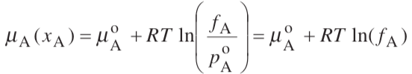

Mix two real gasses, A and B
Gas
Solution
μ_{A}* = μ_{0.A} if p = 1

Slide 5
Solutions
-S U V
H A
-p G T
G = H – TS A = U – ST U = H – PV
Need the Entropy S
Three ways to get entropy and free energy of mixing
Isothermal free energy expression, pressure expression
Isothermal volume expansion approach, volume expression
From statistical thermodynamics

Slide 6
B. Volume Expression: Ideal Gas Mixing
-S U V
H A
-p G T
For isothermal ΔU = C_{V} dT = 0 = dQ + dW
dQ = -dW = pdV
For ideal gas dQ = -dW = nRTln(V_{f}/V_{i})
dQ = TΔS
ΔS = nR ln(V_{f}/V_{i})
Consider a process of expansion of a gas from V_{A} to V_{tot}
The change in entropy is ΔS_{A} = n_{A}Rln(V_{tot}/V_{A}) = - n_{A}Rln(V_{A}/V_{tot})
Consider an isochoric mixing process of ideal gasses A and B.
A is originally in V_{A} and B in V_{B}
V_{tot} is V_{A} + V_{B}
The change in entropy for mixing of A and B is
ΔS_{mixing A and B} = - n_{A}Rln(V_{A}/V_{tot}) - n_{B}Rln(V_{B}/V_{tot}) = - nR(x_{A}lnx_{A} + x_{B}lnx_{B})
For an isothermal, isochoric mixture of ideal gasses (also isobaric since P ~ T/V)
For ideal gasses ΔH_{mixing} = 0 since there is no interaction
ΔG_{mixing} = ΔH_{mixing} - TΔS_{mixing} = - TΔS_{mixing} = nRT(lnx_{A} + lnx_{B})
So, the molar Gibbs Free energy for mixing is ΔG_{mixing} = RT(x_{A}lnx_{A} + x_{B}lnx_{B})
dU=-pdV+TdS
Isothermal and Ideal Gas
dG = RTdp/p

Slide 7
Solutions
-S U V
H A
-p G T
G = H – TS A = U – ST U = H – PV
Need the Entropy S
Three ways to get entropy and free energy of mixing
Isothermal free energy expression, pressure expression
Isothermal volume expansion approach, volume expression
From statistical thermodynamics

Slide 8
C. Statistical Thermodynamics
Boltzmann’s Law: ΔS = k_{B}lnΩ
Is the number of states
For mixing of n_{A} and n_{B} with n total molecules
= n!/(n_{A}! n_{B}!)
Sterling’s approximation for large n, ln(n!) ~ n ln(n) – n
We assume that n is large then
lnΩ = n ln(n) - (n_{A} ln(n_{A}) + n_{B} ln(n_{B}))
= (n_{A} + n_{B}) ln(n) - (n_{A} ln(n_{A}) + n_{B} ln(n_{B}))
lnΩ = -(n_{A} ln(n_{A}/n) + n_{B} ln(n_{B}/n))
ΔS = -k_{B} (n_{A} ln(n_{A}/n) + n_{B} ln(n_{B}/n)) = -nk_{B} (x_{A} ln(x_{A}) + x_{B} ln(x_{B}))
ΔG_{mixing} = ΔH_{mixing} - TΔS_{mixing} = - TΔS_{mixing} = nRT(x_{A} lnx_{A} + x_{B} lnx_{B})

Slide 9
Some Types of Entropy
Thermodynamic entropy measured experimentally, Q/T
Configurational also called Combinatorial
Conformational
Translational and Rotational Entropy (Brownian motion)
Vibrational entropy
Conformational entropy computed in internal or Cartesian coordinates (which can even be different from each other)
Conformational entropy computed on a lattice
Entropy associated with organization on mixing (Hyrophobic effect and many other unexpected features on mixing)

Slide 10
-S U V
H A
-p G T
An “Ideal Solution” means:
The change on mixing:
ΔS = -nk_{B} (x_{A} ln(x_{A}) + x_{B} ln(x_{B}))
Since (ln x) is always negative or 0, ΔS is always positive for ideal solutions
ΔG = -T ΔS
Since (ln x) is always negative or 0, ΔG is always negative (or 0) and ideal solutions always mix
ΔH is 0, there is no interaction in ideal mixtures, there is no excluded volume, particles are ghosts to each other
ΔV = (dΔG/dp)_{T} = 0, there is no loss or gain of volume compared to the summed volume

Slide 11
Boltzmann Probability of a Thermally Reversible Event = exp(-ΔG/kT)
ΔG is the change in free energy for the event
ΔG = ΔH – TΔS (Const. T & P, e.g. an experimental measurement)
ΔA = ΔU – TΔS (Const. T & V, e.g. a simulation on a grid)
Consider an ideal gas with no enthalpic interactions, ΔH = 0
The probability of finding an atom A in a mixture of A and B is the molar concentration x_{A}
ΔS_{A}/k = -ln x_{A} from the Boltzmann probability
and
ΔS/k = - x_{A}ln x_{A} - x_{B}ln x_{B} by a rule of random mixtures
ΔG_{ideal}/kT = x_{A}ln x_{A} + x_{B}ln x_{B} this is always negative since “ln” of a number less than 1 is negative, so mixing always reduces the free energy so it always occurs for an ideal mixture
Hildebrandt Real Solution model considers binary interactions.
The odds of a binary interaction of A and B is x_{A}x_{B}
This interaction has an average enthalpy (or internal energy) ΔH = x_{A}x_{B} Ω_{AB} or x₁x₂ Α₁₂
Where the first term is the Hildebrandt binary interaction parameter and the second is the Margules one-parameter interaction term. For polymers χ₁₂ is used, the Flory –Huggins interaction parameter (with a few modifications).
ΔG_{real solution}/kT = x₁ln x₁ + x₂ln x₂ + x₁x₂ Α₁₂ = x₁ln a₁ + x₂ln a₂ = x₁ln γ₁x₁ + x₂ln γ₂x₂
ΔH /kT = ΔG_{excess} /kT = x₁x₁ Α₁₂ = x₁ln γ₁ + x₂ln γ₂
-S U V
H A
-p G T

Slide 12





Excess free energy per mole
G^{E} is the excess free energy value, so nG^{E}
The excess chemical potential of component “i” in phase L or V, μ_{i}^{E} is given by
This is how you can find the activity coefficients from the Margules one-parameter coefficient (or the Hildebrandt or Flory-Huggins interaction parameters)

Slide 13
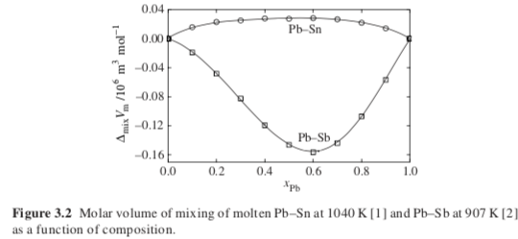
Real Solutions
Molar excess functions or departure functions:
Difference between real value and ideal value
Excess ΔG_{mixing} = ΔG_{mixing} - RT(x_{A}lnx_{A} + x_{A}lnx_{B})
Excess ΔS_{mixing} = ΔS_{mixing} + R(x_{A}lnx_{A} + x_{A}lnx_{B})
Excess ΔH_{mixing} = ΔH_{mixing}
Excess ΔV_{mixing} = ΔV_{mixing}

Slide 14
Real Solutions
x_{A} becomes a_{A} the activity so
ΔG_{mixing} = RT(x_{A}lna_{A} + x_{A}lna_{B})
Excess ΔG_{mixing} = ΔG_{mixing} - RT(x_{A}lnx_{A} + x_{B}lnx_{B})
= RT(x_{A}ln(a_{A}/x_{A}) + x_{B}ln(a_{B}/x_{B}) )
= RT(x_{A}ln(γ_{A}) + x_{B}ln(γ_{B}))
γ Is the activity coefficient
Excess ΔS_{mixing} = -R(x_{A}ln(γ_{A}) + x_{B}ln(γ_{B}))
Method to use departure functions for calculations (PREOS.xls)
Calculation of properties in the ideal state is simple
With an equation of state the departure function can be calculated
For any transition first calculate the departure function to the ideal state
Then carry out the desired change as an ideal mixture or gas
Then use the departure function to return to the real state

Slide 15
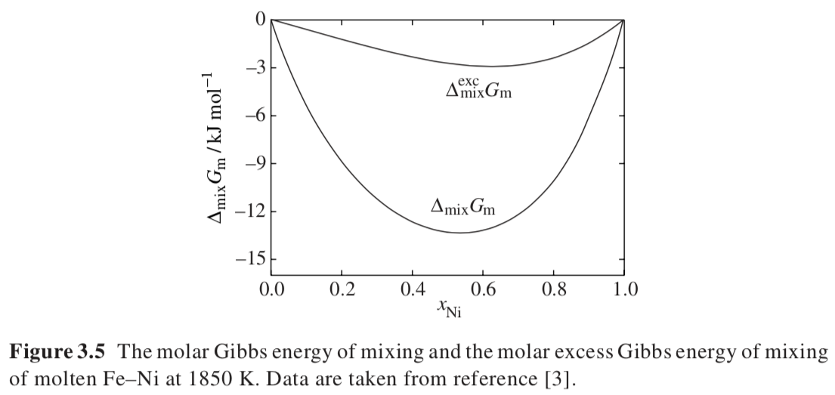
= RT(x_{A}ln(γ_{A}) + x_{A}ln(γ_{B}))
ΔG_{mixing} = nRT(x_{A} lna_{A} + x_{B} lna_{B})

Slide 16
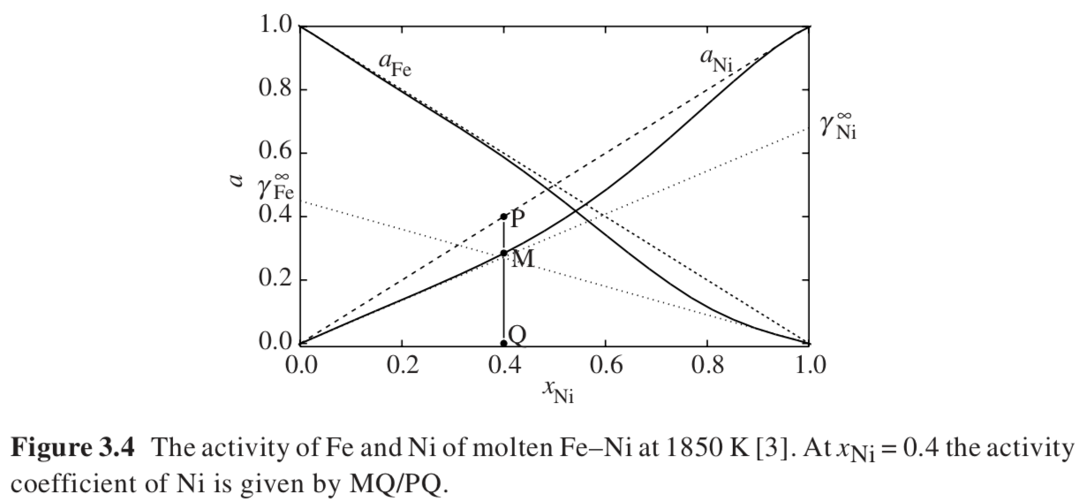
a = γx so da/dx = γ
Get the activity coefficient at infinite dilution by extrapolating the slope for pure component to x = 0
This is used for Henry’s Law and a few other places.
(Activity coefficient is a/x)

Slide 17
We want the infinite dilution activity coefficients to write a function to predict the activity and the activity coefficient.
This is one of the parameters for the functions.
With the function for activity we can predict the free energy and the miscibility.

Slide 18
Solute
Solvent or ideal mixture
Henry’s law for dilute solutions
Vapor pressure of solute = k_{i} x_{i}
k_{i} is the Henry’s Law Constant
x_{i} is the solute molar fraction (low ~0)
Raoult’s Law for solvent or ideal mixtures
Vapor pressure = p* x_{j}
x_{j} is the solvent molar fraction (high ~1)
p* is the vapor pressure of the pure solvent
If a solution is ideal, then x_{A} = a_{A} and γ_{A} = 1
As concentration goes to 1, a solvent is ideal (follows Raoult’s law) so
(da_{A}/dx_{A})_{xA =>1} = 1 = (dγ_{A}x_{A}/dx_{A})_{xA =>1} = γ_{A} + x_{A}(dγ_{A}/dx_{A})_{xA =>1}
But γ_{A} = 1 at x_{A} = 1, then Raoult’s law is followed if
(dγ_{A}/dx_{A})_{xA =>1} => 0 (See next slide)
A solute follows Henry’s Law if
(da_{B}/dx_{B})_{xB =>0} = γ_{B} infinite dilution
= (dγ_{B}x_{B}/dx_{B})_{xB =>0} = (γ_{B} + x_{B}(dγ_{B}/dx_{B}))_{xB =>0}
So
(x_{B}(dγ_{B}/dx_{B}))_{xB =>0} = 0
This isn’t that useful

Slide 19
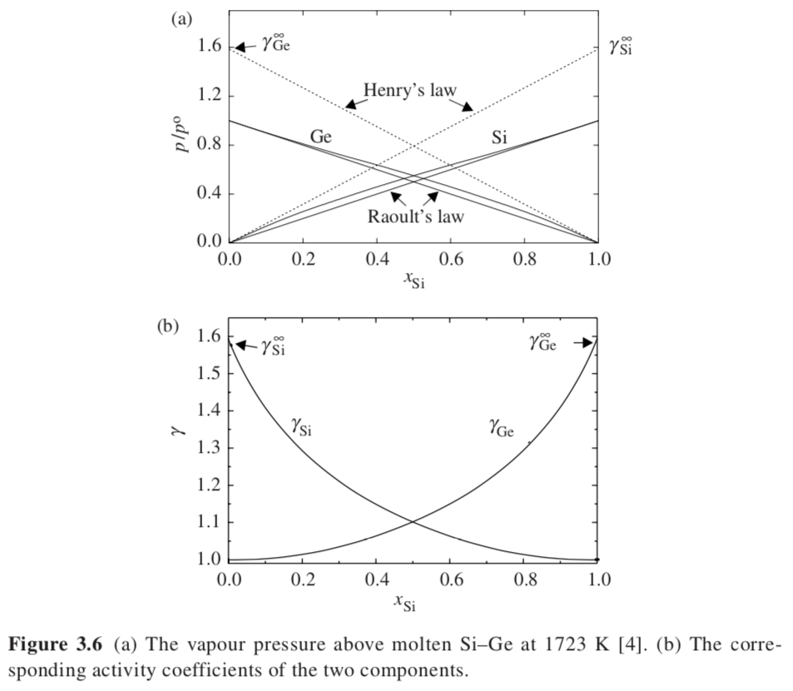
Henry’s law for dilute solutions
Vapor pressure of solute = k_{i} x_{i}
Raoult’s Law for solvent or ideal mixtures
Vapor pressure = p* x_{j}
The infinite dilution value comes from the activity plot extrapolation
The infinite dilution value comes from the activity plot extrapolation
(dγ_{B}/dx_{B})_{xB =>1} => 0
(dγ_{A}/dx_{A})_{xA =>1} => 0

Slide 20
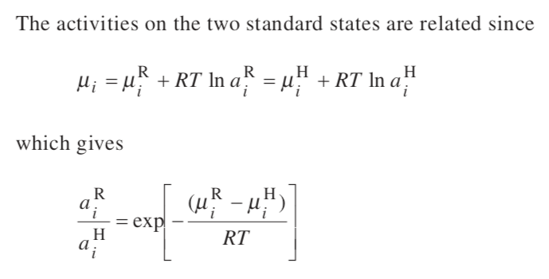
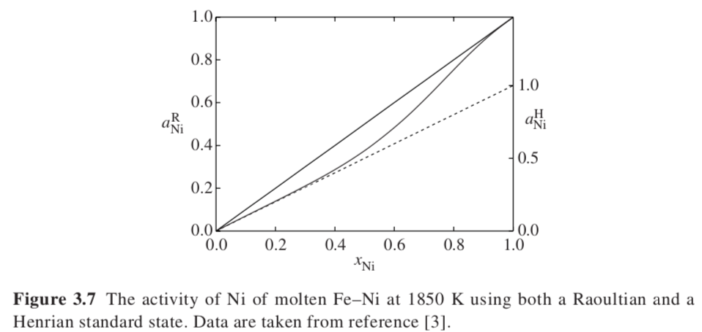
You would use Henrian standard state if the solute had limited solubility like PCBs or oil in water and you wanted the infinite dilution of the water component
Activity of a component in a solution must be defined relative to a standard state, either Henrian (extrapolated) or
Raoultian (measured at x = 1 :: a = 1)

Slide 21
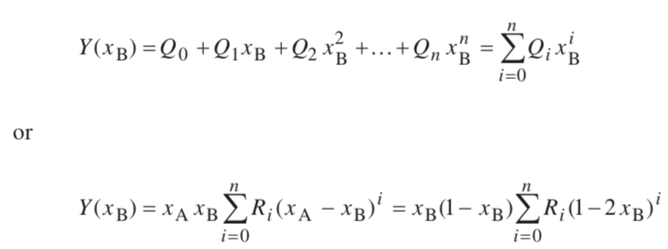
Analytic Solution Models
Want to calculate the miscibility of components
Need to generate a phase diagram
Calculation of the vapor pressure
Simplest approach could be a polynomial. However, this generally doesn’t inherently have any real meaning. The polynomial just reproduces existing data within experimental limits. Extrapolation is dangerous.
Asymmetric feature: vapor pressure
Symmetric Feature: Phase behavior

Slide 22
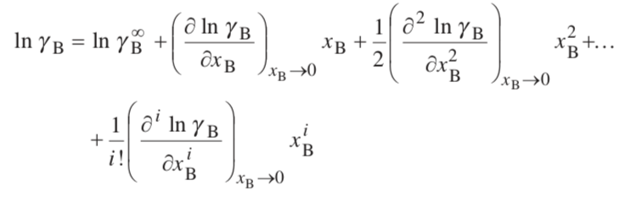
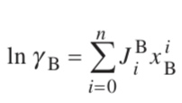
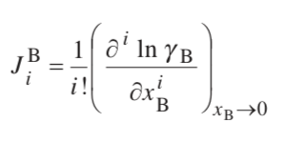

A Taylor Series Expansion For Example (starting with the infinite dilution value)
Excess ΔG_{mixing} = RT(x_{A}ln(γ_{A}) + x_{A}ln(γ_{B}))
Excess ΔS_{mixing} = -R(x_{A}ln(γ_{A}) + x_{A}ln(γ_{B}))
Interaction coefficients
Zeroth order infinite dilution (trivial)
First order ε₁^{B} self-interaction coefficient
This is similar to a virial expansion

Slide 23
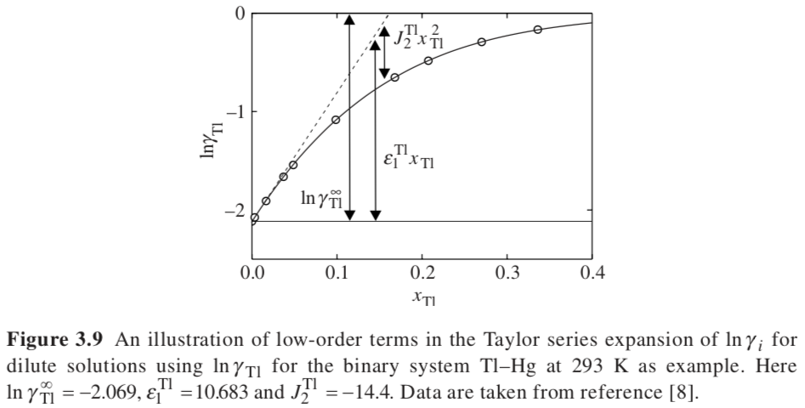
Thallium/Mercury
Lower freezing point of Mercury for thermometer and switches 8.5% -60°C versus -40°C
Also Rat poison

Slide 24
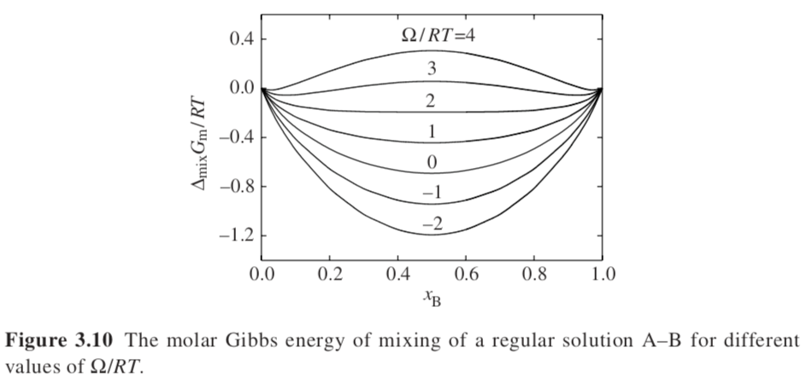
Hildebrand Regular Solution Model
The change on mixing:
ΔS = -nk_{B} (x_{A} ln(x_{A}) + x_{B} ln(x_{B})) Ideal Solution
Since (ln x) is always negative or 0, ΔS is always positive for ideal solutions
ΔG = ΔH -T ΔS
Since (ln x) is always negative or 0, ΔG is positive or negative depending on ΔH :: can mix or demix
Depending on the sign of ΔH
ΔV = (dΔG/dp)_{T} = 0, there is no loss or gain of volume compared to the summed volume
ΔH = n Ω x_{A}x_{B}
is the interaction coefficient or regular solution constant
Molar Gibbs free energy of mixing
ΔG_{m} = RT(x_{A} ln(x_{A}) + x_{B} ln(x_{B})) + Ω x_{A}x_{B}
Ω = zN_{A}[u_{AB} – (u_{AA}+u_{BB})/2]
The equation is symmetric

Slide 25
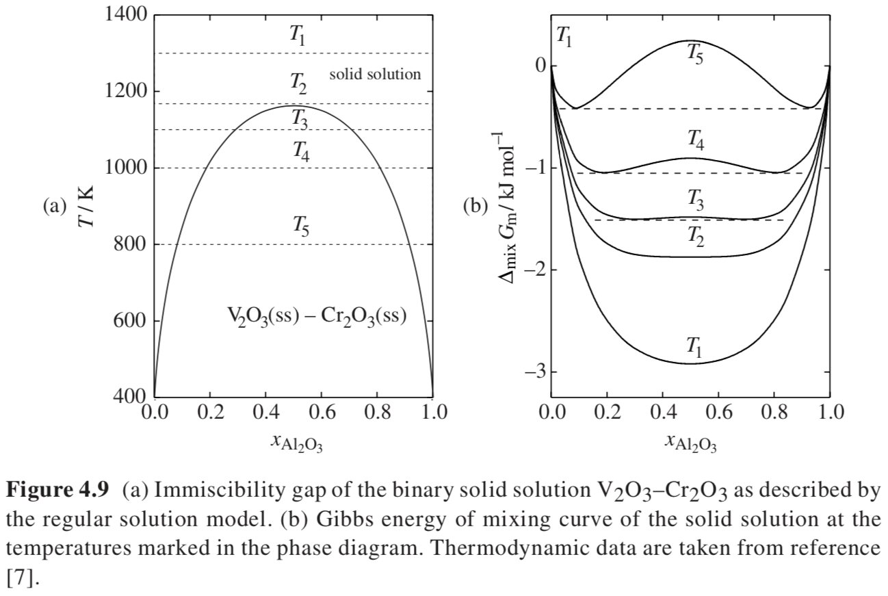
One Crystallographic
Phase
γ => α + β
Two Different Crystallographic
Phases at Equilibrium

Slide 26
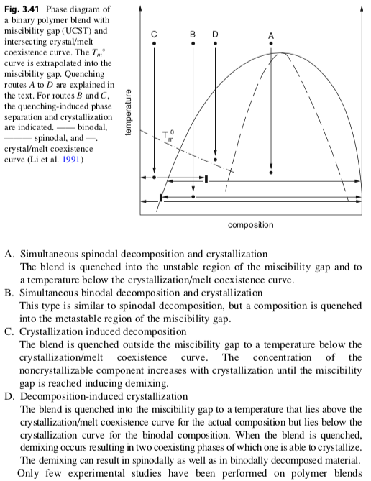
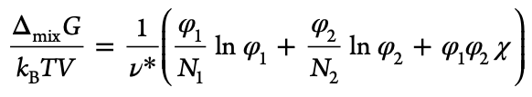
N₁ ≠ N₂
Y. Li, M. Stein, B.-J. Jungnickel, Colloid Polym. Sci. 269, 772 (1991); and ‘Mitteilungen aus dem
Deutschen Kunststoff-Institut’, Nr. 53, April, Darmstadt, 1991
N₁ = N₂

Slide 27





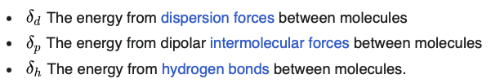
Hildebrand solubility parameter, δ
ΔH = n Ω x_{A}x_{B}
is the interaction coefficient or regular solution constant
Molar Gibbs free energy of mixing
G_{m} = RT(x_{A} ln(x_{A}) + x_{B} ln(x_{B})) + Ω x_{A}x_{B}
= zN_{A}[u_{AB} – (u_{AA}+u_{BB})/2]
Flory-Huggins chi parameter, ~Ω/kT
Hansen solubility parameters

Slide 28
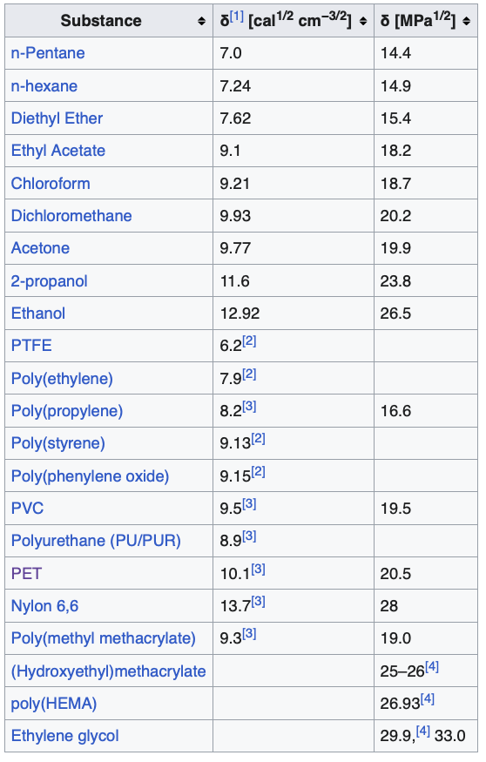

Hildebrand solubility parameter, δ

Slide 29
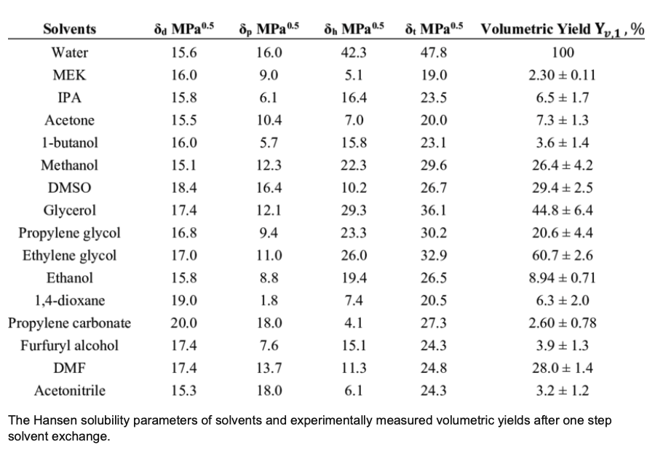
Hansen solubility parameter, δ

Slide 30
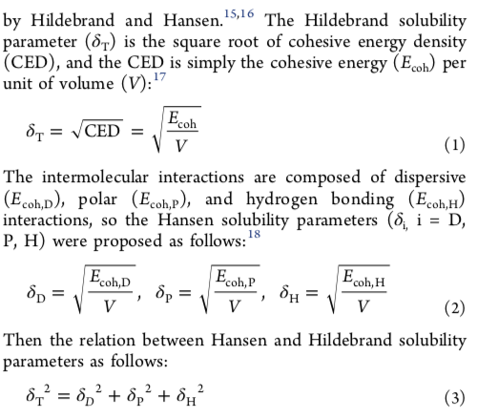





Hildebrand Solubility Parameter, δ
Luo Y, Chen X, Wu S, Ca S Luo Z, Shi Y, Molecular Dynamics Simulation Study on Two-Component Solubility Parameters of Carbon Nanotubes and Precisely Tailoring the Thermodynamic Compatibility between Carbon Nanotubes and Polymers, Langmuir 36 9291-9305 (2020).
Two materials with similar δ are miscible
Flory-Huggins Equation
χ ~ 1/T
Hildebrand and Scratchard
London dispersion forces (attractive)

Slide 31




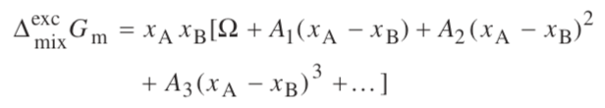
Asymmetric equations for asymmetric phase diagram
Sub-regular solution model
Redlich-Kister Expression

Slide 32
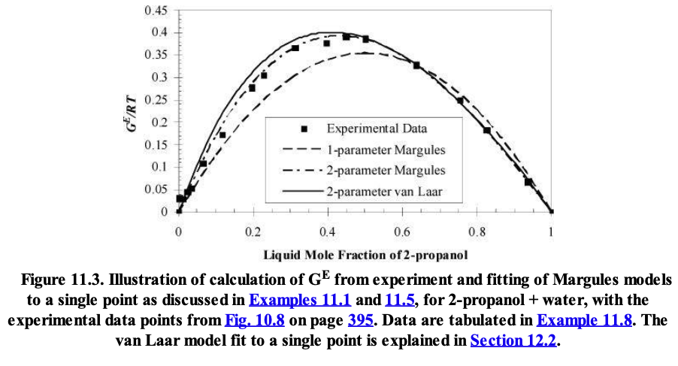

Slide 33
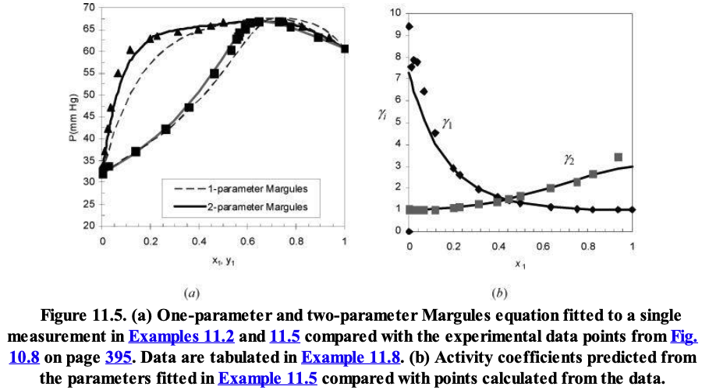

Slide 34
Non-ideal entropy of mixing
Quasi-regular solution model
ΔG_{real solution}/kT = x₁ln x₁ + x₂ln x₂ + x₁x₂ Α₁₂
Α₁₂=Ω₁₂= A/kT
The Margules interaction parameter should have a 1/T dependence, but it often displays a “non-combinatorial entropy term”
Α₁₂=Α/kT + B
This can be interpreted that there is some kind of “ordering” that occurs on mixing
“Hydrophobic effect” is an example. When water and oil are mixed water organizes around oil/water interface reducing the entropy. Entropy depends on number not mass so a large number of water molecules at the interface leads to a large, dominating entropic reduction that causes immiscibility. The enthalpic interaction favors mixing (negative A).
A₁₂ = 0 at the “athermal temperature” , T*
B = -A/(kT*)
Α₁₂=(Α/kT)(1 – T/T*) = Ω₁₂(1 – T/T*) T* is a critical temperature

Slide 35


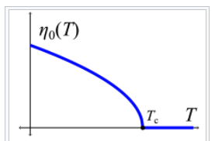




From “Single Component Systems” Slide 34. Landau Theory for Curie transition
At the Curie transition (second order transition)
Γ
Order parameter is 1 at 0 K so
and

Slide 36

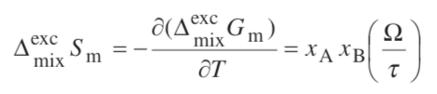
Non-ideal entropy of mixing
Quasi-regular solution model
This is a non-combinatorial entropy
This would occur if there were ordering on mixing, say when you add oil to water. The enthalpy of mixing favors mixing!!! Water organizes at the surface of oil to a great extent; this reduces entropy and makes oil and water demix. Water actually “likes” oil.
This is called the “hydrophobic effect” and is an important concept for protein folding.

Slide 37
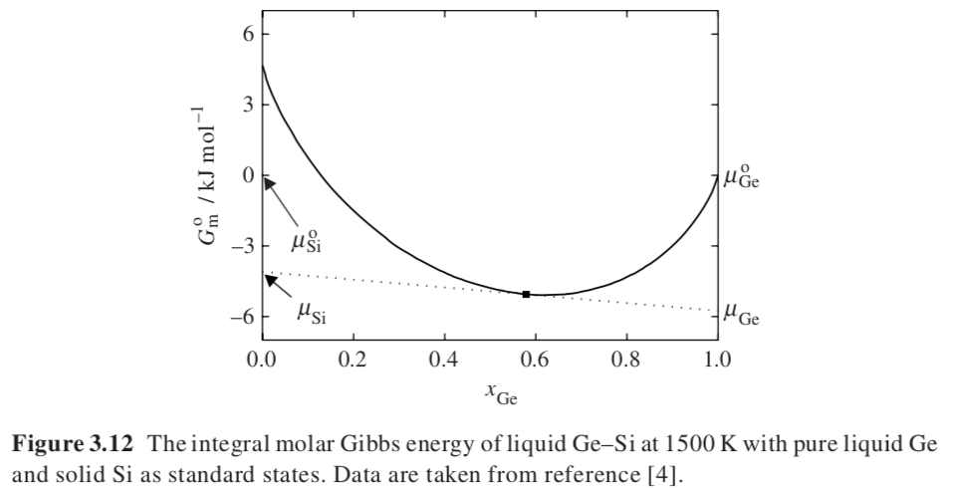
Graphical Method to Estimate Chemical Potential
Does dG/dx_{i} = dG/dn_{i} = μ_{i}?
No
dG/dn_{i} = dG/dx_{i} dx_{i}/dn_{i}
dx_{i}/dn_{i} = d(n_{i}/(n_{i}+n_{j}))/dn_{i} = 1/(n_{i}+n_{j}) – n_{i}/(n_{i}+n_{j})²

Slide 38
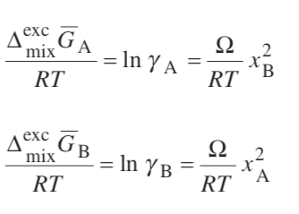
Solving the Regular Solution Model
We know that the excess Gibbs free energy for mixing is given by:
G^{E}/RT = x_{A} ln γ_{A} + x_{B} ln γ_{B} Generic expression using activity coefficient
And we have defined for the regular solution model that
G^{E}/RT = Ω x_{A} x_{B} Hildebrand Regular Solution expression
If we propose the answer RT ln γ_{A} = Ω x_{B}²
We find by substitution generic expression that it equals the regular solution expression since x_{B} + x_{A} = 1
(Solving this directly see next slide.)

Slide 40




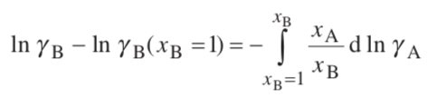
Use of the Gibbs-Duhem Equation to determine the activity of a component
Constant p, T
Restatement of Gibbs-Duhem for Solutions
If you know γ_{A} you can obtain γ_{B} by integration

Slide 41
