Slide 1
Heat Capacity
DSC
Heat is not a state function, so we define a state function related to heat, dS = dQ/T
-S U(E) V
H A(F)
-p G T
dS = dQ/T
dH = VdP + TdS
At constant P (dH = TdS = dQ)_{P}
We have C_{p} = (dQ/dT) _{P} = (dH/dT) _{P}
In the DSC we measure the heat flow dQ/dt (Watts) at a constant heating rate dT/dt at constant pressure,
(dQ/dT) _{P} = C_{p}
So, the y-axis is C_{p} times dT/dt the latter of which is constant

Slide 2
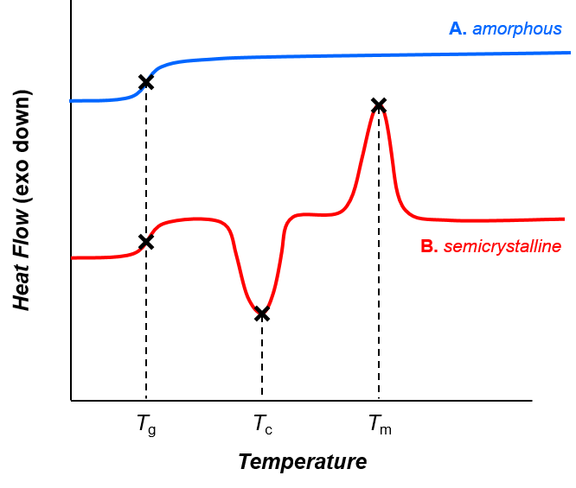
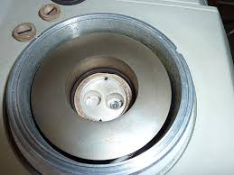
C_{p} = (dH/dT) _{P} = (dQ/dT) _{P} = ((dQ/dt) (dT/dt))_{P}

Slide 3
Derive the expression for C_{p} – C_{V}
From Chapter 1
-S U V
H A
-p G T
C_{p} - C_{v} = α²VT/κ_{T}
α = (1/V) (dV/dT)_{p}
κ_{T} = (1/V) (dV/dP)_{T}
C_{V} = (dU/dT)_{V}
From the Thermodynamic Square
dU = TdS – pdV and, C_{V} = (dQ/dT) _{V} = T (dS/dT)_{V} - p (dV/dT)_{V} = (dU/dT)_{V}
Second term is 0, dV at constant V is 0
(dS/dT)_{V} = C_{V} /T
Similarly
C_{p} = (dH/dT)_{p}
From the Thermodynamic Square
dH = TdS + Vdp so C_{p} = (dH/dT)_{p} = T (dS/dT)_{p} - V (dp/dT)_{p}
Second term is 0, dp at constant p is 0
(dS/dT)_{p} = C_{p} /T
Write a differential expression for dS as a function of T and V
dS = (dS/dT)_{V}dT + (dS/dV)_{T}dV using expression for C_{V} above and Maxwell for (dS/dV)_{T}
dS = C_{V} /T dT + (dp/dT)_{V}dV use chain rule: (dp/dT)_{V} = -(dV/dT)_{p} (dP/dV)_{T} = Vα / (Vκ_{T})
Take the derivative for C_{p}: C_{p}/T = (dS/dT)_{p} = C_{V} /T (dT/dT)_{p} + (α/κ_{T})(dV/dT)_{p} = C_{V} /T + (Vα²/κ_{T})
C_{p} - C_{v} = α²VT/κ_{T}
dS = dQ/T
dU = TdS – PdV
dH = TdS + VdP
dQ = TdS

Slide 4
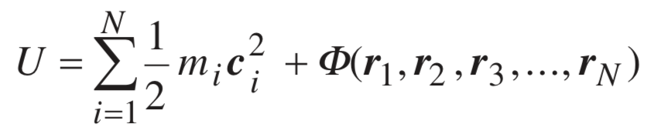


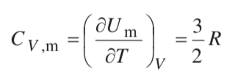
Molecular Basis for the Heat Capacity (Gasses)
Internal Energy of a gas
For an ideal gas, the potential is 0
Monoatomic Gas: Ar
3 translational degrees of freedom each with ½ kT energy
Linear molecule, CO₂, can rotate in two axes, C_{V,m} = 5/2 R
Non-Linear, H₂O, can rotate in three axes, C_{V,m} = 6/2 R
Plus, vibrational degrees of freedom

Slide 5
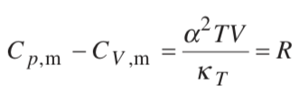
We calculate C_{V} since all models assume constant volume
We measure C_{p} since calorimetric measurements are made at atmospheric pressure
From C_{V} for an ideal gas, you add R to obtain C_{p}
For an ideal gas PV = RT
α is (dV/dT)_{p}/V = R/PV = 1/T
is -(dV/dP)_{T}/V = RT/P²V = 1/P
C_{p} – C_{v} = (1/T)² (TV) P = PV/T = R
For other materials you need to know the thermal expansion coefficient and compressibility as a function of temperature.

Slide 6
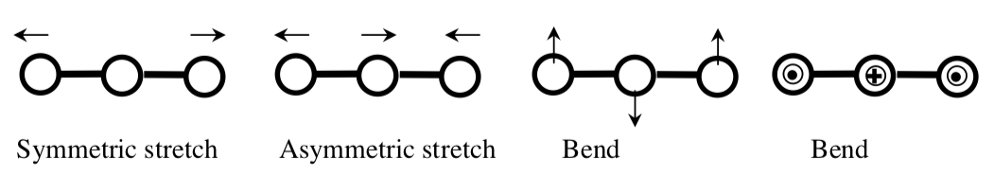
Heat Capacity, multi-atomic gasses and vibrations
Linear molecule, CO₂, can rotate in two axes, C_{V,m} = 5/2 R
Non-Linear, H₂O, can rotate in three axes, C_{V,m} = 6/2 R
Plus, vibrational degrees of freedom
Potential and Kinetic degrees of vibrational freedom add 2(R/2) for each type of vibration
Generally, 3n-6 vibrational modes
(For linear 3n-5 so for CO₂ 4 modes symmetric stretch, asymmetric stretch, two dimensions of bend)

Slide 7
PV = RT
dV/dT = R/P
dV/dP = -RT/P²
For an ideal gas
= 1/V (dV/dT) = R/PV = 1/T
= -1/V (dV/dP) = RT/VP² = 1/P
α²TV/κ_{T} = VP/T = R

Slide 8
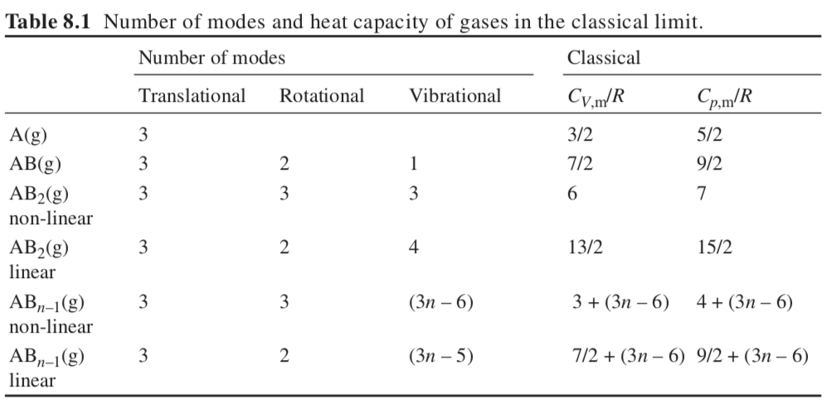

Slide 9
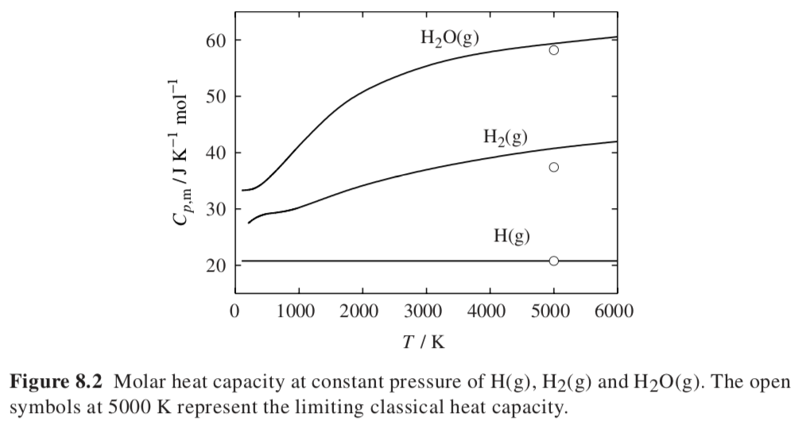
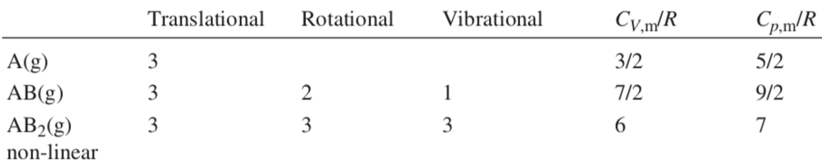
Monoatomic H(g) with only translational degrees of freedom is already fully excited at low temperatures. The vibrational frequencies (n) of H2(g) and H2O(g) are much higher, in the range of 100 THz, and the associated energy levels are significantly excited only at temperatures above 1000 K. At room temperature only a few molecules will have enough energy to excite the vibrational modes, and the heat capacity is much lower than the classical value. The rotational frequencies are of the order 100 times smaller, so they are fully excited above ~10 K.
Ideal Gasses
J/(mol K)
20.8
37.5
58.3
3R = 25 J/(mol K)

Slide 10
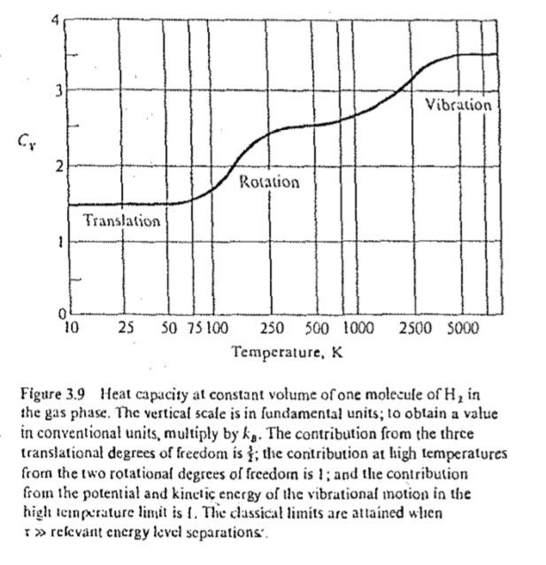
Monoatomic H(g) with only translational degrees of freedom is already fully excited at low temperatures. The vibrational frequencies (n) of H2(g) and H2O(g) are much higher, in the range of 100 THz, and the associated energy levels are significantly excited only at temperatures above 1000 K. At room temperature only a few molecules will have enough energy to excite the vibrational modes, and the heat capacity is much lower than the classical value. The rotational frequencies are of the order 100 times smaller, so they are fully excited above ~10 K.
Ideal Gasses

Slide 11
Heat Capacity of Solids
Dulong and Petit Law (Observation, heat capacity of solids)
C_{V}/n = 3R (25 J/(mol K)
In the classical statistical theory of Ludwig Boltzmann, the heat capacity of solids approaches a maximum of 3R per mole of atoms because:
full vibrational-mode degrees of freedom amount to 3 degrees of freedom per atom (x, y, z),
each corresponding to a kinetic energy term and a potential energy term.
By the equipartition theorem, the average of each term is ¹⁄₂k_{B}T per atom, or ¹⁄₂RT per mole.
Multiplied by 3 degrees of freedom (x, y, z) and the two terms per degree of freedom (kinetic and potential), this amounts to 3R per mole heat capacity.

Slide 12
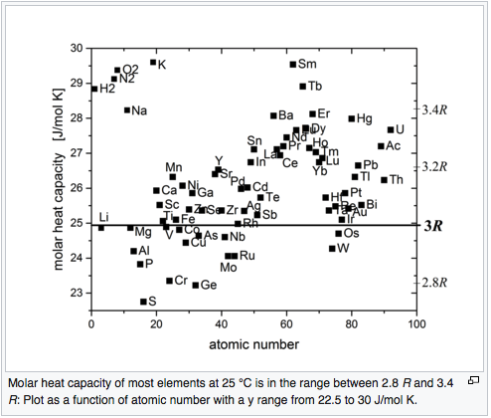
Dulong and Petit Law (Observation for Solids)
C_{v}

Slide 13
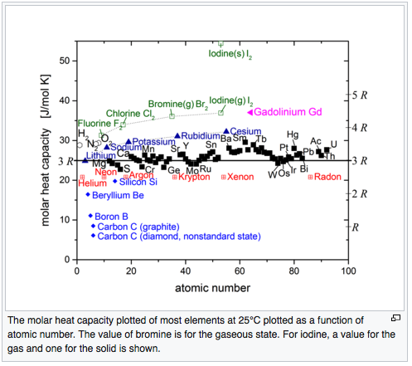
Dulong and Petit Law (Observation for solids)
Fails for strongly bound light atoms
C_{v}

Slide 14

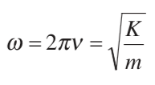


Atoms in a crystal (Dulong and Petit Law)
Works at high temperature
Force Balance
-K x = m d²x/dt²
Plug in a sine wave solution,
x = A sin(ωt)
Yields ω = √(K/m)
So, there is a fixed frequency for a fixed spring constant and mass, since E = hω/2π, there is a fixed or quantized energy
Three Harmonic oscillators, x, y, z
Spring (Potential Energy)
dU/dx = F = -Kx where x is 0 at the rest position
U = -1/2 Kx²
Kinetic Energy
U = ½ mc²
c is the velocity of the atom so dx/dt
Boltzman 1877 Explains
Each atom in a solid has 6 springs
Each spring with ½ kT energy
So, 6/2R = 3R = C_{v}
Potential and Kinetic Energies balance in an oscillatory spring so U = 0
Three degree of freedom oscillators per atom so U_{m} = 3RT
-SUV
H A
-pGT
dU = -pdV + TdS
(dU/dT) _{V} = T(dS/dT) _{V} = C_{V}

Slide 15
Einstein Model
Force Balance
-K x = m d²x/dt²
Plug in a sine wave solution,
x = A sin(ωt)
Yields ω = √(K/m)
So, there is a fixed frequency for a fixed spring constant and mass, since E = hω/2π, there is a fixed or quantized energy
Atoms in a crystal (Dulong and Petit Law)
Works at high temperature
For something like a guitar string, we have quantized energy and frequency, it has one tone, but also overtones so, E = nE₁ where n is the mode of vibration or quantized state, and n has integer values starting with 1. E₁ is the energy of the primary mode, E = nhν or nhω/2π for the vibration.
For quantum mechanics (very small particles like atoms) there is a problem with E = nhν or nhω/2π
1) At absolute 0 there is a ”zero-point energy” that keeps everything from collapsing for instance, we don’t observe collapse as we approach absolute 0. Schrodinger equation finds this zero-point energy is ½ hν
2) If energy were 0 at absolute 0 then we would know both the position of an atom and its momentum = 0
This would disagree with the Heisenberg uncertainty principle. So, you need a “zero-point energy”
3) A “zero-point energy” can be measured experimentally
E = hν (1/2 + n) and n has integer values starting at 0 for the ground state energy.

Slide 16
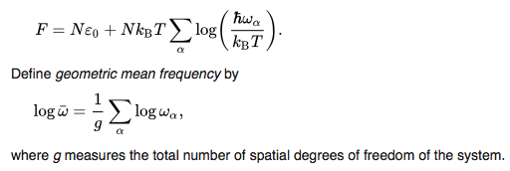
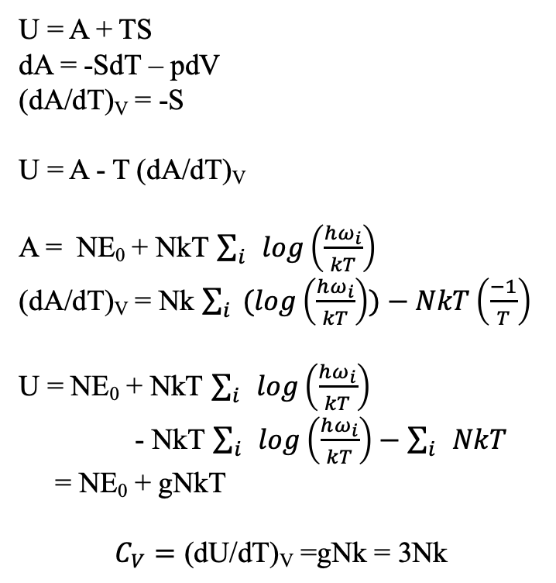
Einstein Derivation of Dulong Petit
-S U(E) V
H A(F)
-p G T
U = A + TS
dA = -SdT – pdV
(dA/dT)_{V} = -S
U = A - T (dA/dT)_{V}
A = NE₀ + NkT $\sum_{i}{log\left(\frac{hω_{i}}{kT}\right)}$
(dA/dT)_{V} = Nk $\sum_{i}{(log\left(\frac{hω_{i}}{kT}\right))−NkT\left(\frac{−1}{T}\right)}$
U = NE₀ + NkT $\sum_{i}{log\left(\frac{hω_{i}}{kT}\right)}$
- NkT $\sum_{i}{log\left(\frac{hω_{i}}{kT}\right)−\sum_{i}{NkT}}$
= NE₀ + gNkT
$$C_{V}=\text{(}\text{dU}\text{/}\text{dT}\text{)}\text{V}\text{ =}\text{gNk}\text{ = 3}\text{Nk}$$
dlnx = dx/x
g is number of DOF or 3

Slide 17


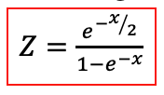
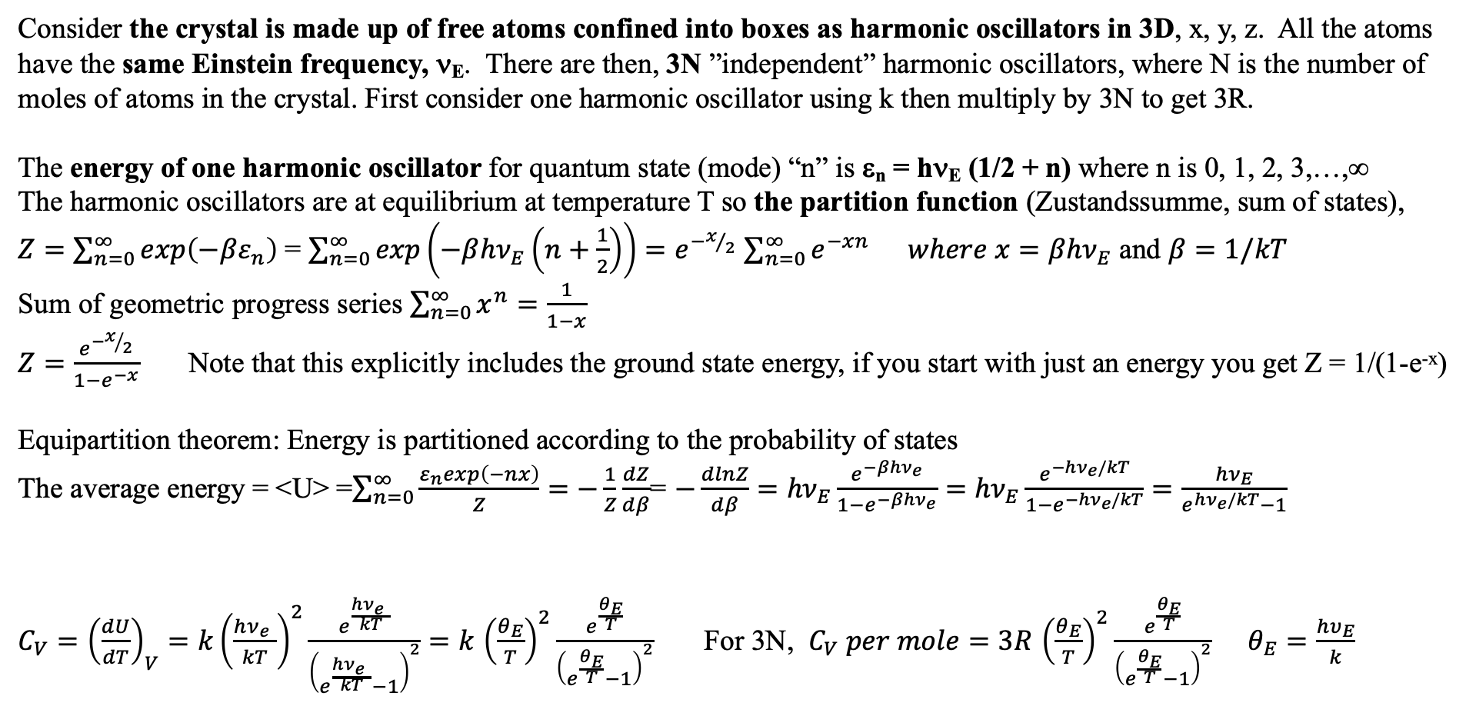
Einstein Model
Consider the crystal is made up of free atoms confined into boxes as harmonic oscillators in 3D, x, y, z. All the atoms have the same Einstein frequency, ν_{E}. There are then, 3N ”independent” harmonic oscillators, where N is the number of moles of atoms in the crystal. First consider one harmonic oscillator using k then multiply by 3N to get 3R.
The energy of one harmonic oscillator for quantum state (mode) “n” is ε_{n} = hν_{E} (1/2 + n) where n is 0, 1, 2, 3,…,∞
The harmonic oscillators are at equilibrium at temperature T so the partition function (Zustandssumme, sum of states),
$Z=\sum_{n=0}^{∞}{exp\left(−βε_{n}\right) }$= $\sum_{n=0}^{∞}{exp\left(−β{hν}_{E}\left(n+\frac{1}{2}\right)\right)=e^{−x/2}}$ $\sum_{n=0}^{∞}{e^{−xn} where x=β{hν}_{E}}$ and $β=1/kT$
Sum of geometric progress series $\sum_{n=0}^{∞}{x^{n}=\frac{1}{1−x} }$
$Z=$ $\frac{e^{−x/2}}{1−e^{−x}}$ Note that this explicitly includes the ground state energy, if you start with just an energy you get Z = 1/(1-e^{-x})
Equipartition theorem: Energy is partitioned according to the probability of states
The average energy = <U> =$\sum_{n=0}^{∞}{\frac{ε_{n}exp\left(−nx\right)}{Z}=−\frac{1}{Z}}\frac{dZ}{dβ}$= $−\frac{dlnZ}{dβ}={hν}_{E}\frac{e^{−βhν_{e}}}{1−e^{−βhν_{e}}}=$ ${hν}_{E}\frac{e^{−hν_{e}/kT}}{{1−e}^{−hν_{e}/kT}}=\frac{{hν}_{E}}{e^{hν_{e}/kT}−1}$
$C_{V}={\left(\frac{dU}{dT}\right)}_{V}=k{\left(\frac{hν_{e}^{}}{kT}\right)}^{2}\frac{e^{\frac{hν_{e}^{}}{kT}}}{{\left(e^{\frac{hν_{e}^{}}{kT}}−1\right)}^{2}}=k$ ${\left(\frac{θ_{E}}{T}\right)}^{2}\frac{e^{\frac{θ_{E}}{T}}}{{\left(e^{\frac{θ_{E}}{T}}−1\right)}^{2}}$ For 3N, $C_{V} per mole=3R$ ${\left(\frac{θ_{E}}{T}\right)}^{2}\frac{e^{\frac{θ_{E}}{T}}}{{\left(e^{\frac{θ_{E}}{T}}−1\right)}^{2}}$ $θ_{E}=\frac{hυ_{E}}{k}$
because

Slide 18
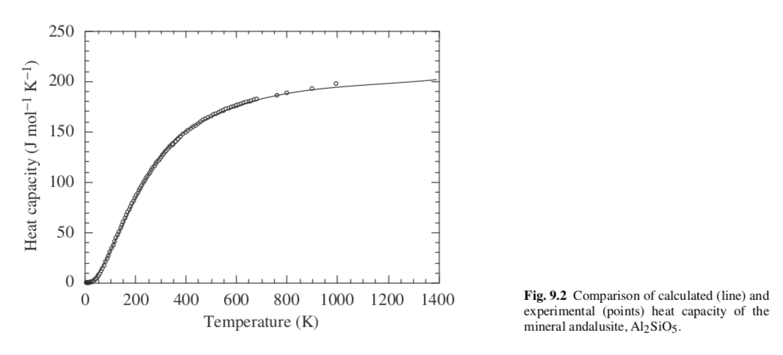
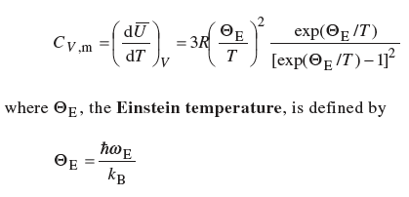
Einstein Model
Phonons
Almost perfect fit, very high value for C_{V}
(see homework paper Caplin Grüner Dunlap)
From Dove

Slide 19
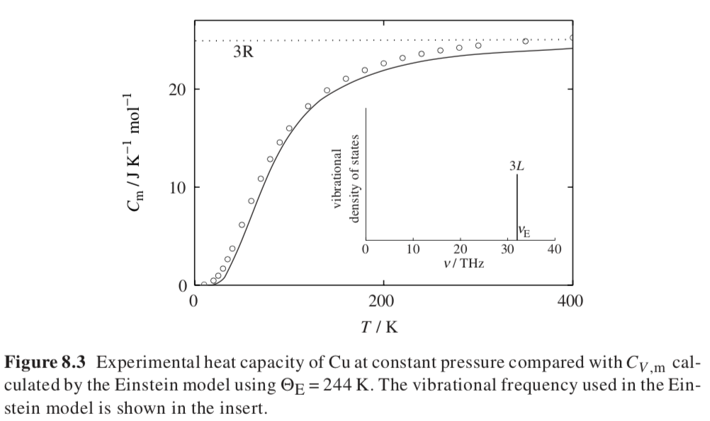
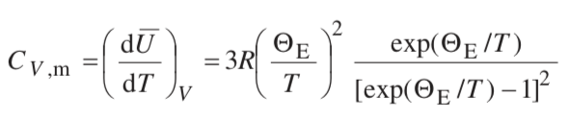
Einstein Model
Works at low and high temperature (3R)
Error in dependence near 0K

Slide 20


Einstein Model
Works at low and high temperature (3R)
Error in dependence near 0K
Single vibrational mode for all three DOF
Low T behavior exp(Θ_{E}/T) doesn’t work
C_{v} follows T³
The deviation is because Einstein ignored that
lattice vibrations are coupled to each other,
not independent
“Collective Lattice Vibrations”

Slide 21
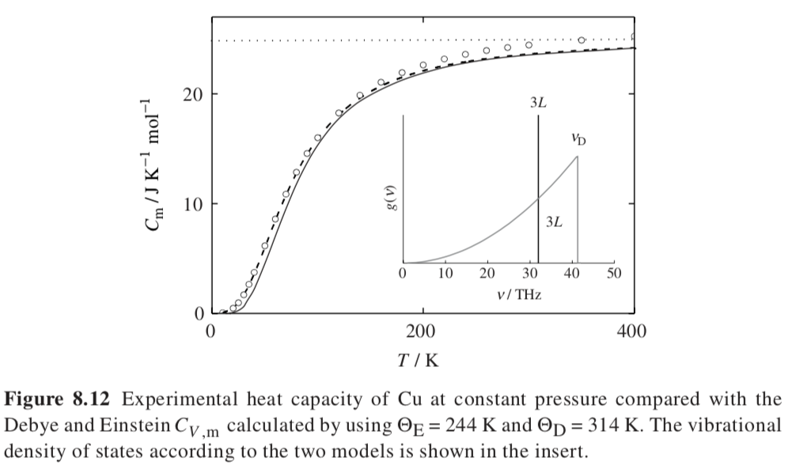
Debye Model
Works

Slide 22
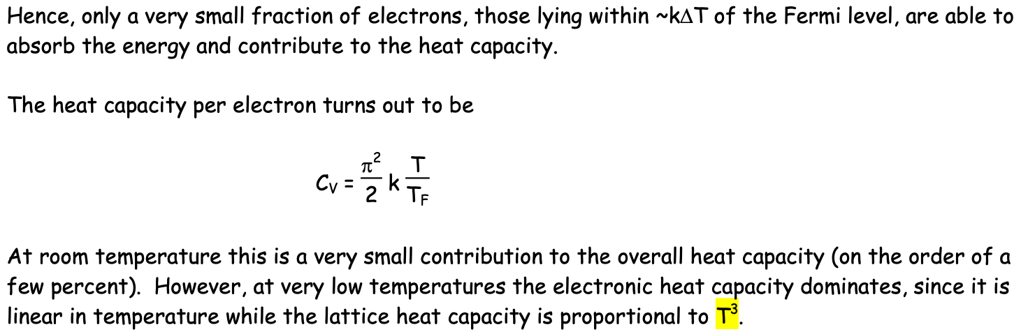
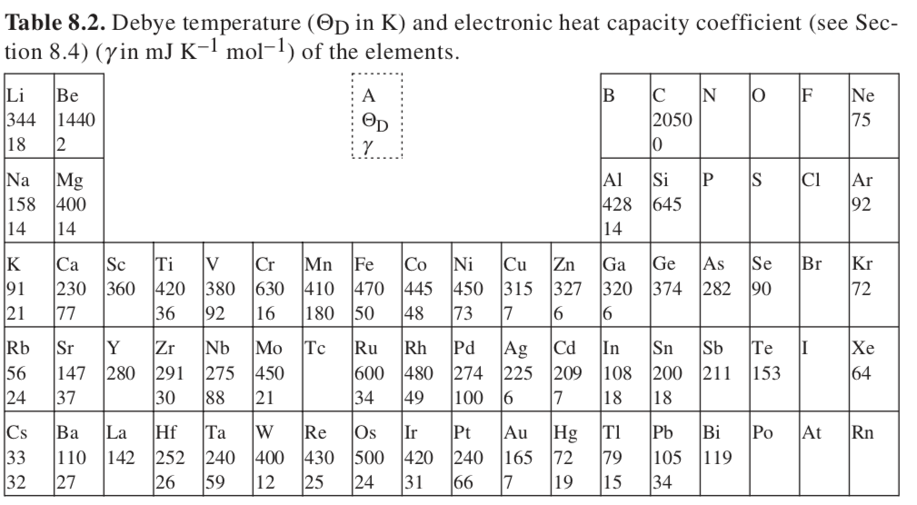
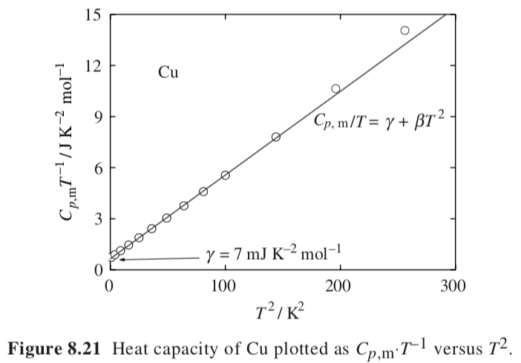

Electronic Contribution to Heat Capacity (Briefly)
Einstein Temp.
Copper 236K
Aluminum 294K
Lead 72.8 K
Iron 355K
http://vallance.chem.ox.ac.uk/pdfs/EinsteinDebye.pdf
For T < 10K
Grüner Constant

Slide 23
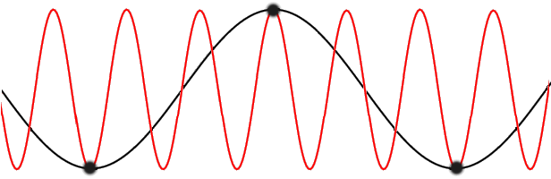
Crystal of lattice spacing a; Sound waves of wavelength λ or k vector 2π/λ
Phonons
Two size scales, a and λ
If λ ≥ a you are within a Brillouin Zone
Wavevector k = 2π/λ
k-vectors exceeding the first Brillouin zone (red) do not carry any more information than their counterparts (black) in the first Brillouin zone.
Black are atoms subject to a high frequency transverse (wave) vibration (red)

Slide 24
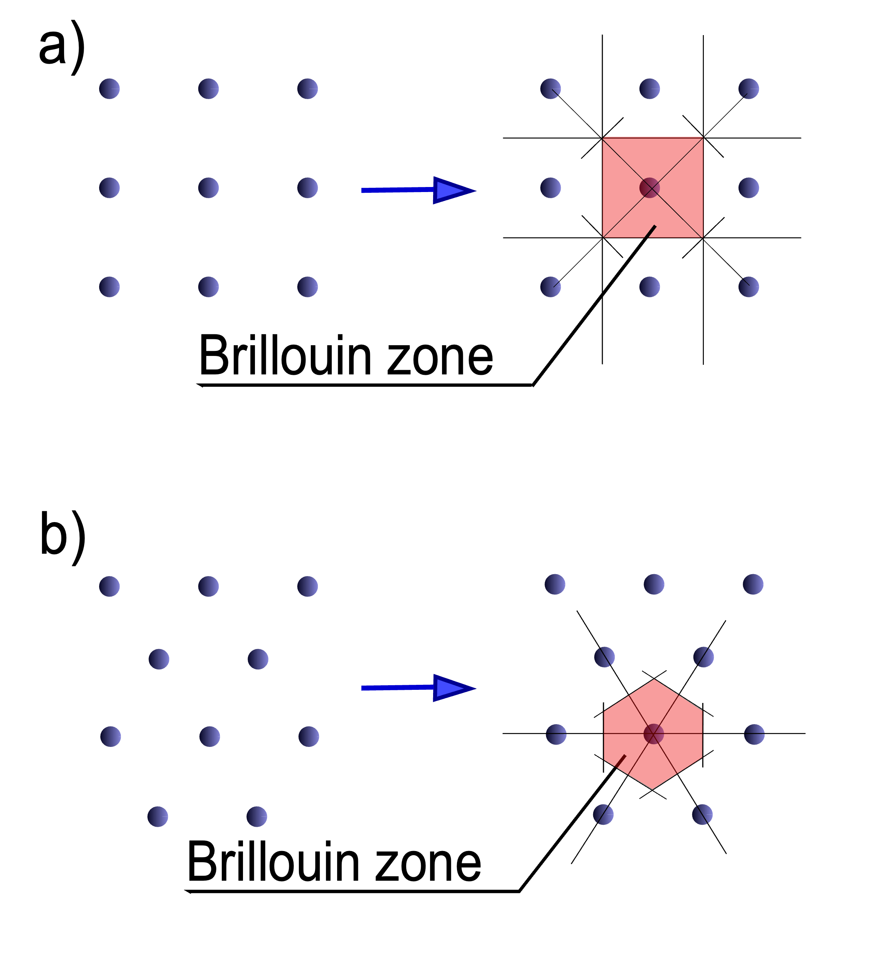
Phonons
Two size scales, a and λ
If λ ≥ a you are within a Brillouin Zone
Wavevector k = 2π/λ
k-vector is like the inverse-space vectors for the lattice (or the Miller indices)
It is seen to repeat in inverse space making an inverse lattice
A phonon with wavenumber k is thus equivalent to an infinite family of phonons with wavenumbers k ± 2π/a, k ± 4π/a, and so forth.
Brillouin zones, (a) in a square lattice, and (b) in a hexagonal lattice
those whose bands become zero at the center of the Brillouin zone are called acoustic phonons, since they correspond to classical sound in the limit of long wavelengths. The others are optical phonons, since they can be excited by electromagnetic radiation.

Slide 25

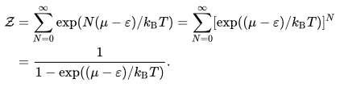
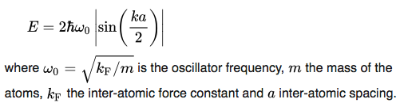
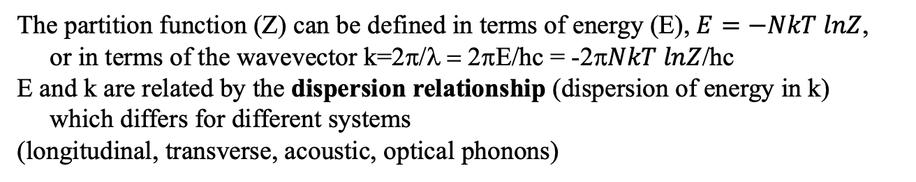
Phonons
Two size scales, a and λ
If λ ≥ a you are within a Brillouin Zone
Wavevector k = 2π/λ
The partition function (Z) can be defined in terms of energy (E), $E=−NkT lnZ$,
or in terms of the wavevector k=2π/λ = 2πΕ/hc = -2π$NkT lnZ$/hc
E and k are related by the dispersion relationship (dispersion of energy in k)
which differs for different systems
(longitudinal, transverse, acoustic, optical phonons)
The density of states is defined by
For a Longitudinal Phonon in a string of atoms the dispersion relation is:
Transverse is like an ocean wave or a guitar string, longitudinal is a compressive wave like sound
sin x = x – x³/3! + x⁵/5! - …
For small x; sin x = x
This relates modulus to frequency

Slide 26
Phonons
Dispersion Relationship is value of energy or frequency of vibrations at a size-scale or wavelengths or what happens to vibrational energy in the crystal, i.e., modulus.
Density of States is how the total energy is distributed to different frequencies of vibration. This is related to what happens at different wavenumbers to different wavelength phonons.
N is an integer related to the vibrational state k

Slide 27
Frequency of a Harmonic Oscillator
Do a Force Balance
F = mx” = Kx where K is the spring constant, m is the mass
Then mx” – Kx = 0 is a second order differential equation or
x” – (K/m)x = 0
If you know that the derivative of exponential is the exponential
Then you can guess one answer (this helps)
x = exp(±√(K/m) t); x’= ±√(K/m) exp(±√(K/m) t); x” = K/m exp(±√(K/m) t)
√(K/m) and t have to have inverse units so √(K/m) = ω
This is the native frequency of the oscillator

Slide 28
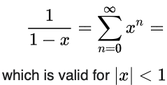
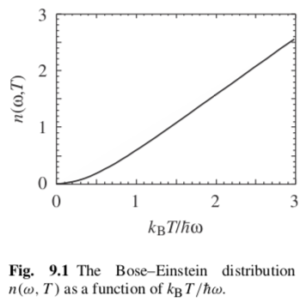
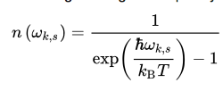
Phonons
μ is the ground state energy and ε is the energy of a state
Bose-Einstein statistics gives the probability of finding a phonon in a given state:
As temperature increases the number at frequency ν increases
As ν increases the number at fixed T drops
If n = exp((μ−ε)/kT)/Z and A/(1-A) = 1/((1/A)-1) and 1/e(x) = e(-x)

Slide 29

Phonons
Atoms or ions of mass m₁, m₂
Separated by a distance a
With spring constant K
2 modes of vibration result for a crystal
with two atoms in a primitive cell
+ is optical (atoms move against each
other, picture Na⁺ Cl⁻ subject to an
oscillating electric field, i.e. IR light)
finite value at k = 0 reflects the
polarization of the material i.e. the
dielectric constant
is acoustic (atoms move with each other) move at speed of sound. 0 energy at k = 0 or infinite λ means motion of the whole object
For three or more atoms in a primitive cell there are Three acoustic modes: One longitudinal (sound) and Two transverse (ocean)
Number of optical models is 3N-3
Fluids can’t support shear stress so, they only have longitudinal (sound) acoustic modes
Dispersion relation (relating E to k) for phonons (much math to get this expression)
Plus optical
Minus Acoustic

Slide 30


Phonons
From Dove
Phonons have energy hω/2π
The energy at 0K is not 0 it is ½ hω/2π
This is a consequence of energy quantization (lattice calculations are done at 0K)
(Uncertainty principle)
n is the number of phonons at wavelength ω and temperature T
Bose-Einstein Relationship
Average of some parameter ”q”

Slide 31
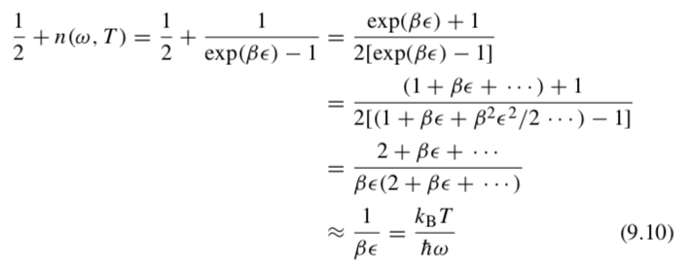

Dulong Petit result for the Bose-Einstein Relationship at high T
Phonons
From Dove
At high T
Bose-Einstein Relationship
3 vibrations for each atom
E = 3RT

Slide 32

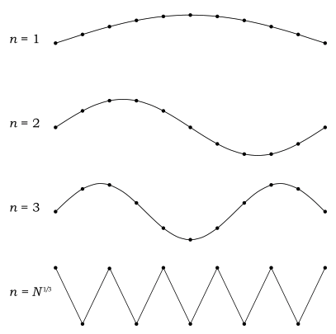




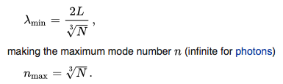
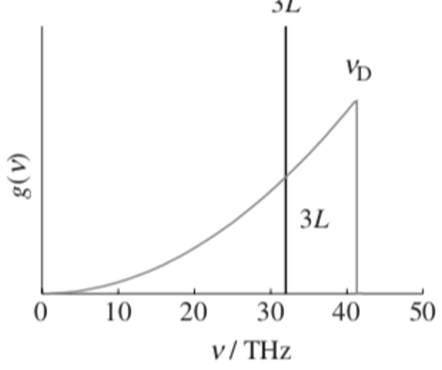
Debye Model (Wikipedia) Why the cutoff in g(ν) at ν_{D}?
For a cube of size L vibrations are limited to certain modes like a string of length L
Modes of vibration, n
c_{s} is the speed of sound in the solid
For 3d
p_{n} is the momentum of a phonon
For N atoms in the box
(Transverse Wave)
This is the highest energy vibration
At high temperature all of the vibrations are excited

Slide 33
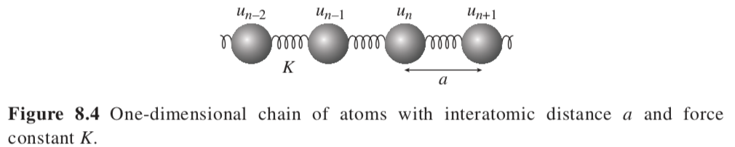


Debye Model (This is “borrowed” by Rouse for polymer dynamics)
(Longitudinal Wave)
Collective modes of vibration
If atom n vibrates and atoms n+1 and n-1 vibrate, the potential energy of n isn’t independent of the motion of the neighboring atoms.
u is POSITION (x) and F is FORCE here
Before we had F = -Ku for uncoupled pairs
For coupled units
Force
F is ma also Kx also
dU = F dx
Force Balance

Slide 34


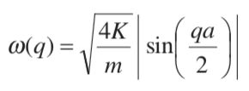
Propose a solution:
Phase
angle δ
Atomic spacing is “a”
”n” is the atom index
Use in the equation of motion and solve for frequency
Force
Angular frequency of vibrations as a function of wavevector, q
This is a dispersion relation relating energy to q or wavelength

Slide 35
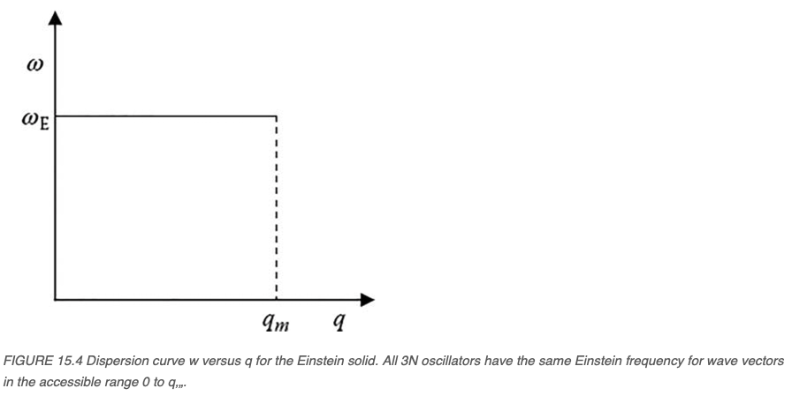
Debye Dispersion Relation
Angular frequency of vibrations as a function of wavevector, q
This is a dispersion relation relating energy to q or wavelength
Debye Dispersion Relation
Einstein Dispersion Relation
https://ebrary.net/196904/mathematics/einstein_model_specific_heat_solids

Slide 36
Phonons
Two size scales, a and λ
If λ ≥ a you are within a Brillouin Zone
Wavevector k = 2π/λ
The partition function (Z) can be defined in terms of E or in terms of the wavevector k=2π/λ= 2πΕ/hc
E and k are related by the dispersion relationship which differs for different systems
(longitudinal, transverse, acoustic, optical phonons)
The density of states is defined by
For a longitudinal Phonon in a string of atoms the dispersion relation is:
Transverse is like an ocean wave or a guitar string, longitudinal is a compressive wave like sound

Slide 37
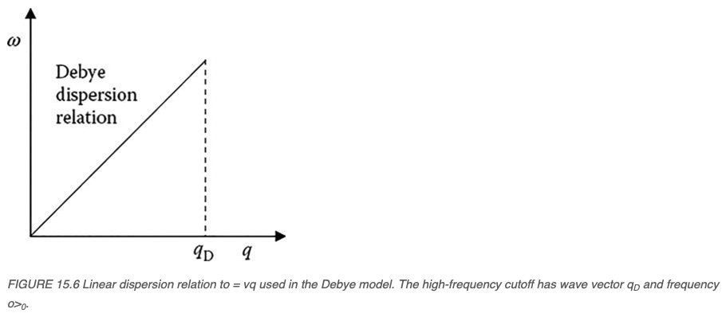
Debye Dispersion Relation
Angular frequency of vibrations as a function of wavevector, q
This is a dispersion relation relating energy to q or wavelength
Einstein Dispersion Relation
Debye Dispersion Relation
For small qa, sin(qa/2) = qa/2
( to q_{D} related to n_{max})
https://ebrary.net/196904/mathematics/einstein_model_specific_heat_solids

Slide 38
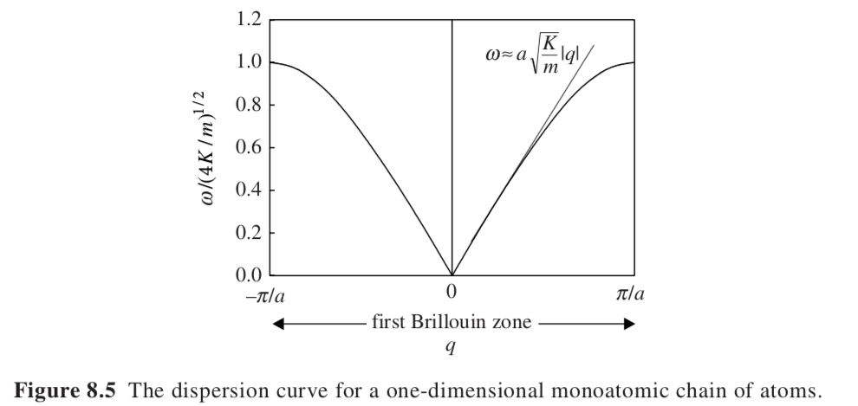

Dispersion Curve
Angular frequency of vibrations as a function of wavevector, q
First Brillouin Zone of the one-dimensional lattice
Longer wavevectors are smaller than the lattice

Slide 39
Dispersion Curve
Angular frequency of vibrations as a function of wavevector, q
Slope is related to
the modulus
First Brillouin Zone of the one-dimensional lattice
Longer wavevectors are smaller than the lattice

Slide 40
Phonons
Two size scales, a and λ
If λ ≥ a you are within a Brillouin Zone
Wavevector k = 2π/λ
k-vectors exceeding the first Brillouin zone (red) do not carry any more information than their counterparts (black) in the first Brillouin zone.

Slide 41

Dispersion Curve
Angular frequency of vibrations as a function of wavevector, q
For small wave vectors (long wavelength) sin(θ) => θ
Acoustic or Ultrasonic range
Acoustic or Ultrasonic Range
Long wavelengths
Group Velocity = dω/dq = a√(K/m)
Speed of sound in the solid
Material is a continuum at these large distances

Slide 42
Dispersion Curve
Angular frequency of vibrations as a function of wavevector, q
For large wave vectors (short wavelengths)
Dispersion region
isn’t proportional to q
For larger q velocity drops until it stops at the Brillouin zone boundary
Standing Wave

Slide 43
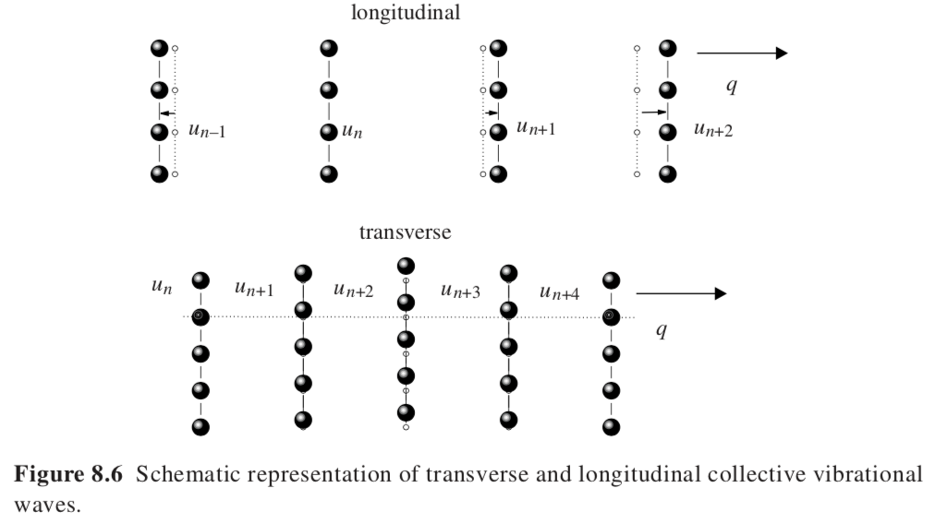
Longitudinal versus Transverse Waves
There are 2 transverse waves
If material is isotropic or for symmetric crystal planes they are degenerate
In plane and out of plane

Slide 44
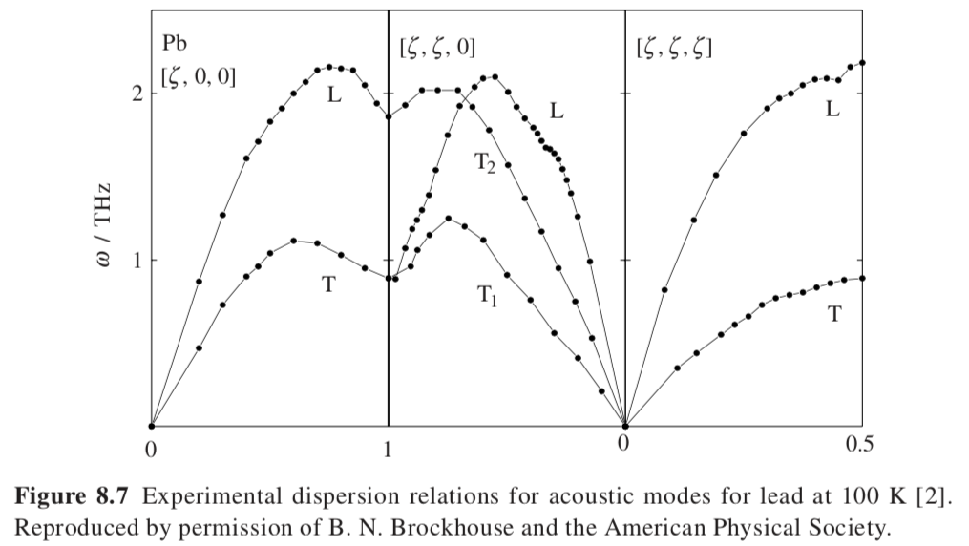
Longitudinal and Transverse dispersion relationships for [100],[110], and [111] for lead
Transverse degenerate for [100] and [111] (4- and 3-fold rotation axis)
Not for [110] (two-fold rotation axis)

Slide 45
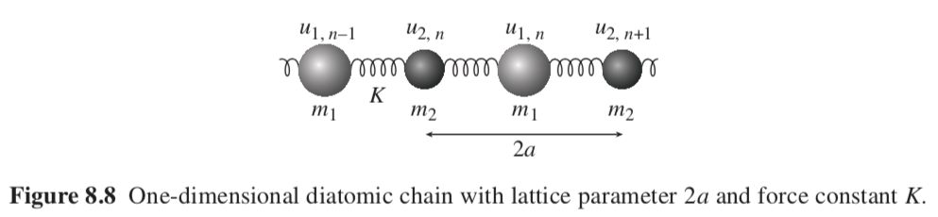
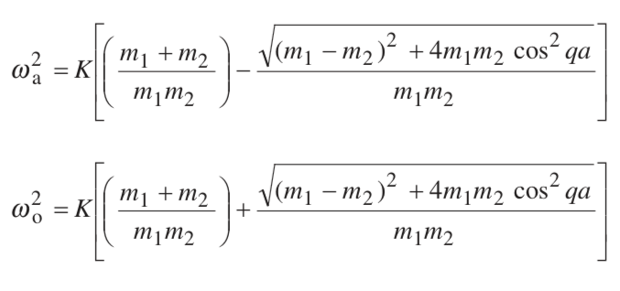
Diatomic Chain Model
Acoustic and Optical modes
Minus Acoustic
Plus Optical

Slide 46
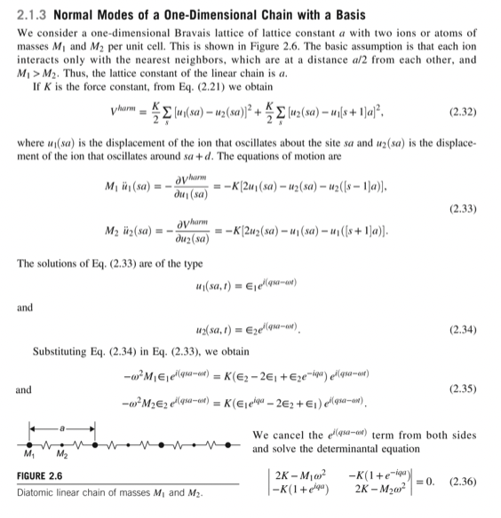
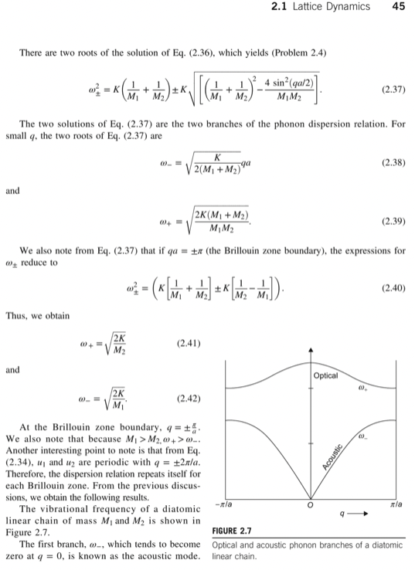
Physics of Condensed Matter
By Prasanta Misra

Slide 47
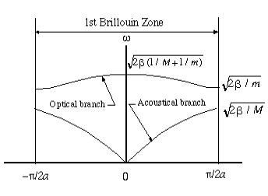
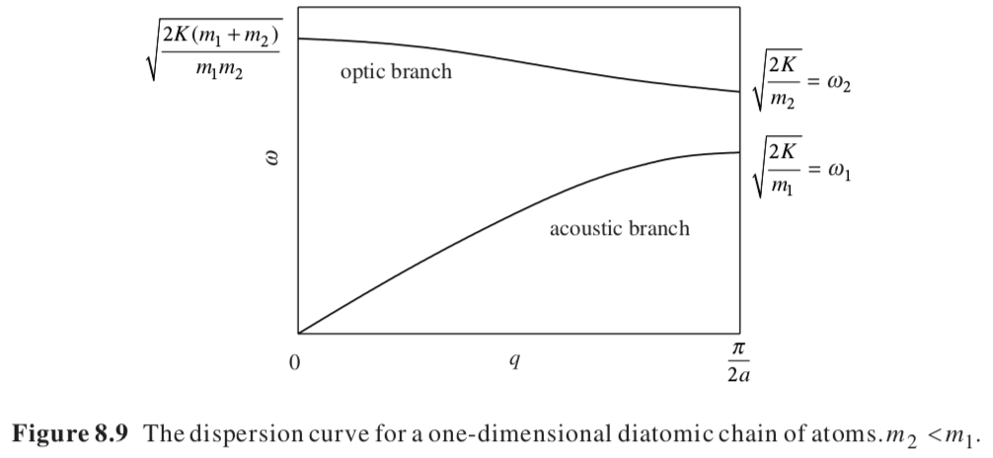



http://www.chembio.uoguelph.ca/educmat/chm729/Phonons/optical.htm

Slide 48
Phonons
Short sizes (long wavelengths) are high energy (frequency)
Dispersion relationship is how the energy or frequency of vibrations related to the size scale or wavelengths or what happens to vibrational energy in the crystal, i.e., modulus.
Density of states is how the total energy is distributed to different frequencies of vibration. This is related to what happens at different wavenumbers to different wavelength phonons.
Probability of energy going to different frequencies due to the structure
N is an integer related to the vibrational state k

Slide 49








Convert dispersion relation to DOS for a 1D wave in the continuum limit
This is a kind of dispersion relation relating energy or frequency to wave vector
Wave equation
Density of states doesn’t depend on time so use:
Choose periodic boundary condition
Apply boundary conditions to
Yields
That is qL = n 2π
This only occurs if:
Since:
n are the modes or the number of waves for a given frequency and the maximum number is how many atoms on a line.
https://eng.libretexts.org/Bookshelves/Materials_Science/Supplemental_Modules_(Materials_Science)/Electronic_Properties/Density_of_States

Slide 50






Convert Dispersion relation to DOS For a 1D wave in the continuum limit
dn =
This number is the density of states (DOS) at a frequency ω
Using dispersion relation
For modes in positive and negative “q=space”
A constant density of states like the Einstein Model
https://eng.libretexts.org/Bookshelves/Materials_Science/Supplemental_Modules_(Materials_Science)/Electronic_Properties/Density_of_States

Slide 51


Dispersion Relationship
Density of States
Number of vibrational modes

Slide 52

3-d Crystal
Transverse and longitudinal optical and acoustic modes exist for 3d crystals.
Dispersion Relationship
Density of States
n atoms in unit cell
3N_{A}n vibrational modes
3N_{A} acoustic modes (Unit cell vibrates as an entity)
3N_{A}(n-1) optical modes (deformation of unit cell)
At high T each mode has k_{B}T (2 springs for each Cartesian coordinate in two directions)
So, heat capacity is 3R
Number of vibrational modes

Slide 53
Debye Model
At low temperature
Low energy, low frequency vibrations
are excited
These are acoustic mode vibrations
Unit cell vibrates as an entity
Long distances compared to a unit cell

Slide 54
Debye Model
Derivation
https://eng.libretexts.org/Bookshelves/Materials_Science/Supplemental_Modules_(Materials_Science)/Electronic_Properties/Debye_Model_For_Specific_Heat

Slide 55




Debye Model
One Longitudinal Two Transverse
Convert to Spherical Coordinates
https://en.wikipedia.org/wiki/Debye_model

Slide 56






Debye Model
There are 8 cubes worth of particles in the sphere
https://en.wikipedia.org/wiki/Debye_model

Slide 57





Debye Model
https://en.wikipedia.org/wiki/Debye_model

Slide 58



Debye Model
At high T (Dulong-Petit)
So far I can’t do this
https://en.wikipedia.org/wiki/Debye_model

Slide 59
Debye Model
https://en.wikipedia.org/wiki/Debye_model

Slide 60


Debye Model
x = T_{D}/T
https://en.wikipedia.org/wiki/Debye_model

Slide 61


Debye Model
https://en.wikipedia.org/wiki/Debye_model

Slide 62






Debye Model
Debye
Einstein
https://en.wikipedia.org/wiki/Debye_model

Slide 63



Debye Model
Debye
Einstein
Dulong Petit
Exponential approach to T = 0
Low T
High T
https://en.wikipedia.org/wiki/Debye_model

Slide 64

https://lampx.tugraz.at/~hadley/ss1/phonons/table/dosdebye.html

Slide 65



https://lampx.tugraz.at/~hadley/ss1/phonons/table/dosdebye.html

Slide 66

Debye Model
At low temperature
Low energy, low frequency vibrations
are excited
These are acoustic mode vibrations
Unit cell vibrates as an entity
Long distances compared to a unit cell
Distribution of frequencies, g(ω), above a cutoff frequency, ω_{D}

Slide 67

Debye Model
At low temperature
Low energy, low frequency vibrations
are excited
These are acoustic mode vibrations
Unit cell vibrates as an entity
Long distances compared to a unit cell
Quantized energy levels
Energy also equals kT
This defines the Debye temperature, θ_{D}

Slide 68



Debye Model
Einstein Model
Heat Capacity is given by,
Einstein temperature:
At Low T this reduces to,
The T³ dependence is seen experimentally

Slide 69


Higher Characteristic T represents stronger bonds

Slide 70

Higher Characteristic T represents stronger bonds

Slide 71
Higher Characteristic T represents stronger bonds

Slide 72


Higher Characteristic T represents stronger bonds

Slide 73
Modulus and Heat Capacity
= E ε
F/A = E Δd/d
F = K Δd
K = F/Δd = E A/d
At large q, ω = √(4K/m)
This yields ω_{D} from E
For Cu, θ_{D} = 344K
ω_{D} = 32 THz
K = 13.4 N/m
ω_{D} = 18 THz

Slide 74




Modulus and Heat Capacity
The Debye Temperature reflects the highest energy, lowest wave vector vibrations so the linear part of the dispersion curve

Slide 75


Slide 76

How to obtain C_{p} from calculated C_{V}?
At low T
C_{V} = C_{p}
The harmonic oscillator model assumes constant volume
So, deviations for constant pressure are related to “anharmonic” vibrations
Anharmonic vibrations contribute to the heat capacity
They also lead to a finite thermal expansion coefficient

Slide 77

Volume Change and thermal expansion parts
Anharmonic vs Harmonic Contributions to Heat Capacity
(due to thermal expansion and thermal conductivity)
Volume Change part

Slide 78





Approximate relationships for C_{p} - C_{V}
If you don’t know the thermal expansion coefficient
If you know the thermal expansion coefficient,
How does the frequency of vibration change with specific volume of a unit cell

Slide 79

http://lampx.tugraz.at/~hadley/ss1/dbr/dos2cv.html

Slide 80

Spectroscopy measures vibrations, this can be used to calculate the density of states, this can be integrated to obtain the heat capacity
Number of vibrational modes
IR: High Polarity Motion of charged atoms under electromagnetic field
NaCl
Raman: High Polarizability
Motion of electrons in polarizable bonds under electromagnetic field
Benzene, Graphene, Nanotubes,

Slide 81




Spectroscopy measures vibrations, this can be used to calculate the density of states, this can be integrated to obtain the heat capacity

Slide 82

Spectroscopy measures vibrations, this can be used to calculate the density of states, this can be integrated to obtain the heat capacity

Slide 83





Entropy from Heat Capacity
-SUV
H A
-pGT
C_{V} = (dU/dT)_{V}
From the Thermodynamic Square
dU = TdS – pdV so C_{V} = (dU/dT)_{V} = T (dS/dT)_{V} - p (dV/dT)_{V}
Second term is 0 dV at constant V is 0
(dS/dT)_{V} = C_{V} /T
Similarly
C_{p} = (dH/dT)_{p}
From the Thermodynamic Square
dH = TdS + Vdp so C_{p} = (dH/dT)_{p} = T (dS/dT)_{p} - V (dp/dT)_{p}
Second term is 0 dp at constant p is 0
(dS/dT)_{p} = C_{p} /T
Integrate C_{p}/T dT or Integrate C_{V}/T dT to obtain S
Low Temperatures Solve Numerically
High Temperatures Series Expansion

Slide 84


Slide 85

Calorimetrically determine S at high temperature then find the Debye temperature that makes the calculation of S match
Large θ_{D} means more stable

Slide 86

Group Contribution Method for Entropy and Heat Capacity
Sum the component entropy and heat capacities

Slide 87






-SUV
H A
-pGT
Entropy correlates with molar volume
Maxwell (dS/dV)_{T} = (dp/dT)_{V}
Triple product (dp/dT)_{V} = -(dV/dT)_{P} (dP/dV)_{T}
or
Θ₀ is characteristic T at V₀
(dS/dθ)_{T} from

Slide 88

dG = -SdT +Vdp
For a transition ΔG = 0
And
dp/dT = ΔS/ΔV
ΔS and ΔV have the same sign
-SUV
H A
-pGT
This isn’t true with a change in oxidation state or coordination number
Tetrahedral Si
Octahedral Si
50%
Octahedral Si
entropy
Tetrahedral Si
50%
Octahedral Si
Octahedral Si
Density = mass/volume
All the Si atoms are tetrahedrally coordinated in pyroxene, while 50% are tetrahedrally coordinated and 50% octahedrally coordinated in garnet. In the ilmenite and perovskite modifications all Si atoms are octahedrally coordinated.

Slide 89

Electronic Heat Capacity
Electrons that escape from the valence band to the conduction band have three degrees of freedom so contribute (3/2)R to the heat capacity (Drude Model of conduction)
For monovalent Cu we expect Dulong Petit 3R plus 3/2 R (but we see only 3R so where is the 3/2 R?)
For Cu, (3 + 3/2)R this isn’t seen due to quantization of the electron energy level
Fermi Level = Electron energy level that at equilibrium is 50% occupied
Electrons above this energy are free electrons on average

Slide 90






Free electron gas at 0 K (shaded)
Excited at T (dashed line)
Ν₁ is the number of electrons excited by kT
These occupy electronic states in a band of kT about the Fermi level
Heat from 0K to T
n(ε_{F}) is the number of electrons at the Fermi level
γ is the electronic heat capacity coefficient
γ is 0 for an insulator and has a value for a metal

Slide 91


Slide 92
For T < 10K

Slide 93

Add an electron from Ag raises Fermi level
Add a hole from Rh reduces n(ε_{F})
A striking example is the electronic heat capacity coefficients observed for Rh–Pd–Ag alloys given in Figure 8.22 [17]. In the rigid band approach, the addition of Ag to Pd gives an extra electron per atom of silver and these electrons fill the band to a higher energy level. Correspondingly, alloying with Rh gives an electron hole per Rh atom and the Fermi level is moved to a lower energy. The variation of the electronic heat capacity coefficient with composition of the alloy maps approximately the shape of such an electron band.

Slide 94







Slide 93 for density of states
Magnetic Heat Capacity
Magnetic excitation
Magnon
Spin waves
Spin waves are propagating disturbances in the ordering of magnetic materials.
Ferromagnet T^{3/2} at low T

Slide 95


Slide 96
Heat Capacity for Systems that Display a Transition
C_{p} = (dH/dT) _{P} = (dQ/dT) _{P} = ((dQ/dt) (dT/dt))_{P}

Slide 97

Heat Capacity for Systems that Display a Transition
Rate of entropy change with T, C_{v} = T(dS/dT)_{V},
-increases as kT approaches the transition temperature.
-At high temperatures all states are active so the change in entropy is small.
This results in a peak in C_{v} and C_{p}

Slide 98





From Kittel and Kroemer Thermal Physics Chapter 2
For a system with quantized energy and two states ε₁ and ε₂, the ratio of the probabilities of the two states is given by the Boltzmann potentials, (τ is the temperature k_{B}T)
If state ε₂ is the ground state, ε₂ = 0, and the sum of exponentials is called the partition function Z, and the sum of probabilities equals 1 then,
Z = exp(-ε₂/τ) + 1
Z normalizes the probability for a state “s”
P(ε_{s}) = exp(-ε_{s}/τ)/Z
The average energy for the system is $U={\left(\sum{ε_{i}e^{−ε_{i}/τ}}\right)}/Z=τ^{2}\left(\frac{dlnZ}{dτ}\right)$

Slide 99
From Kittel and Kroemer Thermal Physics Chapter 2
First term decays with (ε/kT)²
Second term increases with ~ exp(-ε/kT)

Slide 100
Metal-Insulator Transition
First order transition at T_{trs} between an insulator γ = 0 and a metal γ = γ _{met}
A quantum transition, critical quantum behavior
Transition can occur on doping of an oxide like Fe₂O₃
Temperature or Pressure Changes
(dS/dT)_{p} = C_{p} /T

Slide 101




Magnetic Order-Disorder Transition
At the Curie temperature material goes from a ferromagnet to a paramagnet and loses magnetic order
This impacts the entropy and heat capacity
Maximum total order-disorder entropy can be calculated, ΔS
(dS/dT)_{p} = C_{p} /T

Slide 102

Co₃O₄ Transitions
Cathode in Li⁺ batteries or blue pigment for pottery

Slide 103

Co₃O₄ Transitions
The normal spinel contains Co2+ at tetrahedral sites and low-spin Co3+ at octahedral sites. The heat capacity effect observed at T β 900K is in part a low- to high-spin transition of the Co3+ ions and in part a partial transition from normal toward random distribution of Co3+ and Co2+ on the tetrahedral and octahedral sites of the spinel structure. The insert to the figure shows the magnetic order–disorder transition of Co₃O₄ at around 30 K.
(dS/dT)_{p} = C_{p} /T

Slide 104




Slide 105



(dS/dT)_{p} = C_{p} /T
Two levels with energy spacing ε/k_{B}
T > ε/k_{B} both levels occupied equally
T< ε/k_{B} only lower level occupied
Boltzmann statistics yields

Slide 106

Schottky Defects
Endothermic formation enthalpy
Entropy associated with disorder of defect location
ΔG =ΔH - TΔS
(dS/dT)_{V} = C_{V} /T

Slide 107

Fast Ion Conductors (solid oxide fuel cells high T)
Solid electrolytes for batteries and fuel cells
AgI, I lattice remains intact, Ag+ conductor becomes a liquid
Also, Cu₂S, Ag₂S. NaS battery
Heat Capacity drops with temperature

Slide 108
Liquids and Glasses
C_{p} = (dH/dT) _{P} = (dQ/dT) _{P} = ((dQ/dt) (dT/dt))_{P}

Slide 109

Liquids and Glasses
Broad minimum in heat capacity
Loss of short-range order with rising T leads to drop in heat capacity
Initially, loss of vibrational degrees of freedom associated with short range order led to decrease in C_{p}
Later, S increases with T
T(dS/dT)_{p} = C_{p}

Slide 110
Liquids and Glasses
Broad minimum in heat capacity
Loss of short-range order with rising T leads to drop in heat capacity
Initially, loss of vibrational degrees of freedom associated with short range order led to decrease in C_{p}
Later, S increases with T
Kauzmann Paradox
T(dS/dT)_{p} = C_{p}

Slide 111

Anomalous behavior of glasses near absolute 0
Debye C_{V} ~ T³ near 0 K
Behavior is due to anharmonic vibrations
(Relaxation phenomena)

Slide 112

Pseudo-second order transition behavior of glasses
Relaxation phenomena
In glasses

Slide 113

Pseudo-second order transition behavior of glasses
Relaxation phenomena
In glasses

Slide 114

Pseudo-second order transition behavior of glasses
Relaxation phenomena
In glasses

Slide 115


Thermodynamic and Kinetic Fragility
Fragile versus strong glass
Kinetics: Deviation from Arrhenius behavior
= η₀ exp(-E_{a}/k_{B}T)
Scaled Exponential
η = η₀ exp(-E_{a}/k_{B}T)^{m}

Slide 116


ΔS = S_{L}-S_{glass}
m is at T_{m}

Slide 117


Slide 118


Slide 119


Slide 120



Heat Capacity of Polymers
Amorphous structure but with regular order along the chain
1-d vibrational structure
Einstein method works well above 100K
E is the heat capacity contribution for each vibration
N_{atoms} = number of atoms in a mer unit
3 for CH₂
N = number of skeletal modes of vibration
N = 2 for -(CH₂)_{n}-

Slide 121

Below 50K need more detailed breakup of 1d and 3d vibrations using Debye Approach
Weak Van der Waals interactions between chains described by 3d Debye function
For skeletal modes normal to the chain
Strong covalent interactions along chains described by 1d Debye function
For skeletal vibrations in the chain axis
Linear heat capacity increase from 0 to 200K

Slide 122

At low frequency 3d vibrations, at high frequency 1d vibrations
1d Tasarov simplification (generates about 1% error versus experimental)

Slide 123


Polystyrene
N_{atoms} = 16 atoms per unit
N = 6 skeletal mode vibrations
42 total atomic group modes of vibration
N_{E} = 42
θ₁ = 285 K
Or calculate with the Tasarov Equation

Slide 124




Slide 126

Average Energy and the Partition Function
Consider a set of N independent (No Enthalpy) molecules at different energy states, N_{i} molecules at E_{i}
The average energy is $E=\sum_{i}{N_{i}E_{i}}$
The Boltzmann Probability gives $N_{i}=\sum_{i}{\frac{Ne^{−E_{i}/kT}}{Z}}$ and $Z=\sum_{i}{e^{−E_{i}/kT}}$ is the partition function
Then $E=\frac{N}{Z}\sum_{i}{E_{i}e^{−E_{i}/kT}}$
Consider ${\frac{d}{dT}e}^{−E_{i}/kT}=+\frac{E_{i}}{kT^{2}}$ $e^{−E_{i}/kT}$ so $E_{i}e^{−E_{i}/kT}=kT^{2}{\frac{d}{dT}e}^{−E_{i}/kT}$
$$E=\frac{NkT^{2}}{Z}\sum_{i}{{\frac{d}{dT}e}^{−E_{i}/kT}}$$
$$EdT=\frac{NkT^{2}}{Z}dZ$$
$$E=−NkT lnZ$$
For ground state E = 0, Z at T = 0 is 1; for T = ∞, Z is the number of states (degeneracy)
For molecular vibrations E = hω

Slide 127

1907 Einstein Solid Model for Dulong Petit Law at high kT
Energy is quantized, quantum number is “n” goes from 1 to positive integer values
for the principal quantum number
Smallest quantum of energy is ε = hν
Energy for quantum number ”n” is
E_{n} = hν(n+1/2) = ε(n+1/2)
Total number of quantum states N
Total energy Nε(n+1/2)
Ground state energy μ
Geometric Series

Slide 128
1907 Einstein Solid Model for Dulong Petit Law at high kT
Energy = -kT log (Z); log(1/Z) = -log(Z)
exp(x) = 1 + x+ x2/2! + x3/3! +… At high kT => log(hν/kT)
F is A; E is U

Slide 129


1907 Einstein Solid Model for Dulong Petit Law at high kT
F is A; E is U
Molar C_{v}/N = gk or C_{v} = 3R in 3d

Slide 131






Phonons
From Dove
Bose-Einstein Relationship
As temperature increases the number at frequency ν increases
As ν increases the number at T drops

Slide 132
Phonons
From Dove
Einstein Model for Heat Capacity
E is U

Slide 133
Phonons
From Dove

Slide 134







Phonons
From Dove
Phonon Free Energy
F is A Helmholz Free Energy
Including ground state energy
At high T

Slide 135

Phonons
From Dove
For a crystal sum over all vibrations
F is A Helmholz Free Energy

Slide 136









From Kittel and Kroemer Thermal Physics Chapter 3
For quantized phonons
This is of the form $\sum{x^{i}}$ with x <<1 equals 1/(1-x)
Planck Distribution

Slide 137



Einstein Model
Works at low and high temperature
Lower at low temperature
Quantized energy levels
Bose-Einstein statistics determines the distribution of energies
The mean “n” at T is given by
Average energy for a crystal with three identical oscillators

Slide 138
Einstein Model
Works at low and high temperature
Lower at low temperature
Average energy for a crystal with three identical oscillators
Einstein temperature:

Slide 139
Einstein Model
Works at low and high temperature
Lower at low temperature

Slide 140

Einstein Model
Works at low and high temperature
Lower at low temperature
Single vibrational mode for all three DOF
Low T behavior exp(Θ_{E}/T) doesn’t work
C_{v} follows T³
Lattice vibrations are coupled to each other
Collective Lattice Vibrations

Slide 141
Debye Model
Works

